Slide 1
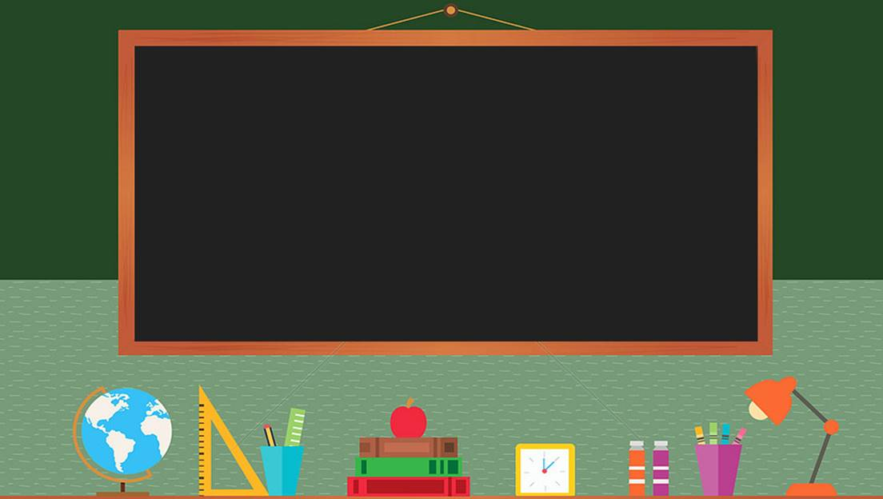

TRƯỜNG THCS LONG BIÊN
BÀI GIẢNG ĐIỆN TỬ MÔN TIẾNG ANH 8
UNIT 8 : SHOPPING
Lesson 3 : A closer look 2
GV: Nguyễn Thị Hiền
Tổ Ngoại Ngữ - Năng khiếu

Slide 2


Slide 3


Unit
8
SHOPPING
LESSON 3: A closer look 2
1

Slide 4
LESSON 3: A CLOSER LOOK 2
WARM-UP
Brainstorming
PRESENTATION
- Adverbs of frequency
- Present simple for future events
Task 1: Complete the sentences.
Task 2: Underline the verbs. Answer the questions.
Task 3: Write A: a timetable, schedule or plan; and B: unplanned future action.
Task 4: Choose the correct answer.
PRACTICE
PRODUCTION
Task 5: Work in pairs. Ask and answer to check planned events for the community fair next month.
CONSOLIDATION
Wrap-up
Homework

Slide 5
WARM-UP
BRAINSTORMING
List as many adverbs of frequency as possible

Slide 6
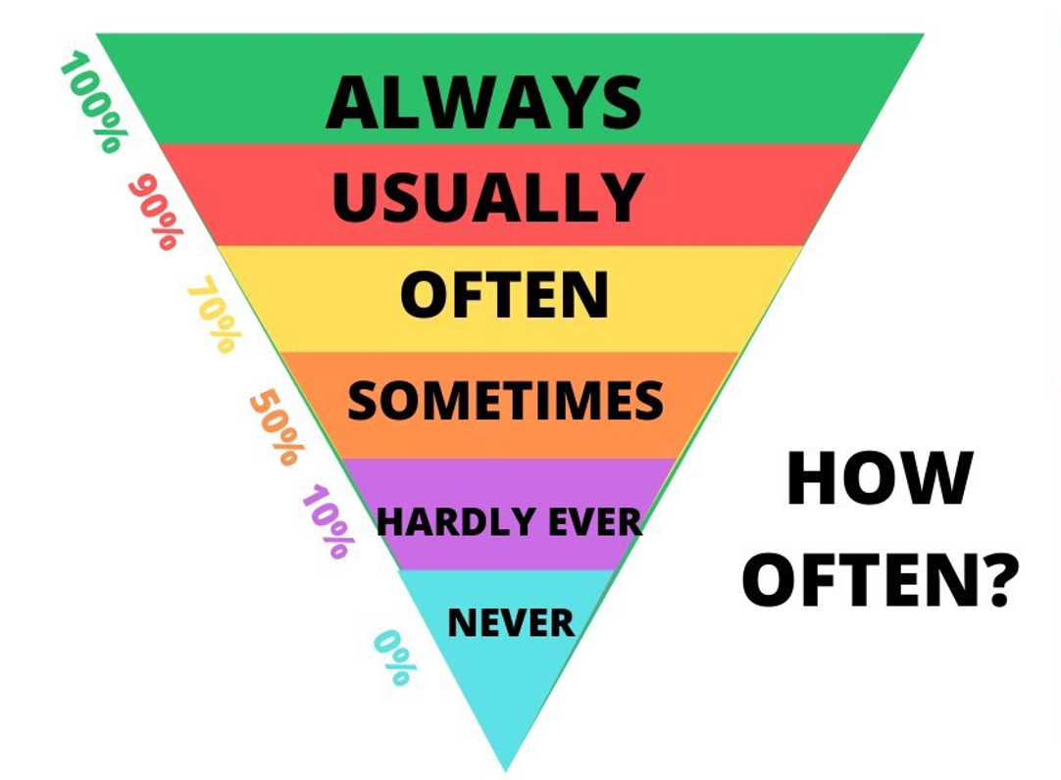
PRESENTATION
ADVERBS OF FREQUENCY

Slide 7
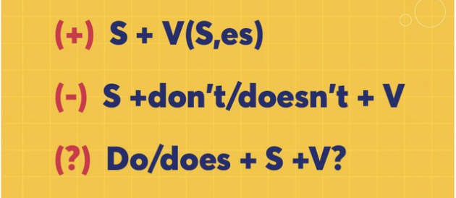
PRESENTATION
SIMPLE PRESENT FOR FUTURE EVENTS
USES
- Facts
- Habitual actions
- Future events

Slide 8
PRACTICE
1
Complete the sentences with the adverbs of frequency from the box.
always
often
sometimes
rarely
never
1. My mother________ shops at the supermarket. She never shops anywhere else.
2. I ________ buy things online, just once or twice a year. I prefer to shop at the shopping mall.
3. You can _______ bargain at a supermarket because the prices are fixed.
4. How ______ do you return things you buy online?
5. I don’t often buy things at the dollar store. My mother only takes me there __________.

Slide 9
PRACTICE
2
Read the schedule for the grade 8 field trip tomorrow, and underline the verbs in the sentences. Then answer the questions.
Field trip to the Double Dragon Chocolate Factory 26 February
9:00 | The bus leaves.
10:00 | Students arrive at the factory.
10:10 | Students watch a documentary introducing the factory.
10:30 | The tour of the factory starts.
12:10 | Students return to school to write the trip reports.
Present simple
What tense are the verbs in the sentences?
Are the sentences about habits or future activities?
Future activities

Slide 10
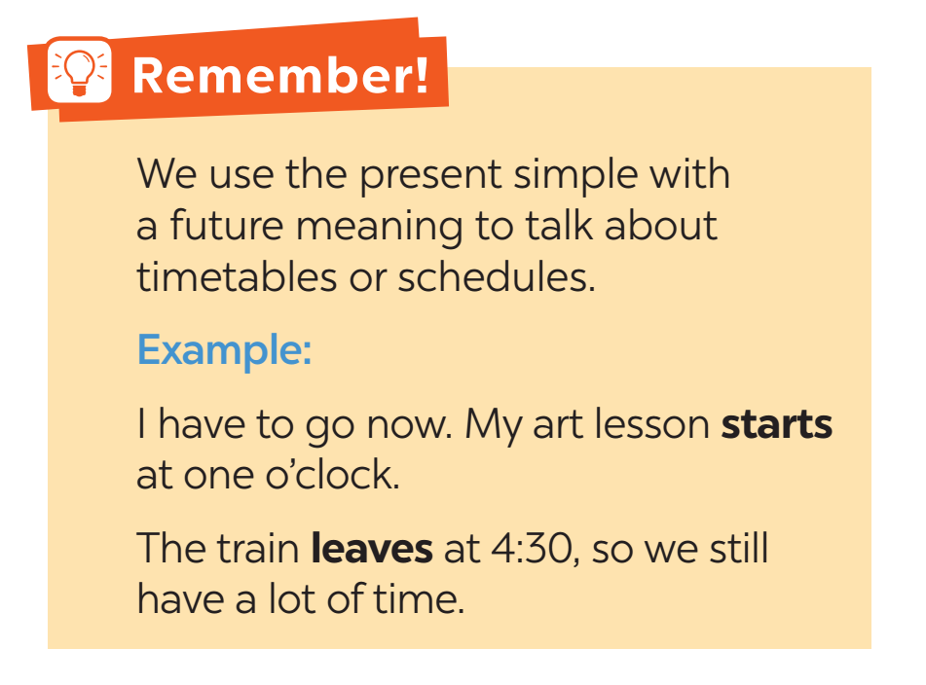

Slide 11
PRACTICE
3
Write A next to a sentence if it relates to a timetable, schedule or plan, and B if it is an unplanned future action.
1. We’ll go to Costco to return this suitcase.
2. Look! We have a whole afternoon for shopping on the second day of our tour.
3. The summer sales end next Sunday.
4. Listen to the announcement. The train doesn’t leave till 12:00.
5. I’m too busy today, so we’ll go shopping on Tuesday.
B
A
A
A
B

Slide 12
PRACTICE
4
Choose the correct answer to complete each sentence.
1. The supermarket in my neighbourhood opens / will open longer hours than the one in yours.
2. Don’t worry. I make / will make a shopping list, and you just give it to the shop owner.
3. We don’t buy / won’t buy a birthday cake this year. We can bake one at home.
4. The bus schedule says that there is / will be a bus to Aeon at 10:05.
5. Look at the advertisement. Does / Will the big sale start next Friday?

Slide 13
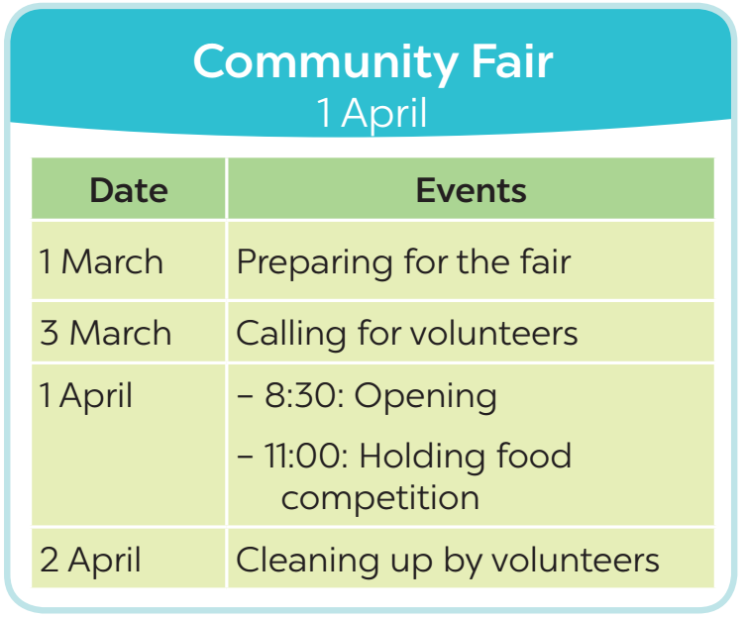
PRACTICE
5
Work in pairs. Ask and answer to check planned events for the community fair next month.
Example:
A: When do we start preparing for the fair?
B: We start on the first of March.

Slide 14
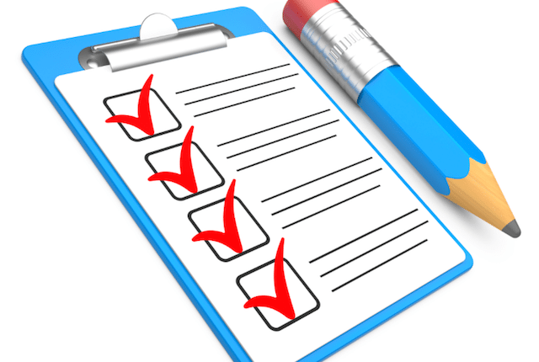
CONSOLIDATION
1
Wrap-up
What have we learnt in this lesson?
Recall adverbs of frequency
Present simple for future uses

Slide 15
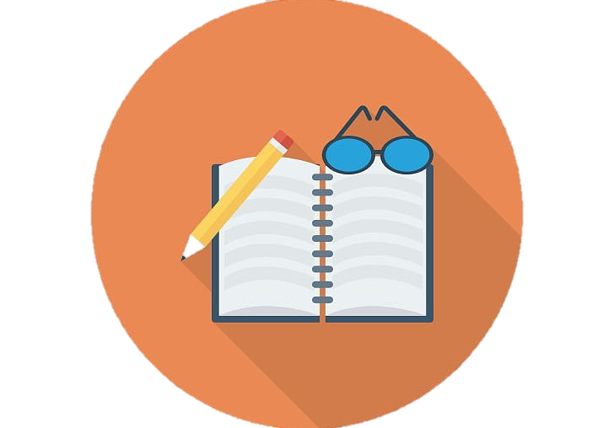
CONSOLIDATION
2
Homework
Learn the use of adverbs of frequency by heart.
Make 5 sentences of the simple present for future meaning
Do the exercises in the Workbook

Slide 16

Website: hoclieu.vn
Fanpage: facebook.com/tienganhglobalsuccess.vn/

