Slide 1


TRƯỜNG THCS LONG BIÊN
BÀI GIẢNG ĐIỆN TỬ MÔN TIẾNG ANH 8
UNIT 11: SCIENCE AND TECHNOLOGY
Lesson 3 : A closer look 2
GV: Nguyễn Thị Hiền
Tổ Ngoại Ngữ - Năng khiếu

Slide 2


Slide 3

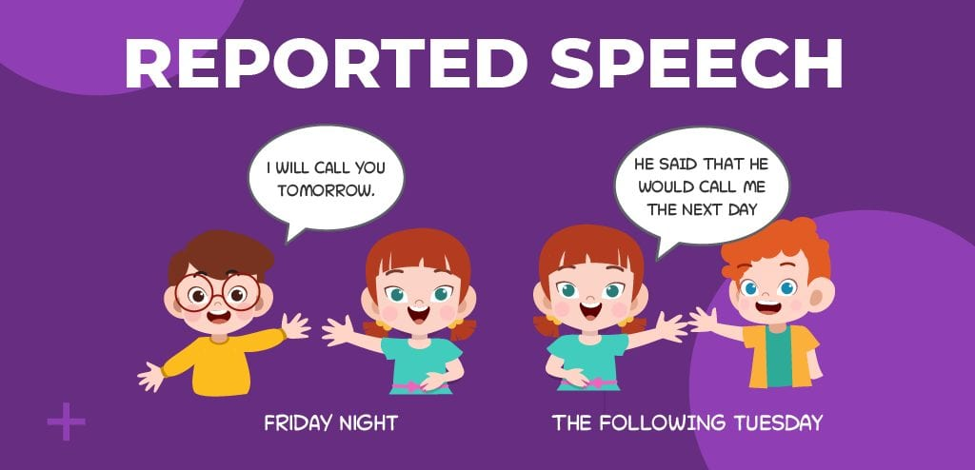
Unit
11
SCIENCE AND TECHNOLOGY
LESSON 3: A CLOSER LOOK 2
1

Slide 4
LESSON 3: A CLOSER LOOK 2
WARM-UP
Game: Memorising
PRESENTATION
Reported speech (statements)
Task 1: Look at part of the conversation in GETTING STARTED again. Then match Minh’s uncle’s direct speech with his reported speech.
Task 2: Complete the second sentences using the correct verb form.
Task 3: Complete the second sentences with the words and phrases from the box.
Task 4: Complete the second sentence in each pair so that it means the same the first one.
PRACTICE
PRODUCTION
Task 5: GAME: He/She said that…
CONSOLIDATION
Wrap-up
Homework

Slide 5
WARM-UP
GAME: MEMORISING
RULE:
Work in 4 groups
Look at the pictures in 30 seconds and try to remember what each people said.
Write down on the posters what each of the people in the picture said.
The group with the most correct answers is the winner.

Slide 6

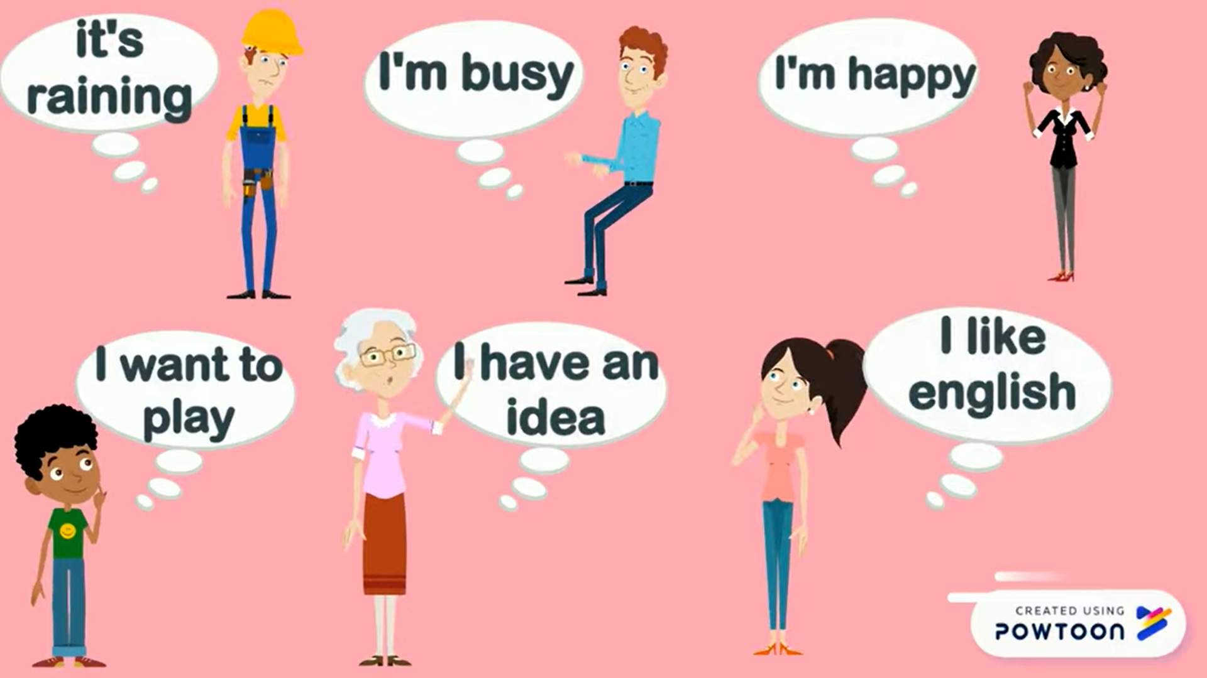
WARM-UP
GAME: MEMORIZING
David
Peter
Linda
Ms. Brown
Sarah
Tom

Slide 7
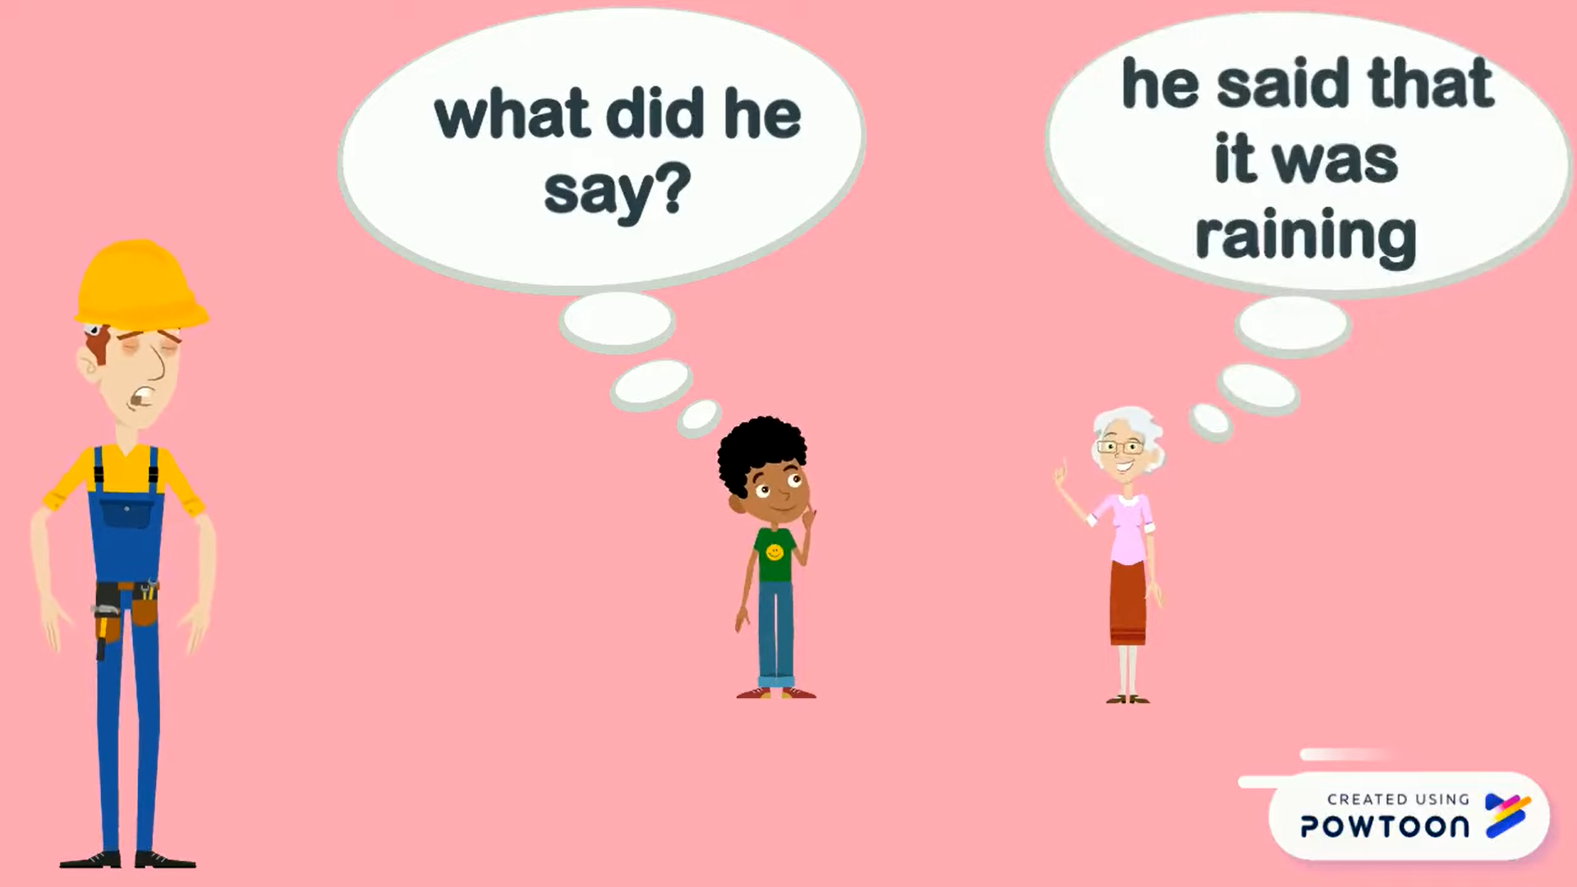
WARM-UP
GAME: MEMORIZING
He said that it was raining.
David

Slide 8
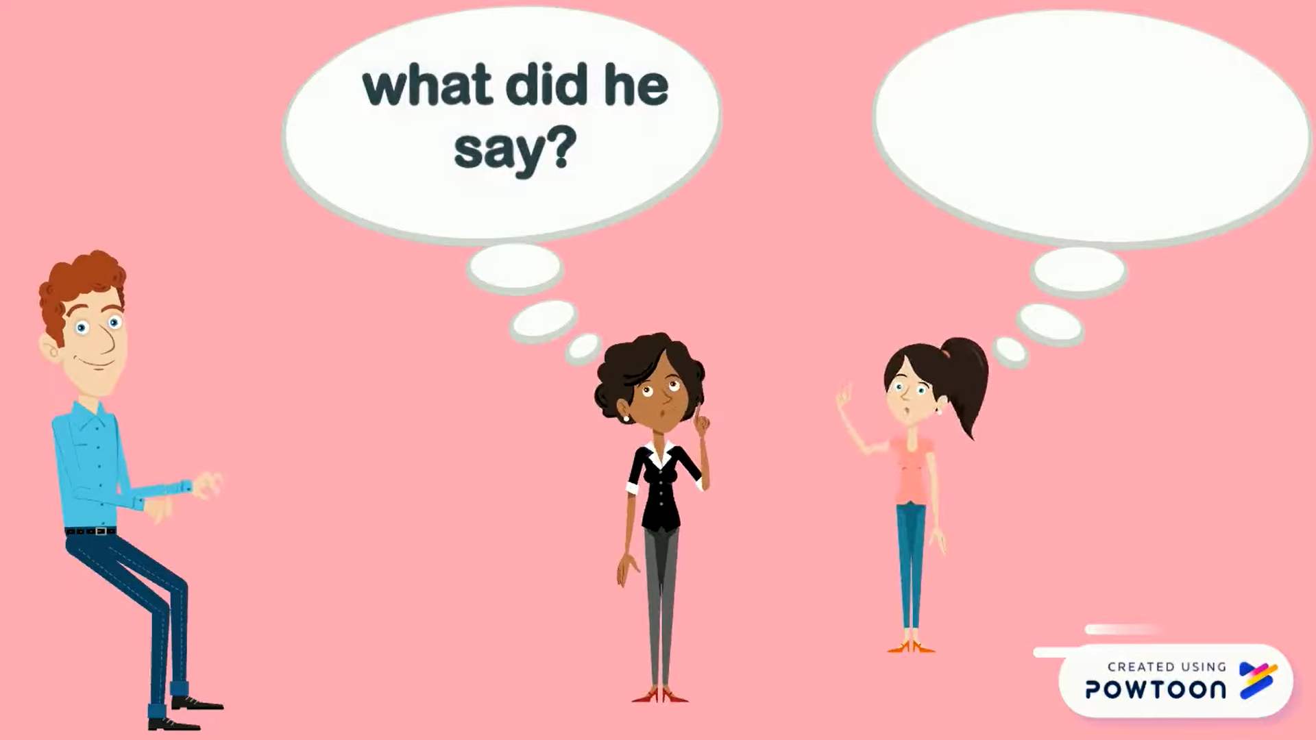
WARM-UP
GAME: MEMORIZING
He said that he was busy.
Peter

Slide 9
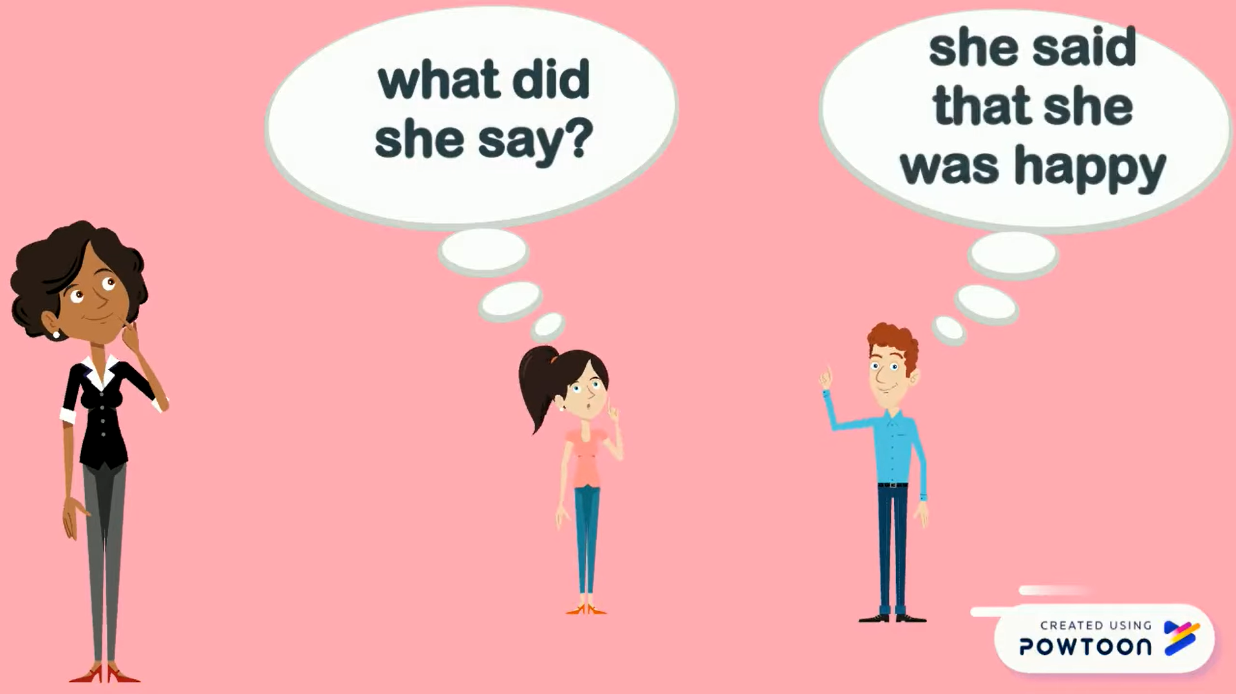
WARM-UP
GAME: MEMORIZING
She said that he was happy.
Linda

Slide 10
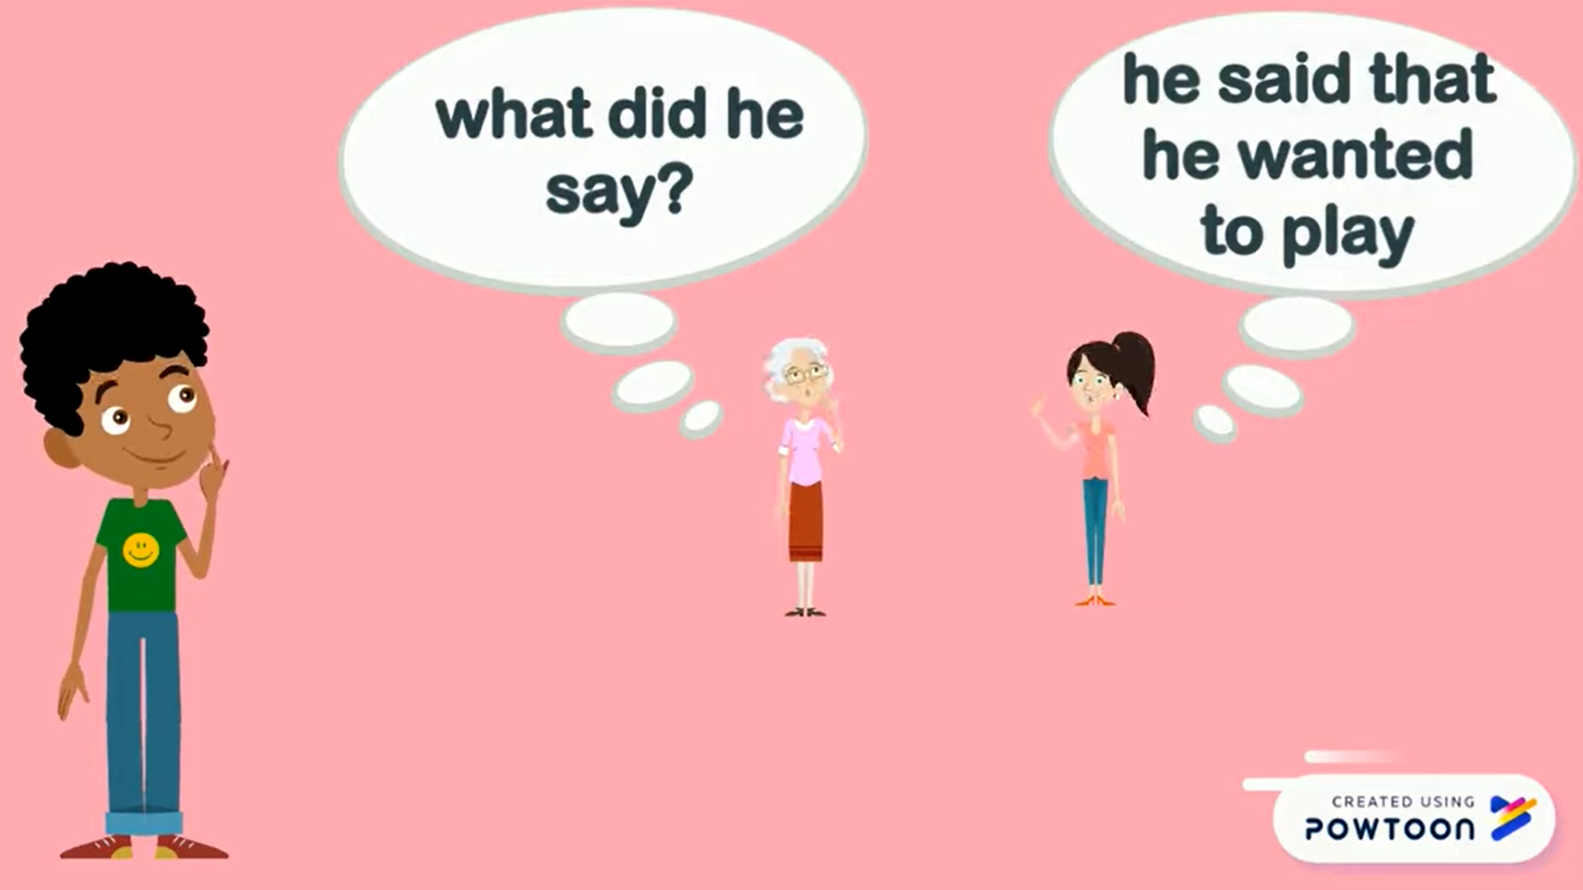
WARM-UP
GAME: MEMORIZING
He said that he wanted to play.
Tom

Slide 11
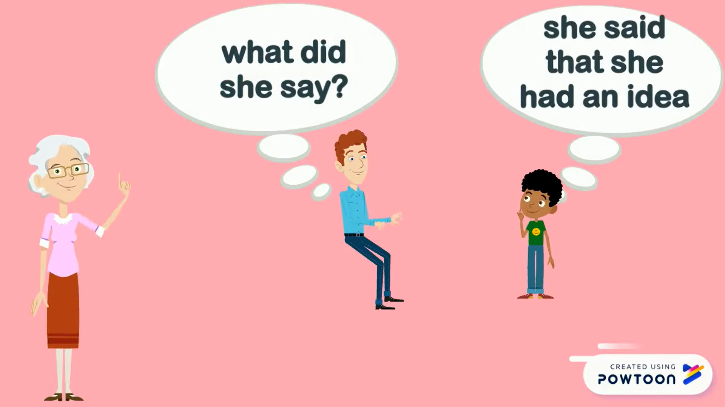
WARM-UP
GAME: MEMORIZING
She said that she had an idea.
Ms. Brown

Slide 12
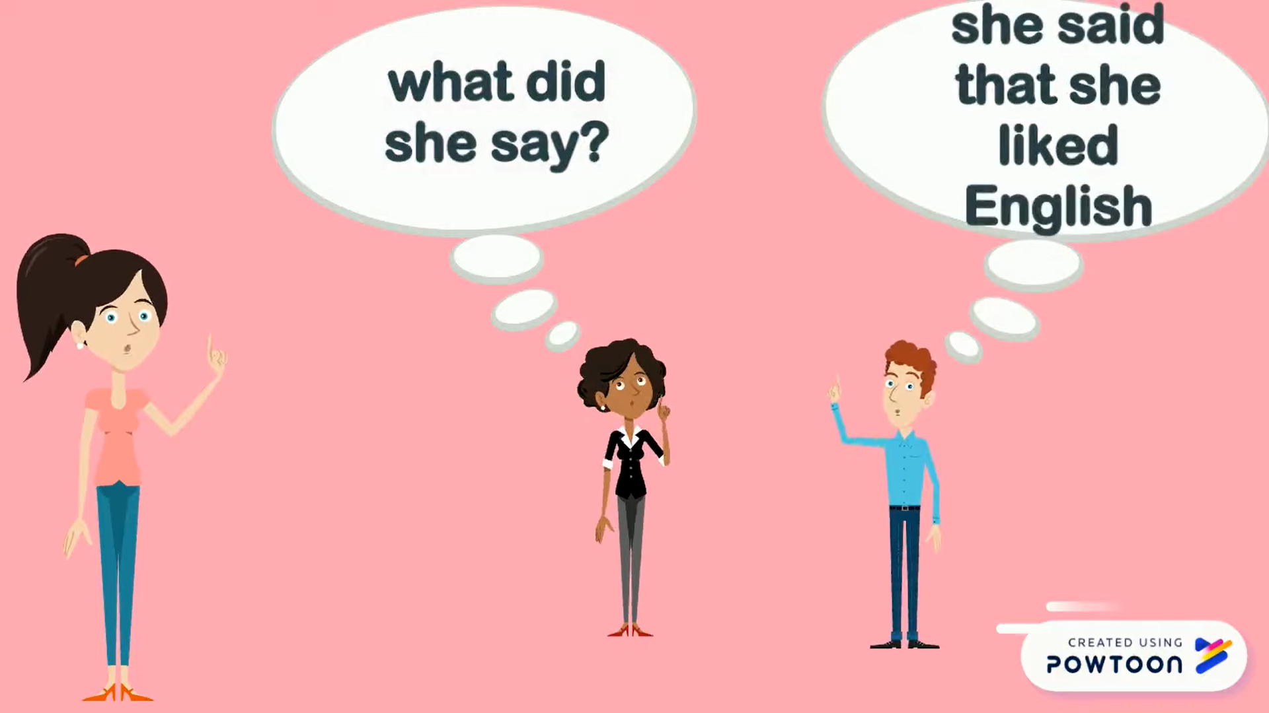
WARM-UP
GAME: MEMORIZING
She said that she liked English.
Sarah

Slide 13
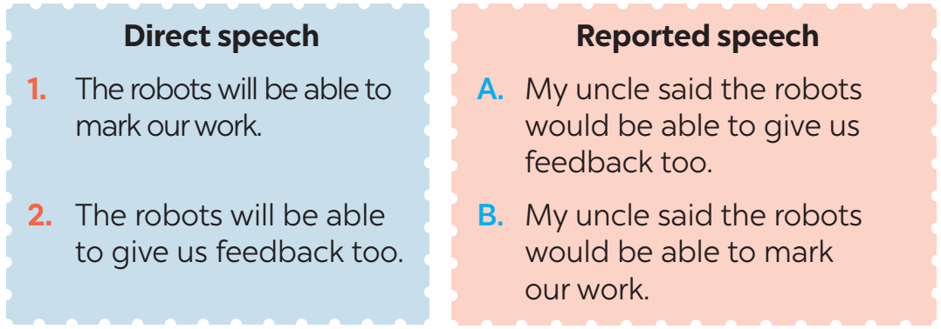
PRESENTATION
REPORTED SPEECH (STATEMENTS)
1
Look at part of the conversation in GETTING STARTED again. Then match Minh’s uncle’s direct speech with his reported speech.
Minh: …My uncle said the robots would be able to mark our work and give us feedback too.

Slide 14
PRESENTATION
REPORTED SPEECH (STATEMENTS)
REMEMBER
Reported speech is used to report what someone said.
1. Change the verb form | Present simple | Past simple
 | Present continuous | Past continuous
 | Will | would
2. Change time and place expressions | now | Then
 | Today/ this week | That day/ that week
 | tomorrow | The following day
 | here | There
3. Change pronouns | I | He/ She
 | we | They
 | me | Him/her

Slide 15
PRACTICE
1
Complete the second sentences using the correct verb form.
1. “I am a member of the IT club.”
 Minh said that he _______ a member of the IT club.
2. “Mai will take an online course to improve her speaking.”
 Nam said Mai ______ take an online course to improve her speaking.
3. “I am talking to Phong on the phone.”
 Tom said he ___________ to Phong on the phone.
was
would
was talking

Slide 16
PRACTICE
1
Complete the second sentences using the correct verb form.
4. “They are going to send me an email.”
 He said they _________ to send him an email.
5. “I don’t have an iPod to listen to music.”
 She said that she ___________ an iPod to listen to music.
was going
didn’t have

Slide 17
PRACTICE
3
Complete the second sentences with the words and phrases from the box.
there that year that day then the next day
1. “I am having a science test tomorrow,” Mary said
 Minh said she was having a science test _____________.
2. “The group is working on their project now,” Tom said
 Tom said the group was working on their project ________.
3. “Mai is reading about Thomas Edison today,” the teacher said
 The teacher said that Mai was reading about Thomas Edison ___________.
the next day
then
that day

Slide 18
PRACTICE
3
Complete the second sentences with the words and phrases from the box.
there that year that day then the next day
4. “They will invent a smart cooker this year, ” my mom said.
 My mum said that they would invent a smart cooker __________.
5. “My teacher will park her car here,” said Mi
 Mi said her teacher would park her car ______.
that year
there

Slide 19
PRACTICE
4
Complete the second sentence in each pair so that it means the same as the first one.
1. “We will live much longer in the future,” said the scientist.
=> The scientist said that _____________________________________.
2. “Our school is going to have a new laboratory here, ”said our teacher.
=> Our teacher said that ____________________________ _______________________.
3. “They are developing technology to monitor students better,”
my dad said.
=> My dad said that _________________________________ _______________________.
we would live much longer in the future
our school was going to have
a new laboratory there
they were developing technology
to monitor students better

Slide 20
PRACTICE
4
Complete the second sentence in each pair so that it means the same as the first one.
4. “There are no classes tomorrow because our teacher is ill,” Tom said.
=> Tom said that ____________________________________ __________________.
5. “We want some students to join the science club next semester,” the teacher said.
=> The teacher said that ______________________________ _____________________________.
there were no classes the next day because
their teacher was ill
they wanted some students to join
the science club the next semester

Slide 21

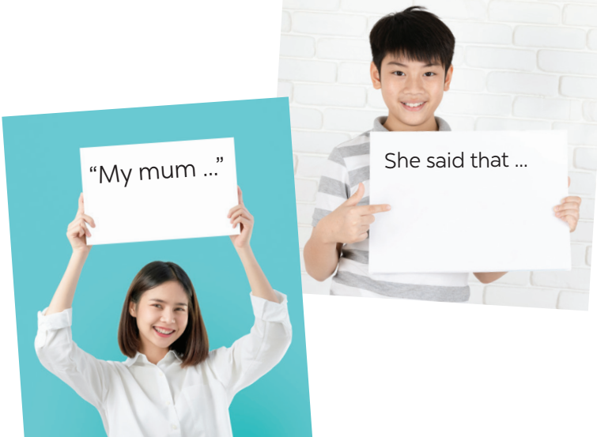
PRODUCTION
5
He/ She said that…
Work in pairs. One student says a sentence and the other changes that sentence into reported speech. Then swap roles.

Slide 22

CONSOLIDATION
1
Wrap-up
What have we learnt in this lesson?
What direct speech and reported speech are
Rules of changing direct speech to reported speech.

Slide 23

CONSOLIDATION
2
Homework
Learn the rules of changing direct speech into reported speech by heart.
Do exercise in the workbook

Slide 24

Website: hoclieu.vn
Fanpage: facebook.com/tienganhglobalsuccess.vn/

