Slide 1
Unit 10 Communication in the future
Lesson 3: A closer look 2

Slide 2
OBJECTIVES
01
02
After this lesson, students will be able to
use prepositions of place and time correctly
use possessive pronouns correctly

Slide 3
01
Preposition OF PLACE

Slide 4
MEMORY QUIZ
Look at the picture
Try to remember everything you see

Slide 5

MEMORY QUIZ

Slide 6




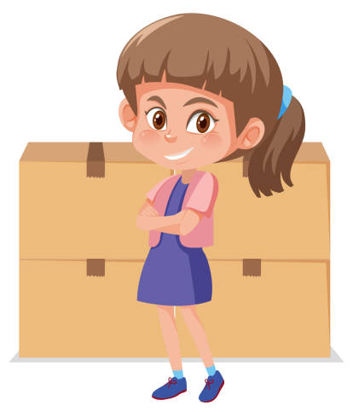


Prepositions of place
on
under
opposite
in front of
in
at

Slide 7
1. (p.107) Complete the sentences with at, in, in front of, on, opposite, or under.
at
1. Lily’s house is ____________ the end of this street.
2. Players always sit ____________ each other in a chess game.
3. She looked ____________ the table and finally found her smartwatch.
4. Don’t walk ____________ the street. Walk ____________ the pavement.
5. Ann stood _______________ me in a line to get on the bus.
at the end of: ở cuối ở
opposite
opposite: đối diện
under
under: phía dưới
in
in: trong; on: trên
on
in front of
in front of: phía trước

Slide 8
02
Preposition OF TIME

Slide 9
Prepositions of place
Match these information with suitable preposition of place.
Centuries ( The 1800s)
In (general)
bigger
On (more specific)
smaller
At (very specific) smallest
Months (July, May)
Decades (the 80s)
Weeks (2 weeks)
Years (1971, 2024)
Months (July, May)
Hours (7 a.m., 12 o’clock)
Weeks (2 weeks)
Decades (the 80s)
Years (1971, 2024)
Day and date (March 8th, 2024; Friday, birthday)
Centuries ( The 1800s)
Day and date (March 8th, 2024; Friday, birthday)
Hours (7 a.m., 12 o’clock)

Slide 10
Prepositions of place
in + a length of time: khoảng thời gian ở tương lai
Robots will replace human shop assistants in ten years.
(Rô bốt sẽ thay thế trợ lý bán hàng trong 10 năm tới)
for + a length of time: một cái gì đó diễn ra trong bao lâu
It rained for three hours yesterday.
(Trời mưa suốt 3 tiếng ngày hôm qua.)
by + a specific time: trước 1 thời điểm cụ thể
We’ll be there by 6 p.m.
(Chúng tôi sẽ tới đó trước 6 giờ.)

Slide 11
2. (p.107) Circle the correct preposition in each sentence.
1. Let’s get ready by / on / for 10 a.m. We are meeting Dr Saito at 10:15.
2. The first camera phone appeared on / at / in May 1999 in Japan.
3. We will be away on / for / by two weeks.
4. In the UK, supermarkets always close early in / by / on Sundays.
5. I think language barriers will disappear in / for / by 30 years.
By + time: trước mấy giờ
In + tháng năm
For + time: trong khoảng
On + ngày
In + năm: sắp tới

Slide 12
3. (p.107) Complete the text with the prepositions from the box. Use each preposition only ONCE.
in on at for by
in
I think smartphones will change a lot (1) ______ the near future. They will be much thinner. (2) ______ 2035, we might be able to roll a phone like a sheet of paper. They will become much smarter, too. They will be able to charge their battery automatically when we are (3) ______ home. They might check the latest news (4) ______ the Internet. We won’t have to wait (5) ______ a long time for these super smartphones.
I think smartphones will change a lot (1) ______ the near future. They will be much thinner. (2) ______ 2035, we might be able to roll a phone like a sheet of paper. They will become much smarter, too. They will be able to charge their battery automatically when we are (3) ______ home. They might check the latest news (4) ______ the Internet. We won’t have to wait (5) ______ a long time for these super smartphones.
By
at
on
for

Slide 13
4. (p.108) Complete the text with the prepositions from the box. Use each preposition only ONCE.
I think smartphones will change a lot (1) ______ the near future. They will be much thinner. (2) ______ 2035, we might be able to roll a phone like a sheet of paper. They will become much smarter, too. They will be able to charge their battery automatically when we are (3) ______ home. They might check the latest news (4) ______ the Internet. We won’t have to wait (5) ______ a long time for these super smartphones.

Slide 14
03
Possessive pronouns

Slide 15

This is your pen, not my pen.
possessive adjective (Tính từ sở hữu )+ N
your pen
my pen
yours
mine
This is yours, not mine.
possessive pronouns (Đại từ sở hữu )
Notes:
T cầm cái bút của môt bạn lên và hỏi Whose pen is it?

Slide 16
Possessive pronouns
Subject | Possessive adjective | Possessive pronouns
I | my | mine
He | His | his
She | Her | Hers
It | Its | Its
You | Your | Yours
We | Our | Ours
they | their | Theirs

Slide 17


Possessive pronouns
Mi is one of my friends.
 Mi is a friend of mine.
Mi
We can use possessive pronouns after of.

Slide 18
5. (p.108) Complete the second sentence so that it has the same meaning as the first sentence.
1. Jack is one of her cousins.
Jack is a ______________________.
2. Is this one of his tablets? Is this a _______________________?
3. Can I borrow a pencil of yours? Can I borrow _____________________?
4. You look like Nick and Peter. Are you one of their relatives?
You look like Nick and Peter. Are you ___________________?
5. Last year, two of our classmates won scholarships to the US.
Last year, __________________________ won scholarships to the US.
1. Jack is one of her cousins.
Jack is a ______________________.
2. Is this one of his tablets? Is this a _______________________?
3. Can I borrow a pencil of yours? Can I borrow _____________________?
4. You look like Nick and Peter. Are you one of their relatives?
You look like Nick and Peter. Are you ___________________?
5. Last year, two of our classmates won scholarships to the US.
Last year, __________________________ won scholarships to the US.
cousin of hers
tablet of his
one of your pencils
a relative of theirs
two classmates of ours

Slide 19
WRAP UP
After this lesson, students have been able to
use prepositions of place and time correctly
01
use possessive pronouns correctly
02

Slide 20
ThankS FOR YOUR ATTENTION!
Please keep this slide for attribution

