Slide 1
GUESSING GAME
Look and guess the places

Slide 2

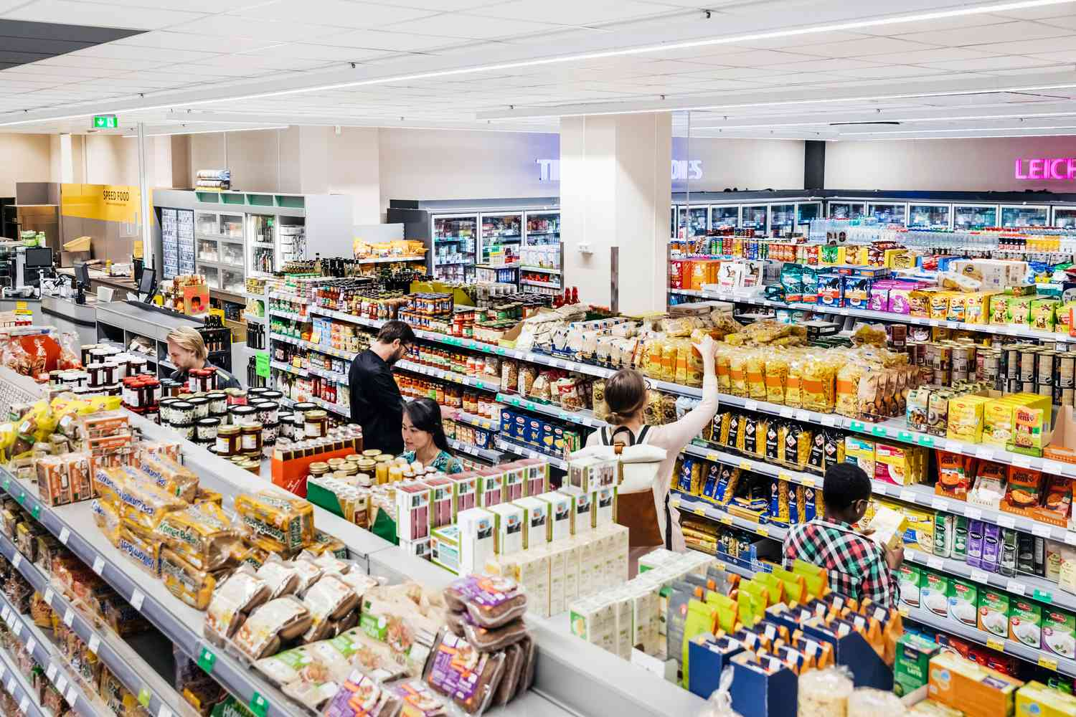
Where is it?
1
Supermarket

Slide 3
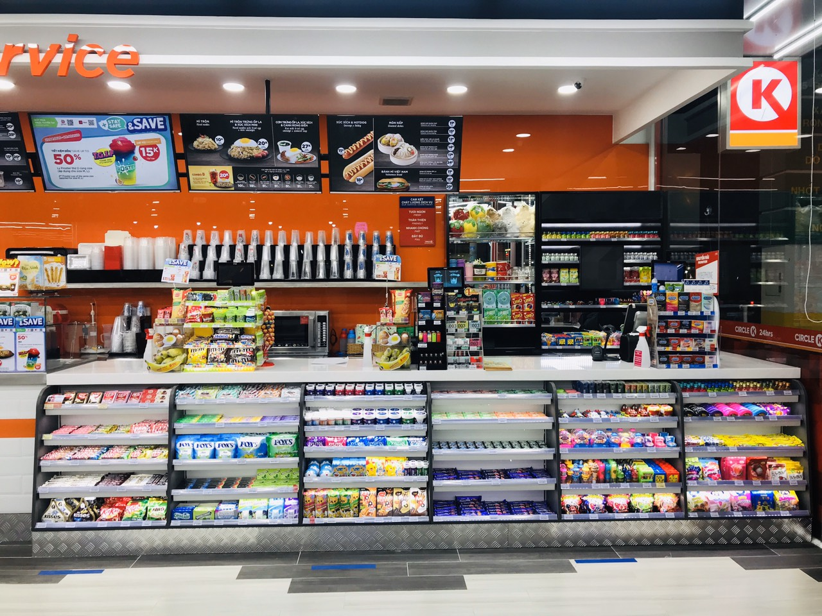
Where is it?
2
Convenience store

Slide 4
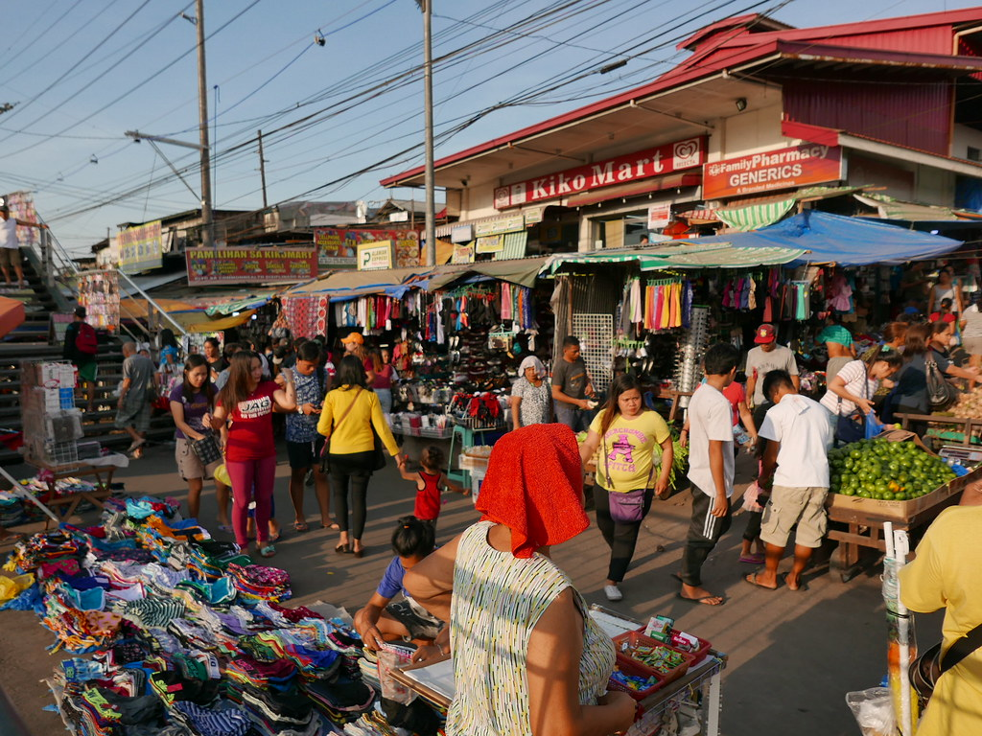
Where is it?
3
Open-air market

Slide 5
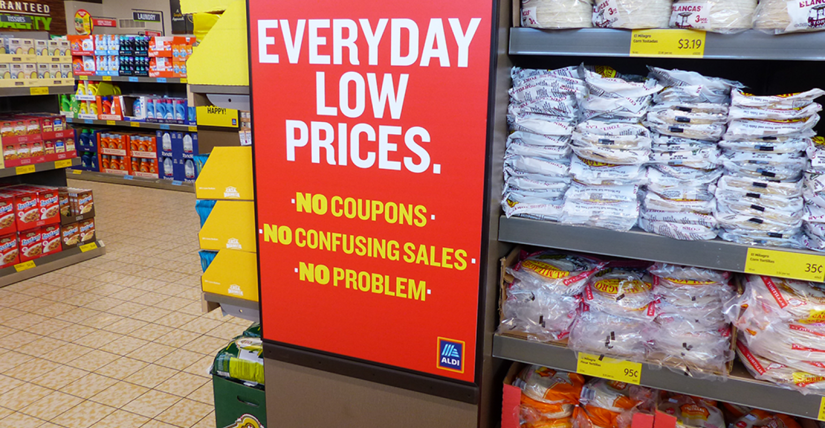
Where is it?
4
Discount shop

Slide 6
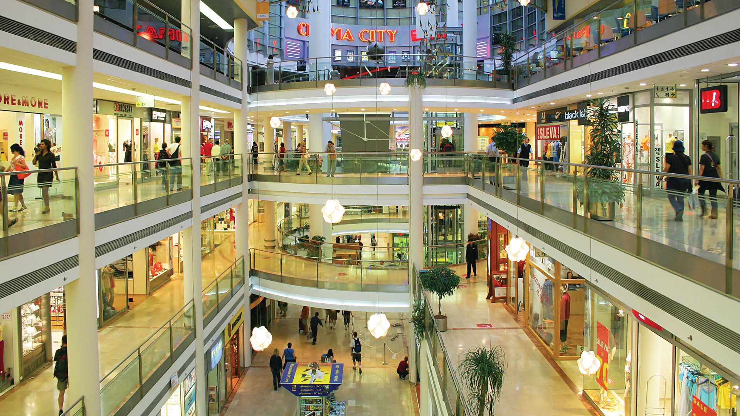
Where is it?
5
Shopping centre

Slide 7
Do you usually go to the shopping centre? Why?
Shopping centre

Slide 8
UNIT 8: SHOPPING
LESSON 5: SKILLS 1

Slide 9
OBJECTIVES
By the end of the lesson, students will be able to:
READING
01
read for specific information about reasons people go to shopping centres
SPEAKING
02
ask and answer about a new shopping centre and a shopping place in their own area.

Slide 10
Ex 1. Read the list below and tick the most common reason(s) why you go shopping?
- hanging out with friends
- reducing stress
- buying goods
- exercising
- browsing

Slide 11
01. New WORDS

Slide 12
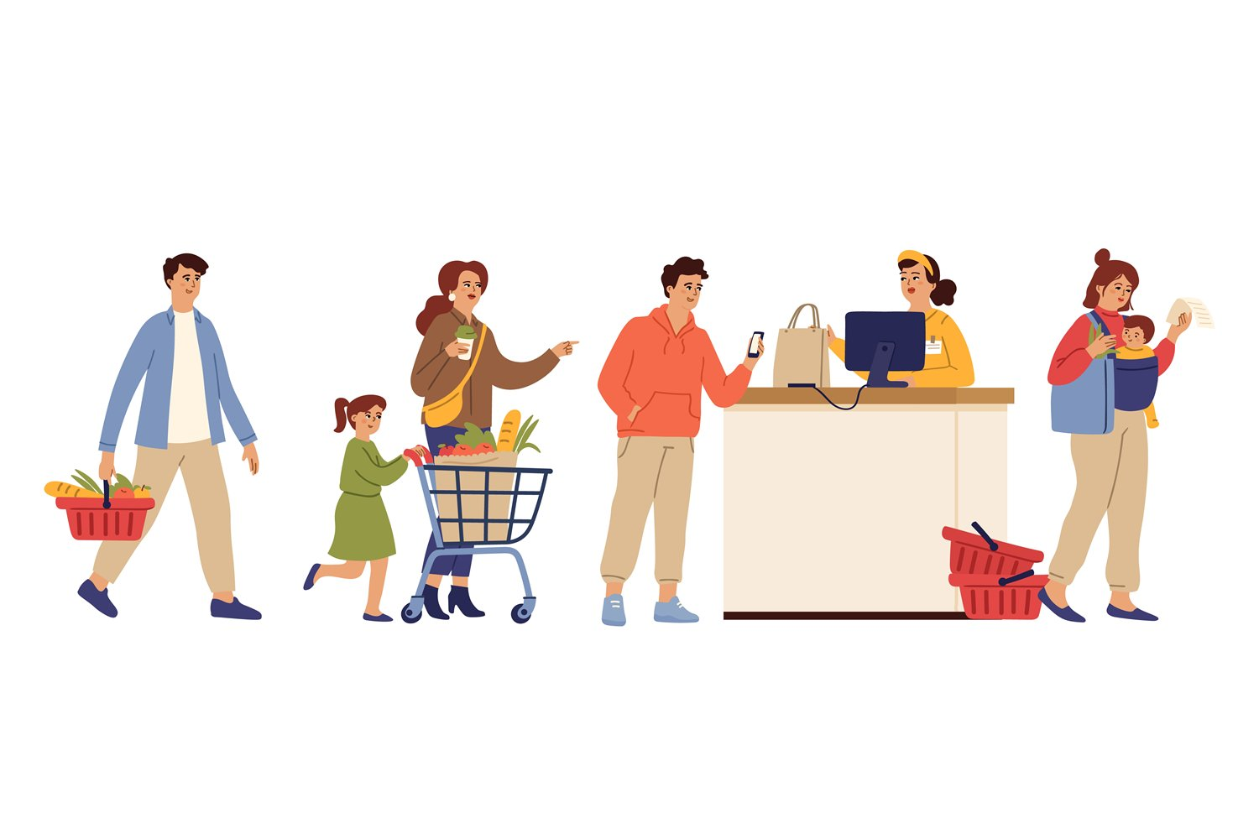

Who are they?
customer (n)
/ˈkʌstəmə/
khách hàng

Slide 13
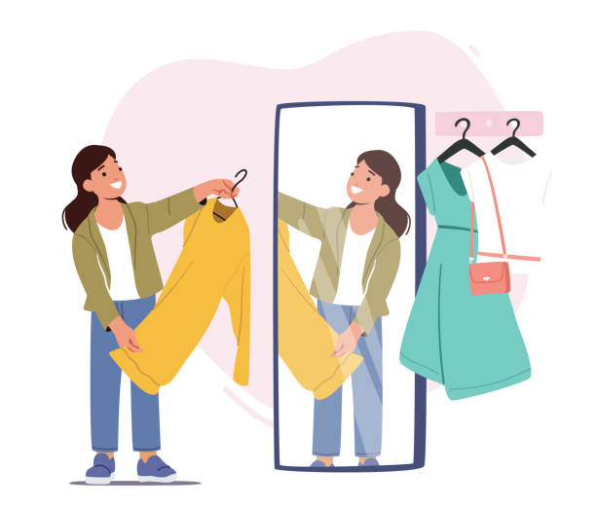
try on (phr.v)
/traɪ ɒn/
thử đồ
(quần áo, giày dép)

Slide 14
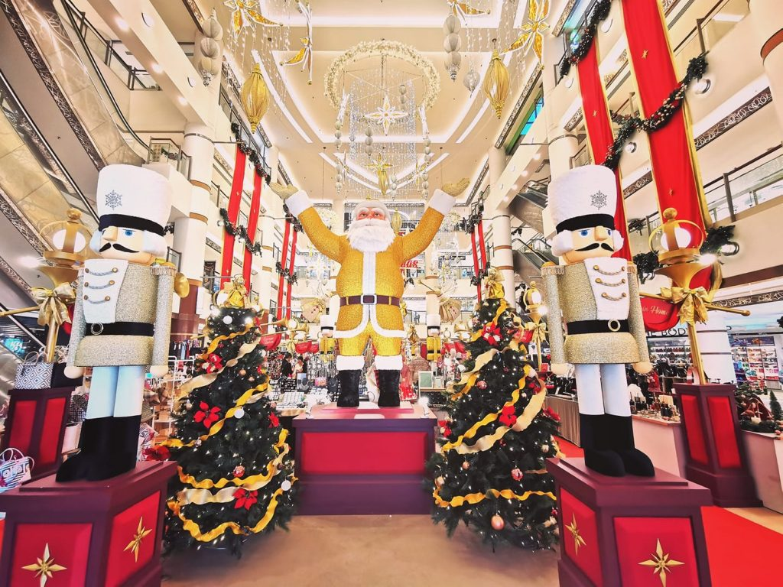
decoration (n)
/ˌdekəˈreɪʃn/
đồ trang trí

Slide 15
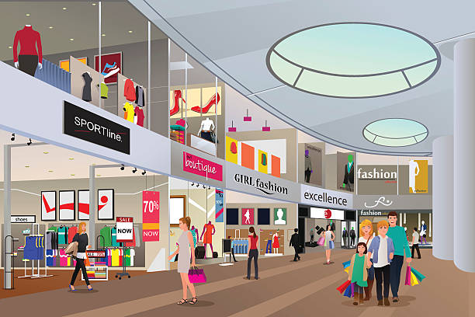
wander (v)
/ˈwɒn.dər/
thả bộ, đi lang thang

Slide 16

well-lit (adj)
/wel.lɪt/
đầy ánh sáng/ được chiếu sáng tốt

Slide 17
New WORDS
Words | Pronunciation | Meaning
1. customer (n) | /ˈkʌstəmə/
2. try on (phr.v) | /traɪ ɒn/
3. decoration (n) | /ˌdekəˈreɪʃn/
4. wander (v) | /ˈwɒn.dər/
5. well-lit (adj) | /wel.lɪt/
khách hàng
thử đồ (quần áo, giày dép)
đồ trang trí
thả bộ, đi lang thang
đầy ánh sáng/ được chiếu sáng tốt

Slide 18
02. READING

Slide 19
Ex 2. Read the passage and choose the correct answer A, B, or C.
Why We Go to Shopping Centres
Shopping centres attract a lot of customers, especially at the weekend, on holidays, or during sales. People go there to shop. Shopping centres offer a wide range of products to choose from. Customers can touch the products and try on clothes and shoes. This makes them feel more comfortable when they decide to buy something.
However, people also go to shopping centres for many other reasons. Some people go there for entertainment. These centres often offer year-round free entertainment for customers of all ages such as live music and special performances. During holidays, shoppers can see decorations and join in the holiday excitement. It’s a good way to relax. Some people go there just to hang out with friends. They go browsing and chat while wandering through the shopping malls. Others visit shopping centres to get exercise. They enjoy walking for one or two hours in clean and well-lit areas. Some people even go there to avoid the heat or cold outside. Shopping centres offer free air conditioning and heating.

Slide 20
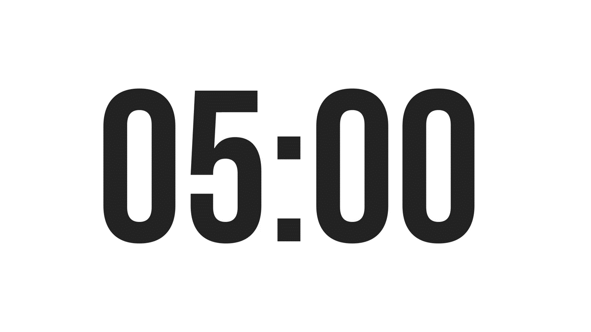
Ex 2. Read the passage and choose the correct answer A, B, or C.
1. People go to a shopping centre ______.
A. only for shopping
B. mainly to hang out
C. for many reasons
4. Some people exercise at a shopping centre because they like its ______.
A. crowds
B. well-lit areas
C. shops
2. At shopping centres, customers can ______.
A. touch the product
B. bargain to get lower prices
C. pay to watch live performances.
5. The word “year-round” in paragraph 2 is similar in meaning to ______.
A. always
B. sometimes
C. rarely
3. A kind of entertainment at a shopping centre is _______.
A. fashion contests
B. live music
C. painting exhibitions
Underline key words

Slide 21
Ex 2. Read the passage and choose the correct answer A, B, or C.
1. People go to a shopping centre ______.
A. only for shopping
B. mainly to hang out
C. for many reasons
Shopping centres attract a lot of customers, especially at the weekend, on holidays, or during sales. People go there to shop. Shopping centres offer a wide range of products to choose from. Customers can touch the products and try on clothes and shoes. This makes them feel more comfortable when they decide to buy something.
However, people also go to shopping centres for many other reasons. Some people go there for entertainment. These centres often offer year-round free entertainment for customers of all ages such as live music and special performances.
2. At shopping centres, customers can ______.
A. touch the product
B. bargain to get lower prices
C. pay to watch live performances.

Slide 22
Ex 2. Read the passage and choose the correct answer A, B, or C.
3. A kind of entertainment at a shopping centre is _______.
A. fashion contests
B. live music
C. painting exhibitions
However, people also go to shopping centres for many other reasons. Some people go there for entertainment. These centres often offer year-round free entertainment for customers of all ages such as live music and special performances. During holidays, shoppers can see decorations and join in the holiday excitement. It’s a good way to relax.

Slide 23
Ex 2. Read the passage and choose the correct answer A, B, or C.
4. Some people exercise at a shopping centre because they like its ______.
A. crowds
B. well-lit areas
C. shops
However, people also go to shopping centres for many other reasons. Some people go there for entertainment. These centres often offer year-round free entertainment for customers of all ages such as live music and special performances.
Others visit shopping centres to get exercise. They enjoy walking for one or two hours in clean and well-lit areas. Some people even go there to avoid the heat or cold outside. Shopping centres offer free air conditioning and heating.
5. The word “year-round” in paragraph 2 is similar in meaning to ______.
A. always
B. sometimes
C. rarely

Slide 24
Ex 3. Fill in each blank with ONE word from the passage.
Shopping centres
1. attract a lot of customers during _______. 2. allow customers to _______ on clothes and shoes. 3. offer free ______________ for customers of all ages. 4. are full of ___________ during holidays. 5. offer ______ air conditioning and heating.
attract
customers
during
allow customers
on
clothes
shoes
offer
free
customers
all ages
full of
during holidays
offer
air conditioning
heating

Slide 25
Ex 3. Fill in each blank with ONE word from the passage.
Shopping centres
1. attract a lot of customers during _______. 2. allow customers to _______ on clothes and shoes. 3. offer free ______________ for customers of all ages. 4. are full of ___________ during holidays. 5. offer ______ air conditioning and heating.
However, people also go to shopping centres for many other reasons. Some people go there for entertainment. These centres often offer year-round free entertainment for customers of all ages such as live music and special performances.
People go there to shop. Shopping centres offer a wide range of products to choose from. Customers can touch the products and try on clothes and shoes. This makes them feel more comfortable when they decide to buy something.
sales
Shopping centres attract a lot of customers, especially at the weekend, on holidays, or during sales.
attract
customers
during
allow customers
try
on
clothes
shoes
offer
free
entertainment
customers
all ages
full of
during holidays
offer
air conditioning
heating

Slide 26
Ex 3. Fill in each blank with ONE word from the passage.
Shopping centres
1. attract a lot of customers during _______. 2. allow customers to _______ on clothes and shoes. 3. offer free ______________ for customers of all ages. 4. are full of ___________ during holidays. 5. offer ______ air conditioning and heating.
attract
customers
during
sales
allow customers
try
on
clothes
Others visit shopping centres to get exercise. They enjoy walking for one or two hours in clean and well-lit areas. Some people even go there to avoid the heat or cold outside. Shopping centres offer free air conditioning and heating.
shoes
offer
free
entertainment
customers
During holidays, shoppers can see decorations and join in the holiday excitement. It’s a good way to relax.
all ages
full of
decorations
during holidays
offer
free
air conditioning
heating

Slide 27
Is there any shopping centre in your area?

Slide 28
03. SPEAKING

Slide 29
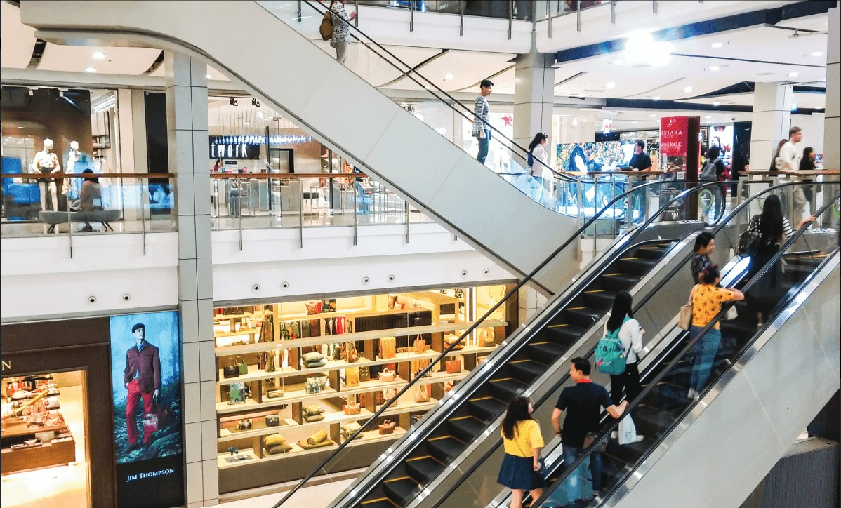
Ex 4. Work in pairs. Ask and answer about a new shopping centre.
Student A reads the suggestions for questions on card A.
Student B reads the information about the new shopping centre on card B (page 91).
Card A
Northwood Shopping Centre
1. Where / it?
2. How many / shops?
3. What / kind of entertainment?
4. What/ opening hours?
5. What date / open?
Card B
Northwood Shopping Centre
Opens next month: 24 March
In Northwood, 8 kilometres from city centre
More than 60 shops, 4 restaurants, 2 cafes, a cinema, a playground for children
Opening hours: 9:00 – 21:00

Slide 30
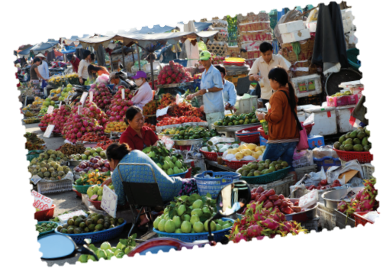
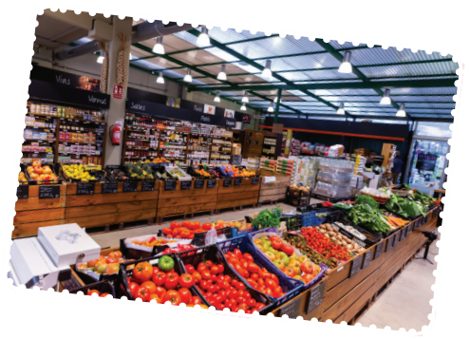
Ex 5. Work in pairs. Ask and answer about a shopping centre, a supermarket or an open-air market in your area. Take notes of your partner’s answers and report them to the class.
1
Think and take notes:
You can use the suggestions below:
where it is
how you get there
what its opening hours are
what you do there
what you like/ don’t like about it.
2
Ask and answer
3
Report in front of class

Slide 31

1
Think of a shopping centre, a supermarket, or an open-air market and take notes:
You can use the suggestions below:
where it is
how you get there
what its opening hours are
what you do there
what you like/ don’t like about it.

Slide 32

2
Work in pairs. Ask and answer
You can use the suggestions below:
where it is
how you get there
what its opening hours are
what you do there
what you like/ don’t like about it.

Slide 33
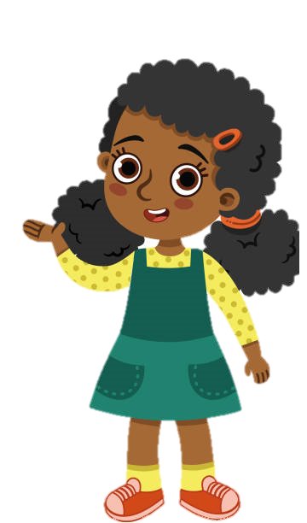
3
Report your friends’ answer.
Hello, my name is Susan. My friend is Ian. Now, I'm going to talk about his favourite shopping place.
Ian’s favourite shopping place is Lotte Centre Ha Noi. It's a large shopping center located in the Ba Dinh District. You can take a taxi, bus, or motorbike to get there. The market is open from 10 a.m. to 10 p.m. every day. Ian likes to browse the stores and see what's new. He usually buys clothes, electronics, and groceries. He also likes to eat at the food court and go to the movies. The thing that he likes most about the shopping centre is the wide variety of stores and restaurants. It's a clean and well-maintained shopping center.
However, there are some things that he dislikes about it. It can be very crowded, especially on weekends. Besides, the prices can be a bit high.
Thanks for your listening.

Slide 34
RECAP
What have you learnt in this lesson?
01
02
READING
SPEAKING
 Reasons why we go to shopping centres.
 Information about new shopping centres.

Slide 35
THANKS!
Do you have any questions?
Please keep this slide for attribution

