Slide 1
UNIT 9 CITIES OF THE WORLD
6th Grade
Lesson 5 Skills 1

Slide 2
OBJECTIVES
After this lesson, students will be able to
01
02
- read for general and specific information about a holiday postcard;
- talk about a city;

Slide 3
01
Reading

Slide 4
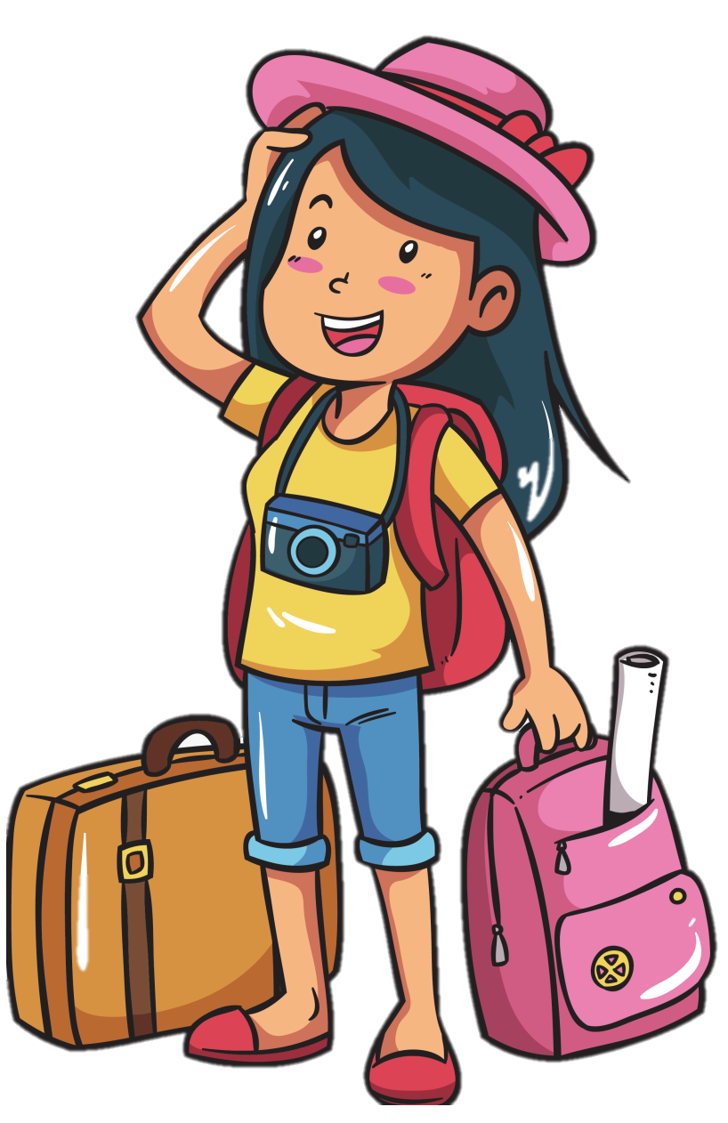

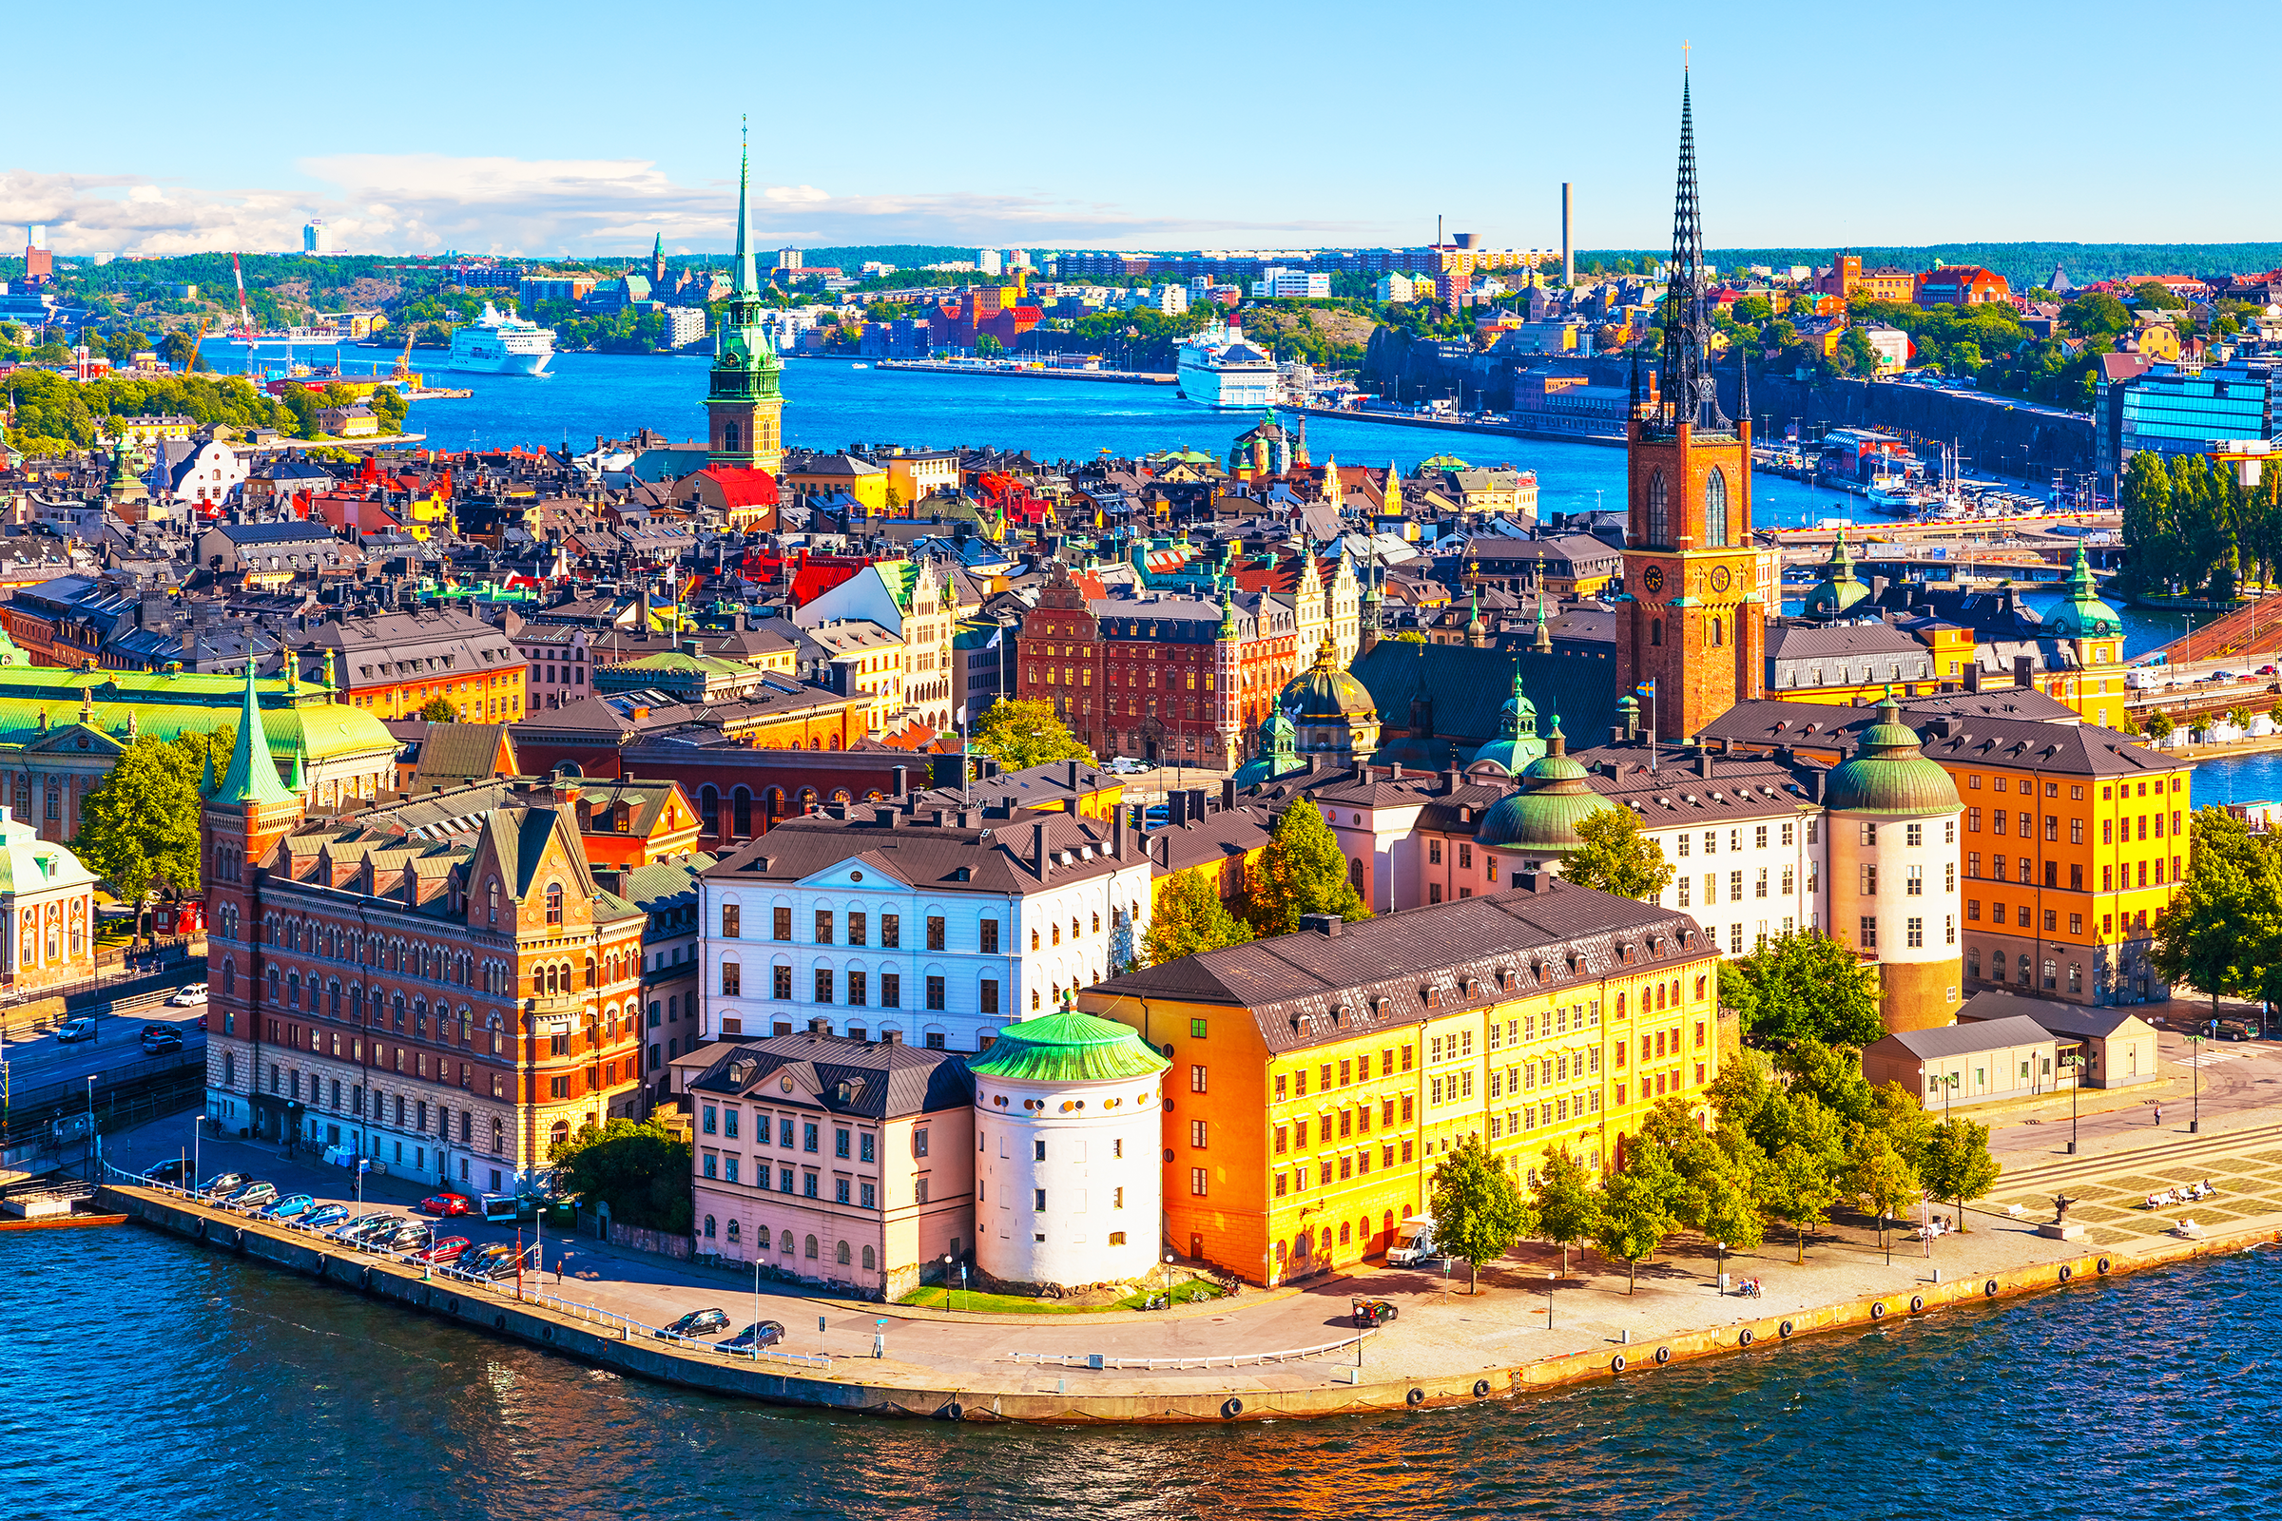
Stockholm
1. When do people write a postcard?
2. What do they often write on their postcard?
They want to tell their family or friends what they see and do, and how they feel about their experience there.
Mai
The sender often writes about his / her stay in a city or country.
Notes:
I have a friend, named mai. she is in holiday so he decided to travel somewhere.
She has come to Sweden and she has been to Stockholm.
During travelling, she has written a postcard to her grandma and grandpa.

Slide 5

café
/ˈkæfeɪ/
tiệm cà phê

Slide 6

helmet
/ˈhelmɪt/
mũ bảo hiểm

Slide 7
Read the postcard and choose the correct answer to each of the questions.
September 6 Dear Grandpa and Grandma, Stockholm is fantastic! Its weather is perfect, sunny all the time! Our hotel is good. It has a swimming pool and a gym. It offers delicious breakfast. Yesterday Mum, Dad and I rented three bikes and cycled to the Old Town. My parents wore their helmets and I wore mine. We visited the Royal Palace first. What a beautiful place! Mum loved it. She said, “Swedish art is amazing.” After that, we had “fika”, a coffee break, in a traditional café. Everything is so wonderful! Wish you were here! Love, Mai
1.This postcard is about ____ in Stockholm.
A. the weather
B. a holiday
C. landscapes
2. Guests can ____ in the hotel.
A. exercise
B. cycle
C. see Swedish art
3. Mai and her parents rented bikes to ____.
A. cycle around the hotel
B. visit the Old Town
C. go shopping
4. “Fika” is a ____.
A. traditional café
B. palace
C. coffee break

Slide 8
Read the postcard and choose the correct answer to each of the questions.
September 6 Dear Grandpa and Grandma, Stockholm is fantastic! Its weather is perfect, sunny all the time! Our hotel is good. It has a swimming pool and a gym. It offers delicious breakfast. Yesterday Mum, Dad and I rented three bikes and cycled to the Old Town. My parents wore their helmets and I wore mine. We visited the Royal Palace first. What a beautiful place! Mum loved it. She said, “Swedish art is amazing.” After that, we had “fika”, a coffee break, in a traditional café. Everything is so wonderful! Wish you were here! Love, Mai
September 6 Dear Grandpa and Grandma, Stockholm is fantastic! Its weather is perfect, sunny all the time! Our hotel is good. It has a swimming pool and a gym. It offers delicious breakfast. Yesterday Mum, Dad and I rented three bikes and cycled to the Old Town. My parents wore their helmets and I wore mine. We visited the Royal Palace first. What a beautiful place! Mum loved it. She said, “Swedish art is amazing.” After that, we had “fika”, a coffee break, in a traditional café. Everything is so wonderful! Wish you were here! Love, Mai
1.This postcard is about ____ in Stockholm.
A. the weather
B. a holiday
C. landscapes
2. Guests can ____ in the hotel.
A. exercise
B. cycle
C. see Swedish art
3. Mai and her parents rented bikes to ____.
A. cycle around the hotel
B. visit the Old Town
C. go shopping
4. “Fika” is a ____.
A. traditional café
B. palace
C. coffee break

Slide 9
Read the postcard and choose the correct answer to each of the questions.
September 6 Dear Grandpa and Grandma, Stockholm is fantastic! Its weather is perfect, sunny all the time! Our hotel is good. It has a swimming pool and a gym. It offers delicious breakfast. Yesterday Mum, Dad and I rented three bikes and cycled to the Old Town. My parents wore their helmets and I wore mine. We visited the Royal Palace first. What a beautiful place! Mum loved it. She said, “Swedish art is amazing.” After that, we had “fika”, a coffee break, in a traditional café. Everything is so wonderful! Wish you were here! Love, Mai
September 6 Dear Grandpa and Grandma, Stockholm is fantastic! Its weather is perfect, sunny all the time! Our hotel is good. It has a swimming pool and a gym. It offers delicious breakfast. Yesterday Mum, Dad and I rented three bikes and cycled to the Old Town. My parents wore their helmets and I wore mine. We visited the Royal Palace first. What a beautiful place! Mum loved it. She said, “Swedish art is amazing.” After that, we had “fika”, a coffee break, in a traditional café. Everything is so wonderful! Wish you were here! Love, Mai
1.This postcard is about ____ in Stockholm.
A. the weather
B. a holiday
C. landscapes
2. Guests can ____ in the hotel.
A. exercise
B. cycle
C. see Swedish art
3. Mai and her parents rented bikes to ____.
A. cycle around the hotel
B. visit the Old Town
C. go shopping
4. “Fika” is a ____.
A. traditional café
B. palace
C. coffee break

Slide 10
Read the postcard and choose the correct answer to each of the questions.
September 6 Dear Grandpa and Grandma, Stockholm is fantastic! Its weather is perfect, sunny all the time! Our hotel is good. It has a swimming pool and a gym. It offers delicious breakfast. Yesterday Mum, Dad and I rented three bikes and cycled to the Old Town. My parents wore their helmets and I wore mine. We visited the Royal Palace first. What a beautiful place! Mum loved it. She said, “Swedish art is amazing.” After that, we had “fika”, a coffee break, in a traditional café. Everything is so wonderful! Wish you were here! Love, Mai
September 6 Dear Grandpa and Grandma, Stockholm is fantastic! Its weather is perfect, sunny all the time! Our hotel is good. It has a swimming pool and a gym. It offers delicious breakfast. Yesterday Mum, Dad and I rented three bikes and cycled to the Old Town. My parents wore their helmets and I wore mine. We visited the Royal Palace first. What a beautiful place! Mum loved it. She said, “Swedish art is amazing.” After that, we had “fika”, a coffee break, in a traditional café. Everything is so wonderful! Wish you were here! Love, Mai
1.This postcard is about ____ in Stockholm.
A. the weather
B. a holiday
C. landscapes
2. Guests can ____ in the hotel.
A. exercise
B. cycle
C. see Swedish art
3. Mai and her parents rented bikes to ____.
A. cycle around the hotel
B. visit the Old Town
C. go shopping
4. “Fika” is a ____.
A. traditional café
B. palace
C. coffee break

Slide 11
Read the postcard and choose the correct answer to each of the questions.
September 6 Dear Grandpa and Grandma, Stockholm is fantastic! Its weather is perfect, sunny all the time! Our hotel is good. It has a swimming pool and a gym. It offers delicious breakfast. Yesterday Mum, Dad and I rented three bikes and cycled to the Old Town. My parents wore their helmets and I wore mine. We visited the Royal Palace first. What a beautiful place! Mum loved it. She said, “Swedish art is amazing.” After that, we had “fika”, a coffee break, in a traditional café. Everything is so wonderful! Wish you were here! Love, Mai
September 6 Dear Grandpa and Grandma, Stockholm is fantastic! Its weather is perfect, sunny all the time! Our hotel is good. It has a swimming pool and a gym. It offers delicious breakfast. Yesterday Mum, Dad and I rented three bikes and cycled to the Old Town. My parents wore their helmets and I wore mine. We visited the Royal Palace first. What a beautiful place! Mum loved it. She said, “Swedish art is amazing.” After that, we had “fika”, a coffee break, in a traditional café. Everything is so wonderful! Wish you were here! Love, Mai
1.This postcard is about ____ in Stockholm.
A. the weather
B. a holiday
C. landscapes
2. Guests can ____ in the hotel.
A. exercise
B. cycle
C. see Swedish art
3. Mai and her parents rented bikes to ____.
A. cycle around the hotel
B. visit the Old Town
C. go shopping
4. “Fika” is a ____.
A. traditional café
B. palace
C. coffee break

Slide 12
Read the text and match the places with the things they have.
September 6 Dear Grandpa and Grandma, Stockholm is fantastic! Its weather is perfect, sunny all the time! Our hotel is good. It has a swimming pool and a gym. It offers delicious breakfast. Yesterday Mum, Dad and I rented three bikes and cycled to the Old Town. My parents wore their helmets and I wore mine. We visited the Royal Palace first. What a beautiful place! Mum loved it. She said, “Swedish art is amazing.” After that, we had “fika”, a coffee break, in a traditional café. Everything is so wonderful! Wish you were here! Love, Mai
a. the Royal Palace
b. delicious breakfast
c. swimming pool
d. 'fika’
e. Swedish art
1. The hotel in Stockholm
2. The Old Town

Slide 13
Read the text and match the places with the things they have.
September 6 Dear Grandpa and Grandma, Stockholm is fantastic! Its weather is perfect, sunny all the time! Our hotel is good. It has a swimming pool and a gym. It offers delicious breakfast. Yesterday Mum, Dad and I rented three bikes and cycled to the Old Town. My parents wore their helmets and I wore mine. We visited the Royal Palace first. What a beautiful place! Mum loved it. She said, “Swedish art is amazing.” After that, we had “fika”, a coffee break, in a traditional café. Everything is so wonderful! Wish you were here! Love, Mai
September 6 Dear Grandpa and Grandma, Stockholm is fantastic! Its weather is perfect, sunny all the time! Our hotel is good. It has a swimming pool and a gym. It offers delicious breakfast. Yesterday Mum, Dad and I rented three bikes and cycled to the Old Town. My parents wore their helmets and I wore mine. We visited the Royal Palace first. What a beautiful place! Mum loved it. She said, “Swedish art is amazing.” After that, we had “fika”, a coffee break, in a traditional café. Everything is so wonderful! Wish you were here! Love, Mai
a. the Royal Palace
b. delicious breakfast
c. swimming pool
d. 'fika’
e. Swedish art
1. The hotel in Stockholm
b. delicious breakfast
c. swimming pool
2. The Old Town

Slide 14
Read the text and match the places with the things they have.
September 6 Dear Grandpa and Grandma, Stockholm is fantastic! Its weather is perfect, sunny all the time! Our hotel is good. It has a swimming pool and a gym. It offers delicious breakfast. Yesterday Mum, Dad and I rented three bikes and cycled to the Old Town. My parents wore their helmets and I wore mine. We visited the Royal Palace first. What a beautiful place! Mum loved it. She said, “Swedish art is amazing.” After that, we had “fika”, a coffee break, in a traditional café. Everything is so wonderful! Wish you were here! Love, Mai
September 6 Dear Grandpa and Grandma, Stockholm is fantastic! Its weather is perfect, sunny all the time! Our hotel is good. It has a swimming pool and a gym. It offers delicious breakfast. Yesterday Mum, Dad and I rented three bikes and cycled to the Old Town. My parents wore their helmets and I wore mine. We visited the Royal Palace first. What a beautiful place! Mum loved it. She said, “Swedish art is amazing.” After that, we had “fika”, a coffee break, in a traditional café. Everything is so wonderful! Wish you were here! Love, Mai
a. the Royal Palace
b. delicious breakfast
c. swimming pool
d. 'fika’
e. Swedish art
1. The hotel in Stockholm
b. delicious breakfast
c. swimming pool
2. The Old Town
b. the Royal Palace
d. 'fika’
e. Swedish art

Slide 15
02
Speaking

Slide 16

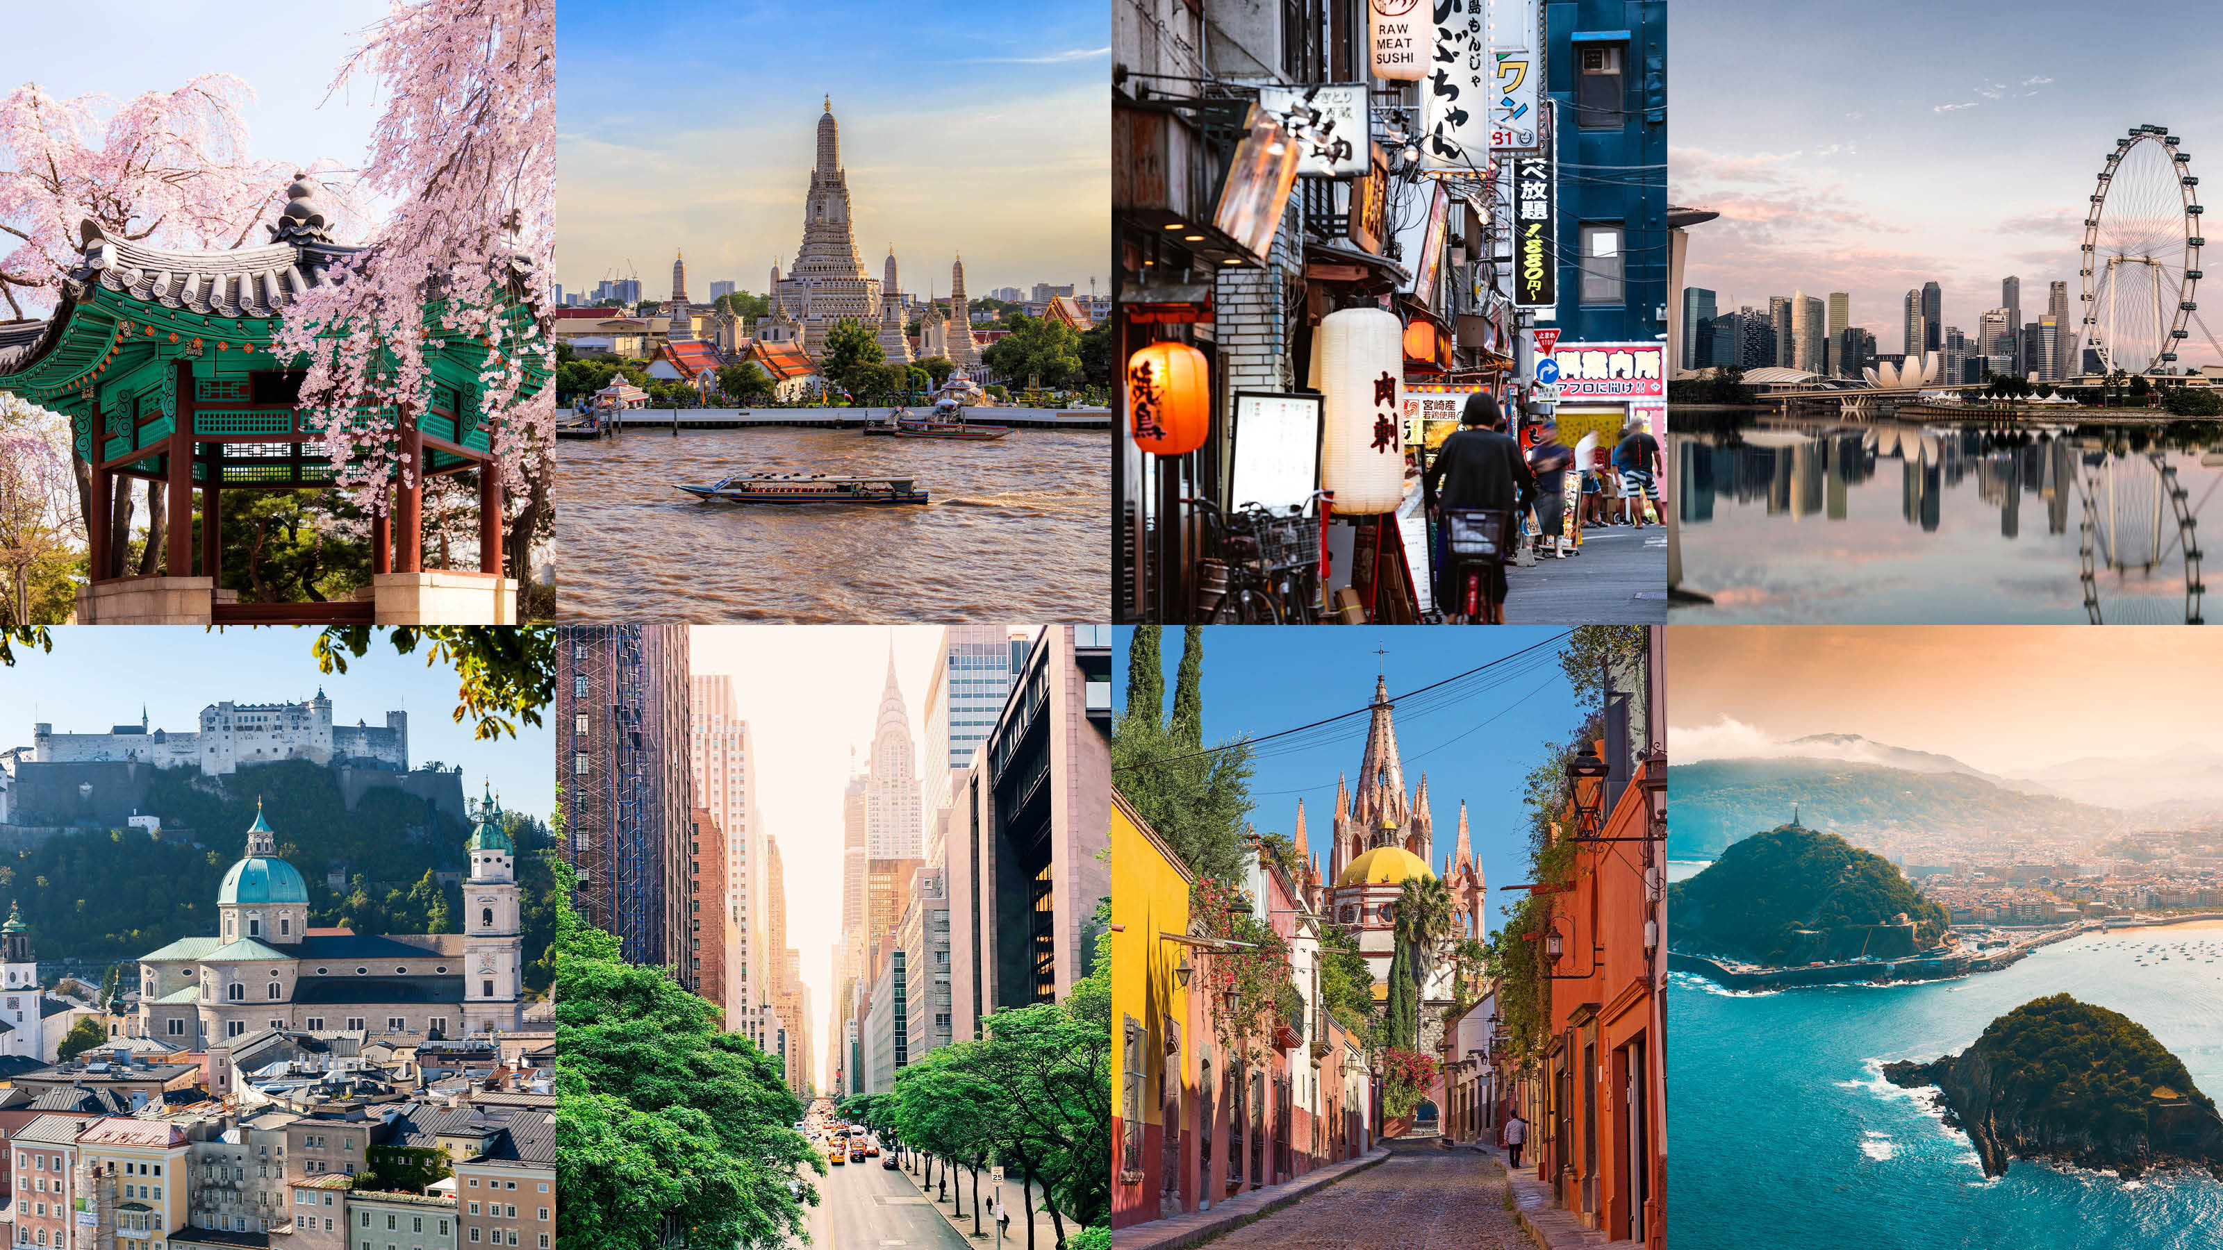
List as many cities as you can in 2 minutes.

Slide 17
Work in groups of 6.
CITIES OF
THE WORLD
Step 1 (3 mins) : Project Planning (Ideas, Roles)
What city is it?
What is it like? (the weather, the food ...)
What can you see and do there?
How do you feel about it?
Leader (1)
Drawers (2-3)
Presenters (2-3)
Step 2 (5 mins) : Monitor the Progress
Step 3 (2 mins) : Check and finish

Slide 18
CHECKING CRITERIA
Criteria | Yes | No
1. Did he/she use the correct verb tense?
2. Did he/she answer all the questions?
3. Did he/she feel unconfident when speaking?
4. Did he/she have eye contact with audience?

Slide 19
Share the with your class.
Hi! We are group …
We're going to tell you about ...

Slide 20
Thanks!
Do you have any questions?

