Slide 1
Unit 7
ENVIRONMENTAL PROTECTION
LESSON 2: A CLOSER LOOK 1

Slide 2

OBJECTIVES
By the end of the lesson, students will be able to:
1
VOCABULARY
use the lexical items related to ENVIRONMENTAL PROTECTION
PRONUNCIATION
2
correctly pronounce words that contain the sounds:
/bl/ and /kl/

Slide 3
Warm-up
UNJUMBLED THE GIVEN WORDS
Example:
GBALLO WAINGRM
GLOBAL WARMING

Slide 4

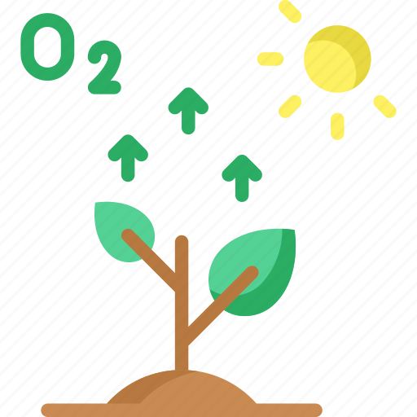
Warm-up
UNJUMBLED THE GIVEN WORDS
XEOGYN
OXYGEN

Slide 5
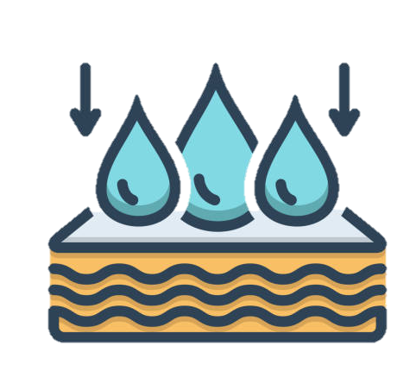
Warm-up
UNJUMBLED THE GIVEN WORDS
BBSOAR
ABSORB

Slide 6

Warm-up
UNJUMBLED THE GIVEN WORDS
SUCBSETAN
SUBSTANCE

Slide 7
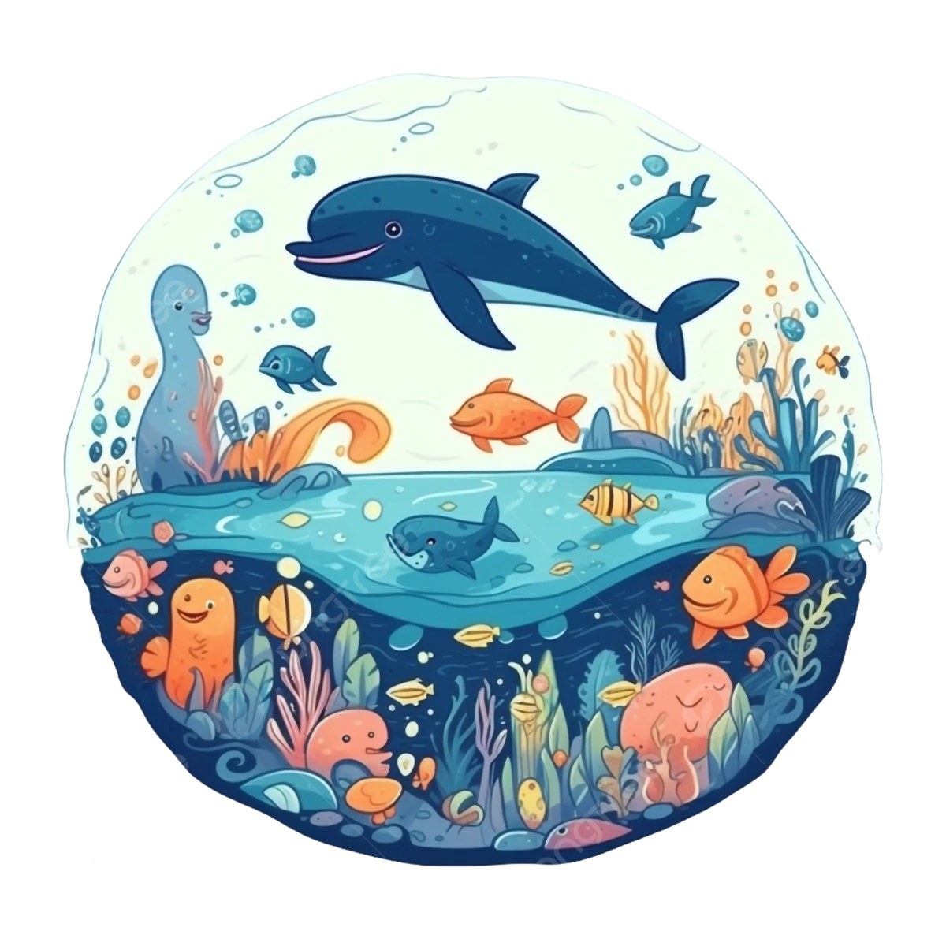
Warm-up
UNJUMBLED THE GIVEN WORDS
ENIRAM LEFI
MARINE LIFE

Slide 8

Warm-up
UNJUMBLED THE GIVEN WORDS
ENXTITICON
EXTINCTION

Slide 9
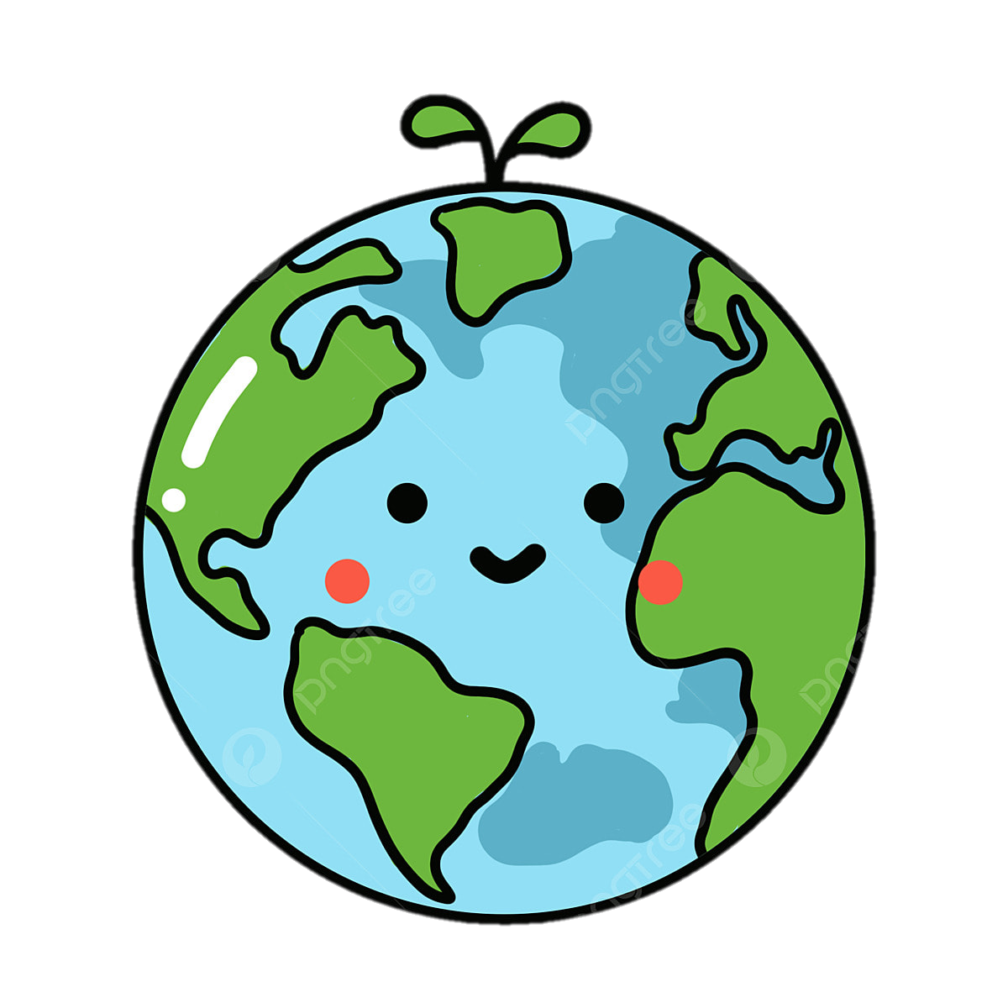
Warm-up
UNJUMBLED THE GIVEN WORDS
MECYSSOET
ECOSYSTEM

Slide 10
01
VOCABULARY

Slide 11

Ecosystem (np)
/ˈiːkəʊsɪstəm/
Hệ sinh thái

Slide 12
Marine life (np)
/məˈriːn laɪf/
sinh vật biển

Slide 13
Absorb (v)
/əbˈzɔːb/
thẩm thấu

Slide 14
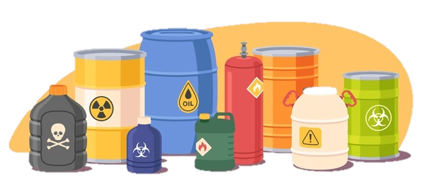
Harmful substance
(n)
/ˈhɑːmfl ˈsʌbstəns/
tác nhân gây hại

Slide 15
Extinction (n)
/ ɪkˈstɪŋkʃn/
sự tuyệt chủng

Slide 16
VOCABULARY
New words | Pronunciation | Meaning
1. ecosystem (n) | /ˈiːkəʊsɪstəm/ | hệ sinh thái
2. marine life (n) | /məˈriːn laɪf/ | sinh vật biển
3. absorb (v) | /əbzɔːʳb/ | thẩm thấu
4. harmful substance (n) | /ˈhɑːmfl ˈsʌbstəns/ | tác nhân gây hại
5. extinction (n) | /ɪkˈstɪŋkʃn/ | sự tuyệt chủng

Slide 17
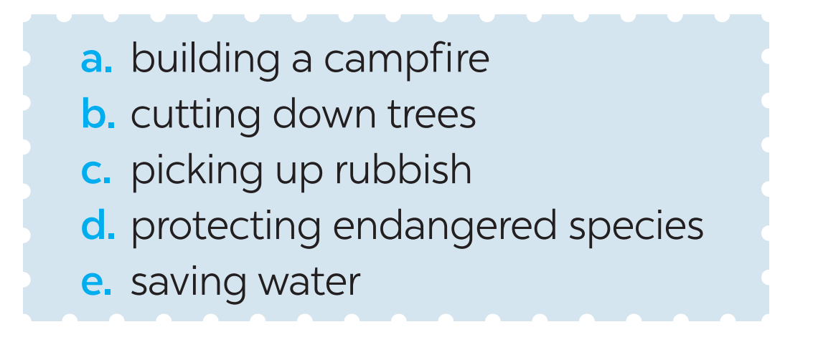
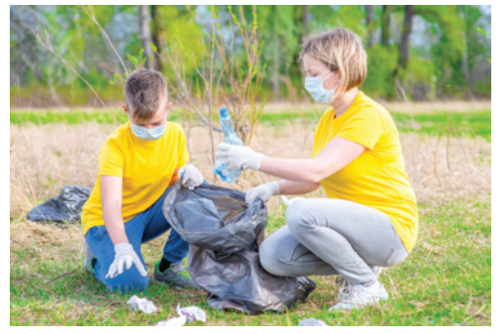
Task 1: Label each picture with a phrase from the list.
c. picking up rubbish

Slide 18
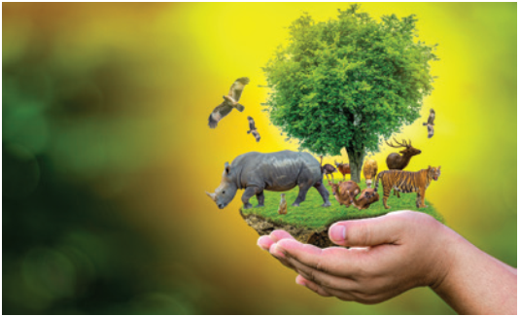
Task 1: Label each picture with a phrase from the list.
d. protecting
endangered species

Slide 19
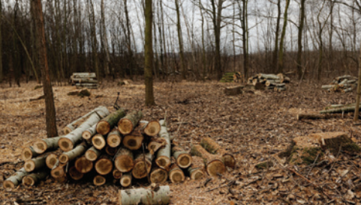
Task 1: Label each picture with a phrase from the list.
b. cutting down trees

Slide 20
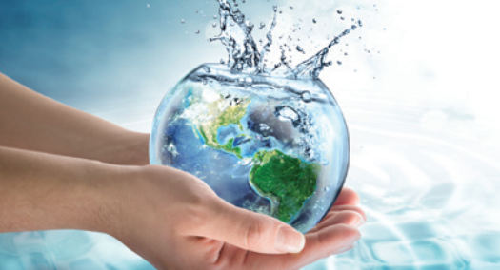
Task 1: Label each picture with a phrase from the list.
e. saving water

Slide 21
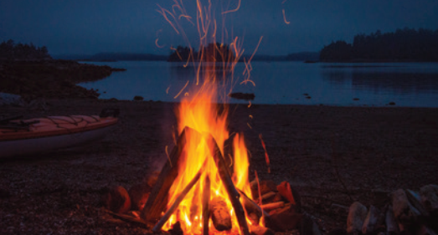
Task 1: Label each picture with a phrase from the list.
a. Building a campfire

Slide 22

Task 1: Label each picture with a phrase from the list.
Tick the actions above that protect the environment.

Slide 23
Task 2: Match each word or phrase in column A with its meaning in column B.
A |  | B
1. ecosystem (n) |  | a. the process of making water, air, soil, etc. dirty by adding harmful substances
2. pollution |  | b. the practice of protecting the natural environment
3. habitat |  | c. the way living and non-living things in a particular area are related to each other
4. Environmental protection |  | d. animals facing a high risk of extinction in the wild
5. Endangered species |  | e. the place where a type of plant or animal lives

Slide 24



WORD FISHING
Work in 4 teams
Choose the “bait” that helps you catch the “fish”
The team with the most fish t the end wins the game.

Slide 25




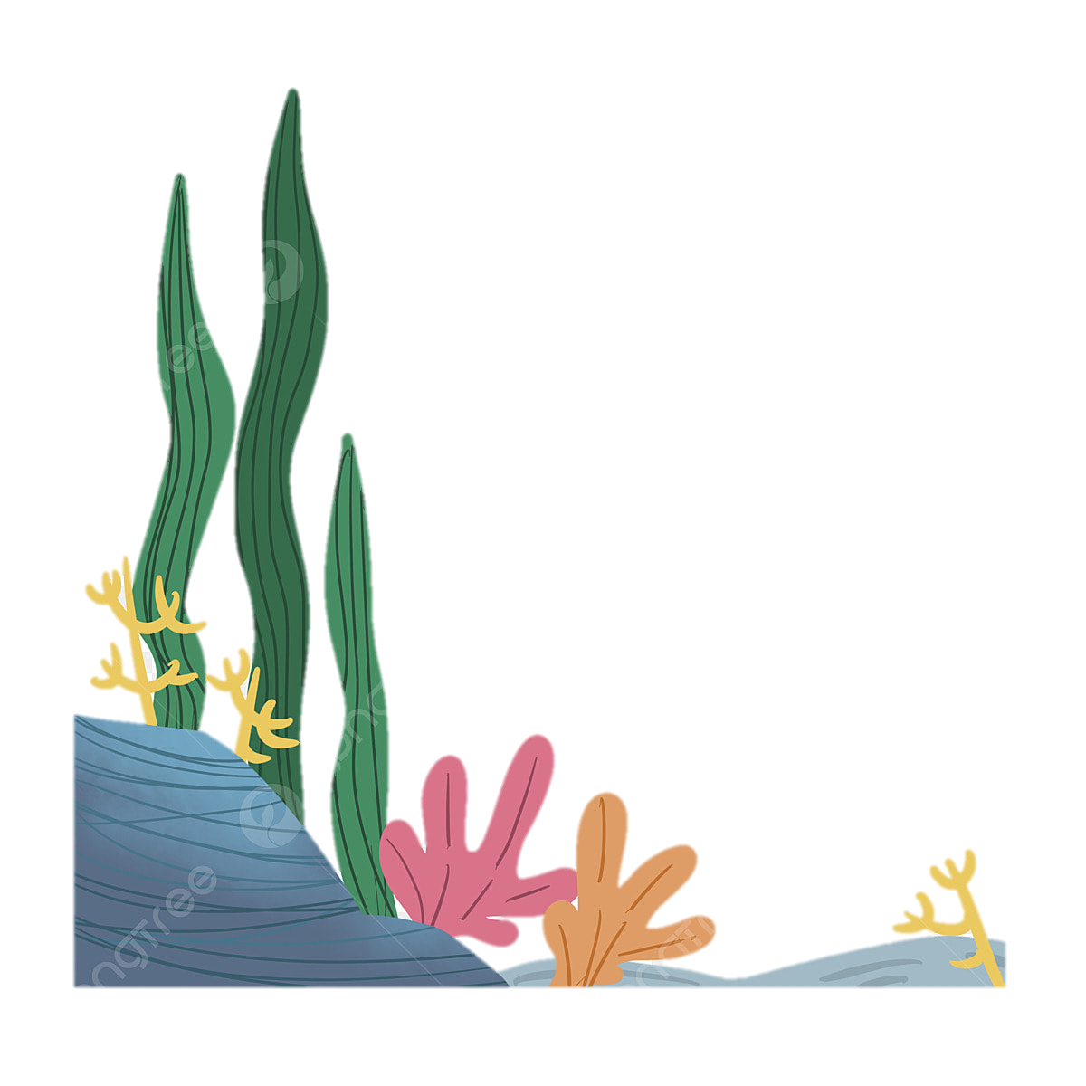




WORD FISHING
People in my neighbourhood are doing a lot to save ….
habitat
endangered species
Harmful substances
Notes:
Give Ss extra points if they can give the example of environmental protection

Slide 26

WORD FISHING
Harmful substances
Forests help release oxygen and absorb …. they also provide homes for many species.
carbon dioxide
nitrogen

Slide 27
WORD FISHING
Con Dao National Park provides a rich …. for marine life.
habitat
carbon dioxide
ecosystem
Notes:
Give Ss extra points if they can give the example of environmental protection

Slide 28

WORD FISHING
Cutting down trees
… is a serious environmental concern as it harms natural habitats.
endangered species
ecosystem

Slide 29
WORD FISHING
An … may be a whole forest, or a small pond, and it can be of any size.
habitat
carbon footprint
ecosystem
Notes:
Give Ss extra points if they can give the example of environmental protection

Slide 30
Task 3: Complete each sentence with a word or phrase from the box.
habitat cutting down trees ecosystem endangered species carbon dioxide
1. People in my neighbourhood are doing a lot to save __________________________.
2. Con Dao National Park provides a rich _________ for marine life.
endangered species
habitat

Slide 31
Task 3: Complete each sentence with a word or phrase from the box.
habitat cutting down trees ecosystem endangered species carbon dioxide
3. Forests help release oxygen and absorb _________________________; they also provide homes for many species.
carbon dioxide

Slide 32
Task 3: Complete each sentence with a word or phrase from the box.
habitat cutting down trees ecosystem endangered species carbon dioxide
Cutting down trees
4. ________________________ is a serious environmental concern as it harms natural habitats.
5. An ______________ may be a whole forest, or a small pond, and it can be of any size.
ecosystem

Slide 33
02
Pronunciation
/bl/ and /kl/

Slide 34
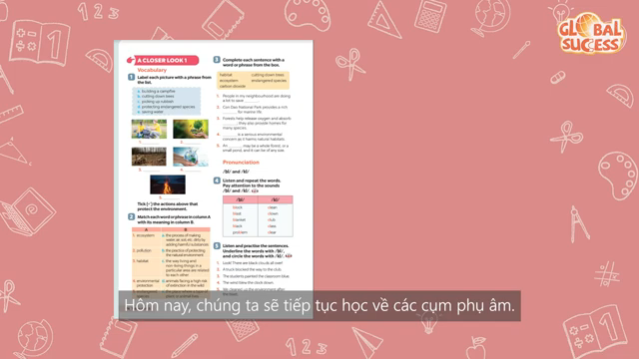

Slide 35
Task 4: Listen and repeat the words. Pay attention to the sounds /bl/ and /kl/.
/bl/ | /kl/
block blast blanket black problem | clean clown club class clear

Slide 36
Task 5: Listen and practise the sentences. Underline the words with /bl/, and circle the words with /kl/.
1. Look! There are black clouds all over!
2. A truck blocked the way to the club.
3. The students painted the classroom blue.
4. The wind blew the clock down.
5. We cleaned up the environment after the blast.

Slide 37
Recap
1
Pollution can have serious effects on the balanced ______.
A. species B. ecosystem C. habitat
2
With so many areas of woodland being cut down, a lot of wildlife is losing its natural____.
A. Life B. protection C. habitat
3
Listen and write down the words
Clap
Blockbuster

Slide 38
HOMEWORK
Do exercises in the workbook.

Slide 39
THANKS
HAVE A NICE DAY!

