Slide 1
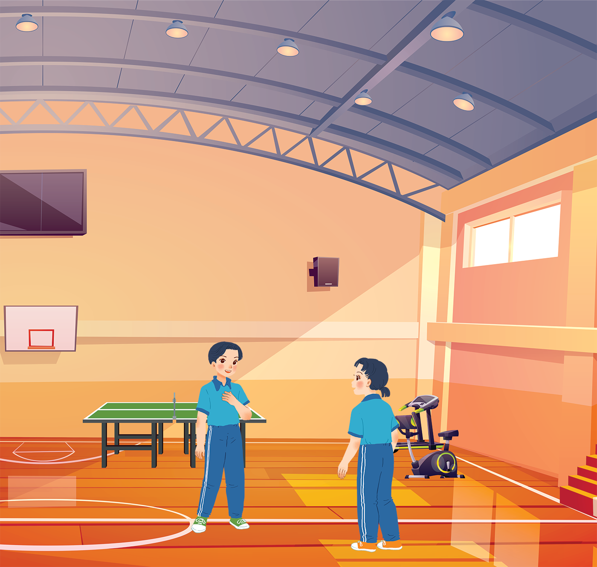
UNIT 8: SPORTS AND GAMES
LESSON 2: A CLOSER LOOK 1
English 6

Slide 2


Vocabulary
1
Write the right words under the pictures.
2
What sports are these things for? Match each thing in column A with a sport in column B.
3
Fill each blank with one of the words from the box.
Pronunciation
/e/ and /æ/
4
Listen and repeat. Pay attention Track to the sounds /e/ and /æ/.
Listen and repeat. Underline the words having the sounds /e/ and /æ/.
5

Slide 3


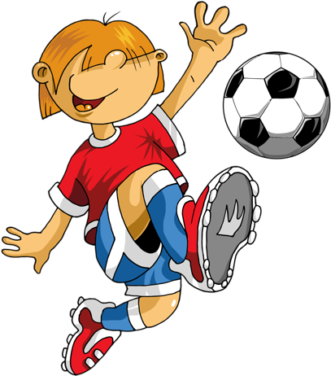
SPORTS AND GAMES
Name the sports and games

Slide 4
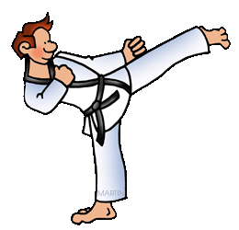


GAME
SPORT
karate

Slide 5
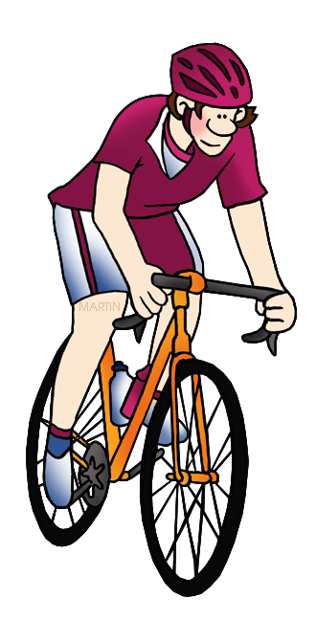
GAME
SPORT
cycling

Slide 6
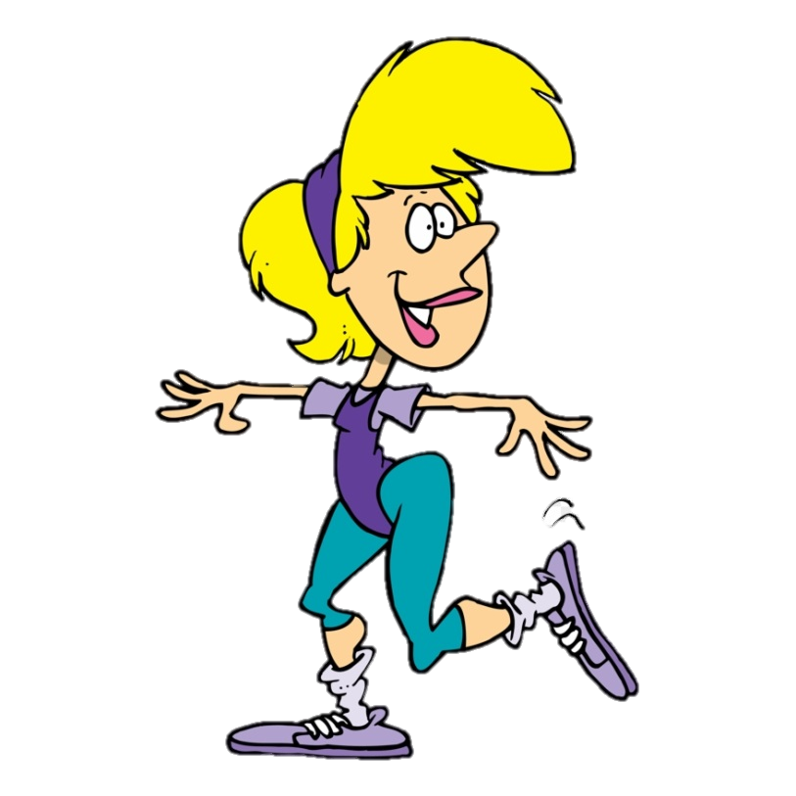
GAME
SPORT
aerobics

Slide 7
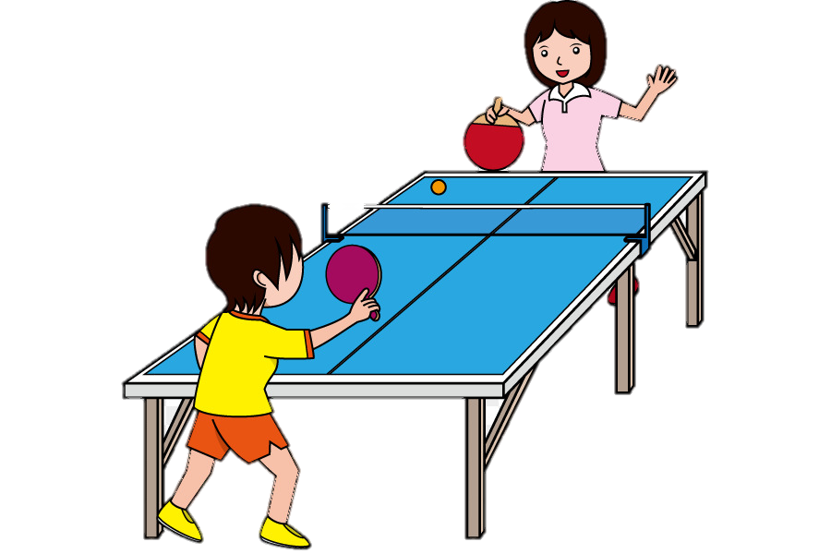
GAME
SPORT
table tennis

Slide 8
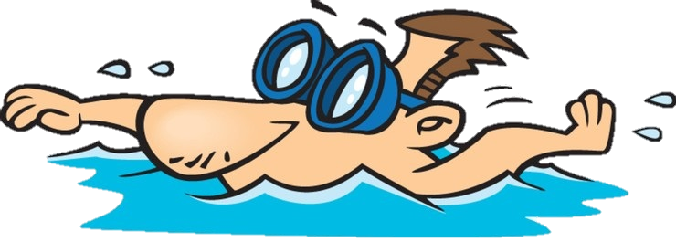
GAME
SPORT
swimming

Slide 9
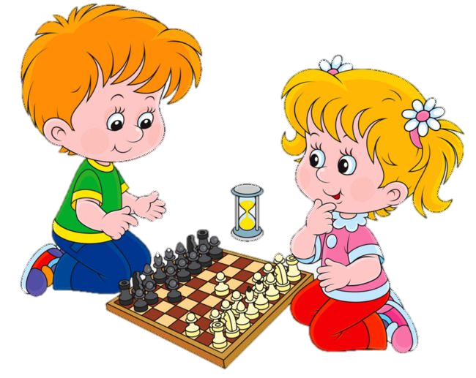
GAME
SPORT
chess

Slide 10
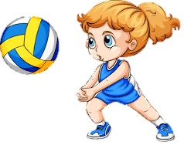
GAME
SPORT
volleyball

Slide 11
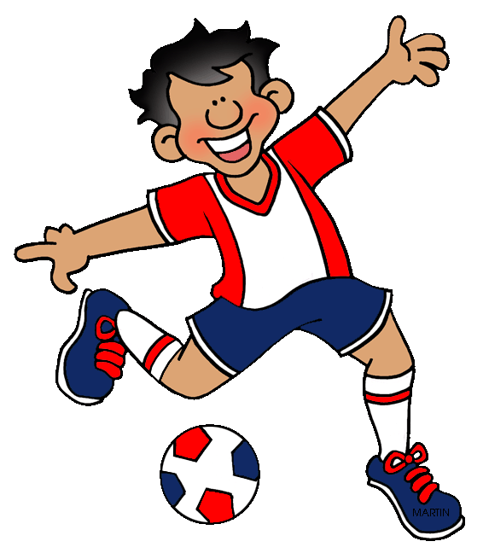
GAME
SPORT
football

Slide 12
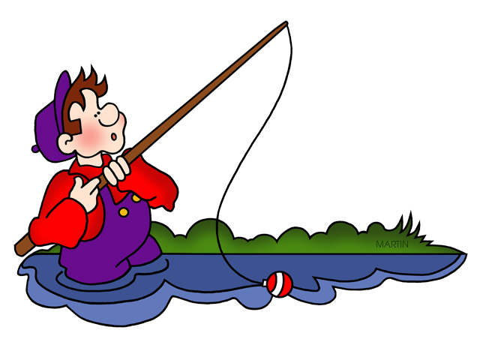
GAME
SPORT
fishing

Slide 13
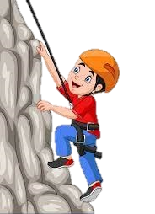

GAME
SPORT
climbing

Slide 14
Vocabulary

Slide 15


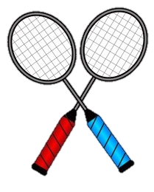

Vocabulary
‘racket (n)
vợt
‘goggles (n)
kính bơi
competi‘tion (n)
cuộc thi
‘champion (n)
vô địch
‘marathon (n)
chạy đua marathong

Slide 16
Rub out and remember
racket (n)
vợt
goggles (n)
kính bơi
competition (n)
cuộc thi
champion (n)
vô địch
marathon (n)
chạy đua marathon

Slide 17

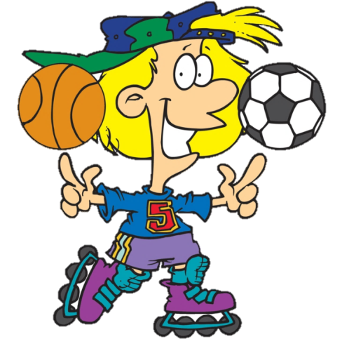
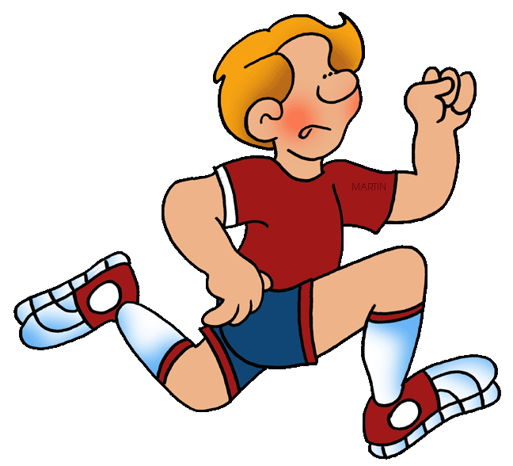
EQUIPMENT QUIZ

Slide 18
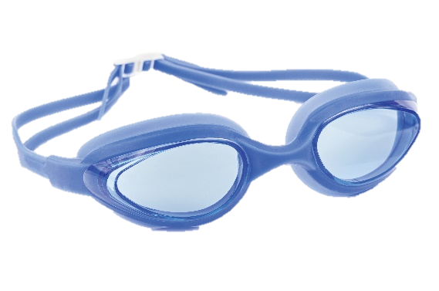
What do you call the glasses which the swimmers use?
TIME’S UP
_____ for going ______
goggles
swimming

Slide 19



Players hit the shuttlecock with a …
TIME’S UP
_____ for playing ______
racket
badminton

Slide 20
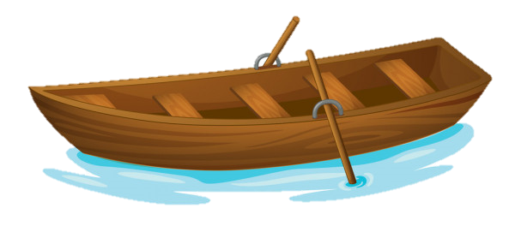
A small vehicle for travelling on water
TIME’S UP
_____ for ______
boat
boating

Slide 21
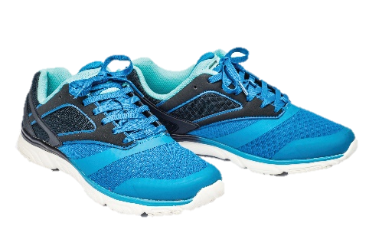
It is a name for shoes designed for sporting activities.
TIME’S UP
_____ for ______
sport shoes
sporting activities

Slide 22
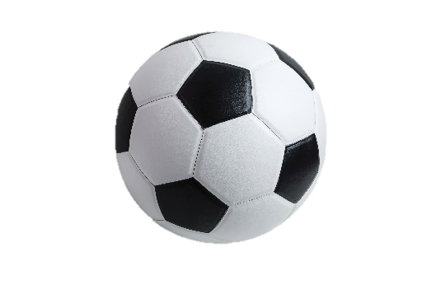
A family of team sports tries to kick it to score a goal
TIME’S UP
_____ for playing ______
ball
football/ ball games

Slide 23


A vehicle with two wheels that you ride by pushing its pedals with your feet
TIME’S UP
_____ for ______
bicycle
cycling

Slide 24
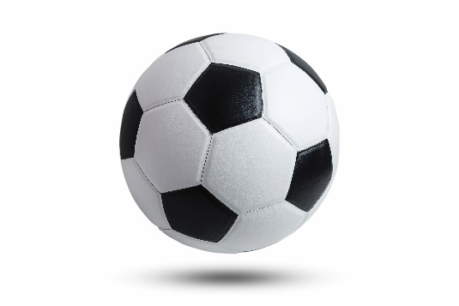
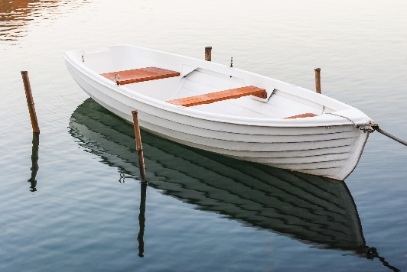
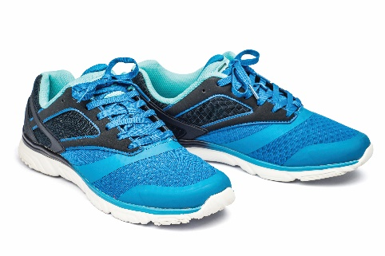
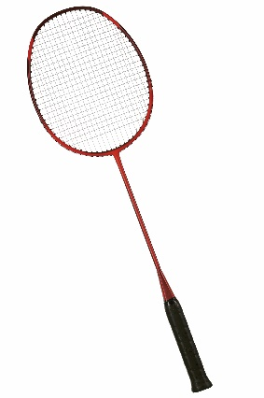
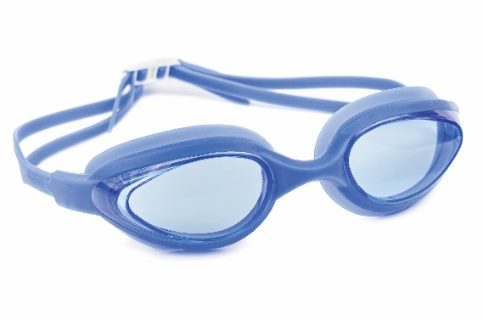
1
Write the right words under the pictures.
ball
racket
sports shoes
boat
goggles
1. ball
2. sports shoes
3.
1.
2.
3. boat
4. racket
5.
4.
5. goggles

Slide 25
2
What sports are these things for? Match each thing in column A with a sport in column B.
A
B
1.
c.
bicycle
a.
cycling
boating
2.
d.
ball
b.
ball games
swimming
c.
a.
cycling
3.
boat
boating
b.
swimming
4.
goggles
d.
ball games
e.
e.
badminton
5.
racket
badminton

Slide 26
3
Fill each blank with one of the words from the box.
champion
competition
sporty
marathon
congratulations
competition.
1.
She won an international sports
_______.
2.
He became the world tennis
_______ when he was very young.
champion when he was very young.
“Can you send my
_______ to the winner of the contest?”
3.
congratulations to the winner of the contest?”
_______. He does exercise every day.
4.
My friend David is very
sporty. He does exercise every day.
5.
The first
_______ took place in 1896.
marathon took place in 1896.

Slide 27
Pronunciation
/e/ and /æ/

Slide 28

4
Listen and repeat the words. Pay attention to the sounds /e/ and /æ/.
/e/ | /æ/
chess tennis exerise contest | racket match marathon active

Slide 29
5
Listen and repeat. Underline the words having the sounds /e/ and /æ/.
1.
They cannot take part in this contest.
2.
They began the match very late.
3.
Please get the racket for me.
4.
We play chess every Saturday.
5.
My grandpa is old, but he’s active.

Slide 30
Who is faster
Write sentences including 2 features:
sports and games
one of the sounds /e/ or /æ/.
Example:
My favourite sport is table tennis.

Slide 31

Homework
Learn vocabulary and the structure by heart.
Do exercise … in your work book
Prepare the next lesson: A closer look 2
Rewrite the sentences into notebooks.
Find 3 more sports or games that have the sound /e/ or /æ/.

