Slide 1


Unit
11
SCIENCE AND TECHNOLOGY
LESSON 2: A closer look 1
1

Slide 2
GAME: LABELLING
WARM-UP
RULE:
Work in 2 teams
Receive the pictures of things and strips of paper with the phrases.
Stick the phrases to the right pictures.
The team with the most correct answers wins

Slide 3
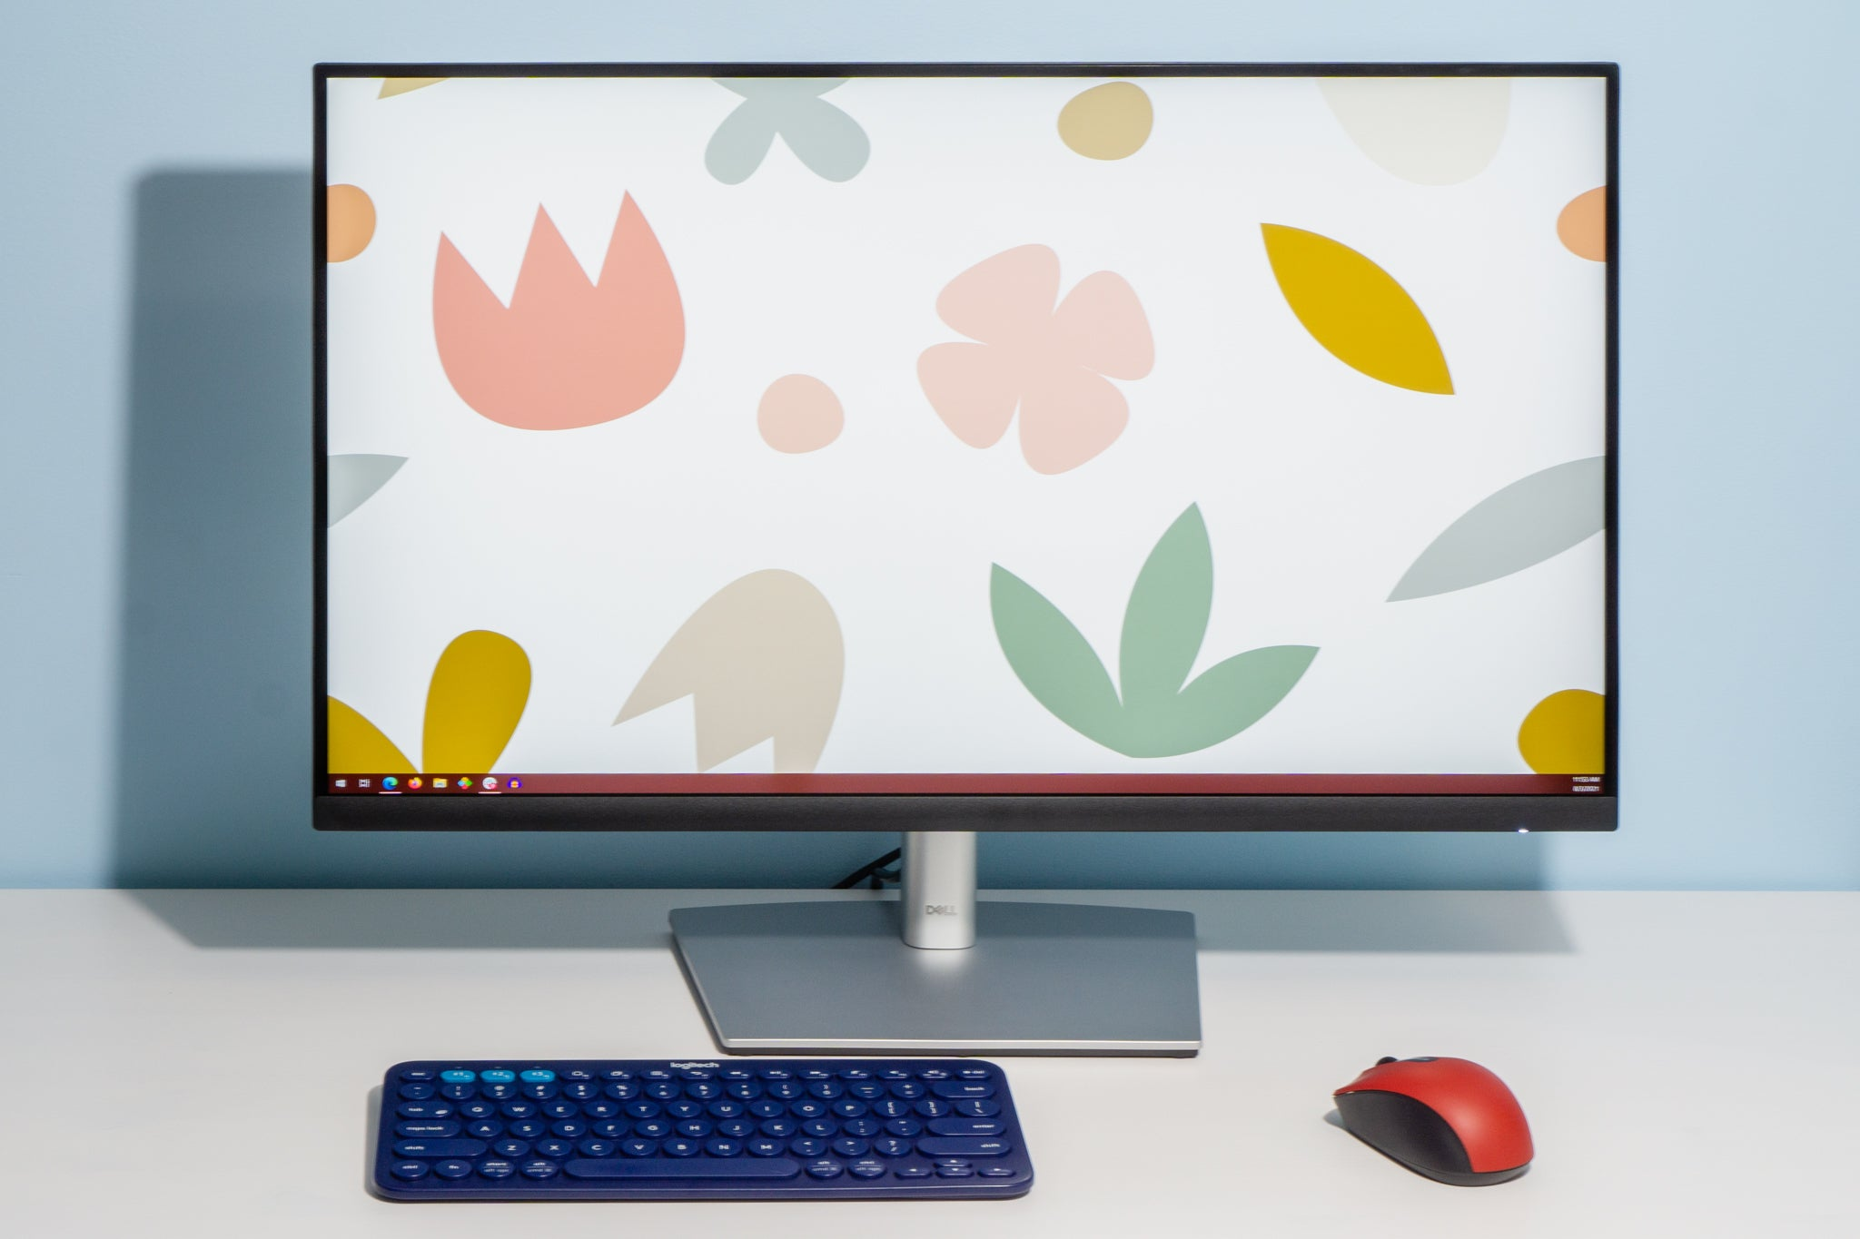


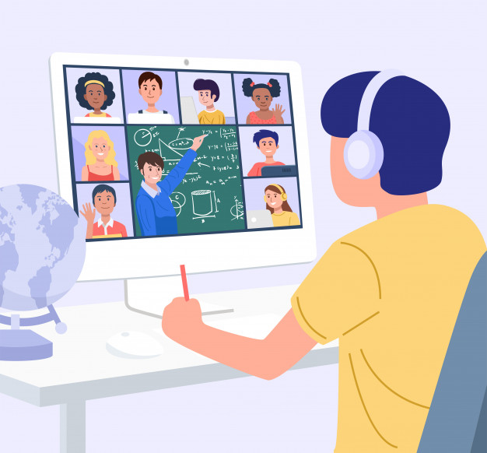
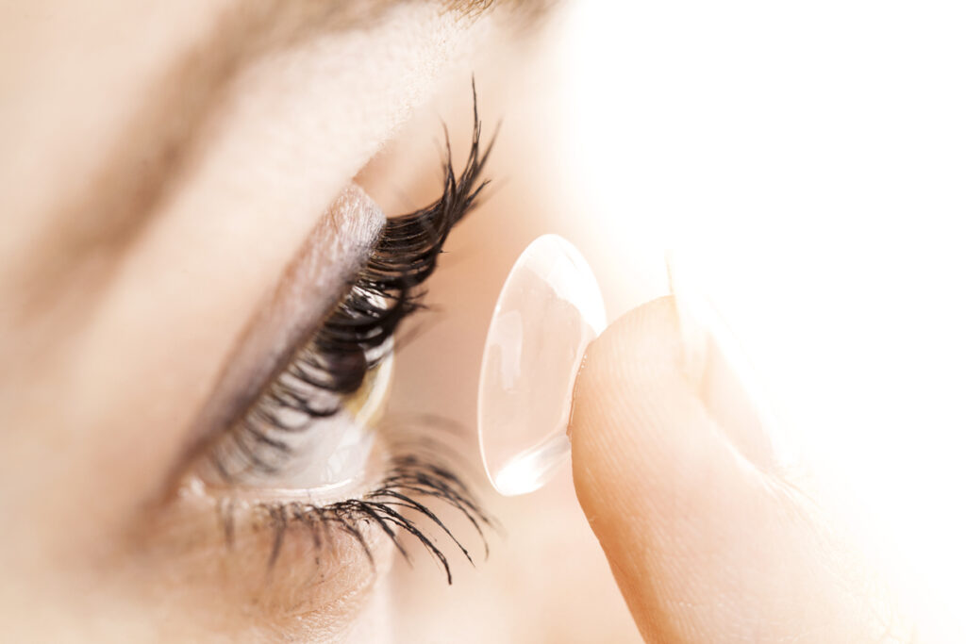

GAME: LABELLING
WARM-UP
Computer screen
Breakout rooms
Robot teacher
Online class
3D contact lenses
Connection

Slide 4
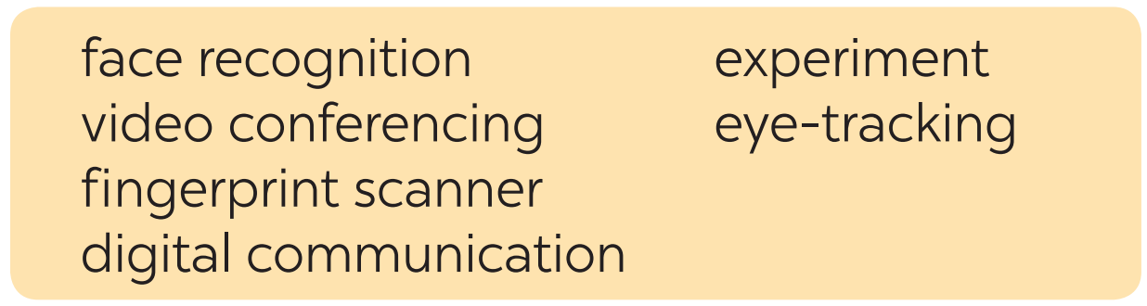
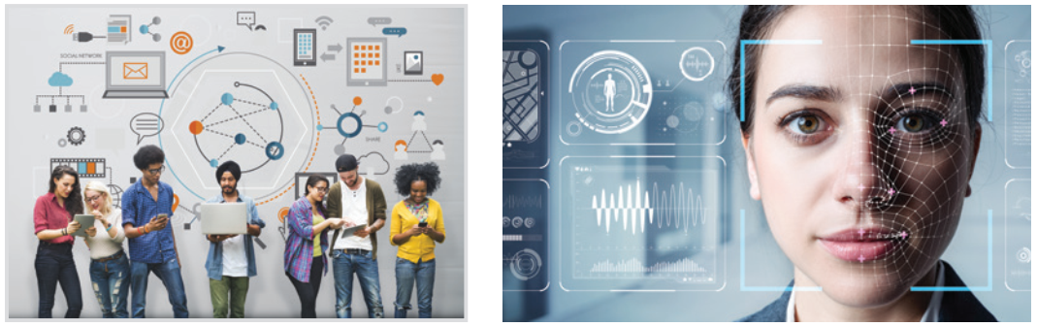
VOCABULARY
1
Write the words and phrases under each picture.
face recognition
1. ___________________
2. _______________
digital communication

Slide 5
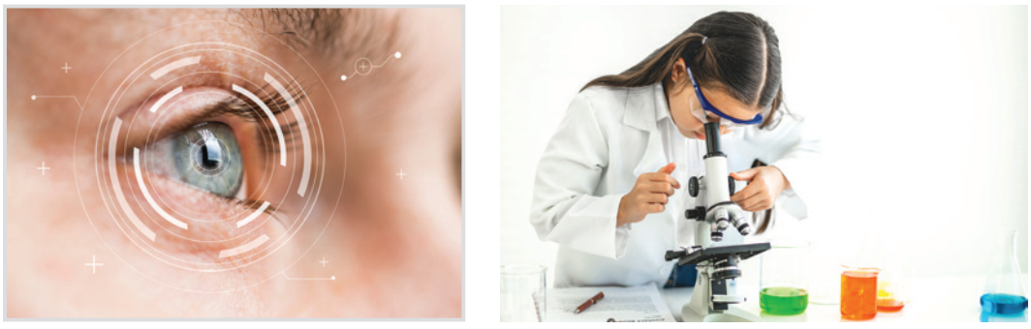
VOCABULARY
1
Write the words and phrases under each picture.
3. ___________
experiment
eye-tracking
4. ___________

Slide 6
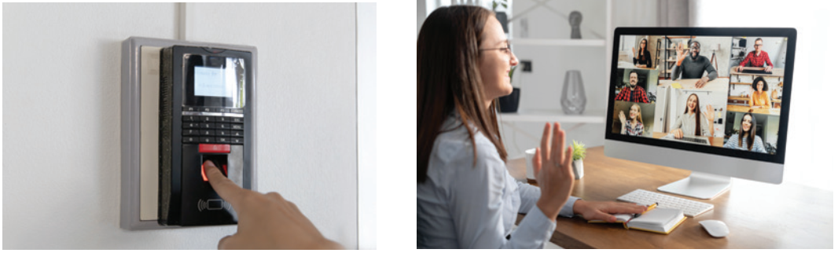
VOCABULARY
1
Write the words and phrases under each picture.
fingerprint scanner
6. ________________
5. ________________
video conferencing

Slide 7
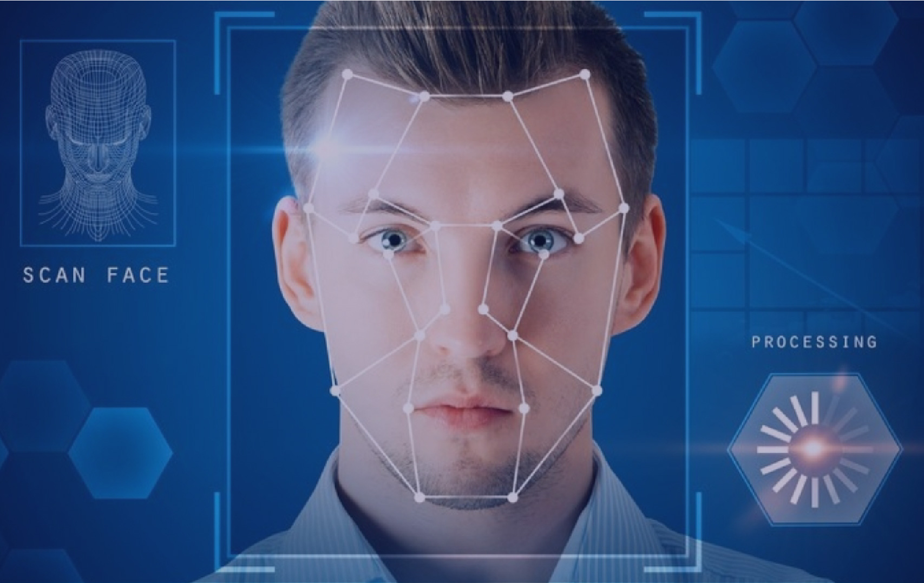

VOCABULARY
face recognition (n)
/feɪsˌrekəɡˈnɪʃn/
công nghệ nhận diện gương mặt

Slide 8

VOCABULARY
experiment (n)
/ɪkˈsperɪmənt/
thí nghiệm

Slide 9
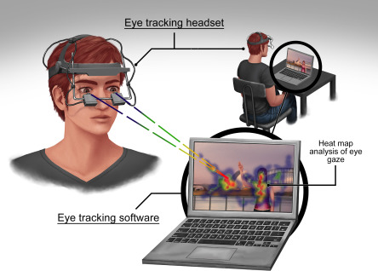
VOCABULARY
eye-tracking (n)
/ˈai ˌtrækɪŋ/
theo dõi (cử động) mắt

Slide 10
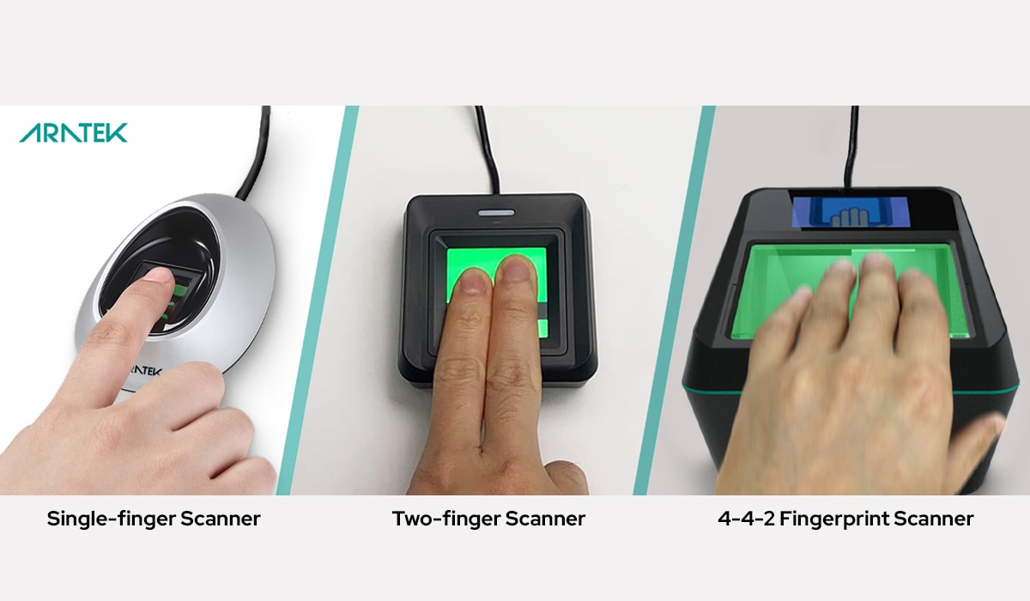
VOCABULARY
fingerprint scanner (n)
/ˈfɪŋɡəprɪnt ˈskænə/
máy quét vân tay

Slide 11
VOCABULARY
digital communication (n)
/ˈdɪdʒɪtl kəˌmjuːnɪˈkeɪʃn/
giao tiếp kỹ thuật số

Slide 12
VOCABULARY
New words | Pronunciation | Meaning
1. face recognition (n) | /feɪsˌrekəɡˈnɪʃn/ | công nghệ nhận diện gương mặt
2. experiment (n) | /ɪkˈsperɪmənt/ | thí nghiệm
3. eye tracking (n) | /ˈai ˌtrækɪŋ/ | công nghệ dõi (cử động) mắt
4. fingerprint scanner(n) | /ˈfɪŋɡəprɪnt ˈskænə/ | máy quét vân tay
5. digital communication (n) | /ˈdɪdʒɪtl kəˌmjuːnɪˈkeɪʃn/ | giao tiếp kỹ thuật số

Slide 13
VOCABULARY
2
Choose the option that best completes each phrase.
A. a device
1.
invent
B. a new area
A. a device
2.
discover
B. a new area
A. a device
3.
create
B. a new area
A. a device
4.
develop
B. a new area

Slide 14
VOCABULARY
3
Complete the sentences with the words and phrases from the box.
invented
created
experiments
discovered
fingerprint scanner
1. Marie Curie and Pierre Curie __________ radium and polonium.
2. Thomas Edison _________ the light bulb in 1880.
3. Sarah Gilbert is the creator of a vaccine. She ______ it in 2020.
4. Scientists have carried out many __________ to find a cure for cancer.
5. Scan your finger on this _______________ to check attendance, please.

Slide 15
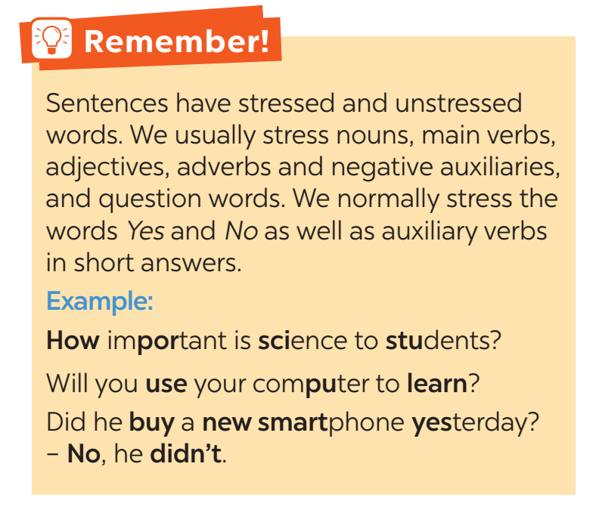
PRONUNCIATION

Slide 16
PRONUNCIATION
4
Listen and repeat the sentences. Pay attention to the bold syllables.
1. I don’t have a computer.
2. Do you call her every day? – No, I don’t.
3. They are not familiar with that new computer.
4. Did you lend her your laptop? – Yes, I did.
5. Who do you work with on Sundays?

Slide 17
PRONUNCIATION
5
Listen and repeat the sentences. How many stressed words are there in each sentence?
1. He is an inventor.
2. We won’t have a robot teacher next year.
3. She likes learning online.
4. Was she checking attendance when you came? - No, she wasn’t.
5. What did he invent?
1. He is an inventor.
2. We won’t have a robot teacher next year.
3. She likes learning online.
4. Was she checking attendance when you came? - No, she wasn’t.
5. What did he invent?
→ 1 stressed words
→ 6 stressed words
→ 3 stressed words
→ 6 stressed words
→ 2 stressed words

Slide 18
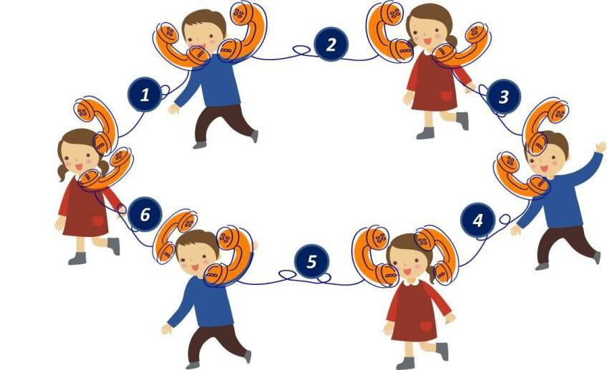
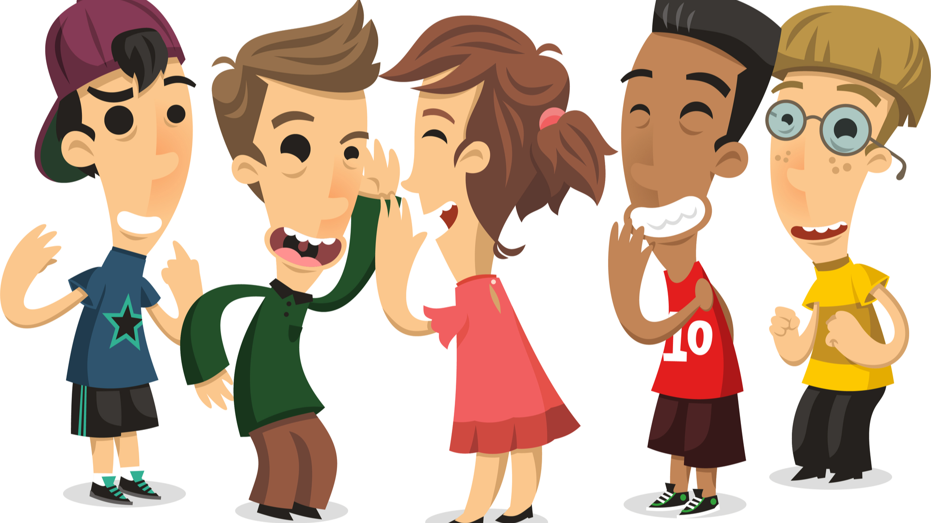
PRODUCTION
5
GAME: BROKEN TELEPHONE

Slide 19

CONSOLIDATION
1
Wrap-up
What have we learnt in this lesson?
words and phrases related to new technologies.
new verb phrases that are used to talk about inventions, discoveries, creation, and development.
sentences stress

Slide 20

CONSOLIDATION
2
Homework
Learn by heart words and phrases learned
Do exercise in the workbook

