Slide 1
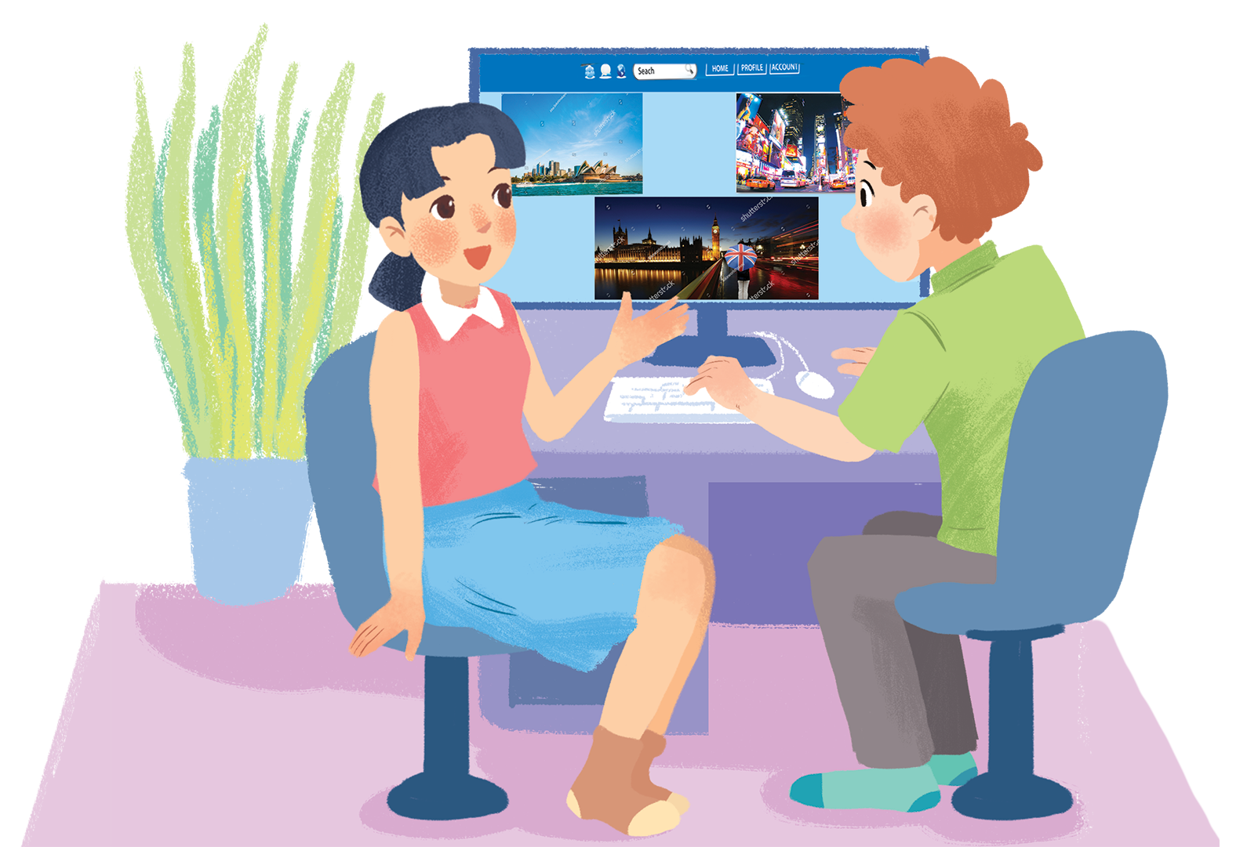
      UNIT 9: CITIES OF THE WORLD
      LESSON 5: SKILLS 1
English 6

Slide 2


Reading
1
Work in groups. Look at the postcard and discuss.
2
Read the postcard and answer the questions.
3
Read the text and match the places with the things they have.
Speaking
4
Work in groups. Choose a city you know. Discuss and answer the questions below.
5
Share the information you have collected in 4 with your class.

Slide 3
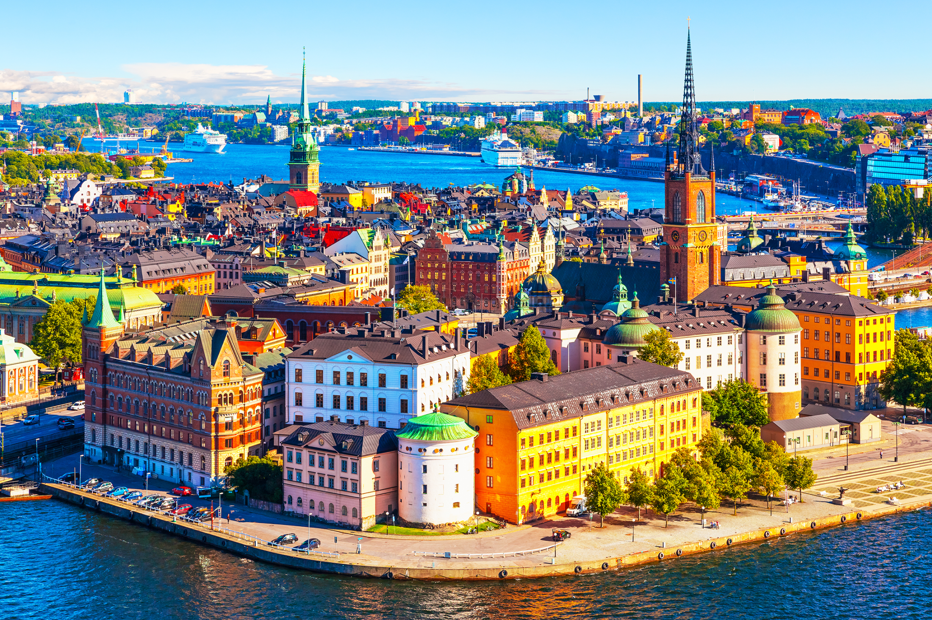
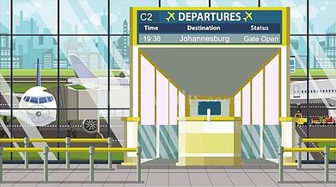
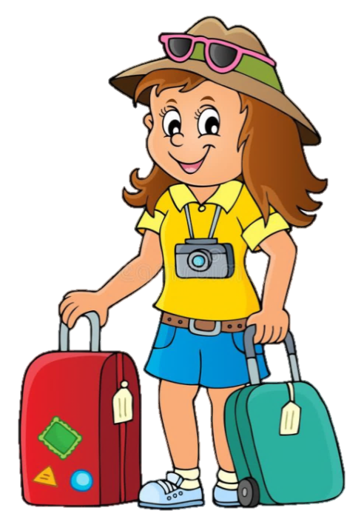
What is she doing?
She is on holiday
I am Mai
What city is Mai in?
Stockholm

Slide 4
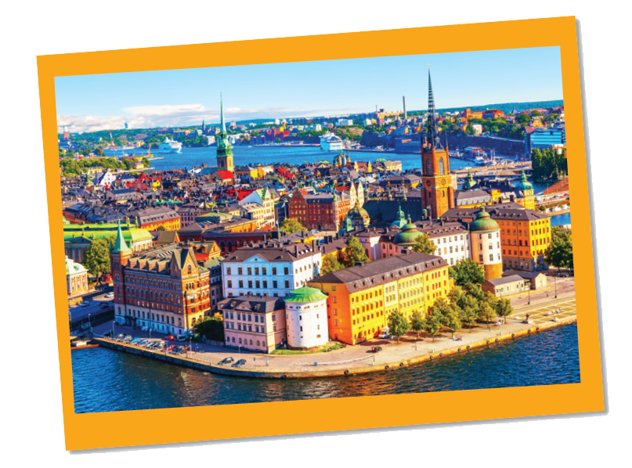
1
Work in groups. Look at the postcard and discuss.
Reading
Love from Sweden

Slide 5
1.
When do people write a postcard?
When they are away from home, often on holiday or business. They want to tell their family or friends what they see and do, and how they feel about their time here.
2.
What do they often write on a postcard?
The sender often writes about his/her stay in a city or country.

Slide 6
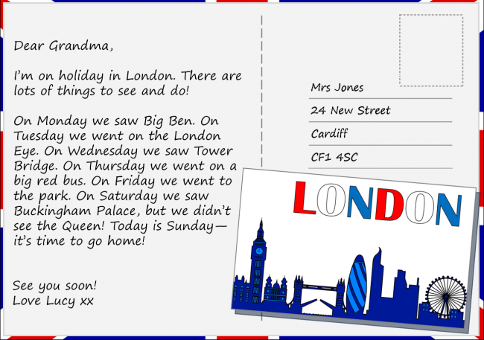
Have you ever written a postcard?
If yes, who did you write to? If no, do you intend to write a postcard in the future?
Yes, I have. /No, I haven’t.
I wrote to my best friend. / I will write to my best friend

Slide 7

2
Read the postcard and answer the questions.
September 6
Dear Grandpa and Grandma,
To: Grandpa & Grandma
Hoan Kiem, Ha Noi, Viet Nam
Stockholm is fantastic!
Its weather is perfect, sunny all the time! Our hotel is good. It has a swimming pool and a gym. It offers delicious breakfast. Yesterday Mum, Dad and I rented three bikes and cycled to the Old Town. My parents wore their helmets and I wore mine. We visited the Royal Palace first. What a beautiful place! Mum loved it. She said, “Swedish art is amazing.” After that, we had “fika”, a coffee break, in a traditional café. Everything is so wonderful!
Wish you were here!
Love,
Mai
S

Slide 8


Vocabulary
fan‘tastic (adj)
tuyệt vời
‘perfect (adj)
hoàn hảo
rent (v)
thuê
‘helmet (n)
mũ bảo hiểm
tradi‘tional (adj)
truyền thống
‘landscape (n)
phong cảnh

Slide 9
MATCHING
fantastic (adj)
truyền thống
perfect (adj)
hoàn hảo
rent (v)
phong cảnh
helmet (n)
tuyệt vời
traditional (adj)
mũ bảo hiểm
landscape (n)
thuê

Slide 10
STRUCTURE
September 6
Dear Grandpa and Grandma,
Stockholm is fantastic!
Its weather is perfect, sunny all the time! Our hotel is good. It has a swimming pool and a gym. It offers delicious breakfast. Yesterday Mum, Dad and I rented three bikes and cycled to the Old Town. My parents wore their helmets and I wore mine. We visited the Royal Palace first. What a beautiful place! Mum loved it. She said, “Swedish art is amazing.” After that, we had “fika”, a coffee break, in a traditional café. Everything is so wonderful!
Wish you were here!
Love,
Mai

Slide 11


Slide 12
1.
This postcard is about in Stockholm.
A.
the weather
B.
a holiday
C.
landscapes
?
2.
Guests can in the hotel.
A.
exercise
B.
cycle
C.
See Swedish art
?
3.
Mai and her parents rented bikes to .
A.
cycle around the hotel
B.
visit the old town
?
C.
go shopping
4.
“Fika” is a .
B.
palace
A.
traditional café
C.
coffee break
?

Slide 13
SUGGEST
September 6
Dear Grandpa and Grandma,
Stockholm is fantastic!
Its weather is perfect, sunny all the time! Our hotel is good. It has a swimming pool and a gym. It offers delicious breakfast. Yesterday Mum, Dad and I rented three bikes and cycled to the Old Town. My parents wore their helmets and I wore mine. We visited the Royal Palace first. What a beautiful place! Mum loved it. She said, “Swedish art is amazing.” After that, we had “fika”, a coffee break, in a traditional café. Everything is so wonderful!
Wish you were here!
Love,
Mai

Slide 14
SUGGEST
September 6
Dear Grandpa and Grandma,
Stockholm is fantastic!
Its weather is perfect, sunny all the time! Our hotel is good. It has a swimming pool and a gym. It offers delicious breakfast. Yesterday Mum, Dad and I rented three bikes and cycled to the Old Town. My parents wore their helmets and I wore mine. We visited the Royal Palace first. What a beautiful place! Mum loved it. She said, “Swedish art is amazing.” After that, we had “fika”, a coffee break, in a traditional café. Everything is so wonderful!
Wish you were here!
Love,
Mai

Slide 15
SUGGEST
September 6
Dear Grandpa and Grandma,
Stockholm is fantastic!
Its weather is perfect, sunny all the time! Our hotel is good. It has a swimming pool and a gym. It offers delicious breakfast. Yesterday Mum, Dad and I rented three bikes and cycled to the Old Town. My parents wore their helmets and I wore mine. We visited the Royal Palace first. What a beautiful place! Mum loved it. She said, “Swedish art is amazing.” After that, we had “fika”, a coffee break, in a traditional café. Everything is so wonderful!
Wish you were here!
Love,
Mai

Slide 16
SUGGEST
September 6
Dear Grandpa and Grandma,
Stockholm is fantastic!
Its weather is perfect, sunny all the time! Our hotel is good. It has a swimming pool and a gym. It offers delicious breakfast. Yesterday Mum, Dad and I rented three bikes and cycled to the Old Town. My parents wore their helmets and I wore mine. We visited the Royal Palace first. What a beautiful place! Mum loved it. She said, “Swedish art is amazing.” After that, we had “fika”, a coffee break, in a traditional café. Everything is so wonderful!
Wish you were here!
Love,
Mai

Slide 17
3
Read the text and match the places with the things they have.
a.
the Royal Palace
1.
The hotel in Stockholm
b.
delicious breakfast
c.
Swimming pool
2.
The Old Town
d.
‘fika’
e.
Swedish art
T

Slide 18
2
Read the postcard and answer the questions.
September 6
Dear Grandpa and Grandma,
To: Grandpa & Grandma
Hoan Kiem, Ha Noi, Viet Nam
Stockholm is fantastic!
Its weather is perfect, sunny all the time! Our hotel is good. It has a swimming pool and a gym. It offers delicious breakfast. Yesterday Mum, Dad and I rented three bikes and cycled to the Old Town. My parents wore their helmets and I wore mine. We visited the Royal Palace first. What a beautiful place! Mum loved it. She said, “Swedish art is amazing.” After that, we had “fika”, a coffee break, in a traditional café. Everything is so wonderful!
Wish you were here!
Love,
Mai
S

Slide 19
b.
delicious breakfast
c.
Swimming pool
a.
the Royal Palace
‘fika’
Swedish art
d.
e.
1.
The hotel in Stockholm
2.
The Old Town
?
?
b.
delicious breakfast
a.
the Royal Palace
c.
Swimming pool
d.
‘fika’
e.
Swedish art

Slide 20
SUGGEST
September 6
Dear Grandpa and Grandma,
Stockholm is fantastic!
Its weather is perfect, sunny all the time! Our hotel is good. It has a swimming pool and a gym. It offers delicious breakfast. Yesterday Mum, Dad and I rented three bikes and cycled to the Old Town. My parents wore their helmets and I wore mine. We visited the Royal Palace first. What a beautiful place! Mum loved it. She said, “Swedish art is amazing.” After that, we had “fika”, a coffee break, in a traditional café. Everything is so wonderful!
Wish you were here!
Love,
Mai

Slide 21
SUGGEST
September 6
Dear Grandpa and Grandma,
Stockholm is fantastic!
Its weather is perfect, sunny all the time! Our hotel is good. It has a swimming pool and a gym. It offers delicious breakfast. Yesterday Mum, Dad and I rented three bikes and cycled to the Old Town. My parents wore their helmets and I wore mine. We visited the Royal Palace first. What a beautiful place! Mum loved it. She said, “Swedish art is amazing.” After that, we had “fika”, a coffee break, in a traditional café. Everything is so wonderful!
Wish you were here!
Love,
Mai

Slide 22
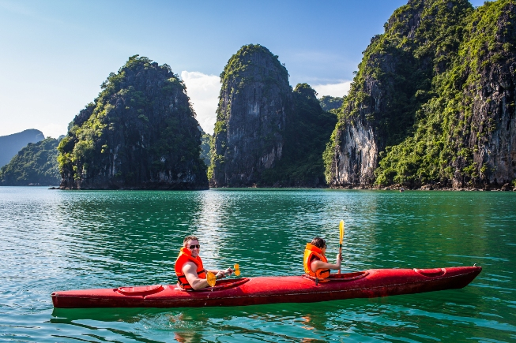
4
Work in groups. Choose a city you know. Discuss and answer the questions below.
Speaking
What city is it?
What is it like? (the weather, the food…)
What can you see and do there?
How do you feel about it?

Slide 23
1. What city is it?
It is Ha Long Bay
6. How do you feel it?
2. What is it like?
The weather is perfect
The food is delicious
happy
HA LONG BAY
4. What can you see and do there
talk to the local people, take photos, go swimming, eat seafood

Slide 24
5
Share the information you have collected in 4 with your class.
You may start your talk with:
We’re going to tell you about …

Slide 25

Homework
  Learn vocabulary and the structure by heart.
  Do exercise in your work book
  Prepare the next lesson: Skills 2

