Slide 1
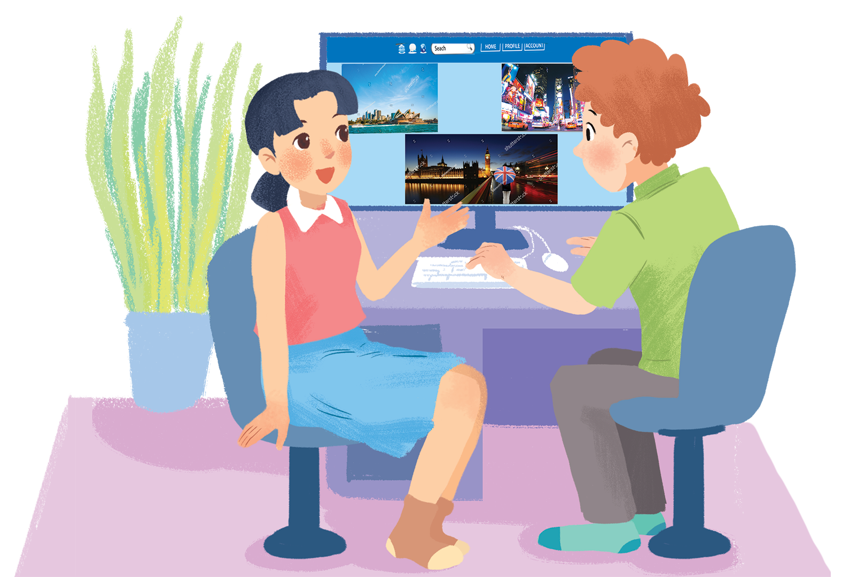
      UNIT 9: CITIES OF THE WORLD
      LESSON 4: COMMUNICATION
English 6

Slide 2


Everyday English
1
Look at the picture. Listen and read the exclamations.
2
Work in pair. Look at the picture below and say what you think by using exclamations with What. You may use the suggestions below.
City landmarks
3
Work in pairs. Write the names of the landmarks under the correct pictures.
4
Write the names of the landmarks in 3 for the descriptions.
5
Work in pairs. Read the questions and circle the correct answers.

Slide 3
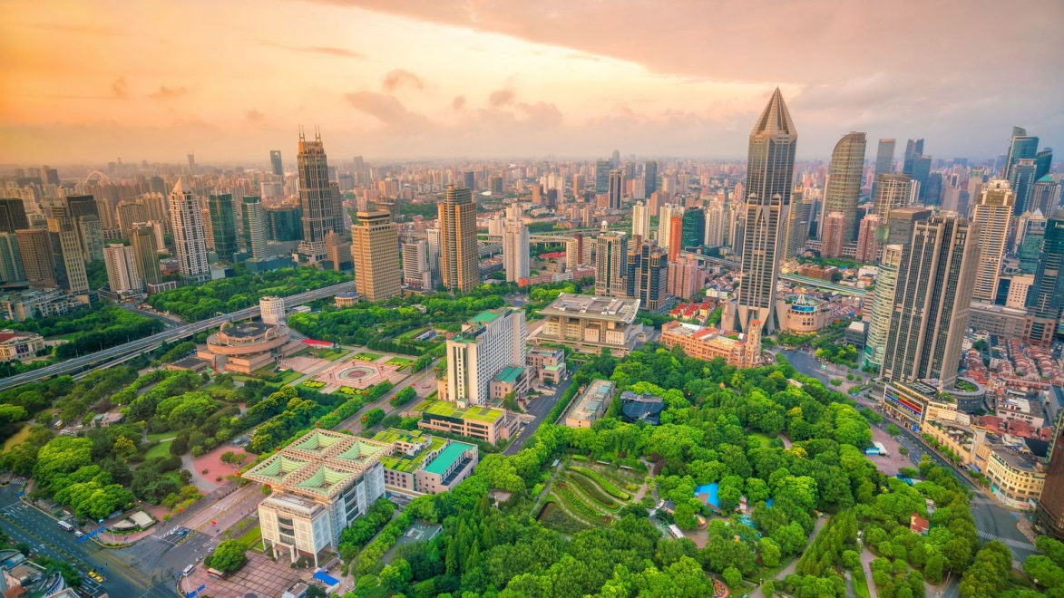

Describing the picture
Is the city green or red?
Are these buildings tall?
How is the sky?
What do you think about the city
What a beautiful city!
People’s Square in Shanghai, China

Slide 4
Expressing exclamations with What
What + (a/an) + adj + noun!
Note: use a/an with countable nouns which are singular.

Slide 5
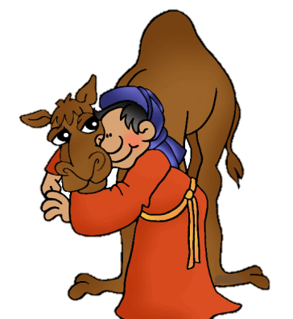


1. What a/an (+ adjective) + singular countable noun
What a nice camel !
2. What + adjective before an uncountable or plural noun
What delicious chocolate !
3. What + object + subject + verb
What a wonderful party we had !

Slide 6
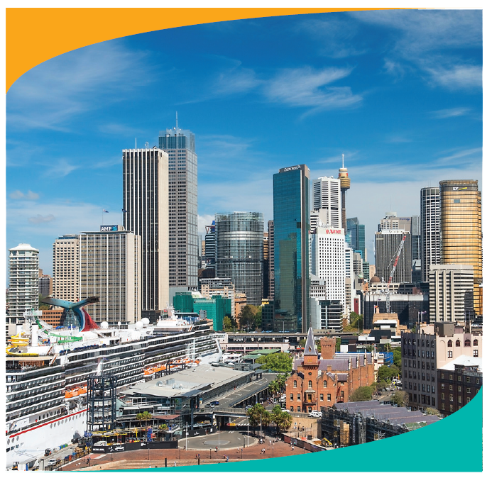
1
Look at the picture. Listen and read the exclamations.
Everyday English
Expressing exclamations with What
Notes:
Slide này không đúng.

Slide 7

1
Look at the picture. Listen and read the exclamations.
1.
What a nice city!
2.
What a clear sky!
3.
What tall buildings!

Slide 8
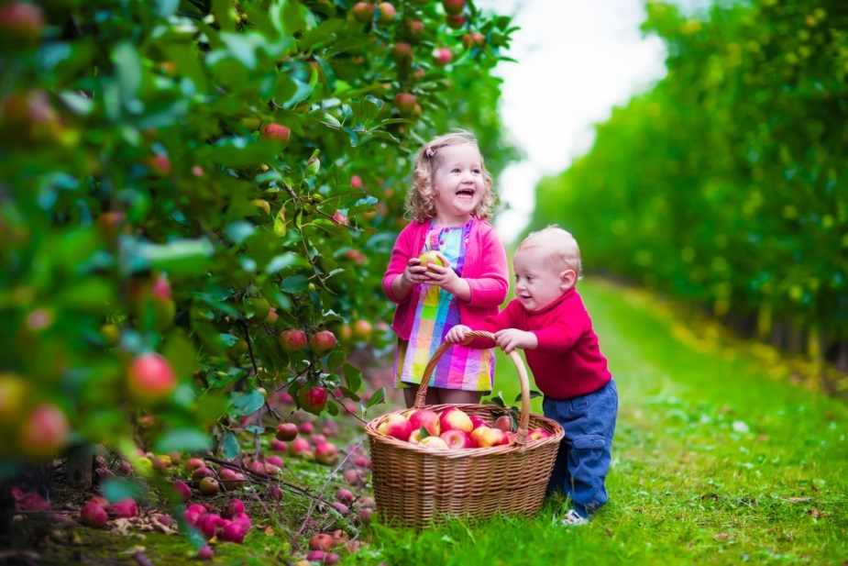
2
Work in pair. Look at the picture below and say what you think by using exclamations with What. You may use the suggestions below.
- happy / beautiful children
- colourful / nice picture
- sunny / beautiful weather
- small / cute boy
- beautiful / colourful apple trees

Slide 9

- happy / beautiful children
- colourful / nice picture
- sunny / beautiful weather
- small / cute boy
- beautiful / colourful apple trees
1.
2.
3.
4.
5.

Slide 10
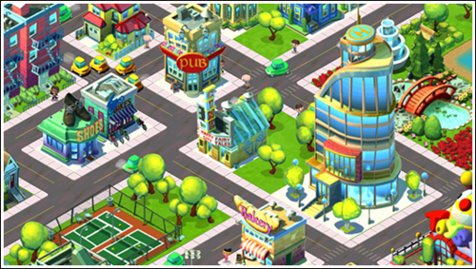

cities
food
weather
girl
dresses
Production

Slide 11
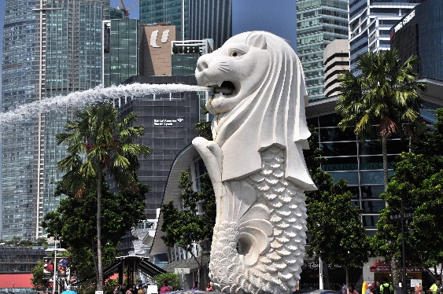
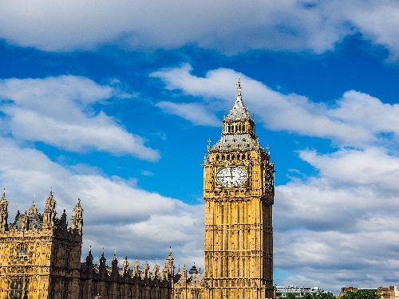
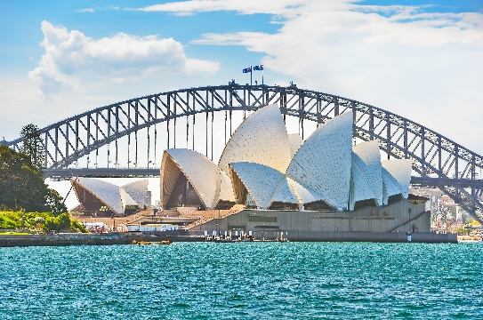
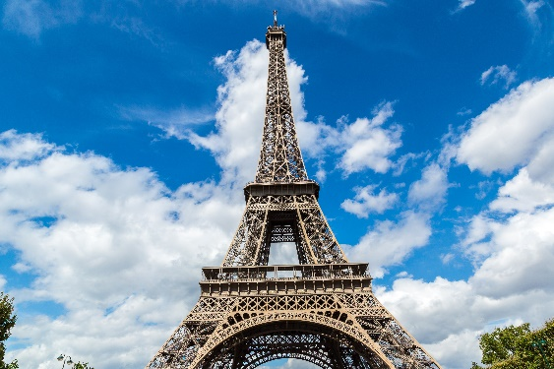
3
Work in pairs. Write the names of the landmarks under the correct pictures.
City landmarks
Eiffel Tower
Big Ben
Sydney Opera House
Merlion
1.
Merlion
2.
Big Ben
Sydney Opera
House
Eiffel Tower
3.
4.
Notes:
City landmarks phải ở trên mục 3

Slide 12


4
Write the names of the landmarks in 3 for the descriptions.
Big Ben
This famous tower is in Paris. Every year, millions of visitors climb to its top to see the whole view of Paris.
1.
This tower is on the bank of the River Thames in London. In the tower, there’s a big clock and a bell.
3.
Eiffel Tower
It’s a theatre on Sydney Harbour. Its roofs are white and look like shells. Visitors from all over the world come to see it.
Merlion
2.
Sydney Opera House
4.
It has the head of a lion and the body of a fish. It’s a famous landmark in Singapore.

Slide 13




Slide 14
HOW TO PLAY:
Make 2 teams
Chose a gift box and answer the question
Then you must choose:
KEEP THE BOX or GIVE THE BOX to the other team
The points in the box can be GOOD or BAD

Slide 15






Slide 16


1.
Which city is nearer to Ha Noi than the others?
A.
Berlin
B.
Bangkok
C.
Tokyo
+10
Keep the Box
Give the Box

Slide 17
2.
The people of Quang Nam are proud of their ancient town, .
A.
Hoi An
B.
Sa Pa
C.
Bach Ma
-1
Keep the Box
Give the Box

Slide 18
3.
Phnom Penh is the capital city of .
A.
Indonesia
B.
The Philippines
C.
Cambodia
-1
Keep the Box
Give the Box

Slide 19
4.
For children, California is famous for its .
A.
Disneyland Park
B.
Golden Gate Bridge
C.
national parks
+10
Keep the Box
Give the Box

Slide 20

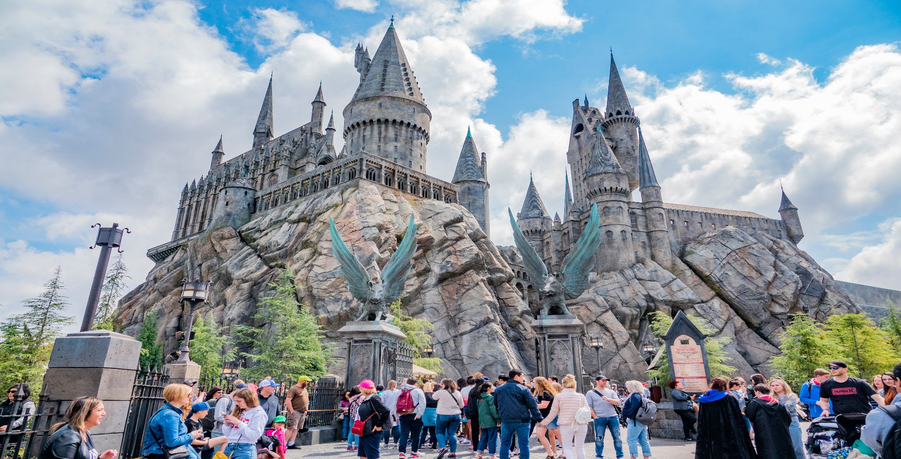
5
Work in pairs. Read the questions and circle the correct answers.

Slide 21
1.
Which city is nearer to Ha Noi than the others?
A.
Berlin
B.
Bangkok
C.
Tokyo
2.
The people of Quang Nam are proud of their ancient town, .
A.
Hoi An
B.
Sa Pa
C.
Bach Ma
3.
Phnom Penh is the capital city of .
A.
Indonesia
B.
The Philippines
C.
Cambodia
4.
For children, California is famous for its .
A.
Disneyland Park
B.
Golden Gate Bridge
C.
national parks

Slide 22

Homework
  Learn vocabulary and the structure by heart.
  Do exercise in your work book
  Prepare the next lesson: Skills 1

