Slide 1
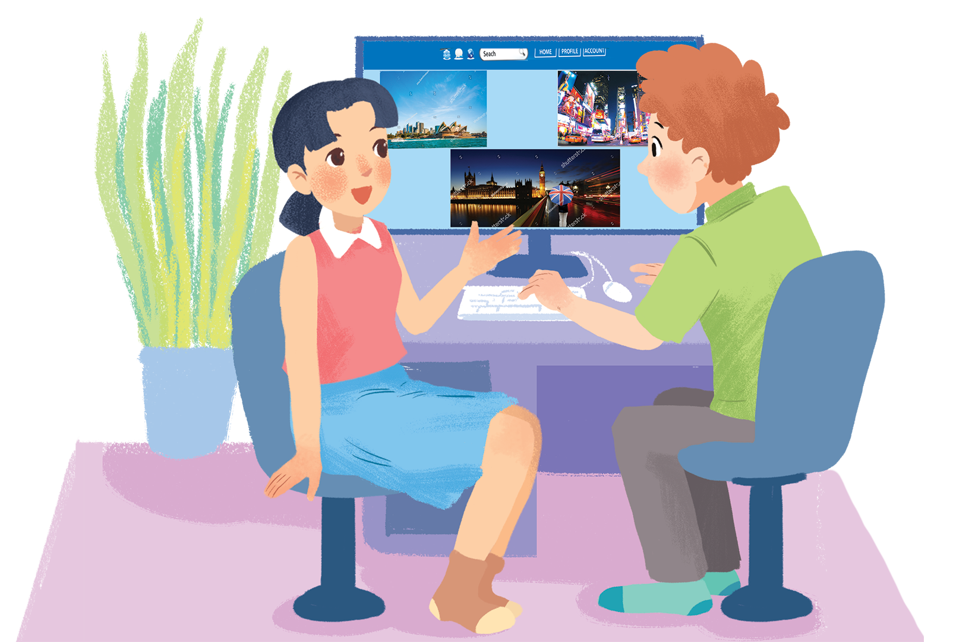
      UNIT 9: CITIES OF THE WORLD
      LESSON 3: A CLOSER LOOK 2
English 6

Slide 2


Grammar
Possessive adjectives
1
Match the sentences with the pictures, paying attention to the underlined part in each sentence.
2
Complete the sentences with the correct possiessive adjectives.
Possessive pronouns
3
Complete the sentences with the correct possessive pronouns.
4
Underline the correct word in brackets to complete each sentence.
5
Choose the correct word to complete the sentences.

Slide 3
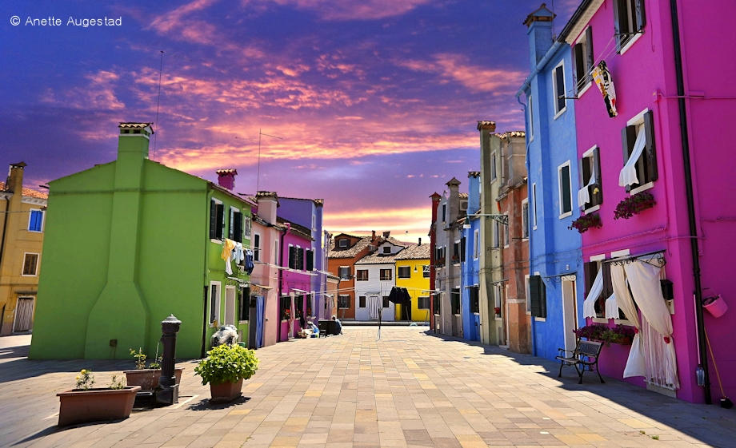
Puzzling sentence
Team A
My
city
is
very
beautiful.
is
very
city
My
beautiful.
KEY

Slide 4

Puzzling sentence
Team B
Their
house
is
very
nice.
nice.
house
very
Their
is
KEY

Slide 5

Puzzling sentence
Team A
Our
school
has
a
garden.
has
school
a
Our
garden.
KEY

Slide 6
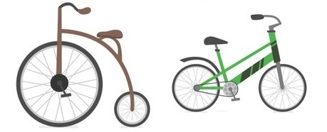
Puzzling sentence
Team B
Your
bike
is
older
than
mine.
than
mine.
older
bike
is
Your
KEY

Slide 7

Puzzling sentence
Team A
His
shoes
are
bigger
than
hers.
shoes
bigger
than
His
hers.
are
KEY

Slide 8


Puzzling sentence
Team B
Her
uniform
is
different
from
theirs.
Her
theirs.
from
different
uniform
is
KEY

Slide 9
My city is very beautiful.
Their house is very nice.
Our school has a garden.
Your bike is older than mine.
His shoes are bigger than hers.
Her uniform is different from theirs.
The words: my, their, our, your, his, her are possessive adjective
The words: mine, hers, theirs are possessive pronounce
Puzzling sentence

Slide 10
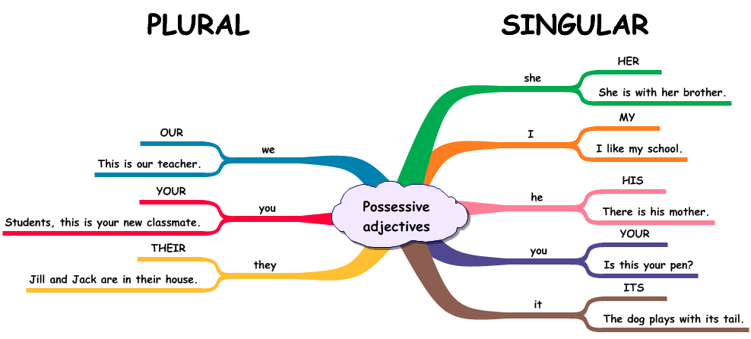

Slide 11

Grammar
Possessive adjectives
A possessive adjective is used only when there’s a noun following it.
Example:
I have a pen.
This is my pen.

Slide 12

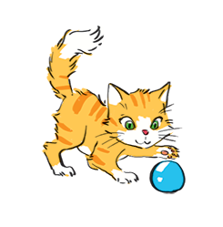
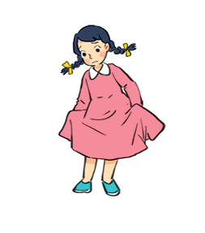
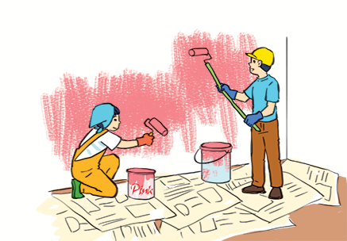

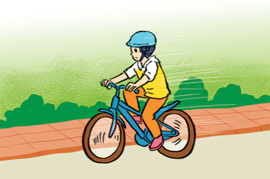
1
Match the sentences with the pictures, paying attention to the underlined part in each sentence.
1.
Sue doesn’t like her new dress.
1 - d
a
b
2.
Billy is riding his bicycle.
2 - f
3.
I’ll write my name in red. Could you write
your name in blue?
d
c
3 - e
4.
The cat is playing with its ball.
4 - b
5.
We love our school.
5 - a
e
f
6.
They are painting their room pink.
6 - c

Slide 13
2
Complete the sentences with the correct possessive adjectives.
1.
My
I love cartoons. favourite cartoon is Dragon Balls.
This book has your name on it. Is it book?
2.
your
Its
3.
The lion has three cubs. cubs are playing under a big tree.
4.
Do you know my friend Anna?
house is close to the park.
Her
5.
We are from Switzerland. country is famous for chocolate.
Our

Slide 14
PRONOUNS
Subject Pronouns | Object Pronouns | Possessive Adjectives | Possessive Pronouns
I
Me
My
Mine
You
You
Your
Yours
He
Him
His
His
She
Her
Her
Hers
It
It
Its
Its
We
Us
Our
Ours
You
You
Your
Yours
They
Them
Their
Theirs

Slide 15
Grammar
Possessive pronouns
A possessive pronoun is used alone, without a noun following it.
Example:
This book is my book, not your book.
This book is mine, not yours.

Slide 16
3
Complete the sentences with the correct possessive pronouns.
1.
I have a new bike. The bike is .
mine
These are Mai’s and Lan’s maps. These maps are .
2.
theirs
3.
This is a present for you. It’s .
yours
his
4.
My father has new shoes. They’re .
5.
This is our new house. The house is .
ours

Slide 17



Slide 18

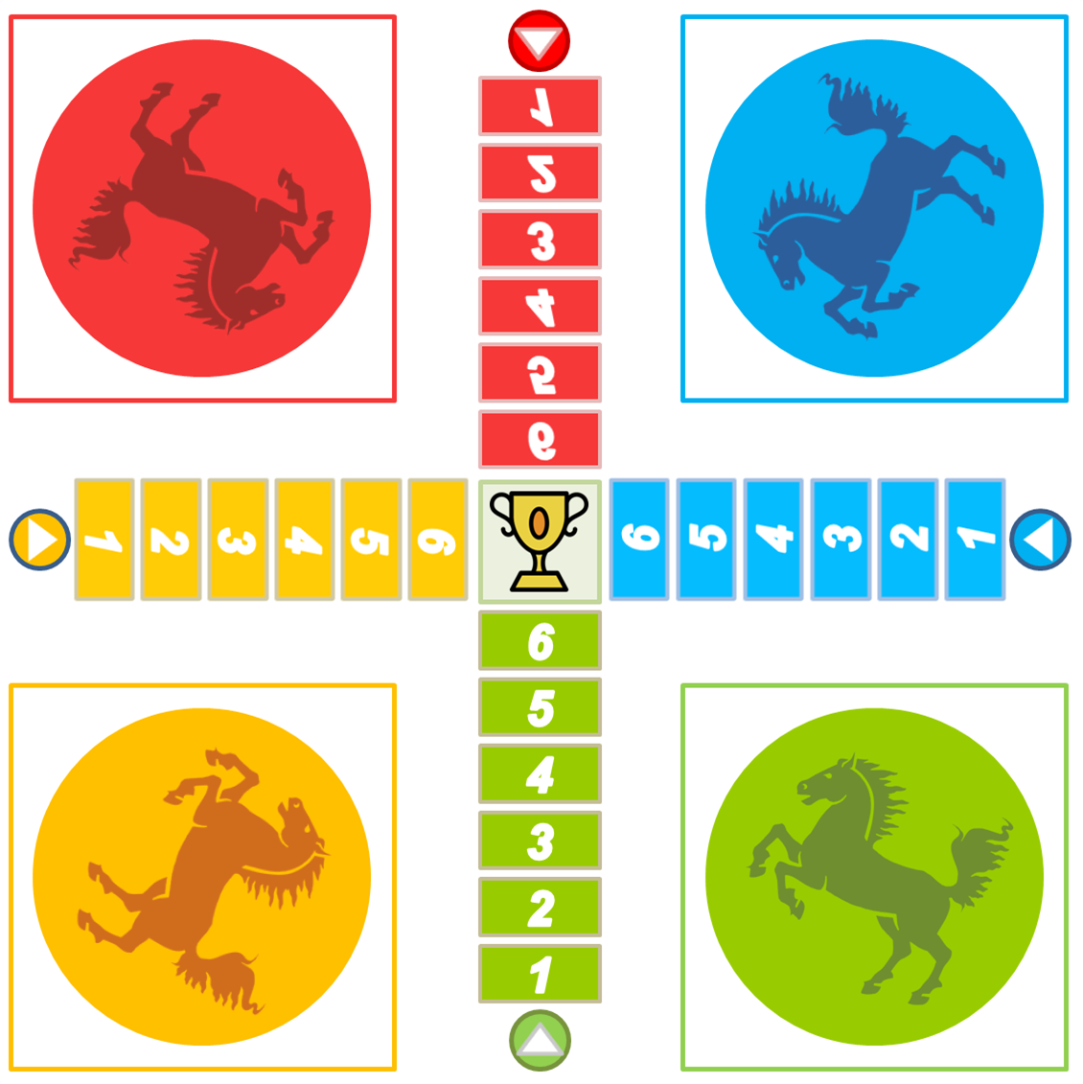




1
1
2
2
3
3
4
4
5
5
5
5
4
4
3
3
2
2
1
1

Slide 19
1. Australia is a strange country. All of _____ big cities are along the coast
A. it’s
B. its
C. it is
D. it

Slide 20
2. Our city is very crowded. How about _________?
A. you
B. your
C. yours
D. you are

Slide 21
3. I love my football club. Does Phong like ______?
A. his
B. him
C. he is
D. he

Slide 22
4. ______ street is short and narrow.
A. Our
B. We
C. Us
D. Ours

Slide 23
5. They cannot find _____ city map anywhere.
A. their
B. them
C. theirs
D. they

Slide 24
6. The book is ________, but you are welcome to read it.
A. my
B. mine
C. yours
D. you

Slide 25
7. _______ bike is dirty, and I can't tell what colour is it.
A. your
B. yours
C. you
D. your are

Slide 26
8. Your country is much bigger than _________.
B. their
A. our
C. ours
D. they

Slide 27
9. _______ dog is so friend-ly. It never barks.
A. They
B. Them
C. Their
D. Theirs

Slide 28
10. _______ not easy to find your way in a strange city.
A. It
B. It’s
C. Its
D. there

Slide 29
4
Underline the correct word in brackets to complete each sentence.
1.
Australia is a strange country. All of (it’s / its) big cities are along the coast.
2.
Our city is very crowded. How about (your / yours)?
3.
I love my football club. Does phong like (his / him)?
4.
(Our / Ours) street is short and narrow.
5.
They cannot f ind (their / theirs) city map anywhere.

Slide 30

5
Choose the correct word to complete the sentences.
1.
The book is (my / mine / yours), but you are welcome to read it.
2.
( Your / Yours / You) bike is dirty, and I can’t tell what colour it is.
3.
Your country is much bigger than (our / ours / their).
4.
(They / Their / Theirs) dog is so friendly. It never barks.
5.
(It / It’s / Its) not easy to find your way in a strange city.

Slide 31

Homework
  Learn vocabulary and the structure by heart.
  Do Exercise 4 and Exercise 5, write the answers on the notebooks.
  Prepare the next lesson: Communication

