Slide 1
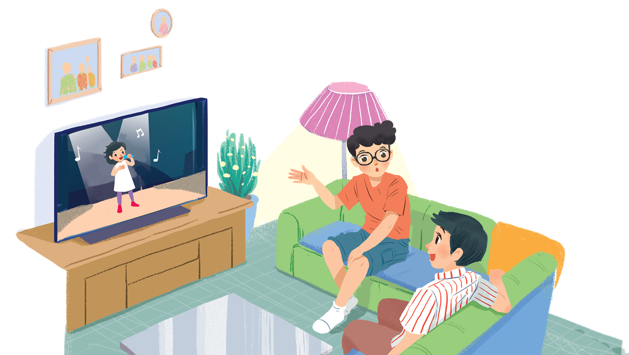
      UNIT 7: TELEVISION
      LESSON 5: SKILL
English 6

Slide 2


Reading
1
Read the first two columns of the TV guide and answer the questions.
2
Read the TV guide in 1 and write the programmes that these people may choose to watch.
Speaking
3
Work in groups. Share your table in 2 with your group and see if they agree with you.
4
Work in groups. Tell your group about your favourite TV programme. Your talk should include:

Slide 3
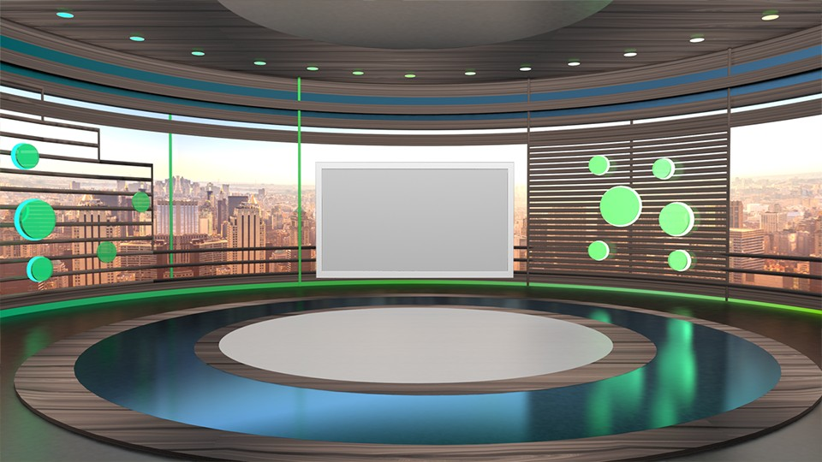
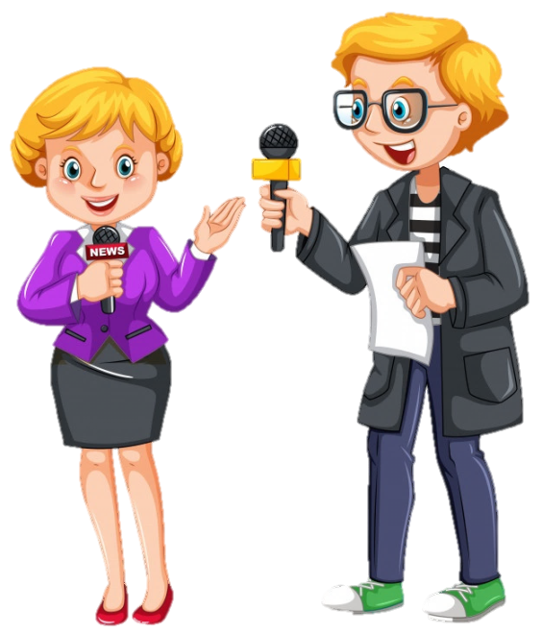

TV channels
Guess the name of the TV channels

Slide 4


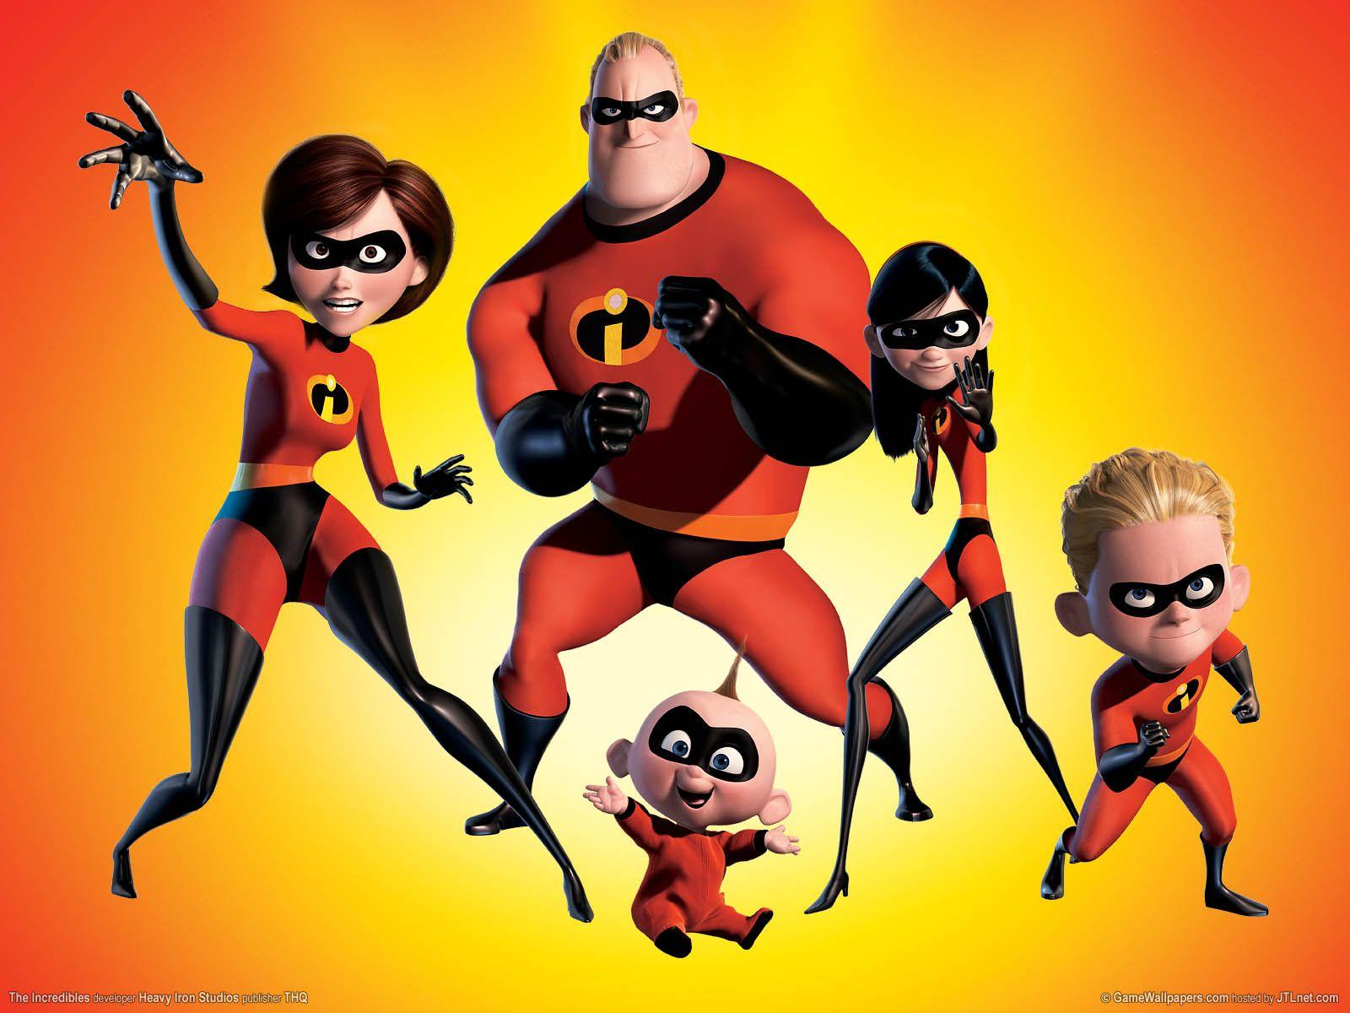

What channel is the Incredibles on?

Slide 5


What channel is Breaking news on?

Slide 6

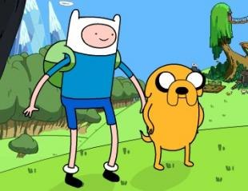

What channel is Adventure Time on?

Slide 7

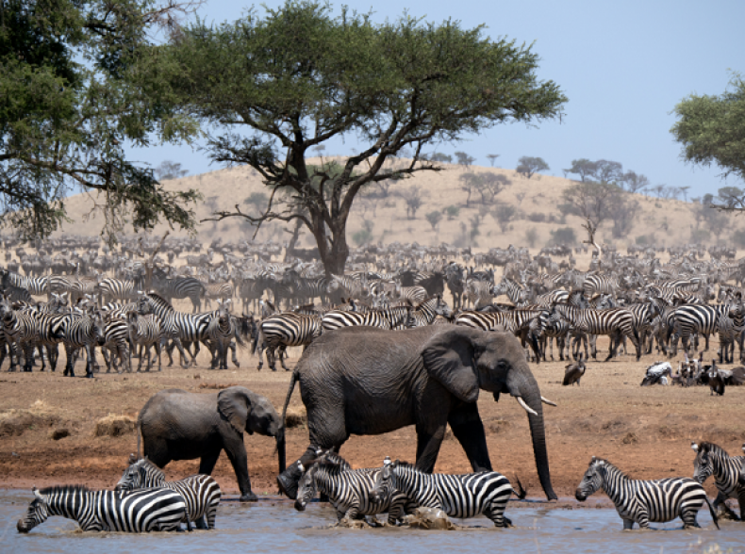

What channel is Wildlife on?

Slide 8


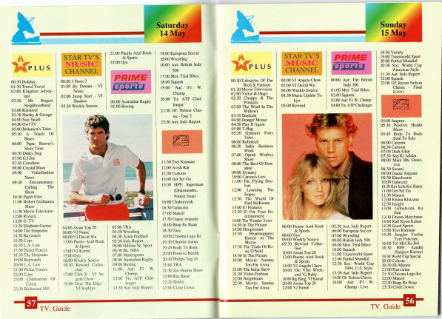
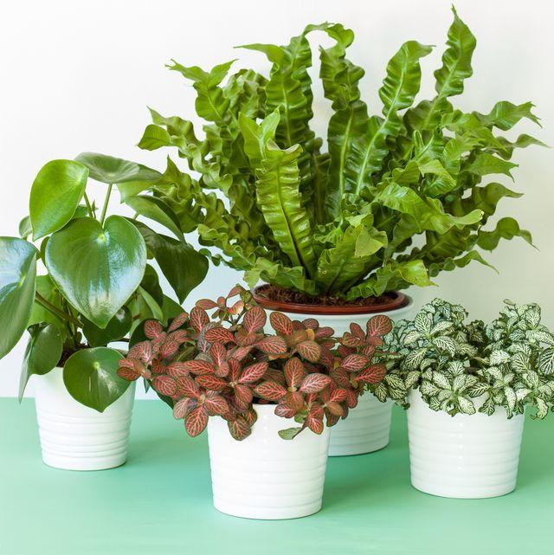
Vocabulary
com‘pete (v)
cạnh tranh
‘plant (n)
cây nhỏ
‘dolphin (n)
cá voi
TV guide (n)
chương trình TV

Slide 9
Rub out and remember
compete (v)
cạnh tranh
plant (n)
cây nhỏ
dolphin (n)
cá voi
TV guide (n)
chương trình TV

Slide 10
Reading

Slide 11
1
Read the first two columns of the TV guide and answer the questions.
TIME | PROGRAMME | DESCRIPTION
8.00 | Wildlife: Cuc Phuong Forest | Watch the colourful world of plants, ﬂowers, and animals in their real life.
9.00 | Comedy: The Fox Teacher | Have a lot of fun with a fox teacher and his students on their first day at school.
10.30 | Sports: The Pig Race | Watch the cute pigs compete in the most exciting races. Who wins?
11.00 | Game show: Children are Always Right | Join this game show today and try to answer interesting questions about pets.
12.15 | Science: The Dolphins | Watch funny and interesting clips of intelligent dolphins in their natural life - the sea.

Slide 12
1
Read the first two columns of the TV guide and answer the questions.
TIME | PROGRAMME
8.00 | Wildlife: Cuc Phuong Forest
9.00 | Comedy: The Fox Teacher
10.30 | Sports: The Pig Race
11.00 | Game show: Children are Always Right
12.15 | Science: The Dolphins
1.
What’s in the Wildlife programme?
It’s Cuc Phuong Forest.
2.
Is The Fox Teacher a comedy?
Yes, it is.
3.
What time is the Sports programme?
It’s on at 10.30.
4.
Can we watch a game show at 10.30?
No, we can’t.
5.
What’s the topic of the Science programme?
It’s about dolphins.

Slide 13
1.
What’s in the Wildlife programme?
It’s Cuc Phuong Forest.
2.
Is The Fox Teacher a comedy?
Yes, it is.
3.
What time is the Sports programme?
It’s on at 10.30.
4.
Can we watch a game show at 10.30?
No, we can’t.
5.
What is the topic of the Science programme?
It’s about dolphins.

Slide 14
Read the TV guide in 1 and write the programmes that these people may choose to watch.
2
People | Programmes
1. Phong wants to know more about dogs and cats.
2. Bob likes programmes that make him laugh.
3. Nga loves learning about plants and animals.
4. Minh likes watching races.
5. Linh is interested in sea animals.

Slide 15
1
Read the first two columns of the TV guide and answer the questions.
TIME | PROGRAMME | DESCRIPTION
8.00 | Wildlife: Cuc Phuong Forest | Watch the colourful world of plants, ﬂowers, and animals in their real life.
9.00 | Comedy: The Fox Teacher | Have a lot of fun with a fox teacher and his students on their first day at school.
10.30 | Sports: The Pig Race | Watch the cute pigs compete in the most exciting races. Who wins?
11.00 | Game show: Children are Always Right | Join this game show today and try to answer interesting questions about pets.
12.15 | Science: The Dolphins | Watch funny and interesting clips of intelligent dolphins in their natural life - the sea.

Slide 16
Read the TV guide in 1 and write the programmes that these people may choose to watch.
2
People | Programmes
1. Phong wants to know more about dogs and cats.
2. Bob likes programmes that make him laugh.
3. Nga loves learning about plants and animals.
4. Minh likes watching races.
5. Linh is interested in sea animals.
Children are Always Right
The Fox Teacher
Cuc Phuong Forest
The Pig Race
The Dolphins

Slide 17
Speaking

Slide 18
3
Work in groups. Share your table in 2 with your group and see if they agree with you.
Example:
A: I think the best programme for Phong is the game show
Children are Always Right.
B: I agree. He wants to know more about pets.

Slide 19

Work in groups. Tell your group about your favourite TV programme. Your talk should include:
4
the name of the programme
the channel it is on
the content of the programme
You can use these suggestions.
the reason you like it
My favourite programme is ...
It’s on ...
It’s about ...
I like it because it …

Slide 20

Homework
  Learn vocabulary and the structure by heart.
  Do exercise … in your work book
  Prepare the next lesson: Skills 2

