Slide 1
Unit 2:
CITY LIFE
LESSON 5: SKILLS 1

Slide 2

OBJECTIVES
After this lesson, students will be able to:
1. Reading
Read for main idea and specific information in an announcement about a competition to find solutions to city problems.
2. Speaking
Talk about city problems and their solutions.

Slide 3
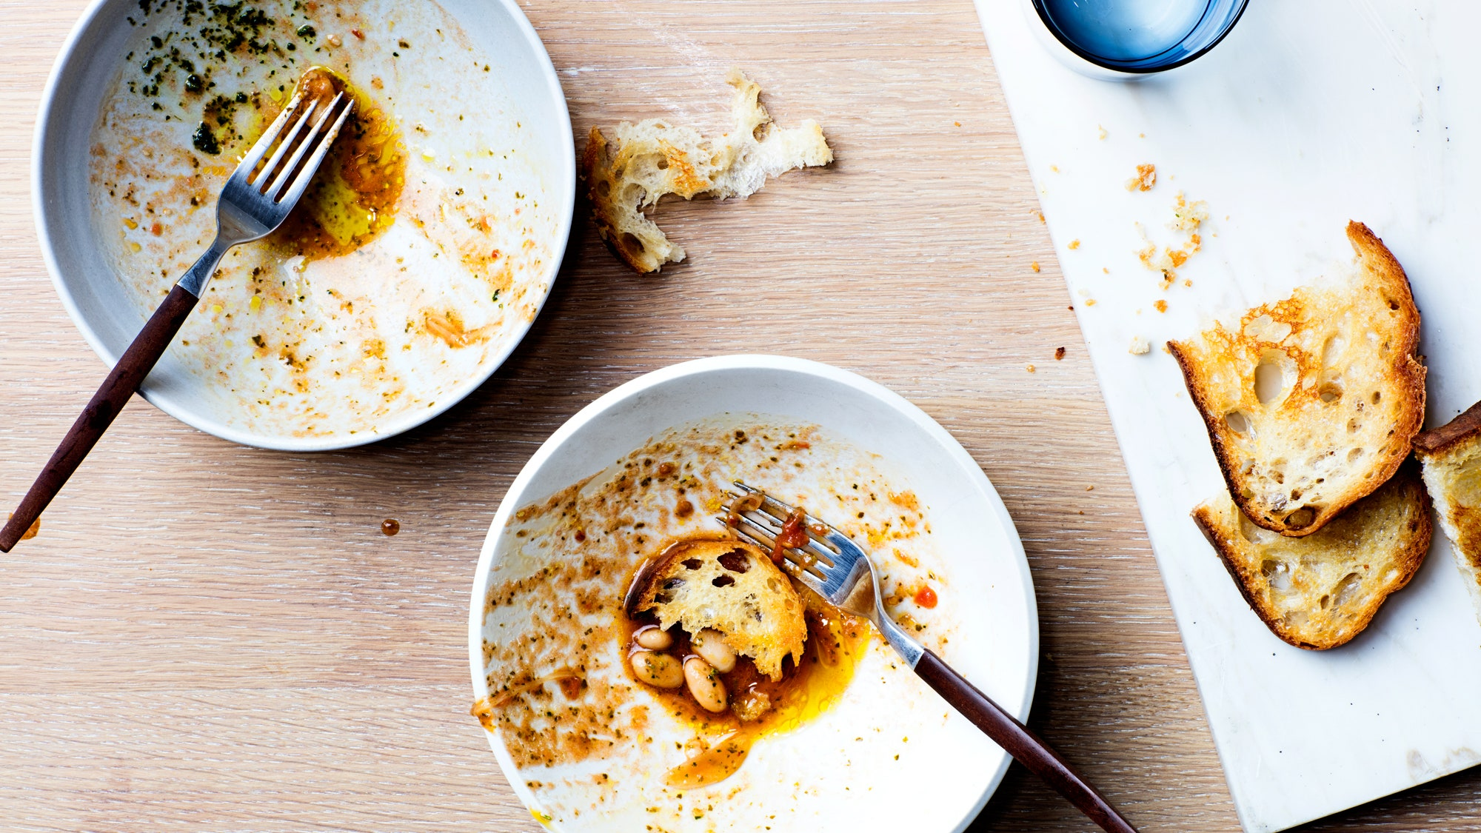

NEW WORDS
Leftovers (n)
/ˈleftəʊvə/
Thức ăn thừa

Slide 4
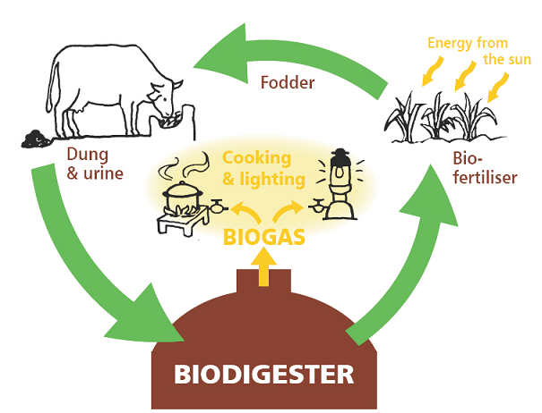
NEW WORDS
Biogas (n)
/ˈbaɪ.əʊˌɡæs/
Khí sinh học
???

Slide 5

NEW WORDS
Authority (n)
/ɔːˈθɒr.ə.ti/
Chính quyền

Slide 6
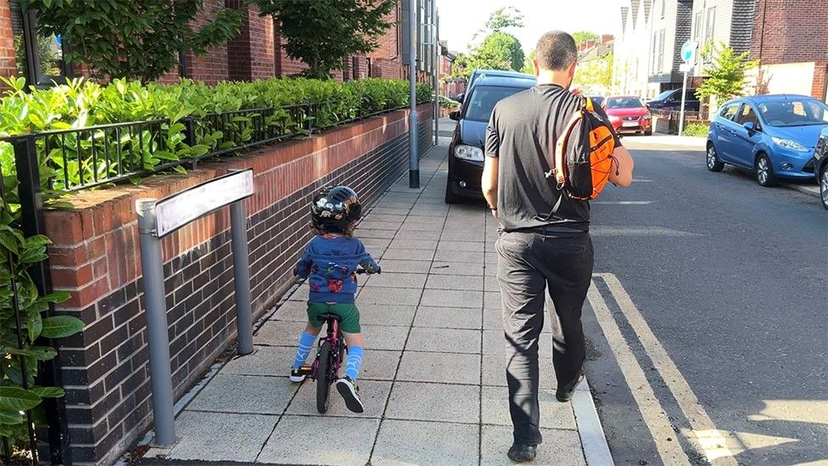
NEW WORDS
Pavement(n)
/ˈpeɪv.mənt/
Vỉa hè

Slide 7
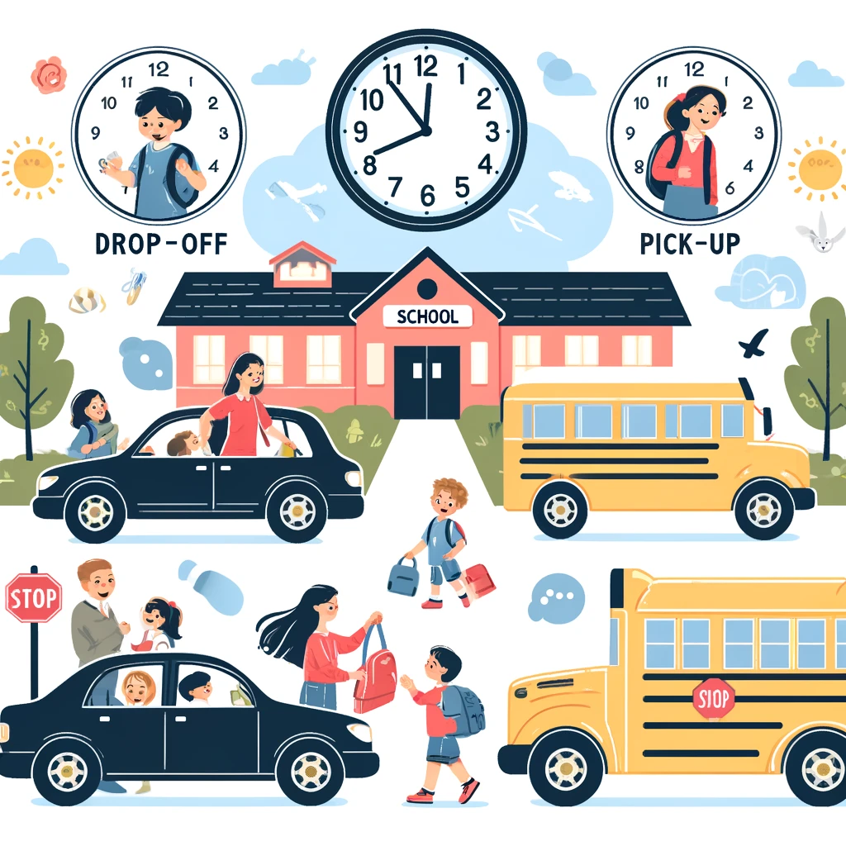
NEW WORDS
drop-off and pick-up times
/ˈdrɒpˌɒf ənd ˈpɪk.ʌp taɪmz/
thời gian trả và đón

Slide 8
NEW WORDS
Words | Pronunciation | Meanings
 |  | Thức ăn thừa
 |  | Khí sinh học
 |  | Chính quyền
 |  | Vỉa hè
 |  | thời gian trả và đón
Leftovers (n) | /ˈleftəʊvə/
Biogas (n) | /ˈbaɪ.əʊˌɡæs/
Authority (n) | /ɔːˈθɒr.ə.ti/
Pavement (n) | /ˈpeɪv.mənt/
Drop-off and pick-up times | /ˈdrɒpˌɒf ənd ˈpɪk.ʌp taɪmz/

Slide 9
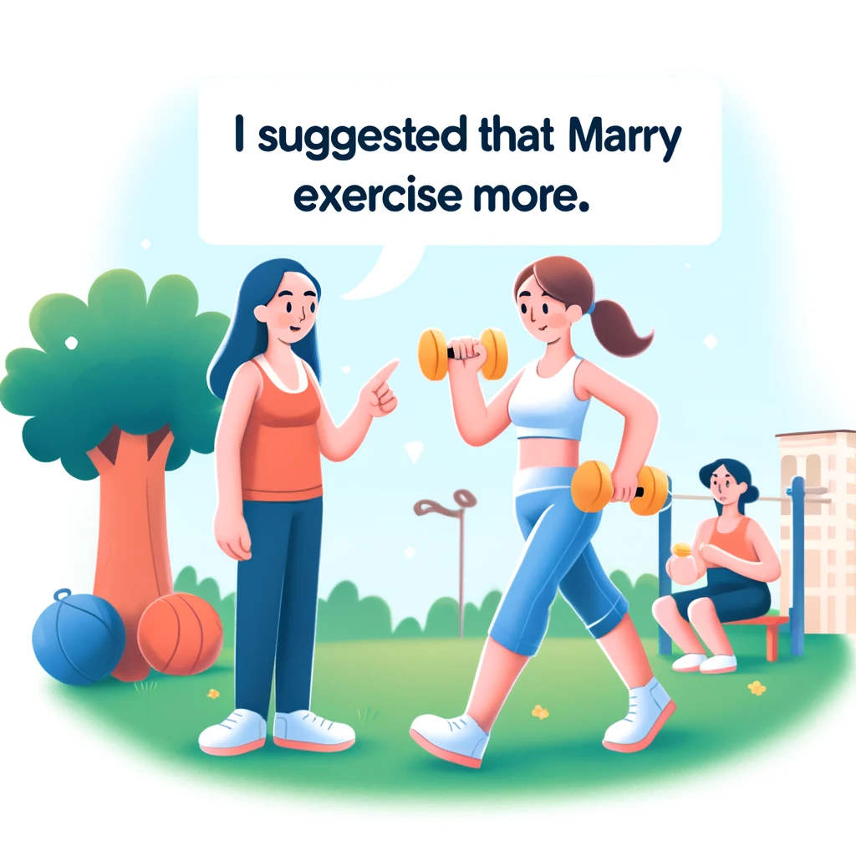
STRUCTURE
suggest + that + S + (should) + V
gợi ý ai đó nên làm gì

Slide 10
01
READING

Slide 11
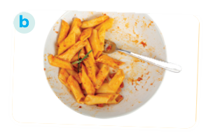
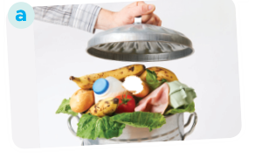

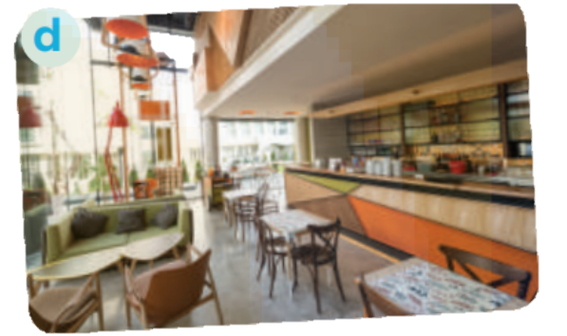
Ex1: Work in pairs. Match the words / phrases with their pictures.
1. food waste
food waste:
chất thải thực phẩm
2. learning space
3. leftovers:
thức ăn thừa
3. leftovers
4. cafeteria
2. learning space: không gian học
4. cafeteria: quán cafe

Slide 12

Ex2: Read part of an announcement about the Teenovator competition. Match the topics in the competition with their winners. There is one extra topic.
Thành phố với đường phố an toàn
Thành phố thân thiện với thanh thiếu niên
Thành phố thực phẩm thông minh
Thành phố không rác thải
List of topics
The street-safe city
The teen-friendly city
The food-smart city
The waste-free city

Slide 13
Ex2: Read part of an announcement about the Teenovator competition. Match the topics in the competition with their winners. There is one extra topic.
Teenovator competition
Teenovator is an annual competition by the City Teen Council. We ask teens to find problems of the city and suggest solutions. Here are this year's winners
_______: Central School
They see that the more developed a city is, the more food people throw away. They suggest carrying out a project which turns food waste into energy. Students would sort their leftovers at school canteens. A nearby farm would come to take the food waste and process it into biogas.
2. ______: Bookworm Team
This team feels that many public amenities, particularly the city library, are not teen-friendly. They suggest a list of changes so that the library can attract more teens. Some of them include designing lively learning spaces for teens and having teen's favourite desserts in the cafeteria.
3. _______: Helena Wilson
Helena realises that there are too many vehicles around school gates. This is unsafe for children who walk to school. She suggests that the city authorities not allow cars at school gates at drop-off and pick-up times. In addition, they should not let motorbikes park on the pavement near school gates.

Slide 14
Ex2: Read part of an announcement about the Teenovator competition. Match the topics in the competition with their winners. There is one extra topic.
C
1. _______: Central School
They see that the more developed a city is, the more food people throw away. They suggest carrying out a project which turns food waste into energy. Students would sort their leftovers at school canteens. A nearby farm would come to take the food waste and process it into biogas.
List of topics
The street-safe city
The teen-friendly city
The food-smart city
The waste-free city

Slide 15
Ex2: Read part of an announcement about the Teenovator competition. Match the topics in the competition with their winners. There is one extra topic.
2. ______: Bookworm Team
This team feels that many public amenities, particularly the city library, are not teen-friendly. They suggest a list of changes so that the library can attract more teens. Some of them include designing lively learning spaces for teens and having teen's favourite desserts in the cafeteria.
B
List of topics
The street-safe city
The teen-friendly city
The food-smart city
The waste-free city

Slide 16
Ex2: Read part of an announcement about the Teenovator competition. Match the topics in the competition with their winners. There is one extra topic.
A
3. _______: Helena Wilson
Helena realises that there are too many vehicles around school gates. This is unsafe for children who walk to school. She suggests that the city authorities not allow cars at school gates at drop-off and pick-up times. In addition, they should not let motorbikes park on the pavement near school gates.
List of topics
The street-safe city
The teen-friendly city
The food-smart city
The waste-free city

Slide 17
Ex3: Read the announcement again. Choose the correct answer.
1. How often does the City Teen Council organise the Teenovator competition?
Once a year.
Twice a year.
Every two years.
Every three years.
2. Who would partner with Central School in Topic 1?
The city council.
The university's canteen.
A biogas factory.
A nearby farm.
Teenovator is an annual competition by the City Teen Council.
an annual
competition
Council.

Slide 18
Ex3: Read the announcement again. Choose the correct answer.
3. What does the word "them" in Topic 2 refer to?
Teen users.
Changes
Learning spaces
Libraries.
4. Which topic has an individual winner?
Topic 1.
Topic 2
Topic 3.
All topics.
changes
They suggest a list of changes so that the library can attract more teens. Some of them include designing lively learning spaces for teens.
them
Topic 1. The waste-free city: Central School
Topic 2. The teen-friendly city: Bookworm Team
Topic 3. The street-safe city: Helena Wilson
Helena Wilson

Slide 19
Ex3: Read the announcement again. Choose the correct answer.
5. Which of the following is INCORRECT about Helena Wilson?
She suggests banning bikes at school gates
She wants the city authorities to take action.
She thinks cars moving near school gates can cause accidents to children.
Her concern is road safety around school for children.
In addition, they should not let motorbikes park on the pavement near school gates.

Slide 20
02
SPEAKING

Slide 21
Ex4: Make a list of city problems and some solutions to them.
Work in pairs and add as many details of problems of city life and solutions.
Example:
Problems | Solutions
Dirty streets | Tell people to throw rubbish away properly
Lack of green spaces | Plant more trees

Slide 22
Ex4: Make a list of city problems and some solutions to them.
Work in pairs and add as many details of problems of city life and solutions.
Suggest:
Problems | Solutions
Traffic congestion | Encourage people to use public transportation and cycling.
Air pollution | Implement tree – planting programs, create green spaces.
High urban population density | Implementation of rural development policy

Slide 23
Ex5: Work in pairs. Talk to your friends about the city problems and suggest solutions to them. You can use the ideas in 4.
Structures:
I think/ In my opinion/ I would say that …
First, Second, Third,…
Then, After that, …
On one hand, On the other hand,…

Slide 24
Ex5: Work in pairs. Talk to your friends about the city problems and suggest solutions to them. You can use the ideas in 4.
Suggested answer:
We think that there are several problems in our city. First, some streets are dirty. Many people put rubbish on the pavements or near the walls. Second, the city looks like a concrete jungle. It lacks green space and the air is not fresh. To solve these problems, the city authority should instruct people to throw rubbish properly. Another solution is to plant more trees even on the roof of high buildings. By doing so, the city can be a more liveable place.

Slide 25
WRAP – UP
After this lesson, students will be able to:
1. Reading
Read for main idea and specific information in an announcement about a competition to find solutions to city problems.
2. Speaking
Talk about city problems and their solutions.

Slide 26
THANK YOU!

