Slide 1

Unit 2:
City life
Lesson 4: Communication

Slide 2
OBJECTIVES
After this lesson, Ss will be able to:
Everyday English
Offer help and respond
Transport in the city
About their favourite means of transport

Slide 3


New words
useful, easy or quick to do
convenient(adj)
/kənˈviː.ni.ənt/
thuận tiện, tiện nghi

Slide 4
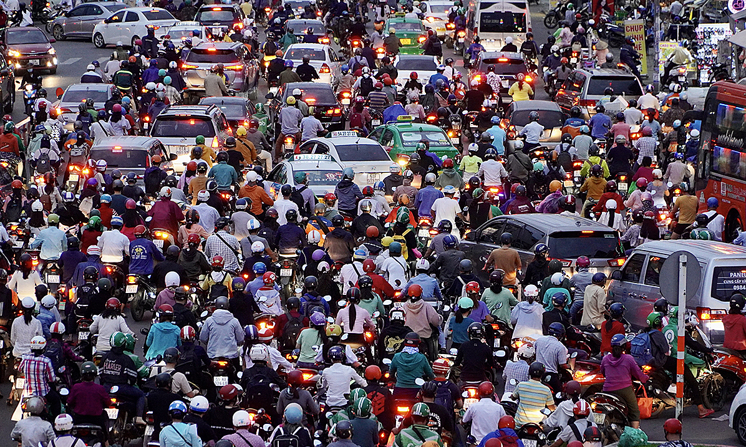
New words
traffic jam (n)
/ˈtræf.ɪk ˌdʒæm/
Ùn tắc giao thông

Slide 5
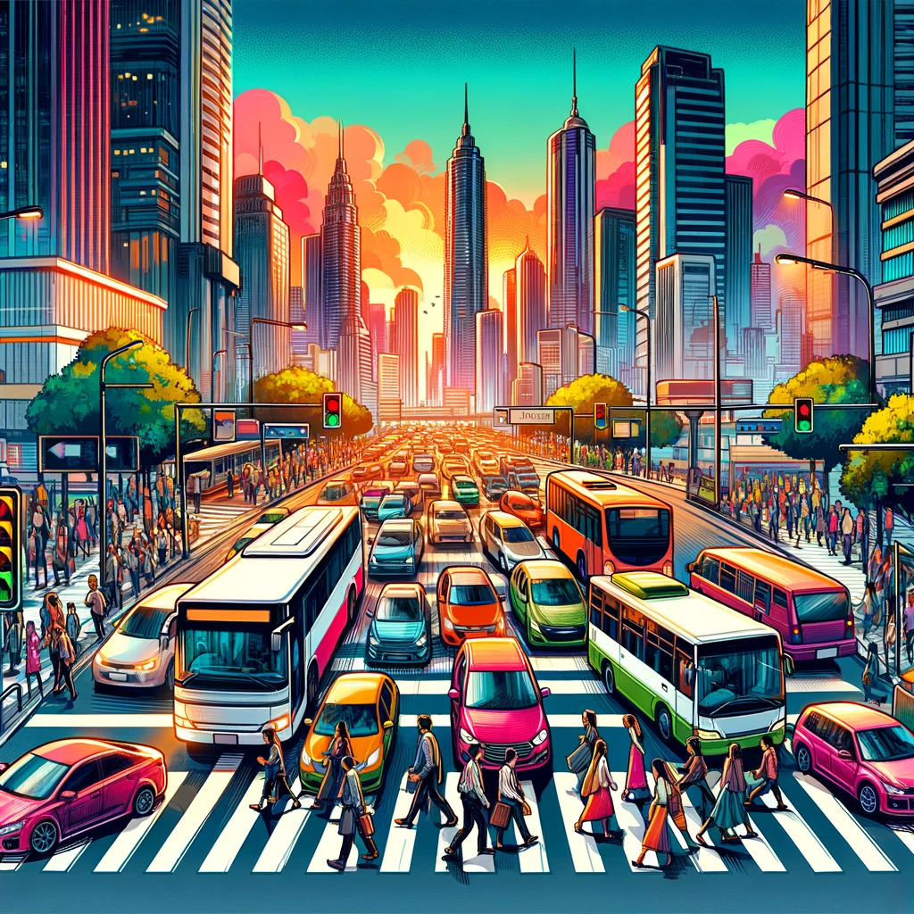
New words
rush hour (n)
/ˈrʌʃ ˌaʊər/
giờ cao điểm

Slide 6
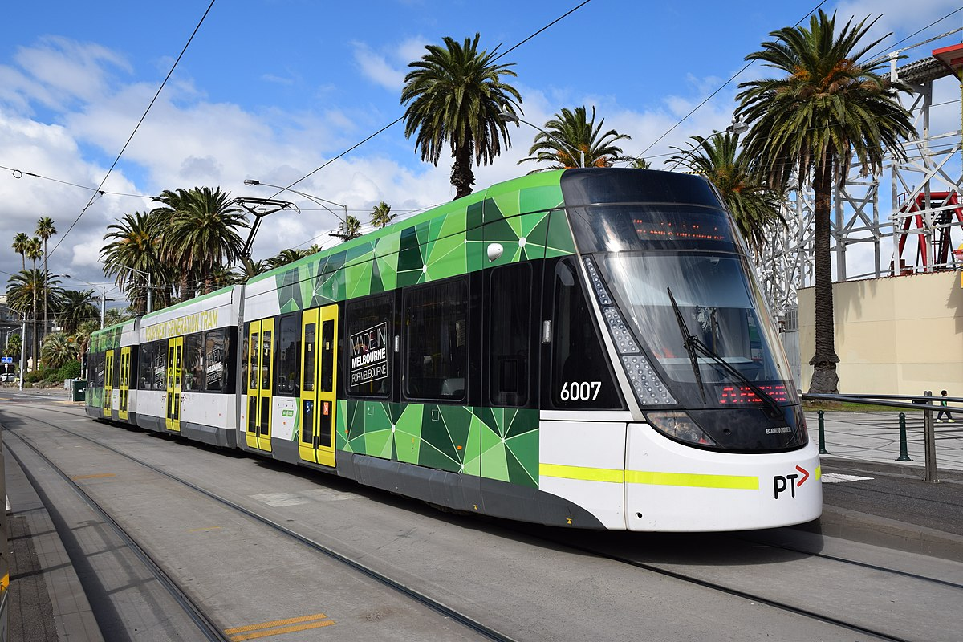
New words
tram
/træm/
Xe điện

Slide 7
New words
Words | Pronunciation | Meanings
 |  | Thuận tiện, tiện nghi
 |  | Ùn tắc giao thông
 |  | Giờ cao điểm
 |  | Xe điện
convenient(adj) | /kənˈviː.ni.ənt/
traffic jam (n) | /ˈtræf.ɪk ˌdʒæm/
rush hour (n) | /ˈrʌʃ ˌaʊər/
tram | /træm/

Slide 8
I. Everyday English
Offer help and respond

Slide 9
Ex1: Listen and read the conversations below. Pay attention to the underlined parts.
1
2
Duong's dad: I can take you to the airport if you like
Duong: Thanks, Dad.
Minh: Would you like me to give you a ride home
Hoang: Thank you. That's so kind of you
Offering help | Responding
Duong's dad: I can take you to the airport if you like
Duong: Thanks, Dad.
Minh: Would you like me to give you a ride home
Hoang: Thank you. That's so kind of you

Slide 10
Ex2: Work in pairs. Make similar conversations with the following situations.
Your friend doesn't know how to use the library smart card. You offer to show him/her
A teacher wants to talk to Ms Hoa, but she is not there. You offer to write a note for Ms Hoa.

Slide 11
Ex2: Work in pairs. Make similar conversations with the following situations.
1. Your friend doesn't know how to use the library smart card. You offer to show him/her
Your friend: That would be great, thanks!
You: I can show you how to use the library smart card if you want.

Slide 12
Ex2: Work in pairs. Make similar conversations with the following situations.
2. A teacher wants to talk to Ms Hoa, but she is not there. You offer to write a note for Ms Hoa.
You: Would you like me to write a note for Ms Hoa?
Teacher: Thank you. That's so kind of you.

Slide 13
II. Transport in the city
About their favourite means of transport

Slide 14
Ex3: Work in pairs. Read the descriptions of three teenagers about their favourite means of transport. Then complete the table below.
Hoang: I live in the suburbs of Ha Noi. I use my bike to get around. It's convenient because I can ride it to places where the bus line doesn't reach. Going by bike might be a bit slow, but I can avoid traffic jams.
Cholada: My favourite means of transport in Bangkok is the sky train. It's crowded at rush hour, but it's always on time. It doesn't get stuck in traffic jams, so I can save time travelling.
Kathy: I love the tram in Melbourne. It offers a discount for students. Sometimes the tram is late, but it always updates its arrival on a smartphone app, so I know in advance and arrange my time easily.

Slide 15
Ex3: Work in pairs. Read the descriptions of three teenagers about their favourite means of transport. Then complete the table below.
Name | Favourite means of transport | Advantage(s) | Drawback(s) | Why using it
Hoang | bike | convenient | slow | avoid (1) _______
Cholada | (2)_________ | on time | (3)________ at rush hour | save time travelling
Kathy | (4)_________ | (5)________ for students | late | arrange time easily
noun
verb
noun
verb
noun

Slide 16
Ex3: Work in pairs. Read the descriptions of three teenagers about their favourite means of transport. Then complete the table below.
Name | Favourite means of transport | Advantage(s) | Drawback(s) | Why using it
Hoang | bike | convenient | slow | avoid (1) _________
Cholada | (2)______ | on time | (3)______ at rush hour | save time travelling
Kathy | (4)______ | (5)_______ for students | late | arrange time easily
1. Going by bike might be a bit slow, but I can avoid traffic jams.
traffic jams

Slide 17
Ex3: Work in pairs. Read the descriptions of three teenagers about their favourite means of transport. Then complete the table below.
Name | Favourite means of transport | Advantage(s) | Drawback(s) | Why using it
Hoang | bike | convenient | slow | avoid (1) _________
Cholada | (2)______ | on time | (3)______ at rush hour | save time travelling
Kathy | (4)______ | (5)_______ for students | late | arrange time easily
2. My favourite means of transport in Bangkok is the sky train.
traffic jams
sky train

Slide 18
Ex3: Work in pairs. Read the descriptions of three teenagers about their favourite means of transport. Then complete the table below.
Name | Favourite means of transport | Advantage(s) | Drawback(s) | Why using it
Hoang | bike | convenient | slow | avoid (1) _________
Cholada | (2)______ | on time | (3)______ at rush hour | save time travelling
Kathy | (4)______ | (5)_______ for students | late | arrange time easily
3. It's crowded at rush hour, but it's always on time.
traffic jams
crowded
sky train

Slide 19
Ex3: Work in pairs. Read the descriptions of three teenagers about their favourite means of transport. Then complete the table below.
Name | Favourite means of transport | Advantage(s) | Drawback(s) | Why using it
Hoang | bike | convenient | slow | avoid (1) _________
Cholada | (2)______ | on time | (3)_________ at rush hour | save time travelling
Kathy | (4)______ | (5)_______ for students | late | arrange time easily
traffic jams
4. I love the tram in Melbourne.
crowded
sky train
tram

Slide 20
Ex3: Work in pairs. Read the descriptions of three teenagers about their favourite means of transport. Then complete the table below.
Name | Favourite means of transport | Advantage(s) | Drawback(s) | Why using it
Hoang | bike | convenient | slow | avoid (1) _________
Cholada | (2)______ | on time | (3)_________ at rush hour | save time travelling
Kathy | (4)______ | (5)_______ for students | late | arrange time easily
5. It offers a discount for students.
traffic jams
crowded
sky train
discount
tram

Slide 21
Ex4: Make notes about a means of transport you are using.
Name of the means of transport
Its advantage(s) and drawback(s)
Why you choose to use it
bus
near house and school, clean, on time, air conditioning
crowded at rush hour

Slide 22
Ex5: Work in groups. Talk to your friends about the means of transport that you use. Use your notes in 4.
Note in 4:
Transport: bus
Advantage(s) and drawback(s):near house and school, clean, on time, air conditioning
Why you choose to use it: crowded at rush hour

Slide 23
Ex5: Work in groups. Talk to your friends about the means of transport that you use. Use your notes in 4.
Suggested answer:
I go to school by bus every day. It is convenient because there are bus stops near my house and my school. The bus is clean and on time. It is very crowded at rush hour, but it has air conditioning so it is cool. That’s why I choose to use it.

Slide 24
SWAP AND CHECK
Check for spelling
Do the words spell correctly?
Check for ideas
Does your friend write about the means of transport that you use?
Check for comprehension
Does the writing make sense?
Check for grammar
Does the writing use the correct tenses and structures?

Slide 25
Wrap – up:
What have we learnt in this lesson?
✓
Offer help and respond to an offer;
✓
Talk about means of transport that they use.

Slide 26
Thank you!

