Slide 1
Unit 2
City life
Lesson 3: A closer look 2

Slide 2
OBJECTIVES
After this lesson, students will be able to:
recognise and use double comparatives
recognise and use some phrasal verbs

Slide 3
01
Double comparatives
Student’s book page 21

Slide 4
Pelmanism

Slide 5
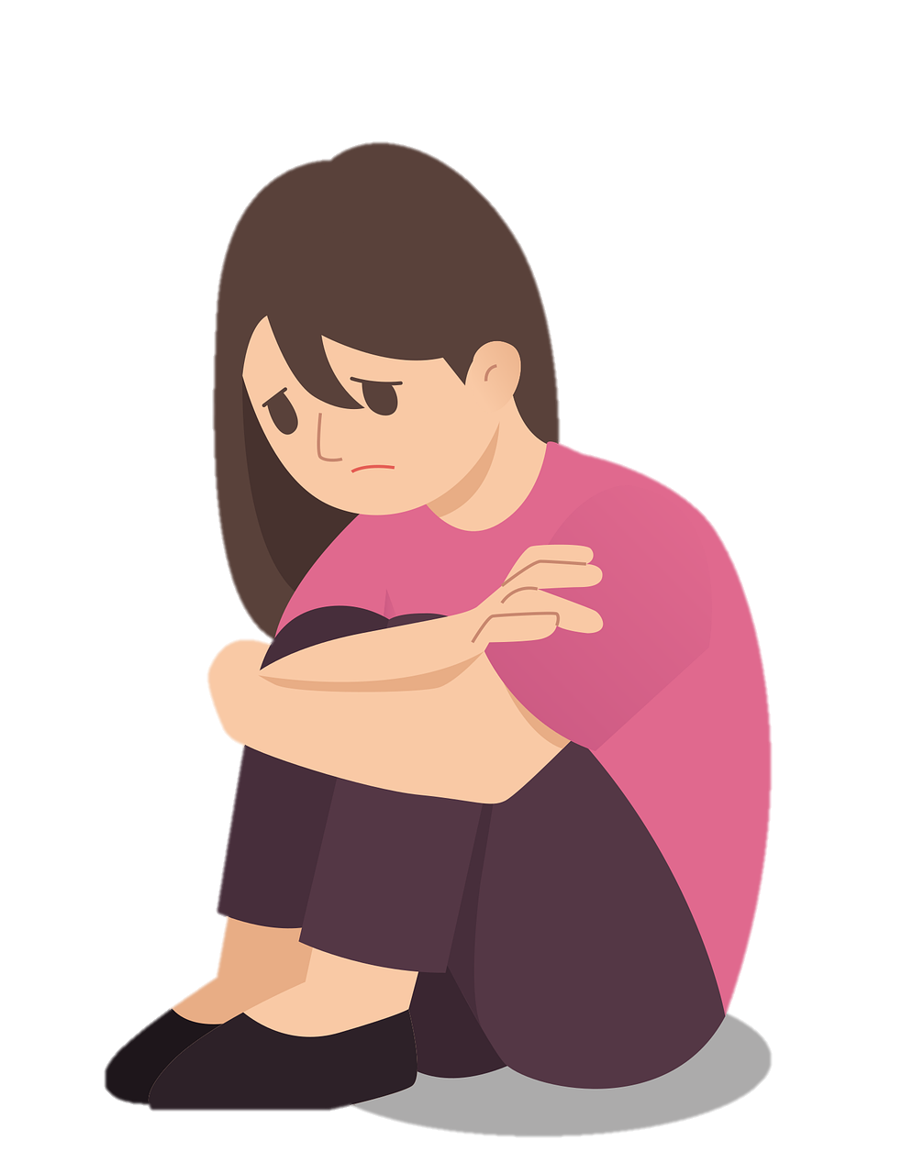



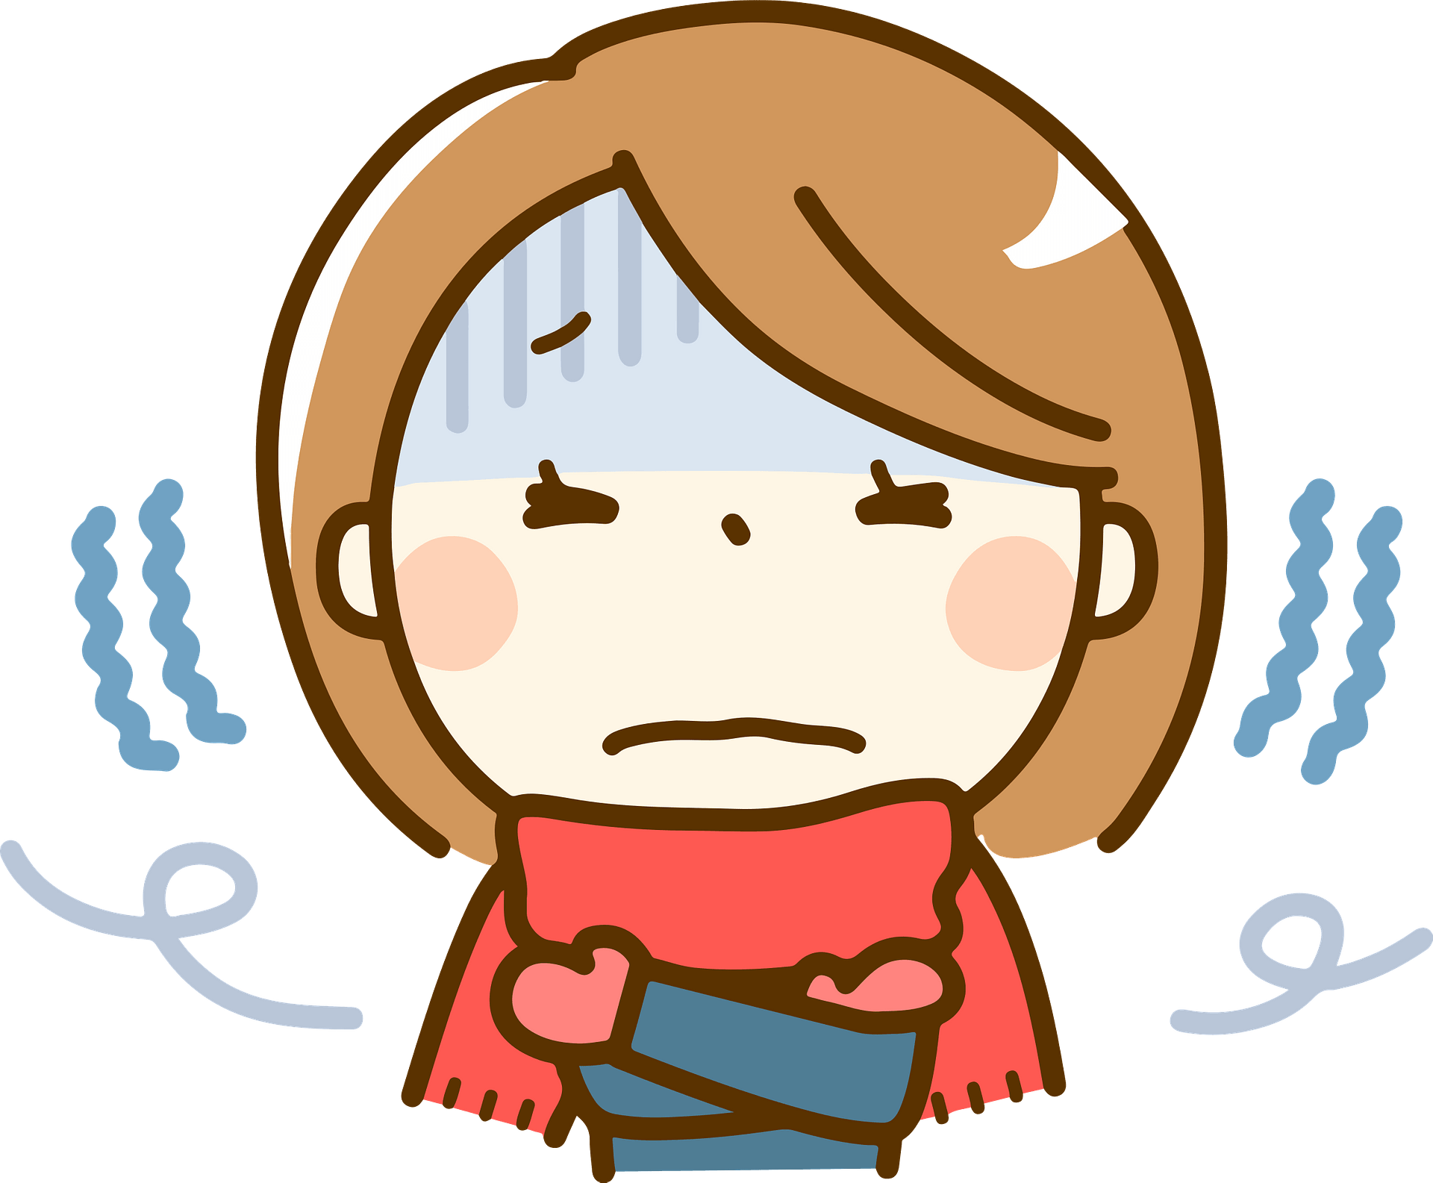



1
2
3
4
When the wind blows stronger
she becomes less happy
When the city is more developed
you will easier get a high score
When you are more careful
a
When Mary is more successful
b
c
we feel colder
d
it becomes more crowded
Notes:
The stronger the wind blows, the colder we feel.
The more developed the city is, the more crowded it becomes.
The more careful you are, the easier you will get a high score.
The more successful Mary is, the less happy she becomes.

Slide 6
When the wind blows stronger, we feel colder.
Khi gió thổi càng mạnh, chúng tôi càng thấy lạnh.
= The stronger the wind blows, the colder we feel.
When the city is more developed, it becomes more crowded.
Khi thành phố càng phát triển, nó càng trở nên đông đúc.
= The more developed the city is, the more crowded it becomes.
We use the with comparative adjectives to show that one thing or situation depends on another.

Slide 7
Double comparatives
The
stronger
the wind blows,
the
colder
we feel.
The
more developed
the
more crowded
it becomes.
the city is,
The
more careful
you are,
the
easier
you will get a high score.
The
more successful
Mary is,
the
less happy
she becomes.
The
comparative ADJ
S. V,
the
comparative ADJ
S. V.
Notes:
The stronger the wind blows, the colder we feel.
The more developed the city is, the more crowded it becomes.
The more careful you are, the easier you will get a high score.
The more successful Mary is, the less happy she becomes.

Slide 8
Ex 1 (p.21) Choose the correct option to complete each sentence.
1. The later / more late it gets, the more worried I get about her.
2. He wants a new house. The larger the house is, the comfortable / more comfortable he feels.
3. She thinks the bigger the city is, higher/ the higher the cost of living gets.
4. The famouser / more famous the city is, the higher number of tourists it can attract.
5. The larger population the town has, difficult/ the more difficult it is to find a job.
1. SSH của tính từ ngắn (late – later)
2. SSH của tính từ dài (comfortable – more comfortable)
3. The + comparative Adj S.V, the + comparative Adj S.V
4,5. SSH của tính từ dài (famous – more famous, difficult – more difficult)

Slide 9
Ex 2 (p.21) Find a mistake in the underlined parts in each sentence below and correct it.
1. I love the spicy food in this city. The hottest the food is, the more I like it. A B C
2. I got stuck in a traffic jam yesterday. The more
A
congested the road was, the tired I became.
B C
3. The modern the library is, the more attractive it is to teenagers. A B C
4. The streets are getting dirtier. The more crowded this
A B
city is, more polluted (C) it becomes.
1. SSH của tính từ ngắn  hotter
2. The + comparative Adj S.V, the + comparative Adj S.V  more tired
3. SSH của tính từ dài  more modern
4. The + comparative Adj S.V, the + comparative Adj S.V  the more polluted

Slide 10
02
Phrasal verbs
Student’s book page 21

Slide 11
Ex 3 (p.21) Match a phrasal verb in column A with a suitable word/ phrase in column B.
A
B
1. get around
d. the city
Đi tham quan thành phố
a. noise pollution
2. carry out
c. a project
Thực hiện dự án
b. friends
3. come down with
e. the flu
Bị cảm
c. a project
4. hang out with
b. friends
Gặp gỡ bạn bè
d. the city
5. cut down on
a. noise pollution
Giảm thiểu ô nhiễm tiếng ồn
e. the flu

Slide 12
Ex 4 (p.21) Complete each sentence with a phrasal verb in . You can change the form of the verb when necessary.
1. I’m __________________ a cold. I have a runny nose and a sore throat.
2. We all need to __________________ using our cars and ride our bikes more to reduce air pollution.
3. When I was in town, I chose to __________________ by bus.
4 Where do teenagers in your neighbourhood often __________________ each other?
5. The authority is __________________ a plan to solve traffic congestion in the downtown area.
coming down with
1. I’m __________________ a cold. I have a runny nose and a sore throat.
2. We all need to __________________ using our cars and ride our bikes more to reduce air pollution.
3. When I was in town, I chose to __________________ by bus.
4 Where do teenagers in your neighbourhood often __________________ each other?
5. The authority is __________________ a plan to solve traffic congestion in the downtown area.
1. come down with
Bị ốm, mắc bệnh
cut down on
2. cut down on: giảm thiểu
3. get around : đi tham quan, dạo quanh
get around
4. hang out with: gặp gỡ
hang out with
carrying out
5. carry out: tiến hành, thực hiện

Slide 13

Ex 5 (p.21) Work in pairs. Tell each other whether you agree or disagree with the following ideas.
1. The busier the city is, the more unhappy its people are.
2. The older the city becomes, the less attractive it is to immigrants.
3. Your home town should cut down on noise pollution.

Slide 14
RECAP
In this lesson, students have been able to:
recognise and use double comparatives
recognise and use some phrasal verbs

Slide 15
Thanks for your attention!

