Slide 1
GAME:
JUMBLE WORDS
Play in teams
Unscramble the words.

Slide 2

Unscramble the word
SONGETCEDDARO
CONGESTED ROAD

Slide 3
Unscramble the word
UCSTCIONTRONTSIE
CONSTRUCTION SITE

Slide 4
Unscramble the word
ERROUNDGUND
UNDERGROUND

Slide 5
Unscramble the word
FRAFTICMAJ
TRAFFIC JAM

Slide 6
Unscramble the word
TWONOWND
DOWNTOWN

Slide 7
UNIT 2:
CITY LIFE
LESSON 2: A CLOSER LOOK 1

Slide 8

OBJECTIVES
By the end of the lesson, students will be able to:
Vocabulary
01
use the lexical items related to City life.
Pronunciation
02
Pronounce the diphthong sounds /aʊ/, /əʊ/, and /eə/ in words and sentences correctly.

Slide 9
01
VOCABULARY

Slide 10
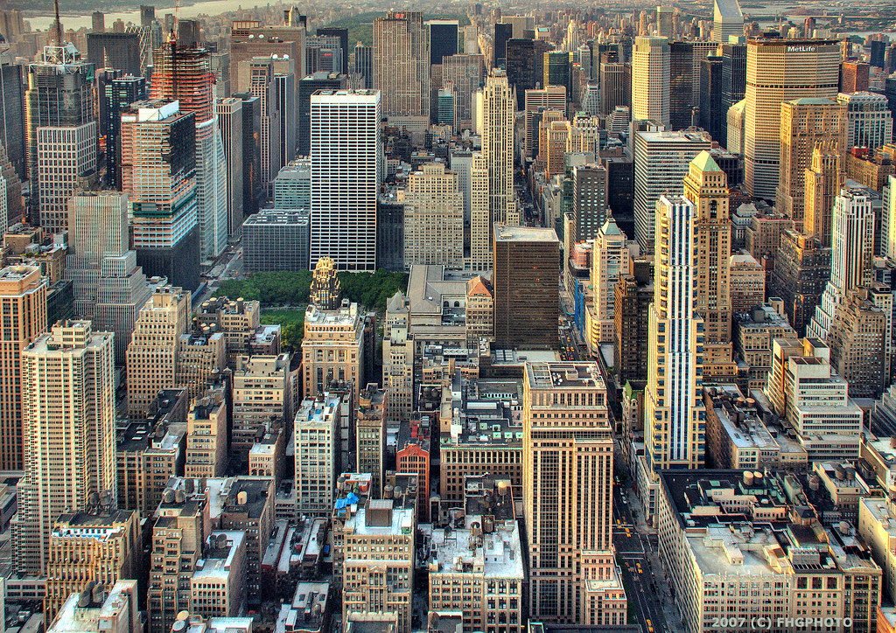

concrete jungle (n)
/ˌkɒŋ.kriːt ˈdʒʌŋ.ɡəl/
rừng bê tông
(khu vực có nhiều nhà cao tầng)

Slide 11
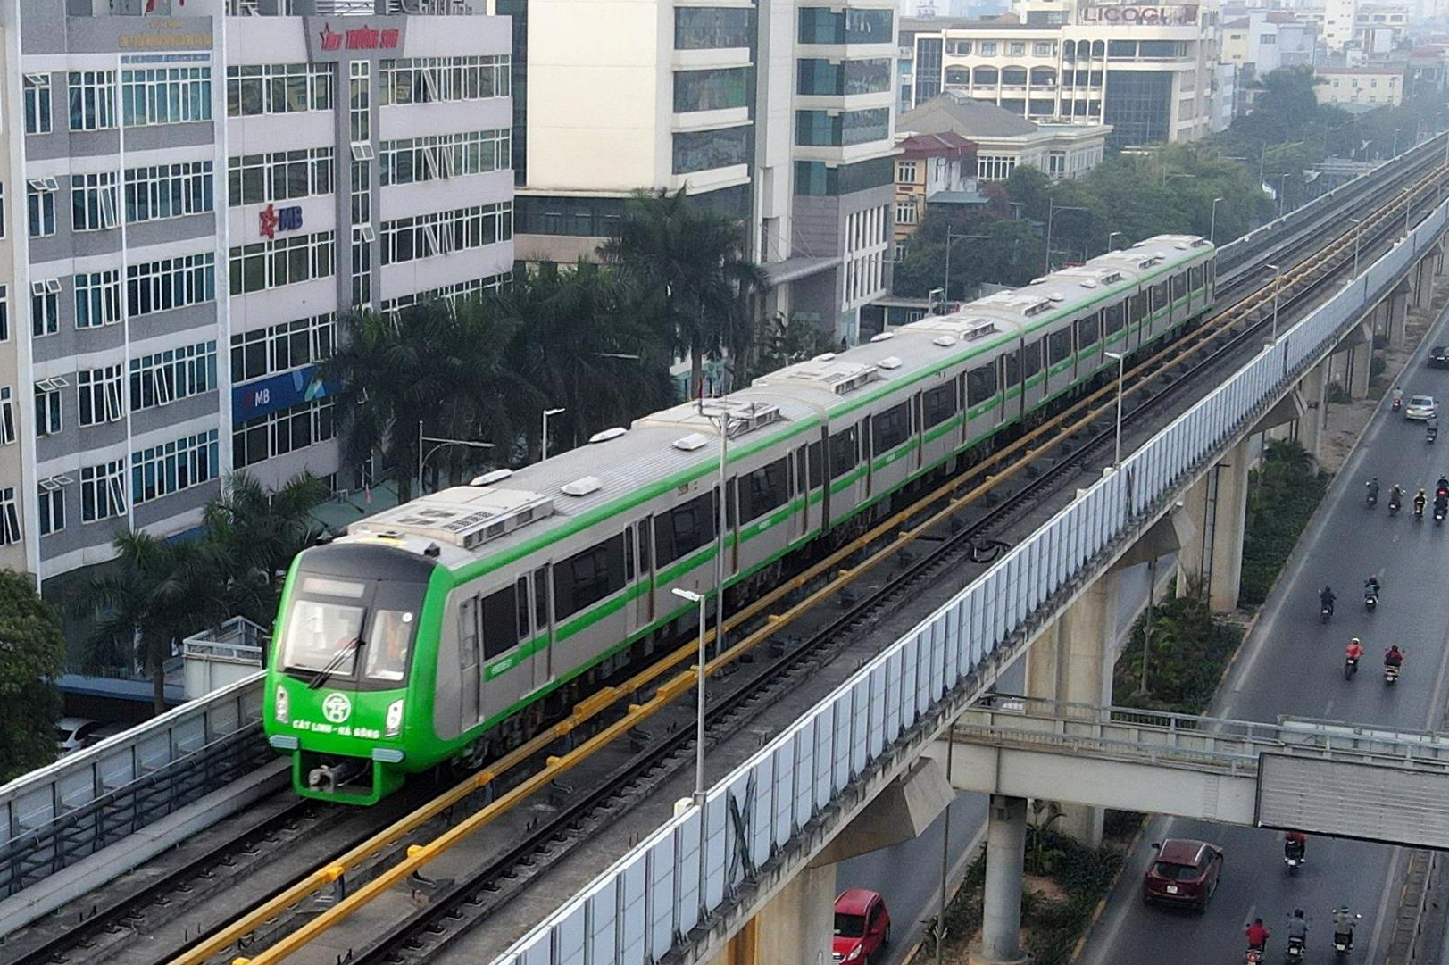
sky train (n)
/skaɪ treɪn/
tàu điện trên cao

Slide 12
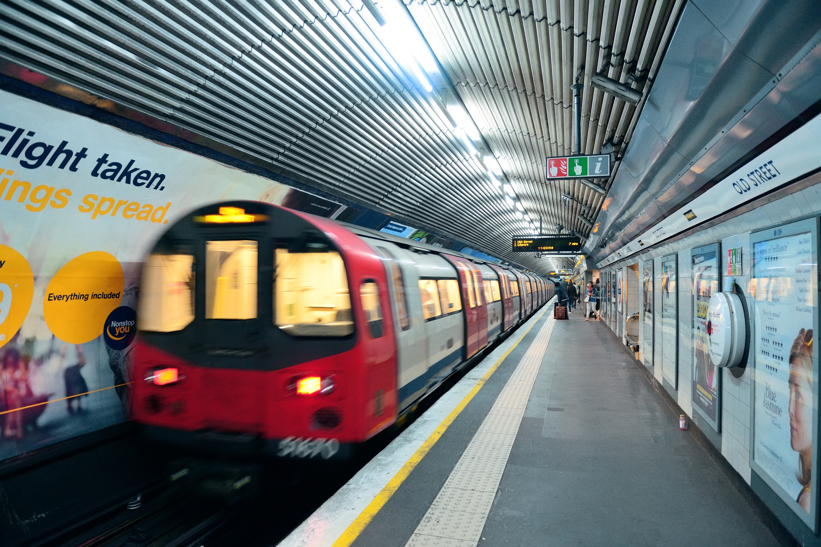
metro (n)
/ˈmet.rəʊ/
hệ thống tàu điện ngầm
underground railway

Slide 13
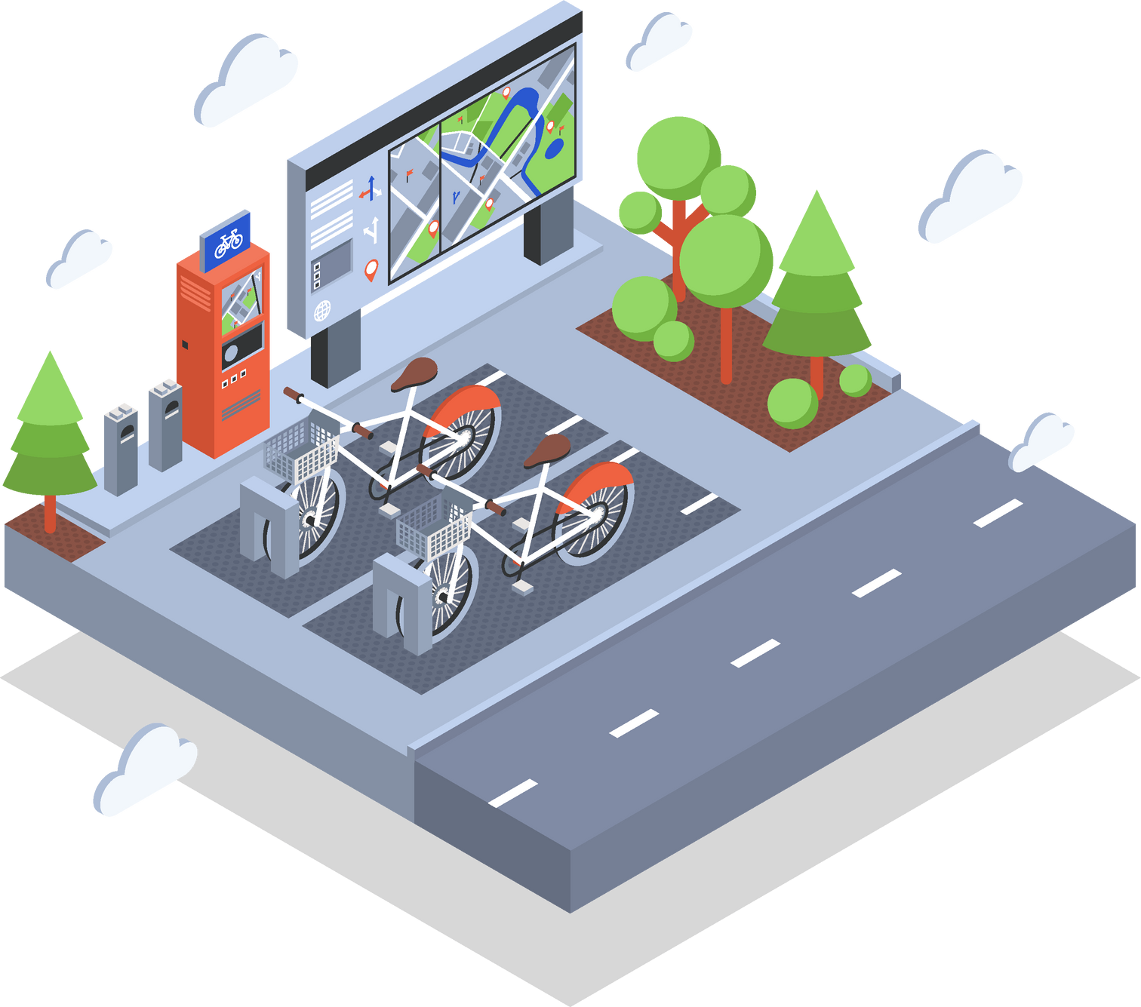
public amenity (n)
/ˈpʌblɪk əˈmiːnəti/
tiện ích công cộng
something that makes a place comfortable or easy to live in

Slide 14

commuter (n)
/kəˈmjuː.tər/
người đi làm

Slide 15
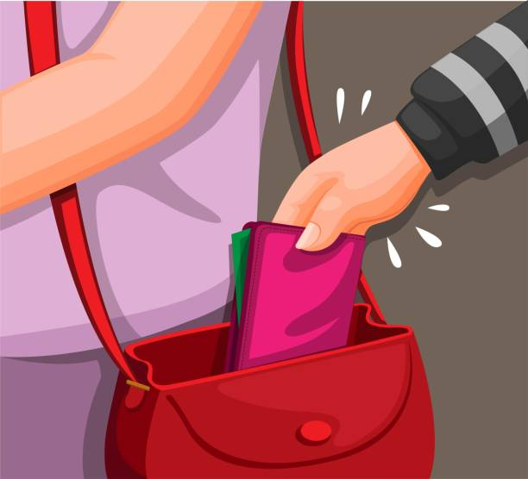
pickpocket (n/v)
/ˈpɪkˌpɒk.ɪt/
kẻ móc túi/ móc túi

Slide 16

liveable (adj)
/ˈlɪv.ə.bəl/
(nơi, địa điểm) đáng sống
suitable or good for living in

Slide 17
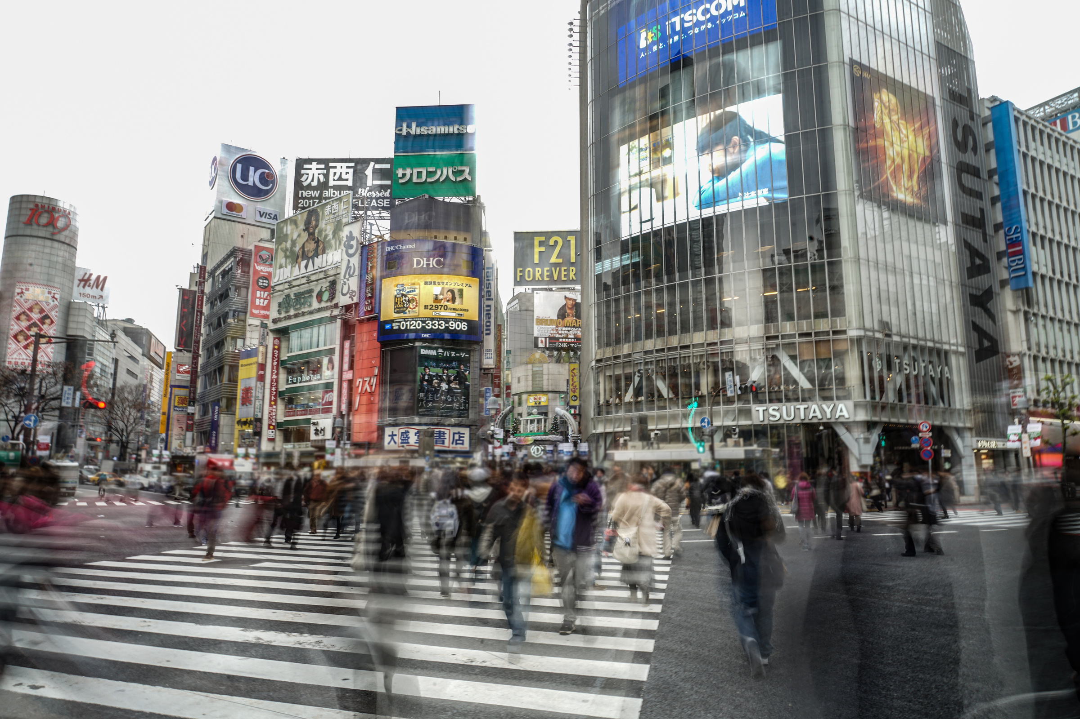
bustling (adj)
/ˈbʌs.lɪŋ/
hối hả, nhộn nhịp, náo nhiệt.
full of busy activity

Slide 18
VOCABULARY
Words | Pronunciation | Meanings
concrete jungle (n) | /ˌkɒŋ.kriːt ˈdʒʌŋ.ɡəl/ | rừng bê tông (khu vực có nhiều nhà cao tầng)
sky train (n) | /skaɪ treɪn/ | tàu điện trên cao
metro (n) | /ˈmet.rəʊ/ | hệ thống tàu điện ngầm
public amenity (n) | /ˈpʌblɪk əˈmiːnəti/ | tiện ích công cộng

Slide 19
VOCABULARY
Words | Pronunciation | Meanings
commuter (n) | /kəˈmjuː.tər/ | người đi làm
pickpocket (n/v) | /ˈpɪkˌpɒk.ɪt/ | kẻ móc túi/ móc túi
liveable (adj) | /ˈlɪv.ə.bəl/ | (nơi, địa điểm) đáng sống
bustling (adj) | /ˈbʌs.lɪŋ/ | hối hả, nhộn nhịp, náo nhiệt.

Slide 20
Ex 1. Match the words/ phrases with their explanations. (P.20)
4
a. an underground train system
1. downtown
b. a city or part of a city with many buildings next to each other
2
2. concrete jungle
c. the centre of a city, especially its main business area
1
3. sky train
d. things in a neighbourhood that make life more comfortable such as parts and shopping centres
4. metro
5
5. public amenities
e. a type of train that runs on a railway high above the ground
3

Slide 21

Ex 2. Choose the correct answer A, B, C, or D. (p.20)
1. The sky train is _____ with commuters at rush hour.
A. packed B. full
C. busy D. interesting
4. It is often more _____ to live in the downtown than in the suburbs.
A. convenient B. peaceful
C. quiet D. silent
2. The town’s public amenities make it a _____ place for its residents.
A. crowded B. boring
C. liveable D. dull
5. Hong Kong is like a concrete jungle with so many people in it. It’s a _____ city.
A. calm B. quite
C. bustling D. high
3. It’s not always _____ on the metro. Pickpocketing sometimes takes place.
A. careful B. dangerous
C. noisy D. safe

Slide 22
Ex 2. Choose the correct answer A, B, C, or D. (p.20)
1. The sky train is _____ with commuters at rush hour.
A. packed B. full
C. busy D. interesting
packed with = crowded with: đông đúc, đầy người
2. The town’s public amenities make it a _____ place for its residents.
A. crowded B. boring
C. liveable D. dull
3. It’s not always _____ on the metro. Pickpocketing sometimes takes place.
A. careful B. dangerous
C. noisy D. safe
take place (phr.v): diễn ra, xảy ra

Slide 23
Ex 2. Choose the correct answer A, B, C, or D. (p.20)
4. It is often more _____ to live in the downtown than in the suburbs.
A. convenient B. peaceful
C. quiet D. silent
suburb (n): vùng ngoại ô
5. Hong Kong is like a concrete jungle with so many people in it. It’s a _____ city.
A. calm B. quite
C. bustling D. high

Slide 24
Ex 2. Choose the correct answer A, B, C, or D. (p.20)
1. The sky train is _____ with commuters at rush hour.
A. packed B. full
C. busy D. interesting
4. It is often more _____ to live in the downtown than in the suburbs.
A. convenient B. peaceful
C. quiet D. silent
2. The town’s public amenities make it a _____ place for its residents.
A. crowded B. boring
C. liveable D. dull
5. Hong Kong is like a concrete jungle with so many people in it. It’s a _____ city.
A. calm B. quite
C. bustling D. high
3. It’s not always _____ on the metro. Pickpocketing sometimes takes place.
A. careful B. dangerous
C. noisy D. safe

Slide 25
Ex 3. Complete the texts, using the words and phrases from the box. (p.20)
metro
safe
John: City life is great! People can travel by public transport, like buses and the (1) __________. There are good schools and hospitals, and other (2) ____________ such as parks, cinemas, and sports facilities. They make cities (3) ____________ places for people.
liveable
concrete jungles
downtown
public amenities
Jenny: City life is terrible! The (4) ____________ area is too crowded. Public transport is always packed with people. Some cities are like (5) ____________ with so many buildings. Some cities are not (6) ____________ because of high crime rates.

Slide 26
Ex 3. Complete the texts, using the words and phrases from the box. (p.20)
metro
safe
downtown
liveable
concrete jungles
public amenities
John: City life is great! People can travel by public transport, like buses and the (1) __________. There are good schools and hospitals, and other (2) ____________ such as parks, cinemas, and sports facilities. They make cities (3) ____________ places for people.
public transport
metro
public amenities
such as parks, cinemas
sports facilities
make cities
liveable
places

Slide 27
Ex 3. Complete the texts, using the words and phrases from the box. (p.20)
safe
downtown
concrete jungles
Jenny: City life is terrible! The (4) ____________ area is too crowded. Public transport is always packed with people. Some cities are like (5) _____________ with so many buildings. Some cities are not (6) ____________ because of high crime rates.
downtown
area
too
crowded
concrete jungles
with so many buildings
safe
not
high crime rates
crime rate: tỉ lệ tội phạm

Slide 28
Who do you agree with, Jenny or John? Explain why?

Slide 29
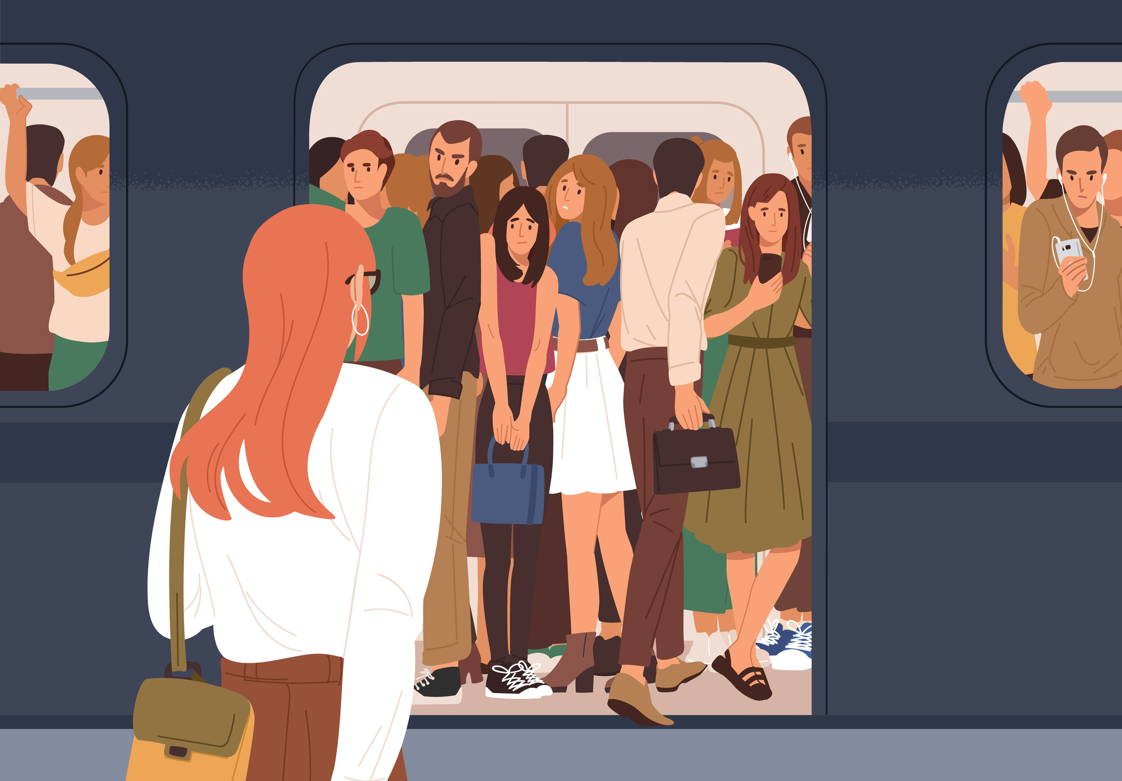
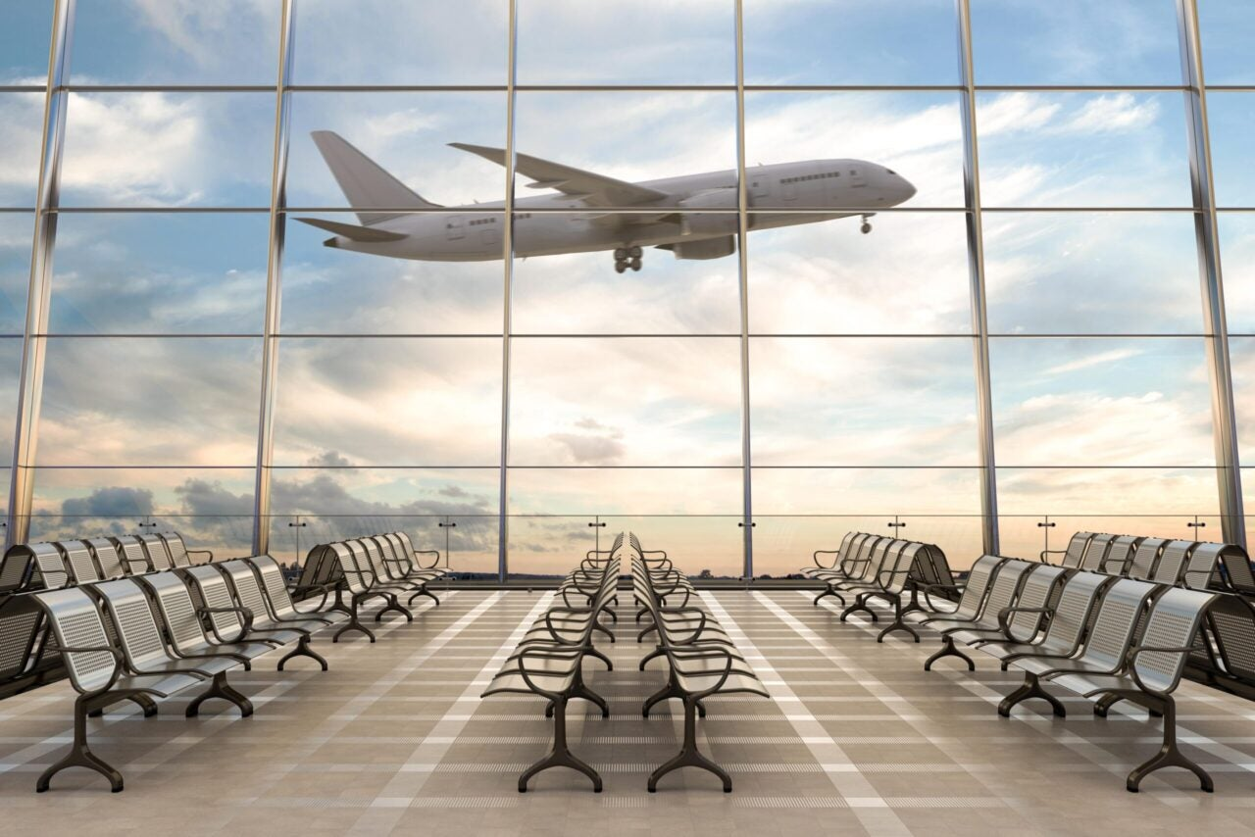

What are they?
crowded
airport
phone
/aʊ/
/eə/
/əʊ/

Slide 30
02
PRONUNCIATION
/aʊ/, /əʊ/, and /eə/

Slide 31
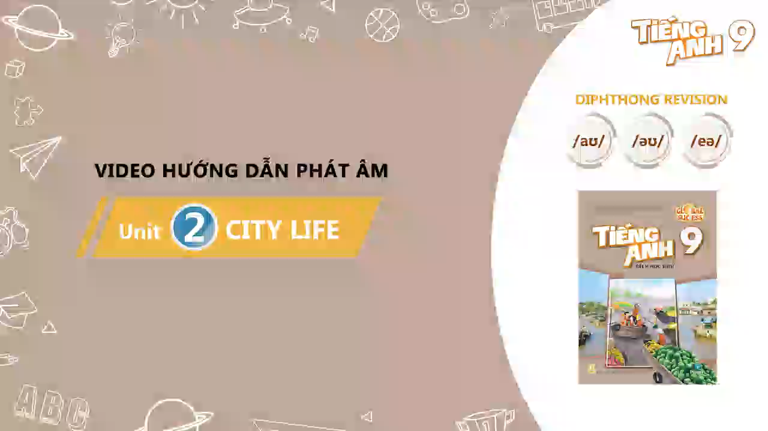
Watch and take notes

Slide 32
Ex 4. Put the words in the correct column. Then listen and check.
crowded
locate
square
outdoor
repair
airport
council
coastal
overseas
/aʊ/ | /əʊ/ | /eə/
crowded
locate
square
outdoor
coastal
repair
council
overseas
airport

Slide 33
Ex 5. Read the sentences. Circle the words with /aʊ/, underline those with /əʊ/, and put a tick (√) next to those with /eə/. Then listen, check, and practise the sentences.
1. They go shopping downtown.
2. The chairman comes from a coastal city.
3. Buses in the old days were not as crowded as they are now.
4. She gets around the city easily thanks to the apps on her phone.
5. I hope we will arrive at the city square in time for the fashion show.



Slide 34
WRAP-UP
What do you have learnt in the lesson today?
Vocabulary

Use the lexical items related to the topic City life.
Pronunciation

Pronounce the diphthong sounds /aʊ/, /əʊ/, and /eə/ in words and sentences correctly.

Slide 35
Thanks!
Do you have any questions?

