Slide 1
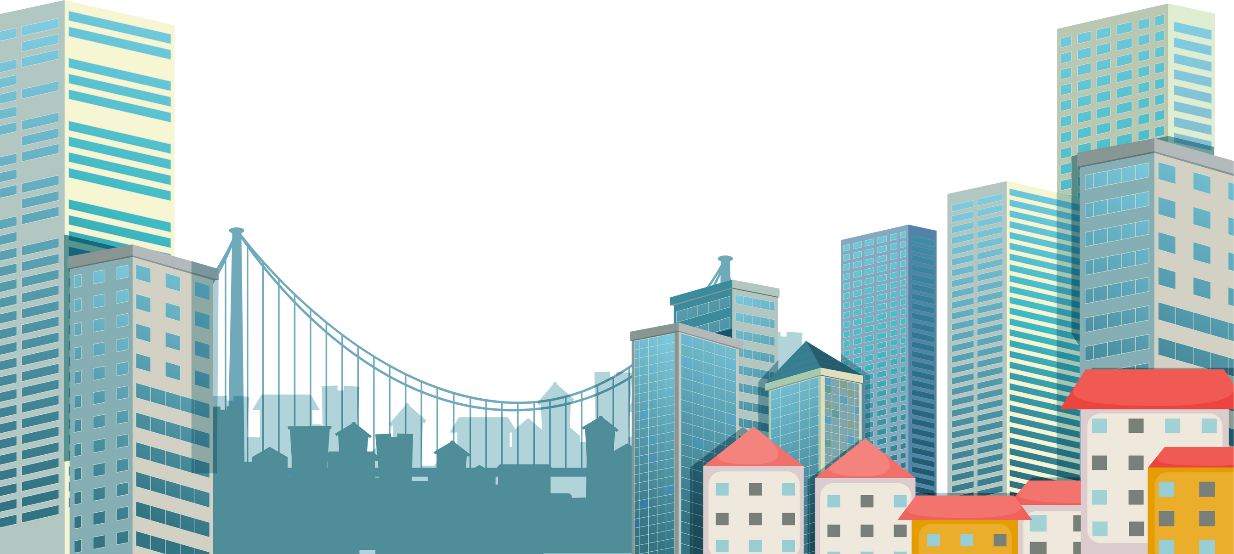
GAME: PICTIONARY
Try to guess the name of the cities through emojis/ pictures

Slide 2



Dubai
Example
+

Slide 3
READY? GO!

Slide 4


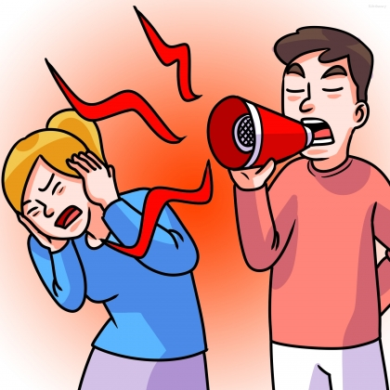
Hanoi
+

Slide 5
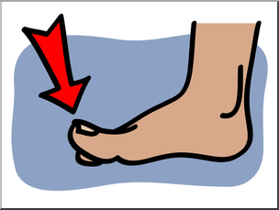


Tokyo
+
+

Slide 6


Bangkok
+

Slide 7
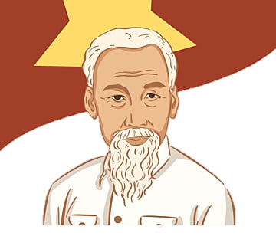
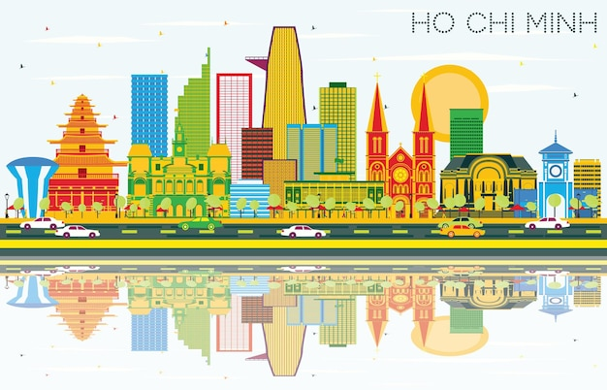
Ho Chi Minh City
+

Slide 8

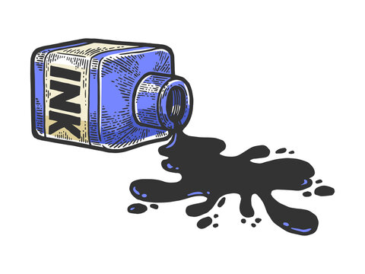

Washington
+
+

Slide 9



London
+
+

Slide 10


Moscow
+

Slide 11



New York
+
+

Slide 12
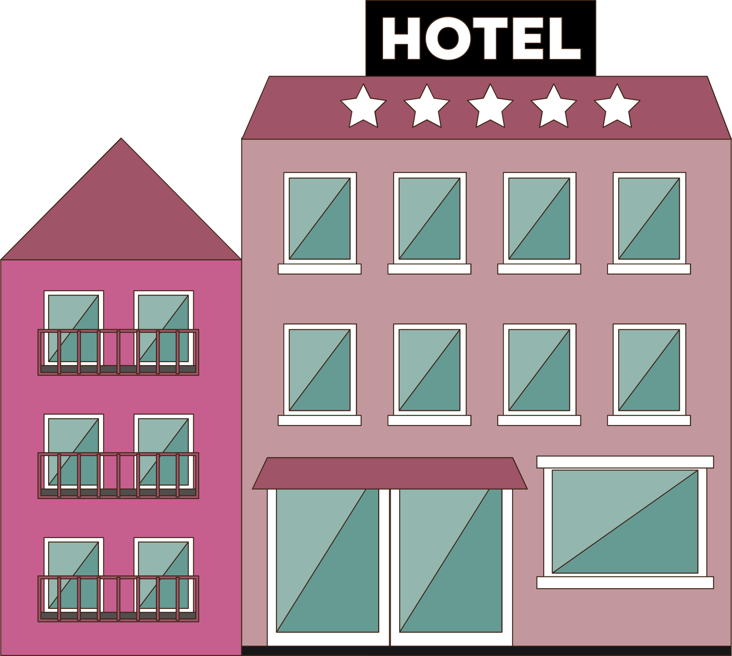
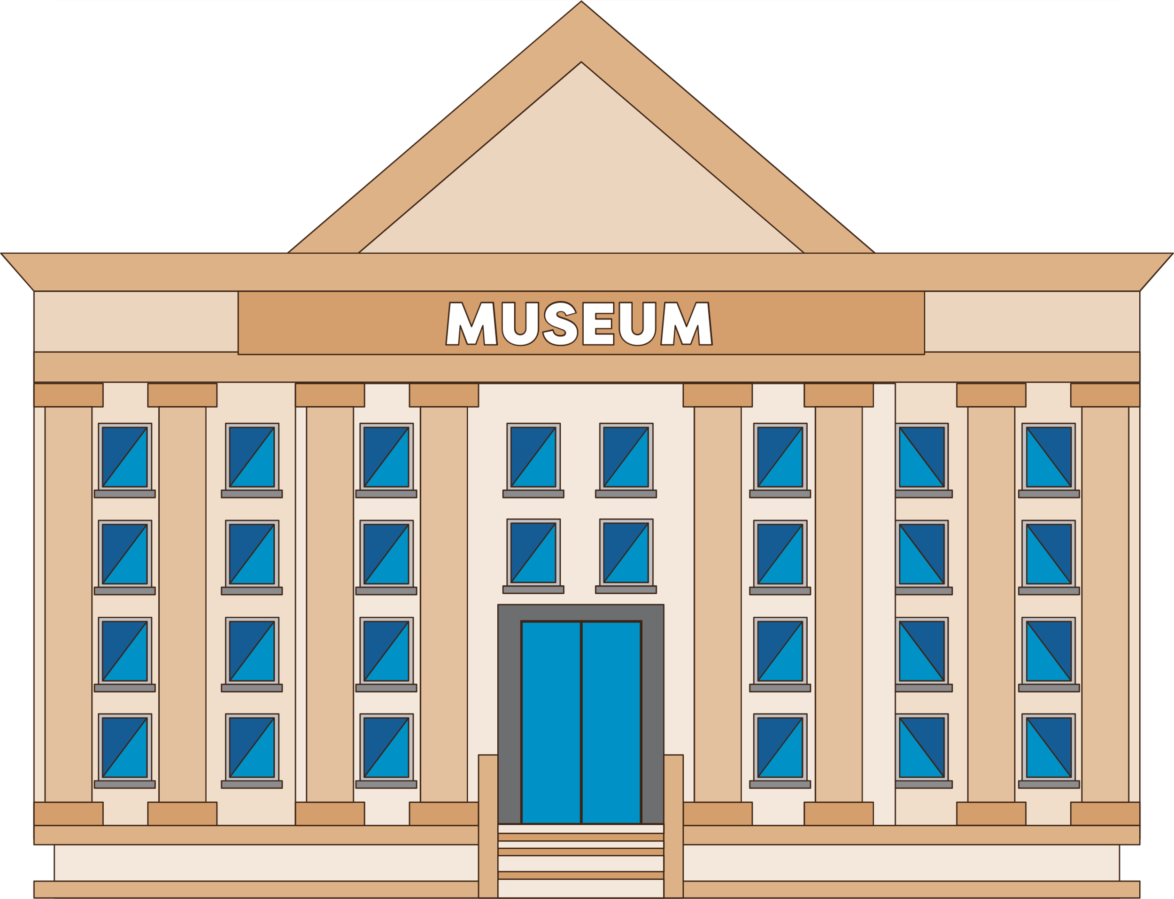
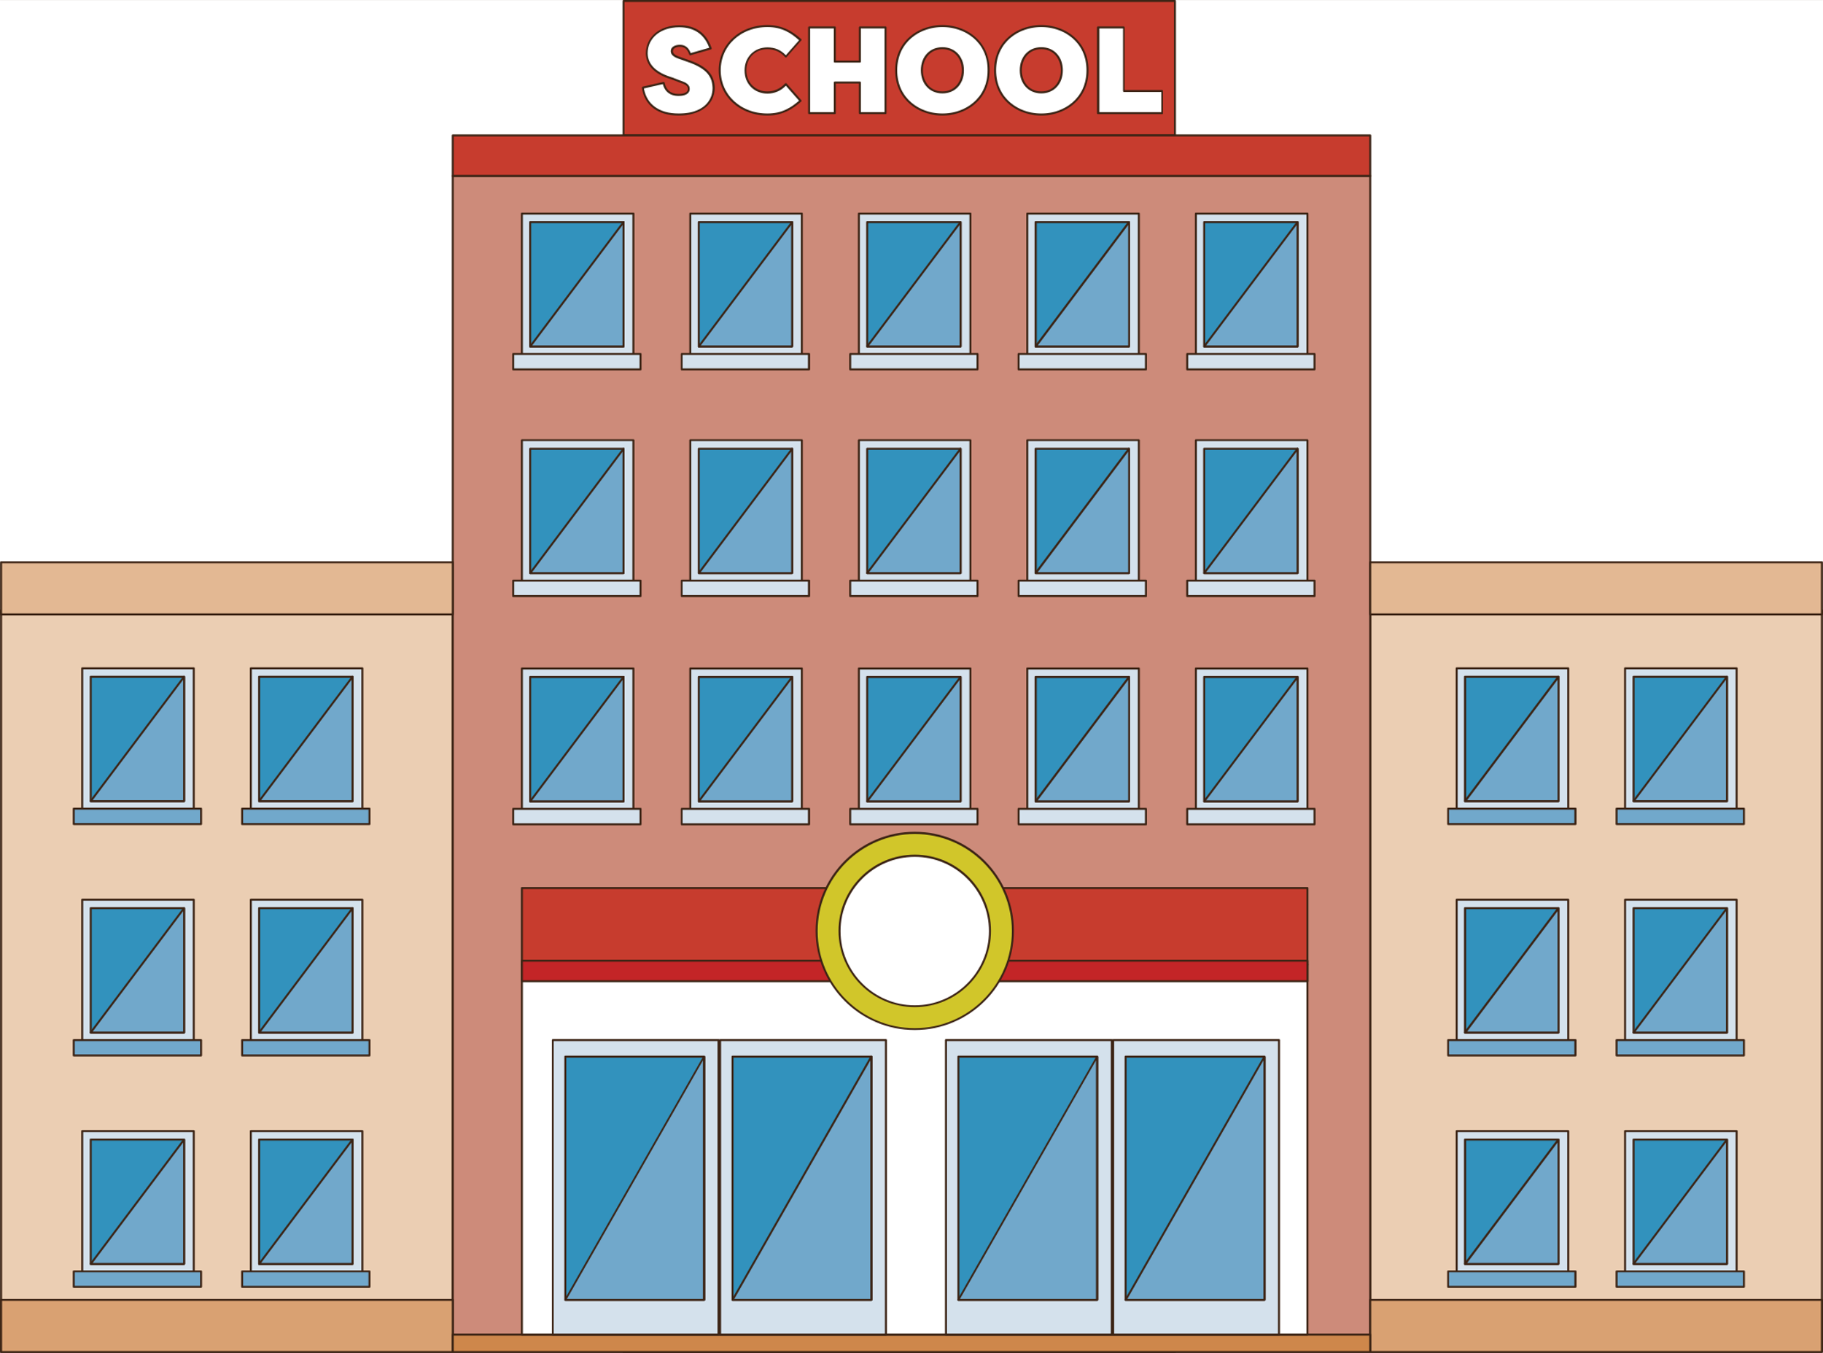

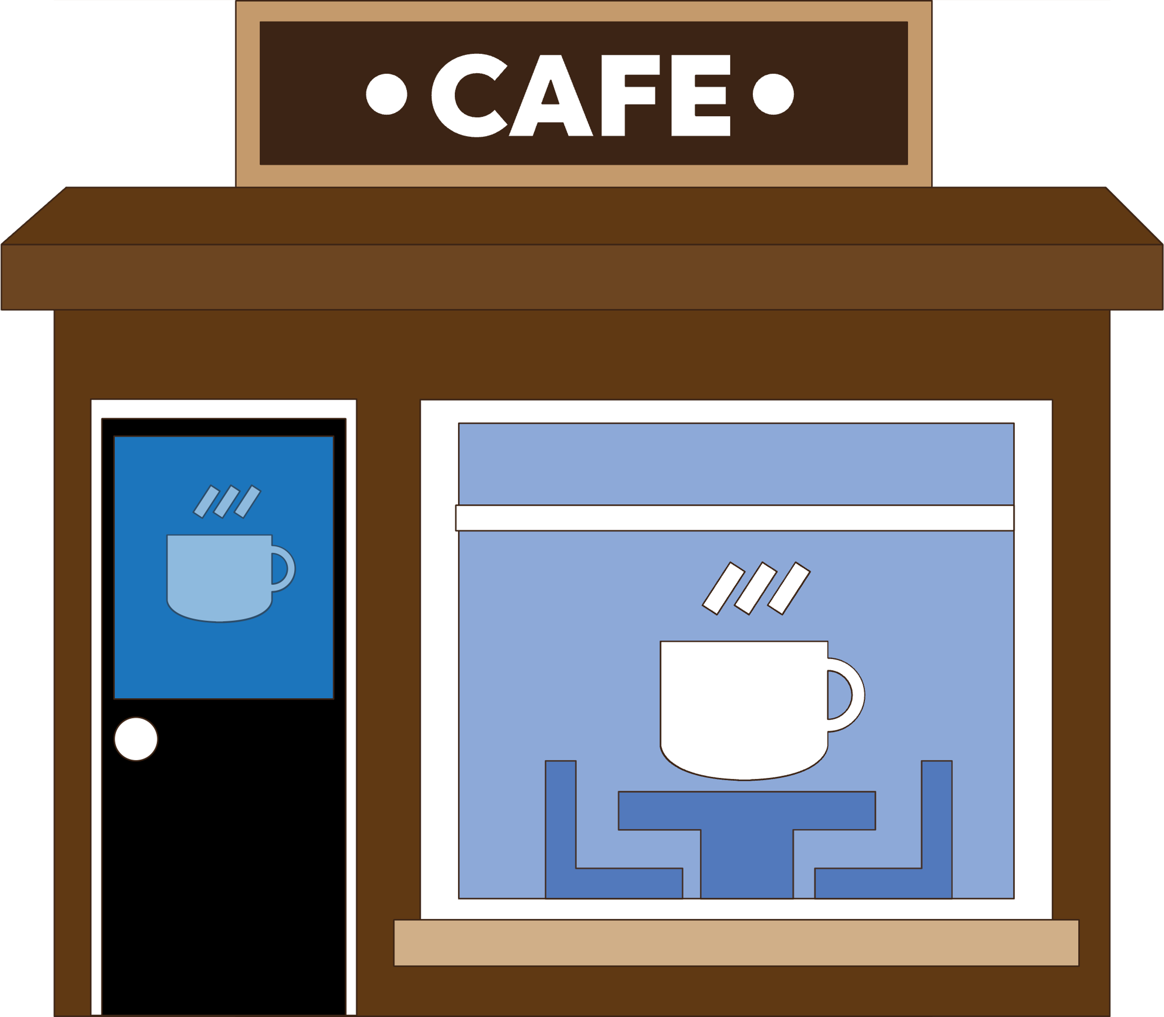

Answer the questions.
Do you like living in the city? Why?
What things don’t you like about the city?

Slide 13

UNIT 2: CITY LIFE
LESSON 1: GETTING STARTED

Slide 14

OBJECTIVES
By the end of the lesson, you will be able to:
gain an overview about the topic: City life.
Gain vocabulary to talk about life in the city.

Slide 15
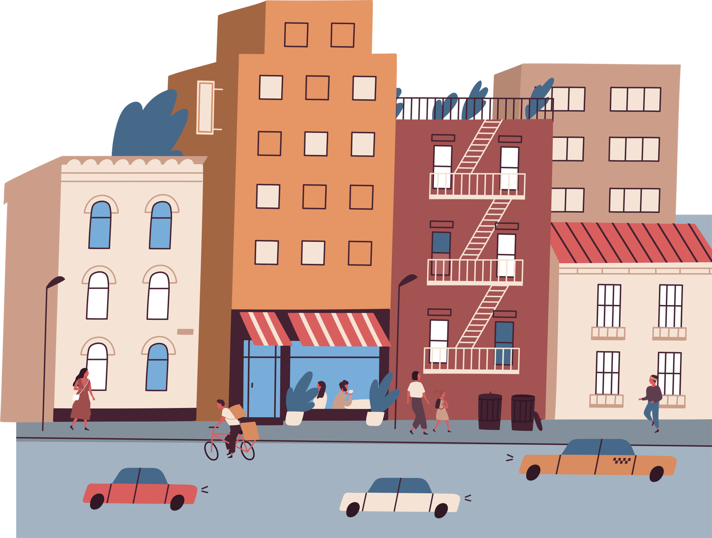

01
NEW WORDS

Slide 16
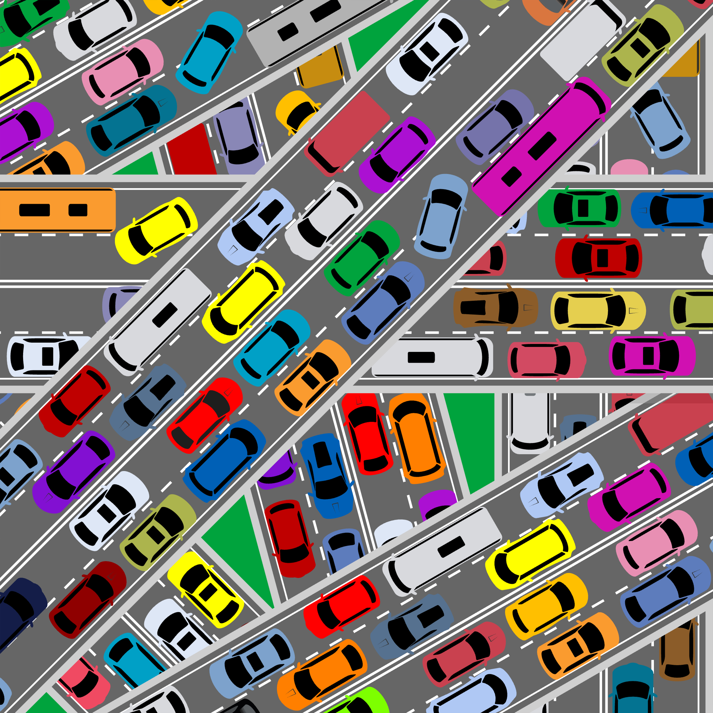

traffic congestion (n)
/ˈtræf.ɪk kənˈdʒes.tʃən/
tắc nghẽn giao thông, tắc đường
= traffic jam

Slide 17

construction site (n)
/kənˈstrʌk.ʃən saɪt/
công trường xây dựng

Slide 18
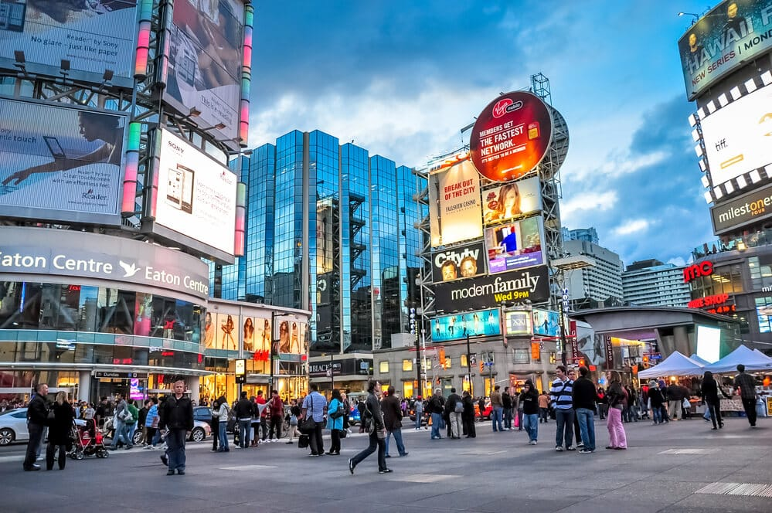
downtown (n)
/ˌdaʊnˈtaʊn/
khu trung tâm thành phố, thị trấn

Slide 19
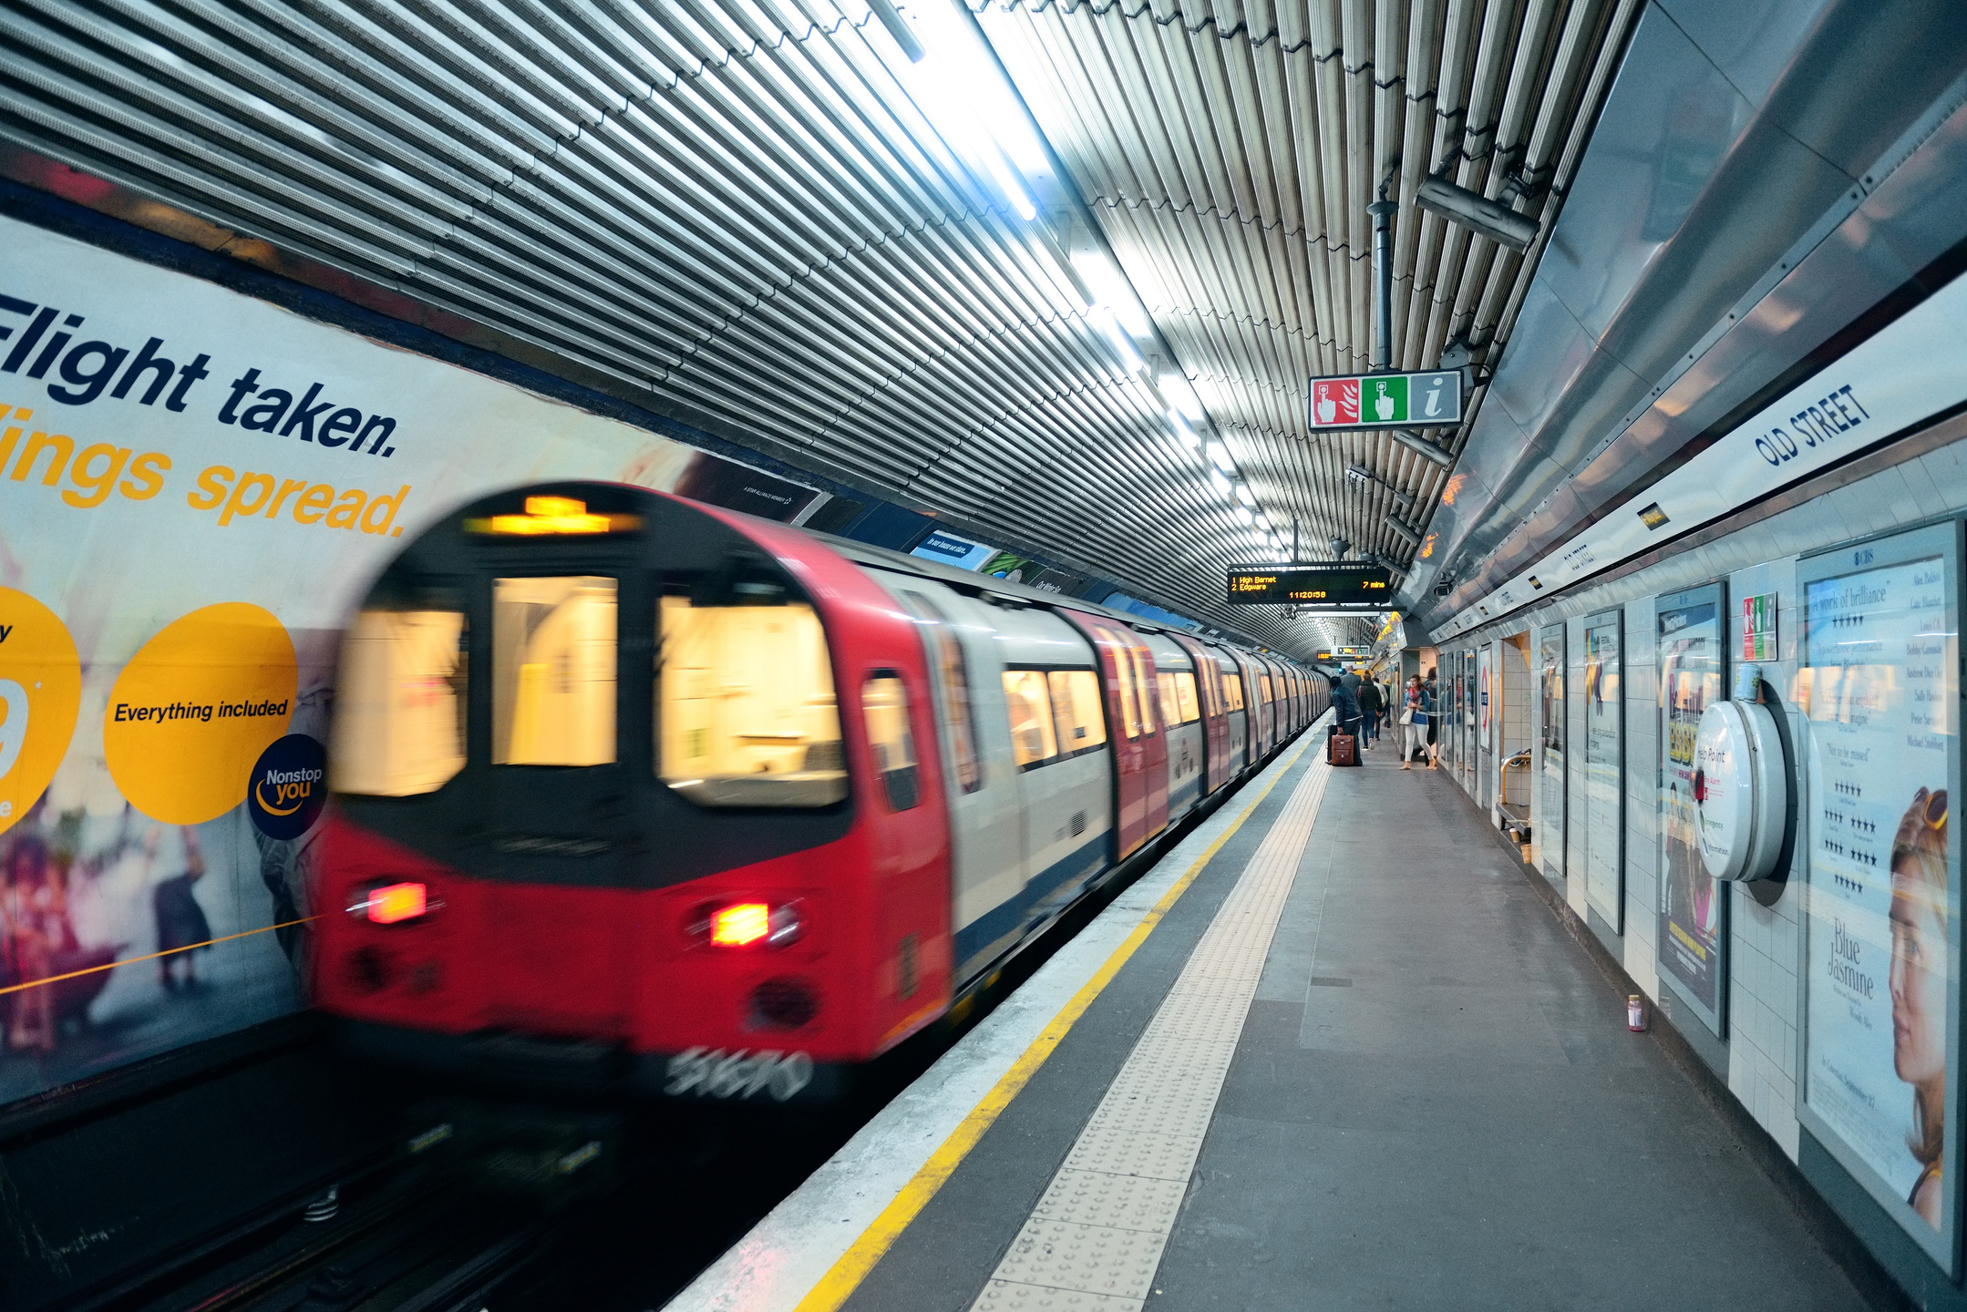
underground (n)
/ˈʌn.də.ɡraʊnd/
hệ thống tàu điện ngầm

Slide 20

rush hour (n)
/ˈrʌʃ ˌaʊər/
giờ tan tầm

Slide 21
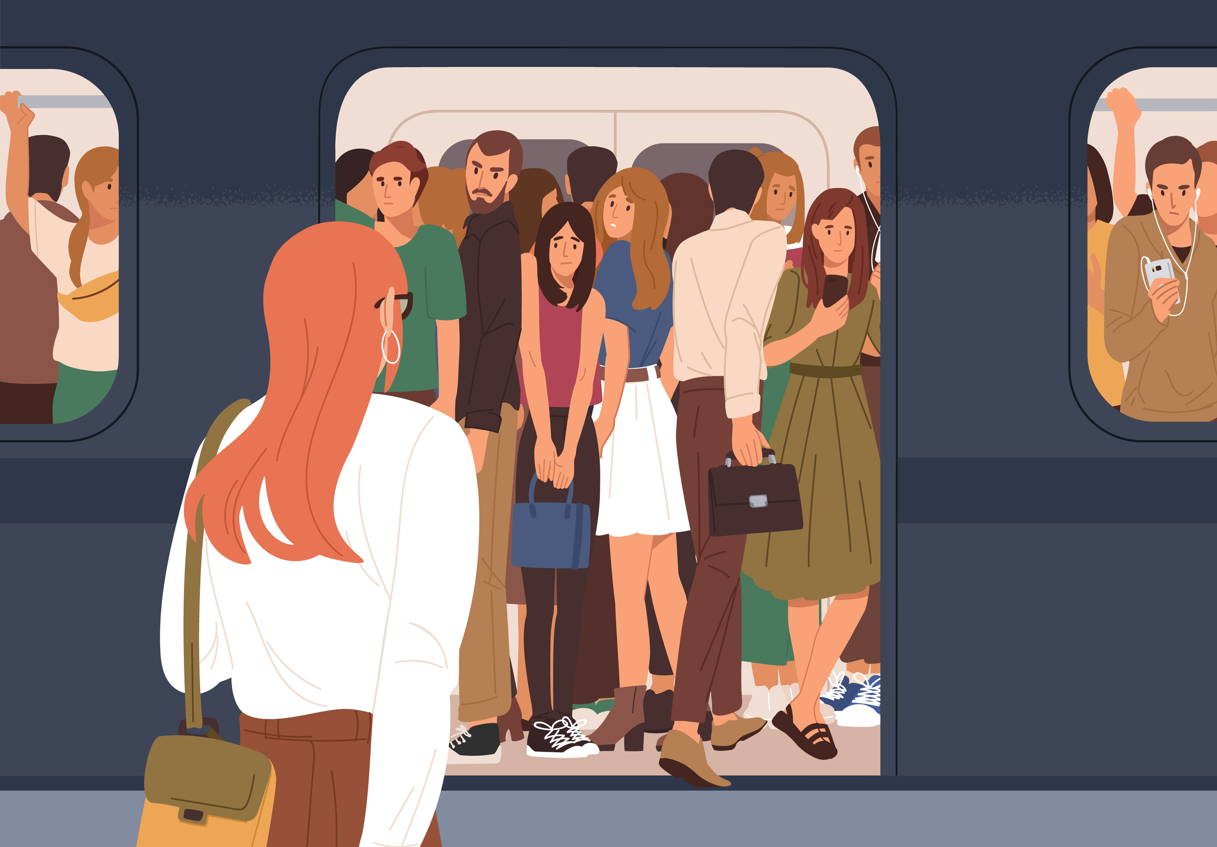
congested (adj)
/kənˈdʒes.tɪd/
tắc nghẽn, đông đúc
= crowded / packed

Slide 22
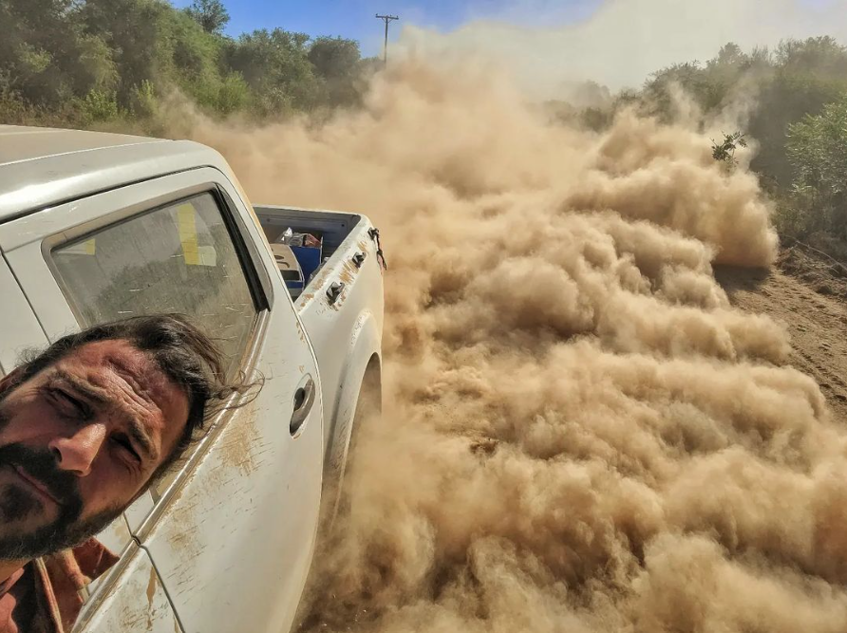
dusty (adj)
/ˈdʌs·ti/
bụi bặm

Slide 23
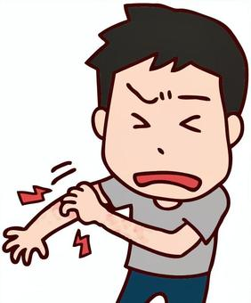
itchy (adj)
/ˈɪtʃ.i/
ngứa, gây ngứa

Slide 24
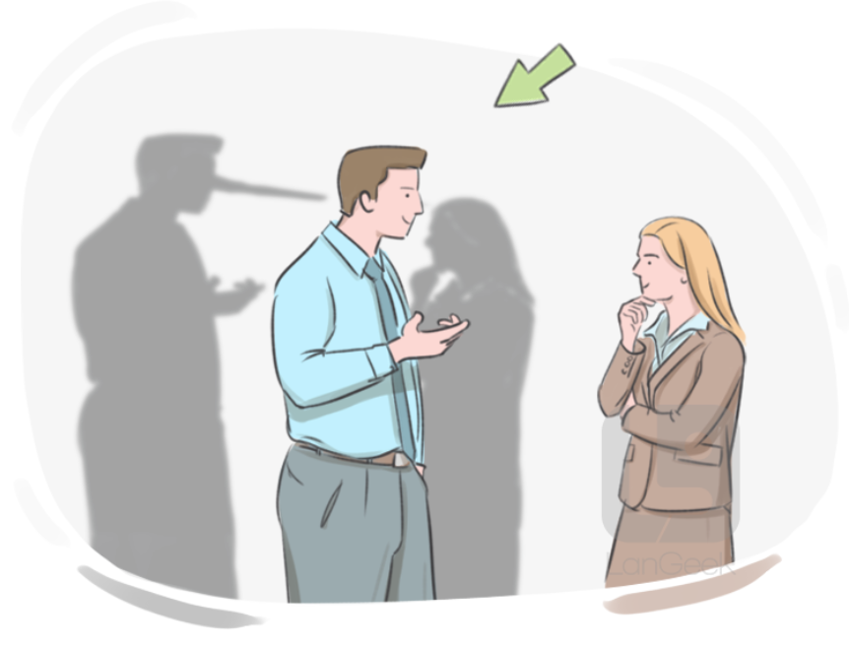
unreliable (adj)
/ˌʌn.rɪˈlaɪə.bəl/
không đáng tin
>< reliable

Slide 25
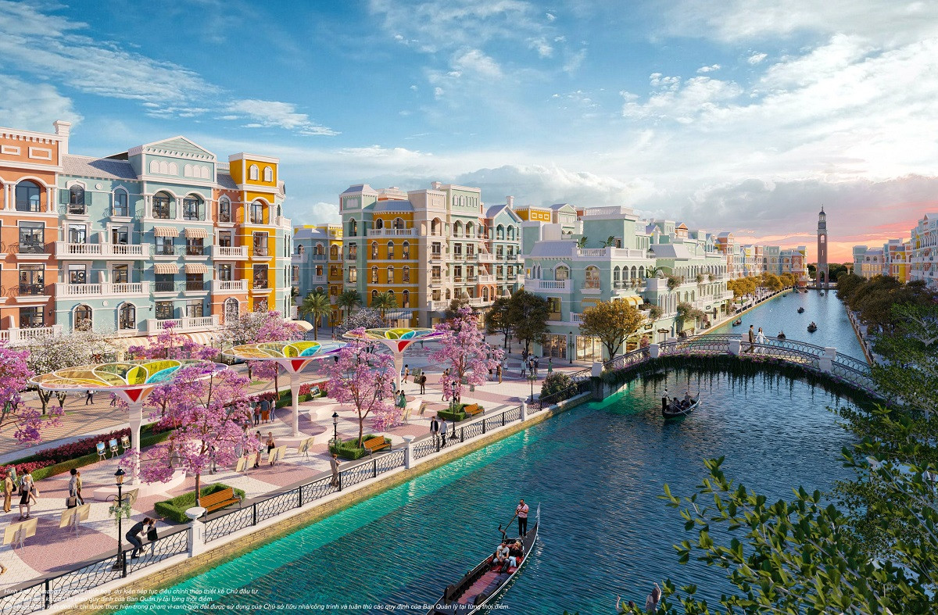
grand (adj)
/ɡrænd/
ấn tượng, hoành tráng, quan trọng
impressive and large or important

Slide 26
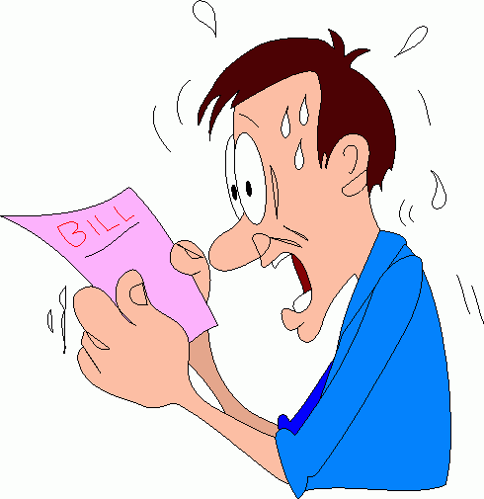
pricey (adj)
/ˈpraɪ.si/
đắt đỏ
= expensive

Slide 27
NEW WORDS
Words | Pronunciation | Meanings
traffic congestion (n) | /ˈtræf.ɪk kənˈdʒes.tʃən/ | tắc nghẽn giao thông
construction site (n) | /kənˈstrʌk.ʃən saɪt/ | công trường xây dựng
downtown (n) | /ˌdaʊnˈtaʊn/ | khu trung tâm thành phố, thị trấn
underground (n) | /ˈʌn.də.ɡraʊnd/ | hệ thống tàu điện ngầm
rush hour (n) | /ˈrʌʃ ˌaʊər/ | giờ tan tầm

Slide 28
NEW WORDS
Words | Pronunciation | Meanings
congested (adj) | /kənˈdʒes.tɪd/ | tắc nghẽn, đông đúc
dusty (adj) | /ˈdʌs·ti/ | bụi bặm
itchy (adj) | /ˈɪtʃ.i/ | ngứa, gây ngứa
unreliable (adj) | /ˌʌn.rɪˈlaɪə.bəl/ | không đáng tin
grand (adj) | /ɡrænd/ | ấn tượng, hoành tráng, quan trọng
pricey (adj) | /ˈpraɪ.si/ | đắt đỏ

Slide 29
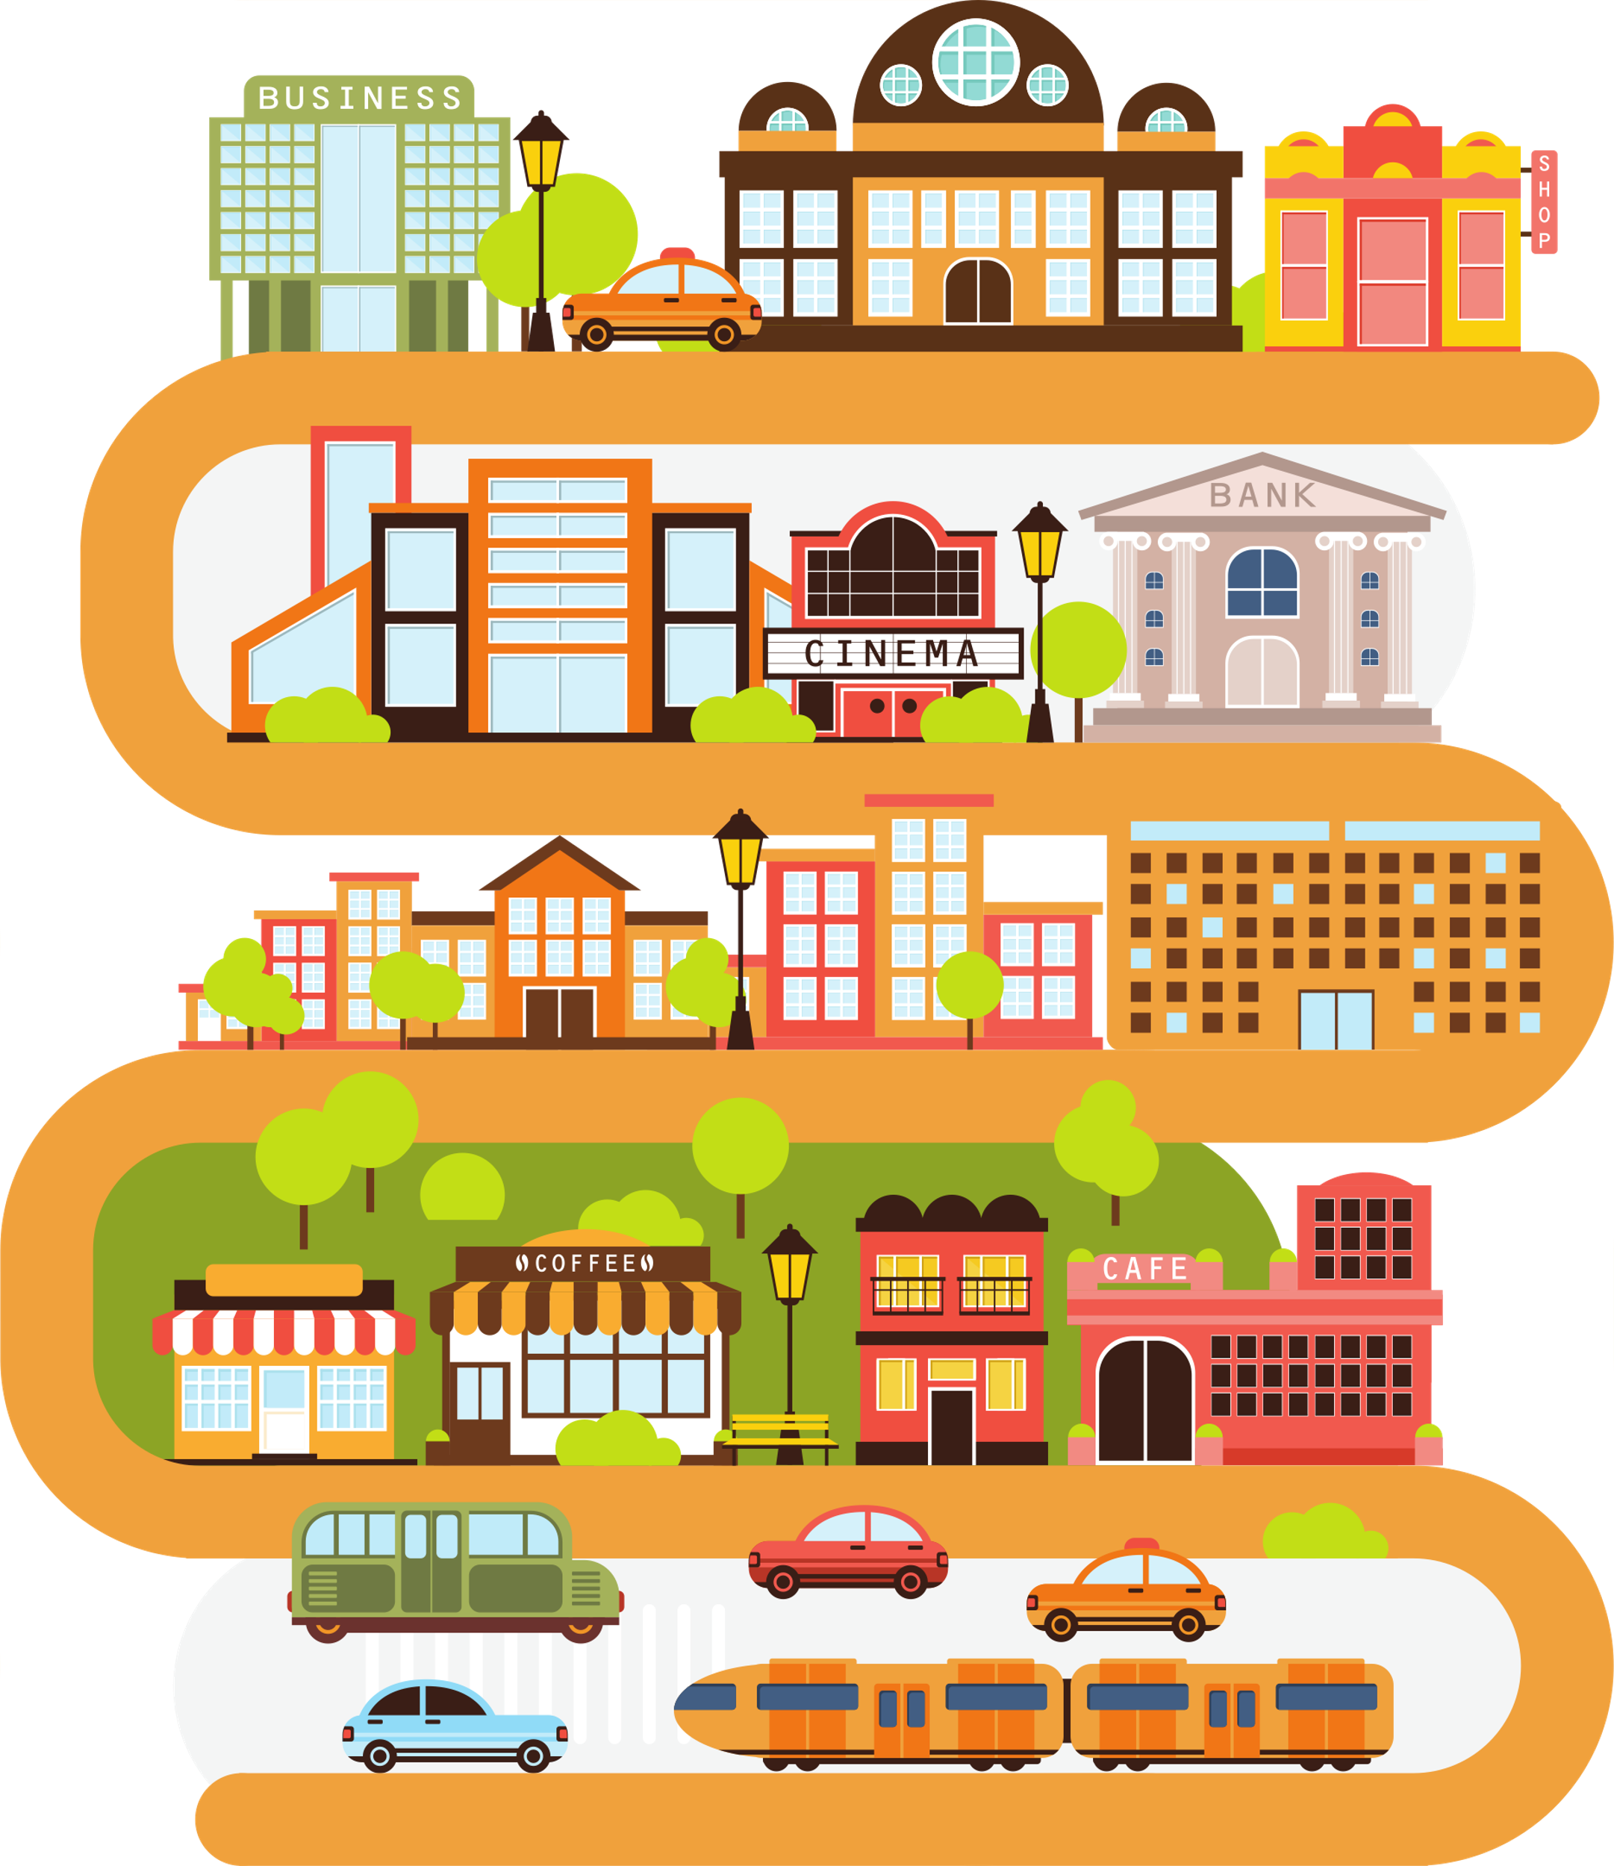
02
PRACTICE

Slide 30
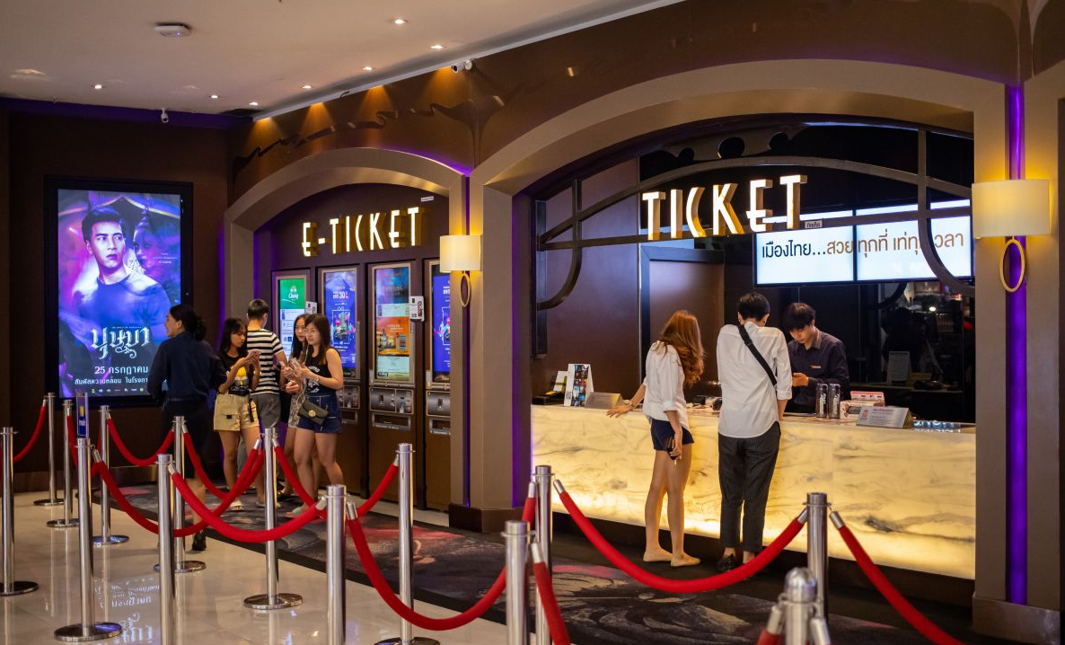
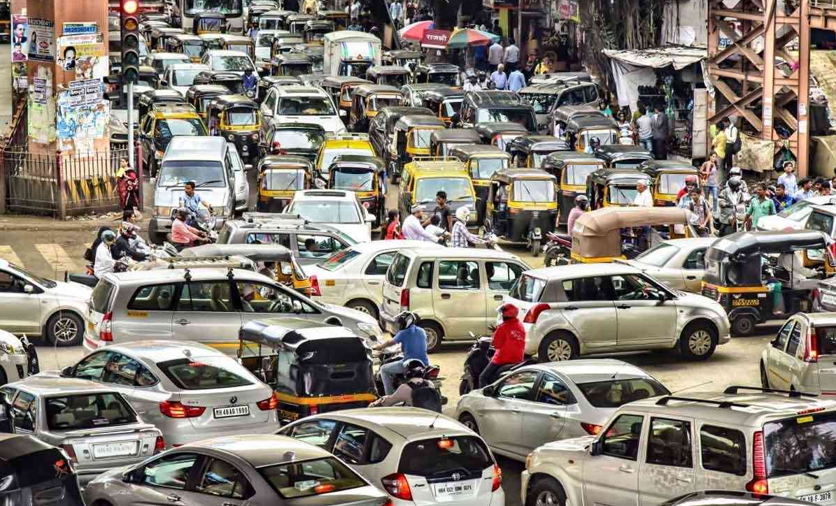
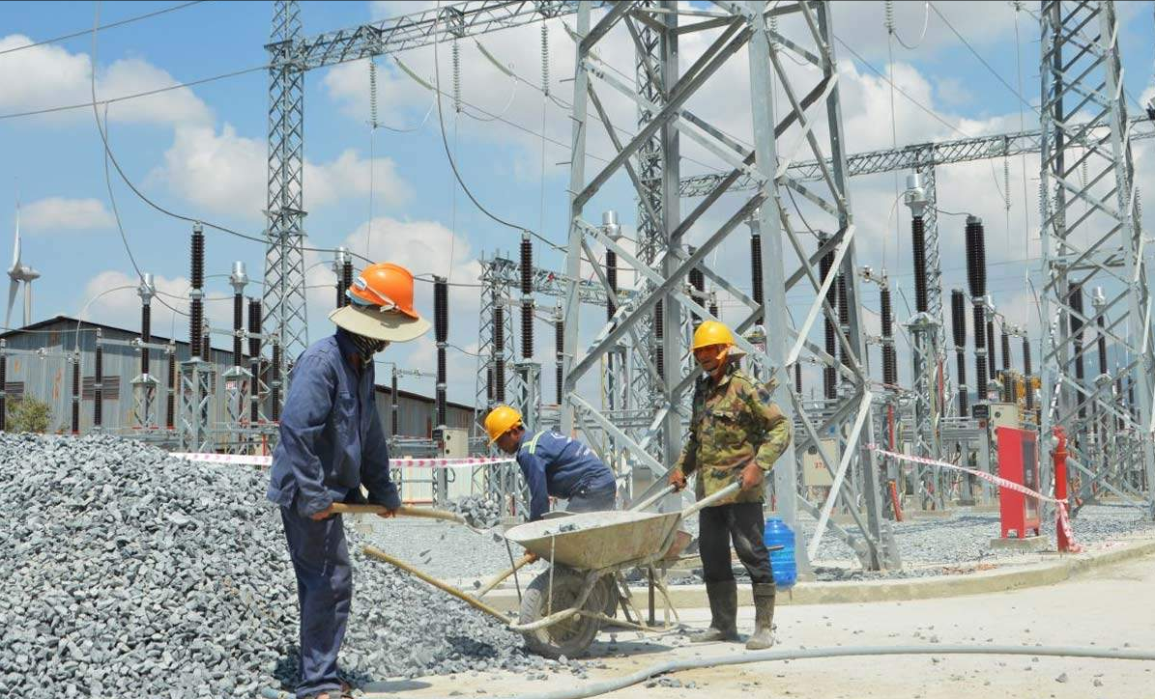
Look at the pictures
cinema
traffic jam
construction site
1. What do you see in each picture?
2. Are the things in the pictures common in your home town?

Slide 31
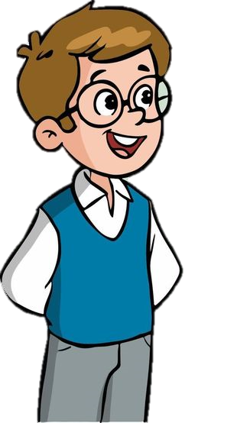

Listen to Ben and Trang. Answer.
…
…
What are they talking about?

Slide 32
Listen and read.
Trang: Hi, Ben. Sorry I couldn’t get online earlier. I got stuck in a traffic jam and came home late.
Ben: No problem, Trang. Did you go by bus?
Trang: No. My dad picked me up. I rarely use the bus. It’s slow and packed with people.
Ben: I mostly get around by underground. It’s more reliable than the bus.
Trang: That’s great.
Ben: But traffic congestion is terrible in London. You know, the more crowded the city gets, the more congested the streets are.
Trang: Yeah … and the more polluted they may become. There’s a construction site in my neighbourhood. It’s dusty, so people easily get itchy eyes.
Ben: It must be noisy, too. The noise probably makes people feel stressed sometimes.
Trang: That’s right. But new buildings make the city look modern and attractive. Do you remember the grand building downtown?
Ben: Of course. How’s it now? When I left Viet Nam, they nearly finished it.
Trang: Well, it’s now a shopping mall. Teens like it because it’s modern and fun.
Ben: Do you often go there?
Trang: Sometimes. I watch movies there with my sister. I want to go there more often, but it’s a bit pricey.
Ben: It’s expensive here in London, too …

Slide 33
Listen to Ben and Trang. Answer.
…
…
What are they talking about?
They are talking about how the city is (life in the city).

Slide 34
Ex 2. Read again and tick true (T) or false (F). (p.19)
Statements | TRUE | FALSE
1. The bus in Trang’s city is slow and crowded.
2. The underground system in Ben’s city is unreliable.
3. There is a dusty and noisy construction site near Trang’s house.
4. Trang thinks new buildings make the city look ugly.
5. Both Trang and Ben find shopping malls expensive.

Slide 35
Ex 2. Read again and tick true (T) or false (F).
Statements | TRUE | FALSE
1. The bus in Trang’s city is slow and crowded.

Trang: Hi, Ben. Sorry I couldn’t get online earlier. I got stuck in a traffic jam and came home late.
Ben: No problem, Trang. Did you go by bus?
Trang: No. My dad picked me up. I rarely use the bus. It’s slow and packed with people.
packed = crowded: đông đúc

Slide 36
Ex 2. Read again and tick true (T) or false (F).
Statements | TRUE | FALSE
2. The underground system in Ben’s city is unreliable.

→ The underground system in Ben’s city is reliable.
Ben: I mostly get around by underground. It’s more reliable than the bus.
Trang: That’s great.

Slide 37
Ex 2. Read again and tick true (T) or false (F).
Statements | TRUE | FALSE
3. There is a dusty and noisy construction site near Trang’s house.

Ben: But traffic congestion is terrible in London. You know, the more crowded the city gets, the more congested the streets are.
Trang: Yeah … and the more polluted they may become. There’s a construction site in my neighbourhood. It’s dusty, so people easily get itchy eyes.

Slide 38
Ex 2. Read again and tick true (T) or false (F).
Statements | TRUE | FALSE
4. Trang thinks new buildings make the city look ugly.

→ Trang thinks new buildings make the city look modern and attractive.
Trang: That’s right. But new buildings make the city look modern and attractive. Do you remember the grand building downtown?
Ben: Of course. How’s it now? When I left Viet Nam, they nearly finished it.

Slide 39
Ex 2. Read again and tick true (T) or false (F).
Statements | TRUE | FALSE
5. Both Trang and Ben find shopping malls expensive.

Trang: Well, it’s now a shopping mall. Teens like it because it’s modern and fun.
Ben: Do you often go there?
Trang: Sometimes. I watch movies there with my sister. I want to go there more often, but it’s a bit pricey.
Ben: It’s expensive here in London, too …

Slide 40
Ex 2. Read again and tick true (T) or false (F).
Statements | TRUE | FALSE
1. The bus in Trang’s city is slow and crowded.
2. The underground system in Ben’s city is unreliable.
3. There is a dusty and noisy construction site near Trang’s house.
4. Trang thinks new buildings make the city look ugly.
5. Both Trang and Ben find shopping malls expensive.






Slide 41
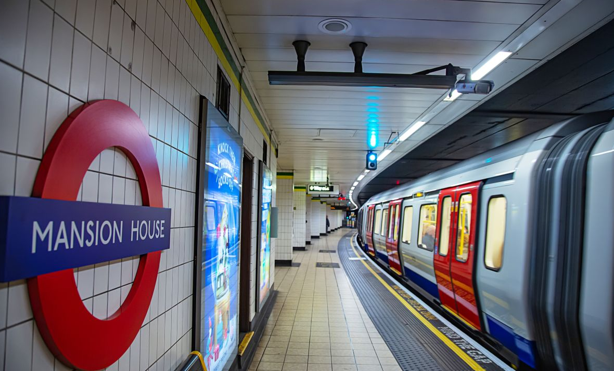
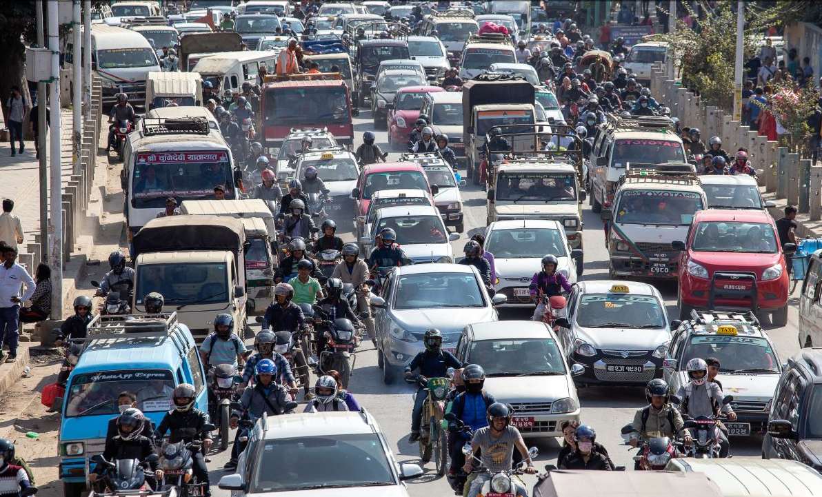
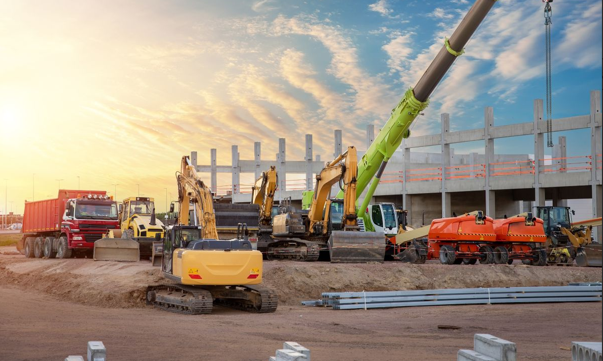
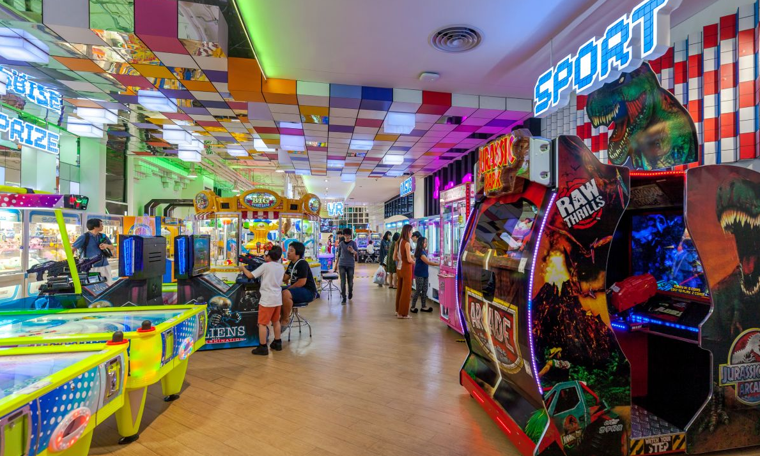
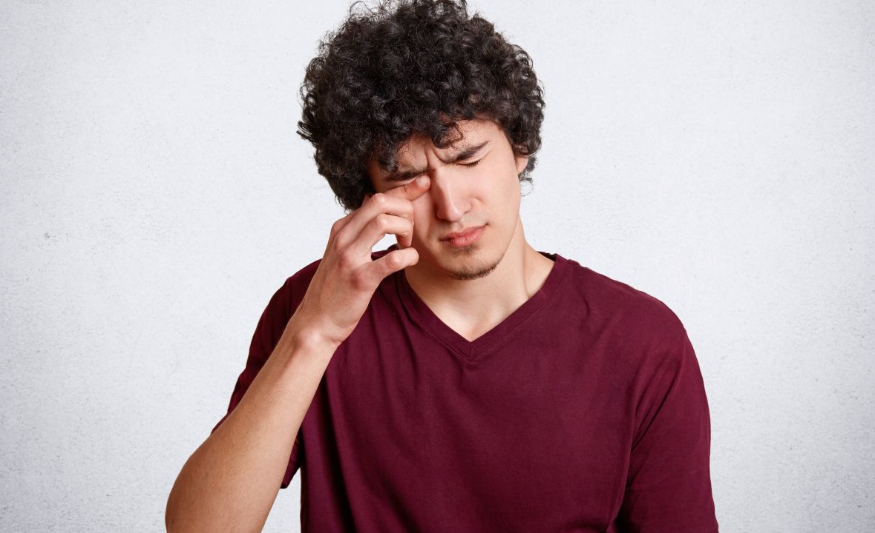
Ex 3. Match the words/ phrases with their correct picture. (p.19)
1. congested road
a
b
2. construction site
3. the underground
4. itchy eyes
3. the underground
1. congested road
5. entertainment centre
c
d
e
2. construction site
5. entertainment centre
4. itchy eyes

Slide 42
Ex 4. Choose the correct answer A, B, C, or D. (p.19)
1. I like getting around by ____, I hate the smell of car exhaust.
A. underground B. private car
C. taxi D. bus
4. The road is narrow, so ____ often occurs at rush hour.
A. traffic light B. traffic flow
C. traffic congestion D. traffic safely
2. Road dust may badly affect our ____.
A. stomach B. back
C. eyes D. leg
5. Many teens fancy spending their weekends in an entertainment ____.
A. industry B. value
C. business D. centre
3. There’s a ____ in my neighbourhood.
It’s noisy and dusty.
A. building B. construction site
C. hospital D. lake

Slide 43
Ex 4. Choose the correct answer A, B, C, or D. (p.19)
1. I like getting around by ____, I hate the smell of car exhaust.
A. underground B. private car
C. taxi D. bus
car exhaust: khí thải xe ô tô
2. Road dust may badly affect our ____.
A. stomach B. back
C. eyes D. leg
affect (v): ảnh hưởng
3. There’s a ____ in my neighbourhood. It’s noisy and dusty.
A. building B. construction site
C. hospital D. lake

Slide 44
Ex 4. Choose the correct answer A, B, C, or D. (p.19)
4. The road is narrow, so ____ often occurs at rush hour.
A. traffic light B. traffic flow
C. traffic congestion D. traffic safely
occur (v): xảy ra
5. Many teens fancy spending their weekends in an entertainment ____.
A. industry B. value
C. business D. centre

Slide 45
Ex 4. Choose the correct answer A, B, C, or D. (p.19)
1. I like getting around by ____, I hate the smell of car exhaust.
A. underground B. private car
C. taxi D. bus
4. The road is narrow, so ____ often occurs at rush hour.
A. traffic light B. traffic flow
C. traffic congestion D. traffic safely
2. Road dust may badly affect our ____.
A. stomach B. back
C. eyes D. leg
5. Many teens fancy spending their weekends in an entertainment ____.
A. industry B. value
C. business D. centre
3. There’s a ____ in my neighbourhood.
It’s noisy and dusty.
A. building B. construction site
C. hospital D. lake

Slide 46
QUIZ: A LIFESTYLE SURVEY
City life or village life?

Slide 47
Ex 5. Quiz: A lifestyle survey. City life or village life.
Complete the quiz.
1. What kind of house do you want to live in?
A. A small and modern apartment.
B. A house with a garden
4. How do you describe your favourite neighbourhood?
A. Crowded and busy.
B. Quiet and green.
2. How do you like to get around?
A. By public transport.
B. By motorbike or bicycle.
5. How do you like to spend time outdoors?
A. Going for a walk or running in the park.
B. Doing gardening or visiting next- door neighbours.
3. Where do you frequently enjoy visiting?
A. Shops, restaurants, cinemas, and art galleries.
B. Local farmers’ markets.

Slide 48
COMPARE YOUR CHOICE WITH YOUR FRIENDS
I choose lots of A.
You will fit in the city.
If you choose…
A
The city life is better for you.
B
The village life is better for you.

Slide 49
Can you add more things about life in the city and in the village?

Slide 50
Talk about the differences between life in the city and in the countryside.

Slide 51
WRAP-UP
What have you learnt today?
It's best to avoid driving downtown during _____ because the traffic congestion can add an extra hour to your journey.
A. rush hour B. traffic light C. construction
1
2
Tick  the words describing life in the city.


packed
dusty
peaceful


green
pricey
modern

Slide 52

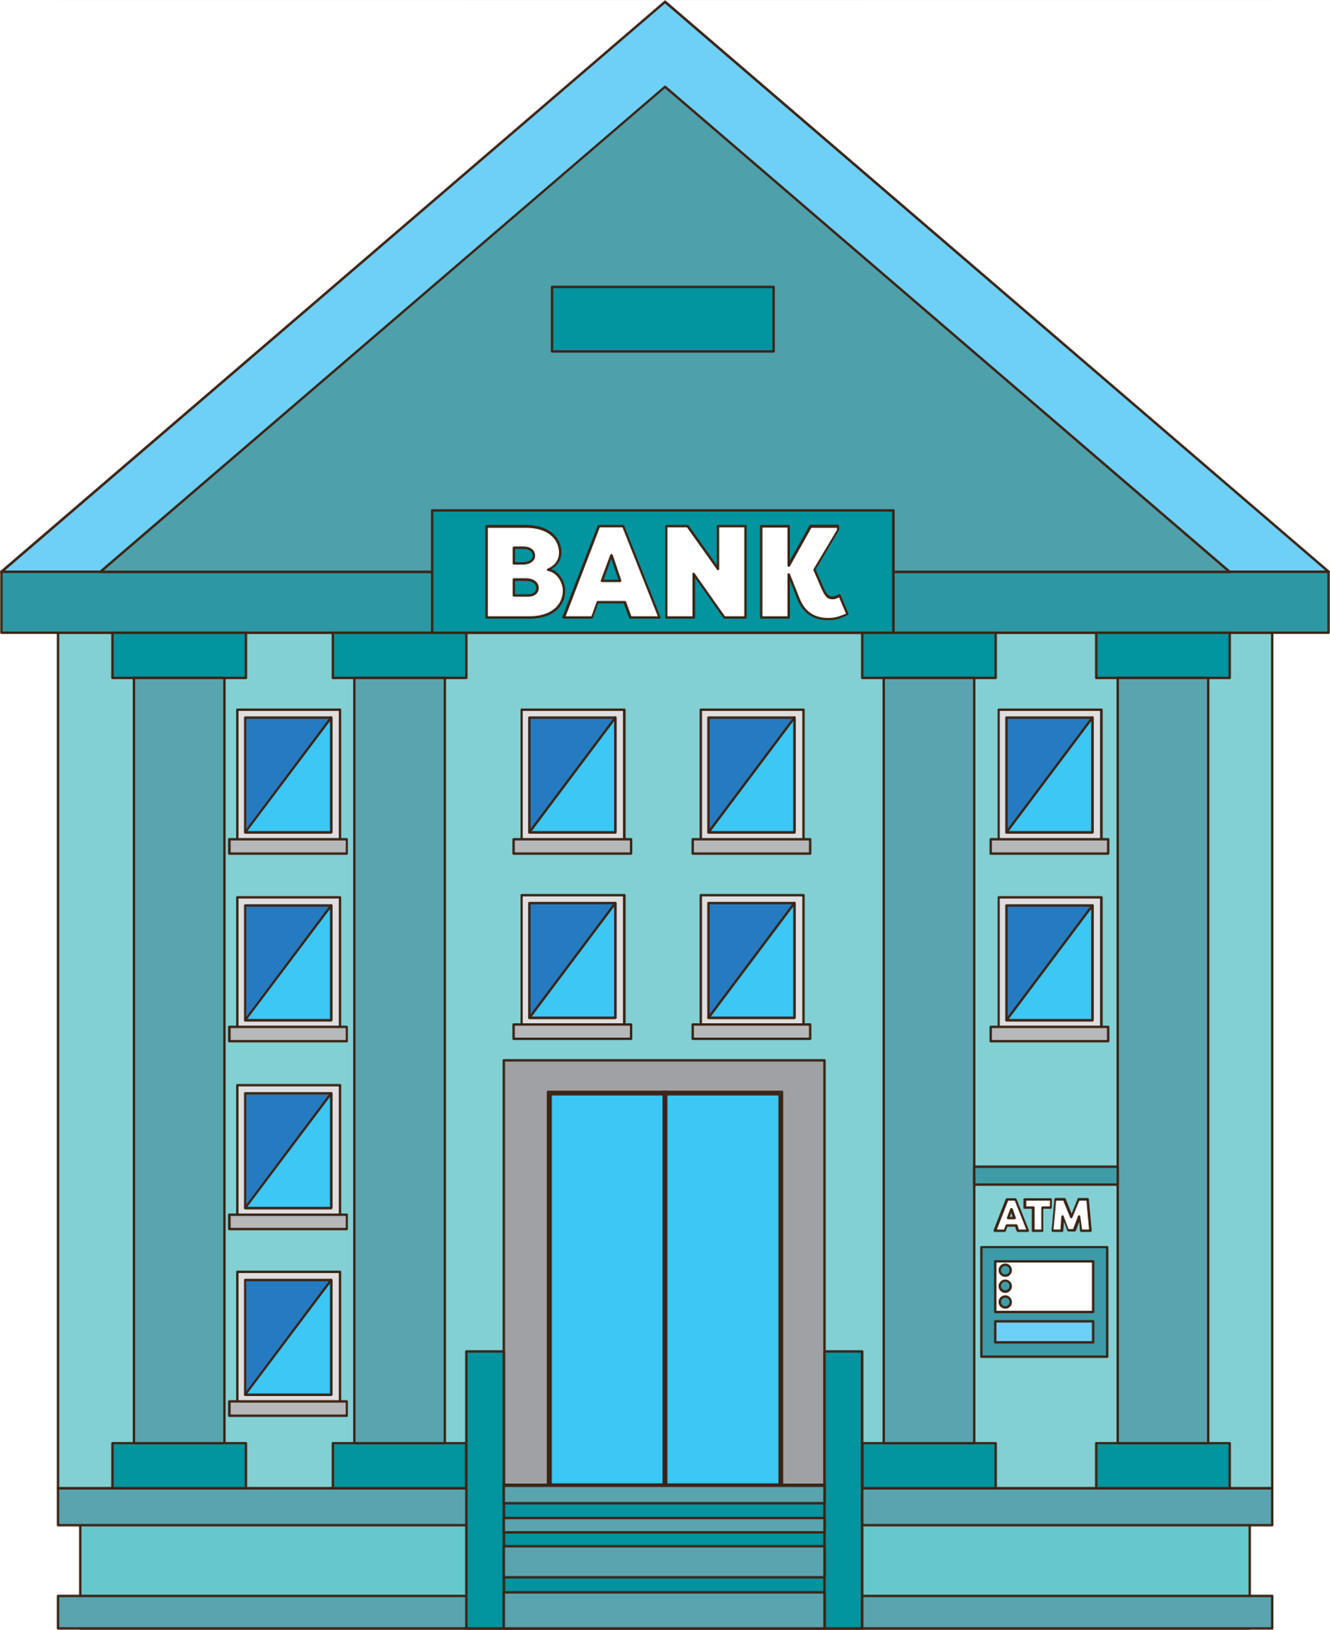
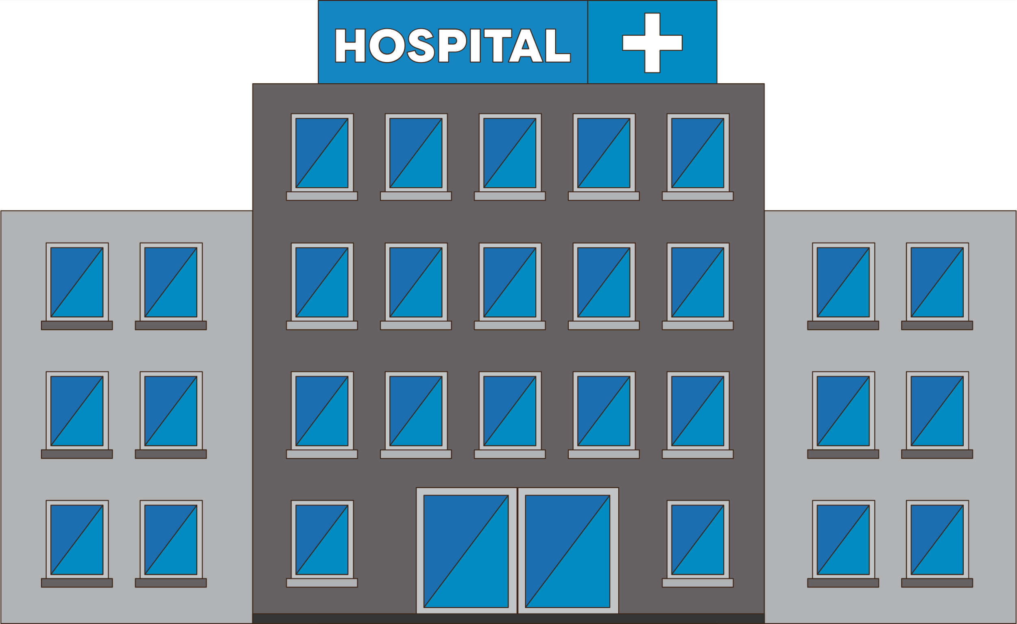
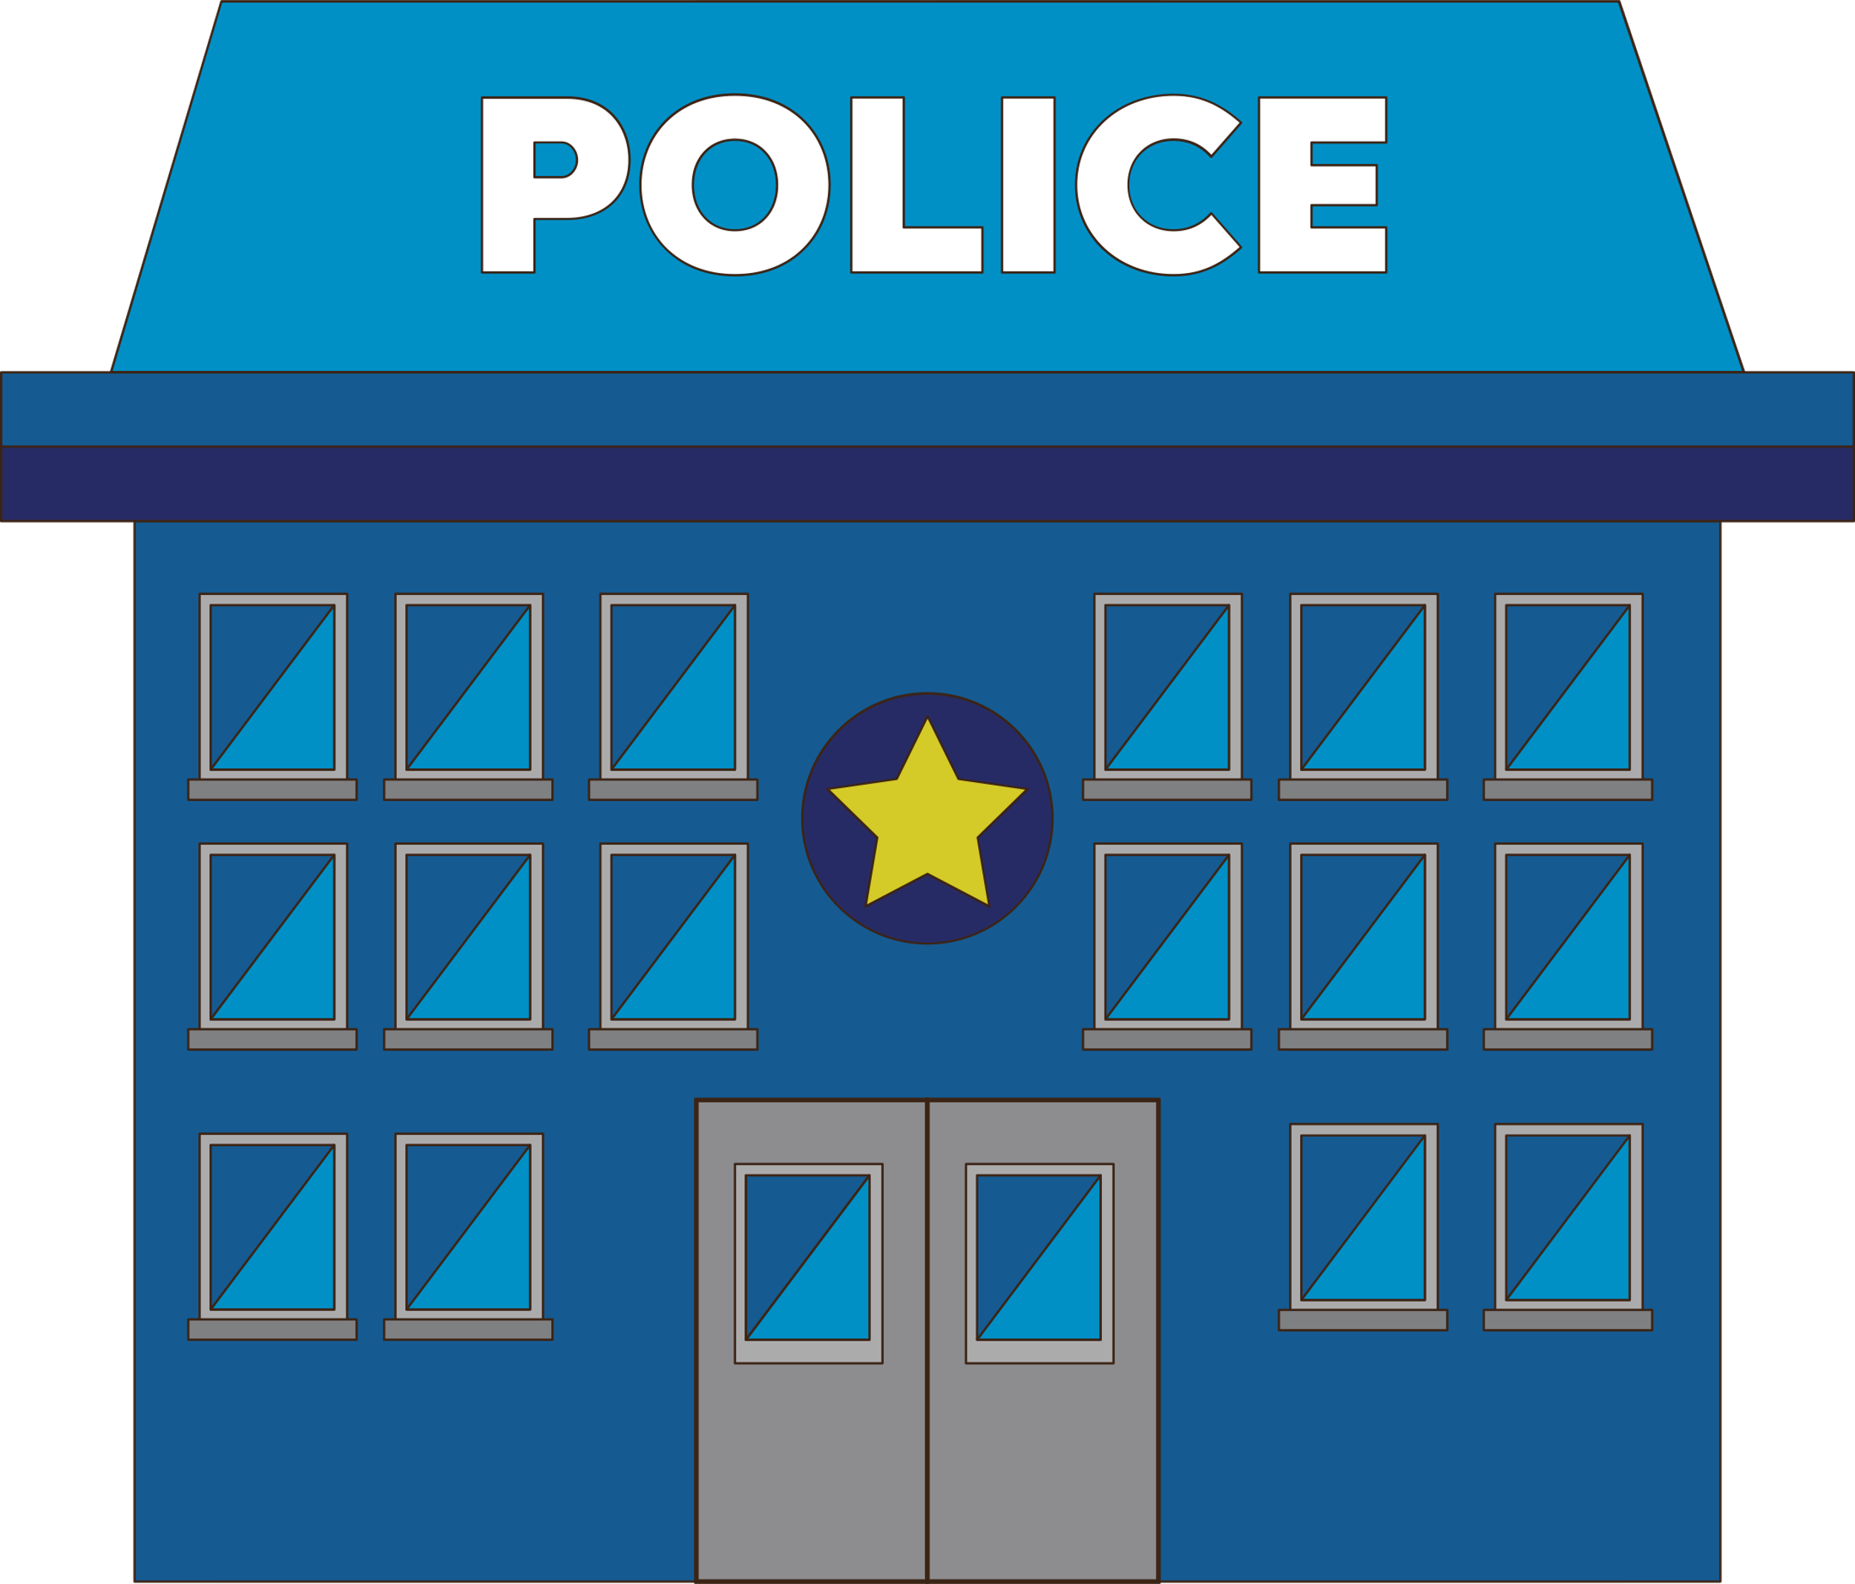

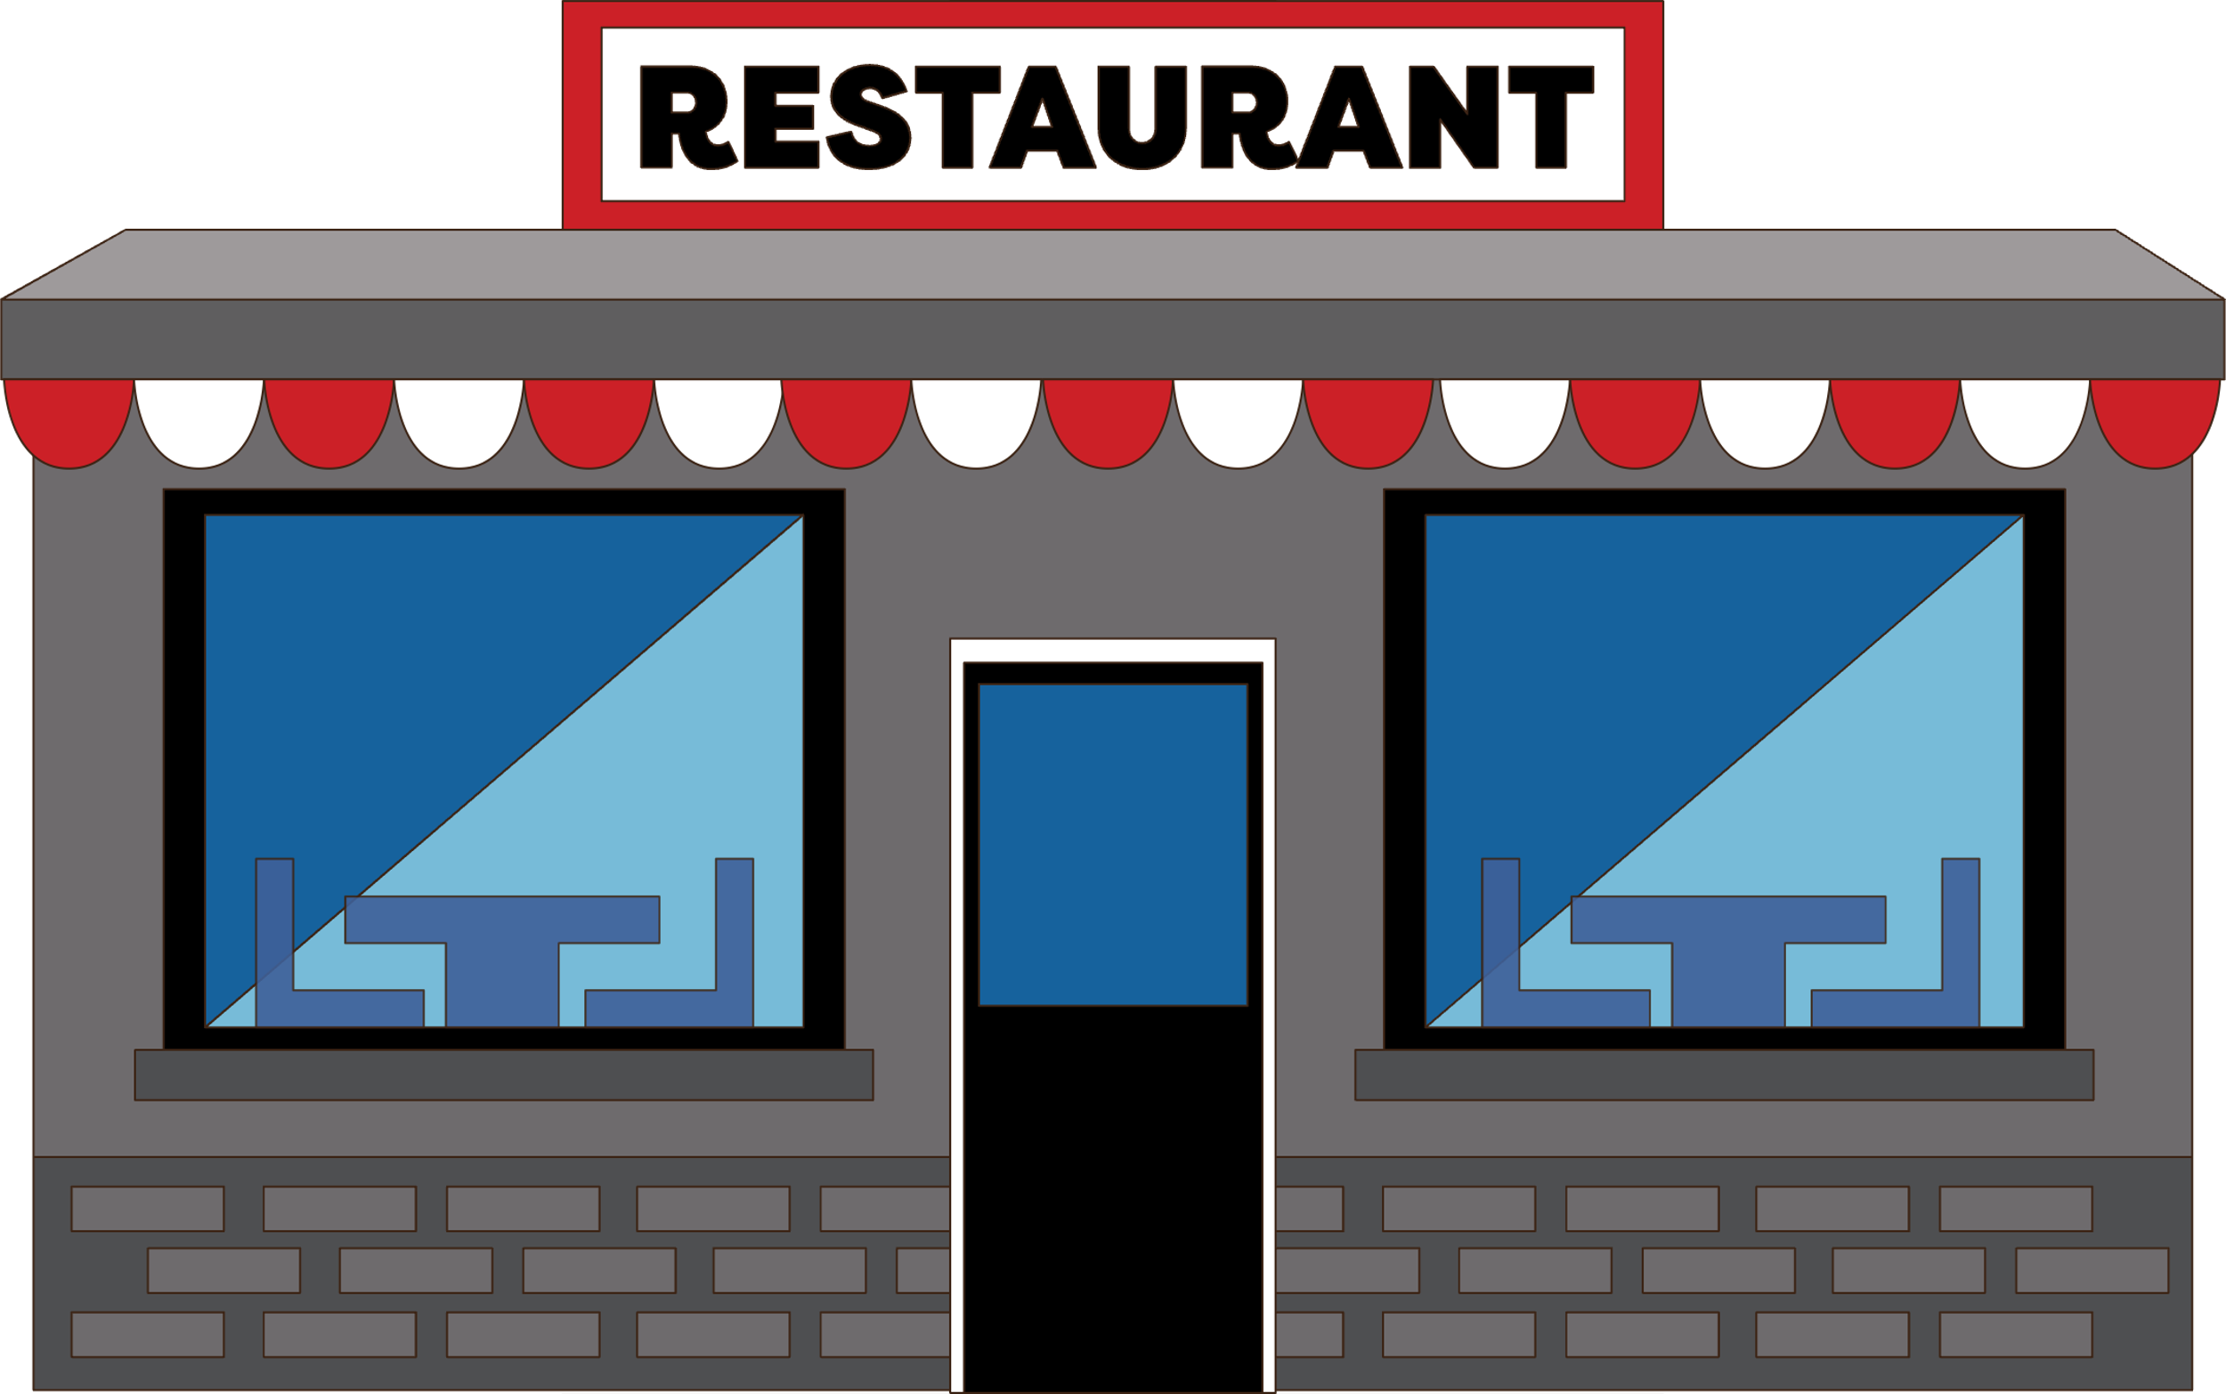
Thanks!
Do you have any questions?

