Slide 1

Good morning class!!!

Slide 2

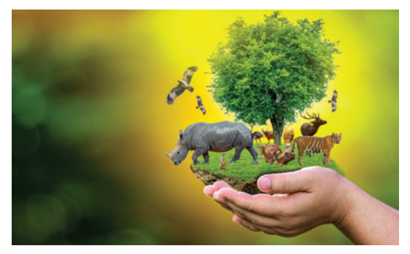
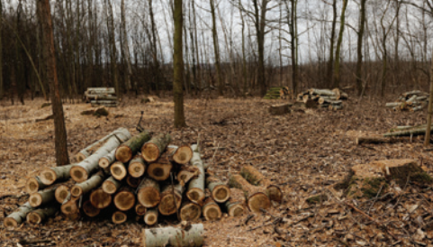
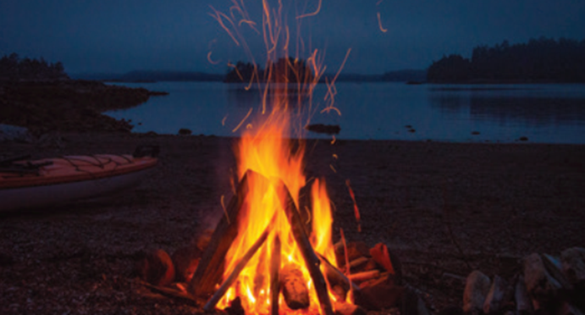
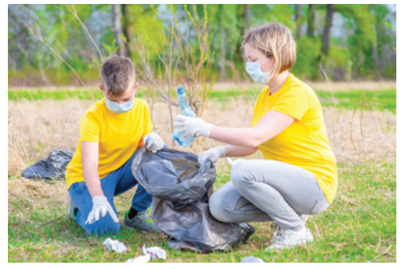
* WARM UP: PELMANISM
1
2
3
4
5
picking up rubbish
protecting endangered species
cutting down trees
saving
water
building a campfire
E
B
C
D
A
1
2
3
4
5

Slide 3

* Tick the actions that protect the environment.
saving
water
protecting endangered species
cutting down trees
building a campfire
picking up rubbish

Slide 4

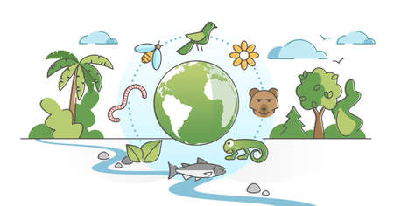
Unit
7
ENVIRONMENTAL PROTECTION
LESSON 2: A CLOSER LOOK 1

Slide 5

* VOCABULARY
- ecosystem (n):
hệ sinh thái
/ˈiːkəʊsɪstəm/

Slide 6
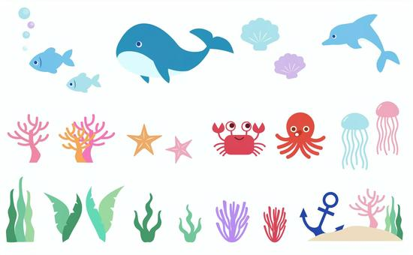
* VOCABULARY
- marine life (n):
sinh vật biển
/məˈriːn laɪf/

Slide 7
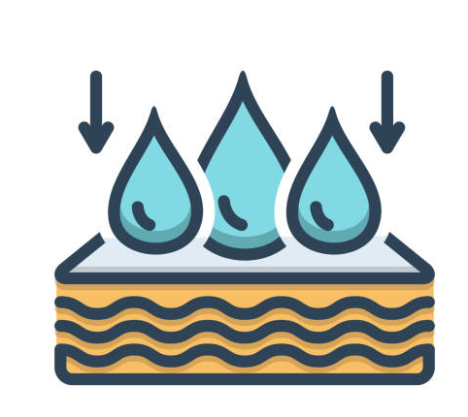
* VOCABULARY
- absorb (v):
hấp thụ
/əbˈzɔːb/

Slide 8
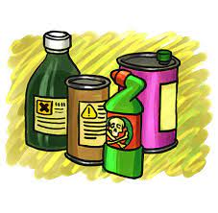
* VOCABULARY
- harmful substance (n):
Chất độc hại, tác nhân gây hại
/ˈhɑːmfl ˈsʌbstəns/

Slide 9

* VOCABULARY
extinction (n):
sự tuyệt chủng
/ ɪkˈstɪŋkʃn/

Slide 10
* VOCABULARY
New words | Pronunciation | Meaning
1. ecosystem (n) | /ˈiːkəʊsɪstəm/ | hệ sinh thái
2. marine life (n) | /məˈriːn laɪf/ | sinh vật biển
3. absorb (v) | /əbzɔːʳb/ | thẩm thấu
4. harmful substance (n) | /ˈhɑːmfl ˈsʌbstəns/ | Chất gây hại
5. extinction (n) | /ɪkˈstɪŋkʃn/ | sự tuyệt chủng

Slide 11
* Checking Vocabulary
New words | Meaning
1. | hệ sinh thái
2. | sinh vật biển
3. | thẩm thấu
4. | Chất gây hại
5. | sự tuyệt chủng
ecosystem (n)
marine life (n)
absorb (v)
harmful substance (n)
extinction (n)

Slide 12
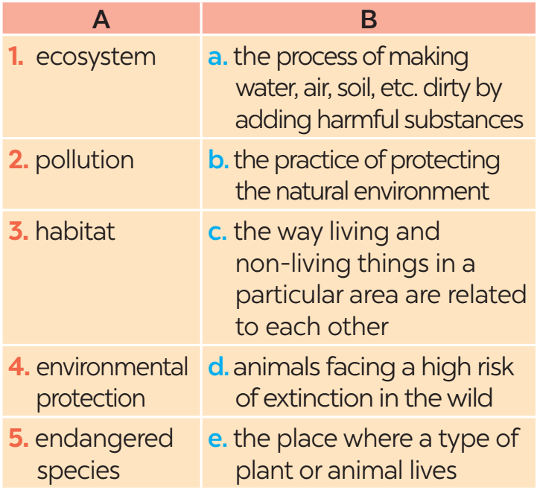
* PRACTICE
2
Match each word or phrase in column A with its meaning in column B.

Slide 13
3
Complete each sentence with a word or phrase from the box
habitat cutting down trees ecosystem endangered species carbon dioxide
1. People in my neighbourhood are doing a lot to save ______________.
2. Con Dao National Park provides a rich _______ for marine life.
3. Forests help release oxygen and absorb _____________; they also provide homes for many species.
4. ________________ is a serious environmental concern as it harms natural habitats.
5. An ________ may be a whole forest, or a small pond, and it can be of any size.
Game:

Slide 14


Game: Lucky numbers
1
2
3
4
5
6
7
8
GA
GB
GA
2
4
6
8
10
12
14
GB
2
4
6
8
10
12
14

Slide 15
3
Complete each sentence with a word or phrase from the box.
habitat cutting down trees ecosystem endangered species carbon dioxide
1. People in my neighbourhood are doing a lot to save _________________.
endangered species

Slide 16
3
Complete each sentence with a word or phrase from the box.
habitat cutting down trees ecosystem endangered species carbon dioxide
habitat
2. Con Dao National Park provides a rich _______ for marine life.

Slide 17
3
Complete each sentence with a word or phrase from the box.
habitat cutting down trees ecosystem endangered species carbon dioxide
3. Forests help release oxygen and absorb _____________; they also provide homes for many species.
carbon dioxide

Slide 18
3
Complete each sentence with a word or phrase from the box.
habitat cutting down trees ecosystem endangered species carbon dioxide
Cutting down trees
4. ________________ is a serious environmental concern as it harms natural habitats.

Slide 19
3
Complete each sentence with a word or phrase from the box.
habitat cutting down trees ecosystem endangered species carbon dioxide
5. An _________ may be a whole forest, or a small pond, and it can be of any size.
ecosystem

Slide 20


LUCKY NUMBER!

Slide 21
LUCKY NUMBER!

Slide 22

UNLUCKY NUMBER

Slide 23
3
Complete each sentence with a word or phrase from the box
habitat cutting down trees ecosystem endangered species carbon dioxide
endangered species
1. People in my neighbourhood are doing a lot to save ______________.
2. Con Dao National Park provides a rich _______ for marine life.
3. Forests help release oxygen and absorb _____________; they also provide homes for many species.
4. _______________ is a serious environmental concern as it harms natural habitats.
5. An _________ may be a whole forest, or a small pond, and it can be of any size.
habitat
carbon dioxide
Cutting down trees
ecosystem

Slide 24

*PRONUNCIATION
How to pronounce words that contain the sounds: /bl/ and /kl/.
4

Slide 25
*PRONUNCIATION
4
Listen and repeat the words. Pay attention to the sounds /bl/ and /kl/.
/bl/ | /kl/
block blast blanket black problem | clean clown club class clear

Slide 26
*PRONUNCIATION
5
Listen and practise the sentences. Underline the words with /bl/, and circle the words with /kl/.
1. Look! There are black clouds all over!
2. A truck blocked the way to the club.
3. The students painted the classroom blue.
4. The wind blew the clock down.
5. We cleaned up the environment after the blast.

Slide 27

* CONSOLIDATION
1
What have we learnt in this lesson?
Vocabulary: The lexical items related to Environmental Protection
Pronunciation: Correctly pronounce words that contain the sounds: /bl/ and /kl/

Slide 28

* Homework
Do exercise in the workbook.
Prepair lesson 3 – A closer look 2

Slide 29


Thank you!
Goodbye!

Slide 30

WARM-UP
AHTTABI
PLTINOOLU
XEOGYN
EEERLAS
BBSOAR
MECYSSOET
-> HABITAT
-> POLLUTION
-> OXYGEN
-> RELEASE
-> ABSORB
-> ECOSYSTEM
JUMBLED

Slide 31
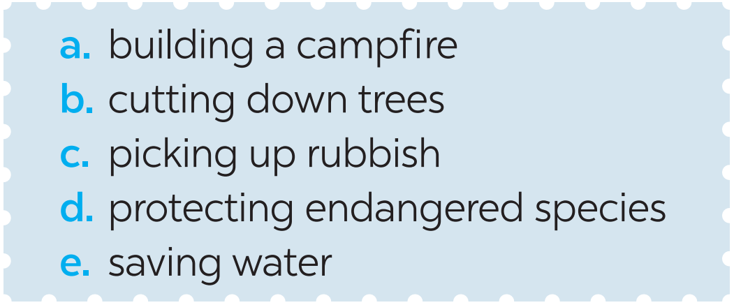
* Warm –up
Game: Pelmanism
1
Label each picture with a phrase from the list.
1. ____________
2. ____________________
picking up rubbish
protecting endangered species

Slide 32
PRACTICE
1
Label each picture with a phrase from the list.
3. ______________
4. ____________
cutting down trees
saving water

Slide 33

PRACTICE
1
Label each picture with a phrase from the list.
5. ________________
building a campfire

