Slide 1
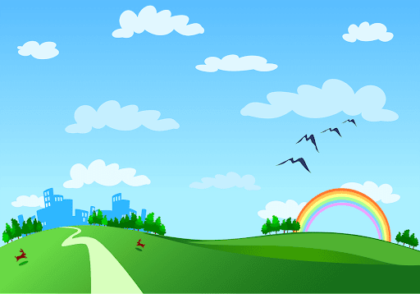
Good morning class!!!

Slide 2
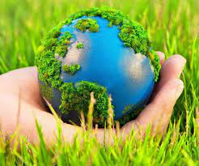
* Warm up
Keyword ( 21 letters)
Protect the nvironment
1
2
3
4

Slide 3

recycle
1. We should reuse and …………..things

Slide 4
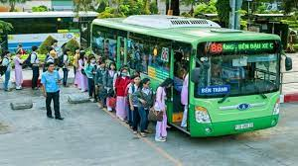
public
2. We should use ………transport to reduce air pollution

Slide 5
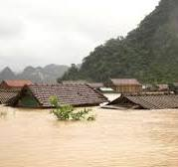
3. If we cut down trees in the forest, there will be more………...
floods

Slide 6

plant
4. We can ………… more trees in our neighbourhood.

Slide 7

Unit
7
ENVIRONMENTAL PROTECTION
LESSON 1: GETTING STARTED

Slide 8

* Vocabulary
- environmental protection:
bảo vệ môi trường
/ɪnˌvaɪərənˈmɛntl prəˈtɛkʃən/

Slide 9
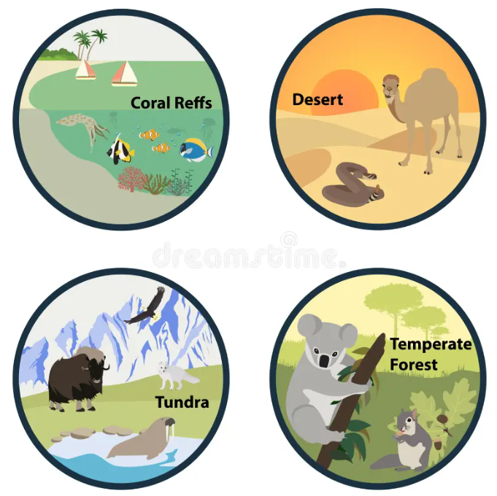

* Vocabulary
habitat (n):
môi trường sống
/ˈhæbɪtæt/

Slide 10
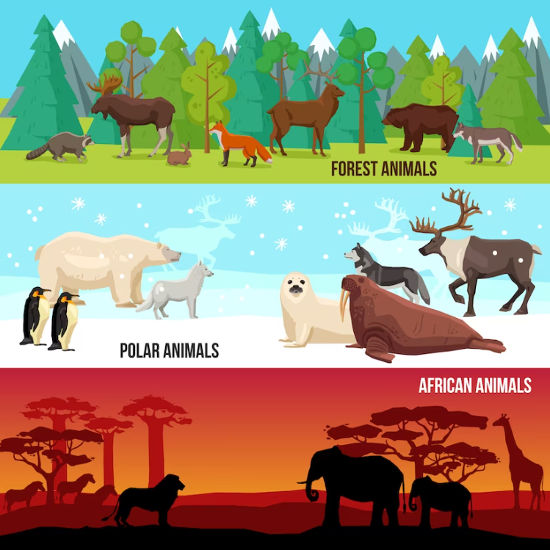
* Vocabulary
endangered species (n):
động vật sách đỏ
/ɪnˈdeɪndʒəd ˈspiːʃiːz/

Slide 11
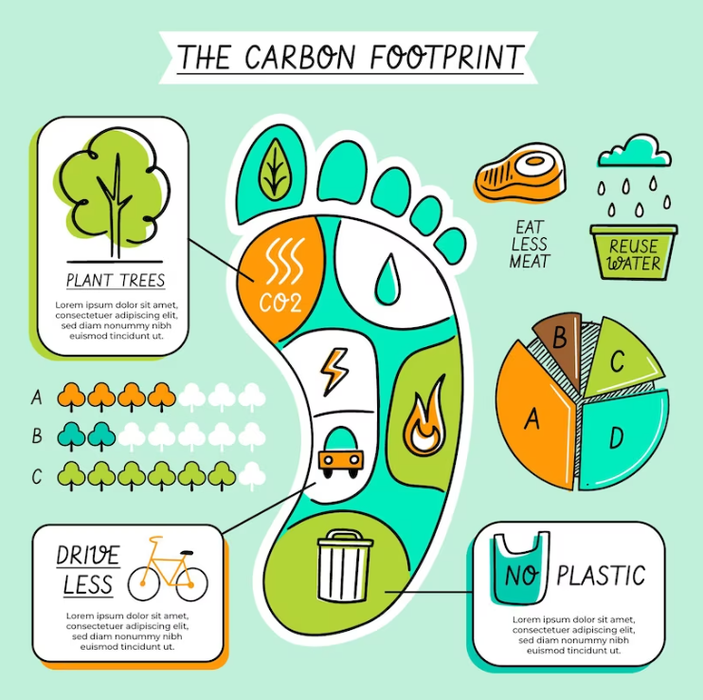

* Vocabulary
- carbon footprint (n):
dấu chân các bon
/ˌkɑːbən ˈfʊtprɪnt/

Slide 12

* Vocabulary
- release (v):
thải ra
/rɪˈliːs/

Slide 13

* Vocabulary
single-use (adj):
dùng một lần
/ˌsɪŋɡl ˈjuːs/

Slide 14
New words | Pronunciation | Meaning
1. environmental protection | /ɪnˌvaɪərənˈmɛntl prəˈtɛkʃən/ | bảo vệ môi trường
2. habitat (n) | /ˈhæbɪtæt/ | môi trường sống
3. endangered species (n) | /ɪnˈdeɪndʒəd ˈspiːʃiːz/ | động vật sách đỏ
4. carbon footprint (n) | /ˌkɑːbən ˈfʊtprɪnt/ | dấu chân cacbon
5. release (v) | /rɪˈliːs/ | thải ra
6. single-use (adj) | /ˌsɪŋɡl ˈjuːs/ | dùng một lần

Slide 15
Checking vocab | Meaning
1. | bảo vệ môi trường
2. | môi trường sống
3. | động vật sách đỏ
4. | dấu chân cacbon
5. | thải ra
6. | dùng một lần
environmental protection
habitat
endangered species
carbon footprint
release
single-use

Slide 16
1
At the Go Green Club
Listen and read.
Club leader: Hello. Welcome back. Today we’re discussing environmental problems and environmental protection. What are our serious environmental problems now?
Nam: Pollution and habitat loss, I think.
Ann: I agree. The air and water quality are getting worse and worse.
Club leader: Any others?
Ann: Yes, I can think of some like global warming, endangered species loss, …
Nam: So what should we do to help protect our environment?
Club leader: We can reduce our carbon footprint even in our homes.
Ann: What do you mean by ‘carbon footprint’?
Club leader: It’s the amount of carbon dioxide we release into the environment.
Ann: I see. So we can do things like turning off devices when we’re not using them.
Club leader: Right … And there is much more we can do, like practising the 3Rs.
Nam: We can plant more trees in our neighbourhood too.
Ann: And try to avoid using single-use products, like plastic bags, and stop littering.
Club leader: Yeah. And we can volunteer at some local environment programmes to save endangered species.

Slide 17
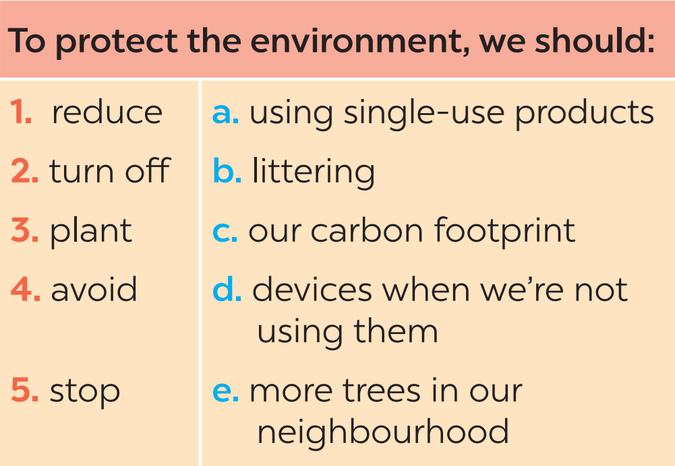
2
Read the conversation again and match the two halves in the two columns.

Slide 18
3
Complete each sentence with one word or phrase from the box.
reduce single-use pollution carbon footprint environment programme
Pollution
1. ________ is a serious problem everywhere.
2. We should avoid dumping waste into lakes and rivers to _______ water pollution.
3. We shouldn’t throw away _________ products but recycle them.
4. ______________ is the amount of carbon dioxide we release into the environment.
5. We hope a lot more people join our ______________________.
reduce
single-use
Carbon footprint
environment programme

Slide 19
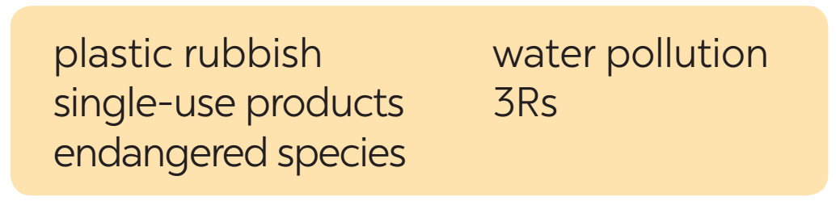

4
Write a phrase from the box under each picture.
1. ____________
2. ____________
3Rs
water pollution

Slide 20
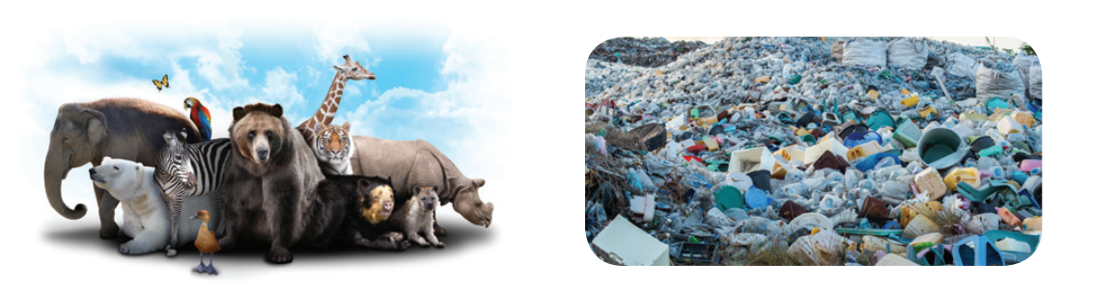
4
Write a phrase from the box under each picture.
3. _______________
4. ____________
endangered species
plastic rubbish

Slide 21
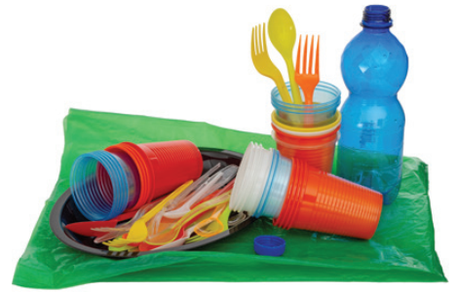
4
Write a phrase from the box under each picture.
5. _______________
single-use products

Slide 22
5
Environment Quiz
1. Which of the following is the greenest form of transport?
A. Motobike B. Bus C. Bicycle
2. Which of the following is a renewable source?
A. Coal B. Oil C. Wind
3. What causes the most pollution?
A. Factories B. Animals C. Hospitals

Slide 23
5
Environment Quiz
4. The surroundings in which we live are our ______.
A. habitat B. place C. environment
5. Which of these will reduce your carbon footprint?
A. Cutting down a lot of trees.
B. Recycling paper products.
C. Leaving the TV on all night.

Slide 24

* CONSOLIDATION
What have we learnt in this lesson?
identify the topic of the unit
use lexical items related to environment protections
identify the language features that are covered in the unit

Slide 25

* Homework
- Do exercises in the workbook.
- Start preparing for the Project of the unit.

