Slide 1

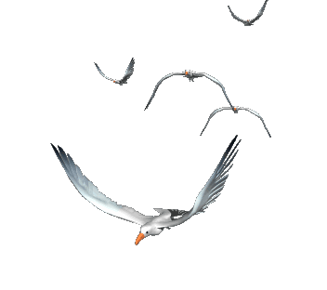


WELCOME TO OUR CLASS

Slide 2
WARM-UP
Match a word/ phrase in column A with a word in column B to make expressions about likes.
A
B
be fond
be keen
be interested
be crazy
be
about
in
on
into
of
MATCHING GAME

Slide 3

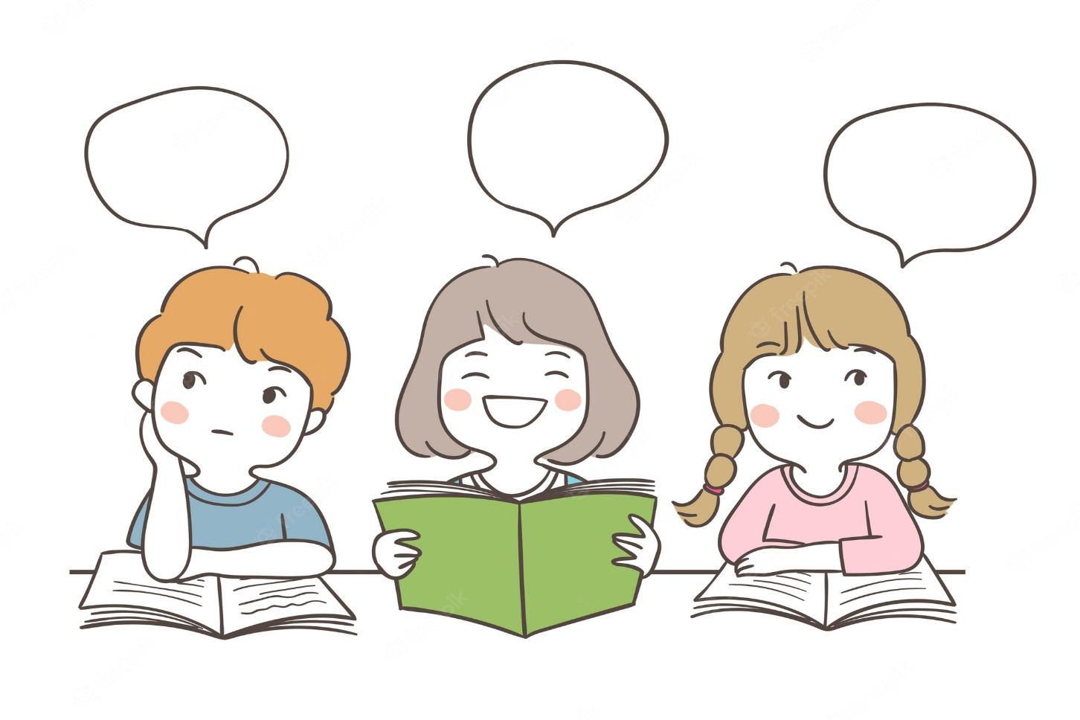
Unit
1
LEISURE TIME
LESSON 2: A CLOSER LOOK 1
I’m keen on…
I’m into…
I’m fond of…

Slide 4

* VOCABULARY
How to express “likes”
be fond of
be keen on
be into
be crazy about
be interested in

Slide 5
* VOCABULARY
New words | Pronunciation | Meaning
1. be interested in | /biː ɪntrəstɪd ɪn/ | hứng thú với
2. be fond of | /biː fɒnd əv/ | thích
3. be keen on | /biː kiːn ɒn/ | quan tâm đến
4. be crazy about | /biː ˈkreɪzi əˈbaʊt/ | say mê
5. be into | /biː ˈɪntuː/ | thích

Slide 6
2
Fill in each blank with a correct word from the box.
into fond keen interested about
fond
I’m _________ of taking photos. In my free time, I usually go out and take photos of people and things.
Mai is ___________ in history. She often goes to museums to see new exhibits and learn about the past.
My sister is _________ on cooking. She wants to become a chef in the future.
My brother spends lots of time surfing the net, but I’m not _________ it.
I’m not crazy _________ doing DIY. I’m never able to finish any DIY projects I start.
interested
keen
into
about

Slide 7
3
Complete the sentences about what you like or dislike doing. Use the word or phrases from the box or your own ideas.
cooking doing DIY surfing the net
playing sport doing puzzles messaging friends
Example: I’m interested in doing DIY.
1. I’m crazy about ______.
2. I’m keen on ______.
3. I’m fond of ______.
4. I’m not interested in ______.
5. I’m not into ______.
playing sport
/surfing the net

Slide 8
3
Complete the sentences about what you like or dislike doing. Use the word or phrases from the box or your own ideas.
cooking doing DIY surfing the net
playing sport doing puzzles messaging friends
1. I'm crazy about surfing the net.
2. I'm keen on doing puzzle.
3. I'm fond of playing sport.
4. I'm not interested in cooking.
5. I'm not into messaging friends.
-I'm crazy about taking photos.
-I'm keen on reading comic books.

Slide 9
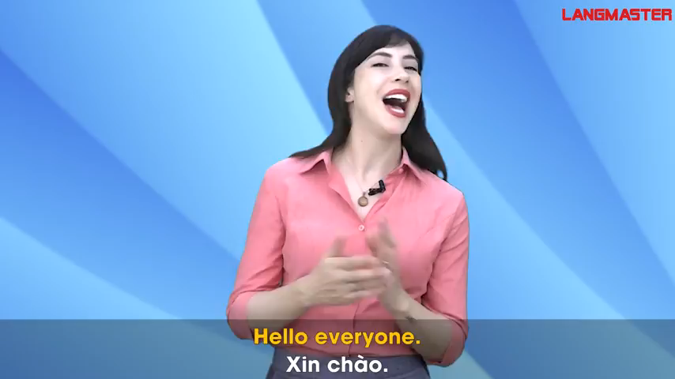
* PRONUNCIATION
/ʊ/ and /u:/

Slide 10

* PRONUNCIATION
4
Listen and repeat the words. Pay attention to the sounds /ʊ/and /u:/. Then put the words into the correct columns.
cook group push June
school would woman move
/ʊ/ | /u:/
cook
group
push
June
would
school
woman
move

Slide 11
PRONUNCIATION
5
Listen and practise the sentences. Underline the bold words with /ʊ/, and circle the bold words with /u:/.
She likes reading books and swimming in the pool.
When it is cool, we like to play football.
She drew and made puddings in her free time.
My mum loves pumpkin soup and coffee with a little sugar.
My brother is fond of watching the cartoon about a clever wolf.

Slide 12

* CONSOLIDATION
1
Wrap-up
What have we learnt in this lesson?
Vocabulary: The lexical items related to Leisure time
Pronunciation: How to correctly pronounce words that contain the sounds: /ʊ/ and /u:/

Slide 13

* Homework
Do exercises in the workbook.

Slide 14
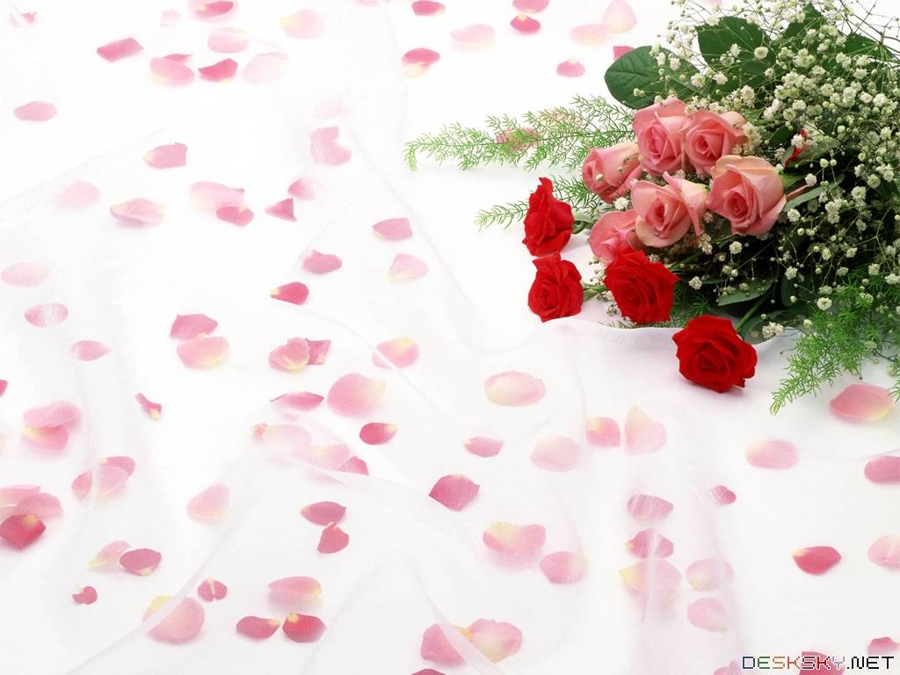
Goodbye.
See you again

