Slide 1
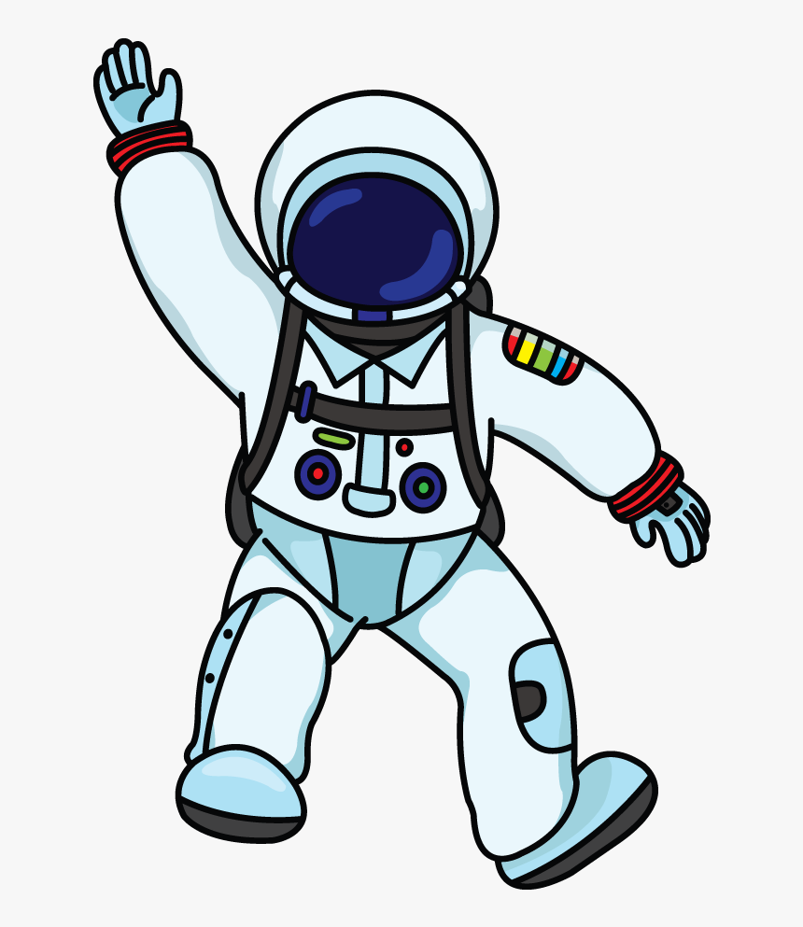




UNIT 10:
Space travel
Part 1 – getting started

Slide 2
Objectives
By the end of the lesson students will be able to:
- know some vocabulary related to astronomy and space travel
- understand the dialogue and do exercises

Slide 3
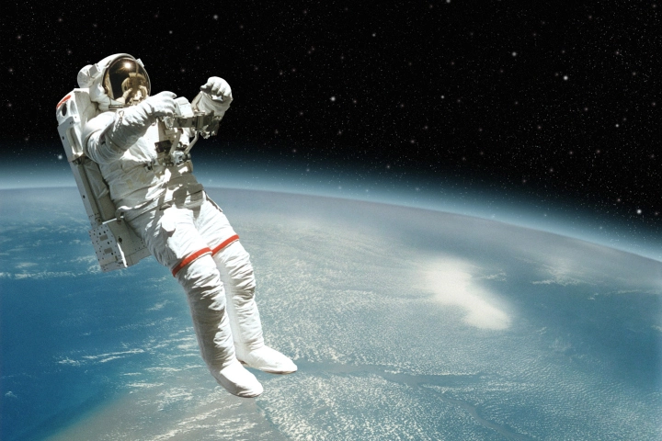
astronaut /ˈæstrənɔːt/

Slide 4
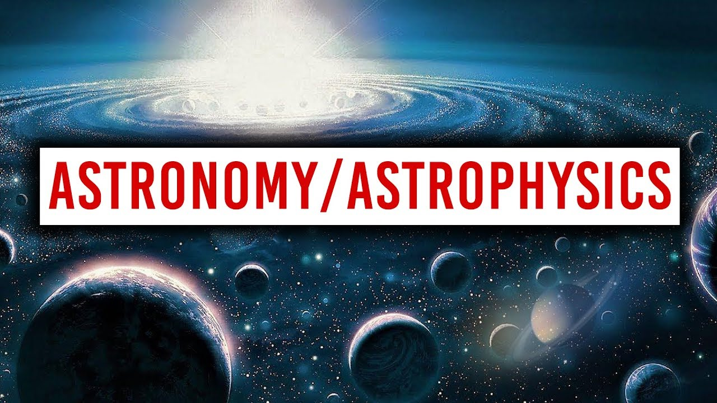
astronomy /əˈstrɒnəmi/

Slide 5
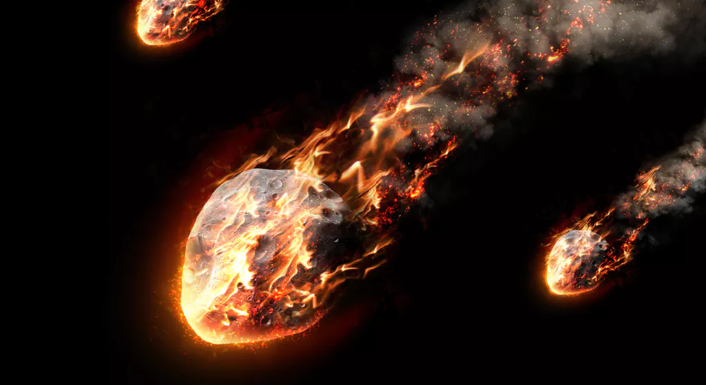
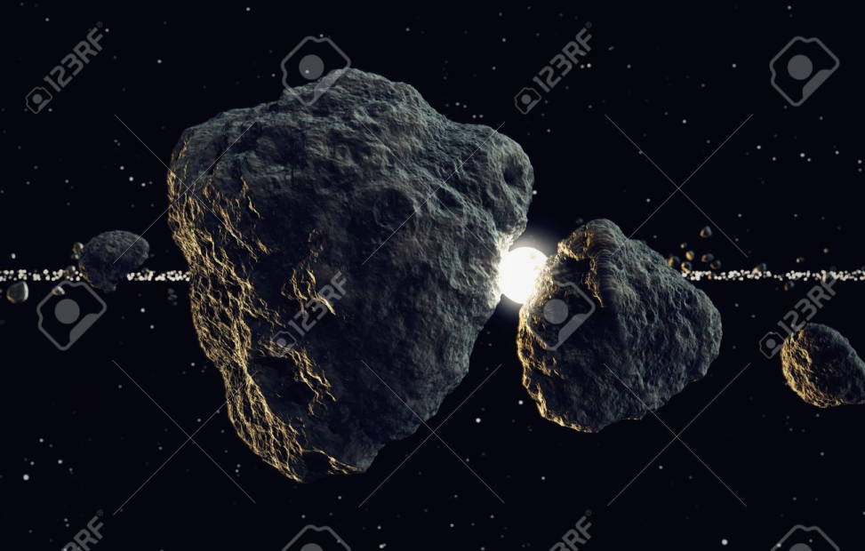
meteorite /ˈmiːtiəraɪt/

Slide 6
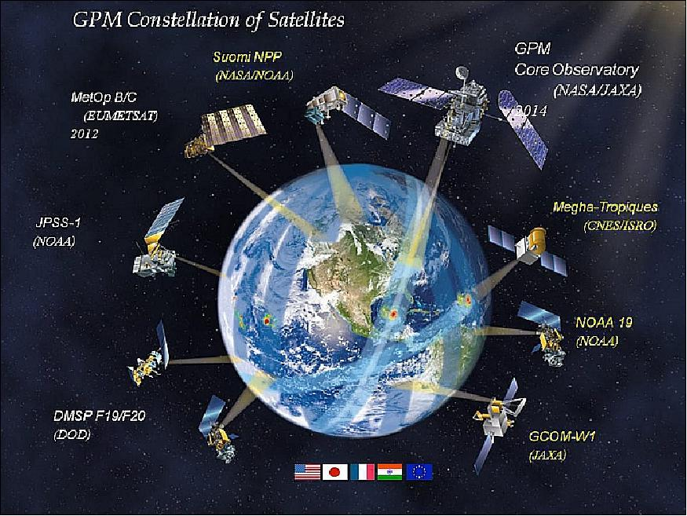
satellite /ˈsætəlaɪt/

Slide 7
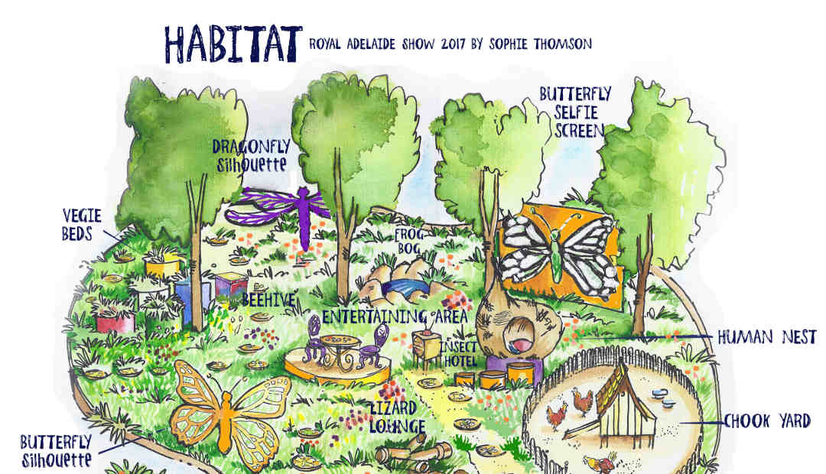
habitable /ˈhæbɪtəbl/

Slide 8
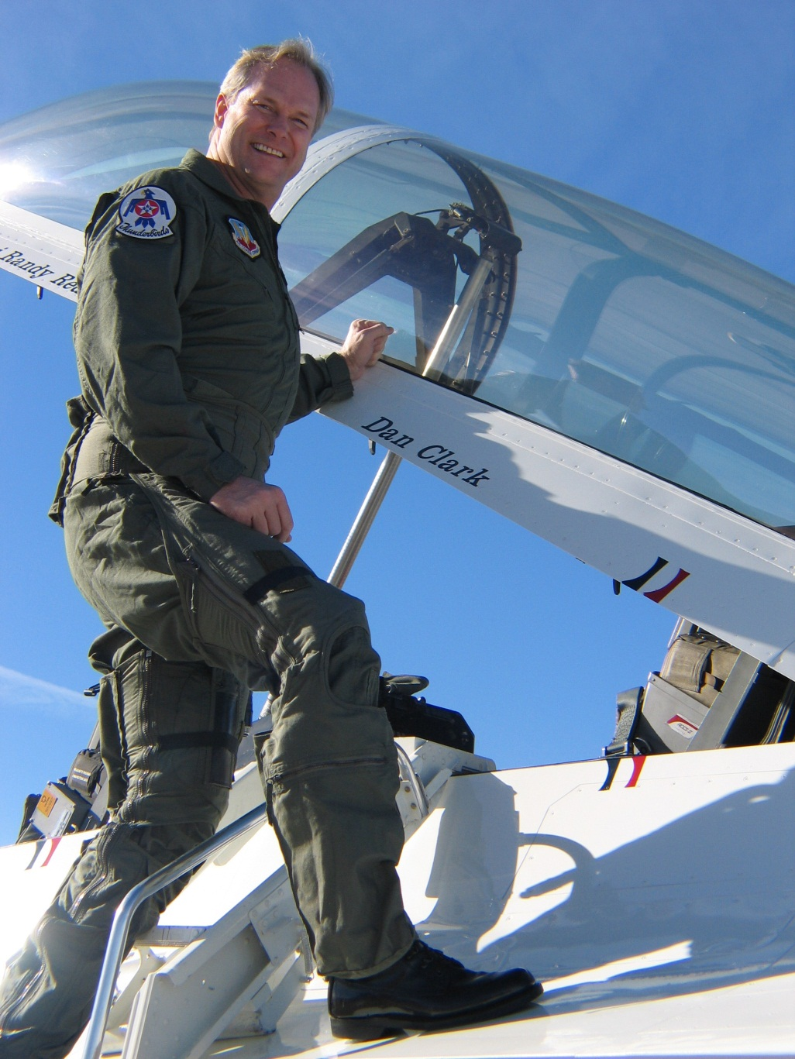
flight suit /ˈflaɪt suːt/

Slide 9
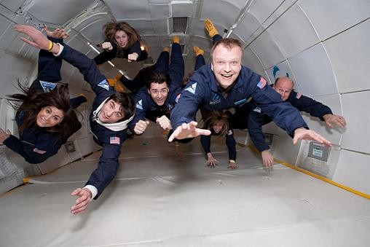
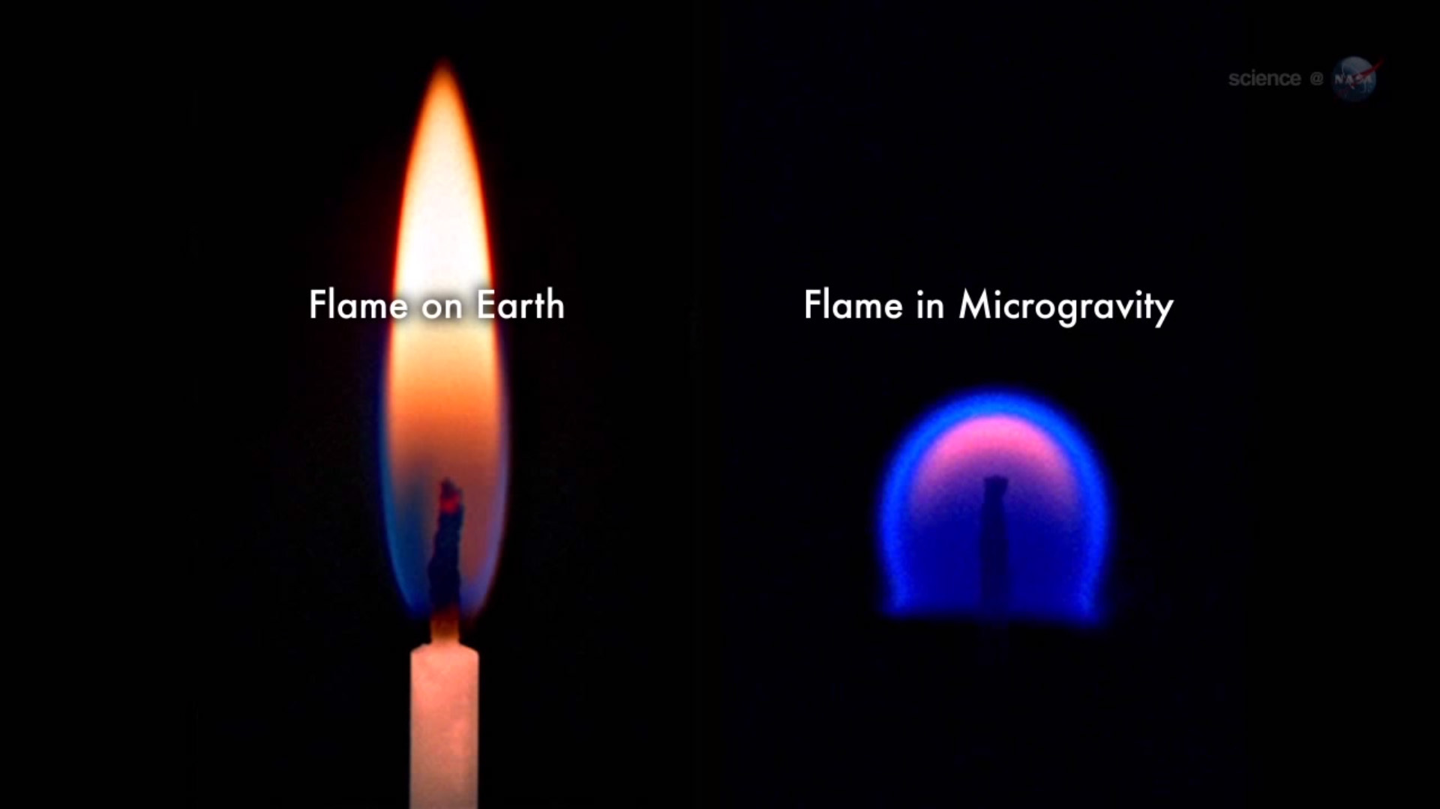
microgravity /ˈmaɪkrəʊˈɡrævəti/

Slide 10
Unit 10: SPACE TRAVEL
Period 81– Lesson 1: Getting started
I. New words:
1. astronaut /ˈæstrənɔːt/ (n): phi hành gia
2. satellite /ˈsætəlaɪt/ (n): vệ tinh nhân tạo
3. astronomy /əˈstrɒnəmi/ (n): thiên văn học
4. meteorite /ˈmiːtiəraɪt/ (n): thiên thạch
5. habitable /ˈhæbɪtəbl/ (adj): có sự sống
6. mission /ˈmɪʃn/ (n): nhiệm vụ
7. scuba diving /ˈskuːbə daɪvɪŋ/ (n): việc lặn có bình khí nén
8. flight suit /ˈflaɪɪŋ suːt/ (n): bộ đồ bay
9. microgravity /ˈmaɪkrəʊˈɡrævəti/ (n): vi trọng lượng
10. parabolic/ˌpærəˈbɒlɪk/(adj): môi trường không trọng lượng

Slide 11


A mission to Mars
Nick: Wow, is that you in this photo? The youngest astronaut in the world doing a spacewalk!
Phuc: Ha! Yeah, it was in a museum in Sweden.
Nick: You look so excited!
Phuc: Well, that trip made me crazy about space. Before I turned ten, I'd already collected lots of books about the universe. I'd learnt about the planets, the stars, satellites, rockets, and stuff.
Nick: You know, last year I visited an astronomy museum and I touched a meteorite.
Phuc: A meteorite! What was it like?
Nick: Honestly, it wasn't as impressive as I'd expected. It was just like an ordinary piece of rock.
Phuc: But perhaps it was from Mars. Think of that!
Nick: Maybe. Do you think there could be life on Mars?
Phuc: It's possibly habitable. It once had an ocean... Who knows, in 20 years we might be flying there on a discovery mission.
Nick: Haha, but we'd need to do some serious training first. They say you practise by scuba diving in a flight suit...
Phuc: That's right. And you also have to experience microgravity on a parabolic flight.
Nick: What's that?
Phuc: The plane flies at high altitude, then it climbs sharply for a few seconds and descends sharply, a bit like a rollercoaster. The people inside the plane start to float. I'd love to do that.
Nick: Sounds a bit scary. But let's take a look at your rock collection. There may be something interesting here...
Phuc: Yes, perhaps a meteorite that landed on Earth from the moon!

Slide 12
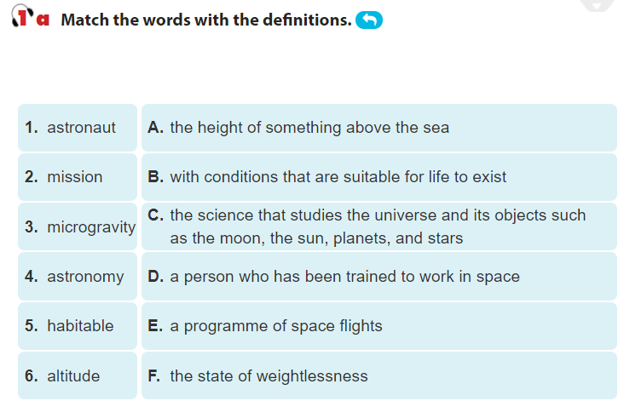

Slide 13
START

Slide 14
$100
Question 1. “the height of something above the sea” has the same meaning with
a) astronaut
c) microgravity
b) mission
d) altitude

Slide 15
$200
Question 2:
“with conditions that are suitable for life to exist” has the same meaning with
a) Habitable
c) microgravity
b) astronomy
d) mission

Slide 16
$300
Question 3: “the science that studies the universe and its objects such as the moon, the sun, planets, and stars ” means
a) altitude
c) astronomy
b) habitable
d) astronaut

Slide 17
$500
Question 4: “a person who has been trained to work in space” has the same meaning with
a) altitude
c) astronomy
b) misson
d) astronaut

Slide 18
$700
Question 5: “a programme of space flights” means
a) astronaut
c) misson
b) microgavity
d) astronomy

Slide 19
$1000
Question 6:
“the state of weightlessness” means
a. microgavity
c) habitable
b) astronomy
d) altitude

Slide 20


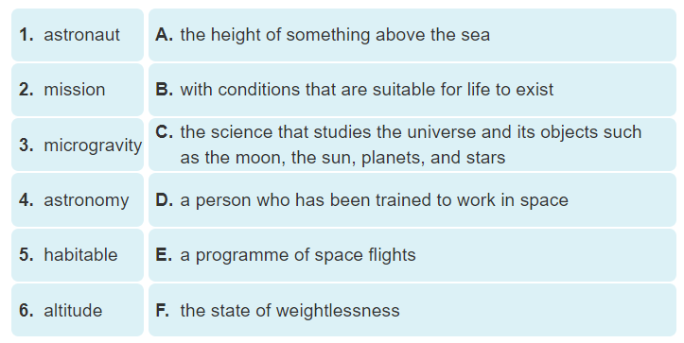

Slide 21
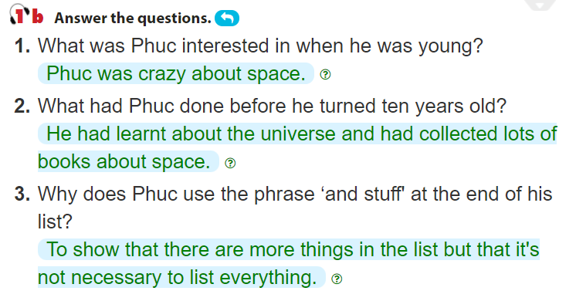
Phuc: Well, that trip made me crazy about space. Before I turned ten, I’d already collected lots of books about the universe. I’d learnt about the planets, the stars, satellites, rockets, and stuff.
Phuc: Well, that trip made me crazy about space. Before I turned ten, I’d already collected lots of books about the universe. I’d learnt about the planets, the stars, satellites, rockets, and stuff.
Nick: You look so excited!
Phuc: Well, that trip made me crazy about space.

Slide 22
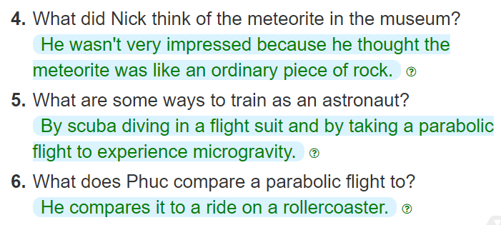
Phuc: A meteorite! What was it like?
Nick: Honestly, it wasn’t as impressive as I’d expected. It was just like an ordinary piece of rock.
Nick: Haha, but we’d need to do some serious training first. They say you practise by scuba diving in a flight suit...
Phuc: That’s right. And you also have to experience microgravity on a parabolic flight.
Phuc: The plane flies at high altitude, then it climbs sharply for a few seconds and descends sharply, a bit like a rollercoaster. The people inside the plane start to float. I’d love to do that.

Slide 23
SAMPLE
Phuc seems keener on space travel than Nick. He was crazy about space when he was young. Phuc knows more about space and astronauts. He says he'd love to experience microgravity, whereas Nick thinks microgravity sounds scary.

Slide 24
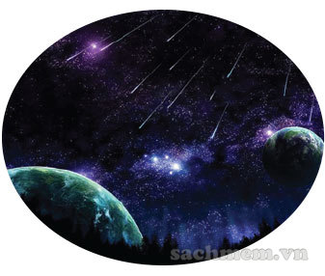
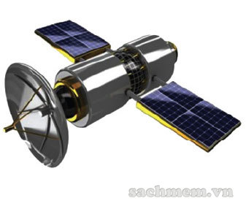
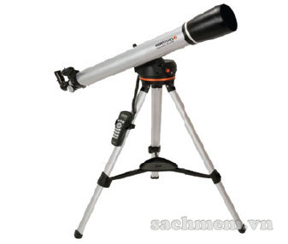
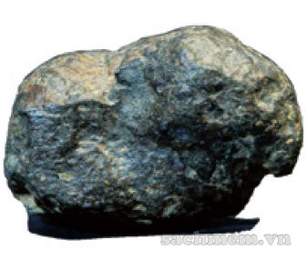
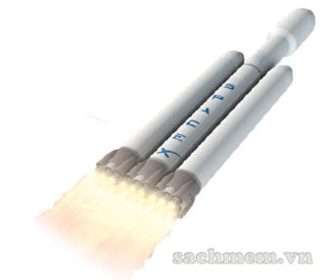
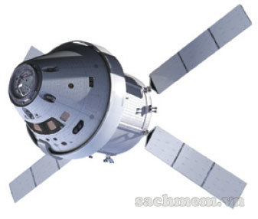
satellite
rocket
universe
meteorite
spacecraft
telescope

Slide 25
rocket
telescope
spacecraft
universe
1.A ………………….... travels round Earth to collect information or to communicate by radio, television, etc. It can also be a natural object which moves round a larger object in space.
meteorite
satellite

Slide 26
rocket
telescope
spacecraft
universe
2. With a ……………… you can have a great experience watching the stars.
meteorite
x
satellite

Slide 27
rocket
x
telescope
spacecraft
3. Our sun and its planets are just a tiny part of the Milky Way, and the Milky Way is just one galaxy in the ……………………………
universe
meteorite
x
satellite

Slide 28
rocket
x
telescope
spacecraft
x
universe
A …………………….. is a piece of rock or other matter from space that has landed on a planet.
meteorite
x
satellite

Slide 29
rocket
x
telescope
spacecraft
x
universe
A ………………… is shaped like a tube and moves very fast. It helps a space shuttle to be sent into space.
x
meteorite
x
satellite

Slide 30
x
rocket
x
telescope
spacecraft
x
universe
A …………………... is a vehicle, with or without people inside, used for travel in space.
x
meteorite
x
satellite

Slide 31
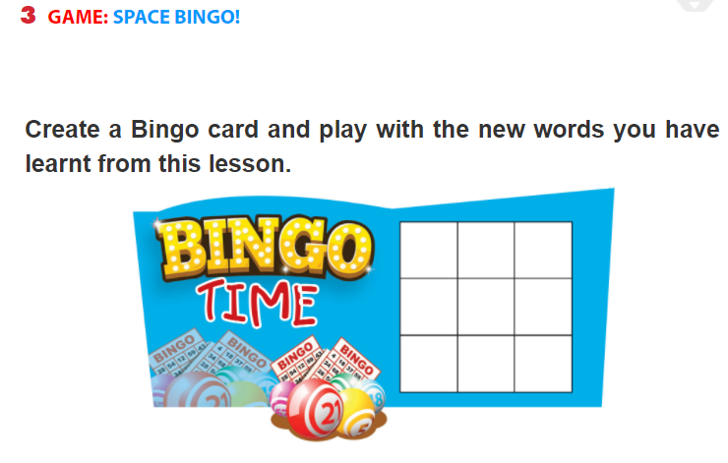

Slide 32
Guides for homework
Question for the good students: How are Astronauts trained? Do you want to become an Astronaut?
Question for the reasonable students: Have you ever seen a spaceship?
- Practice reading the dialogue.
- Write new words then learn them by heart.
- Copy the exercise into notebooks.
Do exercises …….. on page . …
Prepare for “A closer look 1” part.

Slide 33


