Slide 1
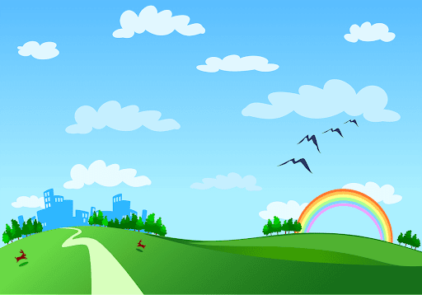
Song Ve secondary school.
Good morning class!!!
Mrs Thu Ba

Slide 2

WARM-UP
Game: Brainstorming
bicycle
bus
MEANS OF TRANSPORTS
train
plane
Motorbike
helicopter
car
boat
ship

Slide 3


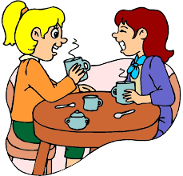
Unit
7
TRAFFIC
LESSON 4: COMMUNICATION
Unit
HOW DO YOU GO TO SCHOOL?

Slide 4

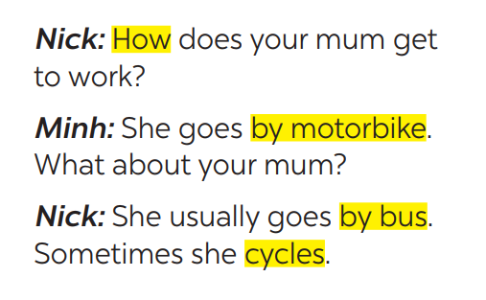

Unit
7
TRAFFIC
LESSON 4: COMMUNICATION
1
Listen and read the conversation, paying attention to the highlighted parts.
Which tense do we use to ask and answer?
Which question word do we use?
* STRUCTURES
How + do /does + S + go to …?
S + go /goes to … by …

Slide 5
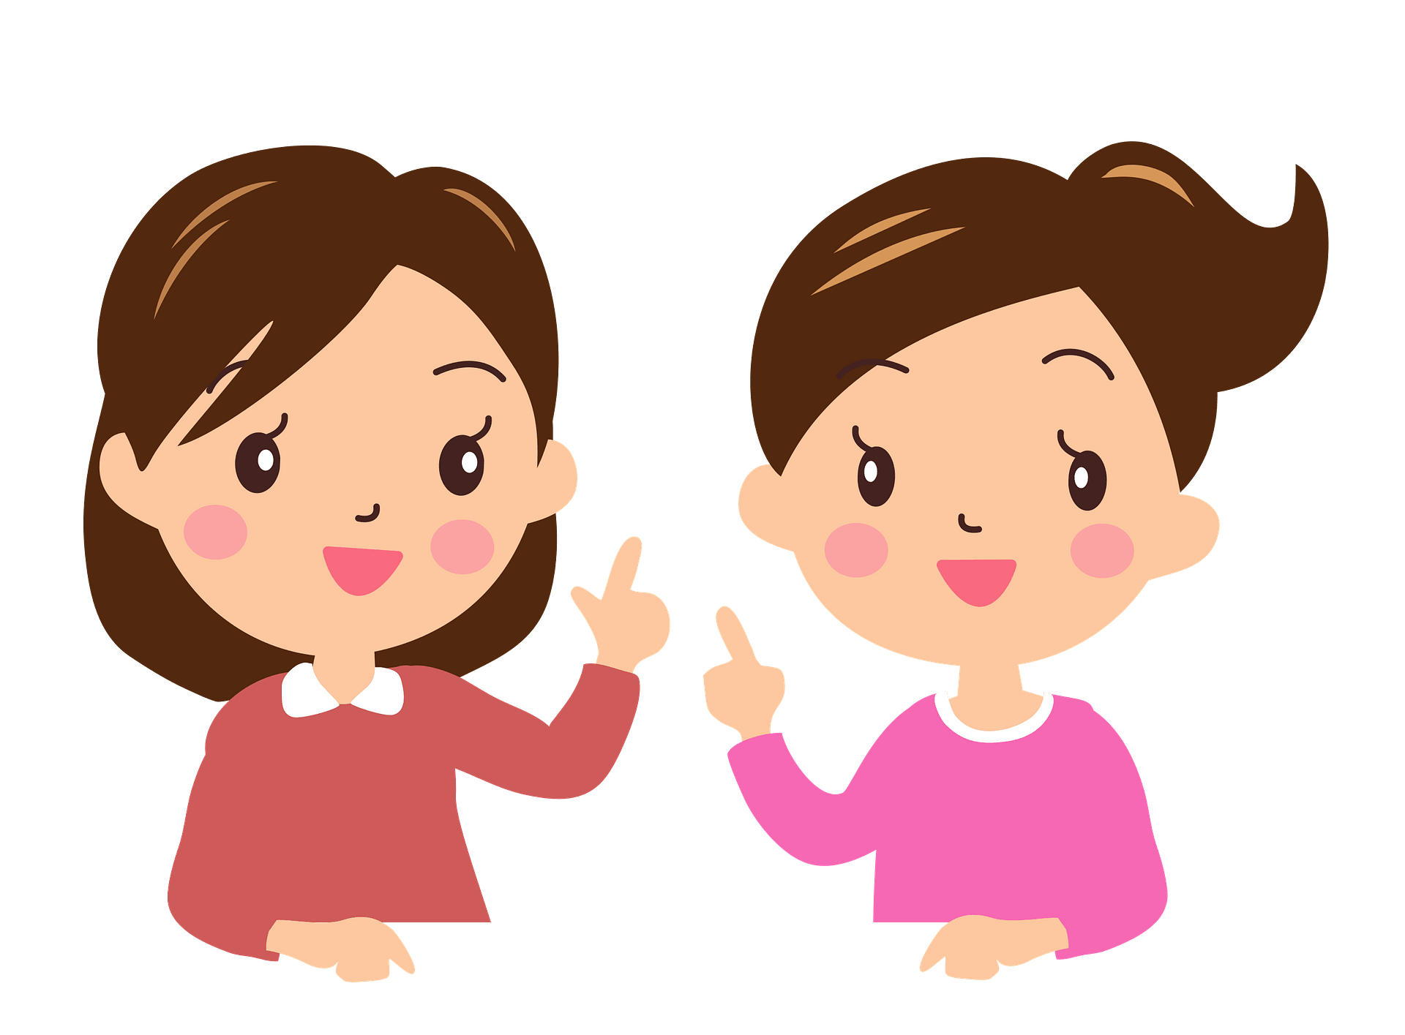
* PRACTICE
2
Work in pairs. Take turns to ask and answer about the means of transport your family members use every day.
He usually drives his car but sometimes he goes by bus.
How does your father
go to work?
How about your father?
He walks because we live near his office.

Slide 6
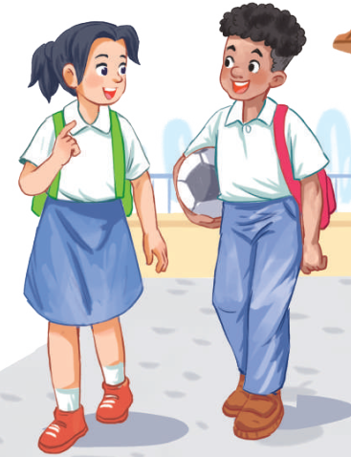
* PRACTICE
2
Ask and answer about the means of transport your family members use every day.
A: How does your father go to work?
B: He usually drives his car but sometimes he goes by bus. How about your father?
A: He walks because we live near his office.

Slide 7
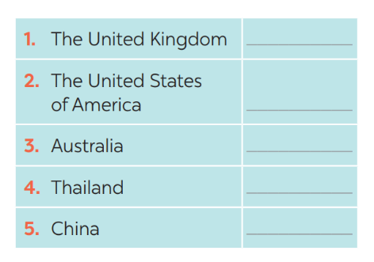
3
When you go on the road, which side do you keep, to the right or to the left?
Which countries below keep to the left? Tick the correct answers.
Strange traffic rules!
✓
✓
✓

Slide 8
4
Listen and check your answers in 3. Then listen again and complete the sentence with no more than THREE words.
One explanation is that some countries use ____________________ as the UK.
the same system
* Audio script
The right side is the wrong side!
Do you know that there are many countries in the world where the traffic rule is to keep to the left? Some of these are the United Kingdom, Australia, Thailand, and so on. There are different explanations
for this. One explanation is that some countries use the same system as the UK.

Slide 9

* PRODUCTION
5
Read the strange driving rules below,
discuss which one do is the strangest rule?

Slide 10
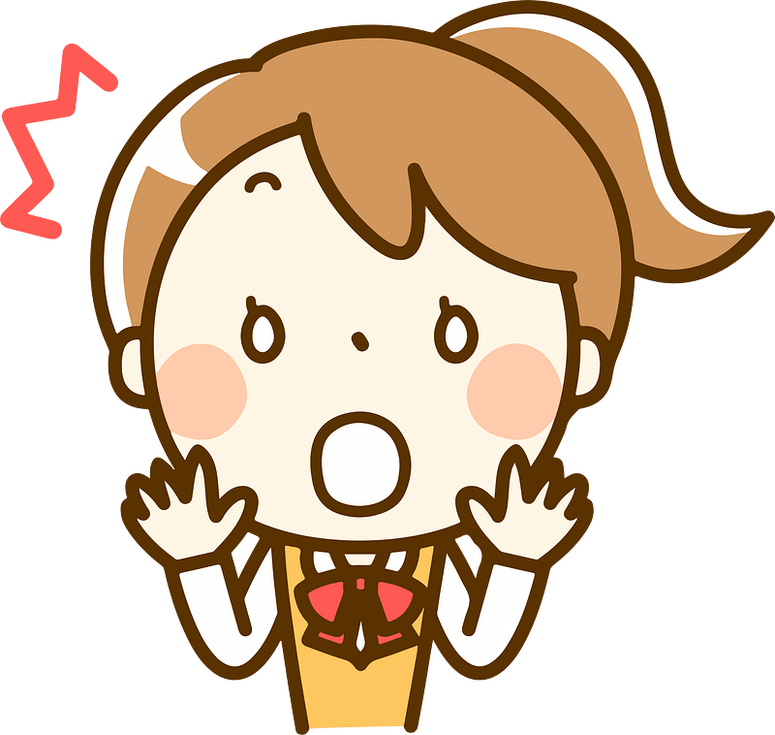
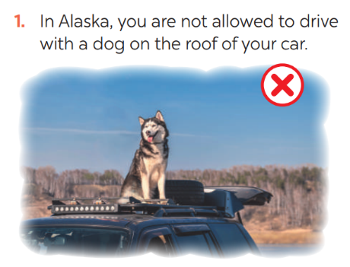
5
Read, discuss which one do is the strangest rule?

Slide 11
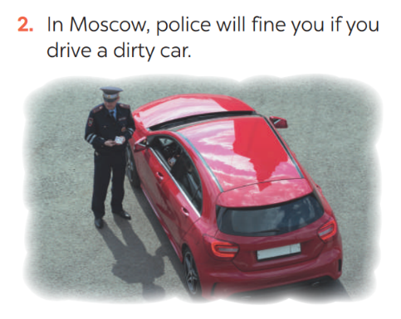
5
Read, discuss which one do is the strangest rule?

Slide 12
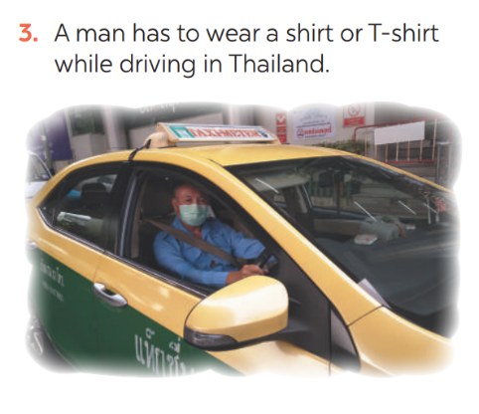
5
Read, discuss which one do is the strangest rule?

Slide 13
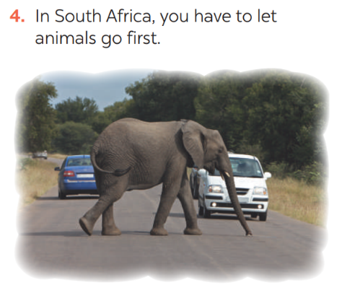
5
Read, discuss which one do is the strangest rule?

Slide 14
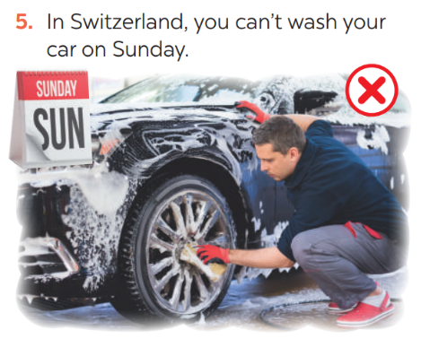
5
Read, discuss which one do is the strangest rule?

Slide 15
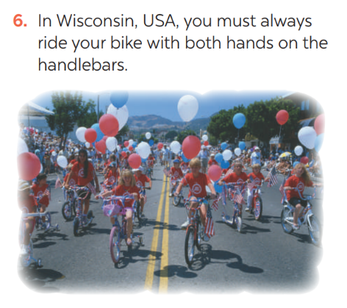
5
Read, discuss which one do is the strangest rule?

Slide 16
* PRODUCTION
5
Work in groups. which one do you think is the strangest rule?
Example: In my opinion, the strangest traffic rule is a man in Thailand has to wear a shirt or T-shirt while driving.

Slide 17

* CONSOLIDATION
In this lesson, we have learn to:
ask and answer about means of transport and some strange traffic rules.
practise using some grammar points and vocabulary related to the topic.

Slide 18


homework
- Do exercises in the workbook.
- Prepare lesson 5 ( skills 1)

Slide 19

Thanks for your atendance!
Goodbye. See you again
Notes:
19

