Slide 1

Unit 9:
CITIES OF THE WORLD part 5: Skills 1
Reading and speaking

Slide 2

6th, March , 2023
Period 73 Unit 9: CITIES OF THE WORLD
Lesson 5: Skills 1(p.32)

Slide 3
Objectives
By the end of the lesson, students will be able to:
develop reading skill for general and specific information;
identify different features of a place;
use what they have learnt to talk about a city

Slide 4
6th, March , 2023
Period 73 Unit 9: CITIES OF THE WORLD
Lesson 5: Skills 1(p.32)
* Vocabulary

Slide 5
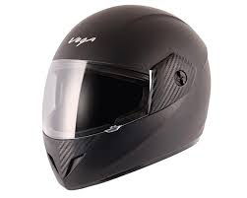
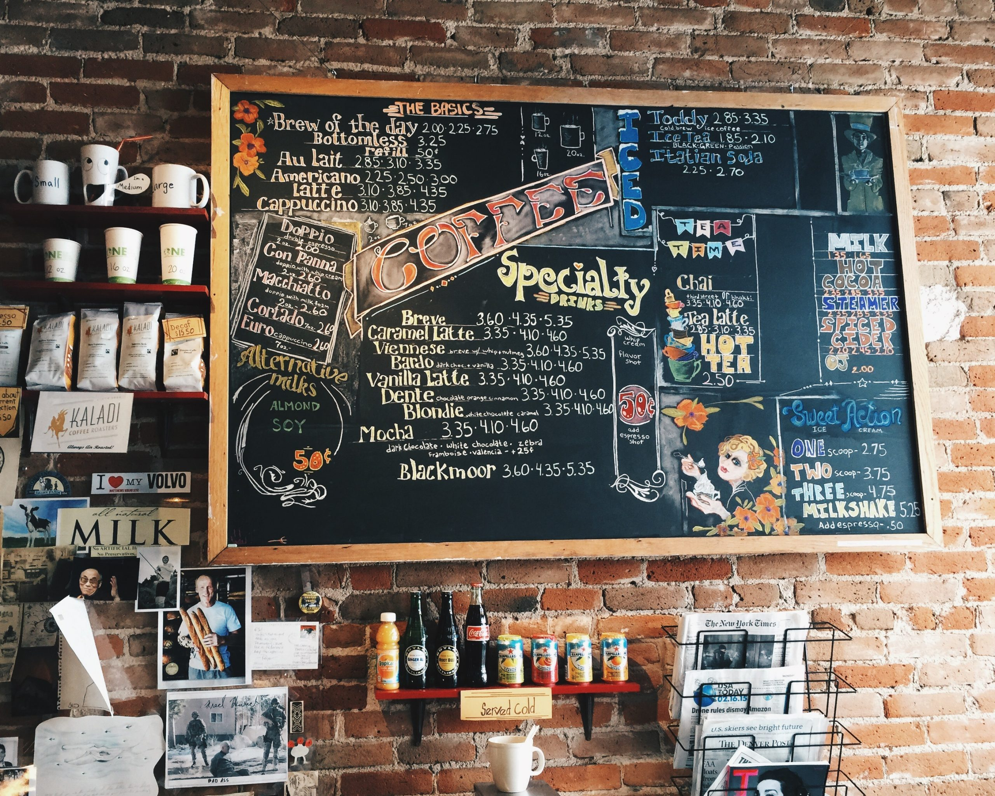
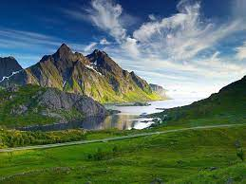
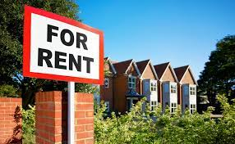

Vocabulary
1. Landscape (n)
/ˈlænd.skeɪp/
2. Helmet (n) /ˈhel.mət/
3. Café (n) /ˈkæf.eɪ/
4. Rent (v) /rent/
5. Fantastic (a)
/fænˈtæs.tɪk/
6. Amazing (a)
/əˈmeɪ.zɪŋ/
Phong cảnh, cảnh quan
Mũ bảo hiểm
Quán ăn có phục vụ đồ uống
Thuê, mướn
Đỉnh, tuyệt vời
Thú vị, hay tuyệt vời

Slide 6
Checking Vocabulary
1. Landscape (n)
2. Helmet (n)
3. Café (n)
4. Rent (v)
5. Fantastic (a)
6. Amazing (a)
Phong cảnh, cảnh quan
Mũ bảo hiểm
Quán ăn có pvu đồ uống
Thuê, mướn
Đỉnh, tuyệt vời
Thú vị, hay tuyệt vời

Slide 7
6th, March , 2023
Period 73 Unit 9: CITIES OF THE WORLD
Lesson 5: Skills 1(p.32)
Vocabulary
Landscape (n)
Helmet (n)
Café (n)
Rent (v)
Fantastic (a)
Amazing (a)
I/ Reading

Slide 8
Part 1: Reading

Slide 9

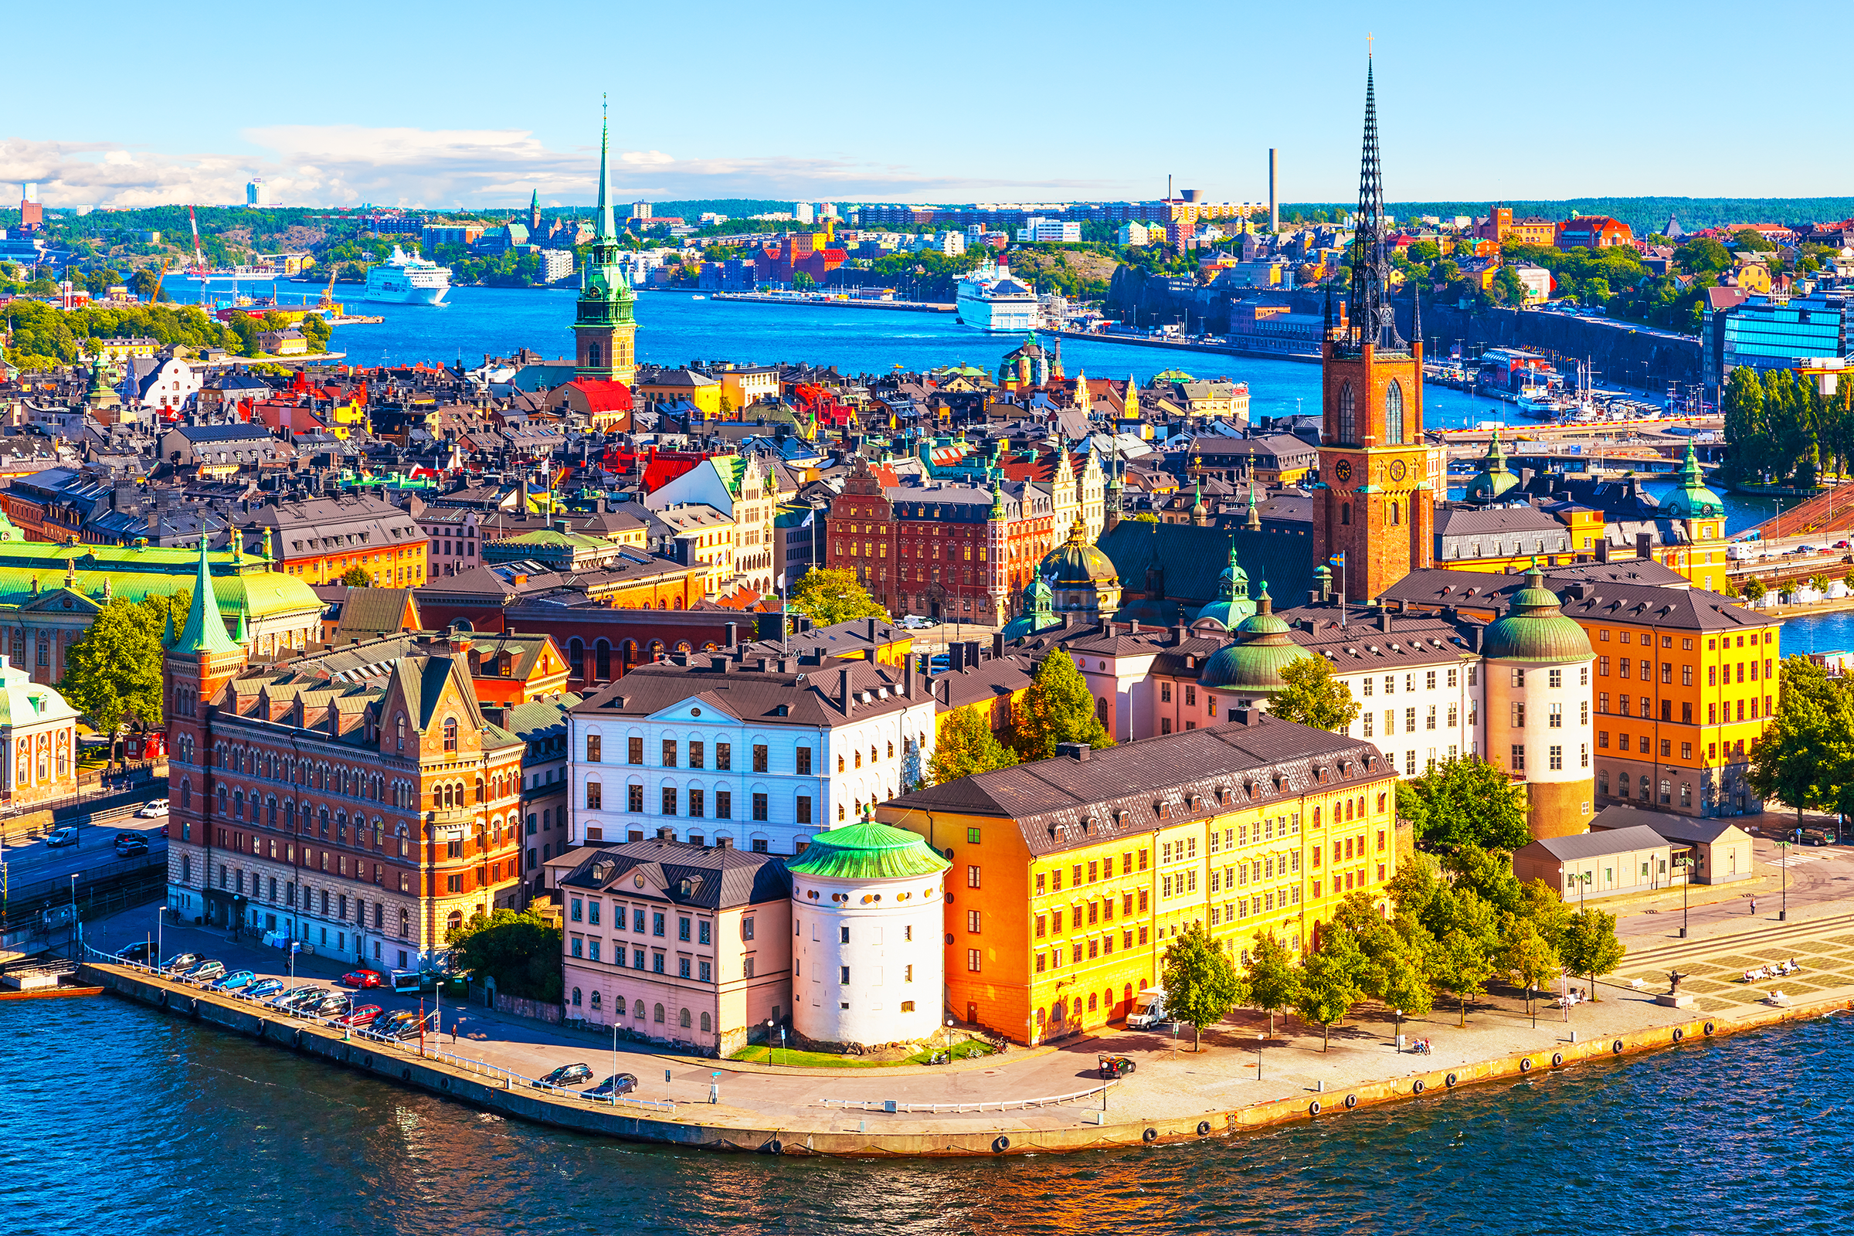
When do people write a postcard?
When they are away from home, often on holiday or business. They want to tell their family or friends what they see and do, and how they feel about their experience there.
What do they often write on a postcard
The sender often writes about his / her stay in a city or country.

Slide 10

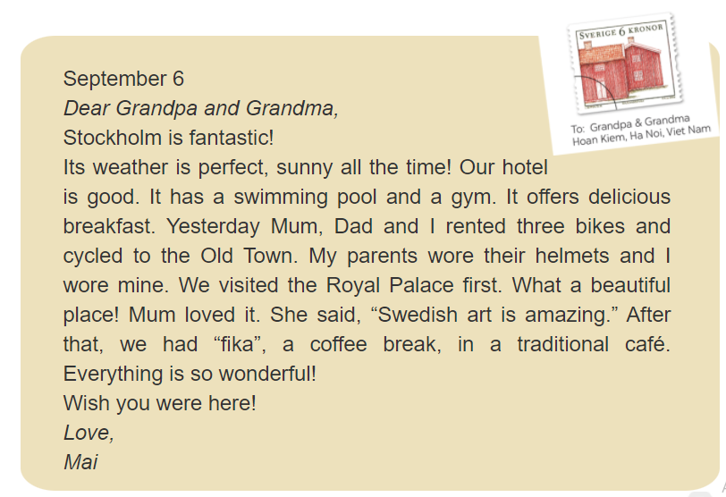

Slide 11
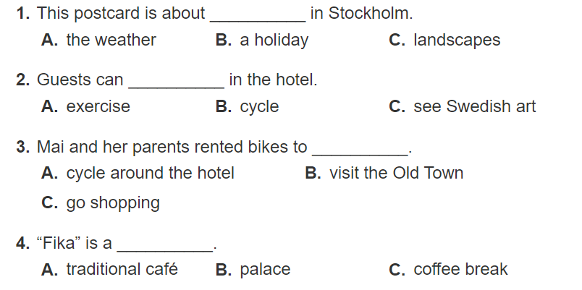

Slide 12

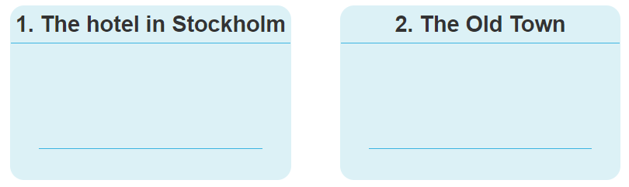
a. The Royal Palace
b. Delicious breakfast
c. Swimming pool
d. “fika”
e. Swedish art

Slide 13
6th, March , 2023
Period 73 Unit 9: CITIES OF THE WORLD
Lesson 5: Skills 1(p.32)
Vocabulary
I/ Reading
II/ Speaking: Talk about a city you know

Slide 14
Part 2: speaking

Slide 15
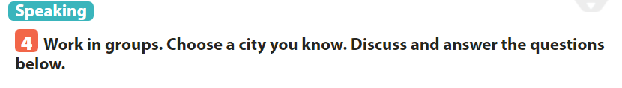
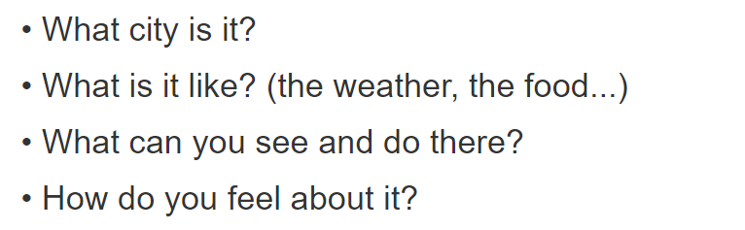
SUGGESTED ANSWER
It’s Vũng Tàu city.
- It has many beautiful beaches, the weather is usually cool, seafood is fresh, cheap and delicious.
- In Vũng Tàu city, I can cycle along the beach, do sightseeing, climb mountains, take beautiful photos, swim in the sea and play on the beach, enjoy special food and seafood, buy souvenirs.
- It’s really great to be in Vũng Tàu city. It’s a liveable place.

Slide 16

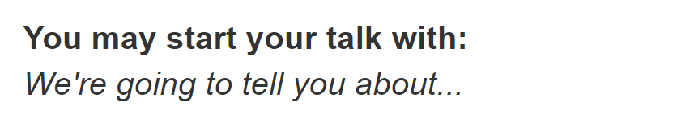
We’re going to tell you about Vũng Tàu city. It has many beautiful beaches, the weather is usually cool, seafood is fresh, cheap and delicious. In Vũng Tàu city, I can cycle along the beach, do sightseeing, climb mountains, take beautiful photos, swim in the sea and play on the beach, enjoy special food and seafood, buy souvenirs. It’s really great to be in Vũng Tàu city. For me, it’s a liveable place.

Slide 17
Sum up
By the end of the lesson, students will be able to:
develop reading skill for general and specific information;
identify different features of a place;
use what they have learnt to talk about a city
Do exercise in workbook
Prepare “Skills 2” part.

Slide 18
Thank you

