Slide 1

Unit 9:
CITIES OF THE WORLD
part 1: Getting started

Slide 2
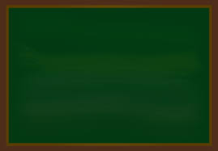
26th, February , 2024
Period 69 Unit 9: CITIES OF THE WORLD
Lesson 1: Getting started(p.26)

Slide 3
THIS UNIT INCLUDES:
Vocabulary
Cities and landmarks
Pronunciation
Sounds: /əʊ/ and /aʊ/
Grammar
• Possessive adjectives
• Possessive pronouns
Skills
• Reading about a holiday postcard
• Talking about a city
• Listening to a description of a city
• Writing a holiday postcard
Everyday English
Expressing exclamations with What

Slide 4
Objectives
By the end of the lesson, students can be able to:
- use the lexical items related to
the topic Cities of the World;
- use the vocabulary and structures to describe cities and landmarks.

Slide 5
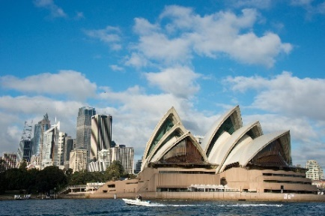
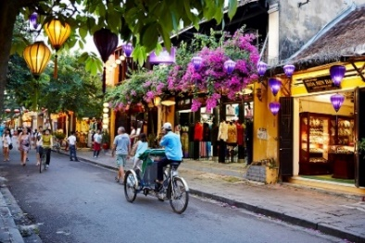
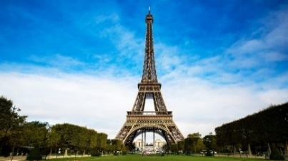
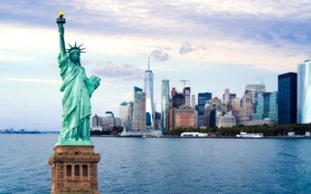
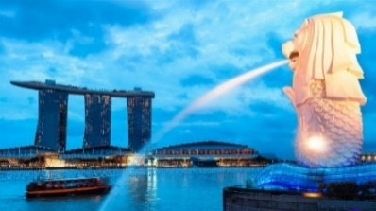
Put the names of the cities in the correct place
Paris
New York
1.
Sydney
Singapore
2.
Hoi An
5.
3.
4.

Slide 6
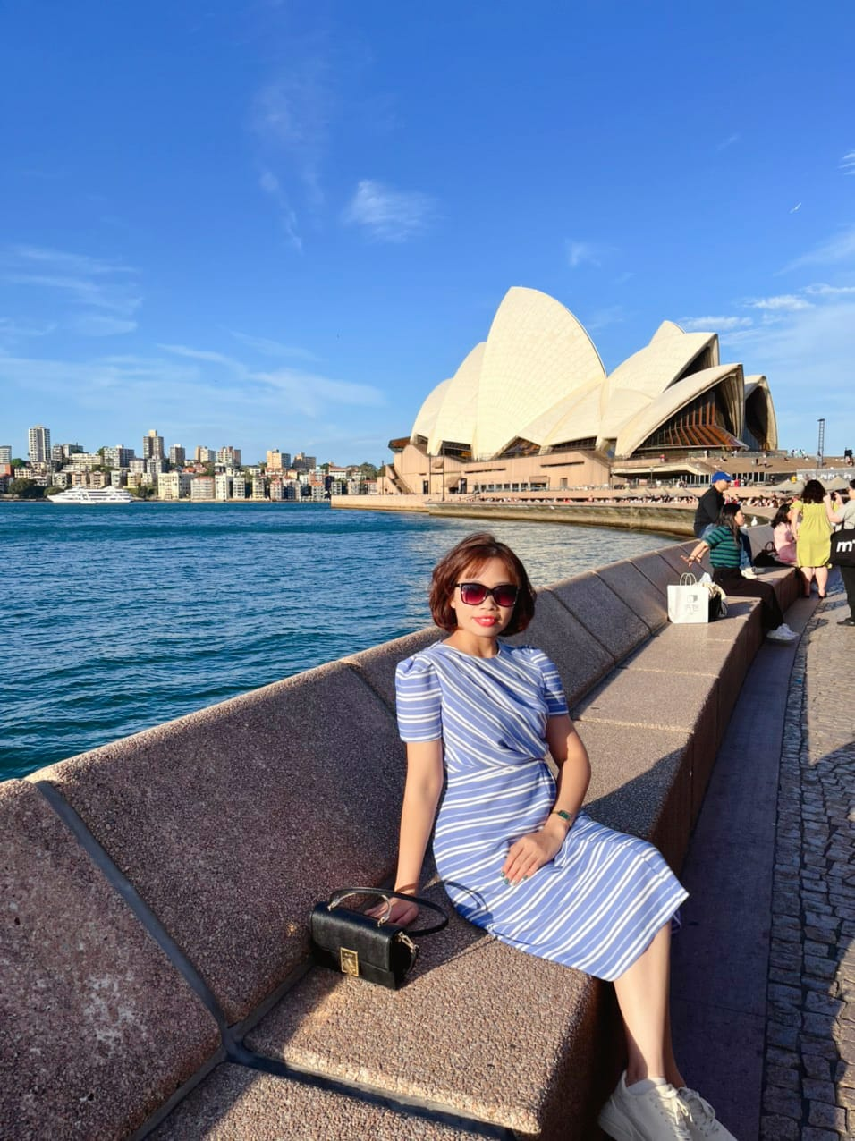

Sydney opera house
Harbour bridge

Slide 7
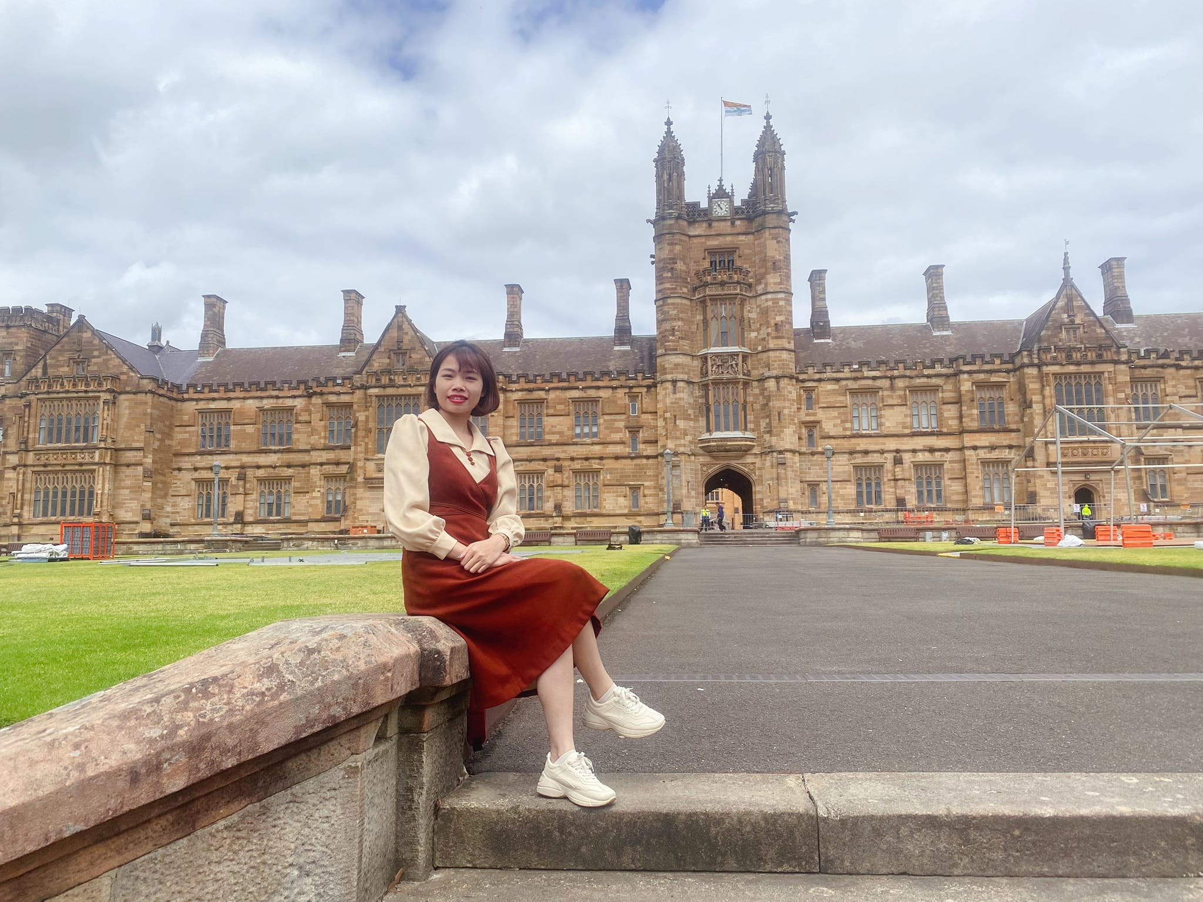
Sydney university

Slide 8
26th, February , 2024
Period 69 Unit 9: CITIES OF THE WORLD
Lesson 1: Getting started(p.26)
* Vocabulary

Slide 9

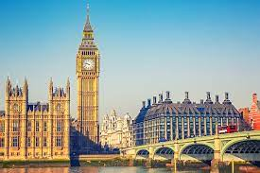
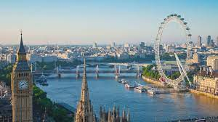
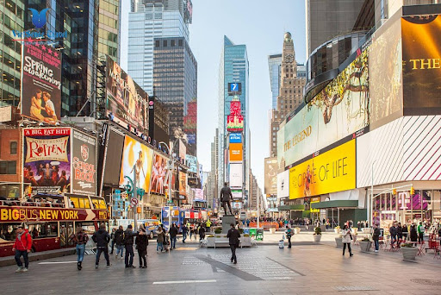
Vocabulary
Big Ben
River Thames
Times Square
Clean(a)
Crowded (a) /ˈkraʊdɪd/
Beautiful (a) /ˈbjuːtɪfl/
Exciting (a) /ɪkˈsaɪtɪŋ/
Landmark (n)
Tháp Big Ben – Luân Đôn - Anh
Sông Thames - Anh
Quảng trưởng thời đại –New York - Mỹ
Sạch, sạch sẽ
Đông đúc, nhộn nhịp
Đẹp đẽ, xinh đẹp
Thú vị
Mốc ranh giới

Slide 10
Match the words with their meanings
1. Big Ben (n)
2. Landmark (n)
3. River Thames
4. Beautiful (a)
5. Times Square
6. Crowded (a)
7. Clean(a)
8. Exciting (a)
Sông Thames
Quảng trưởng thời đại
Sạch, sạch sẽ
Tháp Big Ben
Đông đúc nhộn nhịp
Đẹp
Thú vị
Mốc ranh giới

Slide 11
26th, February , 2024
Period 69 Unit 9: CITIES OF THE WORLD
Lesson 1: Getting started(p.26)
* Vocabulary
I/ Listen and read

Slide 12

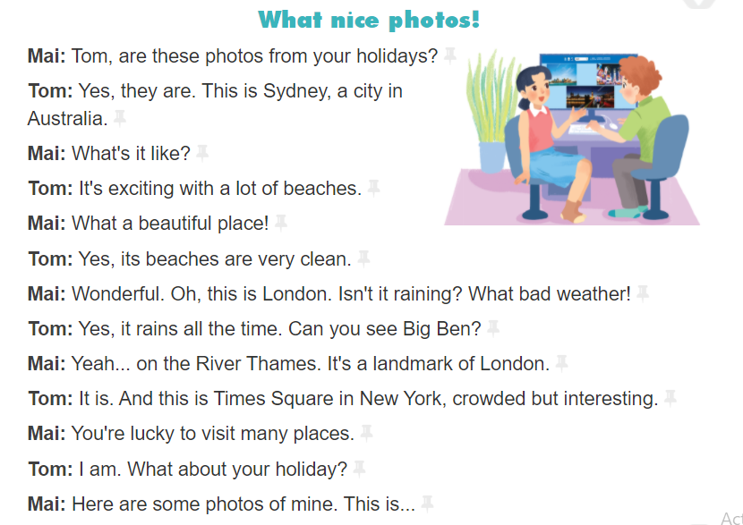

Slide 13
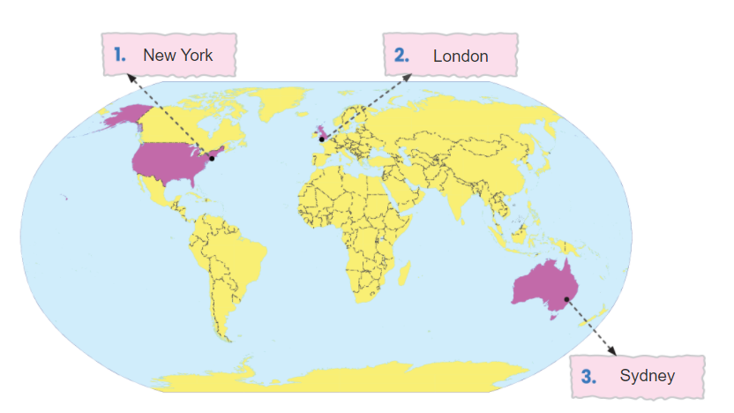
Europe
Asia
America
Africa
Australia

Slide 14
26th, February , 2024
Period 69 Unit 9: CITIES OF THE WORLD
Lesson 1: Getting started(p.26)
* Vocabulary
I/ Listen and read
II/ Practice
Act 3:

Slide 15
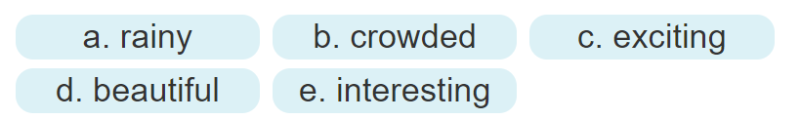
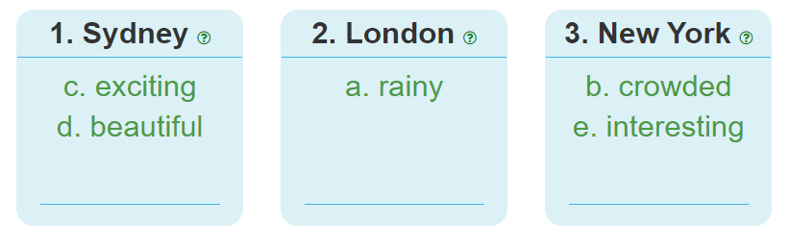

Slide 16

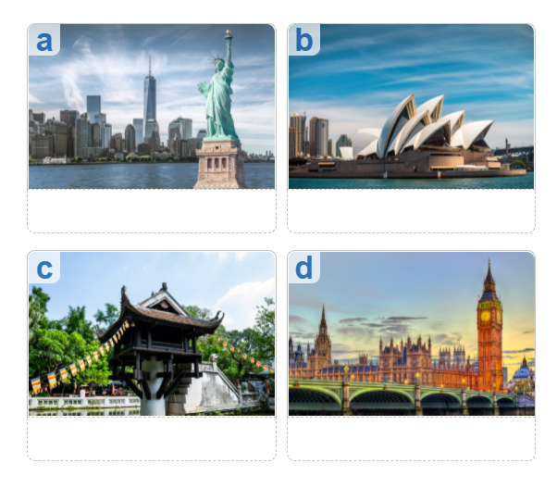
1. Ha Noi
2. London
3. New York
Sydney

Slide 17

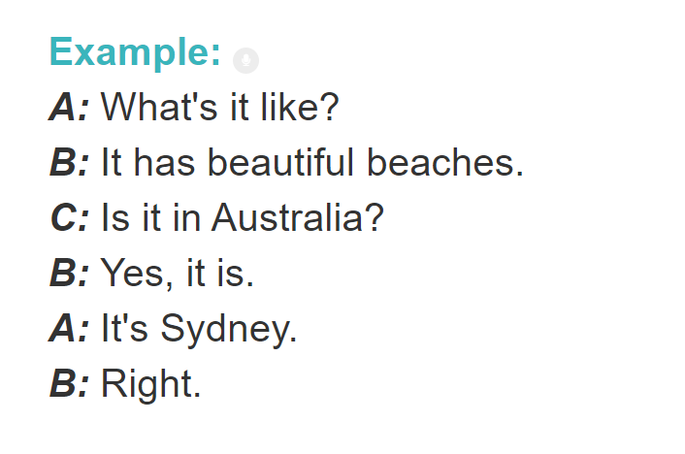

Slide 18
Sum up
By the end of the lesson, students can be able to:
- use the lexical items related to the topic Cities of the World;
- use the vocabulary and structures to describe cities and landmarks.
Do exercises in workbook
Prepare “A CLOSER LOOK 1” part.

Slide 19
Thank you for your attention!
Presentation Template: SlidesMania.com

