Slide 1

Unit 8:
Sports and games
Part 3: A closer look 2

Slide 2
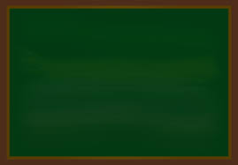
13rd, February , 2023
Period 64 Unit 8: SPORTS AND GAMES
Lesson 3: A closer look 2(p.19)

Slide 3
Objectives
By the end of the lesson, students will be able to:
use the past simple tense and imperatives.

Slide 4
13rd, February , 2023
Period 64 Unit 8: SPORTS AND GAMES
Lesson 3: A closer look 2(p.19)
I/ Grammar
* Past simple tense ( thì quá khứ đơn)
Usage ( cách sử dụng)
Form (công thức)
Adverbs ( trạng từ nhận biết)

Slide 5


Slide 6
13rd, February , 2023
Period 64 Unit 8: SPORTS AND GAMES
Lesson 3: A closer look 2(p.19)
I/ Grammar
* Past simple tense ( thì quá khứ đơn)
Usage ( cách sử dụng): Diễn tả sự việc đã xảy ra và chấm dứt trong quá khứ
Form ( công thức)

Slide 7
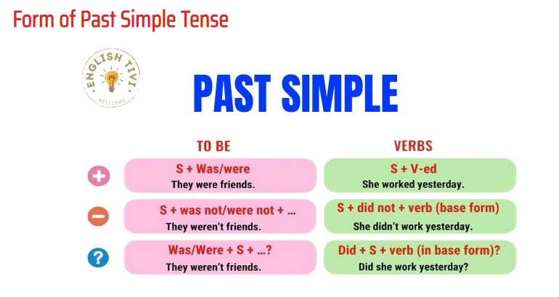
PAST SIMPLE
TO BE
VERBS
S + was/ were + O.
They were friends.
S + V-ed + O.
She worked yesterday.
S + was not/ were not + O.
They weren’t friends.
S + did not + Vo+ O.
She didn’t work yesterday.
Was/ Were + S + O.
Were they friends?
did + S + Vo + O.
Did she work yesterday?

Slide 8
Verb in past Simple Tense
Regular verbs
Động từ có quy tắc
Irregular verbs
Động từ bất quy tắc
Play → played
Ask → asked
Score → scored
Visit → visited
See → saw
Sleep → slept
Have → had
Do → did
Eat → ate
Go → went

Slide 9
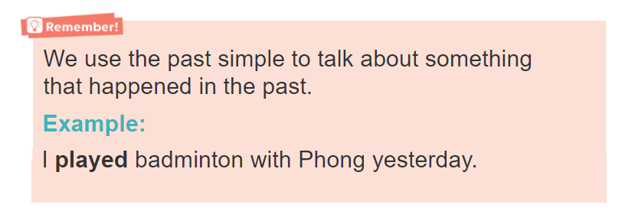
Recognition of Past Simple Tense
The sentence contains adverbs indicating frequency such as: Yesterday, last week, last month, last year, last Christmas, in 2010, two weeks ago

Slide 10
13rd, February , 2023
Period 64 Unit 8: SPORTS AND GAMES
Lesson 3: A closer look 2(p.19)
I/ Grammar
* Past simple tense ( thì quá khứ đơn)
Usage ( cách sử dụng): Diễn tả sự việc đã xảy ra và chấm dứt trong quá khứ
Form ( công thức)
Adverbs: Yesterday, last week, last month, last year, last Christmas, in 2010, two days ago, in the past, when I was small…
* Practice

Slide 11
GAME
CHOOSE THE BEST ANSWER
START

Slide 12


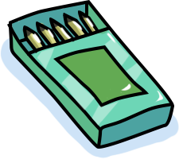















There ____ an interesting match on TV last night.
is
were
was

Slide 13







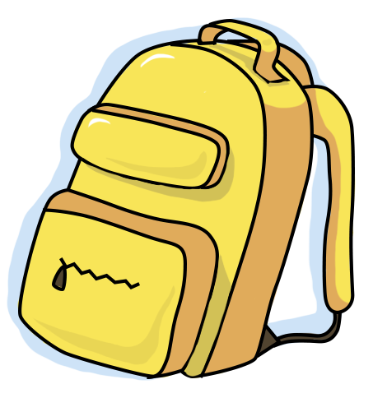

My dad____ a lot of tennis some years ago.
plays
played
is playing

Slide 14


I was at the gym last Sunday, but
I ____ you there.
Not saw
don’t see
didn’t see

Slide 15
The teacher ___ us about our homework this morning.
doesn’t ask
Not asking
didn’t ask

Slide 16

___ sleep well last night?
Do you
Did you
Were you

Slide 17
13rd, February , 2023
Period 64 Unit 8: SPORTS AND GAMES
Lesson 3: A closer look 2(p.19)
I/ Grammar
* Past simple tense ( thì quá khứ đơn)
Practice
Act 2: Give the correct form of the verbs

Slide 18

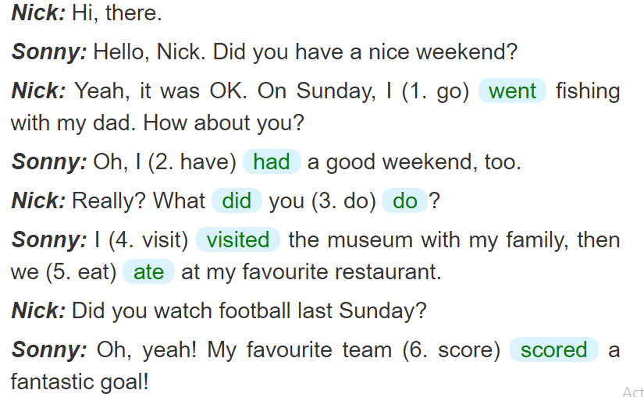

Slide 19
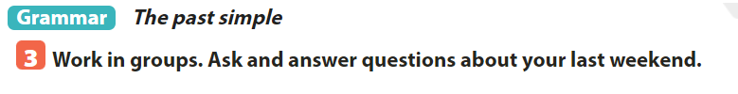
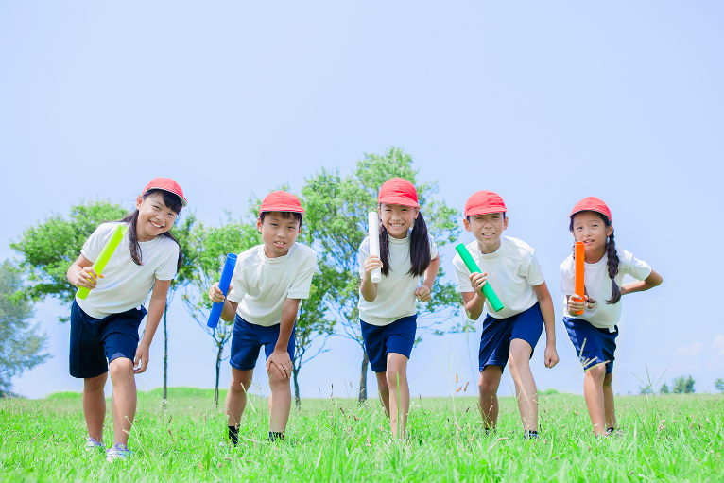
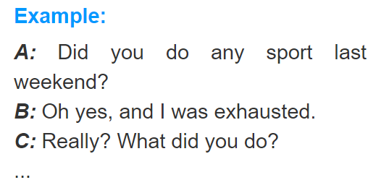

Slide 20
SUGGESTED ANSWER
A: Did you do any sports last weekend?
B: Oh, yes, and I was exhausted.
C: Really? What did you do?
A: I played football with my neighbours at the stadium. We had a great football match.
B: What was the result?
A: We won and I scored a beautiful goal. How about you?
B: I also had a nice weekend with my family. We had a barbecue in the park near our house.
C: Did you fly the kites? It was windy last weekend.
B: Oh, yes. I had a lot of fun. How was your last weekend?
C: I came back my hometown to visit my grandparents. I swam in the river with the children there. It was really interesting.
A: It sounds great!

Slide 21
13rd, February , 2023
Period 64 Unit 8: SPORTS AND GAMES
Lesson 3: A closer look 2(p.19)
I/ Grammar
* Past simple tense ( thì quá khứ đơn)
Practice
Act 2: Give the correct form of the verbs
* Imperative ( câu mệnh lệnh)

Slide 22

Câu mệnh lệnh
Mệnh lệnh khẳng định
V+ …..
Stop talking
Watch out
Mệnh lệnh phủ định
Don’t + V +….
Don’t touch that cat
Don’t climb the tree

Slide 23
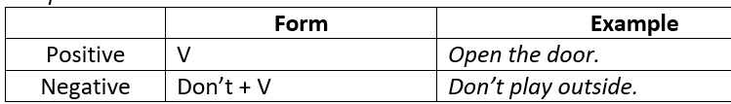
Imperatives
use imperatives to tell someone to do something or to give direct order.
Example:
Pay your fee first.
Put on your trainers / sports shoes.
Listen to the teacher carefully.
Don’t litter.
Don’t eat or drink at the gym.

Slide 24

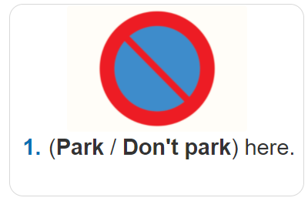
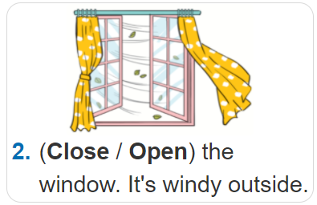
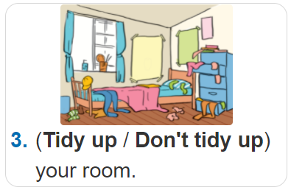
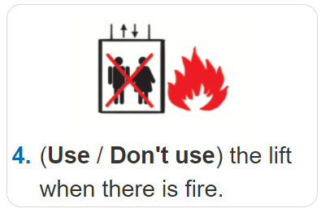
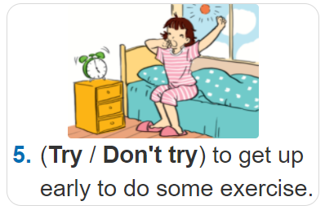

Slide 25

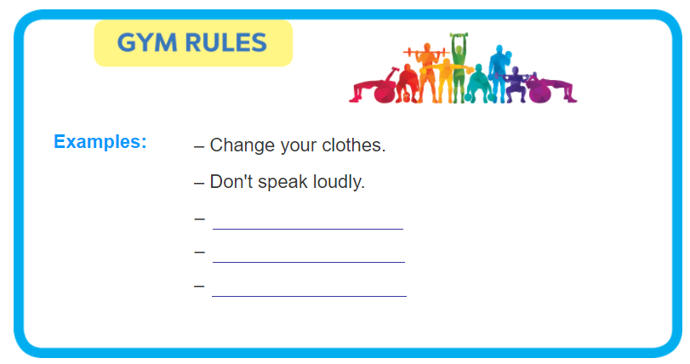
Pay your fee first.
Put on your trainers.
Don’t litter.

Slide 26
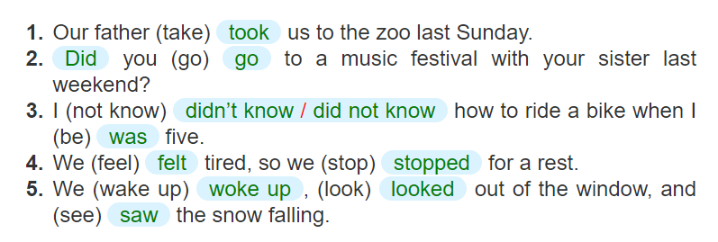

Slide 27
Wrap- up
By the end of the lesson, students will be able to:
use the past simple tense and imperatives.
HOMEWWORK
- Make 3 sentences about yourself, using the past simple.
- Give 3 orders or tell your friends to do an activity/ everyday routine.
- Do exercise B1, 6 page 10,11 ( workbook)
- Prepare “ Communication” part.

