Slide 1





Grade 6
Unit 7:
TELEVISION
Part 1: Getting started

Slide 2
Objectives
Use vocabulary related to the topic television
programmes for children
Talk about
famous children’s programmes.

Slide 3


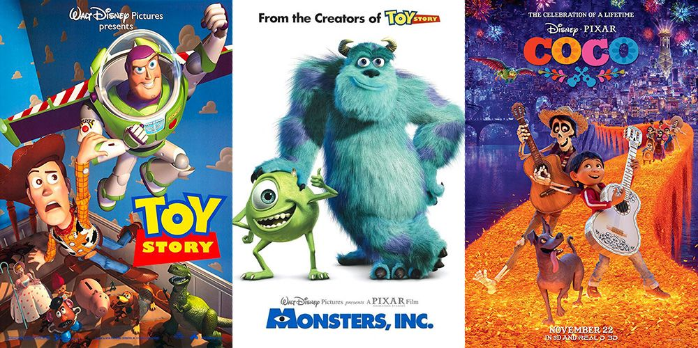

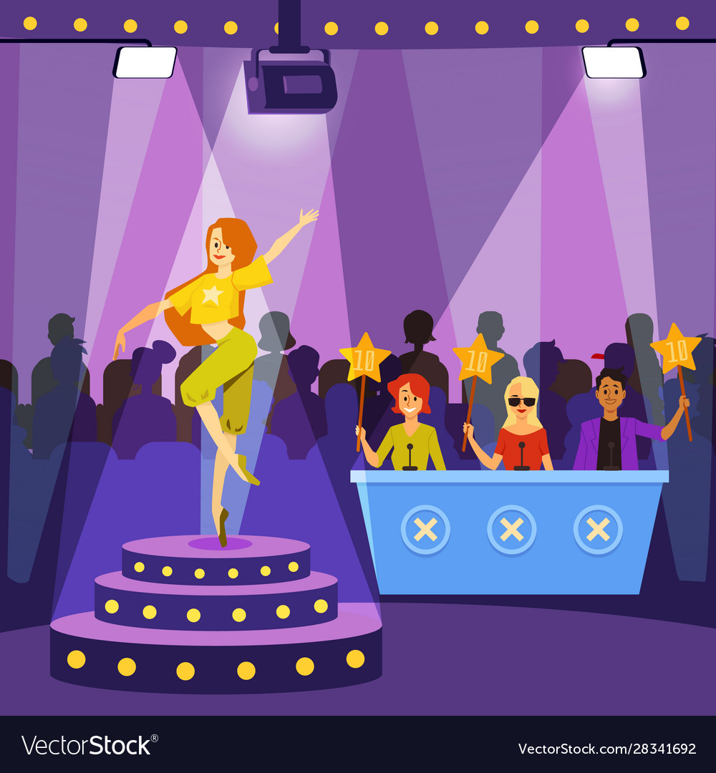

Vocabulary
1. programme (n) /ˈprəʊɡræm/
2. animated (adj) /ˈænɪmeɪtɪd/
3. prefer (v) /prɪˈfɜːr/
4. character (n) /ˈkærəktər/​
5. educational (adj) /ˌedʒuˈkeɪʃənl/
6. talent (n) /ˈtælənt/
(Chương tình truyền hình)
(phim) Hoạt hình
Thích hơn, quan tâm
Nhân vật
Có giáo dục, thuộc về giáo dục
Tài năng

Slide 4
Checking Vocabulary
1. programme (n) /ˈprəʊɡræm/
2. animated (adj) /ˈænɪmeɪtɪd/
3. prefer (v) /prɪˈfɜːr/
4. character (n) /ˈkærəktər/​
5. educational (adj) /ˌedʒuˈkeɪʃənl/
6. talent (n) /ˈtælənt/
Chương tình truyền hình)
(phim) Hoạt hình
Thich hơn, quan tâm
Nhân vật
Có giáo dục, thuộc về giáo dục
Tài năng

Slide 5

16th, January , 2023
Period 55 Unit 7: TELEVISION
Lesson 1: Getting started(p.6)
* Vocabulary
Programme (n) chương trình truyền hình
Animated (a) thuộc phim hoạt hình sôi động
Prefer (v) thích hơn, quan tâm
Character (n) nhân vật
Educational (a) mang tính giáo dục
Talent (n) tài năng
I. Listen and read

Slide 6

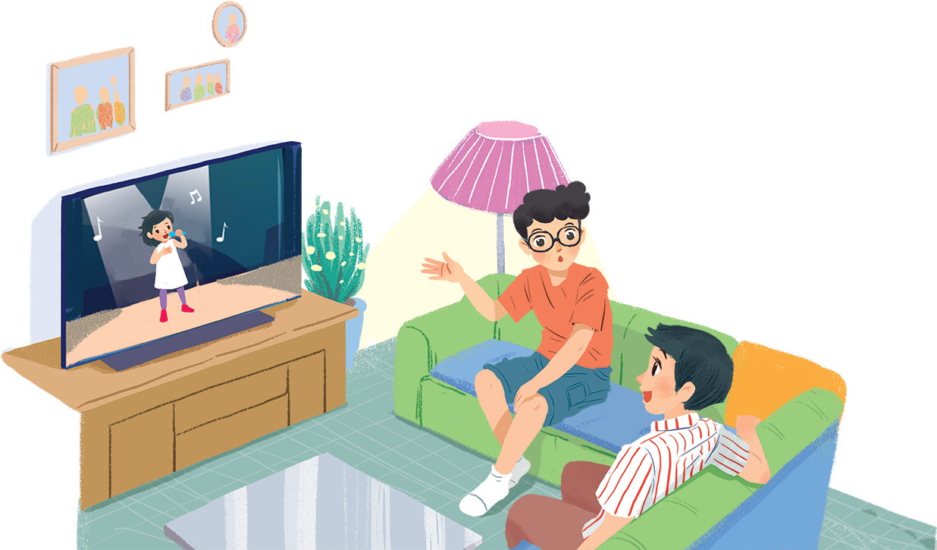

Before Listening
What do you see in the picture?
Which TV programs do you usually watch?

Slide 7


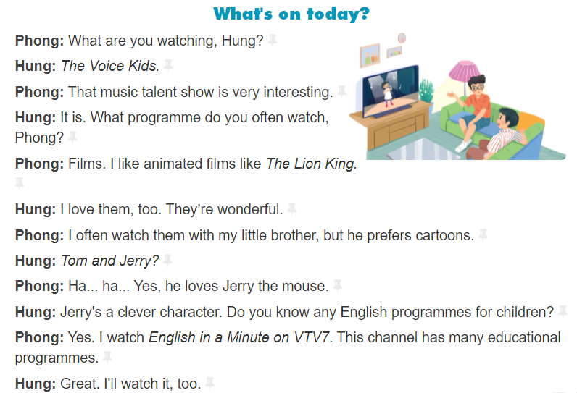

Slide 8
16th, January , 2023
Period 55 Unit 7: TELEVISION
Lesson 1: Getting started(p.6)
* Vocabulary
I.Listen and read
II. Practice
Activity 2: Choose the correct answer

Slide 9
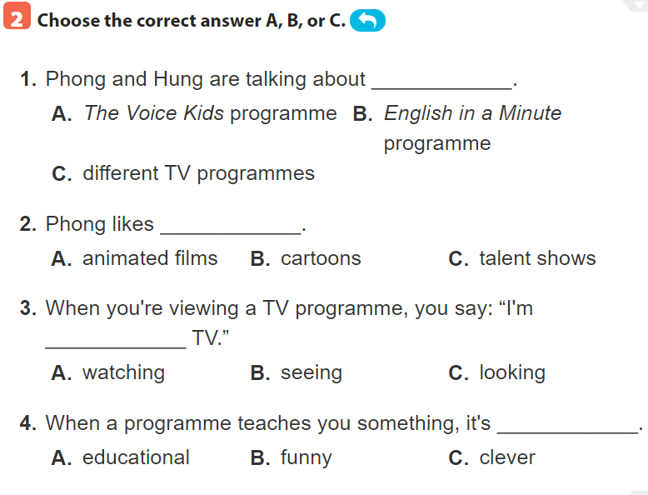
Hung: The Voice Kids.
Phong: Films. I watch English in a Minute on VTV7. This channel has many educational programmes.
Phong: Films. I like animated films like The Lion King.
Phong: I often watch them with my little brother, but he prefers cartoons.
Hung: Tom and Jerry?
Phong: Yes. I watch English in a Minute on VTV7. This channel has many educational programmes.

Slide 10
16th, January , 2023
Period 55 Unit 7: TELEVISION
Lesson 1: Getting started(p.6)
* Vocabulary
I.Listen and read
II. Practice
Activity 2: Chose the correct answer
1.C 2. A 3.A 4.A
Activity 3: Match 1-5 with a-e

Slide 11
1. The Voice Kids
a. Animated film
2. The Lion King
b. Channel
3. Tom and Jerry
c. Music talent show
4. VTV7
d. Educational programme
5. English in a Minute
e. cartoon

Slide 12
16th, January , 2023
Period 55 Unit 7: TELEVISION
Lesson 1: Getting started(p.6)
* Vocabulary
I.Listen and read
Activity 2: Chose the correct answer
Activity 3: Match 1-5 with a-e
1.C 2.A 3.E 4. B 5. D

Slide 13
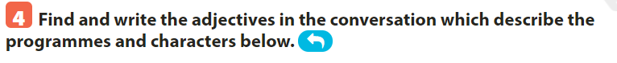
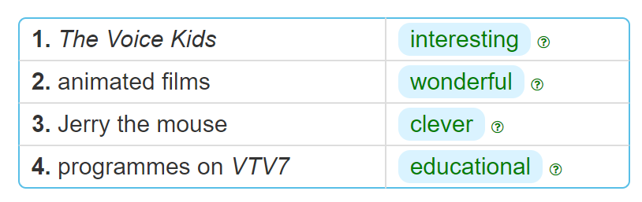
Phong: I often watch them with my little brother, but he prefers cartoons.
Hung: Tom and Jerry?
Phong: Yes. I watch English in a Minute on VTV7. This channel has many educational programmes.
Phong: Films. I like animated films like The Lion King.
Hung: The Voice Kids.
Phong: That music talent show is very interesting.

Slide 14
16th, January , 2023
Period 55 Unit 7: TELEVISION
Lesson 1: Getting started(p.6)
* Vocabulary
I. Listen and read
Activity 2: Chose the correct answer
Activity 3: Match 1-5 with a-e
Activity 4: Write the adjectives
Interesting
Wonderful
Clever
Educational

Slide 15

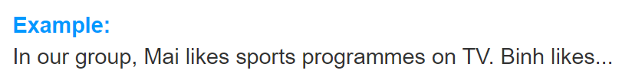
Binh likes animated films.
Hoa enjoys watching Tom and Jerry cartoon.
Hung is interested in The Voice Kids, a music talent show.
I really like English in a minute, an educational programme.

Slide 16
WRAP-UP
VOCABULAY: animated, educational, talent, programme, channel…..
Program : cartoon, music show, The Voice Kids ….
HOMEWORK:
Write your favourite TV programmes on link padlet
Prepare for “A closer look 1” part.
Mobile: 0988 843 590

Slide 17


