Slide 1





Grade 6
Unit 7:
TELEVISION
Part 2: A closer look 1

Slide 2
Objectives
Use the vocabulary and structures to talk about TV programmes
Pronounce and the sounds /θ/ and /ð/ correctly.

Slide 3
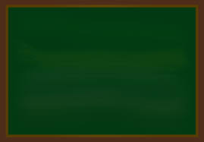
17th, January , 2023
Period 56 Unit 7: TELEVISION
Lesson 2: A closer look 1(p.8)
I/ Vocabulary

Slide 4
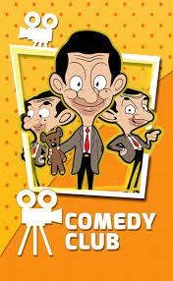
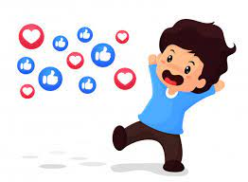
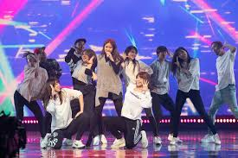

Vocabulary
Cer
Comedy /ˈkɒmədi / (n)
Popular /ˈpɒpjələ(r)/ (adj)
Perform /pəˈfɔːm/ (v)
Performer /pəˈfɔːmə(r)/ (n)
Phim hài
Phổ biến, được yêu thích
Biểu diễn
Người biểu diễn

Slide 5
17th, January , 2023
Period 56 Unit 7: TELEVISION
Lesson 2: A closer look 1(p.8)
I/ Vocabulary
Comedy (n) phim hài
Popular (a) được yêu thích
Perform (v) biểu diễn
Performer (n) người biểu diễn
* Practice

Slide 6

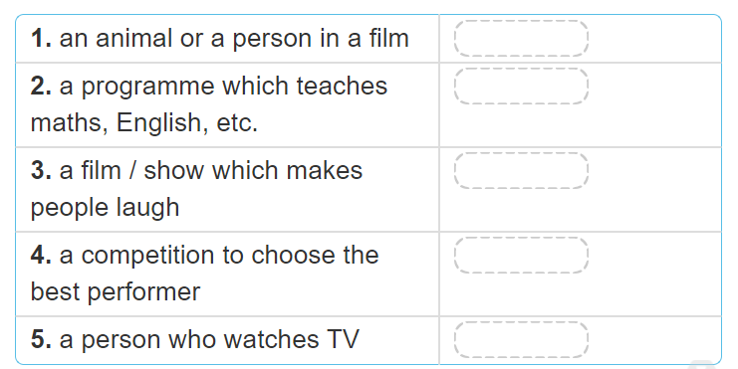
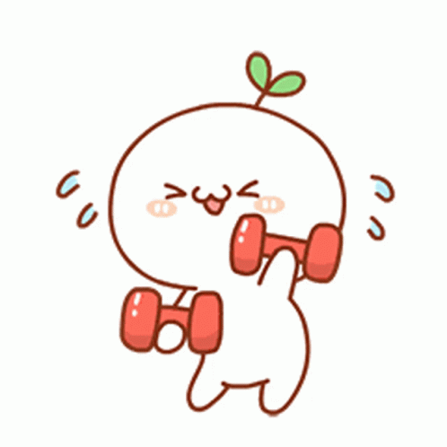
Talent show
viewer
comedy
character
Educational programme

Slide 7
17th, January , 2023
Period 56 Unit 7: TELEVISION
Lesson 2: A closer look 1(p.8)
I/ Vocabulary
* Practice
Actvity 1:
Character
Educational programme
Comedy
Talent show
Viewer

Slide 8

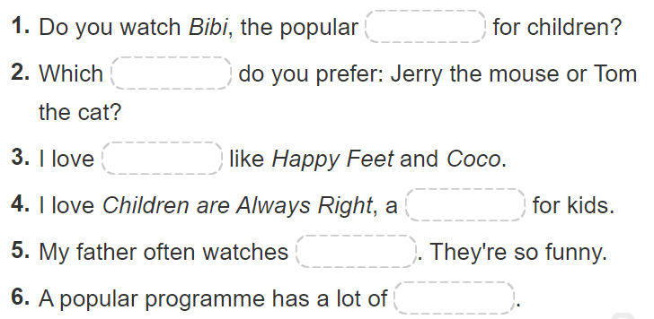
character
animated films
viewers
comedies
game show
channel

Slide 9

Choose the best answer
Note: click anywhere to run the time.
Click a, b or c to choose the correct answer.

Slide 10


1. Do you watch Bibi, the popular……….. for children?
5
4
1
3
2
a. Animated film
b. channel
c. comedies

Slide 11
2. Which …….. do you prefer: Jerry the mouse or Tom the cat?
5
4
1
3
2
a. character
b. Animated film
c. Game show

Slide 12
3. I love …………like Happy Feet and Coco.
5
4
1
3
2
a. game show
b. animated films
c. comedies

Slide 13
4. I love Children are Always Right, a …………..for kids.
5
4
1
3
2
a. Animated film
b. viewer
c. game show

Slide 14
5. My father often watches ………. They're so funny.
5
4
1
3
2
a. comedies
b. Animated film
c. viewers

Slide 15
6. A popular programme has a lot of ……...
5
4
1
3
2
a. channels
b. characters
c. viewers

Slide 16
17th, January , 2023
Period 56 Unit 7: TELEVISION
Lesson 2: A closer look 1(p.8)
I/ Vocabulary
* Practice
Actvity 1:
Activity 2:
1.channel 2. character
3. animated films 4. game show
5. comedies 6. viewers
- Activity 3:

Slide 17

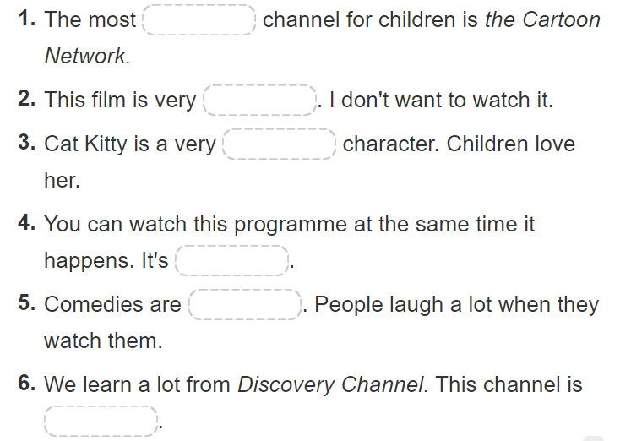
popular
cute
live
educational
boring
funny

Slide 18
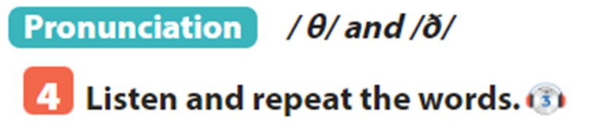
17th, January , 2023
Period 56 Unit 7: TELEVISION
Lesson 2: A closer look 1(p.8)
I/ Vocabulary
* Practice
Activity 3:
1. popular 2. boring 3. cute
4. Live 5. funny 6. educational
II/ Pronunciation

Slide 19
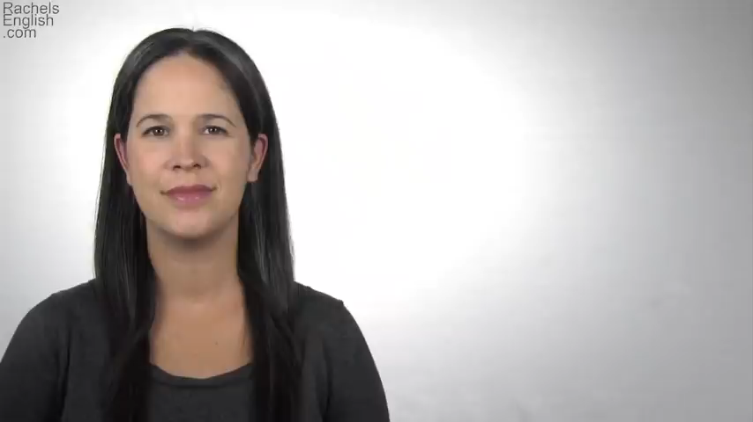
How to pronounce /θ/ and /ð/
PRONUNCIATION

Slide 20

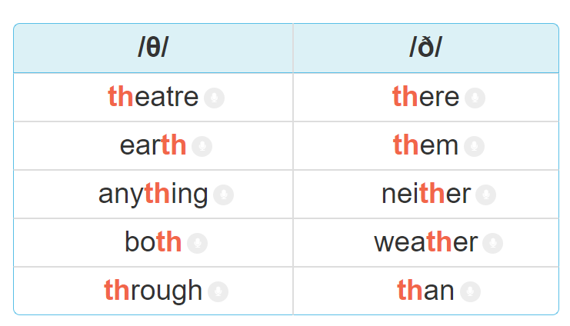

Slide 21

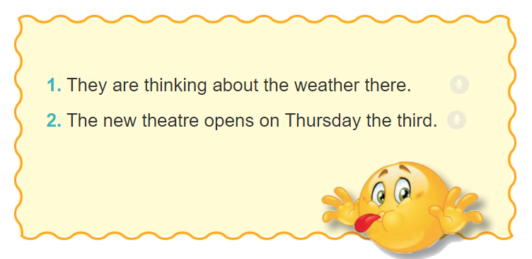

Slide 22
WRAP-UP
VOCABULAY: comedy, viewer, popular, live, channel …..
Pronunciation: Pronounce and the sounds /θ/ and /ð/ correctly.
HOMEWORK:
Do exercises A1, A2, B1,2,3 on page 3-4 ( Workbook)
Prepare for “A closer look 2” part.

Slide 23

/.,mkjhbg cfds12345678m9,0.o[/pư\’

