Slide 1
Unit 11: OUR GREENER WORLD lesson 6: Skills 2
Grade 6

Slide 2
Objectives
By the end of the lesson, students can be able to:
listen to get specific information about way to make the school a ‘green’ place;
write a paragraph about ways to make the school a ‘green’ place.

Slide 3

Explore vocabulary
Encourage (v) /ɪnˈkʌr.ɪdʒ/
Organize (v) /ˈɔː.ɡən.aɪz/
Save (v) /seɪv/
Fair (n) /feər/
Khuyến khích
Sắp xếp
Cứu, giúp
Hội chợ

Slide 4
Part 1: LISTENING

Slide 5
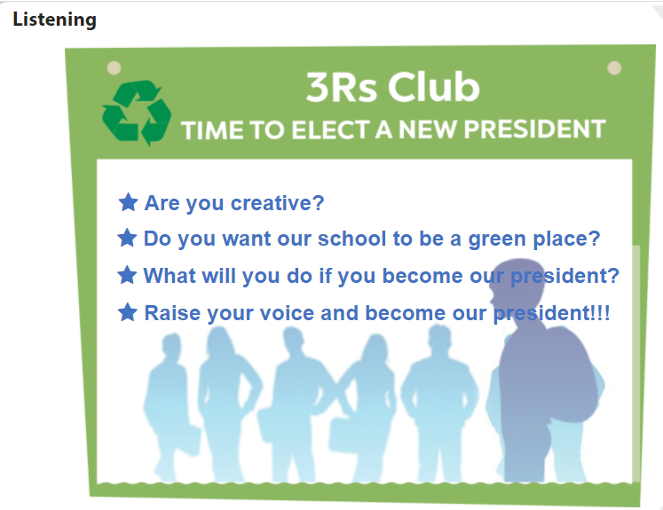

Slide 6
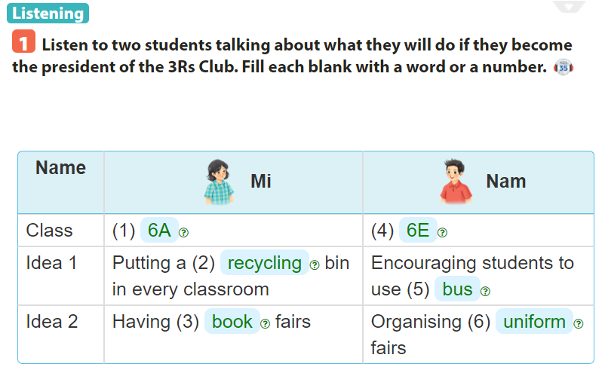

Slide 7
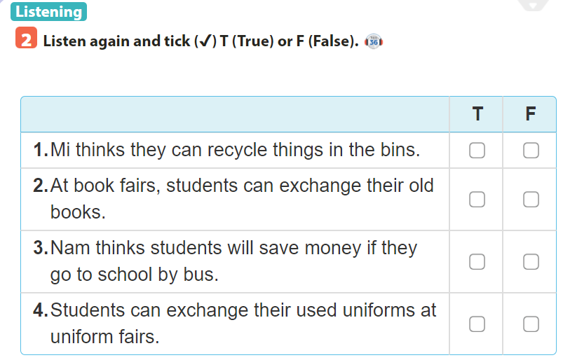


Slide 8
Part 2: WRITING

Slide 9
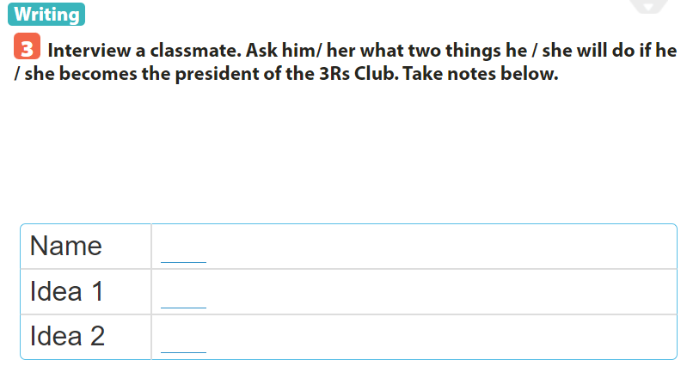
Mai
growing vegetables in the school garden
hold uniform fairs and exchange used uniforms

Slide 10
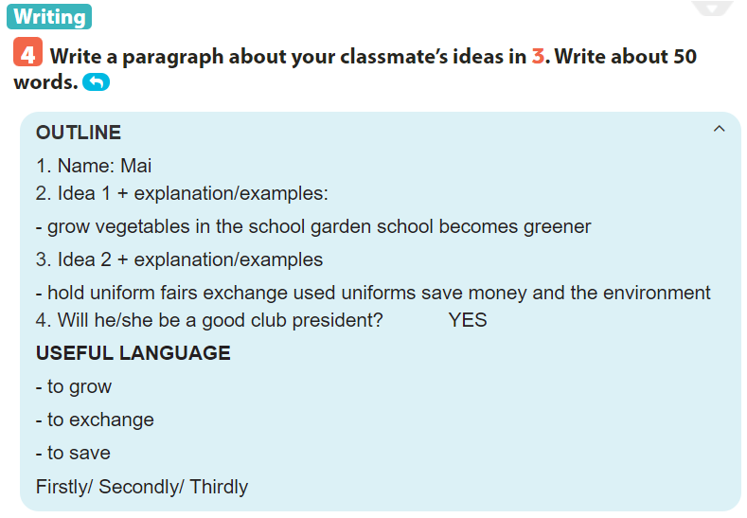

Slide 11
WRITING SAMPLE My classmate is Mai. If she becomes the president of the 3Rs Club, she will do two things. Firstly, she will talk to her friends about growing vegetables in the school garden. The school will become greener. Secondly, she will hold uniform fairs. We can exchange our used uniforms. We can save money and the environment. I think she will be a good president.

Slide 12
SUM UP
By the end of the lesson, students can be able to:
- listen to get specific information about way to make the school a ‘green’ place;
- write a paragraph about ways to make the school a ‘green’ place.
- Do exercise page ……

