Slide 1
Unit 10: OUR HOUSES IN THE FUTURE
Lesson 2: A closer look 1

Slide 2

28th, March , 2022
Period 81 Unit 10: OUR HOUSES IN THE FUTURE
Lesson 2: A closer look 1(p.40)

Slide 3
Objectives
By the end of the lesson, students can be able to:
01
use vocabularies and structures about household appliances;
02
pronounce the two-syllable words correctly.

Slide 4
28th, March , 2022
Period 81 Unit 10: OUR HOUSES IN THE FUTURE
Lesson 2: A closer look 1(p.40)
I/ Vocabulary

Slide 5
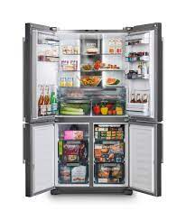
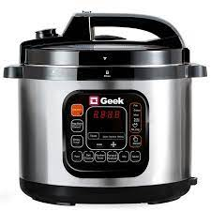
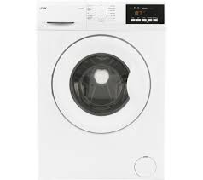

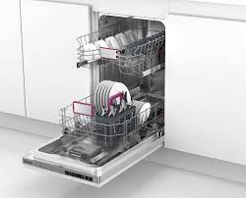
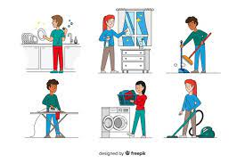

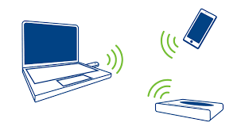
Explore vocabulary
electric cooker (n)
/ɪˈlektrɪk ˈkʊkə(r)/
2. dishwasher (n)
/ˈdɪʃˌwɒʃə(r)/
3. washing machine (n)
/ˈwɒʃɪŋ məˈʃiːn/
4. wireless (a)/ˈwaɪə(r)ləs/
5. Fridge (n) /frɪdʒ/
6. Housework (n) /ˈhaʊs.wɜːk/
7. Receive (v) /rɪˈsiːv/
Nồi cơm điện
Máy rửa bát
Máy giặt
Không dây
Tủ lạnh
Việc nhà cửa
Nhận, tiếp nhận

Slide 6
Checking vocabulary
electric cooker (n)
2. dishwasher (n)
3. washing machine (n)
4. wireless (a)
5. Fridge (n)
6. Housework (n)
7. Receive (v)
Nồi cơm điện
Máy rửa bát
Máy giặt
Không dây
Tủ lạnh
Việc nhà cửa
Nhận, tiếp nhận

Slide 7
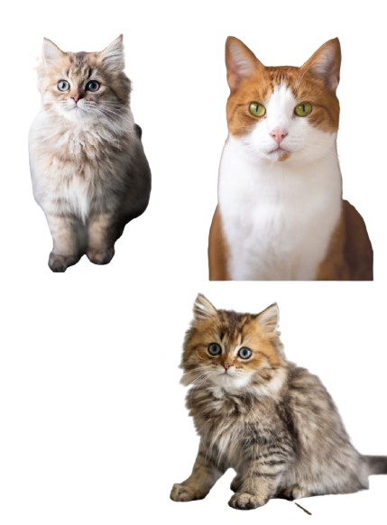
Part 1: vocabulary

Slide 8
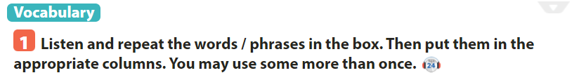
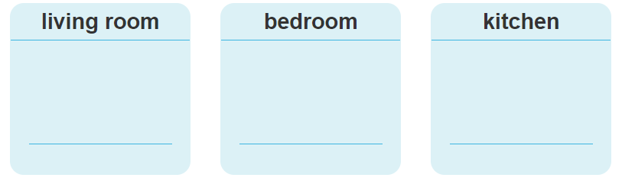
electric cooker
washing machine
fridge
computer
computer
Wireless TV
dishwasher
Wireless TV
electric fan
Smart clock
Smart clock

Slide 9

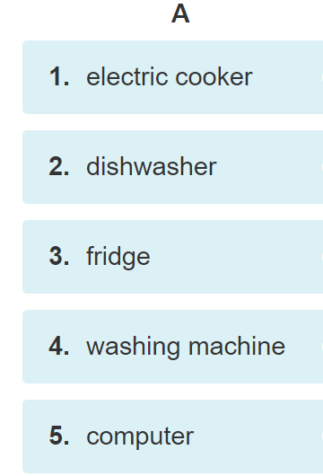
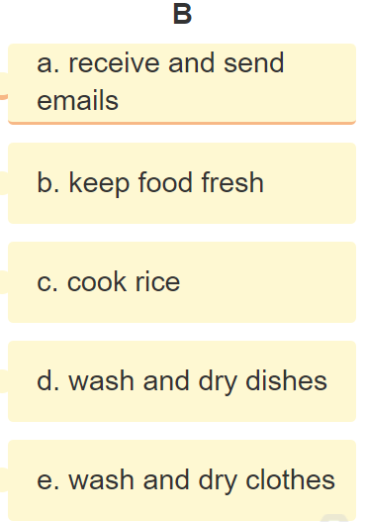

Slide 10
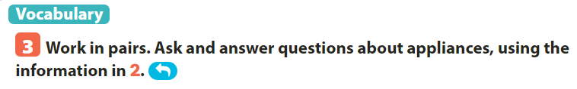
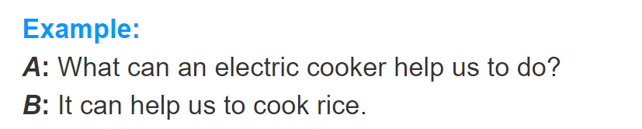
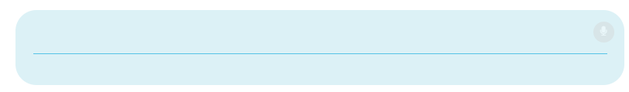
EXAMPLE
A: What can a dishwasher help us to do?
B: It can help us to wash and dry dishes.
A: What can a fridge help us to do?
B: It can help us keep food fresh.

Slide 11
28th, March , 2022
Period 81 Unit 10: OUR HOUSES IN THE FUTURE
Lesson 2: A closer look 1(p.40)
I/ Vocabulary
II/ Pronunciation
Stress in 2- syllable words

Slide 12
Part 2: Pronunciation stress in 2-syllable words

Slide 13
1. Word Stress For Two-Syllable Words a. Two-Syllable Nouns If the word is a two-syllable noun, we usually place the stress on the FIRST syllable. Example: MONkey, TEAcher, DIStance, INsect, TAble, b. Two-Syllable Adjectives If the word is a two-syllable adjective, as with two-syllable nouns, we usually place the stress on the FIRST syllable. Examples: SIlent, BORing, LIttle, PURple, STUpid, CLEver, FRIEndly

Slide 14
1. Word Stress For Two-Syllable Words c. Two Syllable Verbs Conversely, if the word is a two-syllable verb we generally stress the SECOND syllable. Examples: beGIN, surVIVE, aTTEND, coLLECT, preVENT See more examples of verbs where the second syllable is stressed. d. Two Syllable Prepositions The SECOND syllable is also stressed if the word is a preposition. Examples: aROUND, beFORE, beLOW, inSIDE, toWARDS (See more examples of prepositions with stress on second syllable)

Slide 15

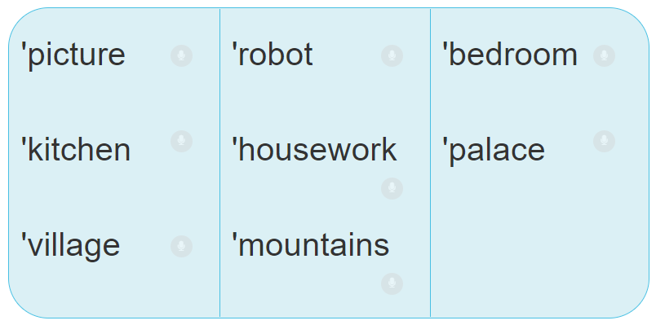

Slide 16
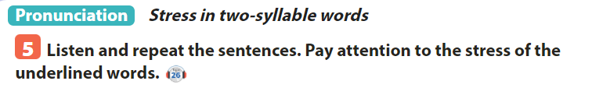
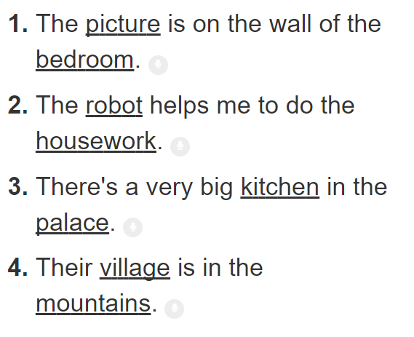
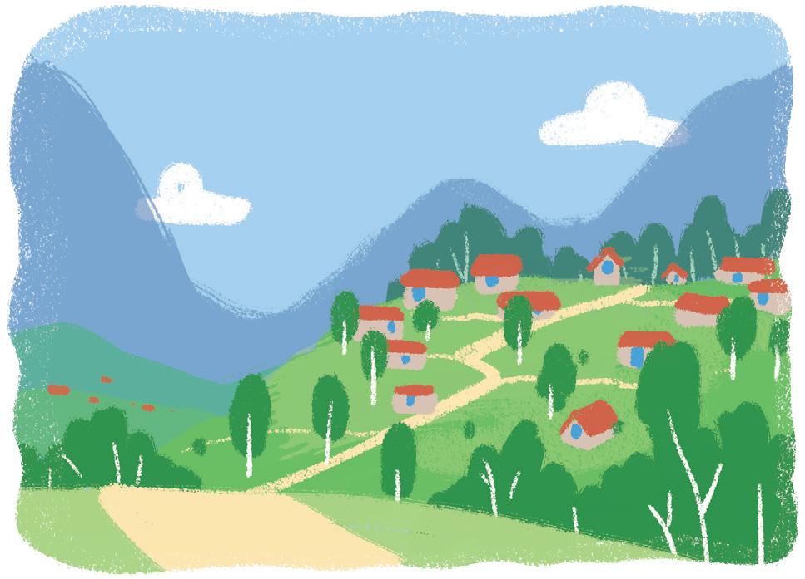

Slide 17
Sum up by the end of the lesson, students can be able to:
01
use vocabularies and structures about household appliances;
02
pronounce the two-syllable words correctly.
03
Do exercise page…..

