Slide 1




Welcome the Teachers to our class
ENGLISH 9
Ai Mo secondary school
The teacher: Vu Thi Trang

Slide 2

Unit 8: TOURISM
Lesson 5: Skills 1

Slide 3
Tourist destination
Phong Nha Cave
Mount Everest
Pyramids of Egypt
Son Doong Cave
Nha Trang beach
The Arctic
Kenya

Slide 4
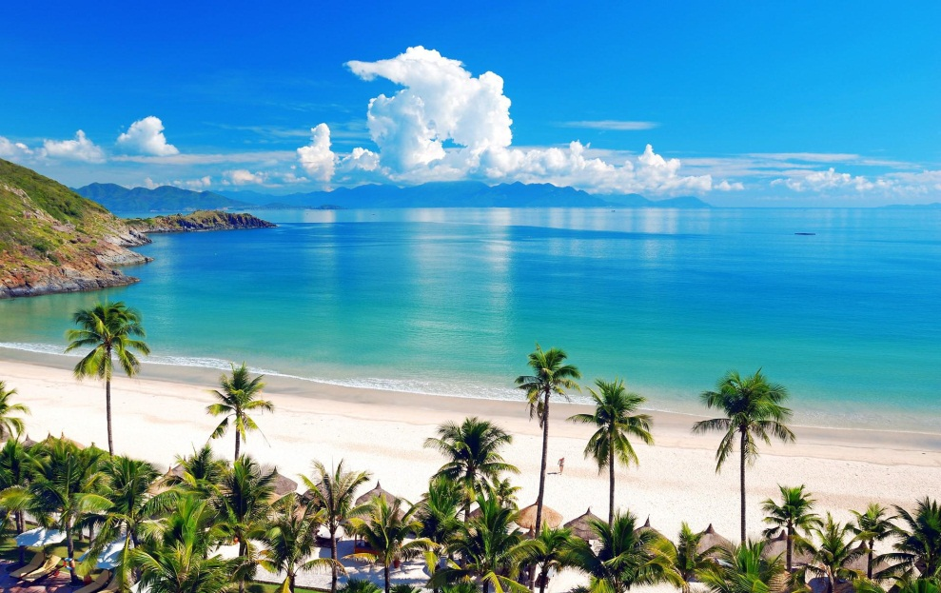
Nha Trang beach

Slide 5
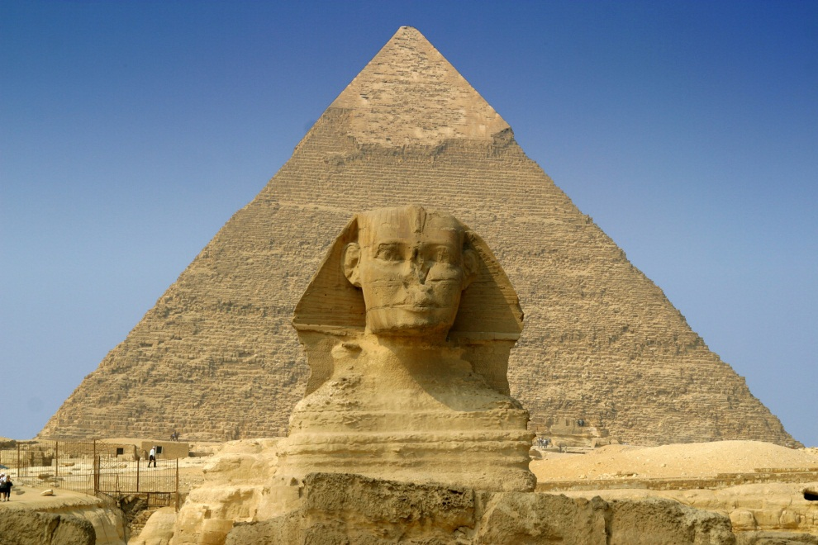
Pyramids of Egypt

Slide 6
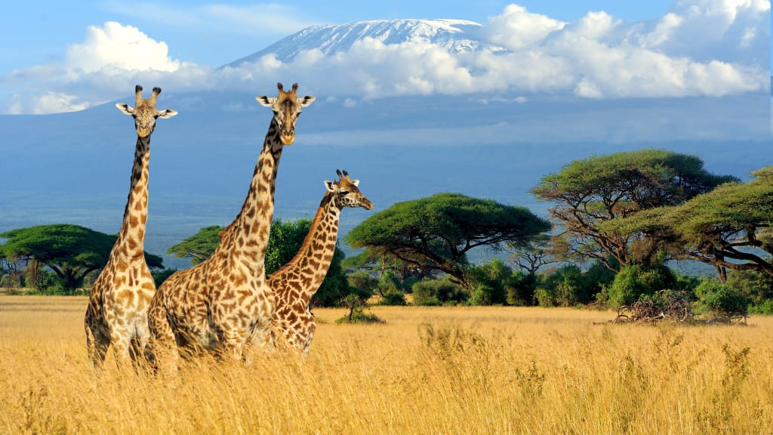
Kenya

Slide 7
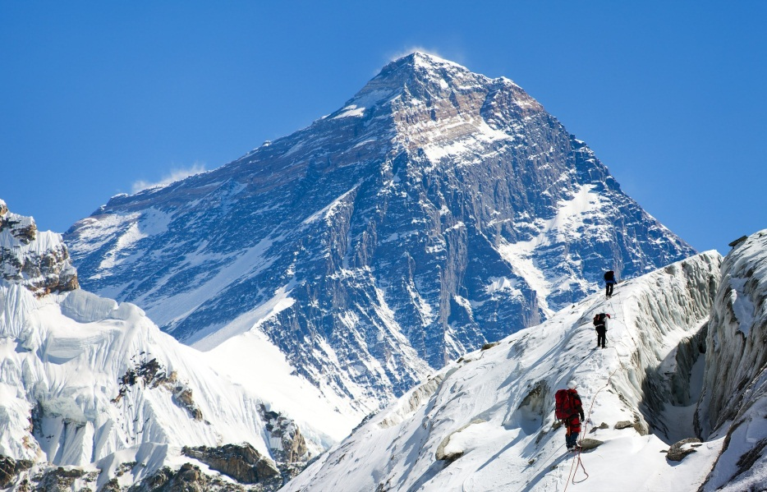
Mount Everest

Slide 8
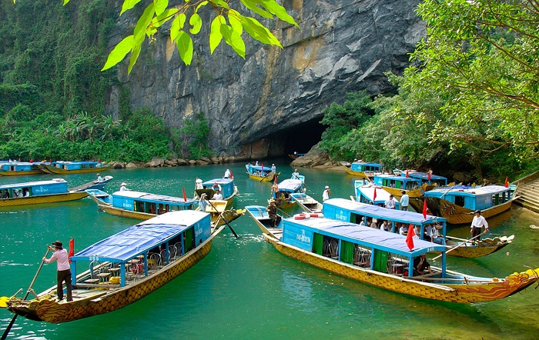
Phong Nha cave

Slide 9
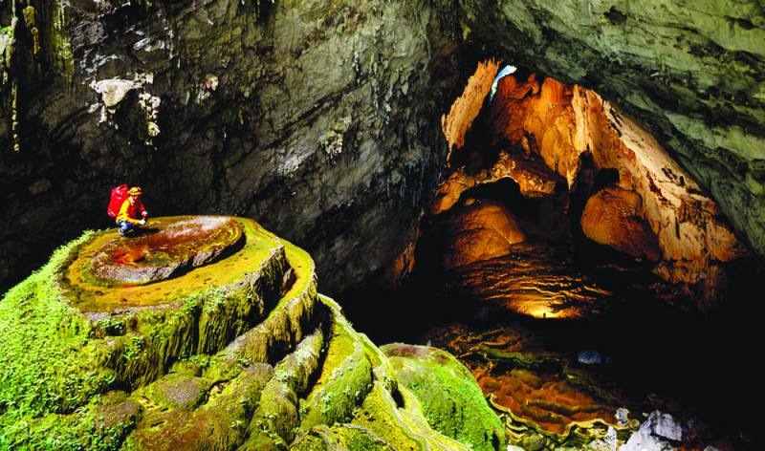
Son Dong cave

Slide 10
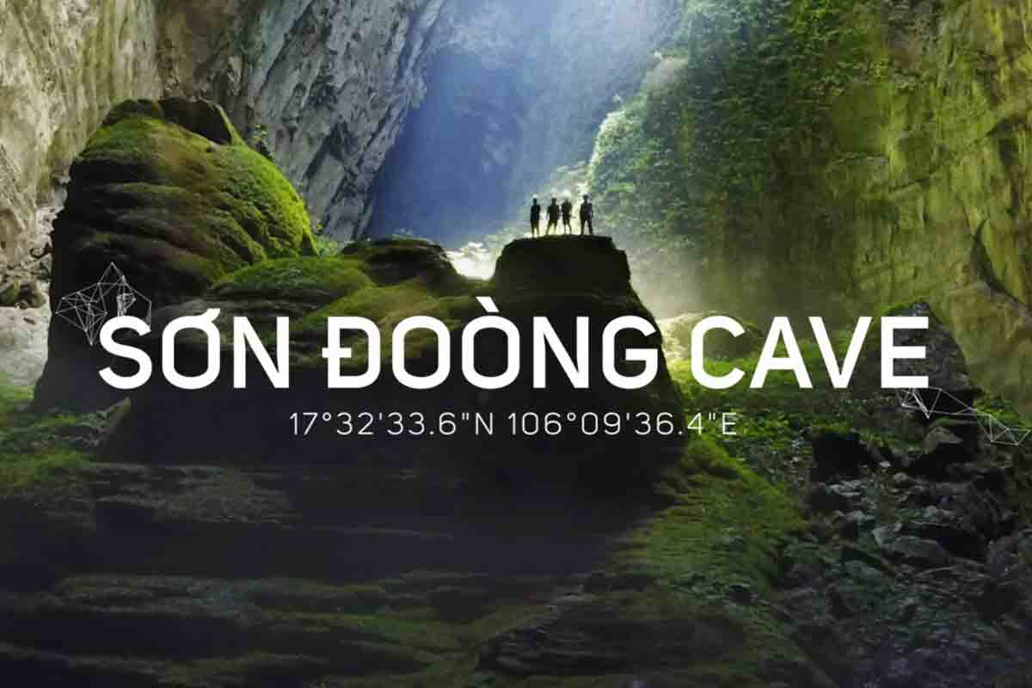
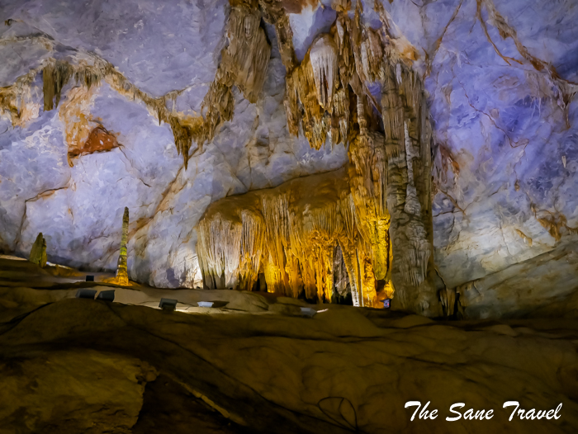

Slide 11
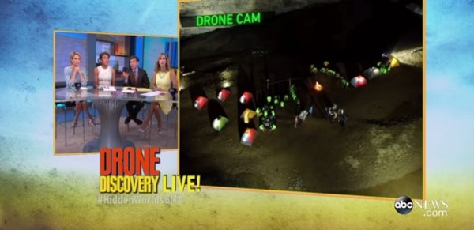
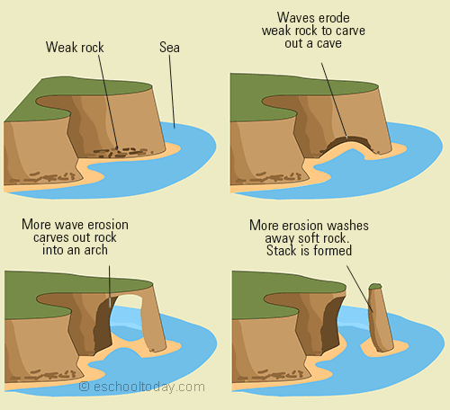
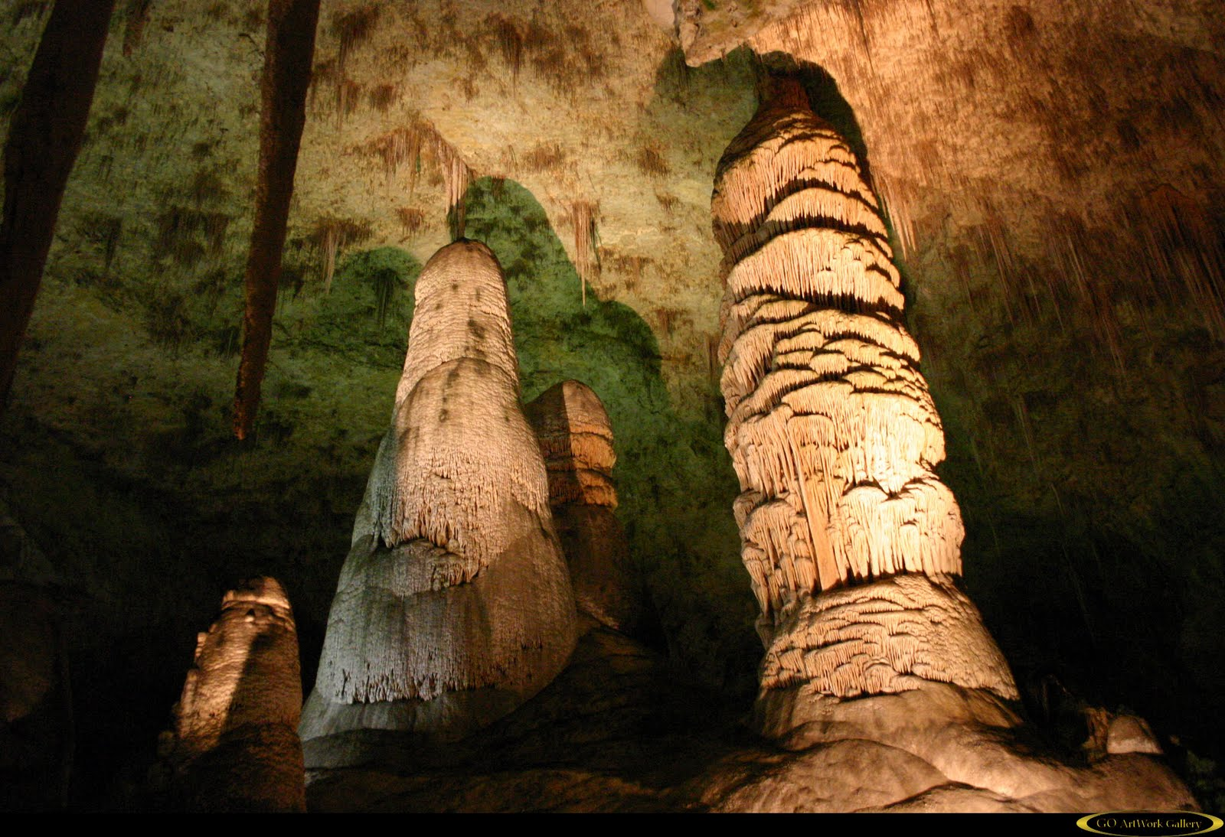
Match the sentences with pictures
Son Doong Cave contains some of the tallest stalagmites in the world.
b. The American Broadcasting Company aired a live program about Son Doong Cave on “Good morning America”.
c. River water erodes weak rock to carve out a cave.
1
2
3

Slide 12
b. The American Broadcasting Company aired a live program about Son Doong Cave on “Good morning America”.
1

Slide 13
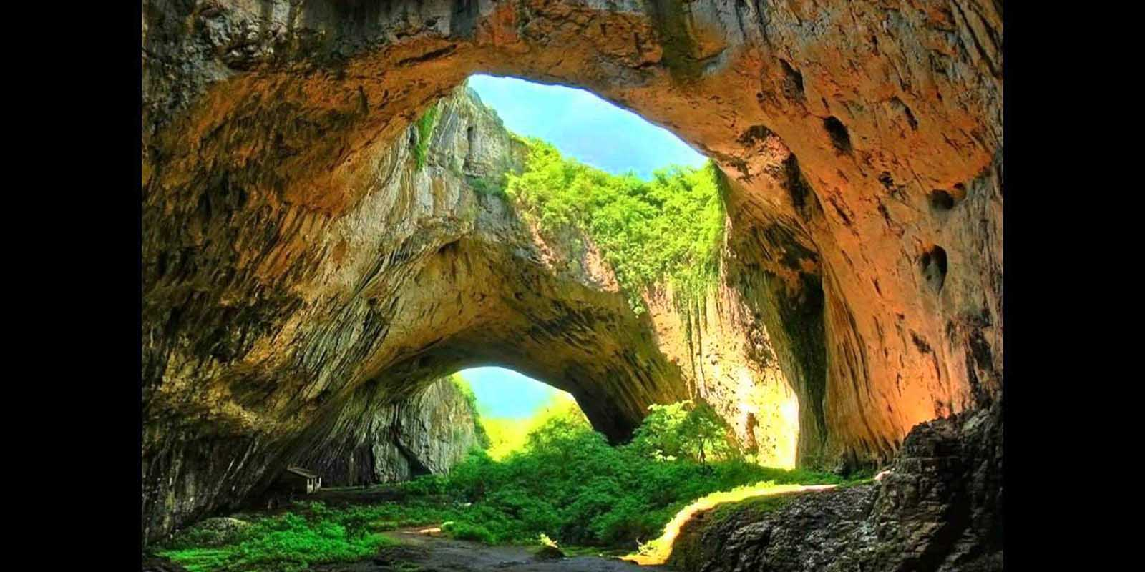
c. River water erodes weak rock to carve out a cave.
2

Slide 14
a. Son Doong Cave contains some of the tallest stalagmites in the world.
3

Slide 15
Air a live
Phát sóng trực tiếp
Erode (v)
/i'roud/
Erosion (n)
/i'rouʒn/
Sự xói mòn
Stalagmite(n)
['stæləgmait]
Măng đá

Slide 16
VOCABULARY
- magnficence (n):/mæɡˈnɪfɪsəns/
- discover (v): /dɪˈskʌvər/
- internationally (adv):
/ˌɪn.təˈnæʃənəli/
- limestone (n): /ˈlaɪm.stəʊn/
- Stalagmite (n): /ˈstæləɡmaɪt/
- access (v): /ˈæk.ses/
- inaccessible (adj): /ˌɪnəkˈsesəbəl/
- local man (n):
- Erode (v) -> erosion (n):
điểm nổi bật
khám phá
Thuộc về quốc tế
Đá vôi
Măng đá
có liên kết, kết nối
không thể kết nối được
người địa phương
Sự xói mòn

Slide 17
Now read the passage and check the information. Son Doong Cave has become more famous after the American Broadcasting Company (ABC) aired a live programme featuring its magnificence on ‘Good Morning America' in May 2015. Located in Quang Binh Province, Son Doong Cave was discovered by a local man named Ho Khanh in 1991, and became known internationally in 2009 thanks to British cavers, led by Howard Limbert. The cave was formed about 2 to 5 million years ago by river water eroding away the limestone underneath the mountain. It contains some of the tallest known stalagmites in the world - up to 70 metres tall. The cave is more than 200 metres wide, 150 metres high, and nearly 9 kilometres long, with caverns big enough to fit an entire street inside them. Son Doong Cave is recognised as the largest cave in the world by BCRA (British Cave Research Association) and selected as one of the most beautiful on earth by the BBC (British Broadcasting Corporation). In August 2013, the first tourist group explored the cave on a guided tour. Permits are now required to access the cave and are made available on a limited basis. Only 500 permits were issued for the 2015 season, which runs from February to August. After August, heavy rains cause river levels to rise and make the cave largely inaccessible.

Slide 18
1/Match the information with the time marks or measurements
a. In 1991
The height of stalagmite
b. In2009
Son Doong cave was discovered.
c. In 2013
The height of the cave
The cave became known worldwide.
d. 200m
The width of the cave
e. 150m
f.70m
The length of the cave
j. 9km
The first tourists explored the cave

Slide 19

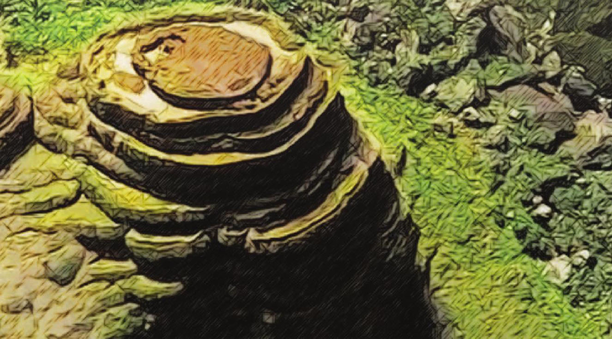
Where is Son Doong Cave located?
=> ………………………………….…
2. When was it discovered?
=> ……………………………
3. How long is the cave?
=> ……………………………
In Quang Binh Province, Viet Nam.
In 1991
The cave is nearly 9 kilometers in length.

Slide 20
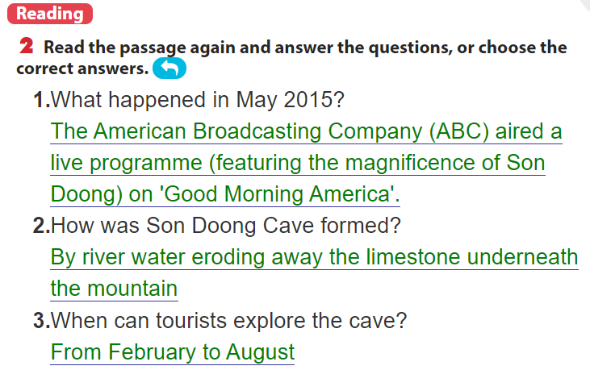
The American Broadcasting Company (ABC) aired a live programme (featuring the magnificence of Son Doong) on 'Good Morning America'.

Slide 21
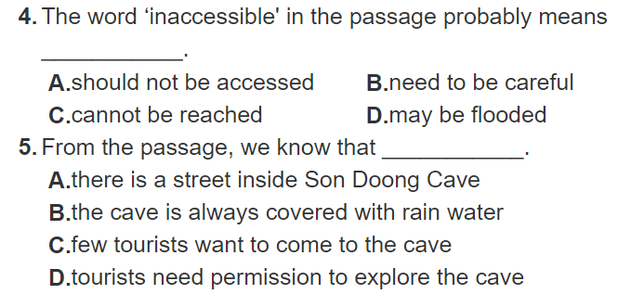

Slide 22
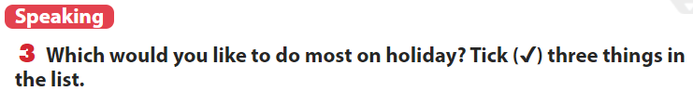
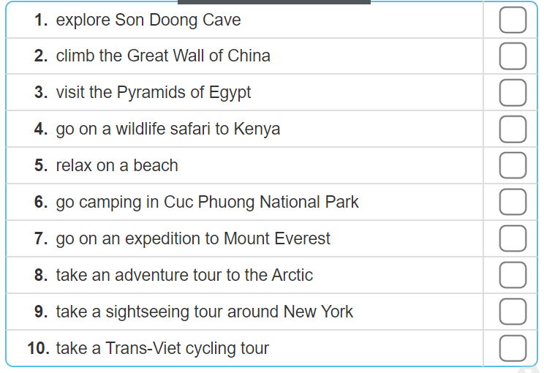

Slide 23
Explaination (giải thích)
1. explore Son Doong Cave (Khám phá hang Sơn Đòong)
2. climb the Great Wall of China (Leo lên Vạn Lý Trường Thành)
3. visit the Pyramids of Egypt (Thăm quan Kim Tự Tháp ở Ai Cập)
4. go on a wildlife safari to Kenya (Thăm quan cuộc sống thiên nhiên hoang dã ở Kenya)
5. relax on a beach (Thư giãn ở bãi biển)
6. go camping in Cuc Phuong national Park ( Đi cắm trại ở vườn quốc gia Cúc Phương.)
7. go on an expedition to Mount Everest (Đi thám hiểm ở đỉnh núi Everest.)
8. take an adventure tour to the Arctic (Một chuyến đi du lịch thám hiểm Bắc Cực.)
9. take a sightseeing tour around New York (Một chuyến đi ngắm cảnh vòng quanh New York.)
10. take a Trans-Viet cycling tour ( Một chuyến du lịch xuyên Việt bằng xe đạp.)

Slide 24
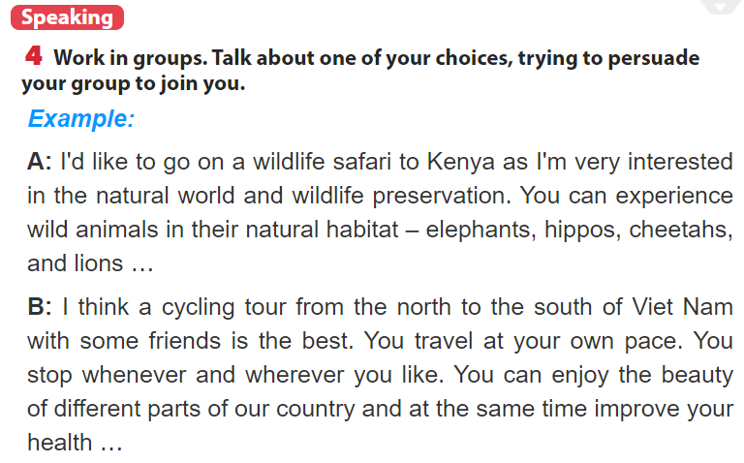

Slide 25



✓
Cooking Verbs
Grammar

Slide 26
Guides for homework
Speak about other place which you
would like to visit.
- Prepare next lesson: Skills 2

Slide 27
Thank you

