Slide 1

Unit 8: TOURISM
Lesson 1: Getting started
Notes:
亮亮图文旗舰店https://liangliangtuwen.tmall.com

Slide 2
Objectives
By the end of the lesson students will be able to:
Use the lexical items related to tourism.
Interact a conversation about tourism and travelling.
- Vocabulary: vocabulary related to tourism and travelling.

Slide 3
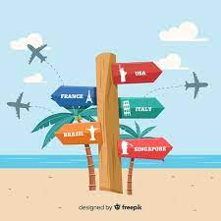

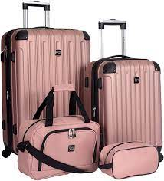
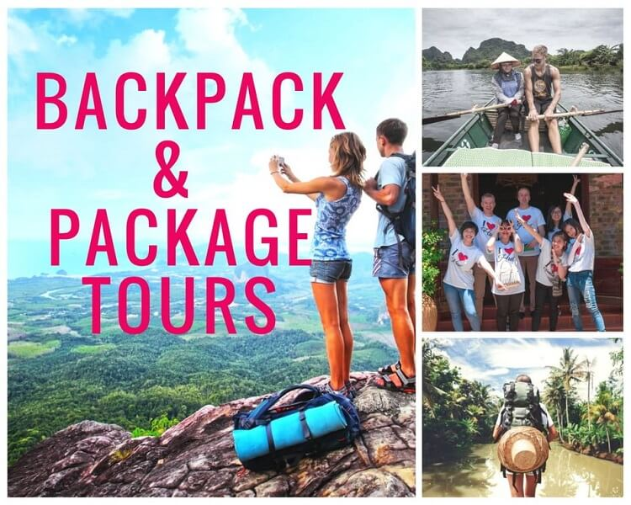
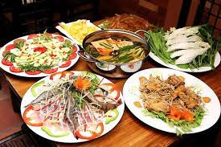
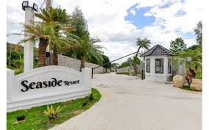

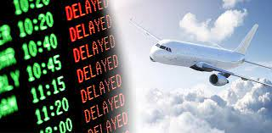
VOCABULARY
- luggage (n): /ˈlʌɡɪdʒ/
- destination (n): /ˌdestɪˈneɪ.ən/
- package tour: /ˈpækɪdʒ ˌtʊər/
- speciality (n): /ˌspeʃiˈæləti/
- price (n): /praɪs/
- delay (v): /dɪˈleɪ/
- seaside resort:
- make up one’s mind = decide:
- afford (v):
- narrow it down: thu hẹp lại
- my cup of tea:
hành lý
điểm đến
du lịch trọn gói
đặc sản
giá cả
trì hoãn
khu nghỉ dưỡng bãi biển
quyết định
có thể chi trả được
thu hẹp lại
sở thích/sự yêu thích của tôi

Slide 4
CHECKING VOCABULARY
1.
2.
3.
4.
5.
6.
7.
8.
9.
1011
điểm đến
trì hoãn
hành lý
du lịch trọn gói
thu hẹp lại
sở thích/sự yêu thích của tôi
có thể chi trả được
đặc sản
giá cả
khu nghỉ dưỡng bãi biển
quyết định
- luggage (n):
- destination (n):
- package tour:
- speciality (n):
- price (n): /praɪs/
- delay (v): /dɪˈleɪ/
- seaside resort:
- make up one’s mind = decide:
- afford (v):
- narrow it down:
- my cup of tea:

Slide 5

TRAVEL PLANS
Nick: Hi, Chau. How are things?
Chau: Good. Have you made up your mind about where to go on holiday?
Nick: Well, I've narrowed it down to two countries – my first choice is France and my second is Japan. What do you think?
Chau: Well, France is one of the largest countries in Europe. Since we've got a four-week summer holiday, you could go on a cycling tour of the country or go on a package tour.
Nick: No, I'm not into package tours. I'd like to visit the Alps, and climb Mont Blanc – the highest mountain in Western Europe. I'd also love to explore Paris, and go sightseeing in the historic city of Versailles.
Chau: Sounds exciting! I think it's quite warm there, much warmer than in Britain. I can just picture you, tanned and relaxed, tasting delicious local specialties like frogs' legs and snails!
Nick: Ha ha! That's not really my cup of tea. Perhaps I should go to Japan and stay at a seaside resort, eating sushi and sashimi every day! Anyhow, Japan is only my second choice.
Chau: Right. So what do your parents think about your plans?
Nick: Oh, they're cool. I'm glad that they let me make my own decisions.
Chau: Lucky you. Whatever you decide, you'll have a good time.
Nick: So what about you? Planning anything?
Chau: Well, my family … (fades out)

Slide 6
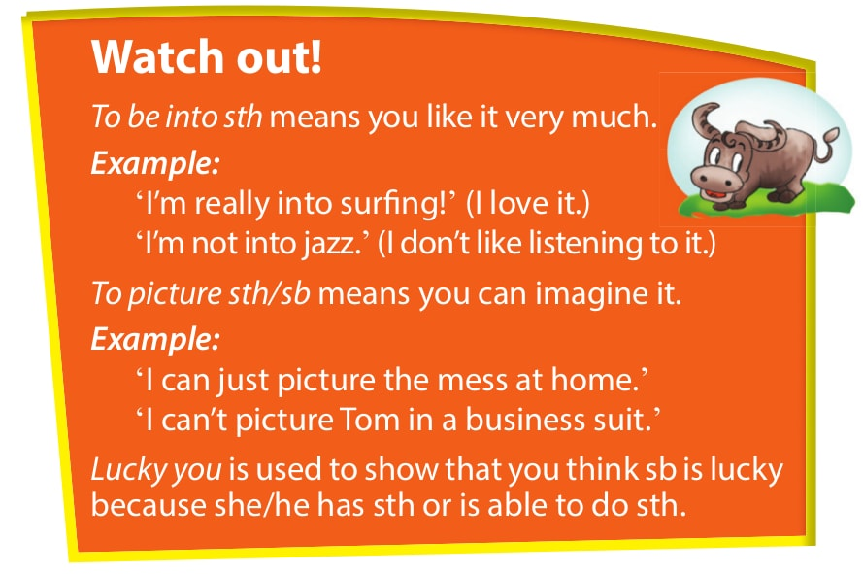

Slide 7
made up your mind
made a decision:
2. reduced it:
3. a trip where your travel and hotels are arranged for you:
4. move around and discover things:
5. something you don't really like:
narrowed it down
a package tour
Explore
not my cup of tea

Slide 8
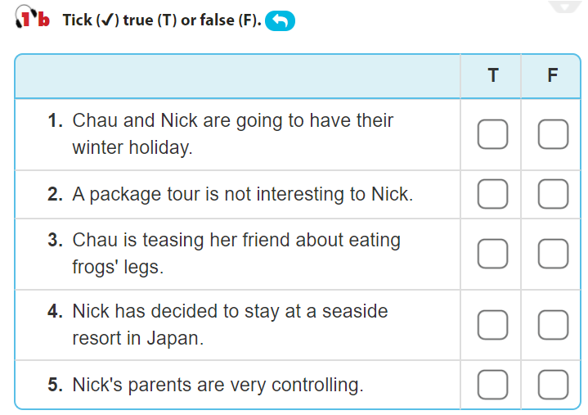
✓
✓
Chau: Well, France is one of the largest countries in Europe. Since we’ve got a four-week summer holiday, you could go on a cycling tour of the country or go on a package tour.
Nick: Ha ha! That’s not really my cup of tea. Perhaps I should go to Japan and stay at a seaside resort, eating sushi and sashimi every day! Anyhow, Japan is only my second choice.
Nick: No, I’m not into package tours. I’d like to visit the Alps, and climb Mont Blanc – the highest mountain in Western Europe.
✓
Nick: Oh, they’re cool. I’m glad that they let me make my own decisions.
Chau: Sounds exciting! I think it’s quite warm there, much warmer than in Britain. I can just picture you, tanned and relaxed, tasting delicious local specialities like frogs’ legs and snails!
✓
✓

Slide 9
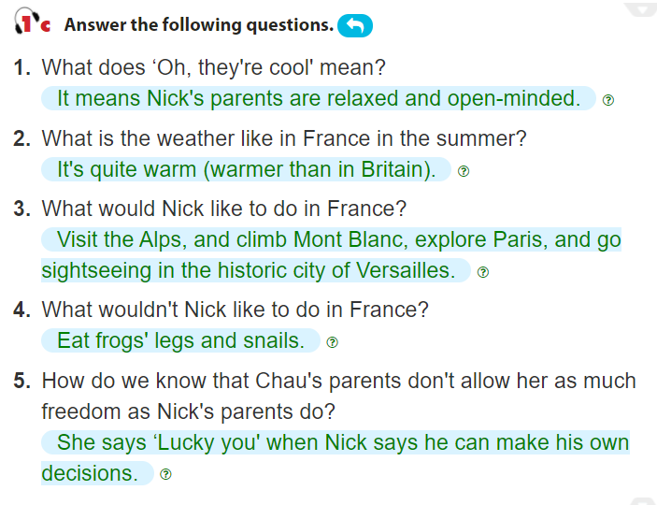
Chau: Sounds exciting! I think it’s quite warm there, much warmer than in Britain.
Chau: Sounds exciting! I think it’s quite warm there, much warmer than in Britain. I can just picture you, tanned and relaxed, tasting delicious local specialities like frogs’ legs and snails! Nick: Ha ha! That’s not really my cup of tea.
Chau: Lucky you. Whatever you decide, you’ll have a good time.
Chau: Sounds exciting! I think it’s quite warm there, much warmer than in Britain. I can just picture you, tanned and relaxed, tasting delicious local specialities like frogs’ legs and snails! Nick: Ha ha! That’s not really my cup of tea.
Nick: No, I’m not into package tours. I’d like to visit the Alps, and climb Mont Blanc – the highest mountain in Western Europe. I’d also love to explore Paris, and go sightseeing in the historic city of Versailles.

Slide 10
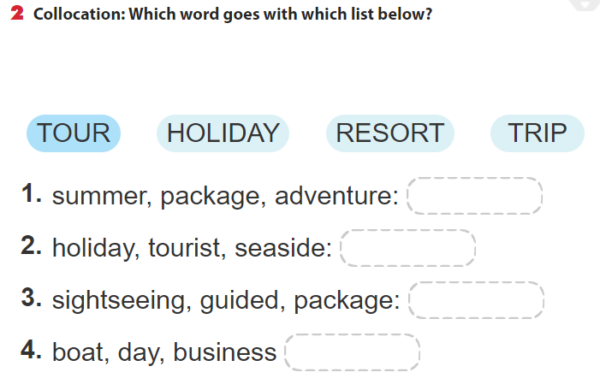
tour
holiday
Resort
trip

Slide 11


1. summer, package, adventure:
a. tour
Choose the best answer
b. holiday
b. holiday
c. resort
d. trip

Slide 12
2. holiday, tourist, seaside:
a. tour
Choose the best answer
b. holiday
c. resort
c. resort
d. trip

Slide 13
3. sightseeing, guided, package:
a. tour
a. tour
Choose the best answer
b. holiday
c. resort
d. trip

Slide 14
4. boat, day, business :
a. tour
Choose the best answer
b. holiday
c. resort
d. trip
d. trip

Slide 15
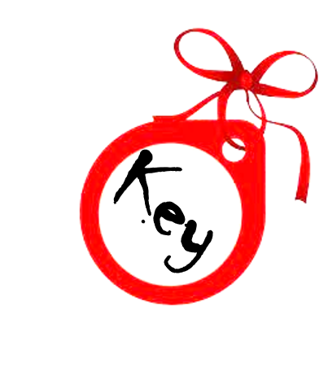
tour
holiday
Resort
trip

Slide 16
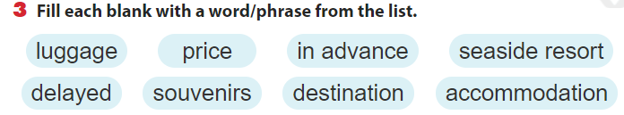
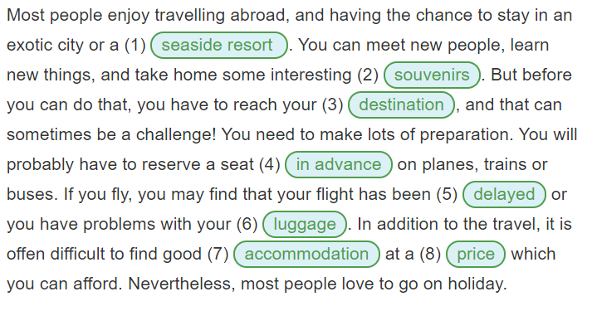

Slide 17
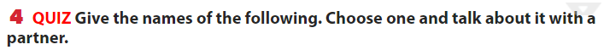
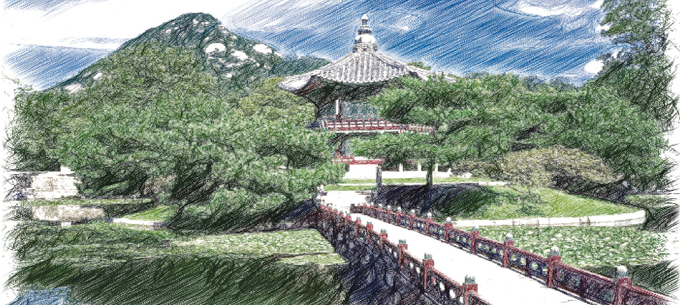
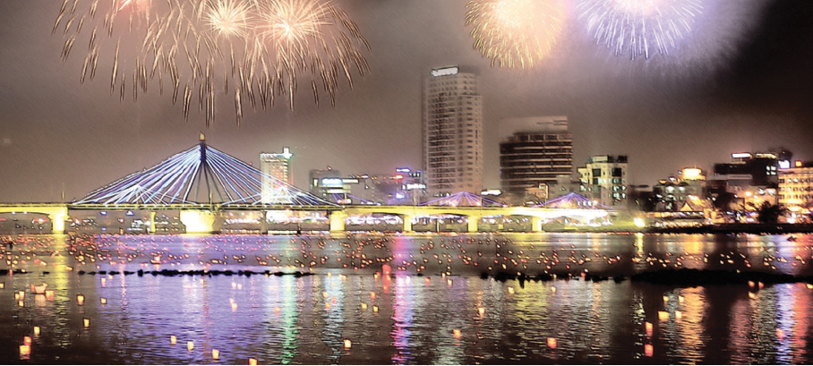

Slide 18
Da Nang city
1.The city in Viet Nam where the International Fireworks Festival is held annually
2. A structure near Beijing, China, that is one of the New7Wonders of the World
3. An island in Korea that is a popular place for a holiday
4. A local product that you would like to introduce to foreign visitors
5. A custom of your locality that might surprise tourists
6.Advice that you would like to give to a tourist visiting your area
The Great Wall of China
Jeju Island
Conical hat
Dying teeth black
Tourist should visit my area in the spring to join some traditional festivals here.

Slide 19
Sum up
By the end of the lesson students will be able to:
- Use the lexical items related to tourism.- Interact a conversation about tourism and travelling.
Vocabulary: vocabulary related to tourism and travelling.
HOMEWORK: Do exercise page…..
PREPARE “ A CLOSER LOOK 1 “ part

Slide 20
Thank you

