Slide 1

WELCOME ALL THE TEACHERS
TO CLASS 5G
Teacher: Mai Thi Nen
DUC GIANG PRIMARY SCHOOL

Slide 2
* Games:
Group the words

Slide 3
* Mark the word stress.
party Sunday
enjoyed invite
‘
‘
‘
‘

Slide 4

1. Listen and repeat
‘party
‘
I went to Mai’s birthday party yesterday.
‘Sunday
‘
They took part in the festival on Sunday.
‘
‘
enjoyed
We enjoyed the food and drink at the party.
invite
‘
‘
I want to invite Tony and Phong to my birthday party.

Slide 5

2. Mark the word stress. Then say the words aloud.
1. water | 2. party | 3. enjoy | 4. birthday
5. invite | 6. Monday | 7. comics | 8. picnic
9. cartoon | 10. Sunday | 11. repeat | 12. complete
‘
‘
‘
‘
‘
‘
‘
‘
‘
‘
‘
‘

Slide 6
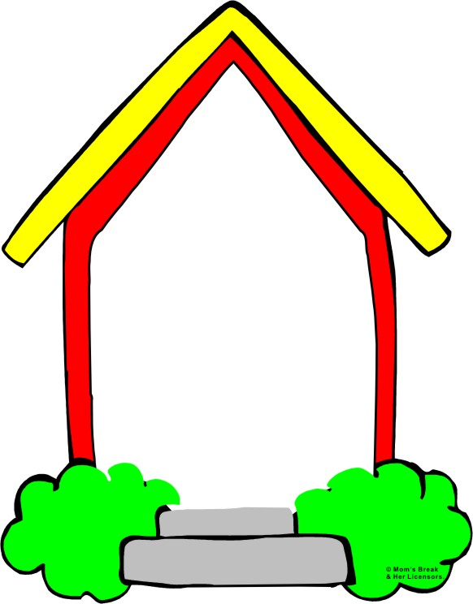
* Game:
Clap or touch

Slide 7
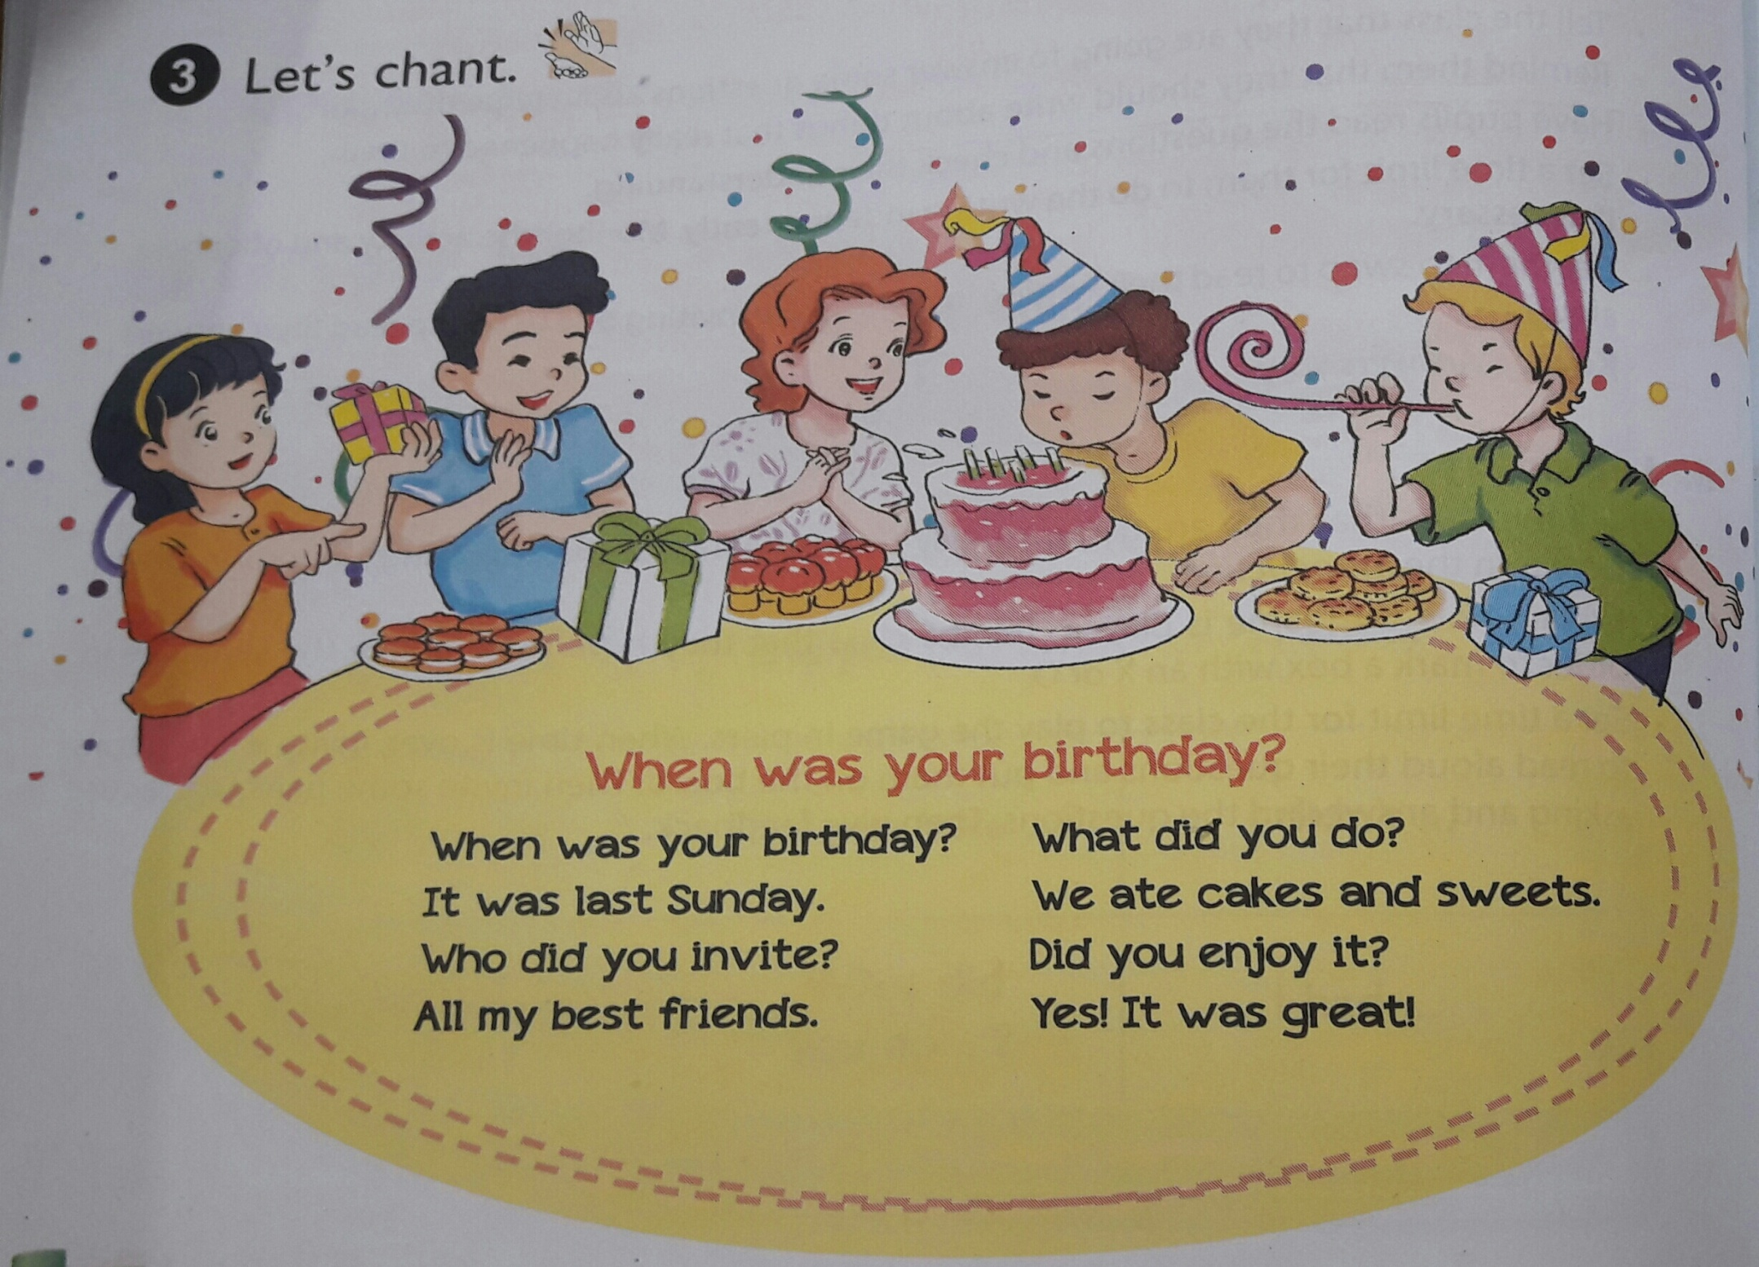
3. Let’s chant
When was your birthday?
When was your birthday?
What did you do?
It was last Sunday.
We ate cakes and sweets.
Who
did you invite?
Did you enjoy it?
All my best friends.
Yes!
It was great!

Slide 8
Thanks
for
your listening!

Slide 9
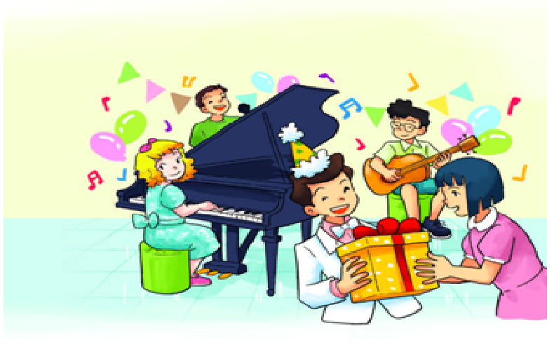
4. Read and answer.
My name is Nam. It was my birthday last Sunday. I invited some of my classmates to the party. They gave me presents like comics books, robots and a teddy bear. We ate cakes, sweets, fruit and ice cream. We drank fruit juice. We sang English and Vietnamese songs. We danced, too. Phong played the guitar and Linda played the piano. The party ended at 7 p.m. We enjoyed it very much.

Slide 10
Questions:
1. When was Nam’s birthday party?
2. Who went to Nam’s birthday party?
3. What did Phong do at the party?
4. What did Linda do at the party?

Slide 11
* lucky colors:

Slide 12
It was last Sunday.
When was Nam’s birthday party?

Slide 13
Lucky color

Slide 14
2. Who went to Nam’s birthday party?
Some of his classmates

Slide 15
3. What did Phong do at the party?
He played the guitar.

Slide 16
Lucky color

Slide 17
She played the piano.
4. What did Linda do at the party?

