Slide 1
WELCOME  TO  OUR  CLASS
ENGLISH 7
Unit 3:
COMMUNITY SERVICE
Teacher: Bui Thi Huyen Trang

Slide 2
WARM-UP: Which of the activities below are traditional volunteer activities in Vietnam? Tick () the boxes.
1. taking care of sick people in hospitals
2. raising money for sick / poor people
3. cooking meals homeless/poor people
4. donating blood
5. cleaning streets / lakes / ponds
6. tutoring young children in remote areas
7. donating books, clothes to poor children
8. donating food, blankets and clothes to people in flooded areas








Slide 3
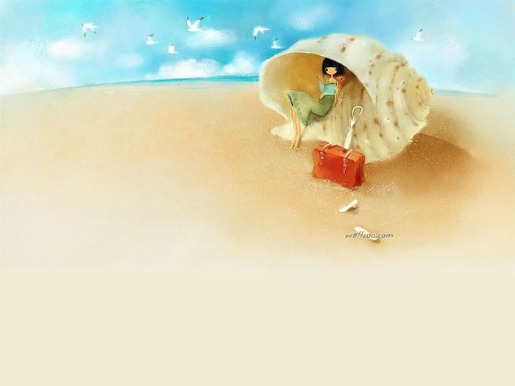
NEW LESSON
Unit 3:
COMMUNITY SERVICE
Skills 2

Slide 4
LISTENING

Slide 5
1 Discuss the following questions.
How do people benefit from volunteer work?
Who do you think benefits from volunteer work?
Gain confidence: Volunteering can help you gain confidence by giving you the chance to try something new and build a real sense of achievement.
Make a difference: Volunteering can have a real and valuable positive affect on people, communities and society in general.
Meet people: Volunteering can help you meet different kinds of people and make new friends.
Be part of a community: Volunteering can help you feel part of something outside your friends and family.
Learn new skills: Volunteering can help you learn new skills, gain experience and sometimes even qualifications.
Take on a challenge: Through volunteering you can challenge yourself to try something different, achieve personal goals, practice using your skills and discover hidden talents.
Have fun! Most volunteers have a great time, regardless of why they do it.
I think both of the volunteer and the people who get help benefit from volunteer work.

Slide 6

2. Listen to the recording and answer the questions.
1. Why does Phuc do volunteer work?
2. Why does Phuc feel more self-confident?
3. Why does the reporter think Phuc is confident?
4. Why does Mai think volunteering is special?
Phuc does volunteer work because he thinks it makes a difference in the community.
Phuc feels more self-confident because he has made many new friends.
The reporter thinks Phuc is confident because Phuc has answered the interview very well.
Mai thinks volunteering is special because she can help others, and because she can see how happy the children are when they learn.

Slide 7
Audio script:
R = Reporter
P = Phuc
M = Mai
R: So Phuc, why do you volunteer?
P: I volunteer because it makes a difference in our community. We can encourage people to protect the environment and our community will be a better place.
R: Do you think volunteering is good for yourself too?
P: Oh yes, I've made many new friends, and I feel much more self-confident.
R: I agree. You've answered the interview very well... And you Mai?
M: Volunteering is special to me because I can help others. It's special because I can see how happy the children are when they learn.

Slide 8
3. Listen again and fill in the blanks.
I __________ because I can make a difference in our community.
I've made many new friends, and I _______ much more self-confident.
Volunteering is special to me __________ I can help others.
It's special __________ I can see how happy the __________ are when they learn.
volunteer
feel
because
because
children

Slide 9
WRITING

Slide 10
Study skills - Giving reasons
Giving reasons for your ideas and opinions makes your speaking and writing more interesting and convincing.
Example:
I volunteer because it makes a difference in our community.

Slide 11
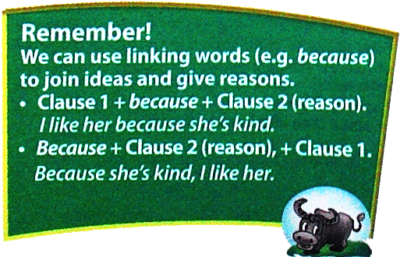

Slide 12
4. Combine the two sentences using because
1. He didn't wear enough warm clothes. He's had a cold for two days.
2. It rained. I stayed home.
3. The lake is full of rubbish. They've decided to clean it up.
4. She works in that small town. She's lived in that small town for three years.
5. The neighbourhood is nice and quiet. They think they should move there.

Slide 13
5. Look at your volunteer ideas in Speaking 4 Choose one idea and write a short paragraph about it.
What do you want to do?
Why do you want to do it? (Why is it necessary? Why is it interesting?)
How are you going to do it?

Slide 14
Ideas in Speaking 4
G1: To raise money, we could
+ collect waste paper / used glass / bottles and sell them
+ Save from the money for breakfast
+ make post cards and sell them ,….
G2: To provide food, we could
+ Cook food and bring to street children
+ plant vegetables at school ground and take them to the elderly people
+ Offer coupons for breakfast / lunch / dinner for the poor people ,…
G3: To help repair things, we could
+ help the old rebuild their houses, fix the roofs…
+ help them repair the household appliances,…

Slide 15
G4: To help people with transportation, we could
+ Give rides to the elderly; Give people a lift…
+ Take old people across the road
+ Offer free bus tickets to disabled people / the poor ,…
+ Direct the traffic; Clean and make streets clear…
G5: To tutor young children, we could
+ Provide homework help before or after school
+ Offer evening classes for street children
+ Donate books, notebooks and other school things
G6: To recycle rubbish, we could
+ Collect paper, glass, bottles, cans for reusing or recycling
+ Ask and encourage people to classify rubbish for recycling
+ Put garbage bins in the schoolyard, along the streets,..

Slide 16
Example 1:
I want to raise funds for street children. I want to do it because we will be able to provide them with food and books. They will no longer be hungry. They will be able to read. I will ask my friends to help me. We will make postcards and sell them.

Slide 17
Example 2:
I want to cook food and bring it to the elderly. I want to do it because we will be able to provide them with nutritious food. They will be healthier to live with us. I will ask my friends to help me to plant more vegetables at the school ground. And I will ask people to donate money to buy more good food for them.

Slide 18


HOMEWORK
- Practice listening to the conversation again.
- Write a short paragraph to tell about a volunteer work you want to do, present to the class in the next period
- Prepare for Unit 3: LOOKING BACK
+

Slide 19
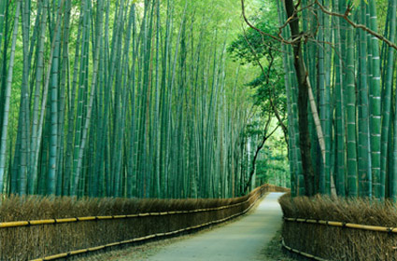
THANKS FOR YOUR ATTENTION!
Goodbye!
See you again!

