Slide 1

welcome the students
Teacher: Nguyen Thi Thuy
Class: 4A1

Slide 2

Unit 4: When’s Your Birthday
Lesson 1

Slide 3

Monday, July 2nd 2018
Unit 4: When’s Your Birthday
Lesson 1
1.Look, listen and repeat:
- october: tháng 10
- first: ngày mùng 1 – 1st
- second: ngày mùng 2 – 2nd
- third: ngày mùng 3 – 3rd
- fifth: ngày mùng 5 – 5th
- twelfth: ngày 12 – 12th
- fourteenth: ngày 14 – 14th
- twentieth: ngày 20 – 20th
- twenty – second: ngày 22 – 22nd
- thirty – first: ngày 31 – 31st

Slide 4

Read and match :
October
First
Second
Third
Twelfth
Fourteenth
Twentieth
Twenty – second
Thirty – first
Ngày mùng 3
Ngày 22
Tháng 10
Ngày mùng 1
Ngày 14
Ngày 20
Ngày mùng 2
Ngày 12
Ngày 31
Take a look at the following pictures

Slide 5
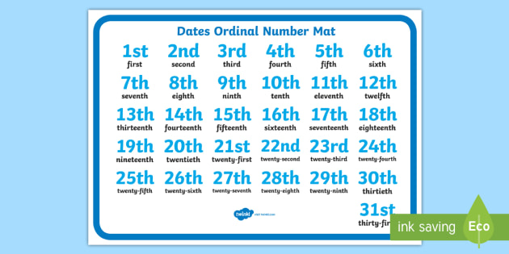
These are the ordinal numbers

Slide 6
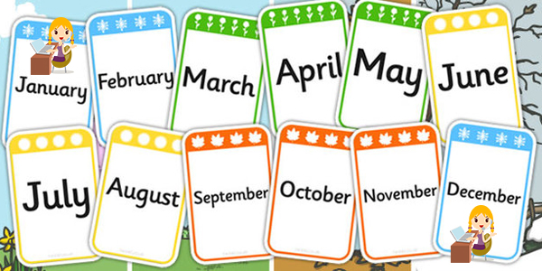
These are months of the year

Slide 7
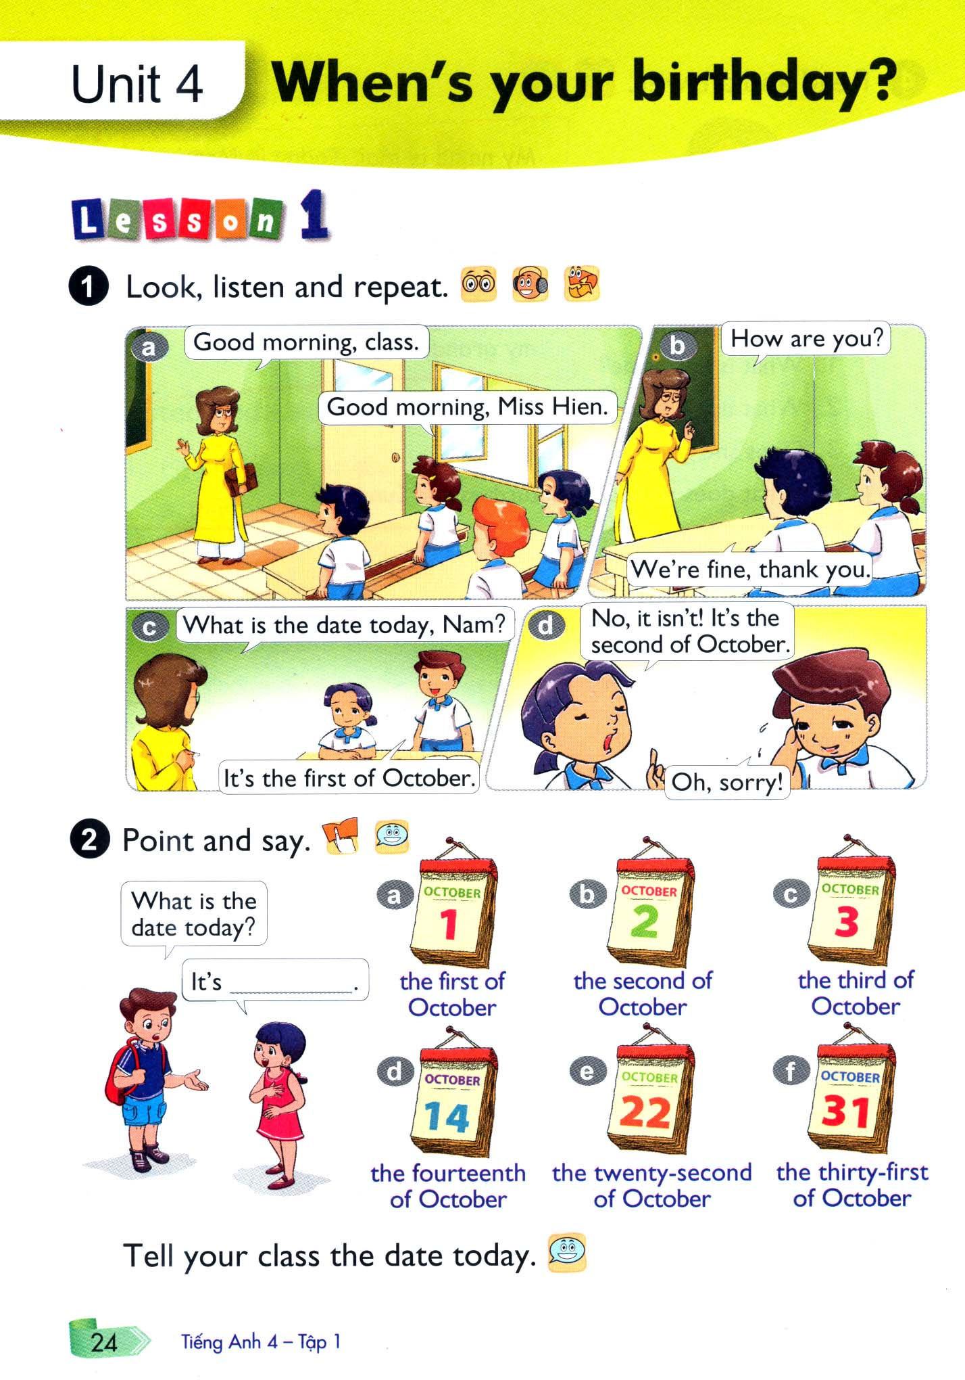

What new structure are you?

Slide 8

2. Point and say:
1. Examples:
What is the date today?: Hôm nay là ngày bao nhiêu?
It's the fourth of July
What is the date today?: Hôm nay là ngày bao nhiêu?
>> It’s the first of October
the second of October
2. Form:
What is the date today ?
It’s + the date (ngày) of month (tháng).

Slide 10
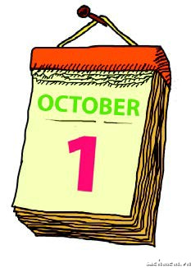
2. Point and say:
What is the date today?
a. It’s the first of October.

Slide 11
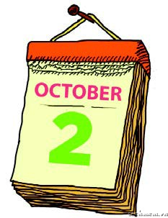
2. Point and say:
What is the date today?
b. It’s the second of October

Slide 12
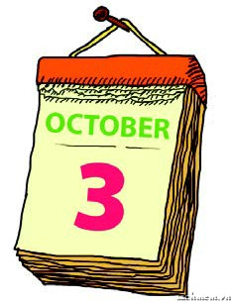
2. Point and say:
What is the date today?
c. It’s the third of October

Slide 13
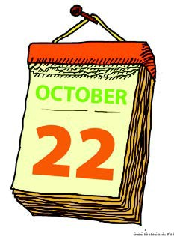
2. Point and say:
What is the date today?
e. It’s the twenty – second of October

Slide 14
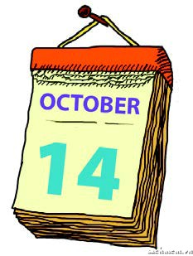
2. Point and say:
What is the date today?
d. It’s the fourteenth of October

Slide 15
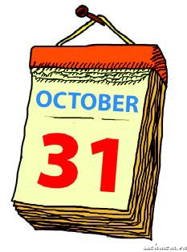
2. Point and say:
What is the date today?
f. It’s the thirty – first of October

Slide 16
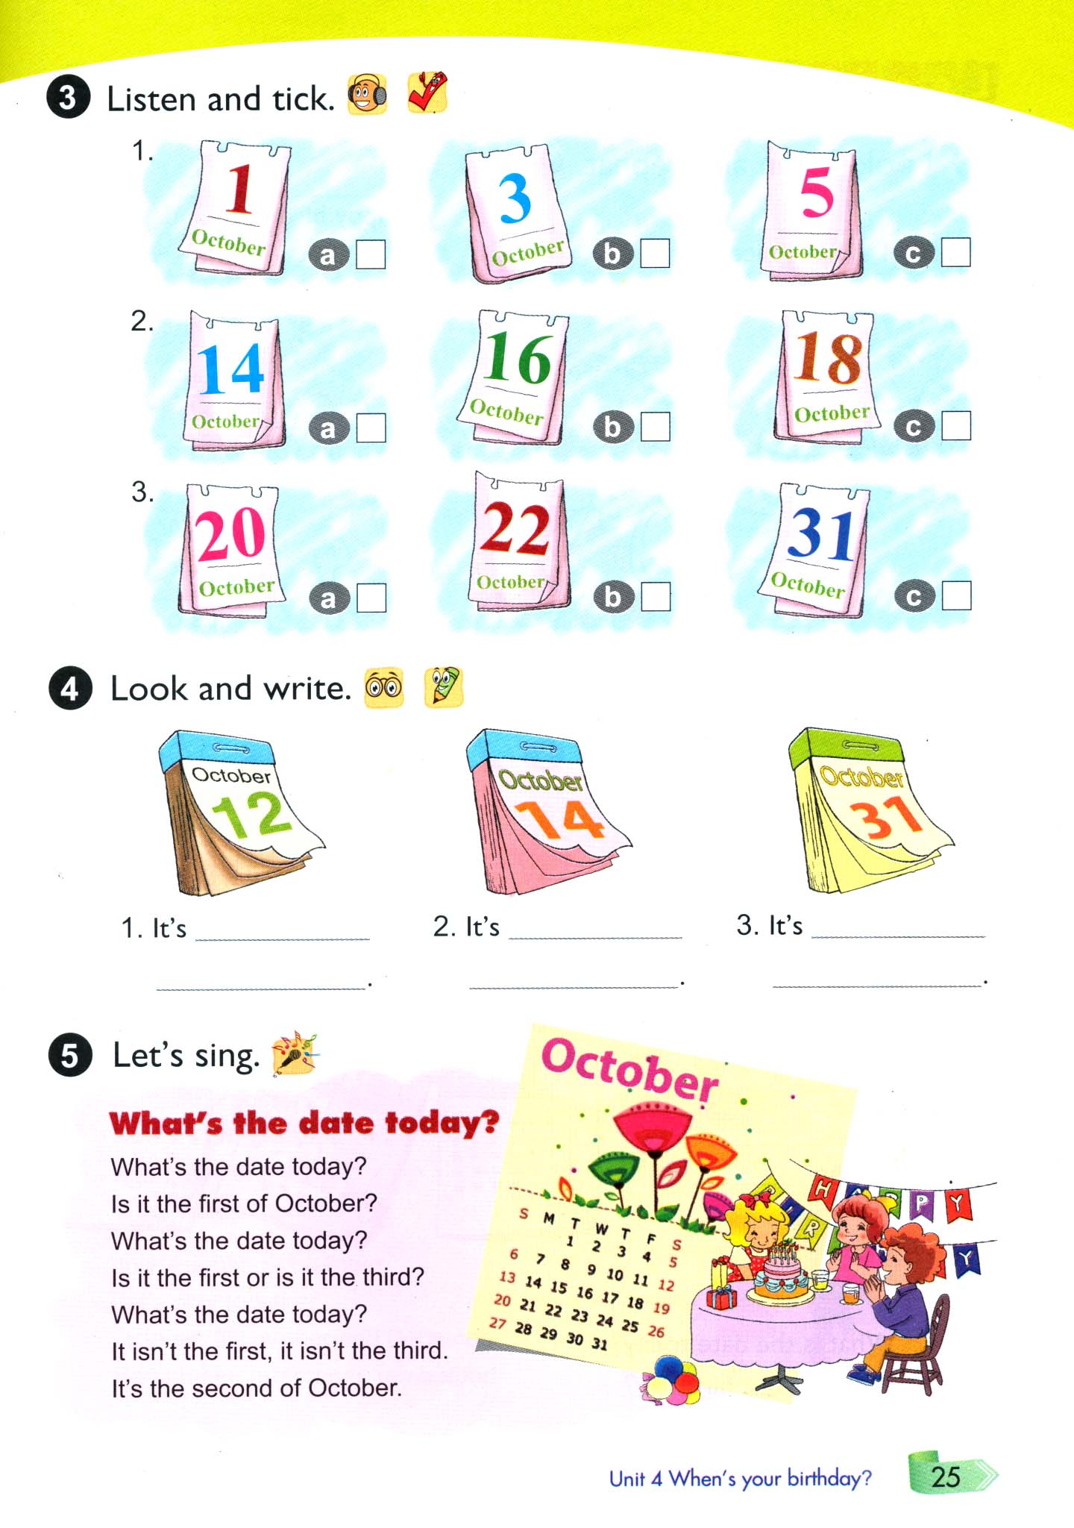


Slide 17
the twelfth of
October.
the fourteenth of October.
the thirty-first of October

Slide 18

How to play:
Check the box looking for and answer questions.

Slide 19
Questions
secret crossword
Answer
1
 | O | C | T | O | B | E | R
 |  |  |  | F | I | R | S | T
 |  | T | H | I | R | D
 |  | F | I | F | T | H
 |  |  |  | T | H | U | R | S | D | A | Y
S | E | C | O | N | D
 |  |  | C | L | A | S | S
 | T | O | D | A | Y
A
2
B
3
C
4
D
5
E
6
F
7
G
8
H
“Tháng 10” by English
“Ngày mùng 1” by English
“Ngày mùng 3” by English
“Ngày năm” by English
“Thứ năm” by English
“Ngày mùng 2” by English
“Lớp học” by English
“Hôm nay” by English

Slide 20

h o m e w o r k s
Review new words
Follow the conversation
Review song “ What's the date today ? ”

Slide 21

Goodbye and see you again students

