Slide 1
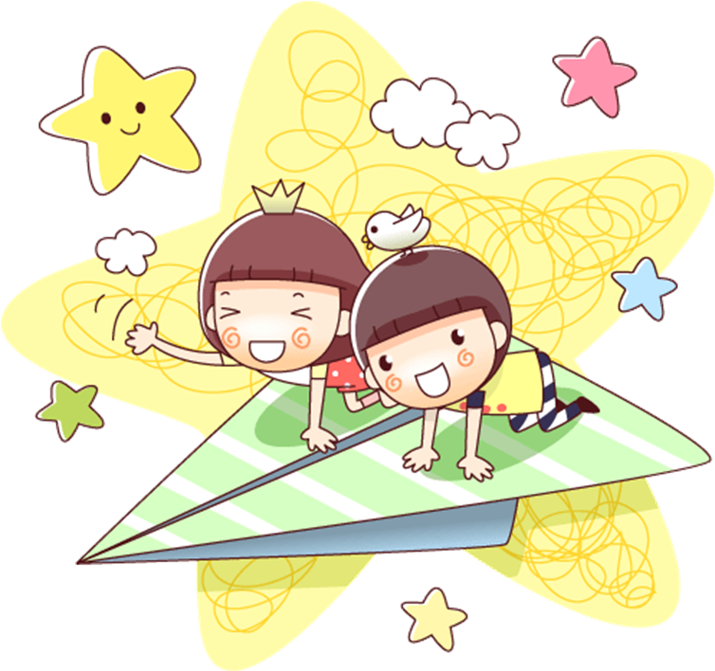
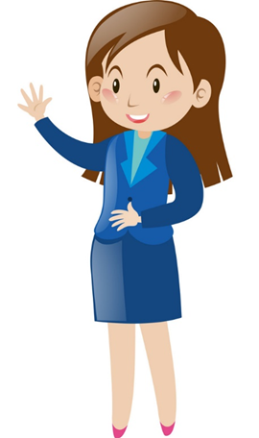
English 3
Unit 1
Nice to see you again
Lesson 2
Teacher: Ms. Huyền Phạm

Slide 2
Vocabulary

Slide 3
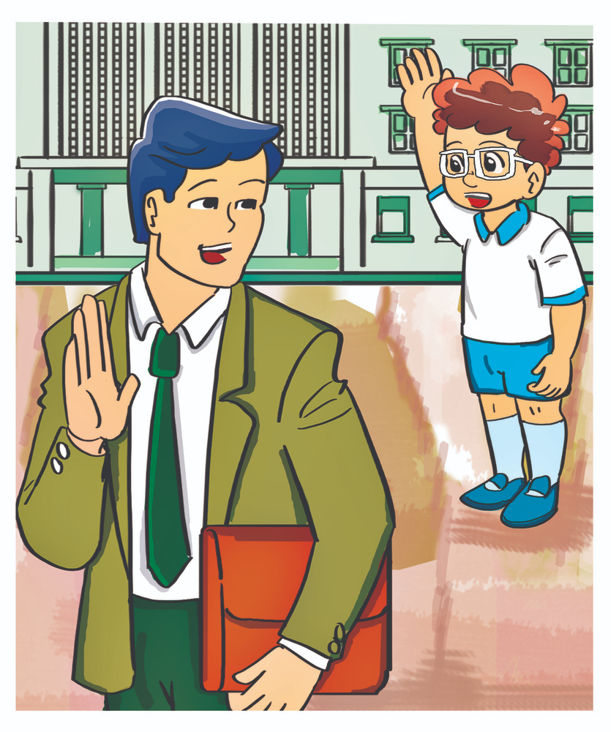
Vocabulary
Goodbye
Tạm biệt

Slide 4

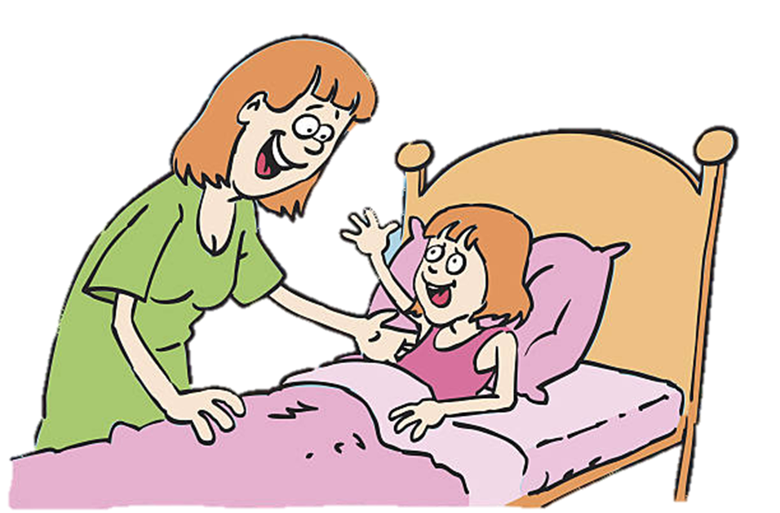
Vocabulary
night
Đêm
goodnight
Chúc ngủ ngon

Slide 5
Vocabulary
See you
See you late
: Hẹn gặp lại
See you again
Nice to meet you
: Rất vui được gặp bạn
Tomorrow
: Ngày mai

Slide 6
Grammar

Slide 7

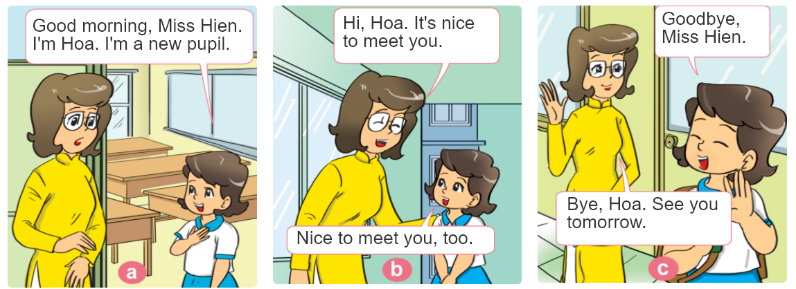
1. Look, listen and repeat.

Slide 8
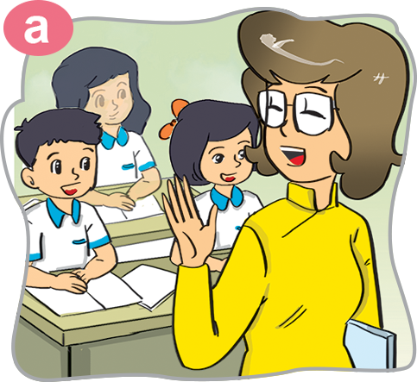


2. Point and say
Goodbye,
Miss Hien.
Goodbye.
See you tomorrow.

Slide 9
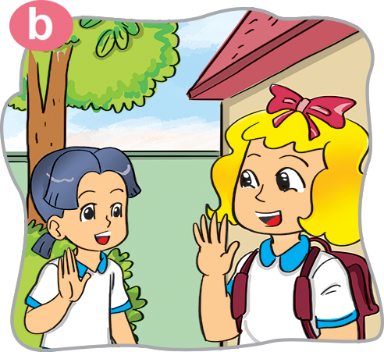
2. Point and say
Goodbye,
Linda.
Goodbye.
See you later.

Slide 10
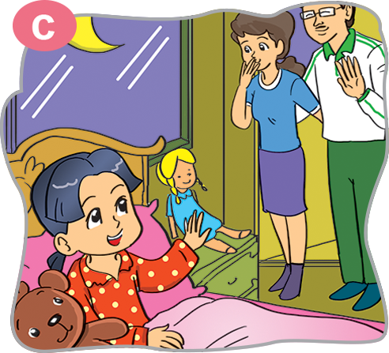
2. Point and say
Goodnight
Goodnight

Slide 11
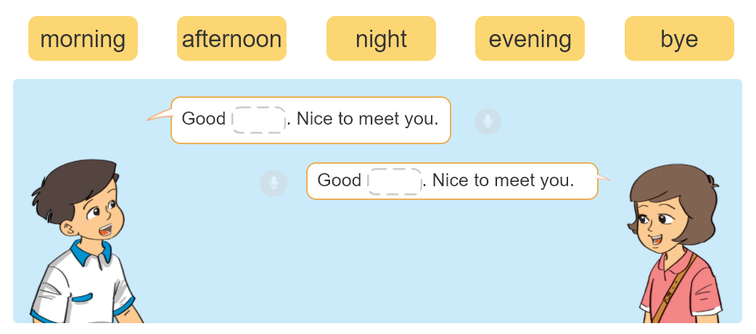
3. Let's talk

Slide 12
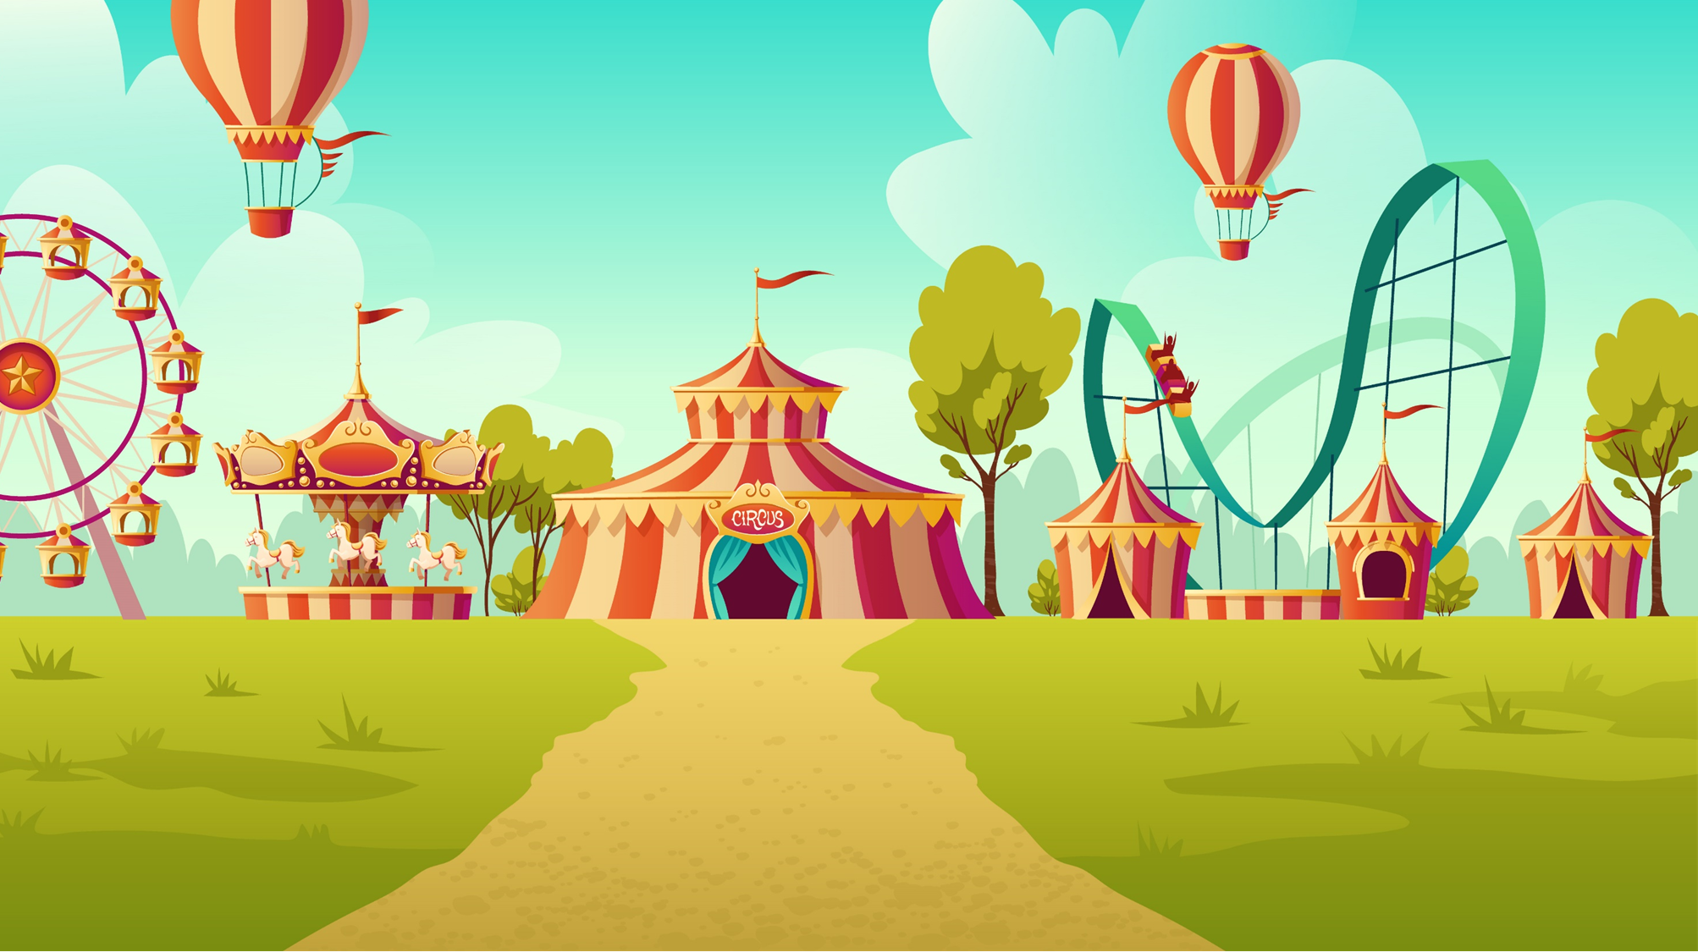



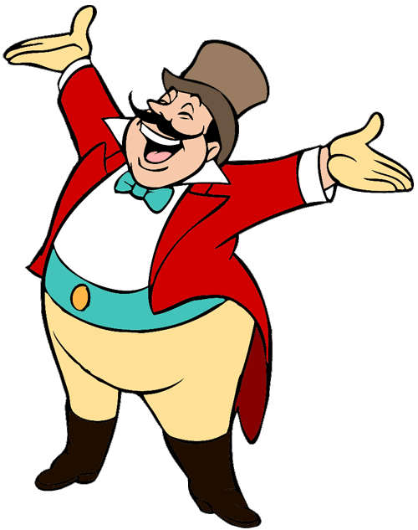
Ms Huyền Phạm
0936.082.789
START

Slide 13

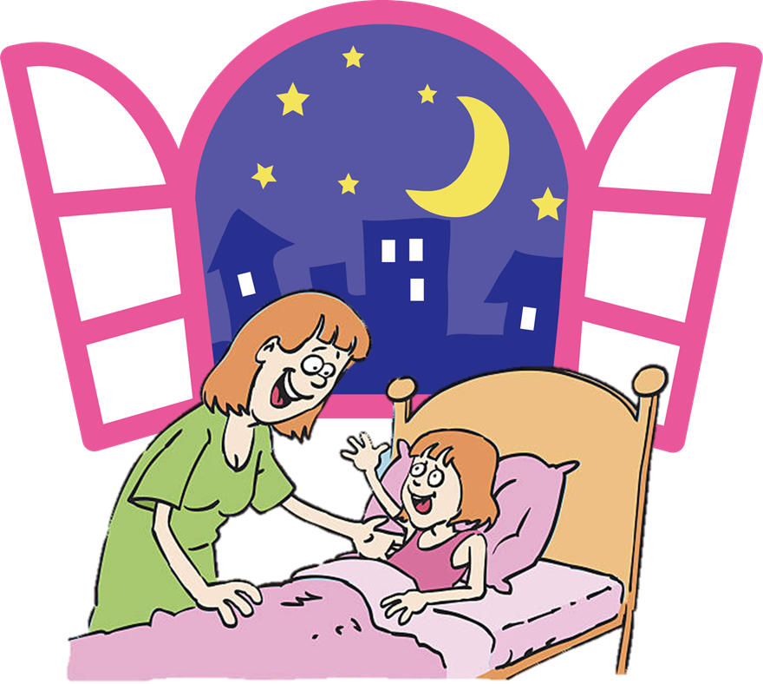



Good morning
Goodnight
Good afternoon

Slide 14
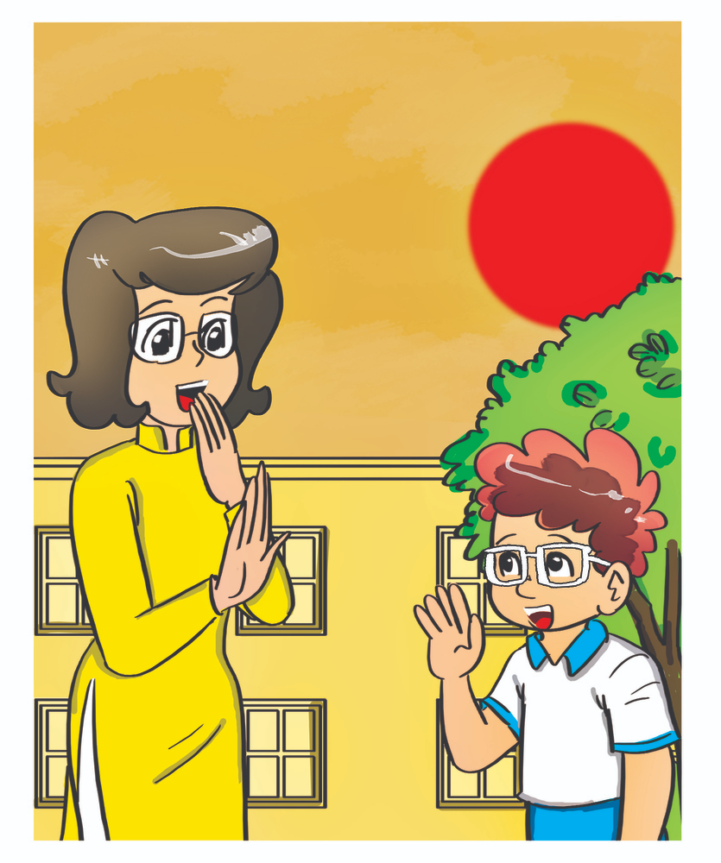
Ms Huyền Phạm
0936.082.789
Bye
Hello
Goodnight

Slide 15
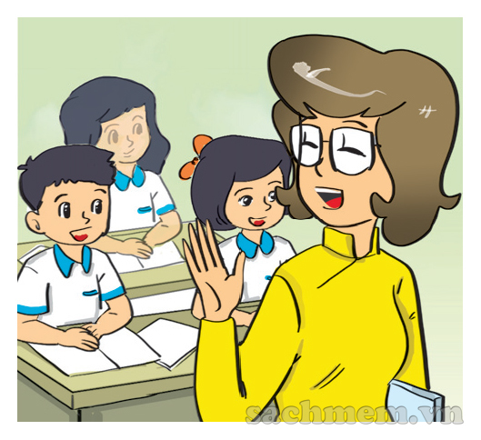
Goodbye. _______.
Ms Huyền Phạm
0936.082.789
Thanks
Nice to see you.
See you tomorrow.

Slide 16
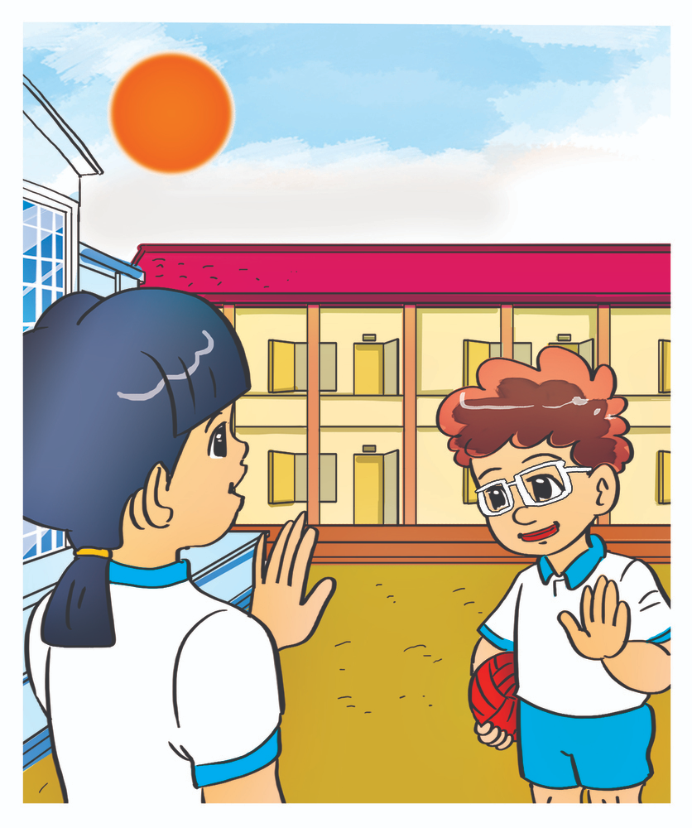
Hello. __________.
Ms Huyền Phạm
0936.082.789
Nice to meet you.
See you.
See you later.
Next

Slide 17
Ms Huyền Phạm
0936.082.789
Good morning.
Nice to meet you.
Good bye.

Slide 18
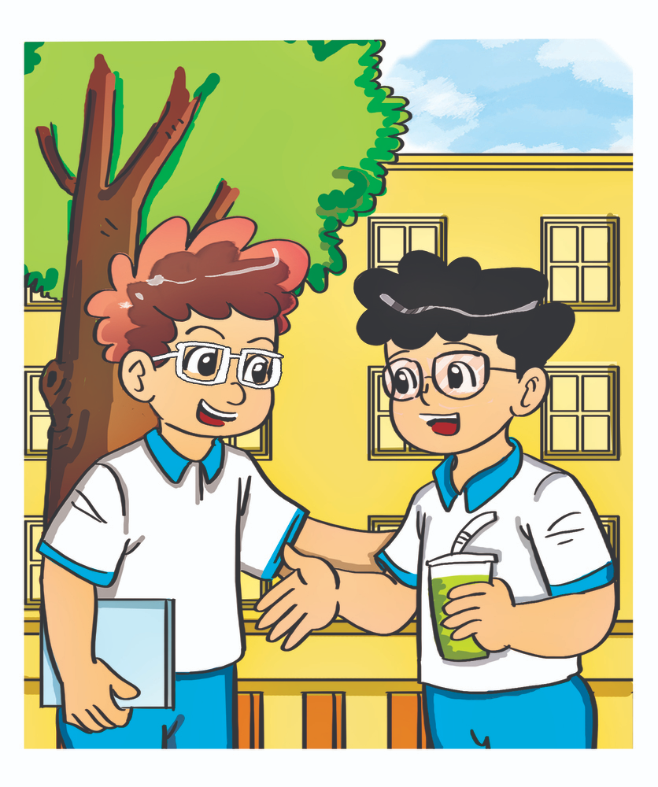
Hello._______.
Ms Huyền Phạm
0936.082.789
Goodnight
Good evening
Nice to see you again

Slide 19
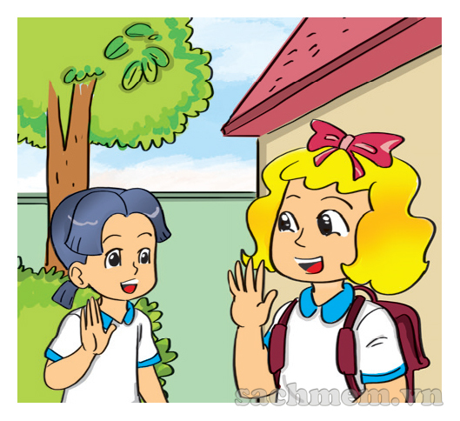
_____. See you later.
Ms Huyền Phạm
0936.082.789
Good bye
Good morning
Goodnight
Next

Slide 20
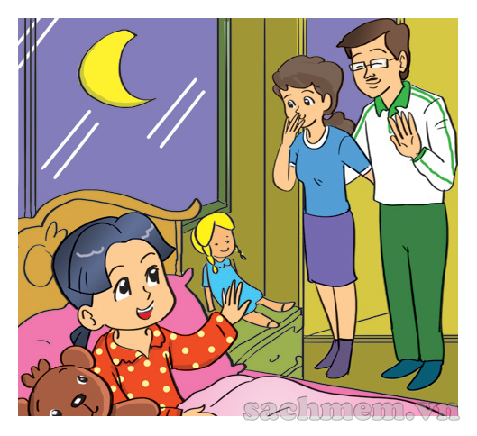
Ms Huyền Phạm
0936.082.789
Goodmorning
Goodnight
Nice to see you.

Slide 21


GOOD JOB!
Ms Huyền Phạm
0936.082.789

Slide 22
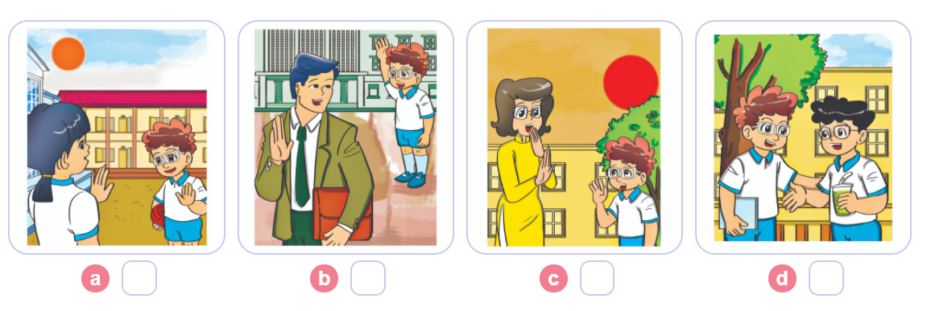
4. Listen and number
1
2
3
4
2
4
1
3

Slide 23
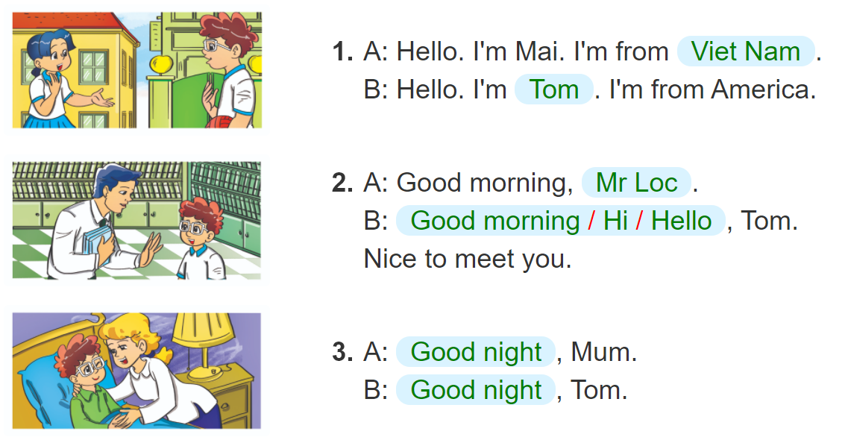
5. Look and write.
______________
_______.
_____________.
____________________________________,
________________,
________________,

Slide 24
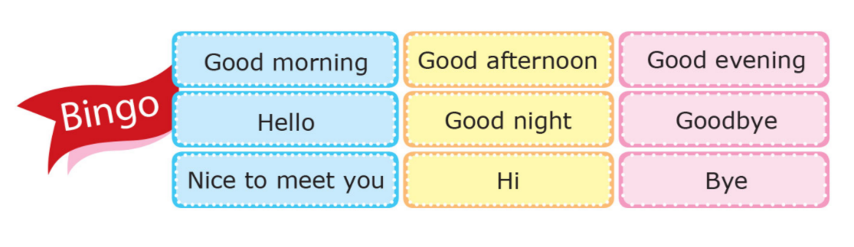
6. Let's play

