Slide 1
Unit 18
What will the weather
be like tomorrow?
Lesson 1

Slide 2
Vocabulary

Slide 3


Vocabulary
cloudy
/ˈklaʊdi/

Slide 4

Vocabulary
windy
/ˈwɪndi/

Slide 5

Vocabulary
snowy
/ˈsnəʊi/

Slide 6

Vocabulary
rainy
/ˈreɪni/

Slide 7

Vocabulary
sunny
/ˈsʌni/

Slide 8

Vocabulary
stormy
/ˈstɔːrmi/

Slide 9

Vocabulary
foggy
/ˈfɒɡi/

Slide 10

Vocabulary
cool
/kuːl/

Slide 11

Vocabulary
cold
/kəʊld/

Slide 12

Vocabulary
warm
/wɔːrm/

Slide 13

Vocabulary
hot
/hɒt/

Slide 14
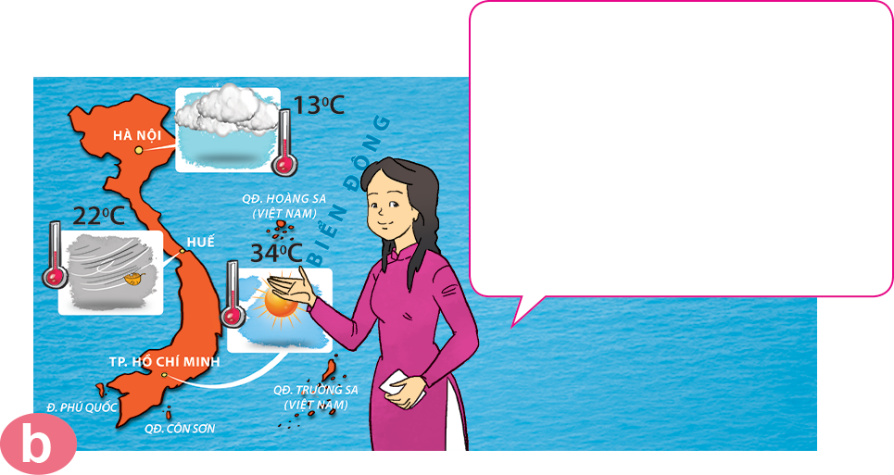
weather forecast
/ˈweðə fɔːkɑːst/
take a look
/teɪk ə lʊk/
Đón xem

Slide 15





Vocabulary
stormy
cloudy
rainy
sunny
windy
snowy
cold
cool
warm
hot

Slide 16




START

Slide 17




foggy
snowy
rainy
Next

Slide 18

cloudy
foggy
snowy
Next

Slide 19

windy
sunny
rainy

Slide 20

windy
rainy
snowy
Next

Slide 21

snowy
rainy
foggy

Slide 22

snowy
cloudy
foggy
Next

Slide 23
rainy
stormy
sunny

Slide 24
cool
cold
warm
Next

Slide 25
cool
hot
warm

Slide 26
warm
cold
hot
Next

Slide 27
cool
cold
hot

Slide 28




Ms Huyền Phạm
0936.082.789

Slide 29
Grammar

Slide 30
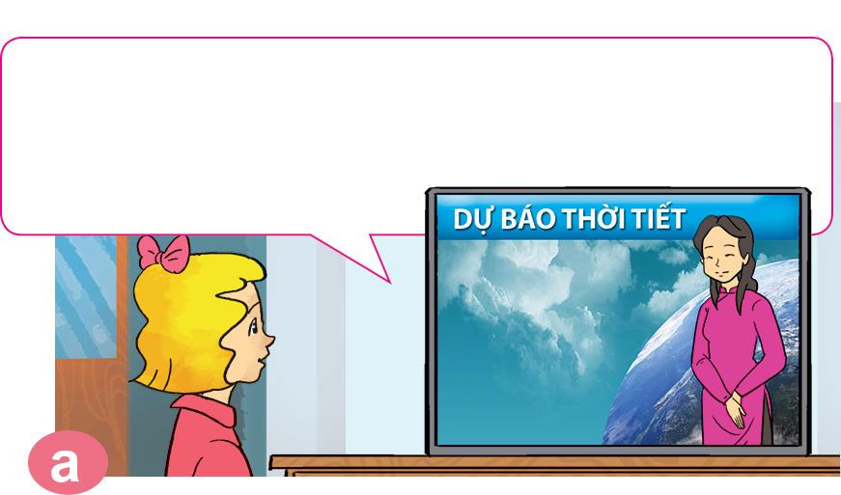
1. Look, listen and repeat.
It's cold and cloudy in Ha Noi. It's cool and windy in Hue. It's hot and sunny in Ho Chi Minh City.
Good evening and welcome to the weather forecast. Let's take a look at the weather today.

Slide 31
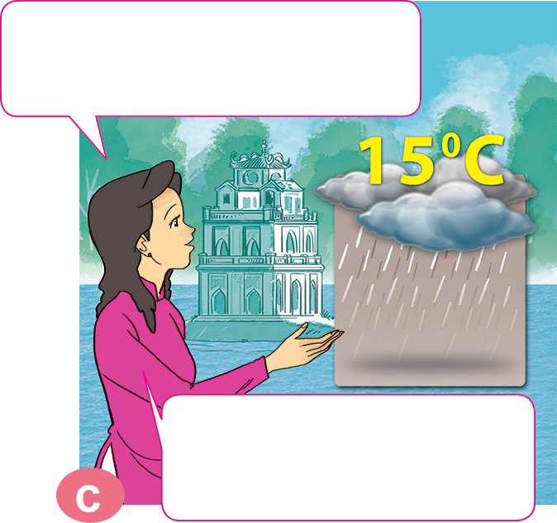
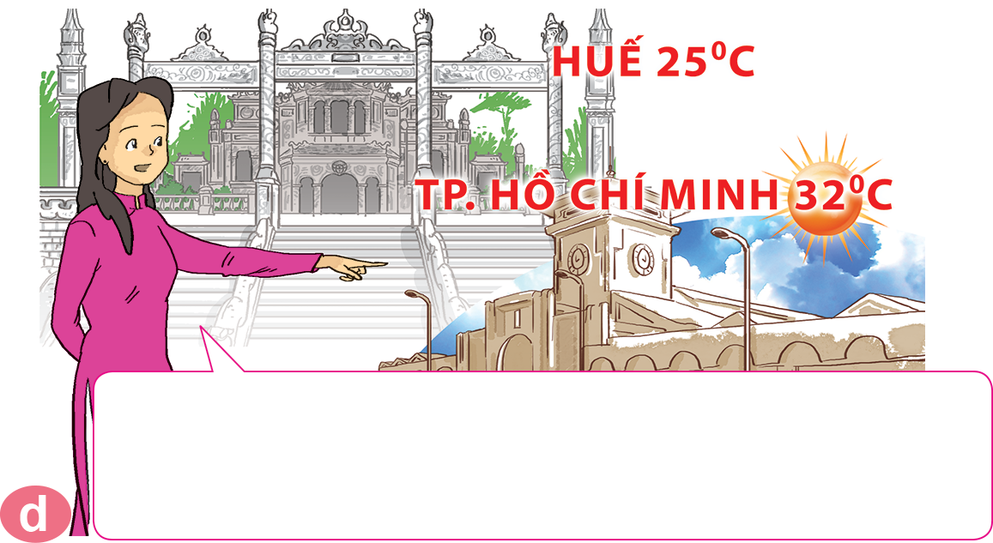
1. Look, listen and repeat.
What will the weather be like tomorrow?
It will be warm and foggy in Hue. In Ho Chi Minh City, it will be hot and sunny. That's the weather forecast for tomorrow.
Well, it will be cold and rainy in Ha Noi.

Slide 32



2. Point and say.
What will the weather be like tomorrow?
It will be __________________.
hot and sunny

Slide 33
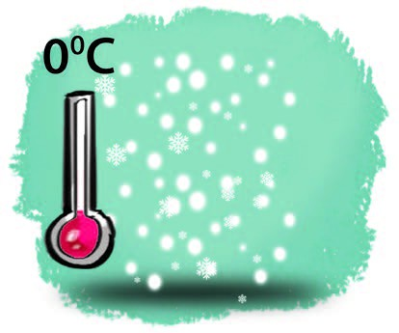
2. Point and say.
What will the weather be like tomorrow?
It will be __________________.
cold and snowy

Slide 34

2. Point and say.
What will the weather be like tomorrow?
It will be __________________.
warm and stormy

Slide 35

2. Point and say.
What will the weather be like tomorrow?
It will be __________________.
cool and cloudy

Slide 36
Unit 18
What will the weather be like tomorrow?
It will be ______ and _________.
cold, snowy
cool, cloudy
hot, sunny
warm, stormy
Ms.Phạm English

Slide 37


3. Let’s talk
What's the weather like today?
It's _____ and _______.
What will the weather be like tomorrow?
It will be _____ and ______.

Slide 38
4. Listen and circle a, b or c.
a. snowy and stormy.
b. snowy and very cold.
c. stormy and very cold.
1
It will be ___________
in Sa Pa tomorrow.
a. foggy and windy.
b. snowy and windy.
c. cold and windy.
2
It will be ____________
in Ha Noi tomorrow.
a. sunny and foggy.
b. stormy and cloudy.
c. sunny and windy.
It will be ___________
in Da Nang tomorrow.
3

Slide 39
5. Read and complete.
Mai: Let's (1) _______ for a picnic tomorrow.
Tony: What will the (2) _______ be like tomorrow?
Linda: Well, it will be cold and (3) ________.
Mai: How do you know that?
Linda: I watched the weather (4) ________ on TV.
Tony: We can't go for a picnic if it's stormy.
Mai: OK, let's stay home, eat popcorn and
(5) _________ cartoons.
Tony and Linda: Great idea!
go
weather
watch
forecast
go
stormy
weather
stormy
forecast
watch

Slide 40







Ms Huyền Phạm
0936.082.789
Notes:
Ms Huyền Phạm - 0936.082.789 – YOUTUBE: MsPham. Facebook: Dạy và học cùng công nghệ.

Slide 41



What will the weather
be like tomorrow?
It’ll be cool and windy.
It’s cool and windy.
Ms Huyền Phạm
0936.082.789
Notes:
Ms Huyền Phạm - 0936.082.789 – YOUTUBE: MsPham. Facebook: Dạy và học cùng công nghệ.

Slide 42


It’ll be snowy and cold.
What will the weather
be like tomorrow?
It’s be snowy and cold.
Ms Huyền Phạm
0936.082.789
Notes:
Ms Huyền Phạm - 0936.082.789 – YOUTUBE: MsPham. Facebook: Dạy và học cùng công nghệ.

Slide 43


It’ll be sunny and hot.
What will the weather
be like tomorrow?
It’ll be sunny and warm.
Ms Huyền Phạm
0936.082.789
Notes:
Ms Huyền Phạm - 0936.082.789 – YOUTUBE: MsPham. Facebook: Dạy và học cùng công nghệ.

Slide 44


It’ll be cloudy and warm.
What will the weather
be like tomorrow?
It will be cloudy and hot.
Ms Huyền Phạm
0936.082.789
Notes:
Ms Huyền Phạm - 0936.082.789 – YOUTUBE: MsPham. Facebook: Dạy và học cùng công nghệ.

Slide 45

It’ll be stormy.
What will the weather
be like tomorrow?
It will stormy.
Ms Huyền Phạm
0936.082.789
Notes:
Ms Huyền Phạm - 0936.082.789 – YOUTUBE: MsPham. Facebook: Dạy và học cùng công nghệ.

Slide 46
tomorrow
What will the weather
be like _________?
yesterday
Ms Huyền Phạm
0936.082.789
Notes:
Ms Huyền Phạm - 0936.082.789 – YOUTUBE: MsPham. Facebook: Dạy và học cùng công nghệ.

Slide 47
is
What ____ the weather
be like next sunday?
will
Ms Huyền Phạm
0936.082.789
Notes:
Ms Huyền Phạm - 0936.082.789 – YOUTUBE: MsPham. Facebook: Dạy và học cùng công nghệ.

Slide 48
to
What will the weather
____ like next week?
It will be sunny and warm.
be
Ms Huyền Phạm
0936.082.789
Notes:
Ms Huyền Phạm - 0936.082.789 – YOUTUBE: MsPham. Facebook: Dạy và học cùng công nghệ.

Slide 49
will is
What will the weather
be like tomorrow?
It ____ rainy and cool.
will be
Ms Huyền Phạm
0936.082.789
Notes:
Ms Huyền Phạm - 0936.082.789 – YOUTUBE: MsPham. Facebook: Dạy và học cùng công nghệ.

Slide 50
The weather forecast
What will _______
be like tomorrow?
It will be hot and windy.
The weather
Ms Huyền Phạm
0936.082.789
Notes:
Ms Huyền Phạm - 0936.082.789 – YOUTUBE: MsPham. Facebook: Dạy và học cùng công nghệ.

Slide 51

Good job!
Ms Huyền Phạm
0936.082.789
Notes:
Ms Huyền Phạm - 0936.082.789 – YOUTUBE: MsPham. Facebook: Dạy và học cùng công nghệ.

