Slide 1
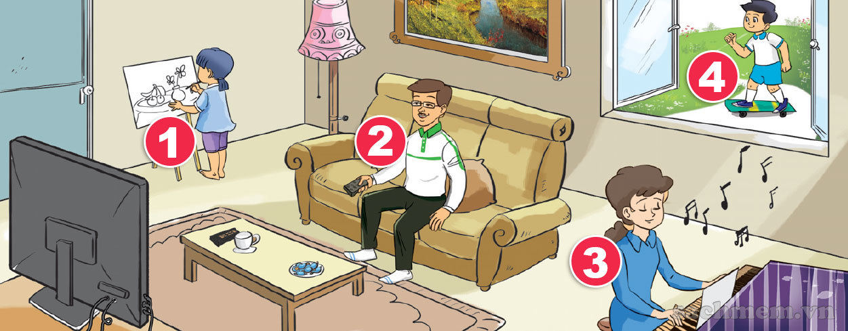

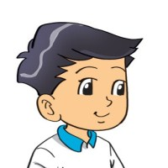
3. Let's talk.
4
What is he/she doing?
He/she _________.

Slide 2
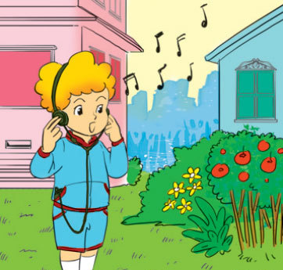

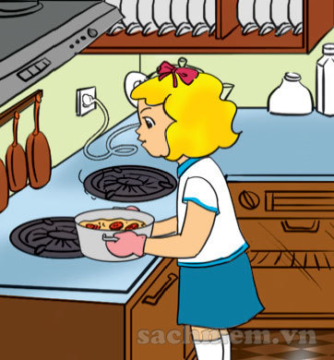
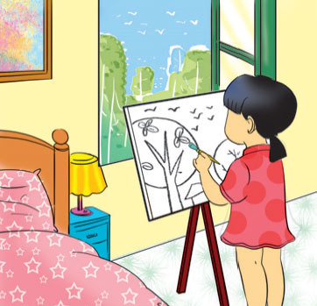

4. Listen and number.
a
b
c
d
3
1
4
2
1
2
3
4

Slide 3
5. Read and complete
1. What are you doing?
2. What's Mai doing?
3. What's Peter doing?
What are Tony and
Linda doing?
a. He's watching TV.
b. I'm playing the piano.
c. They're skating.
d. She's cooking.

Slide 4












Ms Huyền Phạm
0936.082.789
Ms Huyền Phạm
0936.082.789
Ms Huyền Phạm
0936.082.789
Ms Huyền Phạm - 0936.082.789 – YOUTUBE: MsPham. Facebook: Dạy và học cùng công nghệ.
Ms Huyền Phạm
0936.082.789
Notes:
Ms Huyền Phạm - 0936.082.789 – YOUTUBE: MsPham. Facebook: Dạy và học cùng công nghệ.

Slide 5





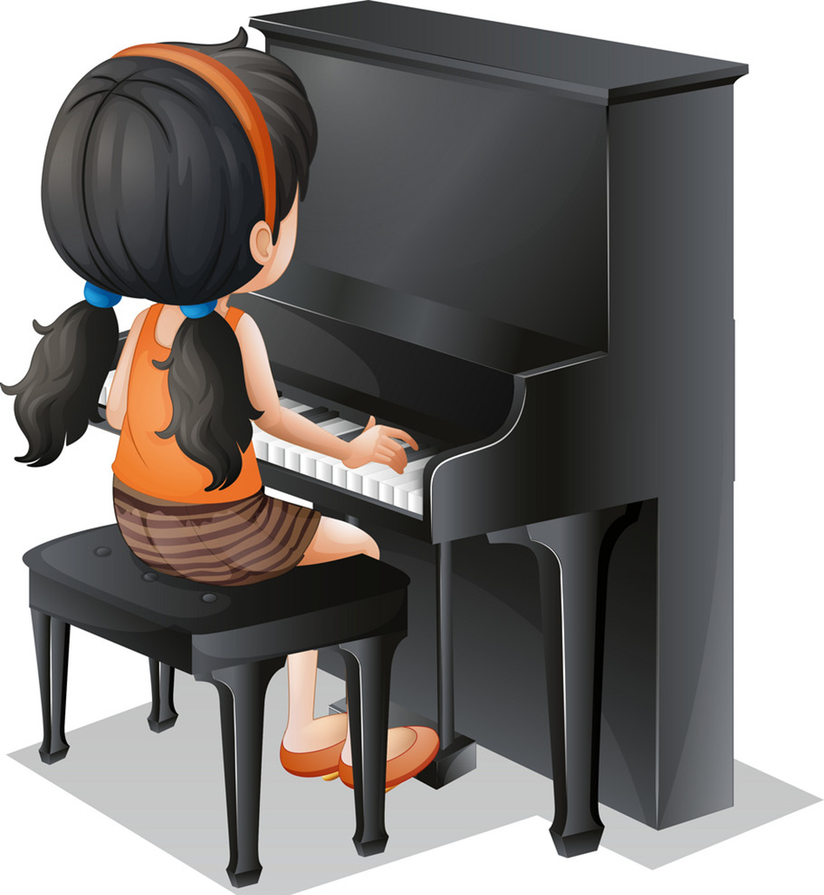




What's she doing?
She's playing the piano.
Next
Sai
sai
sai
Đúng
Notes:
Ms Huyền Phạm - 0936.082.789 – YOUTUBE: MsPham. Facebook: Dạy và học cùng công nghệ.

Slide 6
What's she doing?
She's watching TV.
Next
Sai
sai
Đúng
sai
Notes:
Ms Huyền Phạm - 0936.082.789 – YOUTUBE: MsPham. Facebook: Dạy và học cùng công nghệ.

Slide 7
What's she doing?
She's singing.
Next
Notes:
Ms Huyền Phạm - 0936.082.789 – YOUTUBE: MsPham. Facebook: Dạy và học cùng công nghệ.

Slide 8
What's he doing?
He's drawing.
Next
Sai
ĐÚNG
sai
sai
Notes:
Ms Huyền Phạm - 0936.082.789 – YOUTUBE: MsPham. Facebook: Dạy và học cùng công nghệ.

Slide 9
__________________
I’m singing.
Next
What’s you doing?
What’s she doing?
What’s he doing?
What are you doing?
Notes:
Ms Huyền Phạm - 0936.082.789 – YOUTUBE: MsPham. Facebook: Dạy và học cùng công nghệ.

Slide 10
__________________
She’s listening to music.
Next
What’s he doing?
What’s she doing?
What are you doing?
What are they doing?
Notes:
Ms Huyền Phạm - 0936.082.789 – YOUTUBE: MsPham. Facebook: Dạy và học cùng công nghệ.

Slide 11
__________________
He’s drawing.
Next
What’s your mother doing?
What’s she doing?
What’s he doing?
What are they doing?
Notes:
Ms Huyền Phạm - 0936.082.789 – YOUTUBE: MsPham. Facebook: Dạy và học cùng công nghệ.

Slide 12
Next
What's he doing?
______ playing the piano.
He’s
he
She’s
She
Notes:
Ms Huyền Phạm - 0936.082.789 – YOUTUBE: MsPham. Facebook: Dạy và học cùng công nghệ.

Slide 13
What's your grandmother doing?
________ watching TV.
Next
They’re
He’s
I’m
She’s
Notes:
Ms Huyền Phạm - 0936.082.789 – YOUTUBE: MsPham. Facebook: Dạy và học cùng công nghệ.

Slide 14
What's your father doing?
________ cooking.
Next
She’s
She
He’s
He
Notes:
Ms Huyền Phạm - 0936.082.789 – YOUTUBE: MsPham. Facebook: Dạy và học cùng công nghệ.

Slide 15
Next
What's ________ doing?
He’s cleaning the floor.
Your brother
Your sister
Your mother
She
Notes:
Ms Huyền Phạm - 0936.082.789 – YOUTUBE: MsPham. Facebook: Dạy và học cùng công nghệ.

Slide 16
What's _____ doing?
She's drawing.
Next
She’s
She
He’s
He
Notes:
Ms Huyền Phạm - 0936.082.789 – YOUTUBE: MsPham. Facebook: Dạy và học cùng công nghệ.

Slide 17








Notes:
Ms Huyền Phạm - 0936.082.789 – YOUTUBE: MsPham. Facebook: Dạy và học cùng công nghệ.

Slide 18

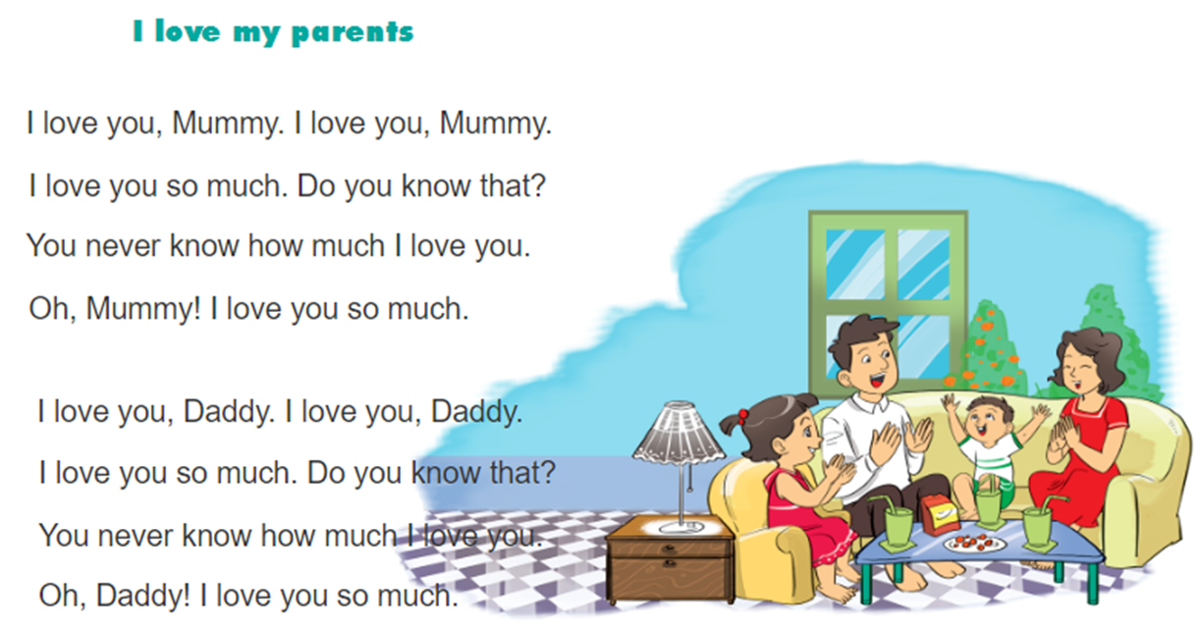
6. Let’s chan

