Slide 1
Unit 17
What toys do
you like?
Lesson 3

Slide 2

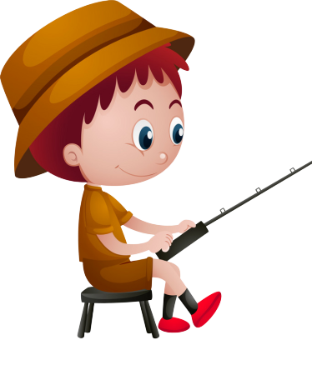


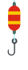

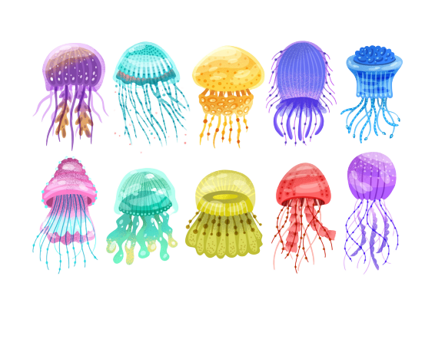

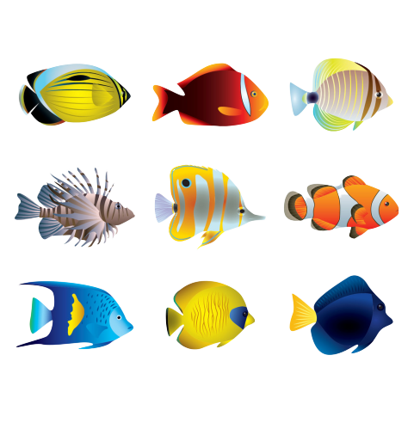


GO FISHING
Game
PLAY
EXIT
Notes:
Ms Huyền Phạm - 0936.082.789 – YOUTUBE: MsPham. Facebook: Dạy và học cùng công nghệ.

Slide 3










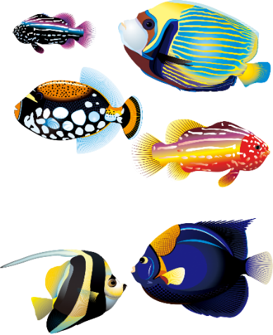

0
Score:
EXIT
7
8
6
9
2
4
1
10
5
3
13
12
11
14
15
Notes:
Ms Huyền Phạm - 0936.082.789 – YOUTUBE: MsPham. Facebook: Dạy và học cùng công nghệ.

Slide 4

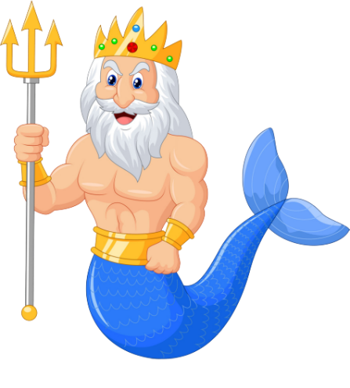



How many dolls do you have?
A
I have two.
B
I like dolls.
C
These are dolls.
D
STOVE
Notes:
Ms Huyền Phạm - 0936.082.789 – YOUTUBE: MsPham. Facebook: Dạy và học cùng công nghệ.

Slide 5
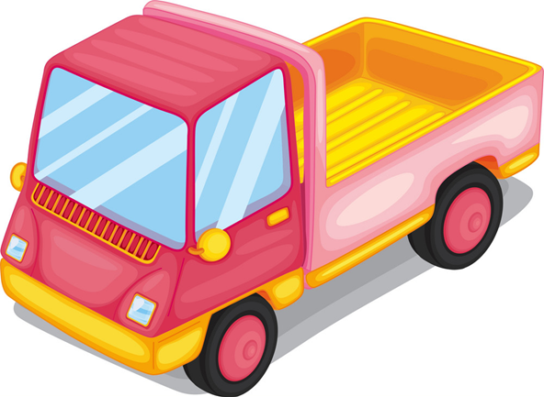
How many trucks does he have?
A
He have three.
B
He has three.
C
I have three.
D
Climb
Notes:
Ms Huyền Phạm - 0936.082.789 – YOUTUBE: MsPham. Facebook: Dạy và học cùng công nghệ.

Slide 6
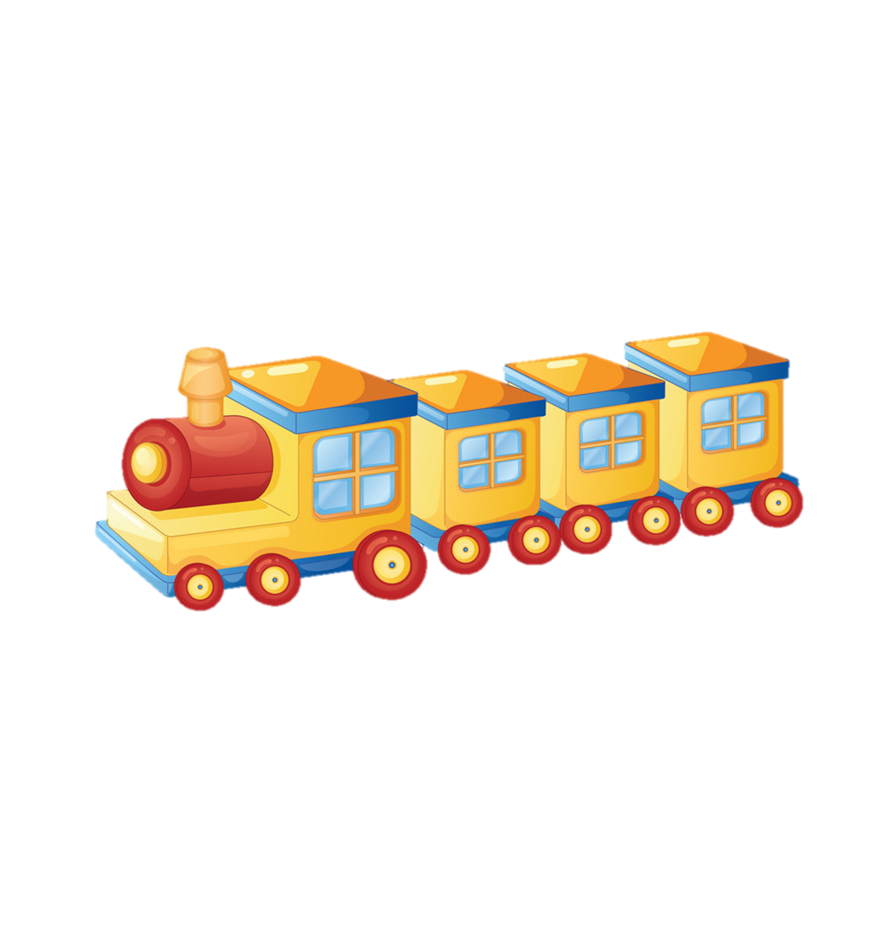
What toys do you like?
A
I like trains.
B
I like train.
C
I likes trains.
D
May
Notes:
Ms Huyền Phạm - 0936.082.789 – YOUTUBE: MsPham. Facebook: Dạy và học cùng công nghệ.

Slide 7
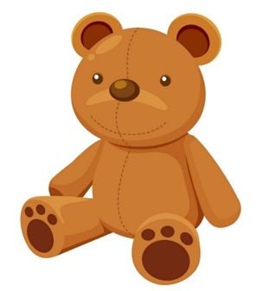
What toys do you _____?
I like teddy bears.
A
have
B
like
C
do
D
Watch
Notes:
Ms Huyền Phạm - 0936.082.789 – YOUTUBE: MsPham. Facebook: Dạy và học cùng công nghệ.

Slide 8
________ do you like?
I like cars.
A
What pets
B
How many toys
C
What toys
D
Next to
Notes:
Ms Huyền Phạm - 0936.082.789 – YOUTUBE: MsPham. Facebook: Dạy và học cùng công nghệ.

Slide 9
________ do you have?
I like parrots.
A
What pets
B
What toys
C
How many parrots
D
Next to
Notes:
Ms Huyền Phạm - 0936.082.789 – YOUTUBE: MsPham. Facebook: Dạy và học cùng công nghệ.

Slide 10
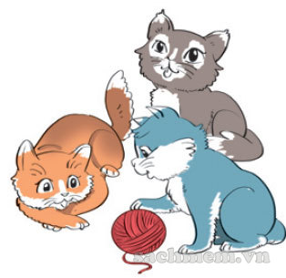
How many cats do you _____?
I have three.
A
are
B
have
C
is
D
She plays chess
in his free time.
Notes:
Ms Huyền Phạm - 0936.082.789 – YOUTUBE: MsPham. Facebook: Dạy và học cùng công nghệ.

Slide 11
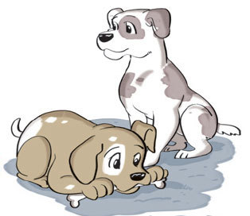
How many dogs ___ your brother have?
He has two.
A
is
B
do
C
does
D
They likes sport.
Notes:
Ms Huyền Phạm - 0936.082.789 – YOUTUBE: MsPham. Facebook: Dạy và học cùng công nghệ.

Slide 12
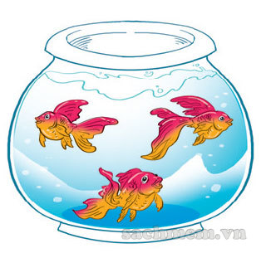
How many ____ does she have?
She has three.
A
goldfish
B
goldfishes
C
goldfishes
D
She should take some warm water.
Notes:
Ms Huyền Phạm - 0936.082.789 – YOUTUBE: MsPham. Facebook: Dạy và học cùng công nghệ.

Slide 13
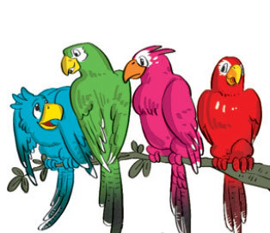
What pets do you like?
___________.
A
I have four.
B
I have parrots.
C
I like parrots.
D
He shouldn’t watch much TV.
Notes:
Ms Huyền Phạm - 0936.082.789 – YOUTUBE: MsPham. Facebook: Dạy và học cùng công nghệ.

Slide 14


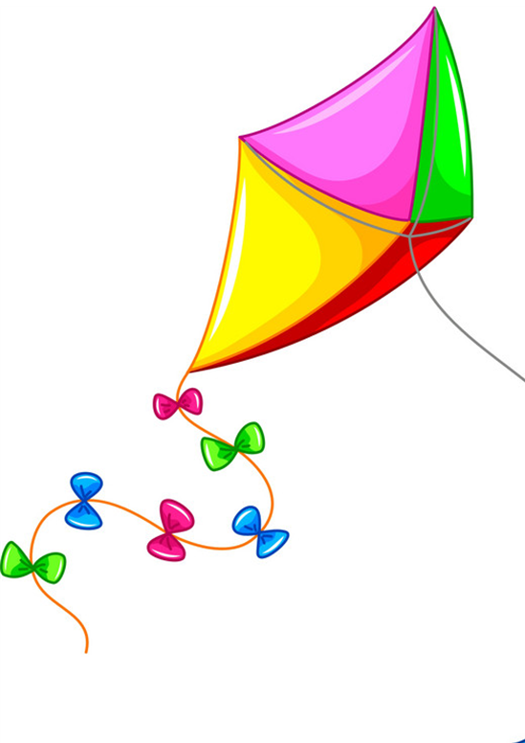


What toys do you like?
I like ___________.
planes
dolls
kites
trucks
robbots
trains
teddy bears

Slide 15
How many ______ do you have?
I have _________.
parrots
cats
goldfish
dogs

Slide 16
How many ______ does she/he have?
She/ he has_________.
parrots
cats
goldfish
dogs

Slide 17
Phonics

Slide 18

1. Listen and repeat.
i-e | kite | This is my kite.
i | ship | I like ships.

Slide 19
2. Listen and write.
1. I have a new __________.
2. Do you like ___________?
kite
ships

Slide 20

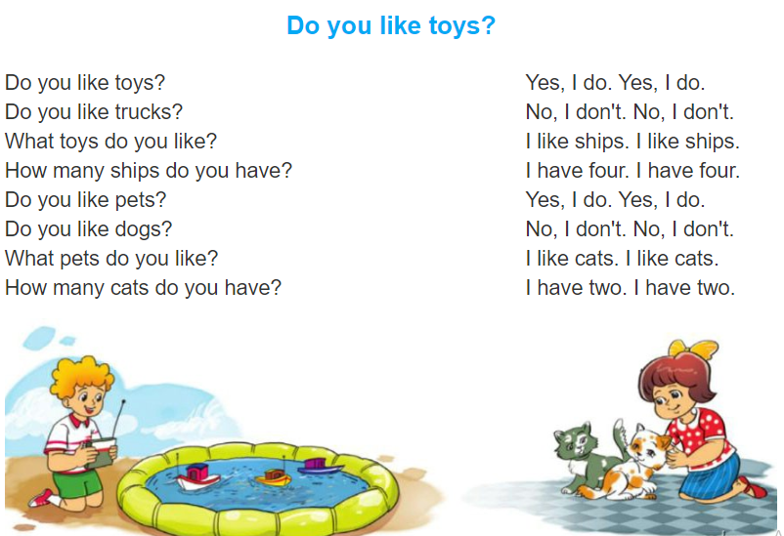

3. Let's chant.

Slide 21
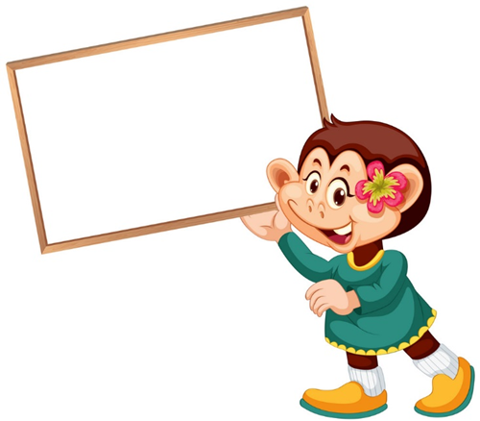

4. Read and match.
1
Do you like toys?
a
Robots.
2
What toys do you like?
b
Nine.
3
What pets do you like?
c
Yes, I do.
4
How many cats do you have?
d
Cats.

Slide 22
5. Read and complete.
How
has
cats
like
ten
truck
I have many toys. I have five (1) _____ , three planes, and (2) _____ yo-yos. My friend Mary has some pets. She (3) _____ two dogs and three (4) _____. What about you? What toys do you (5) _____? (6) _____ many pets do you have?
truck
ten
has
cats
like
How

Slide 23
6. Project
Draw and colour your toys or pets.
Talk to your classmates about them.

