Slide 1
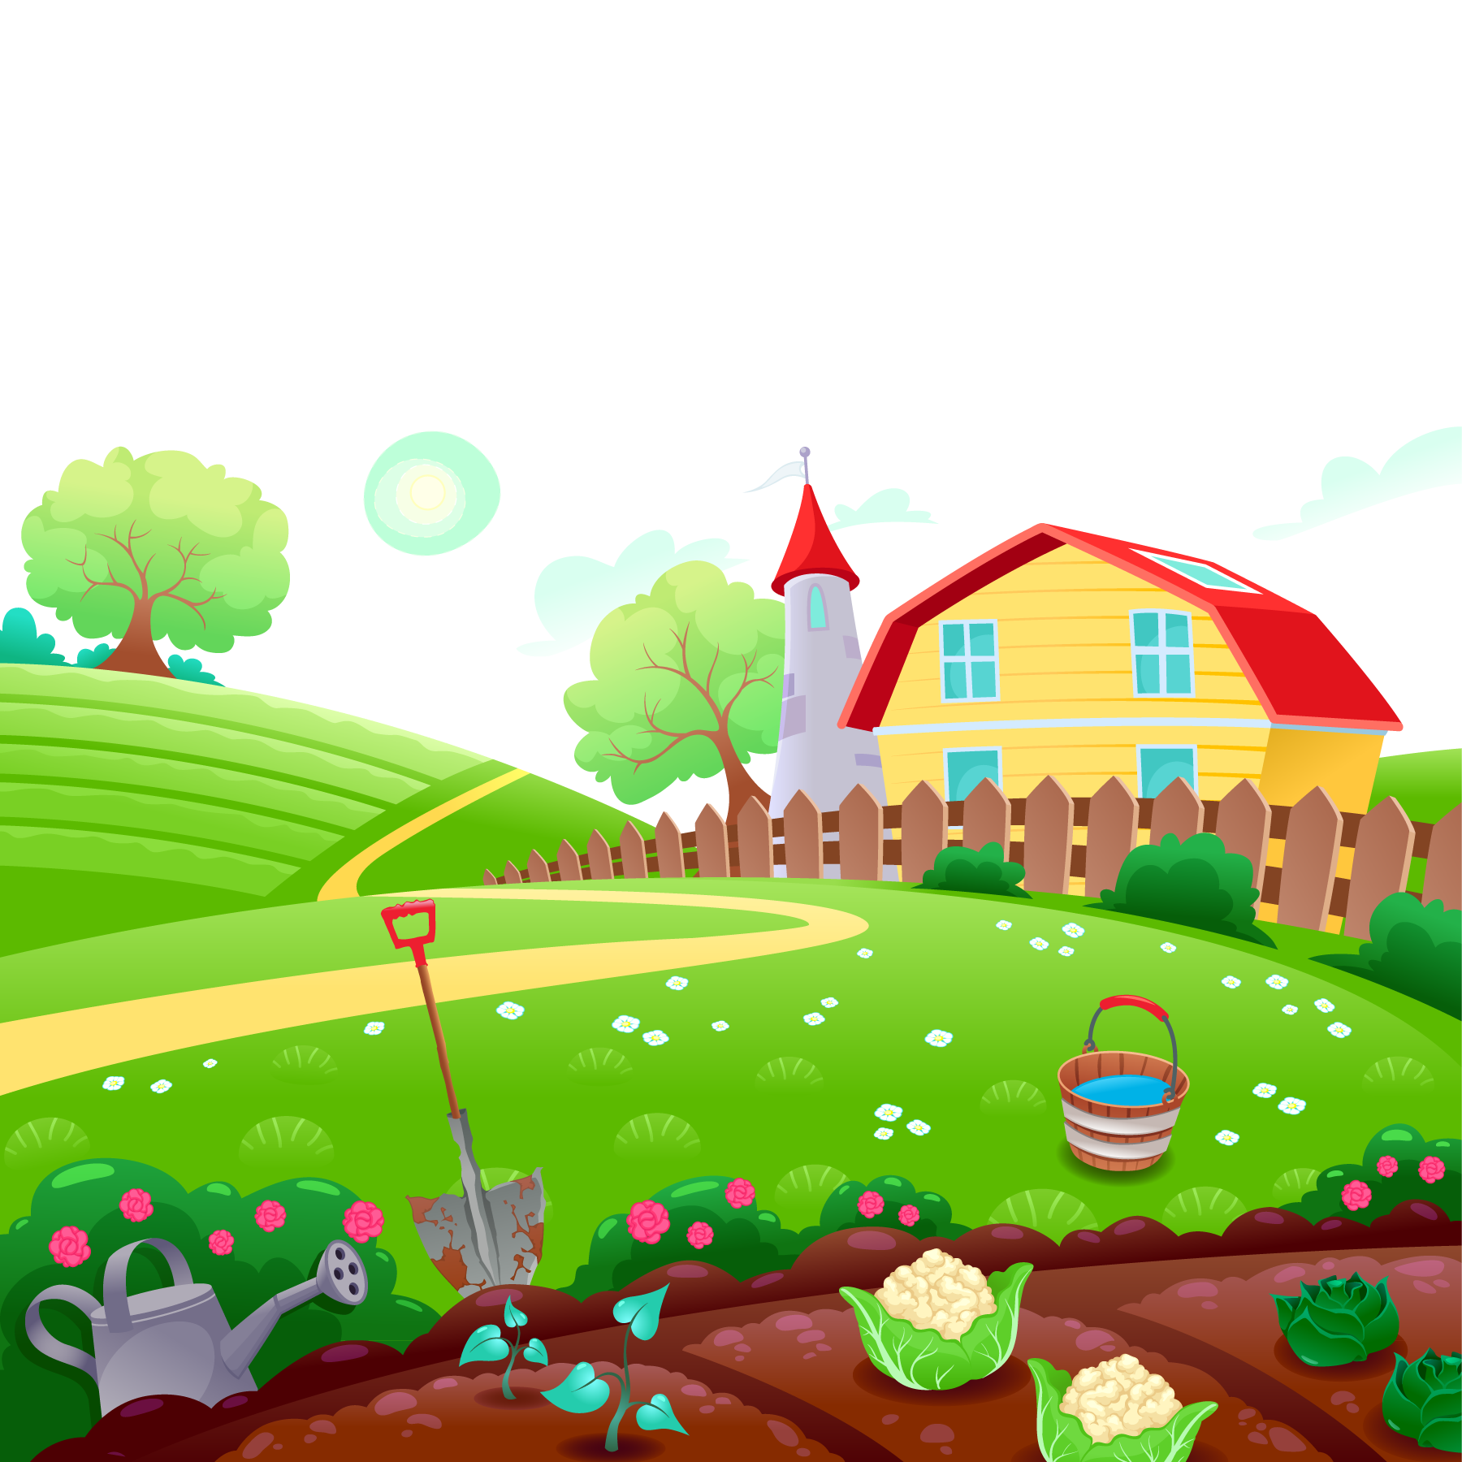

UNIT 16. DO YOUHAVE ANY PETS?
LESSON 3
By Jessica

Slide 2
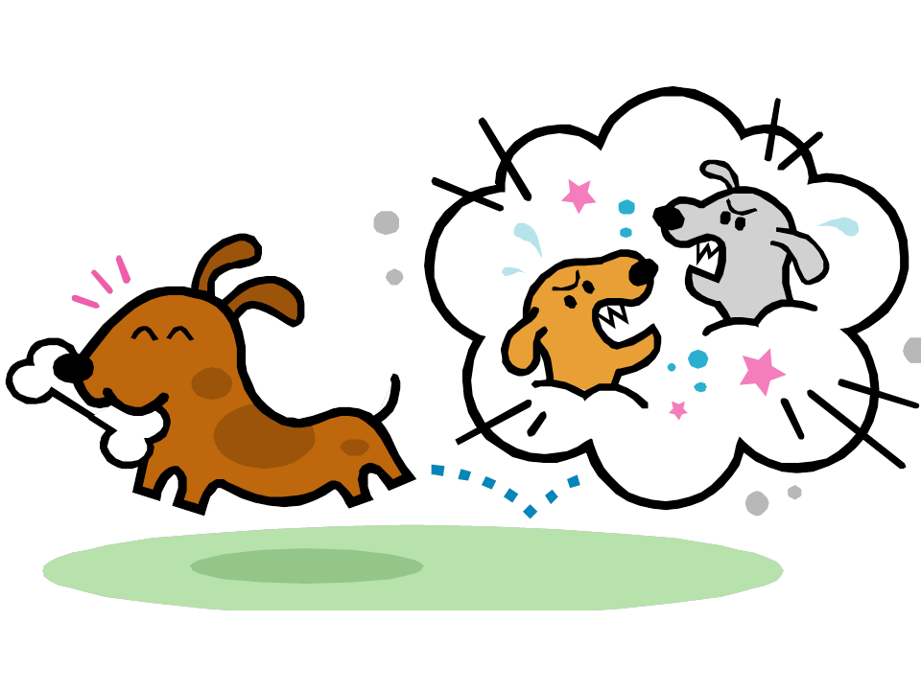

WARM UP
By Jessica

Slide 3

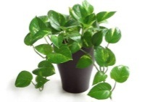
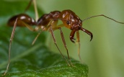

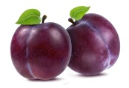
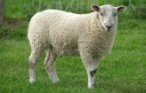

JUMPING GAME
dog
frog
old
otstrich
parrot
otopus
ocean
R
R
L
R
L
R
L
Gợi ý: Giáo viên đọc 1 số từ có âm short “o” hoặc long “o”
Cho học sinh xếp thành hàng, đọc đến từ có âm short “o” học sinh nhảy sang PHẢI, long “o” học sinh nhảy sang TRÁI.
By Jessica

Slide 4




LONG SOUND
By Jessica

Slide 5

dog
Where is your dog?
By Jessica

Slide 6
parrot
LONG SOUND
My parrot is in the garden.
By Jessica

Slide 7
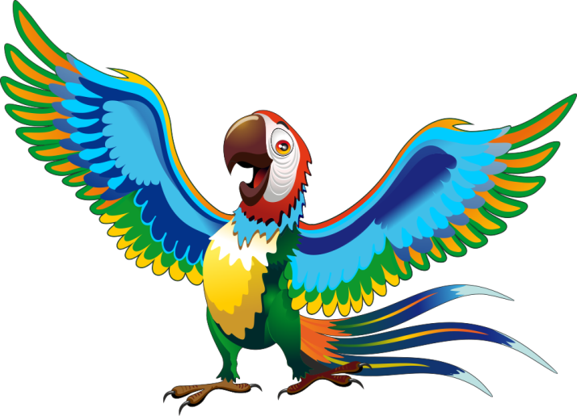
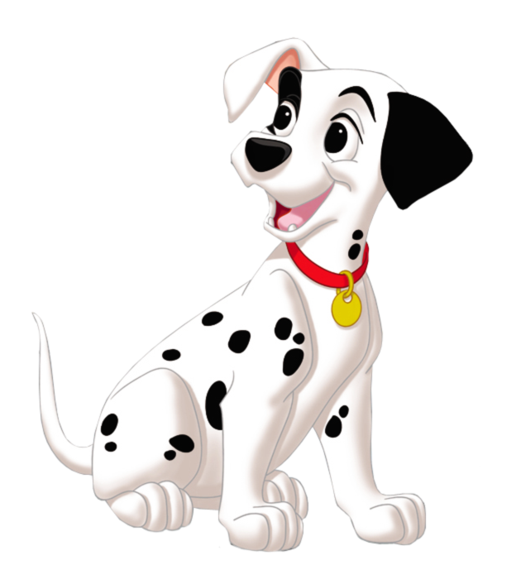

2. Listen & write
1
parrot
Peter has a .
2
dog
My brother doesn’t has a .
By Jessica

Slide 8

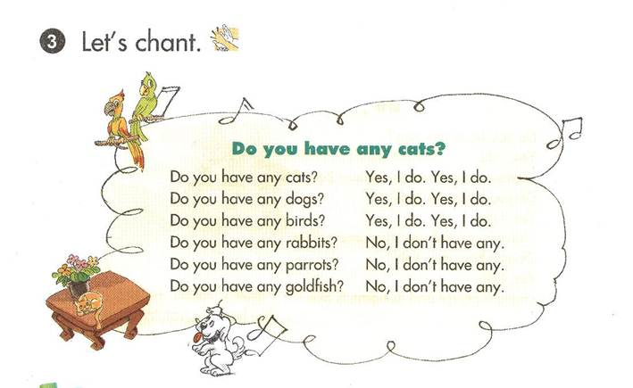

By Jessica

Slide 9
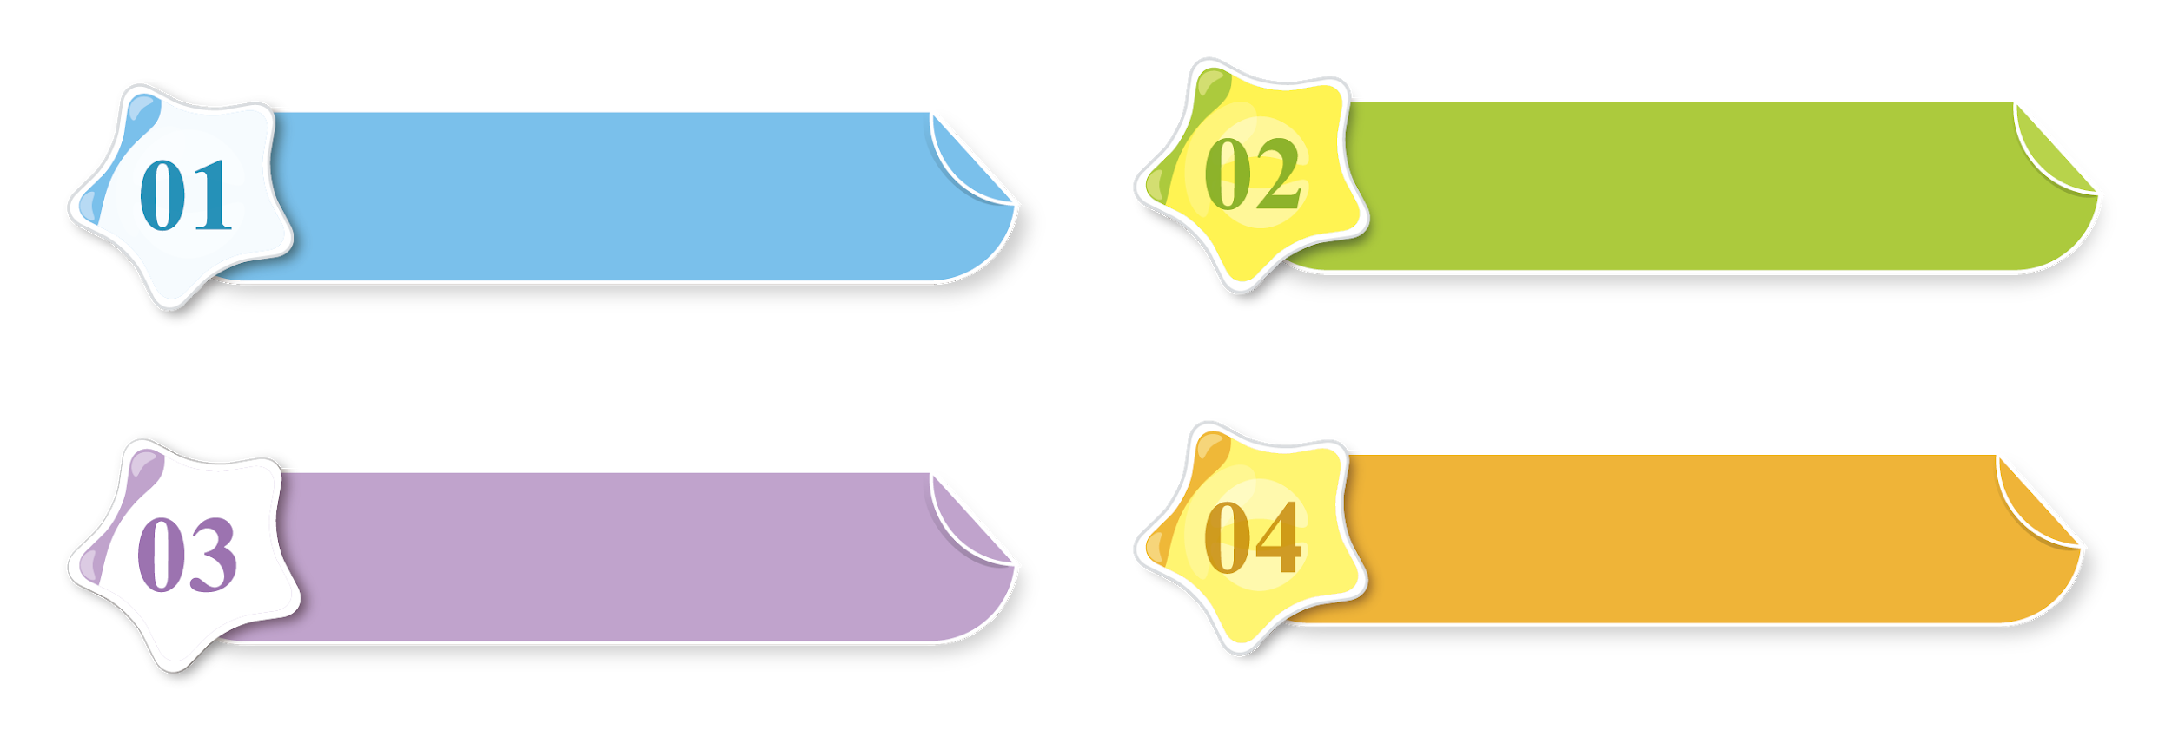
Do you have any pets?
a
It’s in the garden, on the tree over there.
Do you have any goldfish?
b
They’re in the yard.
Where ‘s your cat?
c
Yes, I do. I have two dogs and a cat.
Where are your dogs?
d
No, I don’t.
By Jessica

Slide 10
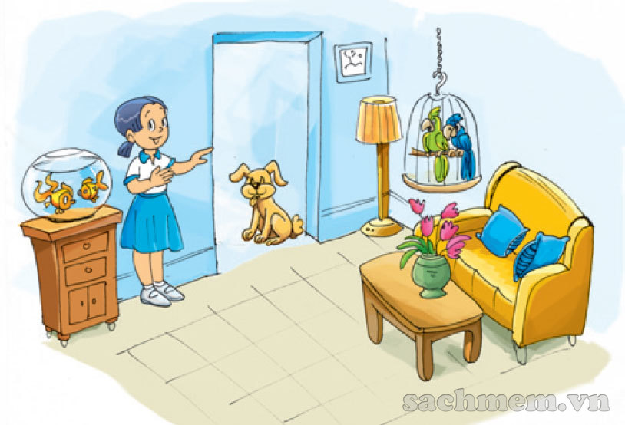
READ & WRITE
Hi! My name is Mai.
I am eight years old.
I have a dog, two
goldfish and two parrots.
This is my dog.
It is at the door. These are my goldfish. They are in the fish tank. And those are my parrots. They are in the cage. I love my pets very much.
By Jessica

Slide 11
READ & WRITE
By Jessica
1. How old is Mai?
🡪 She is 8 years old.
2.Does she have any pets?
🡪 Yes, she does.
3.What pets does she have?
She has a dog, two goldfish
and two parrots.
4.Where is her dog?
🡪 It is at the door.
5.Where are her goldfish?
🡪 They are in the fish tank.

Slide 12
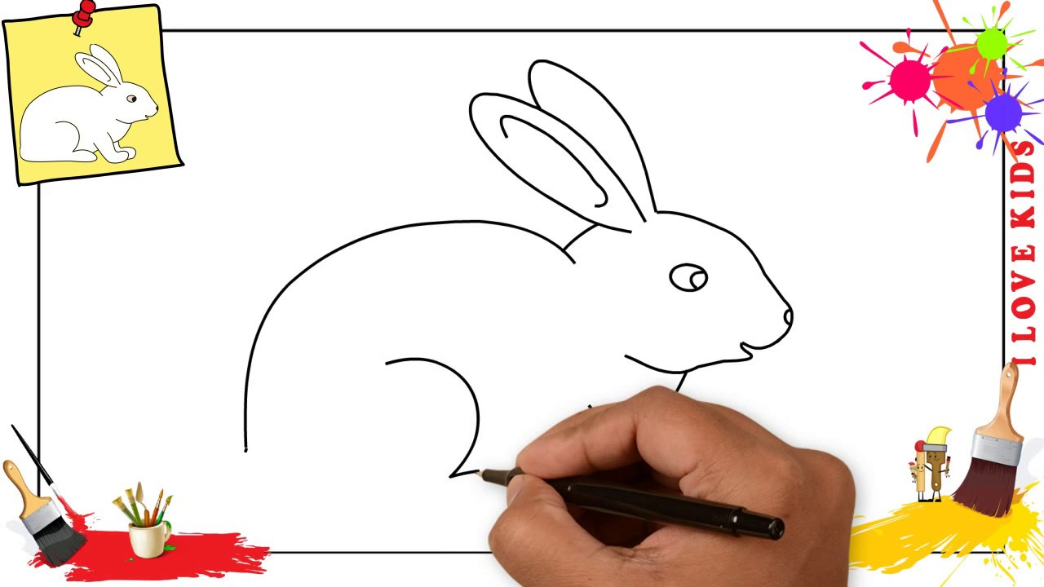
DRAWING RABBIT
By Jessica

Slide 13

By Jessica

Slide 14


Slide 15




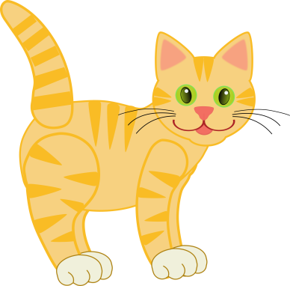
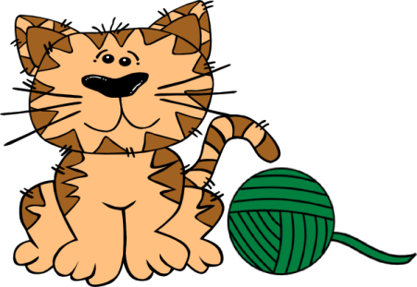
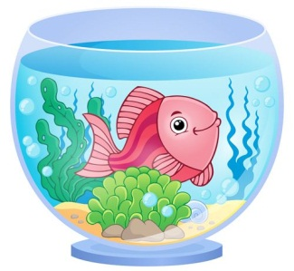
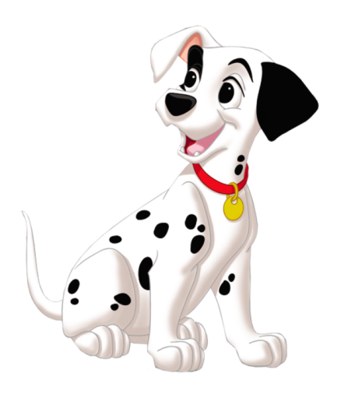
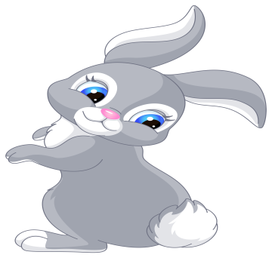
PET HOUSE
END

Slide 16
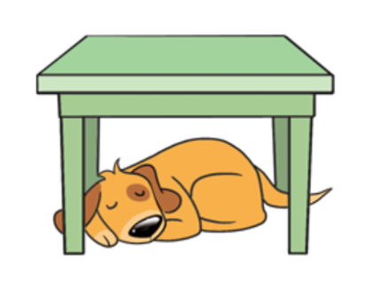




The dog is under the table
The dog is behind the table
The dog is next to the table

Slide 17
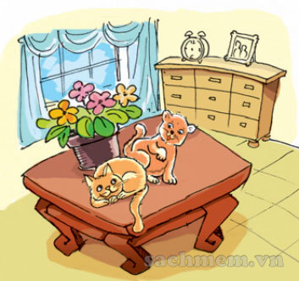
The cats are under the table
The cats are next to the flower pot.
The cats are behind the flower pot.

Slide 18

The goldfish is on the fish tank.
The goldfish is under the fish tank.
The goldfish is in the fish tank.

Slide 19
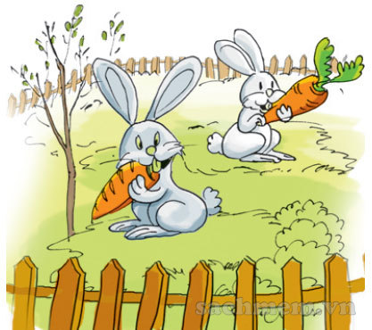
The rabbits is in the fish tank.
The rabbit is in the garden.
The rabbit is near the garden.

Slide 20
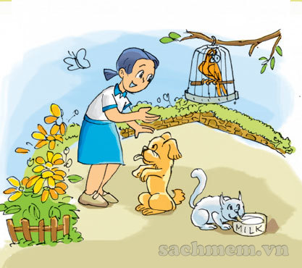
The cat is in front of the dog.
The cat is under the dog.
The cat is next to the dog.

Slide 21
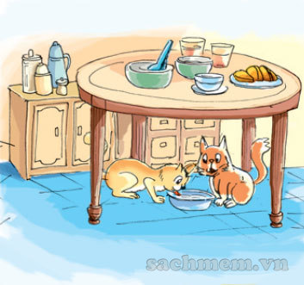
The cats are under the table.
The cats are on the table.
The cats are in the table.

Slide 22
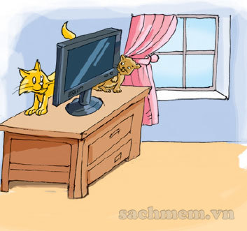
The cat is on the TV.
The cat is in the TV.
The cat is behind the TV.

Slide 23
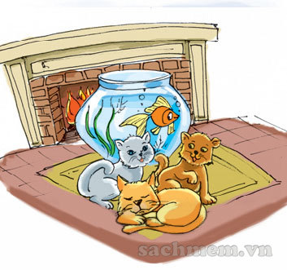
The cats are in the fish tank.
The cats are behind the fish tank.
The cats are in front of the fish tank.

Slide 24


Slide 25



By Jessica

