Slide 1

Unit 2: Family
Lesson 2.3
Page 29

Slide 2

WARM UP

Slide 3
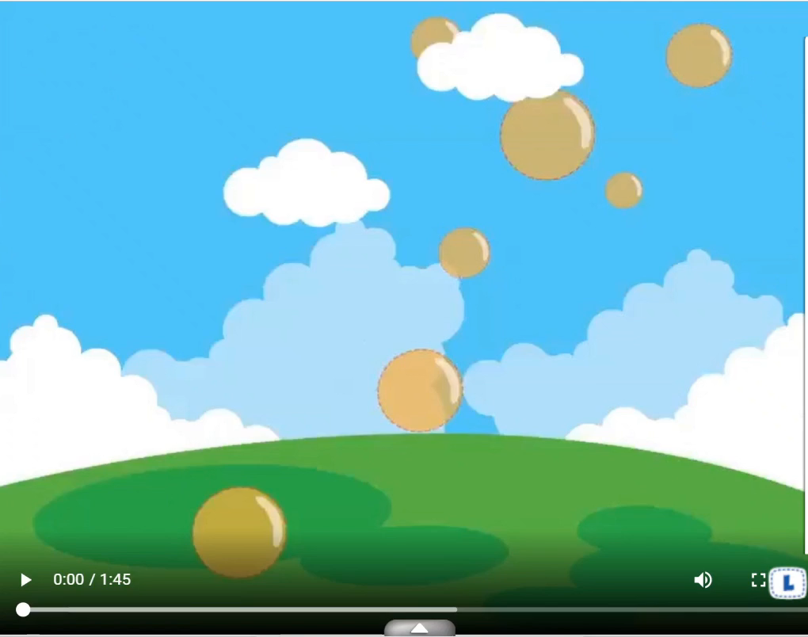

Slide 4






Memory Game
1
2
3
4
5
6
sister
uncle
7
8
9
grandfather
10
11
12
cousin
aunt
grandmother
Notes:
Divide the class into teams.
Ask each team to take turns choosing 2 numbers.
Get them a point if the picture matches with the word.
Click on the red circles to hide the picture and word if they don’t match.
Give a chance to another group.

Slide 5
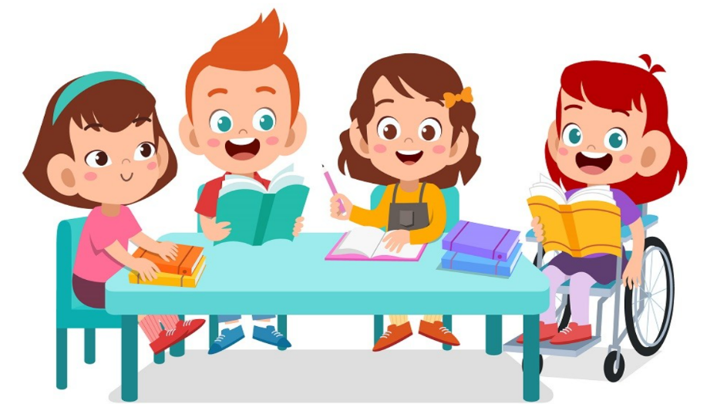
It’s time to learn …

Slide 6

Speaking

Slide 7
E
2. Role-play.
Example:
Tina: This is my brother, Ben.
Mark: Hello, Ben. I’m Mark.
Ben: Hello, Mark.
Notes:
2. Role-play.
Divide the class into groups of three.
Demonstrate the activity using the example.
Ask them to role-play the activity.
Swap roles and repeat.
Afterwards, have some pairs demonstrate the activity in front of the class.

Slide 8
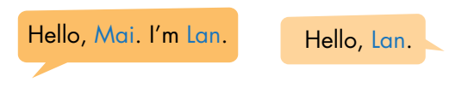
F
2. Role-play.
Example:
Lily: This is my sister, Mary.
Sam: Hello, Mary. I’m Sam.
Mary: Hello, Sam.
Notes:
2. Role-play.
Divide the class into groups of three.
Demonstrate the activity using the example.
Ask them to role-play the activity.
Swap roles and repeat.
Afterwards, have some pairs demonstrate the activity in front of the class.

Slide 9

CONSOLIDATION

Slide 10
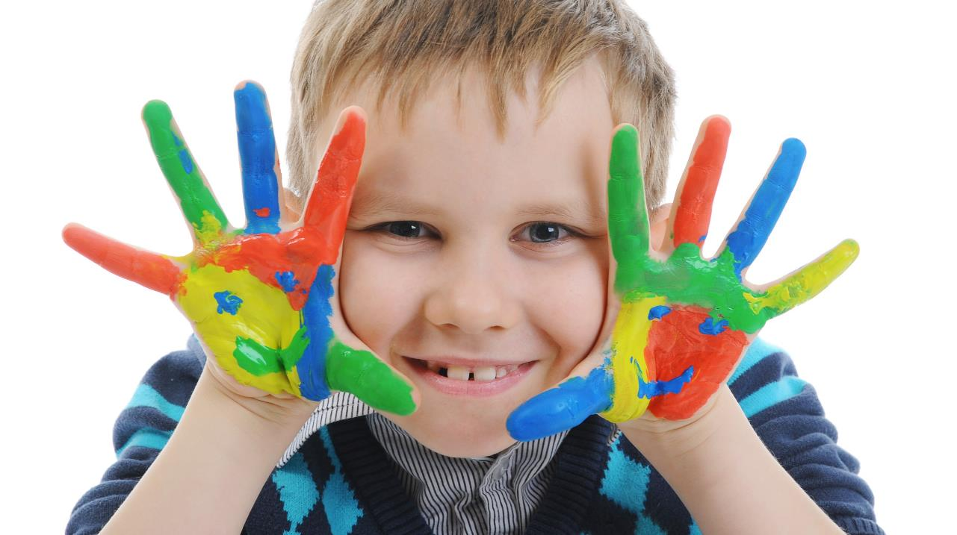
Enjoy your day!

