Slide 1

Unit 2: Family
Lesson 1.2
Page 25

Slide 2

Speaking

Slide 3

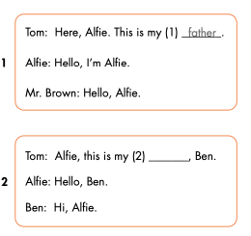
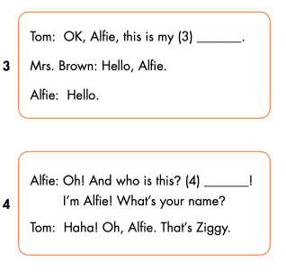
mother
brother
Hello

Slide 4

CONSOLIDATION

Slide 5
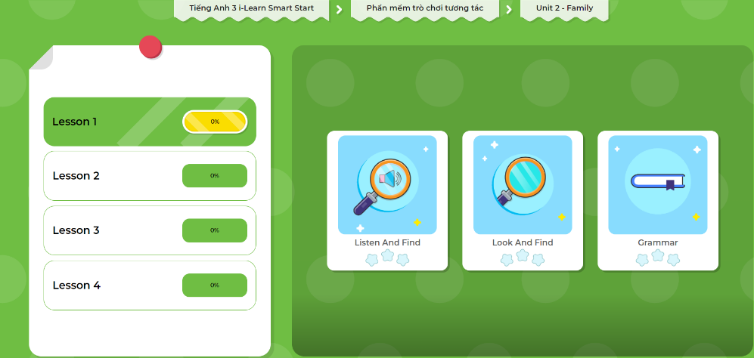
Extra Practice
DHA App
Let’s play!
Click on the picture below

Slide 6


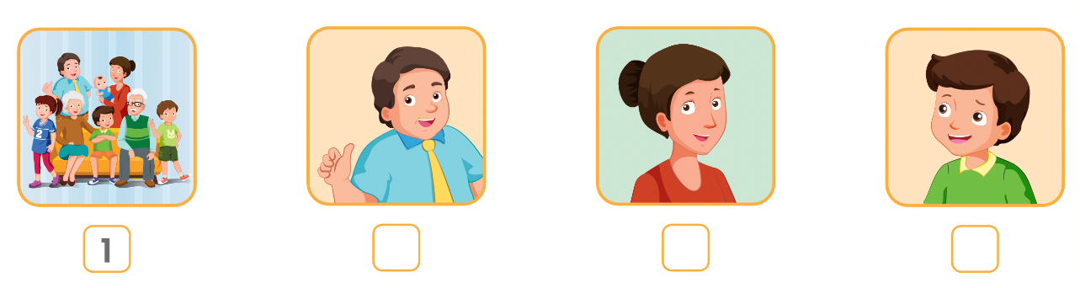
Extra Practice
WB p. 19
Click on the icon to hear the sound
4
2
3

Slide 7

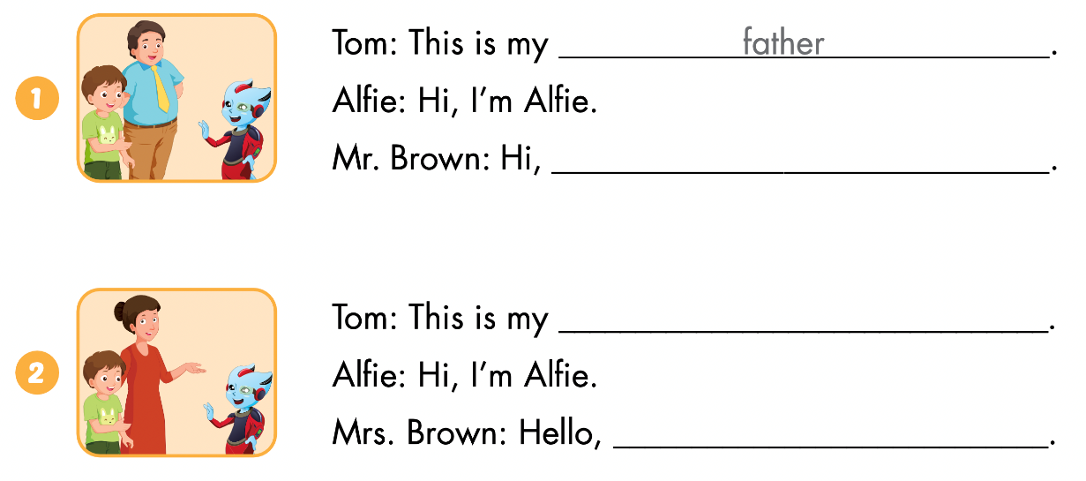
Alfie
mother
Alfie

Slide 8
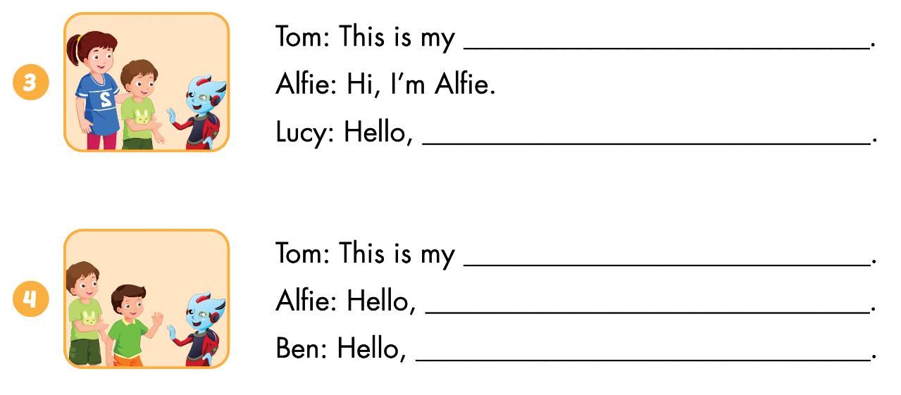
sister
Alfie
brother
Ben
Alfie

Slide 9

Let’s draw.
Draw your family
Work in pairs
Tell your partner about your family

Slide 10

WRAP-UP

Slide 11
Lesson 3
Today’s lesson
Phonics
/ʌ/
Structures/ Sentence patterns
This is my (father).
Hello, I’m Alfie.
Hello Alfie.

Slide 12
Lesson 3
Homework
Learn by hearts vocabularies and make sentences using them.
Do the exercises on page 19 WB
Do the exercises in Tiếng Anh 3 i-Learn Smart Start Notebook on page 17
Prepare the next lesson (page 26 SB)
Play the consolidation games in Tiếng Anh 3 i-Learn Smart Start DHA App on www.eduhome.com.vn

Slide 13

Lesson 3
Stay positive and have a nice day!

