Slide 1
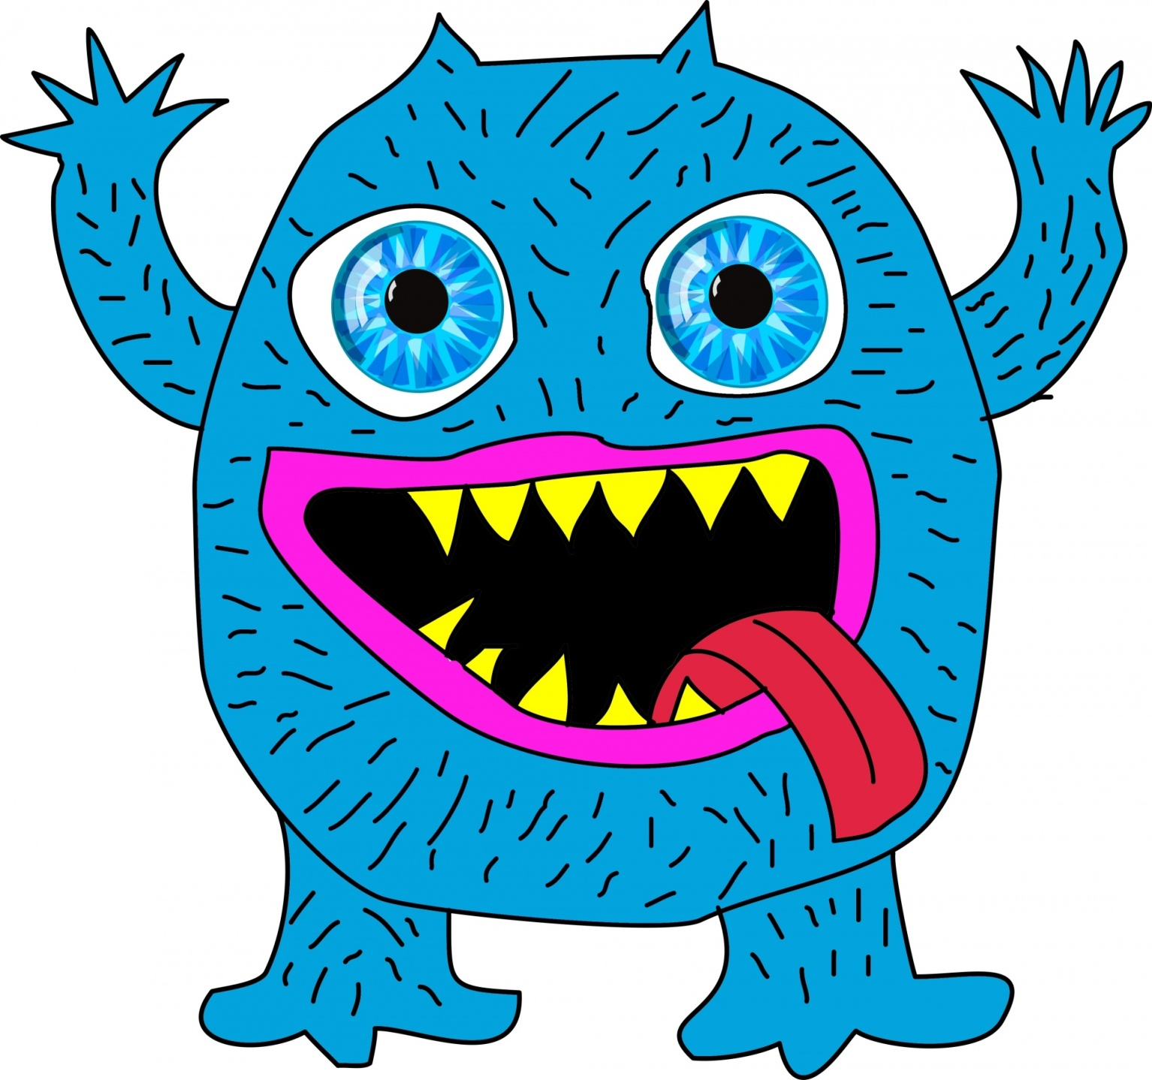
There’s a
monster
There are

Slide 2
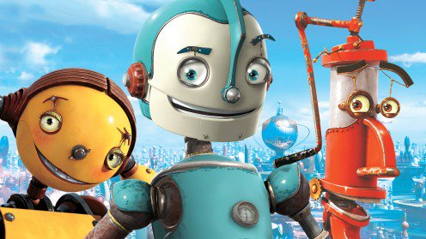
There’s a
three robots
There are

Slide 3
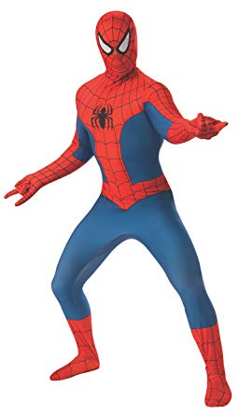
There’s a
Spiderman
There are

Slide 4
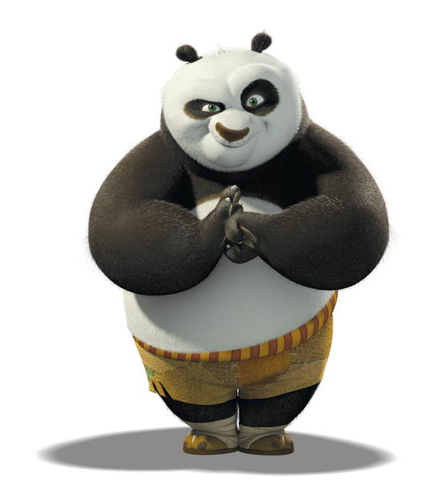
There’s a
panda
There are

Slide 5
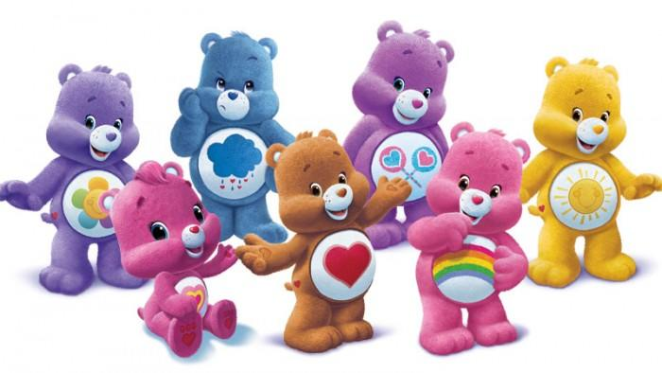
There’s a
seven teddy bears
There are

Slide 6
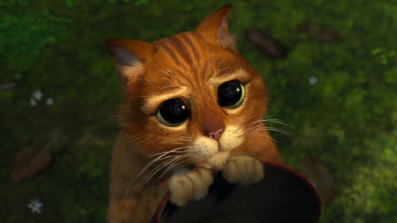
There’s a
cat
There are

Slide 7
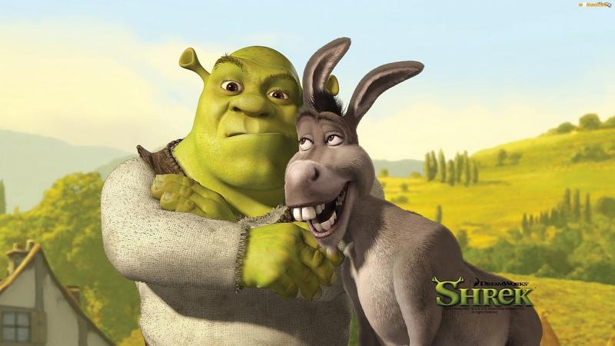
There’s a
friends
There are

Slide 8
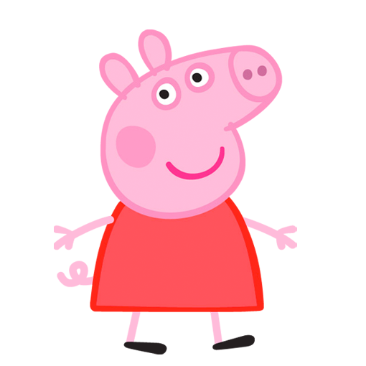
There’s a
pig
There are

Slide 9
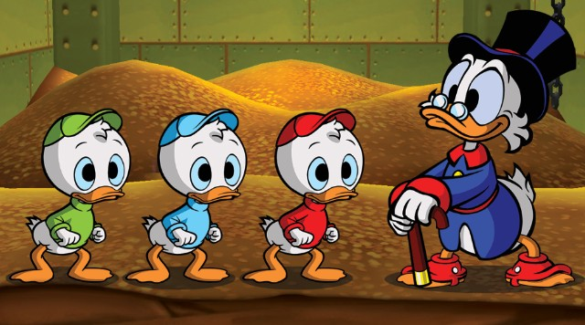
There’s a
ducks
There are

Slide 10
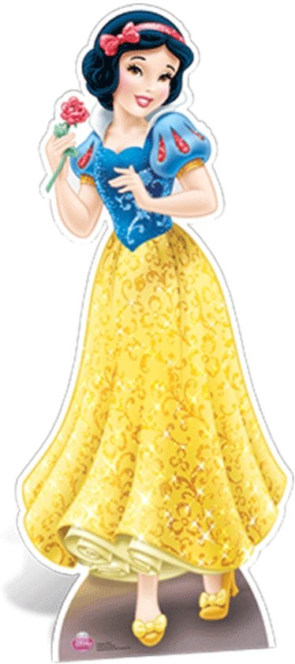
There’s a
princess
There are

Slide 11
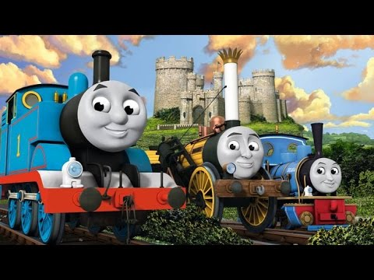
There’s a
trains
There are

Slide 12
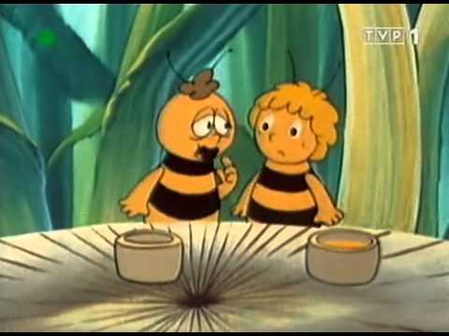
There’s a
bees
There are

Slide 13
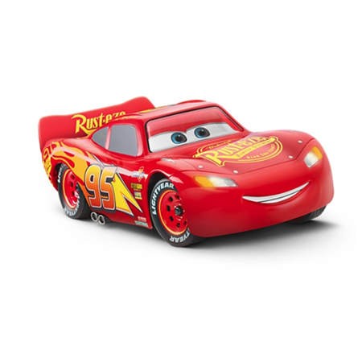
There’s a
car
There are

Slide 14
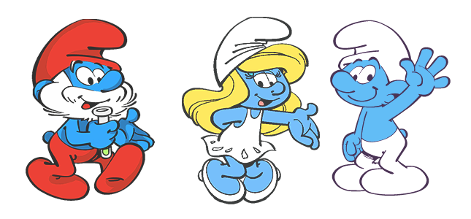
There’s a
three smurfs
There are

Slide 15
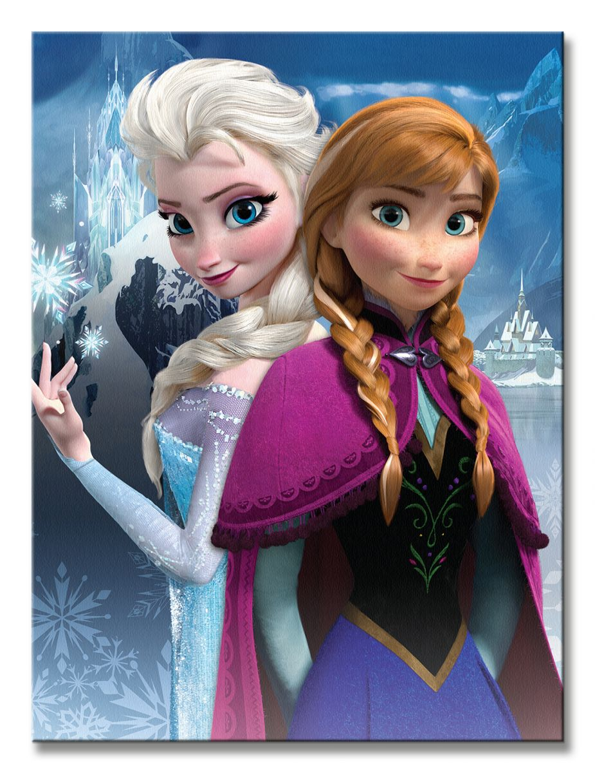
There’s a
sisters
There are

Slide 16
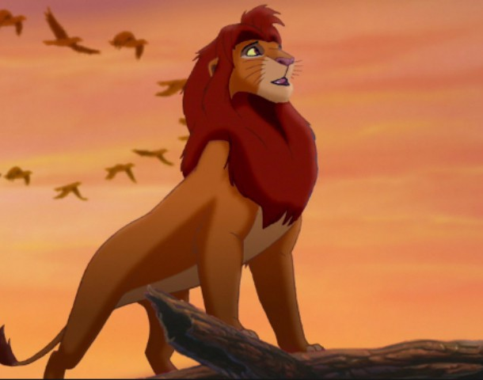
There’s a
lion
There are

Slide 17
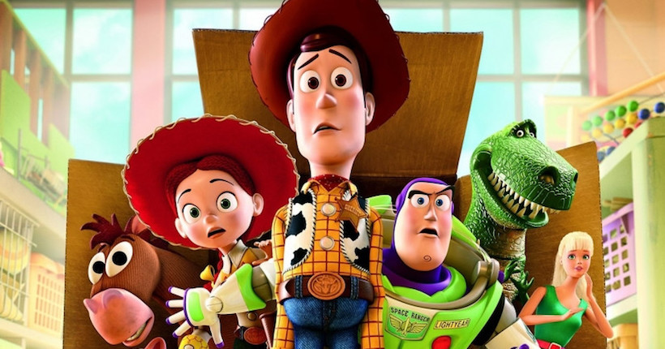
There’s a
toys
There are

Slide 18
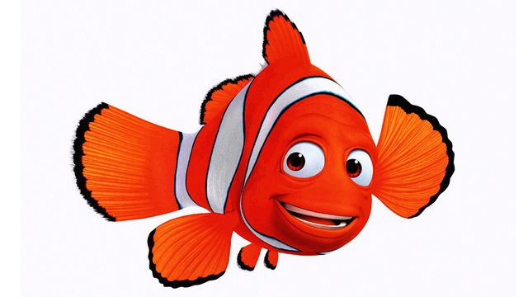
There’s a
fish
There are

Slide 19
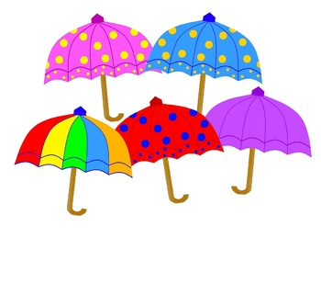
There’s a
umbrellas
There are

Slide 20
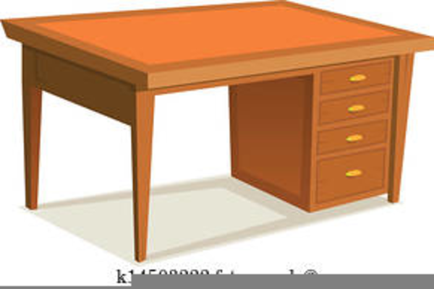
There’s a
desk
There are

Slide 21

There’s a
bookshelf
There are

Slide 22
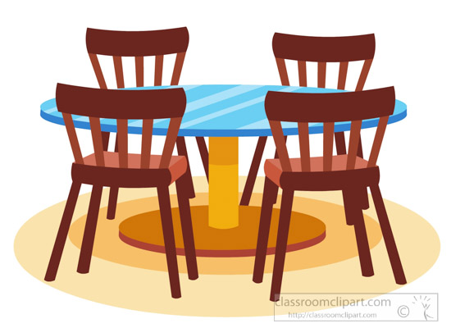
There’s a
chairs
There are

Slide 23
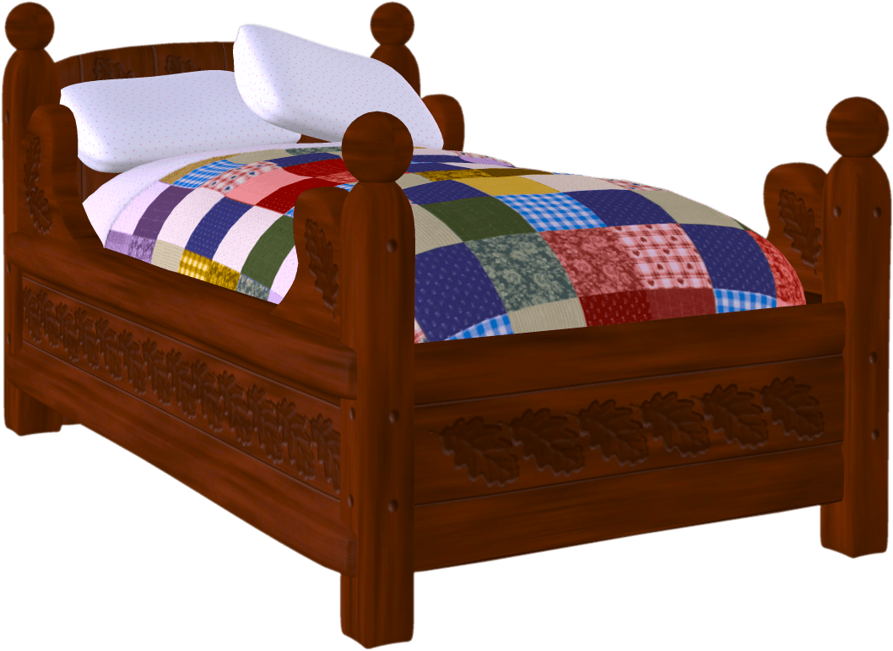
There’s a
bed
There are

Slide 24
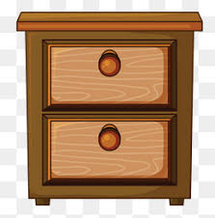
There’s a
drawers
There are

Slide 25

There’s a
rug
There are

Slide 26

There’s a
wardrobe
There are

Slide 27
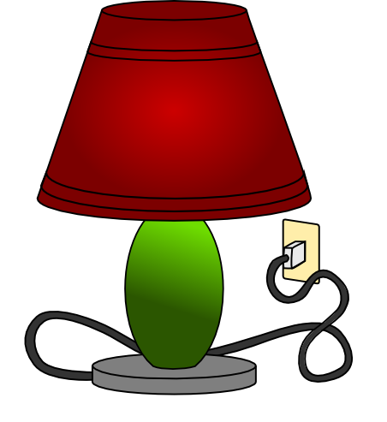
There’s a
There are

Slide 28
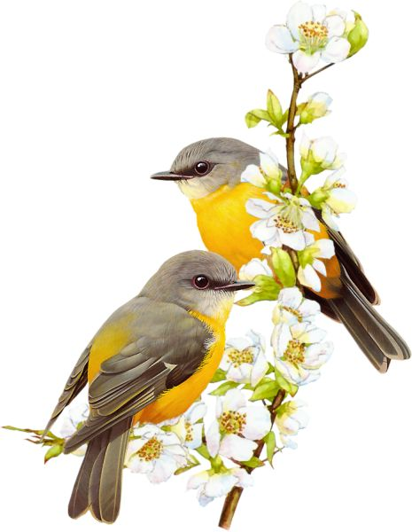
There’s a
birds
There are

Slide 29
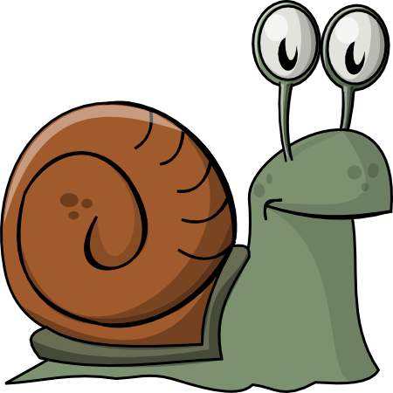
There’s a
snail
There are

Slide 30

There’s a
butterflies
There are

Slide 31



Slide 32


Slide 33


