Slide 1
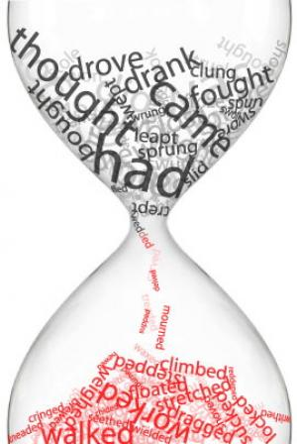
Past Simple

Slide 2
Present (now) | Past
The Oxford Castle _____a shopping centre now. | But it _____a prison in the past.
The Moshulu _____a luxury restaurant now. | But it _____a sailing ship in the past.
The Musee d’Orsay _____an art gallery now. | But it _____a train station.
The Smolny Institute _____the office of the Governor now. | But it _____a school for rich girls.
is
was
is
was
was
is
was
is

Slide 3
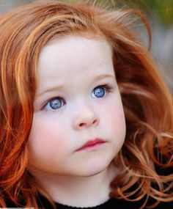
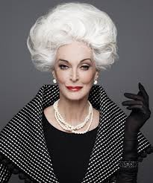
use
Actions and situations in the past
These actions and situations are finished
Example:
My hair was red when I was a girl, but it’s grey now.
In the past
Now

Slide 4
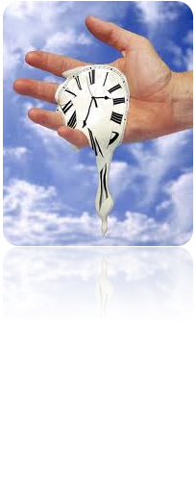
Time expressions:
Yesterday
in (June, 1995, the 1980s)
last (night, month, week,
Thursday, year)
(a week, two days) ago.

Slide 5
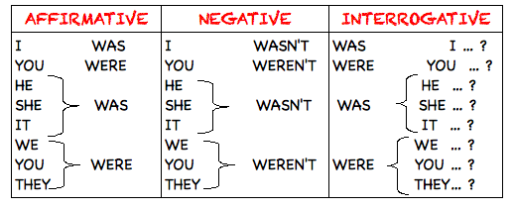
Verb “be”

Slide 6
Past Simple: to be
+ | The past simple of the verb to be is was for I, he, she, it and were for we, you, they. | He was in France two weeks ago.
 |  | We were very busy yesterday morning.
- | To make the negative, we put not after was or were. The short forms are wasn't and weren't. | She was not (wasn’t) at the cinema yesterday.
 |  | They were not (weren't) here last night.
? | In the question form, we put was or were before the subject. | Was George at the party on Sunday?
 |  | Where were you yesterday?

Slide 7
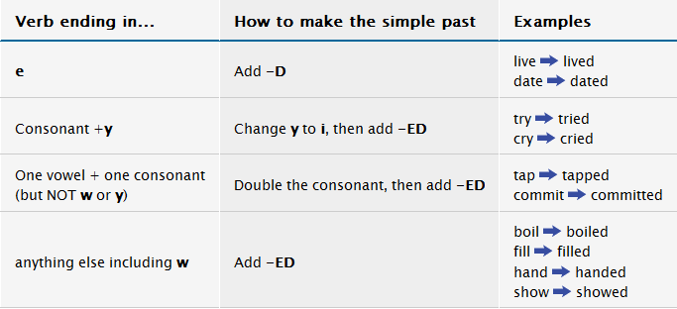
Regular verbs (positive)

Slide 8
practice
Task 3 Write the Past Simple of these verbs in the correct column.
Laugh, tidy, stay, plan, hate, cry, love, study, dance, kiss, watch, change, enjoy, try, live, prefer, cook, work, walk
+ed
+d
y→i + ed
Double consonant + ed

Slide 9
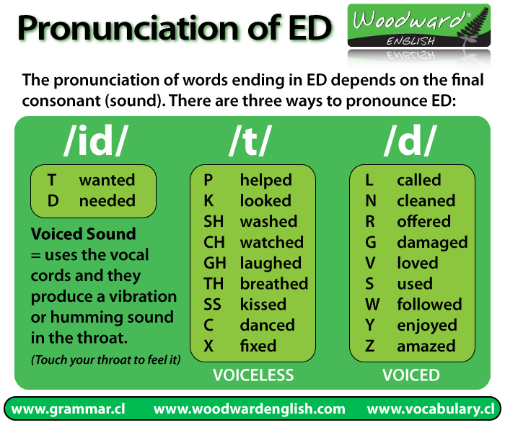

Slide 10
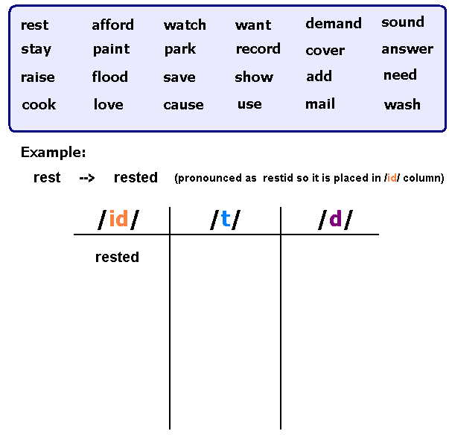

Slide 11
Answers
Student A: 1 studied 2 lived 3 played 4 started 5 were
Student B: 1 produced 2 lived 3 planned 4 married 5 was
Student C: 1 studied 2 watched 3 stopped 4 lived 5 were

Slide 12
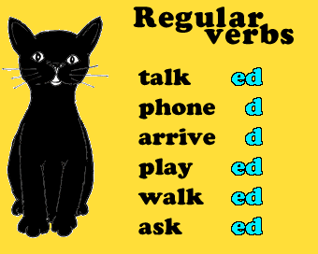
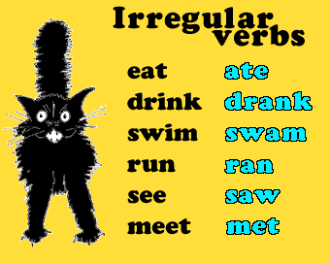
Regular Verbs Vs. irregular verbs

Slide 13
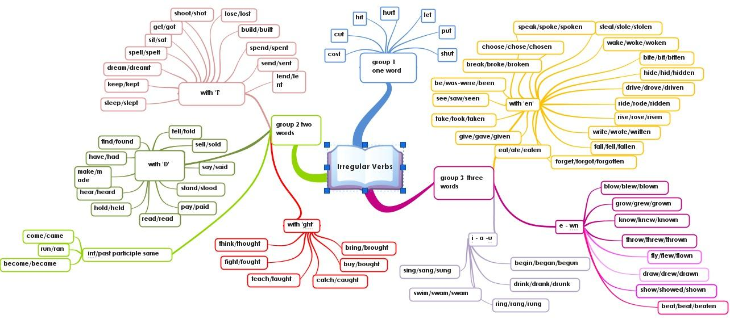
How to remember Irregular verbs

Slide 14
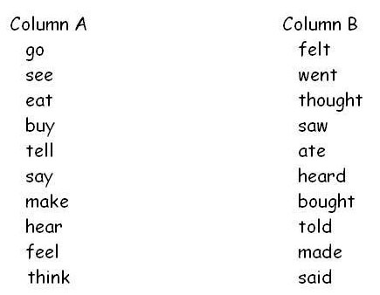
practice

Slide 15
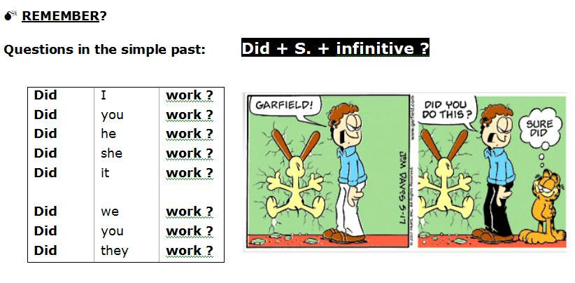
questions

Slide 16
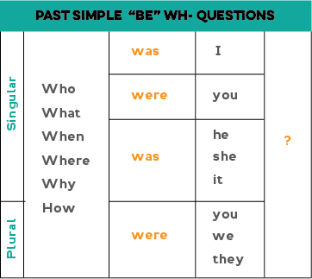
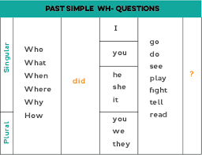
Questions with wh-

Slide 17
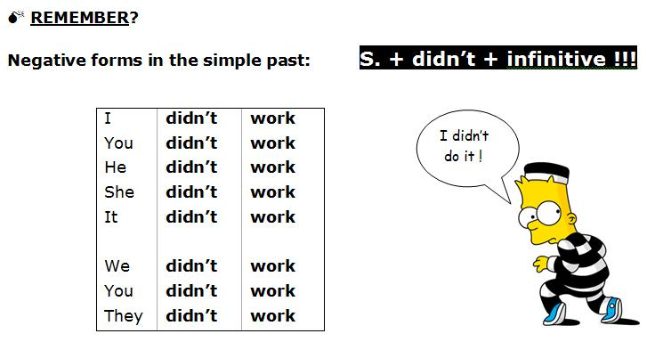
Negative form

Slide 18

That’s all

