Slide 1

DOAN KET PRIMARY SCHOOL
ENGLISH 4
UNIT 9. WHAT ARE THEY DOING?
LESSON 1
Teacher: Nguyen Phuong Anh

Slide 2




A. Vocabulary
V
V-ing
watch a video
watching a video
Xem video
listen to music
listening to music
Nghe nhạc
read a text
reading a text
Đọc đoạn văn
write a dictation
writing a dictation
Viết chính tả

Slide 3
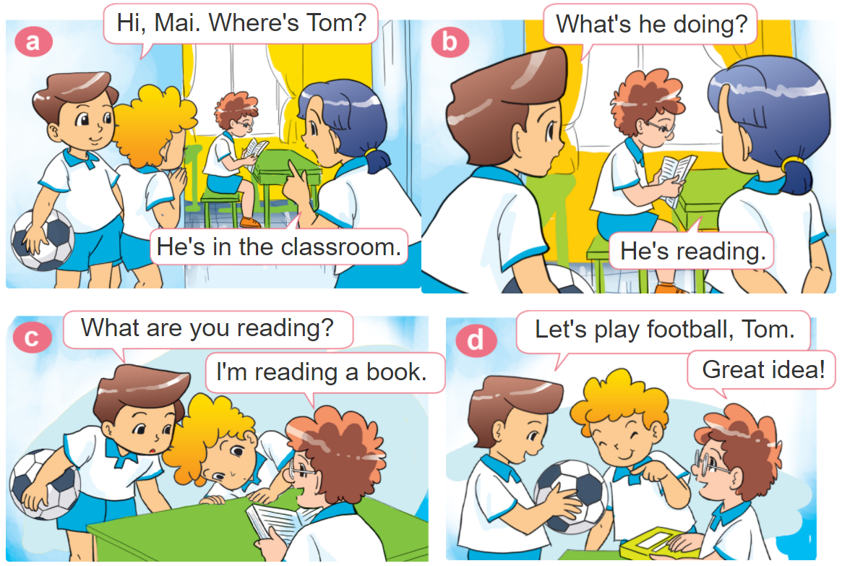

1. Look, listen and repeat.

Slide 4




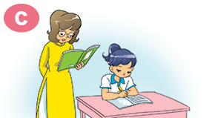
2. Point and say
What's she / he doing?
She / he’s _________.
watching
a video
reading a text
listening to music
writing a dictation

Slide 5
Grammar
Hỏi và trả lời cô ấy/anh ấy đang làm gì:
What's she / he doing?
(Cô ấy / anh ấy đang làm gì?)
She / he’s _______.
+ V-ing
(Cô ấy / anh ấy đang _____)
Hỏi và trả lời BẠN đang làm gì:
What are you doing?
(Bạn đang làm gì?)
I’m _______.
+ V-ing
(Tôi đang _____)

Slide 6
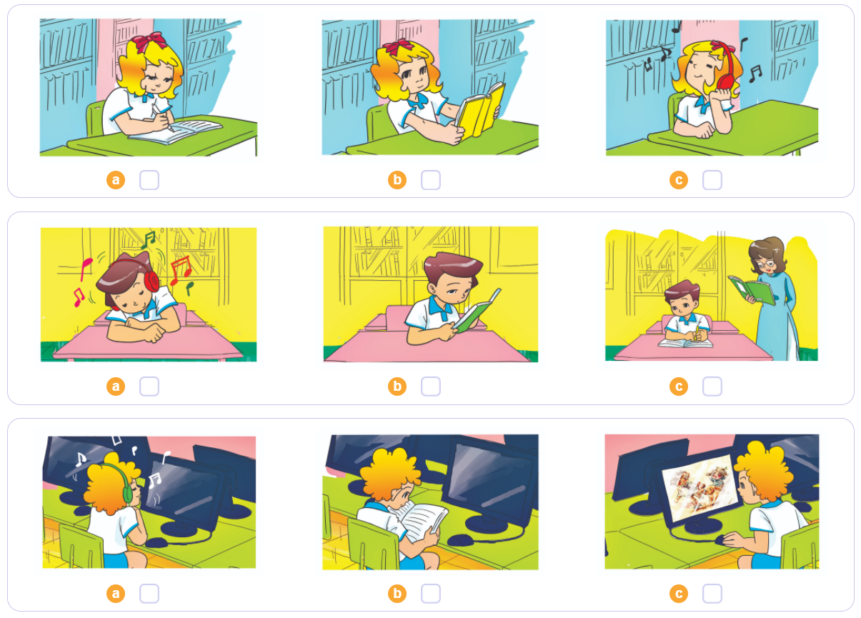


4. Listen and tick
1
2
3

Slide 7
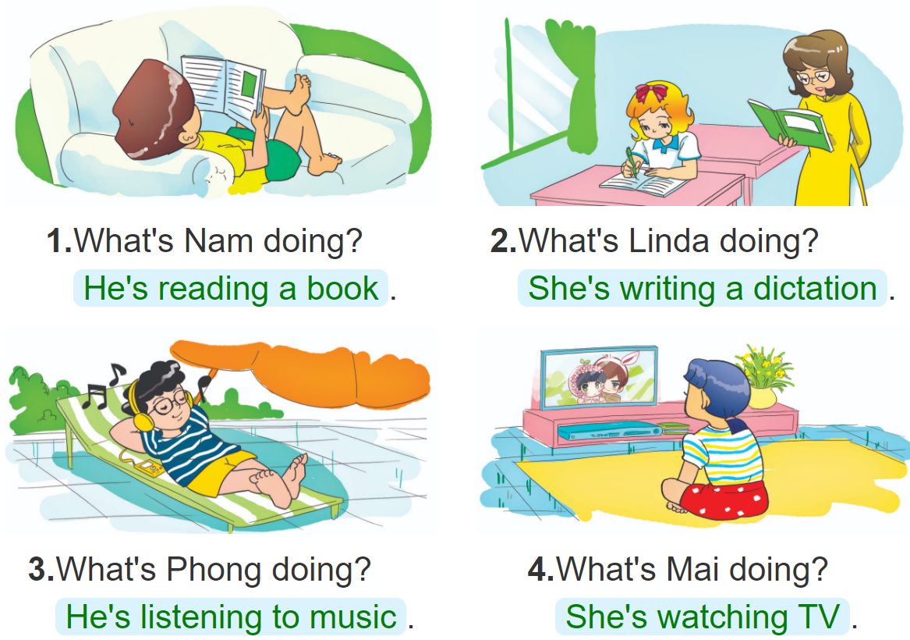
5. Look and write
________________________
____________________________
____________________________
_________________________

Slide 8
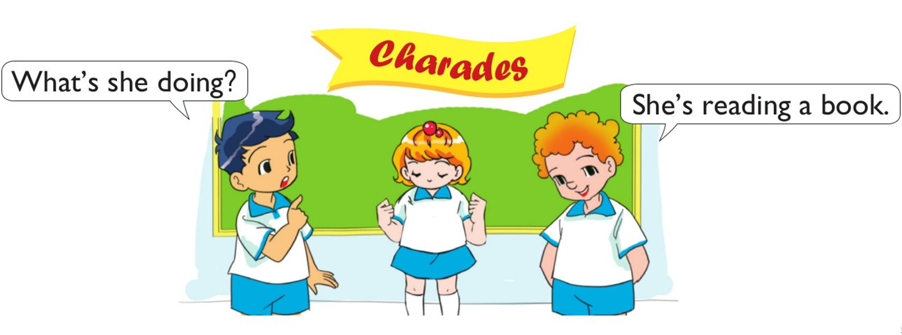
6. Let’s play

Slide 9
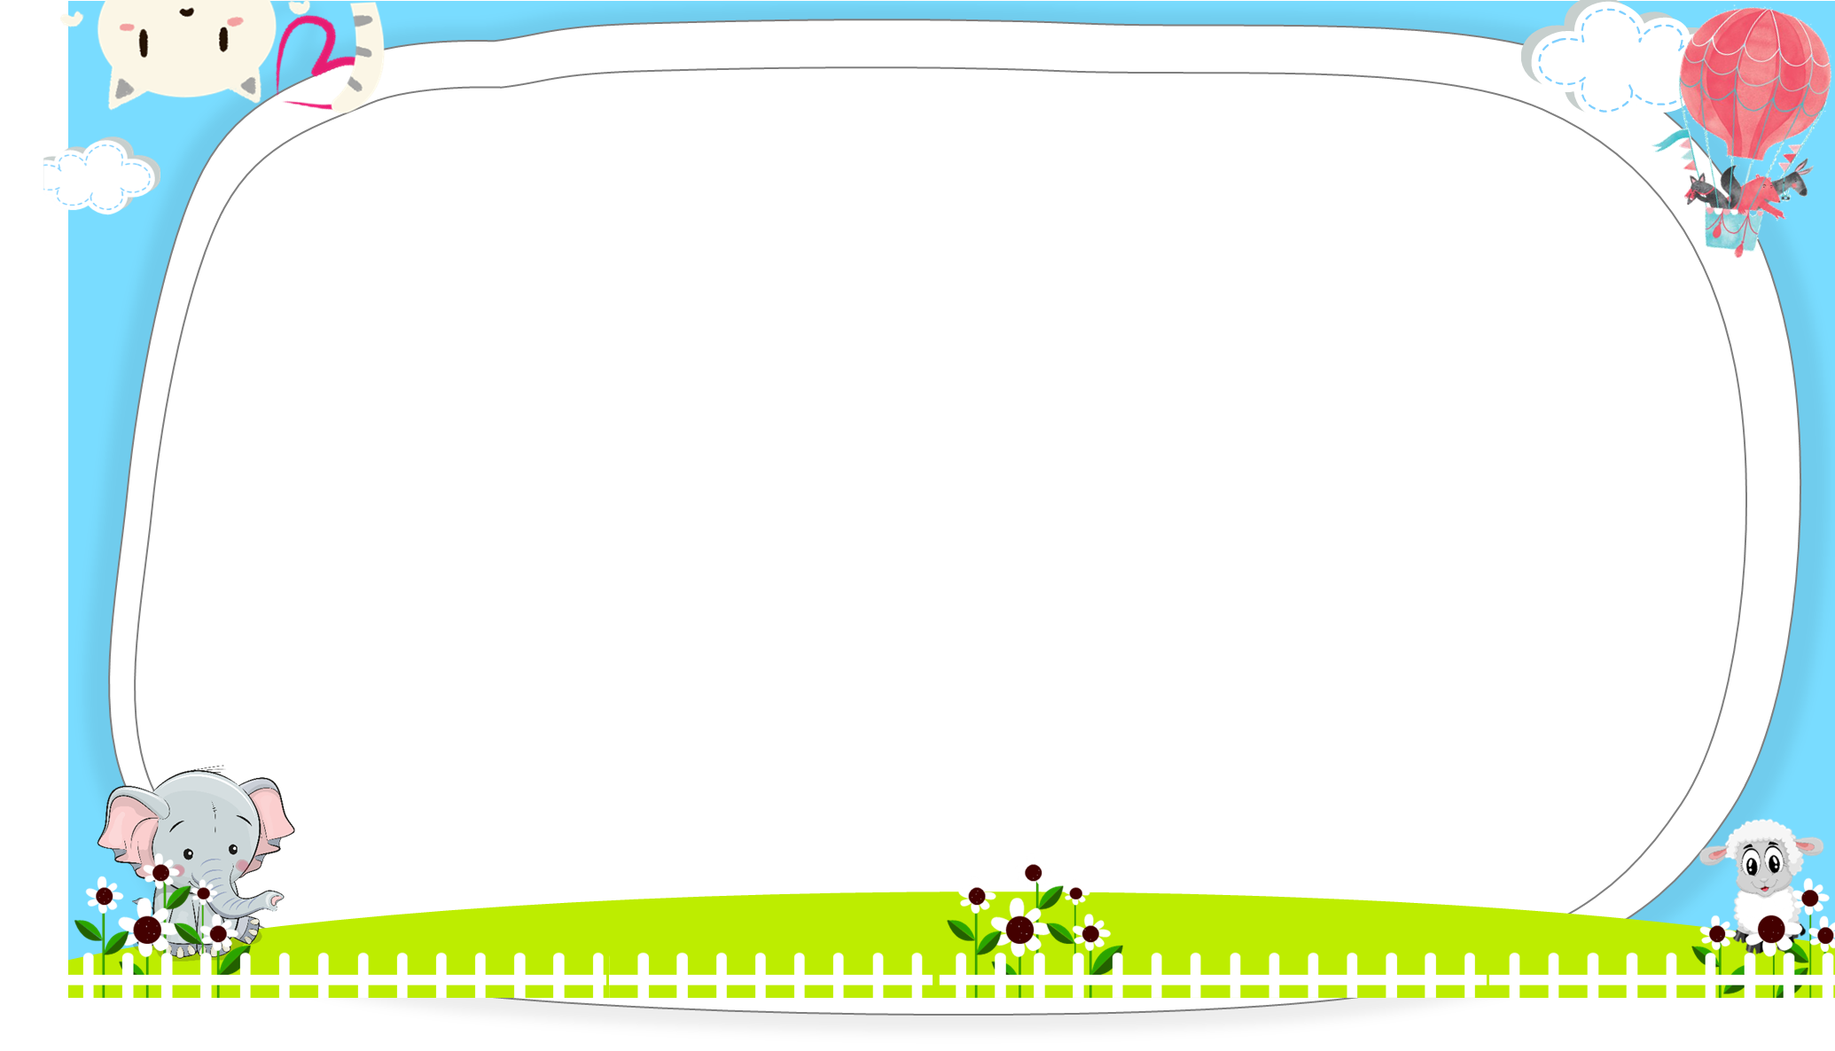
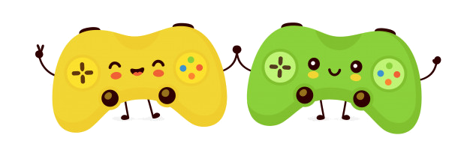



AND
GAME
PLAY

Slide 10



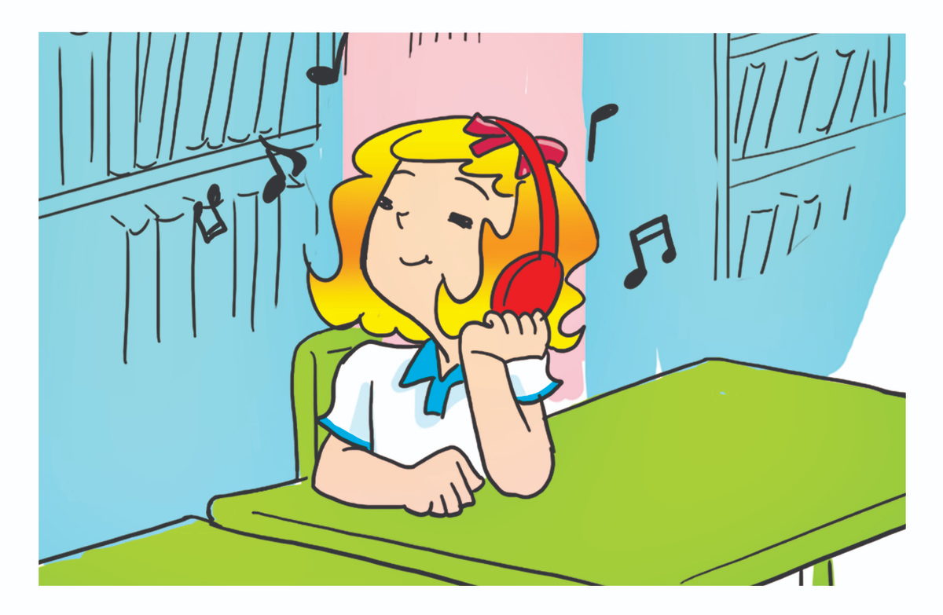
She
He
What's _______ doing?
______ is listening to music.
Next

Slide 11
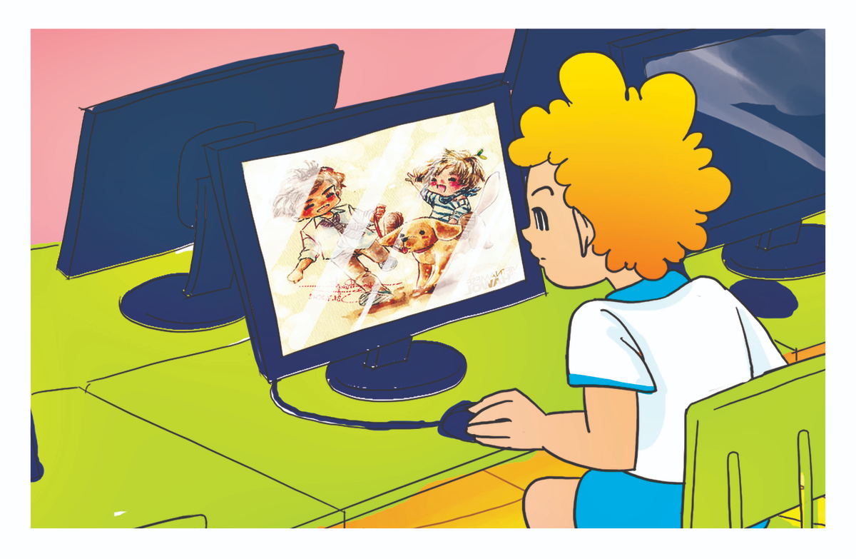
He
She
What's _______ doing?
______ is watching a video.
Next

Slide 12
He
She
What's _______ doing?
______ is listening to music.
Next

Slide 13
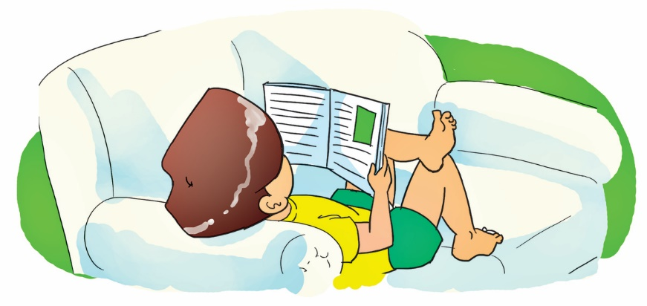
He
She
What's _______ doing?
______ is reading a text.
Next

Slide 14

She
He
What's _______ doing?
______ is writing a text.
Next

Slide 15
listen to music
listening to music
What's he doing?
He’s _________.
Next

Slide 16
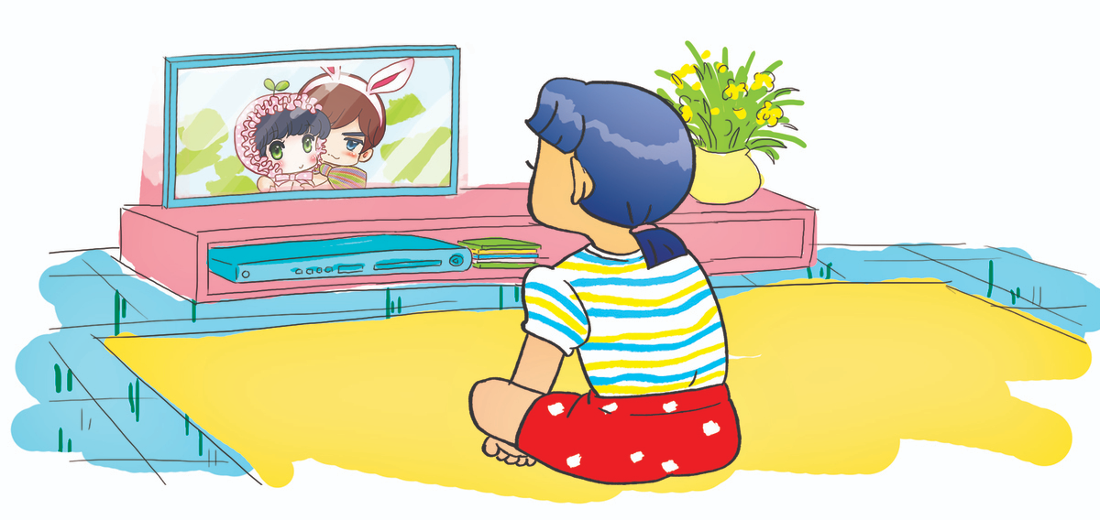
watching a video
listening to music
What's she doing?
She’s _________.
Next

Slide 17
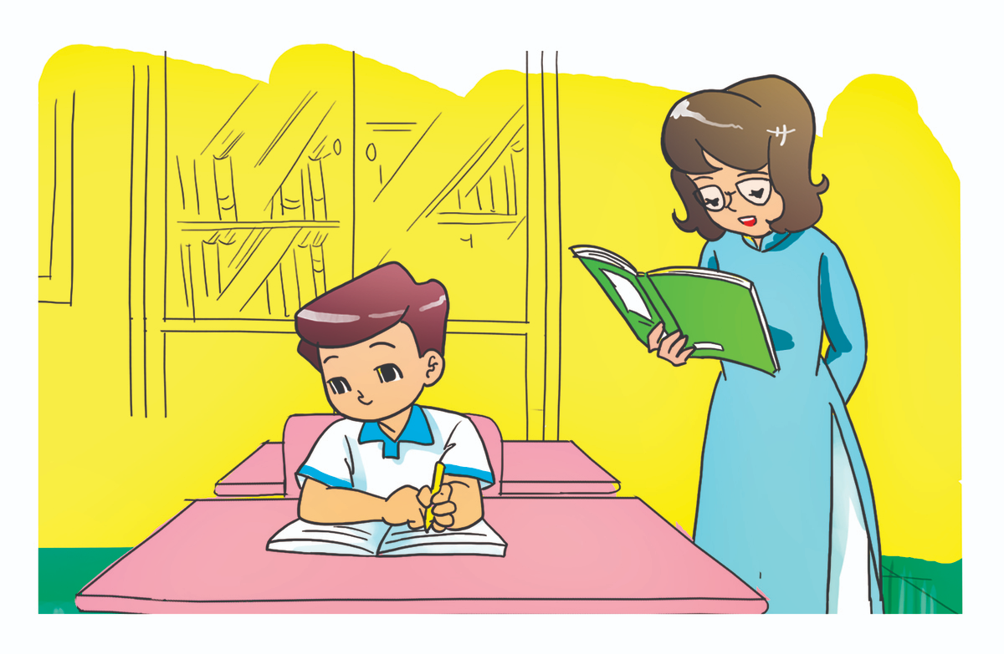
Reading a text
Writing a dictation
What's he doing?
He’s _________.
Next

Slide 18
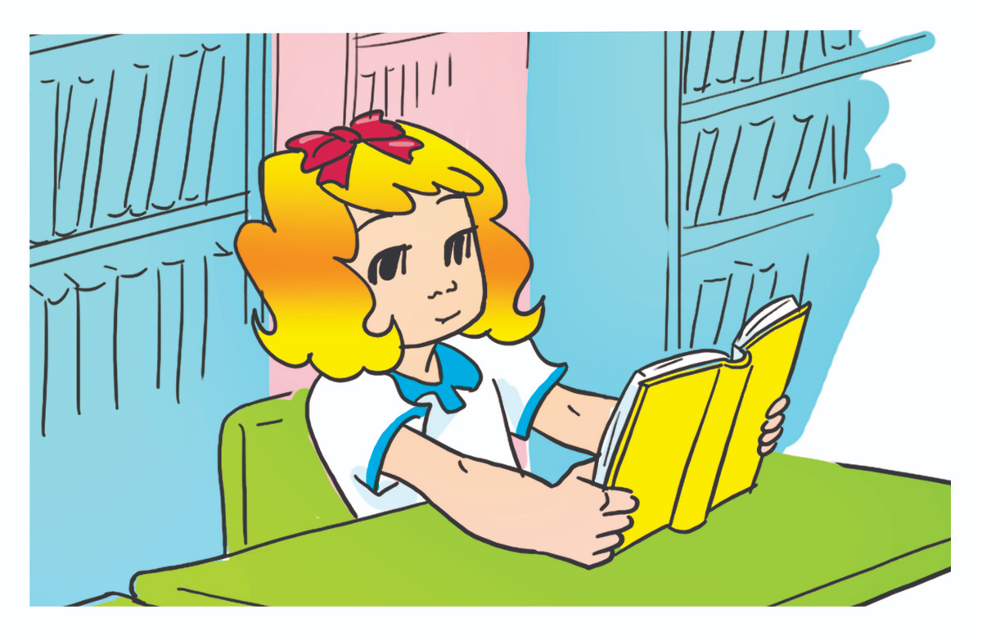
listening
reading
What's she doing?
She’s _________.
Next

Slide 19

Next

