Slide 1

DOAN KET PRIMARY SCHOOL
ENGLISH 4
UNIT 3. What day is it today?
LESSON 1
Teacher: Nguyen Phuong Anh

Slide 2
vocabulary

Slide 3

MsPham-9036082789
Calendar
Year
Month
Day
Week
Date

Slide 4
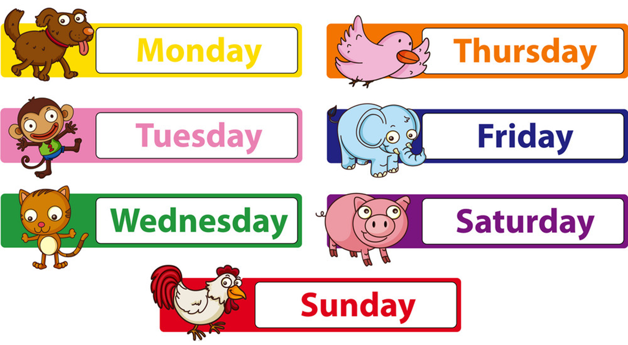
Days of a week

Slide 5
What is the day missing?

Slide 6
What is the day missing?

Slide 7
What is the day missing?

Slide 8
What is the day missing?

Slide 9
What is the day missing?

Slide 10
What is the day missing?

Slide 11
What is the day missing?

Slide 12
grammar

Slide 13
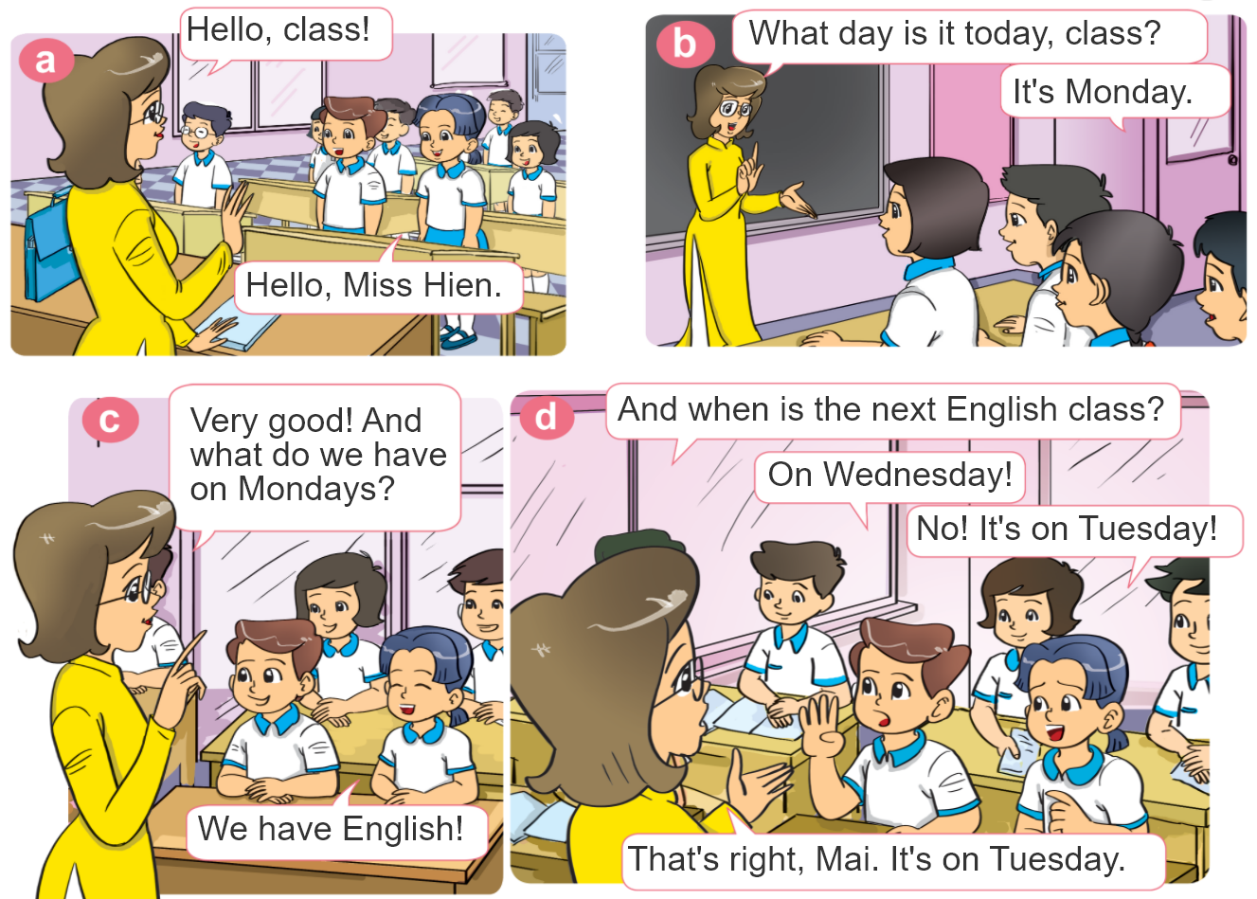

1. Look, listen and repeat.

Slide 14

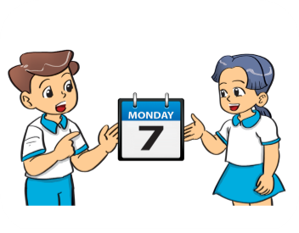

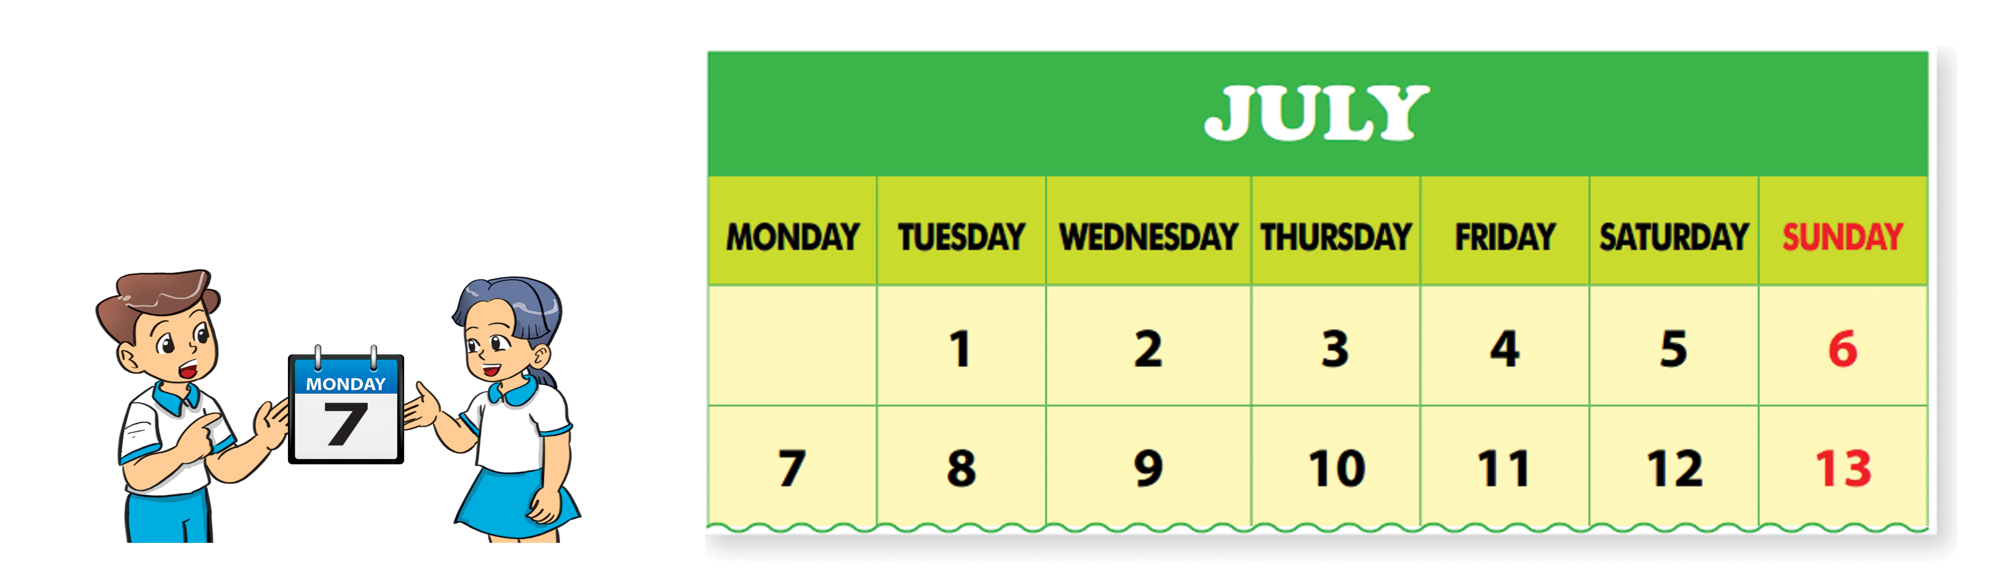
2. Point and say.
What day is it today?
It’s ___________.

Slide 15
Structures
Cách hỏi và trả lời hôm nay là thứ mấy:
What day is it today?
(Hôm nay là thứ mấy?)
It’s _______.
+ day
(Thứ _______)

Slide 16






Click hình chú Thỏ hoặc chú Rùa khi chọn đáp án.
Notes:
Ms Huyền Phạm - 0936.082.789 – YOUTUBE: MsPham. Facebook: Dạy và học cùng công nghệ.

Slide 17


What day is it today?
It’s five.
It’s Wednesday.
Notes:
Ms Huyền Phạm - 0936.082.789 – YOUTUBE: MsPham. Facebook: Dạy và học cùng công nghệ.

Slide 18

What day is it today?
It’s seven.
It’s Friday.
Notes:
Ms Huyền Phạm - 0936.082.789 – YOUTUBE: MsPham. Facebook: Dạy và học cùng công nghệ.

Slide 19

What day is it today?
It’s Saturday.
It’s eight.
Notes:
Ms Huyền Phạm - 0936.082.789 – YOUTUBE: MsPham. Facebook: Dạy và học cùng công nghệ.

Slide 20

What day is it today?
It’s Friday.
It’s six.
Notes:
Ms Huyền Phạm - 0936.082.789 – YOUTUBE: MsPham. Facebook: Dạy và học cùng công nghệ.

Slide 21

What day is it today?
It’s Thursty.
It’s Thursday.
Notes:
Ms Huyền Phạm - 0936.082.789 – YOUTUBE: MsPham. Facebook: Dạy và học cùng công nghệ.

Slide 22


What day is it today?
It’s Tuesday.
It’s four.
Notes:
Ms Huyền Phạm - 0936.082.789 – YOUTUBE: MsPham. Facebook: Dạy và học cùng công nghệ.

Slide 23

It’s Thursday.
What day
is it today?
What
is it today?
Notes:
Ms Huyền Phạm - 0936.082.789 – YOUTUBE: MsPham. Facebook: Dạy và học cùng công nghệ.

Slide 24

It’s Monday.
What day
is it tomorrow?
What day
is it today?
Notes:
Ms Huyền Phạm - 0936.082.789 – YOUTUBE: MsPham. Facebook: Dạy và học cùng công nghệ.

Slide 25

Notes:
Ms Huyền Phạm - 0936.082.789 – YOUTUBE: MsPham. Facebook: Dạy và học cùng công nghệ.

Slide 26
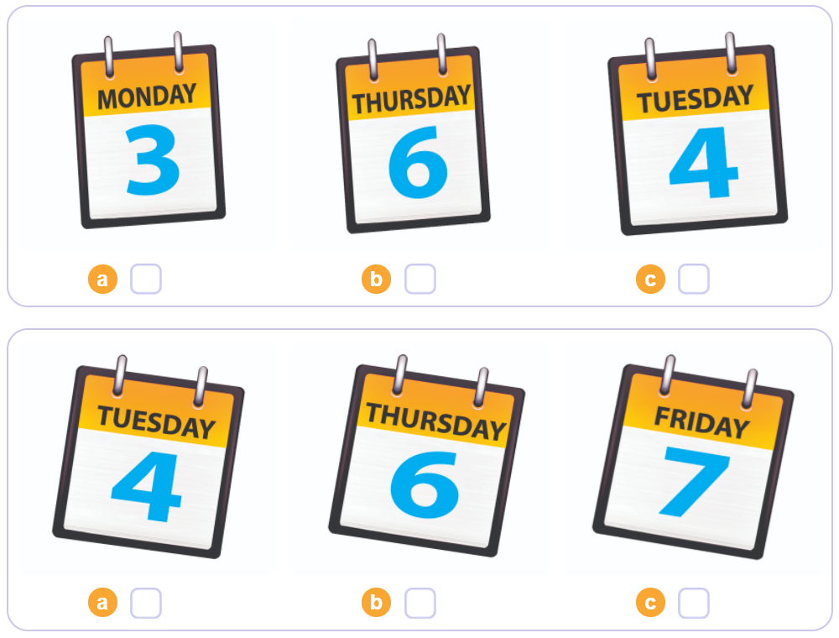

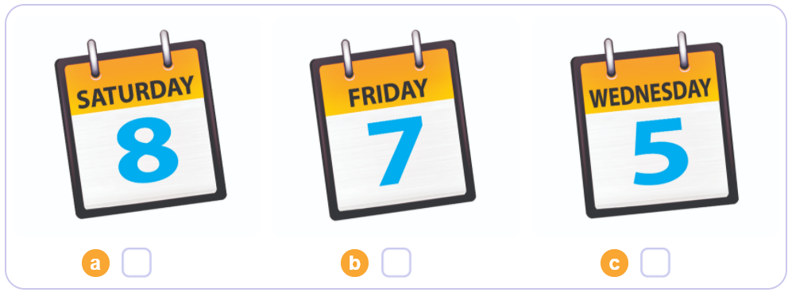
3. Listen and tick.
1
2
3

Slide 27
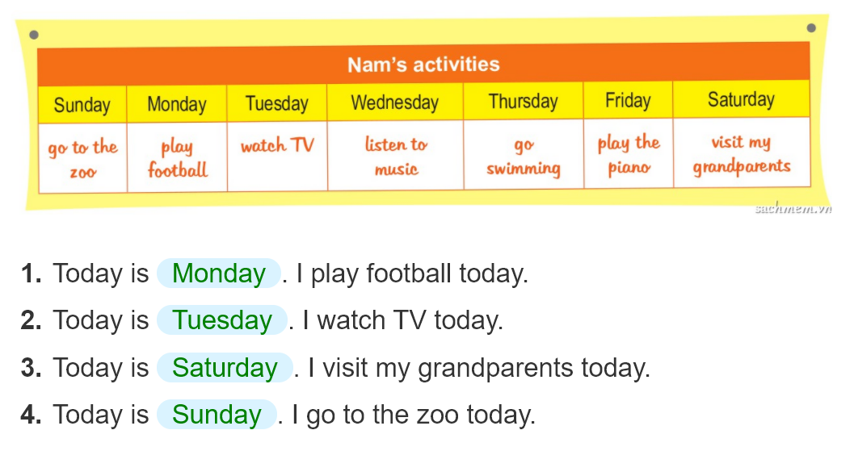
4. Look and write.
_______.
_______.
_______.
______.

Slide 28
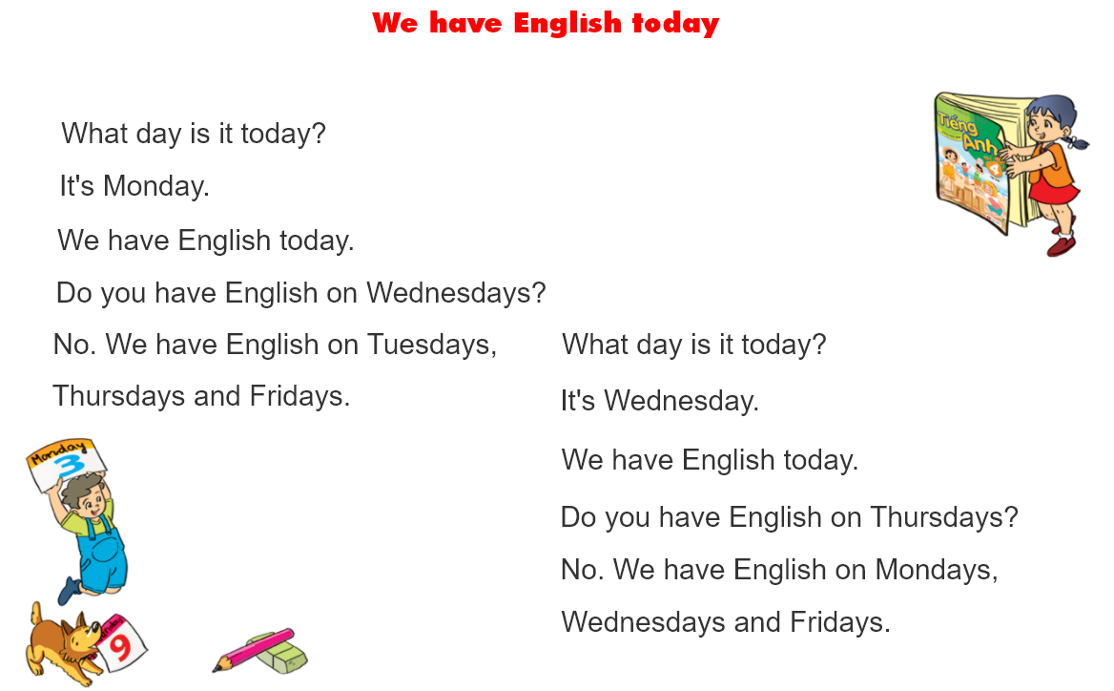


5. Let’s sing

