Slide 1


DOAN KET PRIMARY SCHOOL
ENGLISH 4
UNIT 1. NICE TO SEE YOU AGAIN
LESSON 3
Teacher: Nguyen Phuong Anh

Slide 2
Objectives
By the end of the lesson, students will be able to:
1. Knowledge:
- Use the words and Pronounce the sounds of the letters l and n in the words “Linda” and “night” respectively.
- Listen and circle the correct words filling the gapped sentences. Then fill the gapped sentences and say them aloud.
- Say the chant Hello, friends!
- Read the information in the student’s cards, and answer the questions.
- Write about themselves, using the writing frame.
- Show the name cards, read a classmates’ card and talk about it.
- Sentence Patterns: Revision
- Vocabulary: Revision
2. Skills: Listening, reading, writing and speaking.
Attitudes/ Quality:
- To help Ss know how to make friends.
4. Forming competence:
- Communication
- Self- study
- Apply what they have learned to solve learning tasks

Slide 3




Slide 4
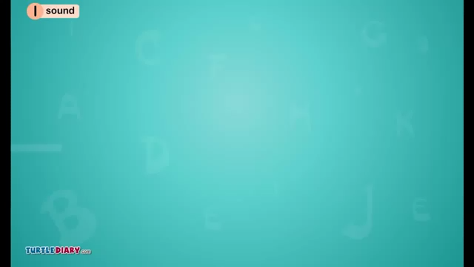
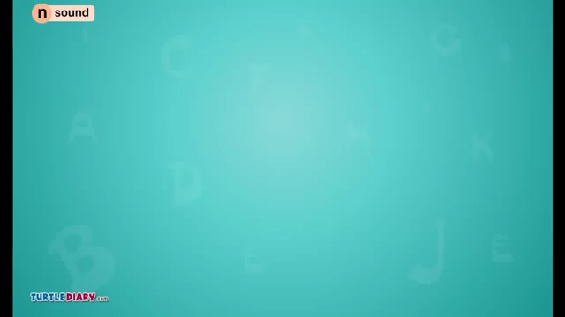



Slide 5

Hello, Linda
Linda

Slide 6
night
Good night

Slide 7



LISTEN & CIRCLE. THEN WRITE & SAY ALOUD
1.Hello. I'm ________.
a.Linda
b.Nam
2.I'm from _________.
a.Viet Nam
b.England
3.______. My name's Linda.
a.Hi
b.Hello
4.Good ___________.
a.night
b.afternoon
Nam
Hello
England
night
1
2
3
4

Slide 8

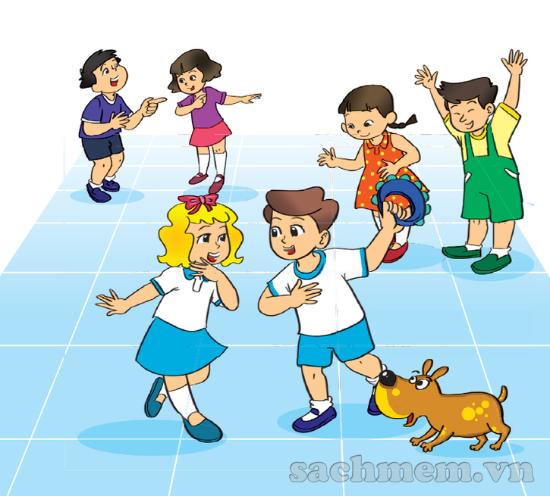
LET’S SING
Hello, friends!
Hello. I'm Linda.
I’m from England.
Nice to meet you, Linda.
Hello. I’m Nam.
I’m from Viet Nam.
Nice to meet you, Nam.
Hello, Linda.
Hello, Nam.
We’re friends.

Slide 9
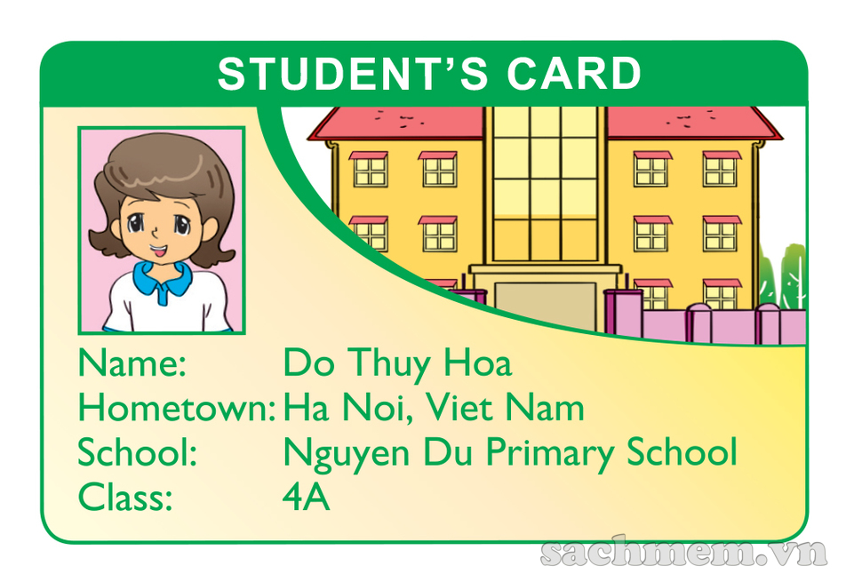
READ & ANSWER
1. What is the girl's name?
2. Where is she from?
→ Her name is Do Thuy Hoa.
→ She's from Ha Noi, Viet Nam.

Slide 10
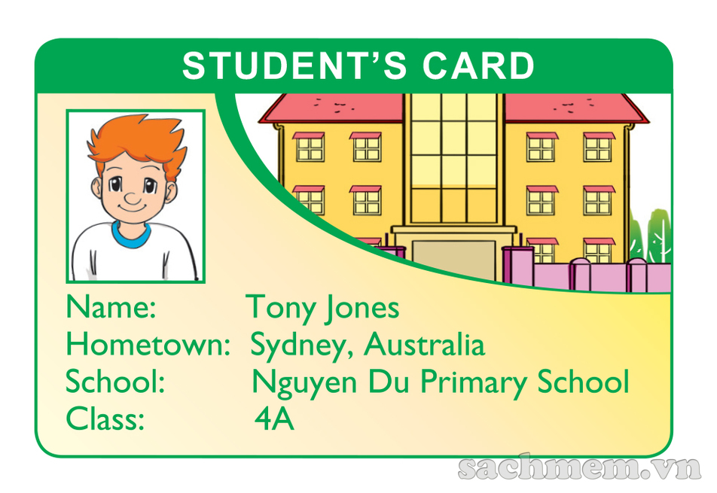
READ & ANSWER
1. What is the boy's name?
2. Where is he from?
→ His name is Tony jones.
→ He's from Sydney, Australia.

Slide 11
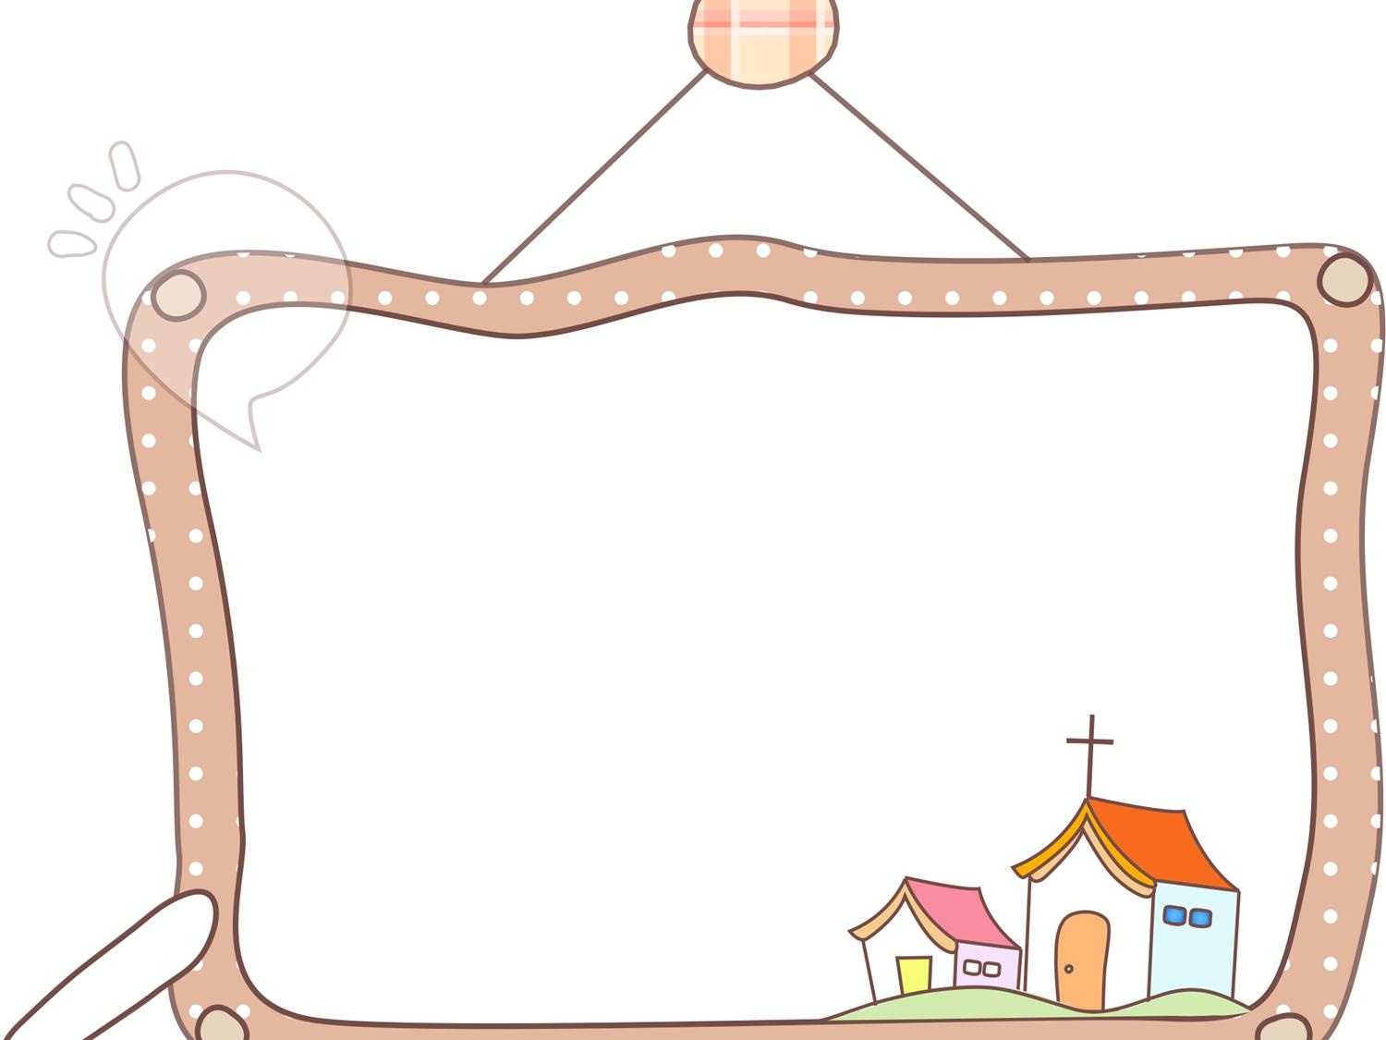
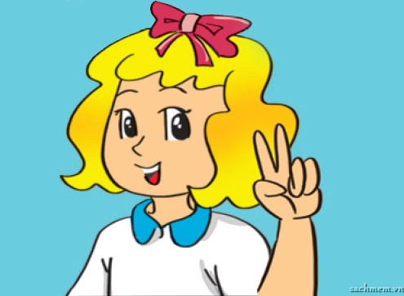
WRITE ABOUT YOU
My name is
I am from
My school is
Linda
England
Nguyen Du primary school

Slide 12
PROJECT
Name:
Hometown:
School:
Class:
Linda
London, England
Nguyen Du Primary School
4A

Slide 13

Let’s play

Slide 14
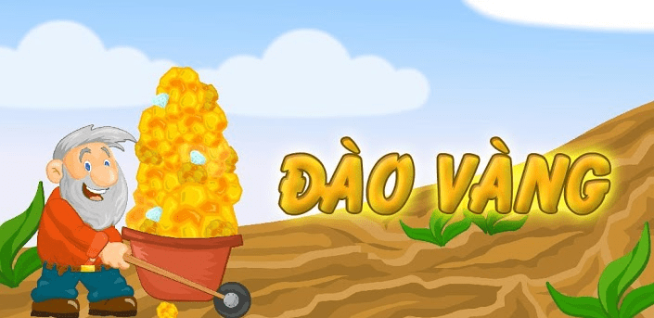
GOLD MINER

Slide 15


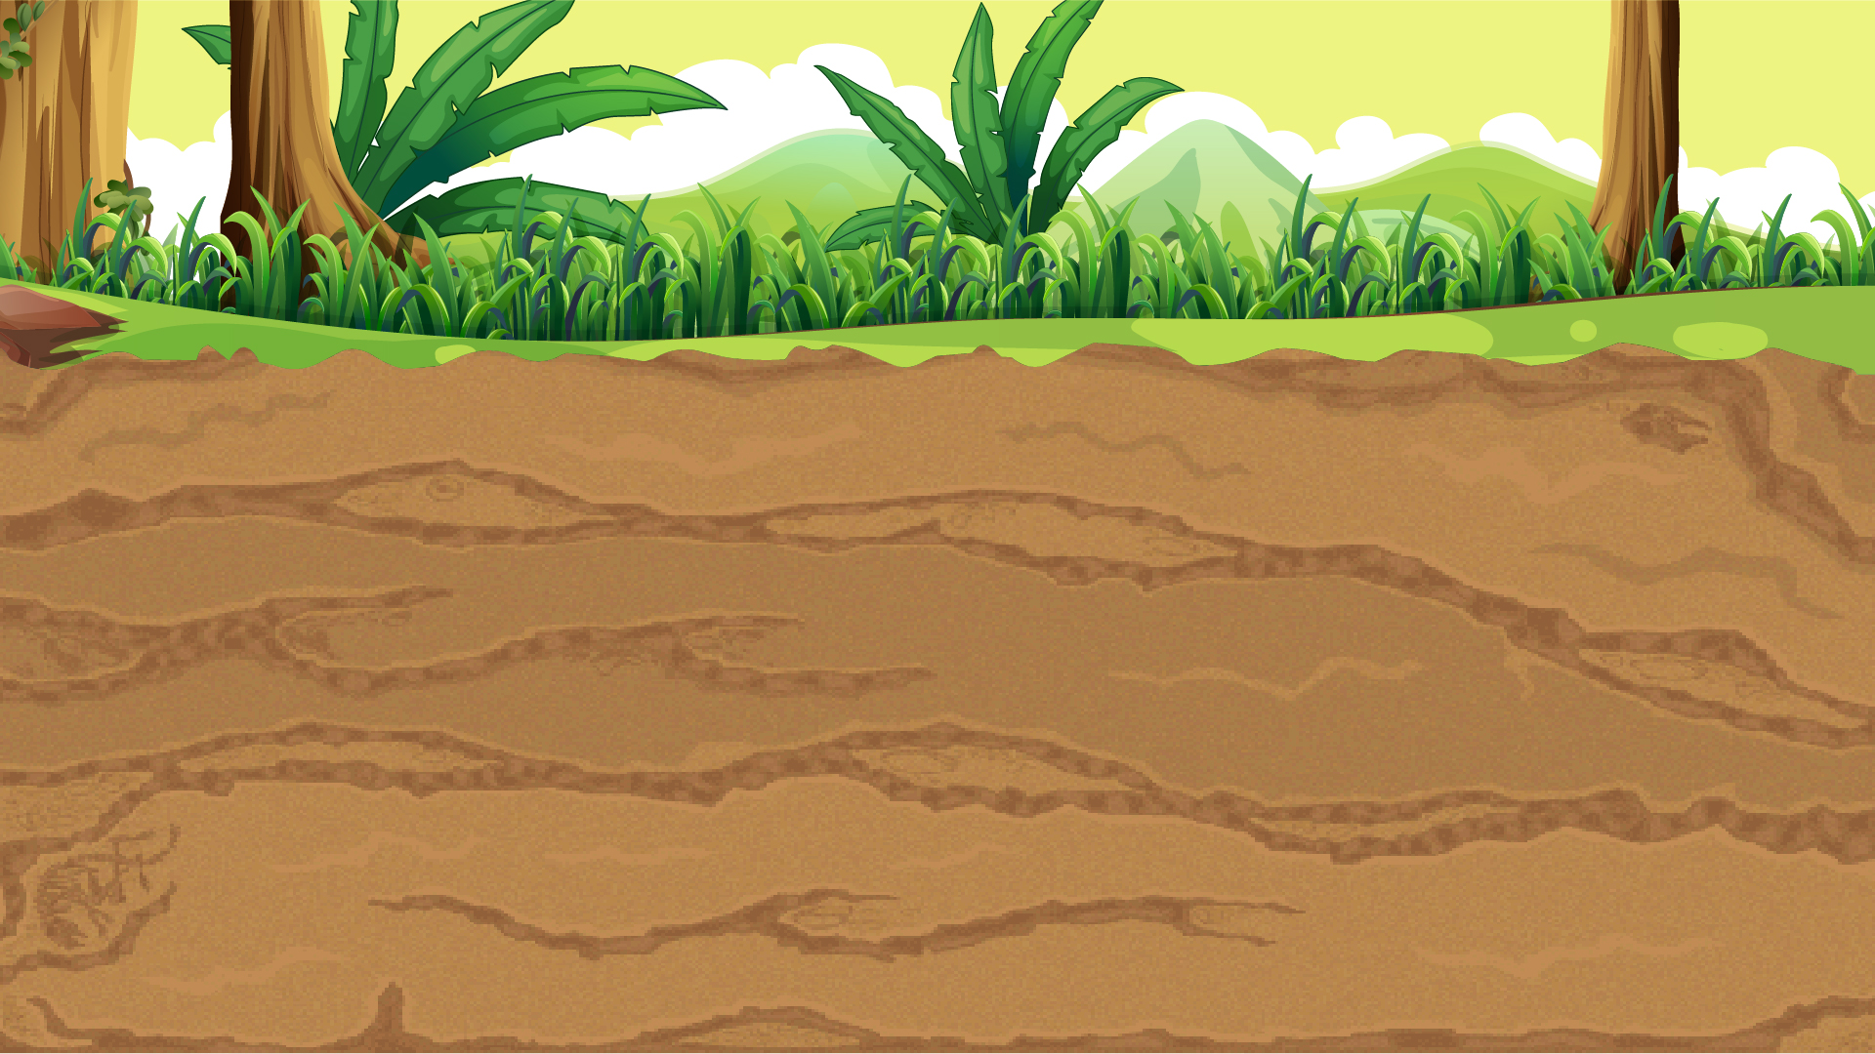
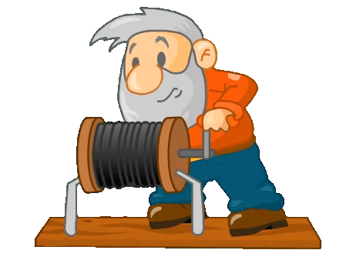




70$
900$
20$
900$
100$
400$
250$
800$
500$
1000$
400$
80$
600$
150$
500$

Slide 16
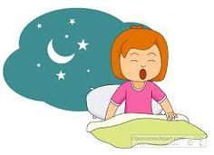




Good night
Good morning
Good afternoon

Slide 17
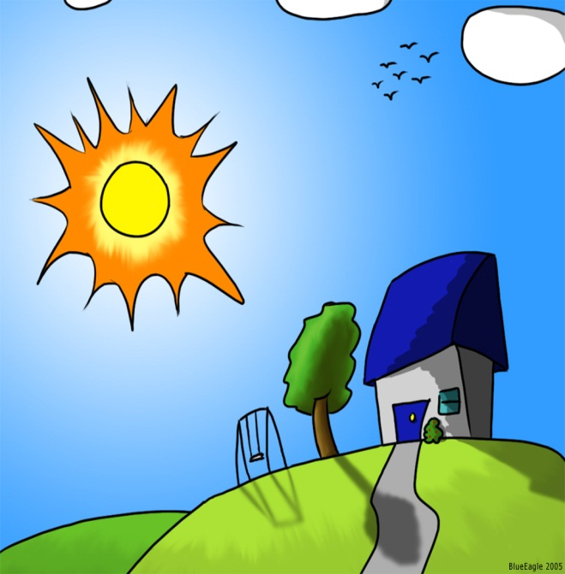
Good morning
Good afternoon
Good evening

Slide 18

Good bye
Good afternoon
Good morning

Slide 19

Good afternoon
Good evening
Good morning

Slide 20
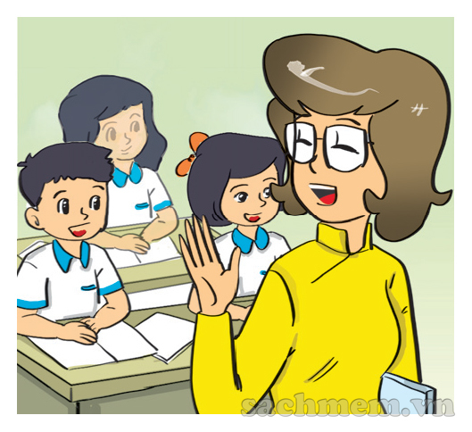
Hello
Hi
Good bye

Slide 21
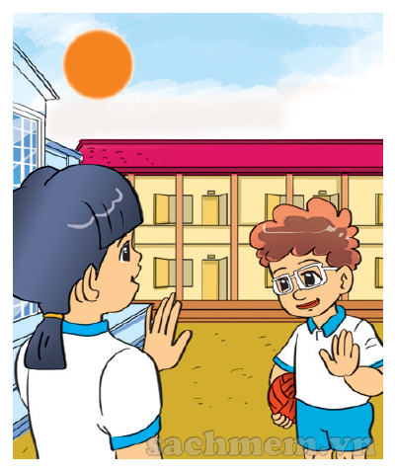
Good afternoon
Good evening
Good night

Slide 22
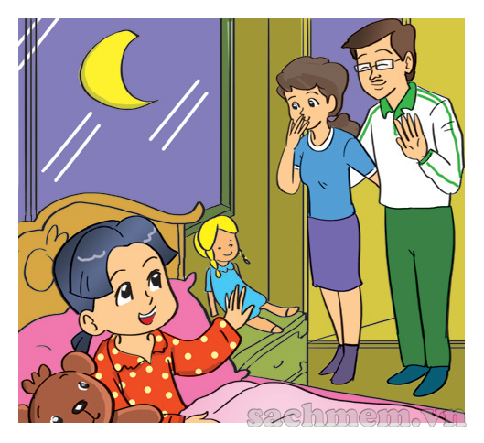
Good afternoon
Good night
Good morning

Slide 23
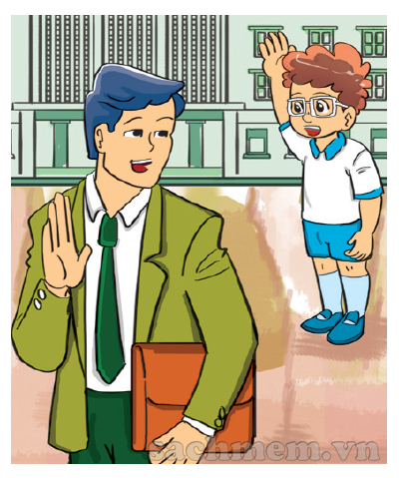
Good morning, Mr Loc
Good afternoon, Mr Loc
Good bye, Mr Loc

Slide 24
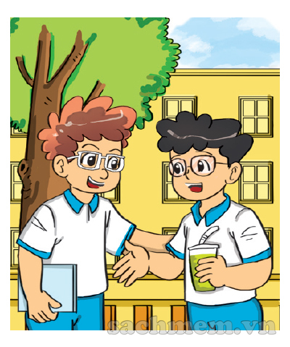
Good by
Hello/ Hi
Bye

Slide 25
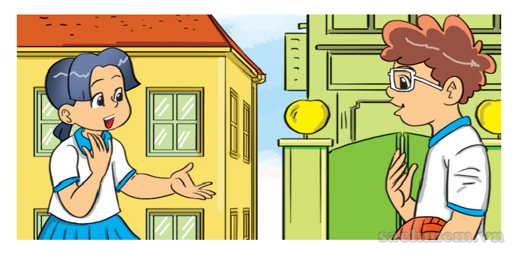
Good bye
bye
Hello, How are you?

Slide 26



