Slide 1

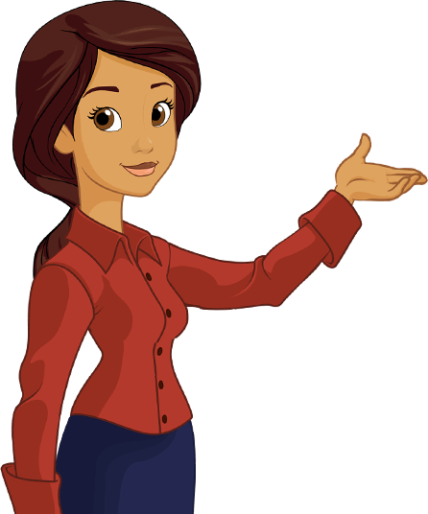
DOAN KET PRIMARY SCHOOL
ENGLISH 4
UNIT 1. NICE TO SEE YOU AGAIN
LESSON 2
Teacher: Nguyen Phuong Anh

Slide 2
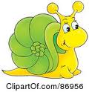
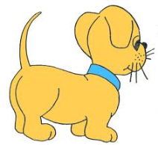
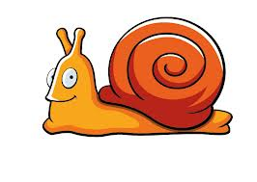
Objectives
- By the end of the lesson, students will be able to:
1. Knowledge:
- Know the way to say and respond goodbye.
- Sentence Patterns: Goodbye. See you tomorrow. / Goodbye. See you later. / Good night.
- Vocabulary: see you tomorrow, see you later, good night
2. Skills.
- Listening and speaking.
Attitudes/ Quality:
- Ss will be able to work hard, love their friends.
- Be polite.
4. Forming competence:
- Co- operation
- Self- study
- Ss know how to greet and introduce themselves.

Slide 3

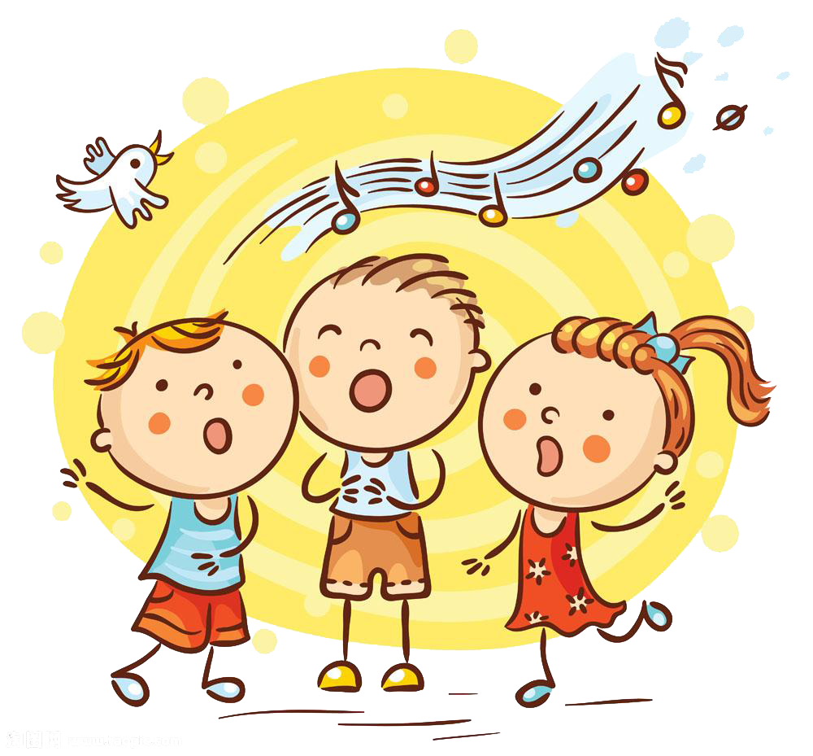
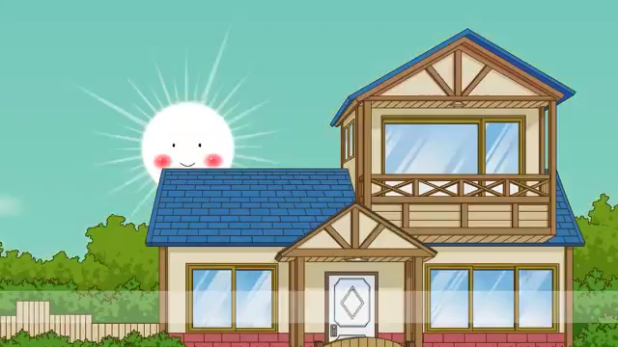

Slide 4
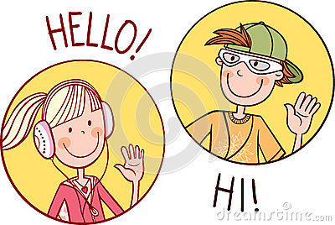

Slide 5
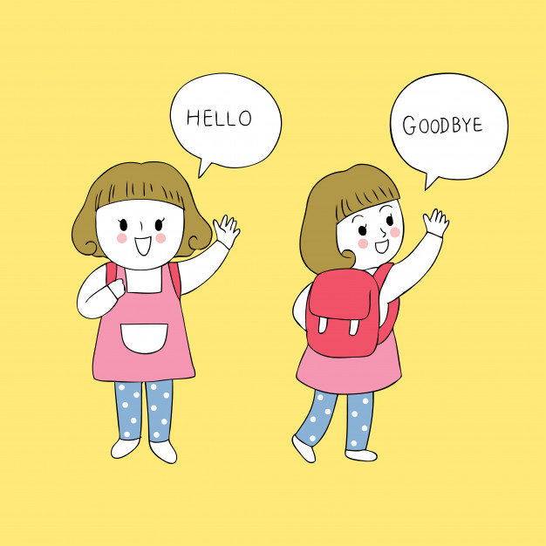

Slide 6
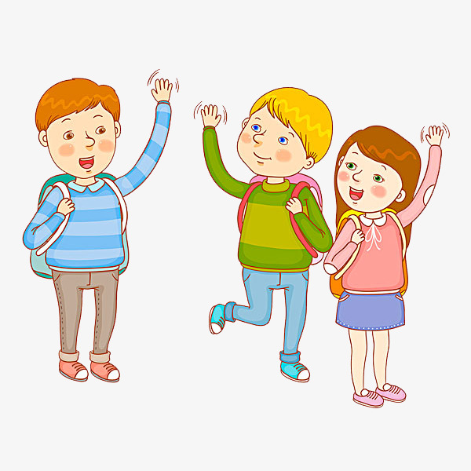


Slide 7
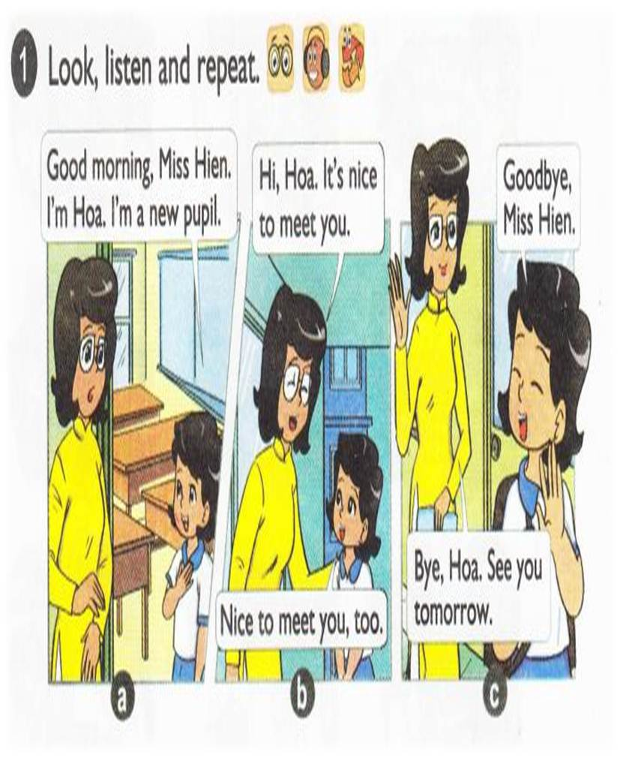


Slide 8
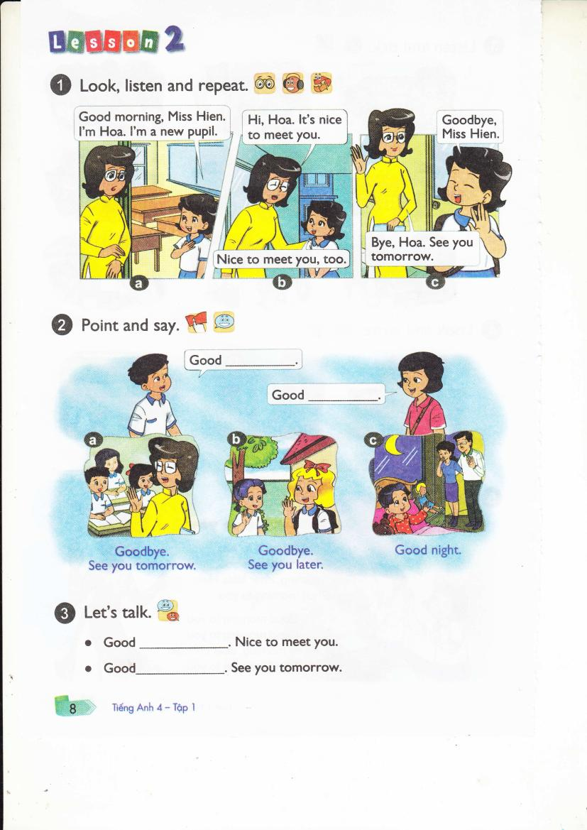

Slide 9
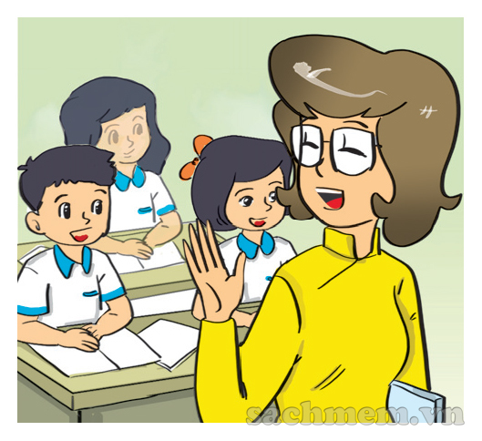
Goodbye. See you tomorrow.
MAI
NAM

Slide 10
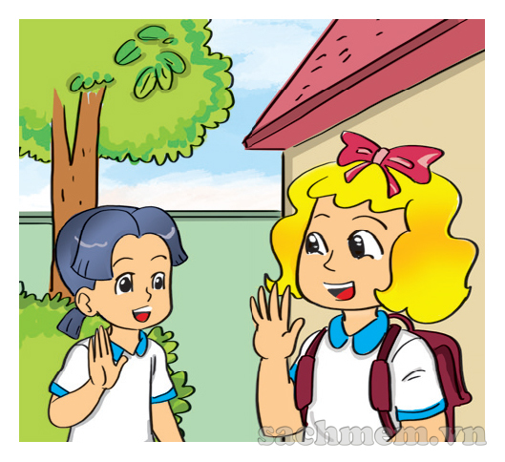
Goodbye. See you tomorrow.
MAI
NAM

Slide 11
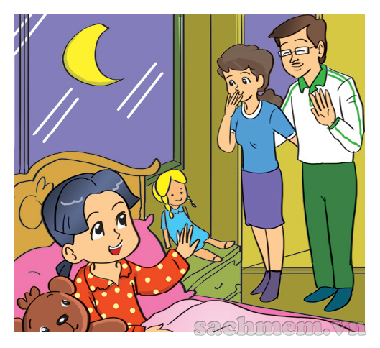
Good night
MAI
NAM

Slide 12

Good night
Goodbye
See you tomorrow
See you later

Slide 13
Goodbye
See you tomorrow.
Good morning/ afternoon/ evening
Nice to meet you.

Slide 14
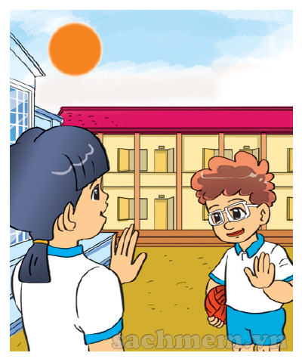
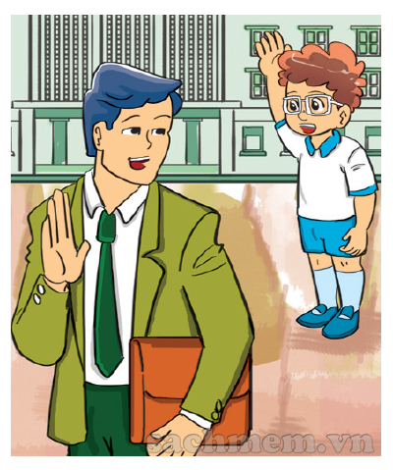
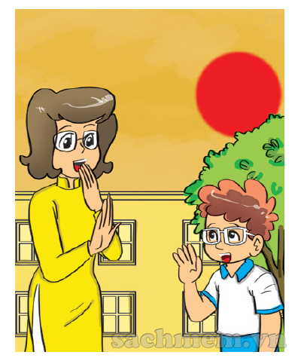
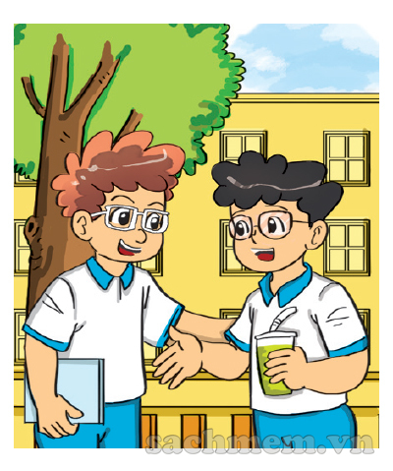
LISTEN & NUMBER
2
4
1
2
3
1
3
4

Slide 15
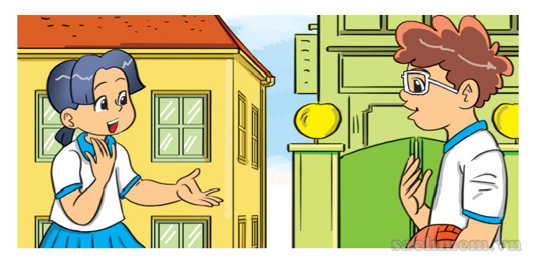
LOOK & WRITE
1.A: Hello. I'm Mai. I'm from .
B: Hello. I'm . I'm from America.
Viet Nam
Tom

Slide 16
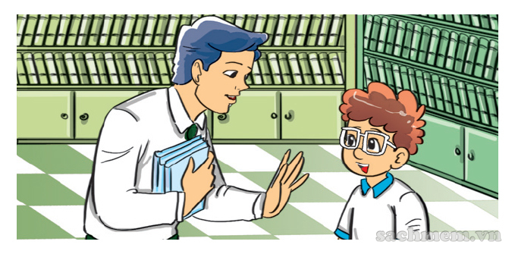
LOOK & WRITE
2.A: Good morning, . B: , Tom.
Nice to meet you.
Mr. Loc
Good morning / Hi / Hello

Slide 17
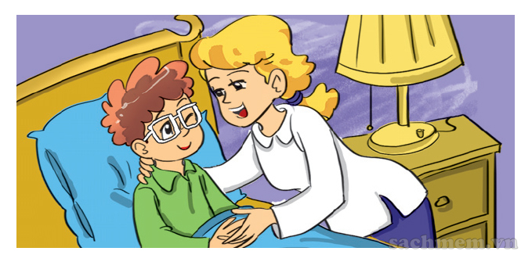
LOOK & WRITE
3.A: , Mum. B: , Tom.
Good night
Good night

Slide 18
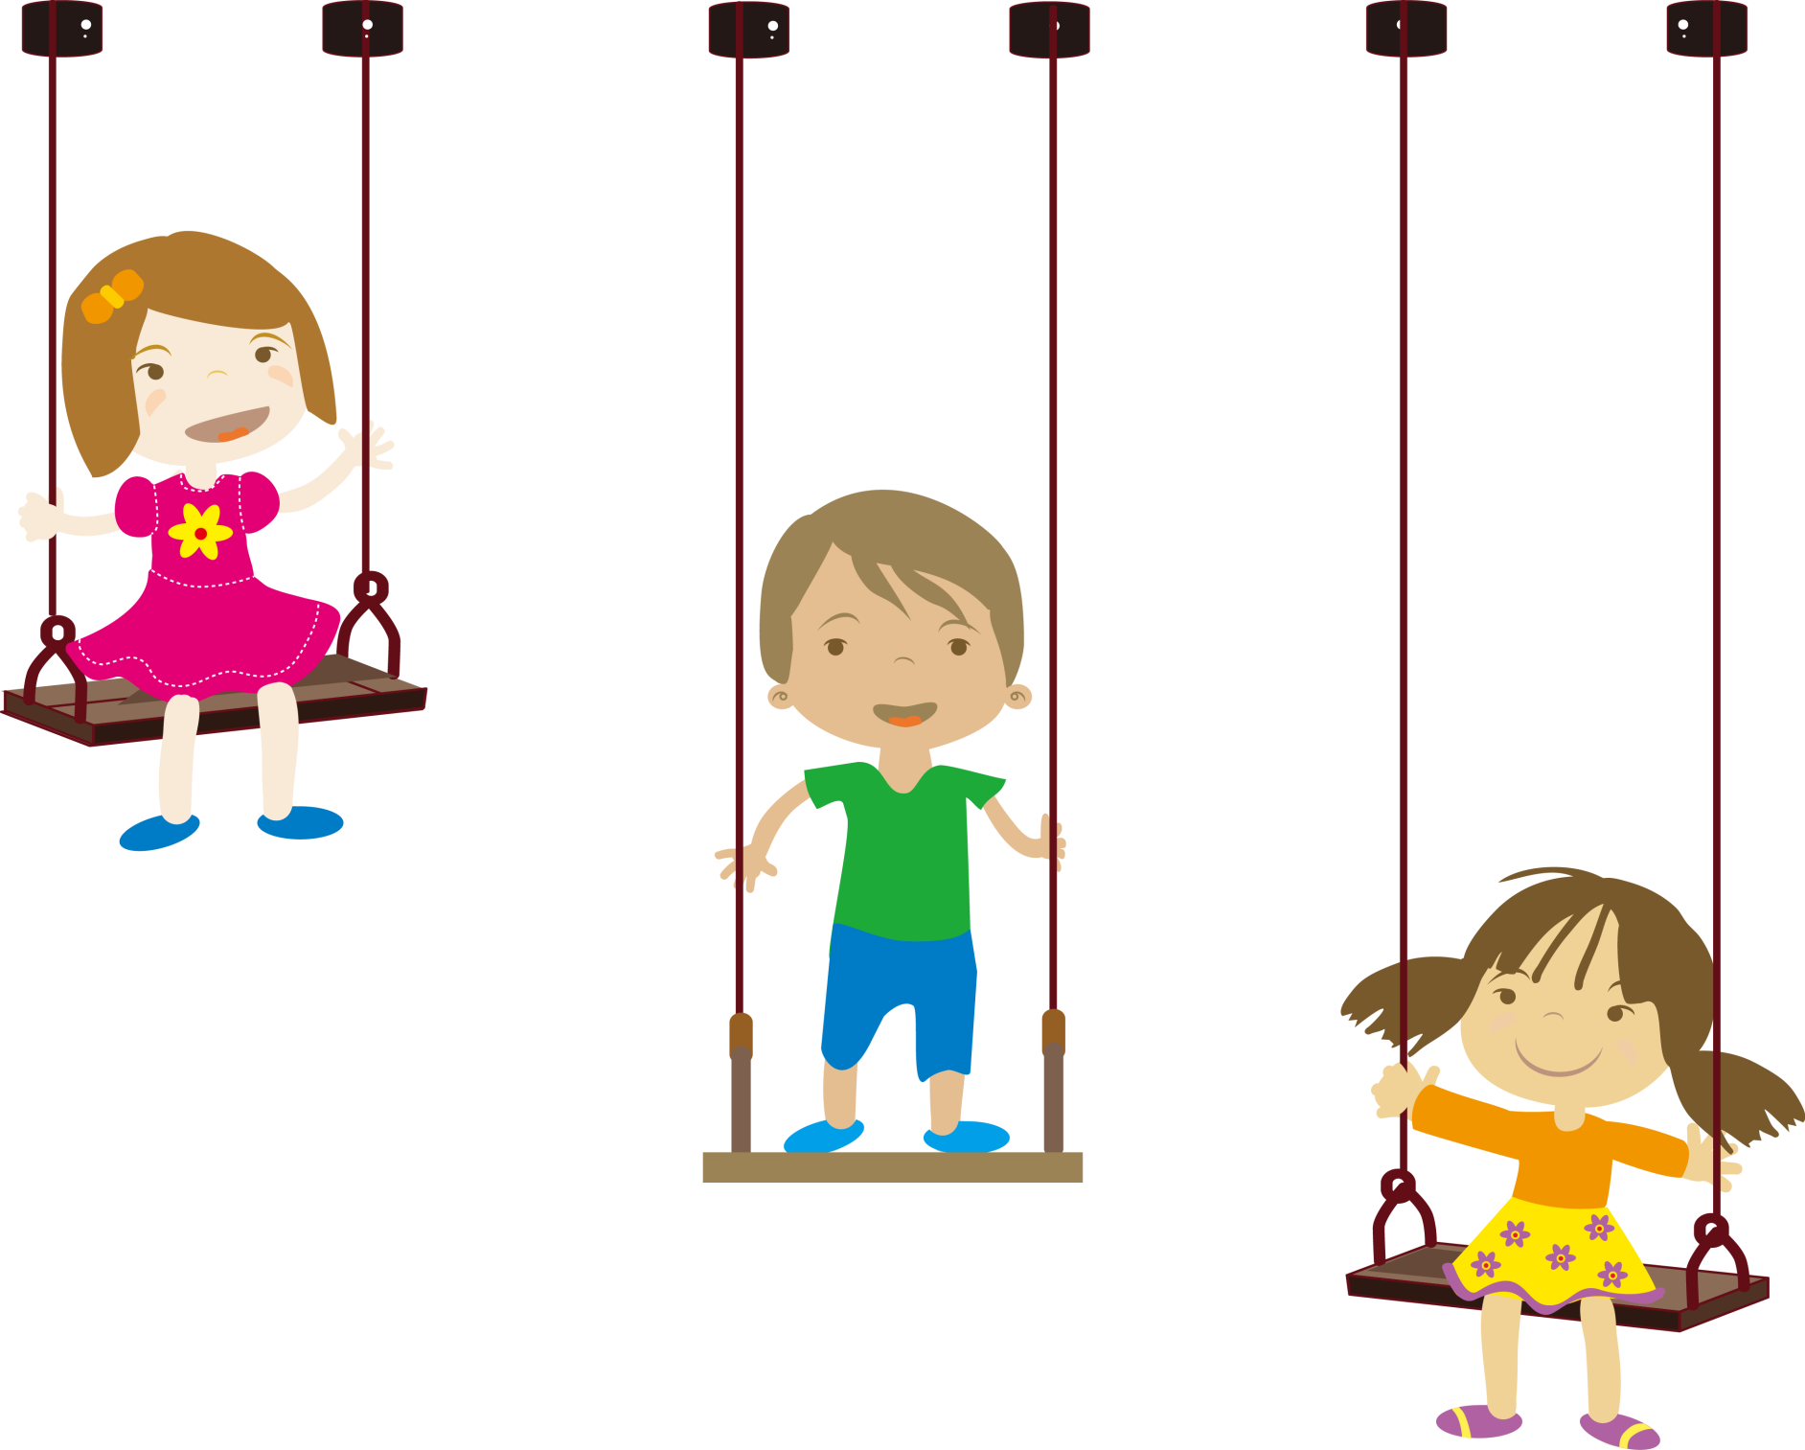


Slide 19
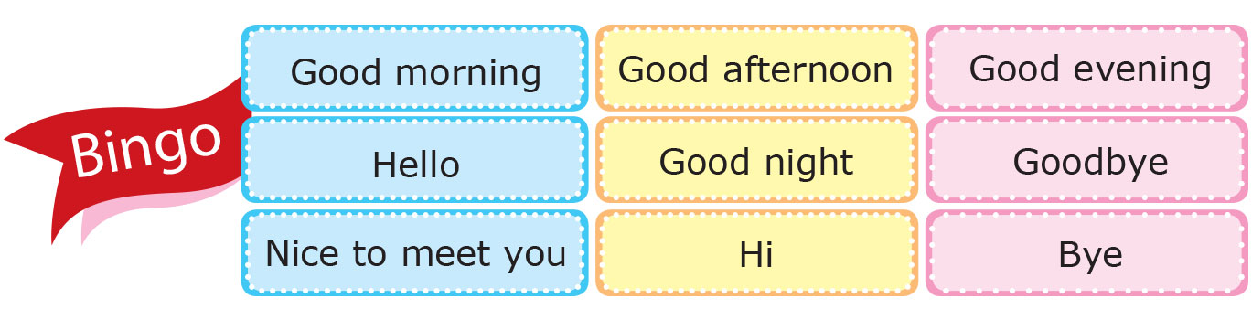

Slide 20



