Slide 1



LONG BIEN
SECONDARY SCHOOL
WELCOME TO CLASS 6A2
UNIT 3: FRIENDS
– LESSON 2: PRONUNCIATION AND SPEAKING
Teacher: Ms. Le Doan
ENGLISH IS FOR FUN

Slide 2
WARM-UP

Slide 3
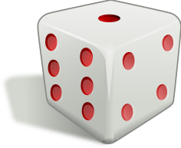

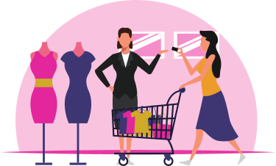
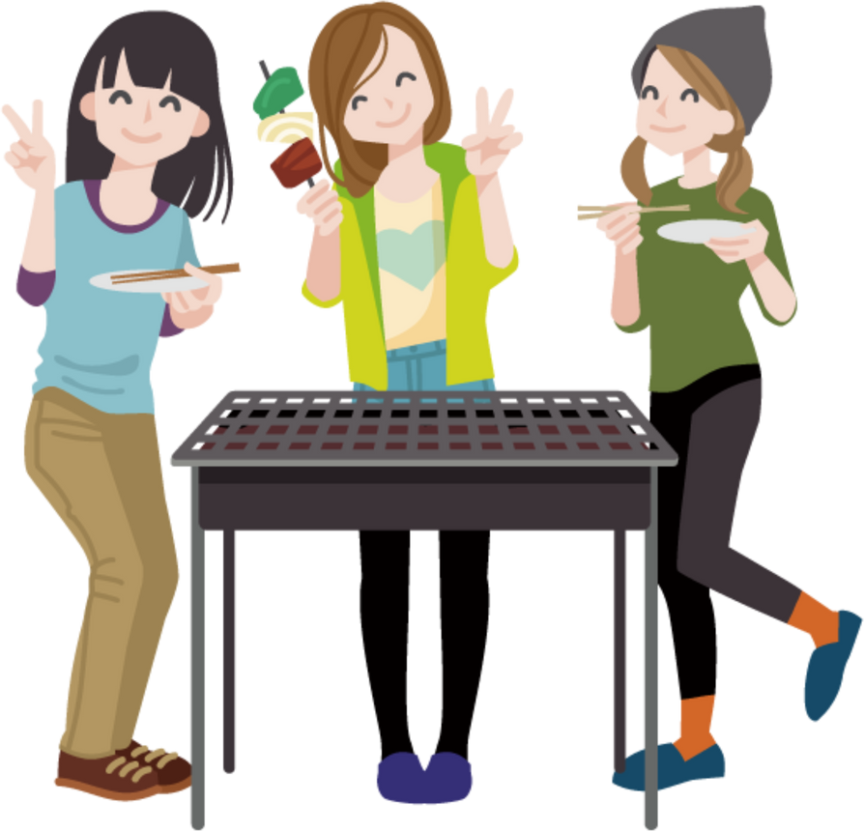
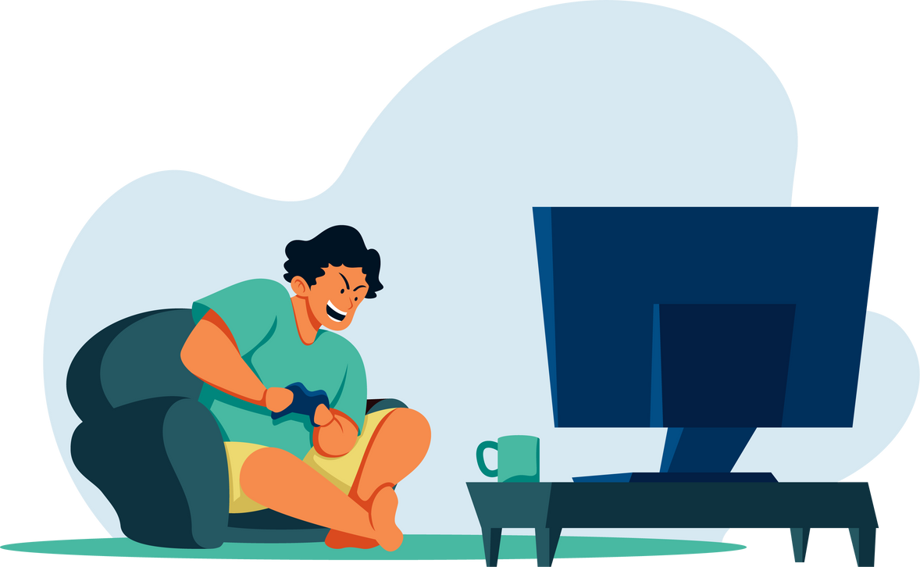
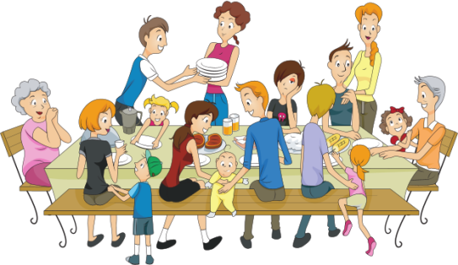
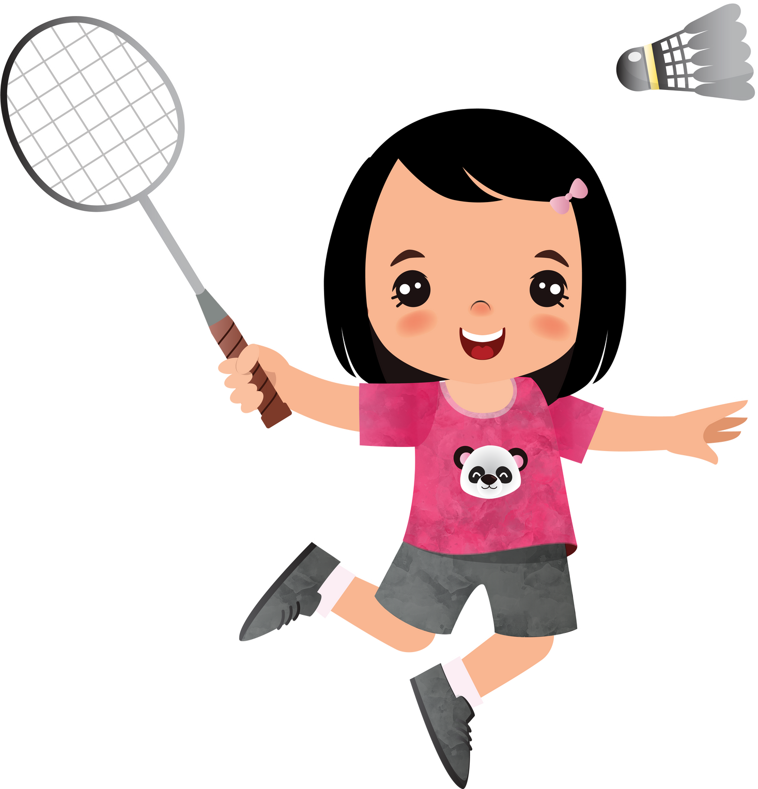
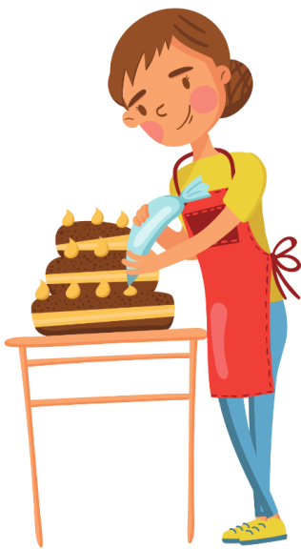
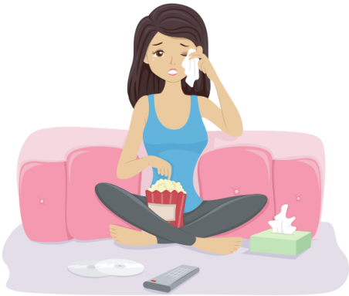
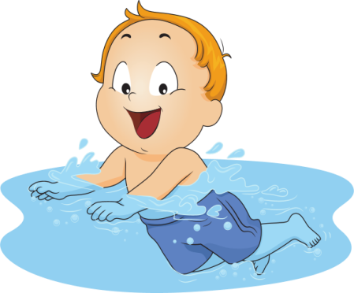

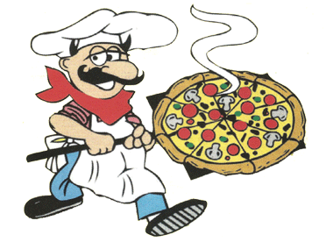
https://freeonlinedice.com/
3
4
5
1
2
9
6
7
8
10
6

Slide 4
PRONUNCIATION

Slide 5

WATCH THE VIDEO AND PRACTICE.

Slide 6
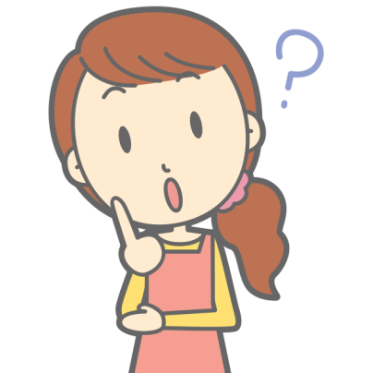

Listen to the questions and guess the intonation goes up or down?
1. What are you doing tonight?
2. What are you doing on the weekend?
3. What are you doing on next Sunday?

Slide 7
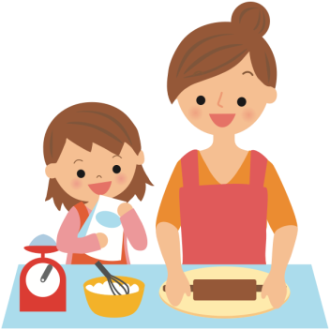
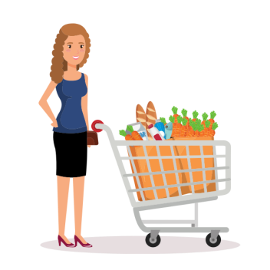
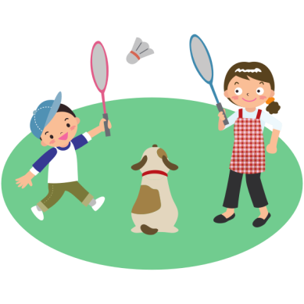
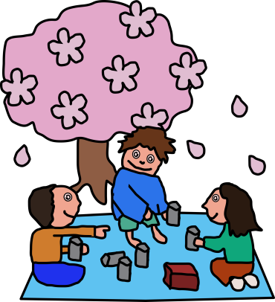
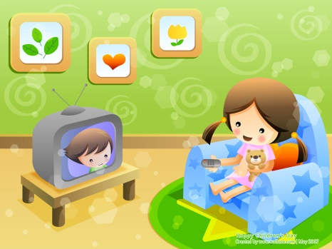

PRONUNCIATION
Practice the conversation and you can replace the underline words.
Matt : What are you doing on Saturday?
Lisa : I’m having a barbecue. Do you want to come?
Matt: Sorry, I can’t. I’m watching a movie with Jack,
Lisa: What about Tuesday?
Matt: I’m free. Why?
Lisa: I’m having a party. Do you want to come?
Matt: Sure!
Lisa: Great! Talk to you later.
go shopping
play badminton
make a cake
watch a movie
play at the park
have a picnic
This Photo by Unknown Author is licensed under CC BY-SA-NC

Slide 8
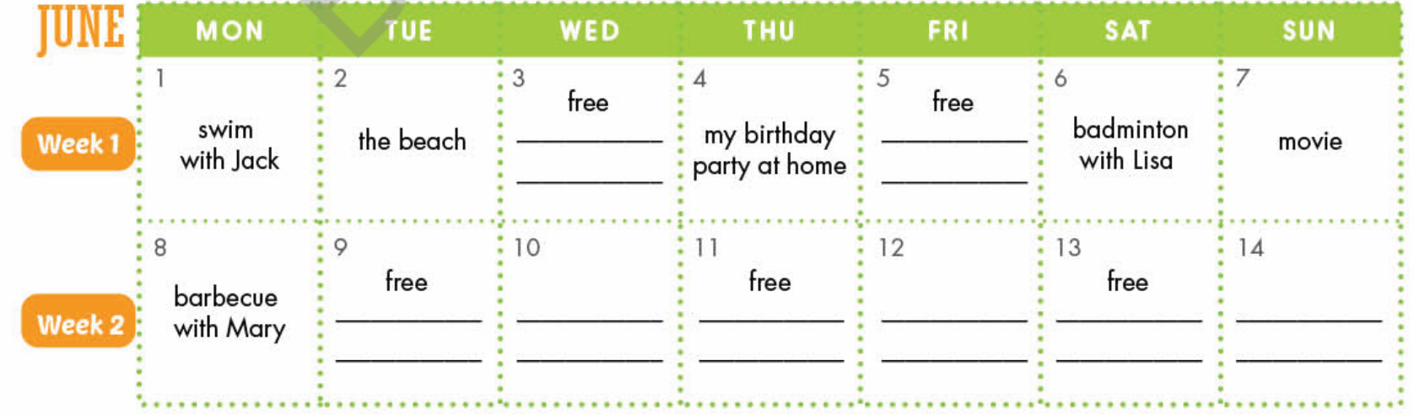
Look at the schedule and practice with your partner
What are you going on Monday?
I’m going swimming with Jack
What about Wednesday?
I’m free. Why?

Slide 9
WRAP-UP

Slide 10
ORDER THE WORDS TO MAKE A CORRECT SENTENCE.
playing / with / friends / chess / this week / you / your / Are/ ?
…………………………………………………………………………………..
2. are / this summer / on / We / going / to the beach / holidays
…………………………………………………………………………………..
3. getting / married / next / are / They / month
…………………………………………………………………………………..
4. TV / dinner / not / series / after / is / She / watching
…………………………………………………………………………………..
5. meeting / Friday / morning/ on / ? / Sarah / Is / mother / her
…………………………………………………………………………………..
6. Sunday / ? / next / with / Is / Josh / his / breakfast / having / girlfriend
…………………………………………………………………………………..
Are you playing chess with your friends this week?
We are going to the beach this summer holidays.
They are getting married next month.
She is watching TV after dinner
Is Sarah meeting her mother on Friday morning?
Is Josh having breakfast with his girlfriend next Sunday?

Slide 11
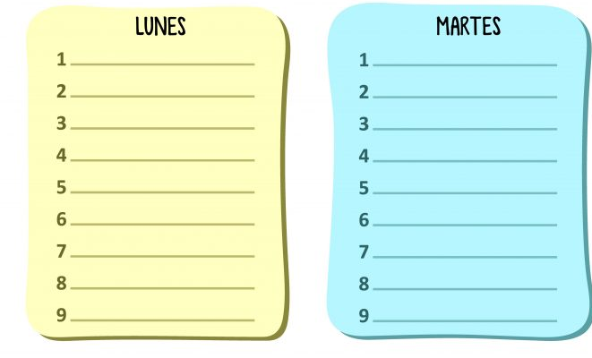
HOMEWORK
Learn new words.
Practice writing new words on writing sheet
Make your own plan for next weekend using the table below and the write about it using present continuous
Sunday
Saturday

