Slide 1



LONG BIEN
SECONDARY SCHOOL
WELCOME TO CLASS 6A2
UNIT 3: FRIENDS
– LESSON 1: PRONUNCIATION AND SPEAKING
Teacher: Ms. Le Doan
ENGLISH IS FOR FUN

Slide 2

WARM-UP
Listen and chant along the video

Slide 3
PROUNUNCIATION

Slide 4

Listen to the words and focus on underline letter
bl
+
ack
=
black
bl
bl
+
ond
=
blond
bl
+
ue
=
blue
black
blond
blue

Slide 5
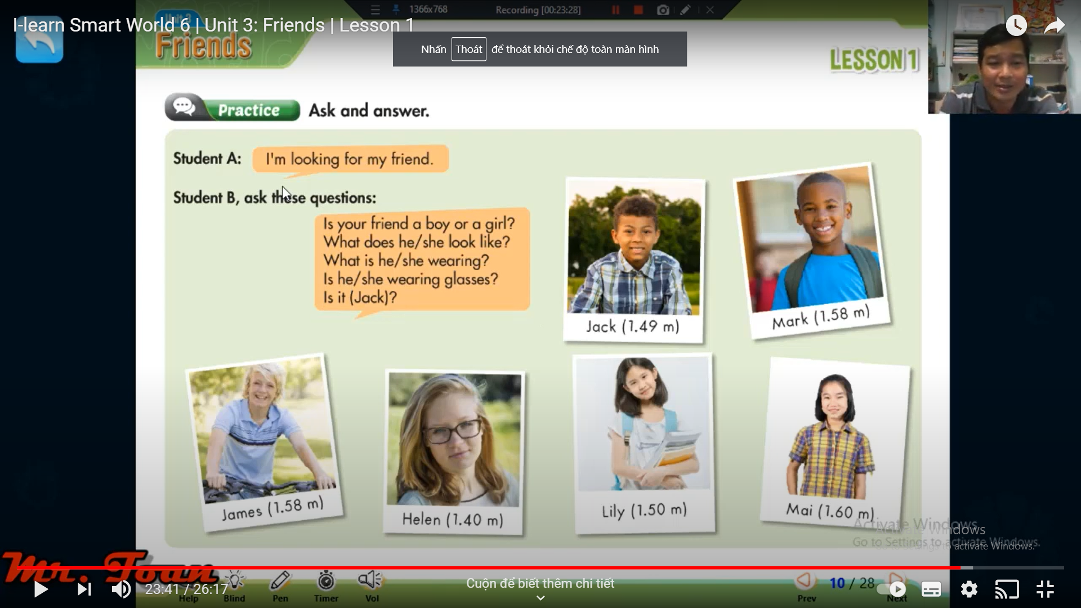
Choose one of them is the friend you are looking for and practice with your partner. You can look at sample sentences and you can replace the red word.
A: I’m looking for my friend.
B: Is your friend a boy or a girl?
A: My friend is a girl
B: What does she look like?
A: She is tall and has black hair.
B: Is she wearing glasses?
A: No, she isn’t.
B: Is it Mai?
A: Yes, she is.

Slide 6
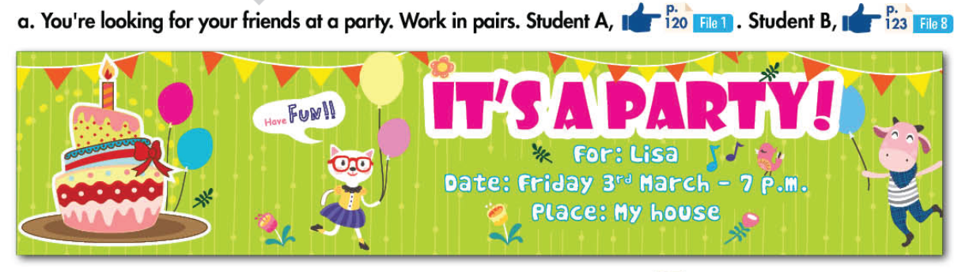
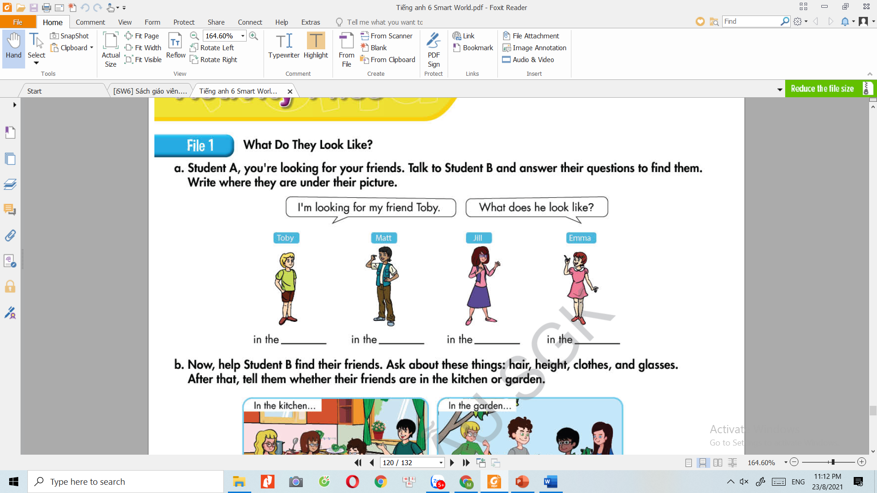
A: I’m looking for my friend, Toby
B: Is your friend a boy or a girl?
A: My friend is a boy
B: What does he look like?
A: He is short with blond hair and he’s wearing brown shorts
B: Is he wearing glasses?
A: No, he isn’t.
B: He’s in the dinningroom
In the dinning room

Slide 7
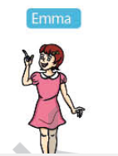
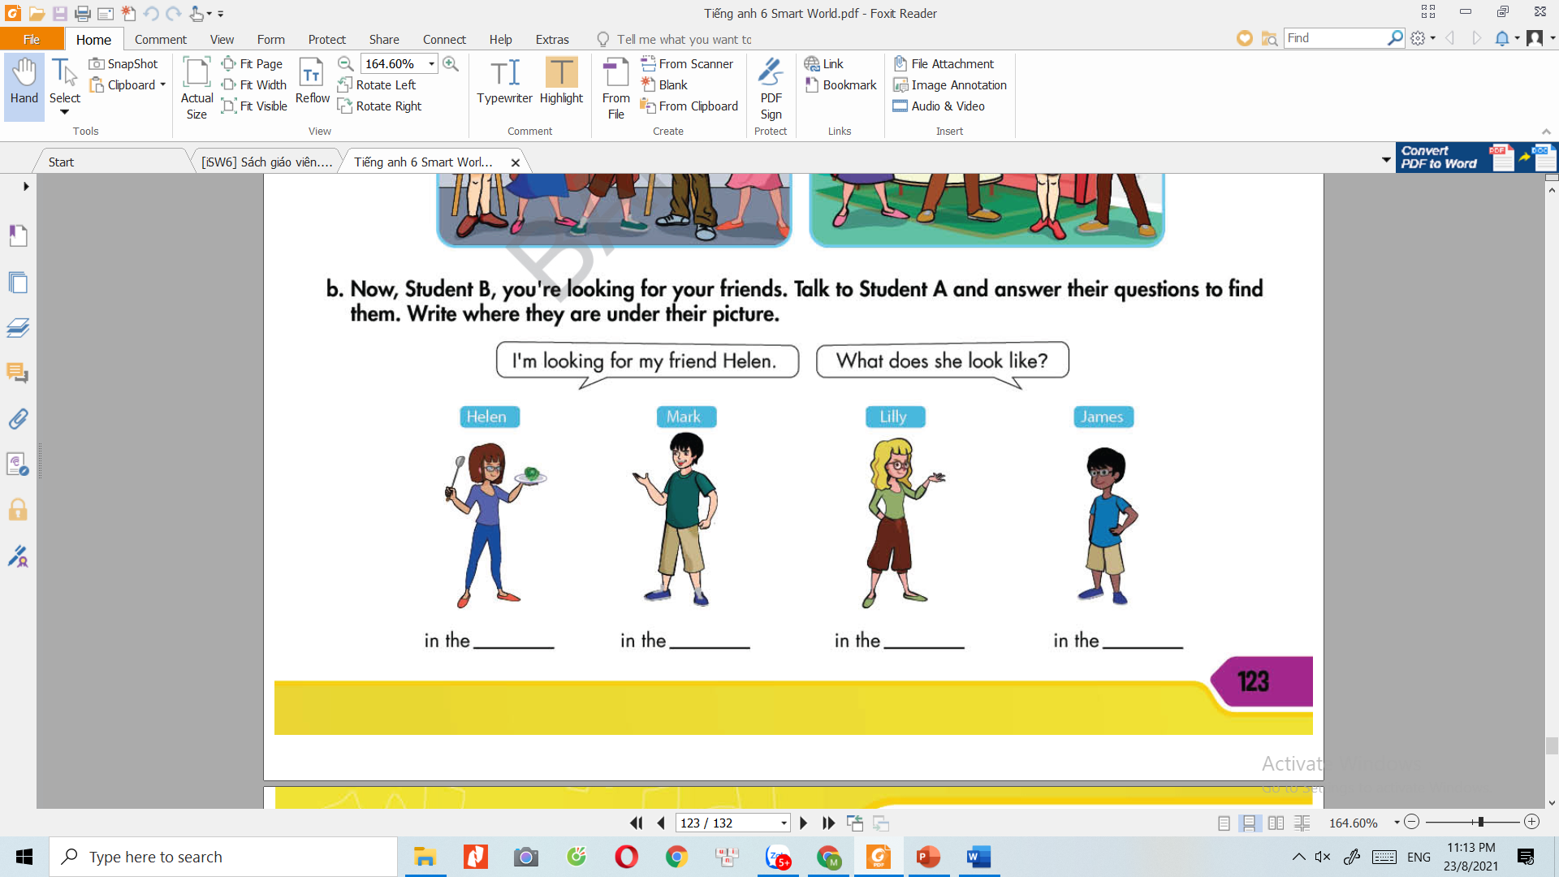
In the dinning room
In the livingroom
In the livingroom
In the livingroom
In the kitchen
In the kitchen
In the kitchen
In the garden

Slide 8
WRAP-UP

Slide 9
Guessing game:
- Teacher call a student randomly and ask him/her to describe a classmate. The other student guesses who is he/she?

Slide 10
HOMEWORK
- Write some sentences about your best friend.
Prepare the next lesson.

