Slide 2

CUSTOMS AND TRADITIONS
OF VIET NAM
Should and shouldn’t

Slide 3
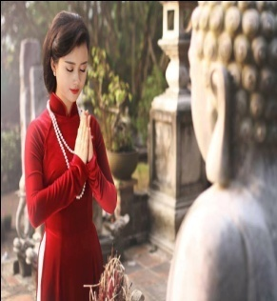
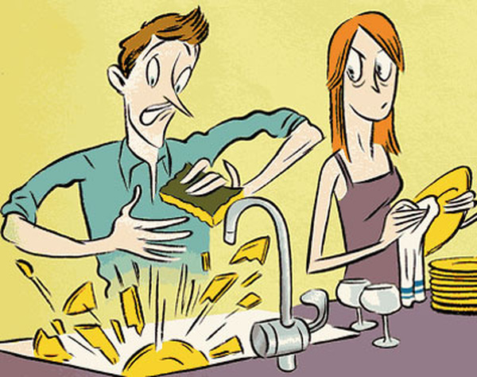
should or shouldn’t ?
a. We _______ pray in the pagoda
should
shouldn’t
b. We __________ break things on the first day of the lunar month

Slide 4
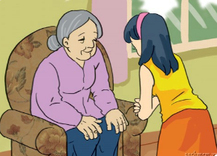
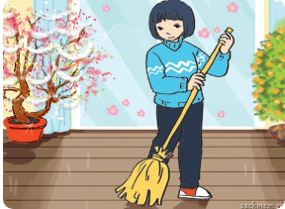
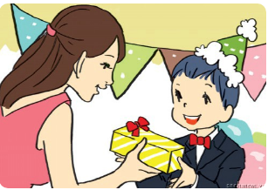
1.You respect old people
should
2.According to tradition, you sweep the floor on the first day of Tet
shouldn’t
3. Children take things from adults with both hands
should

Slide 5
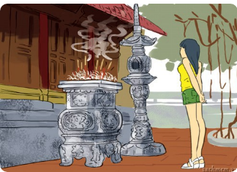
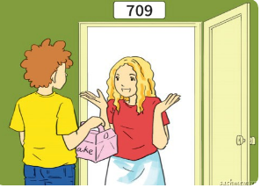
4. You wear shorts when going to the pagoda
shouldn’t
should
5. You bring a gift when you visit someone’s house

Slide 6
1.You should respect old people
2.According to tradition, you shouldn’t sweep the floor on the first day of Tet
3. Children should take things from adults with both hands

Slide 7
4. You shouldn’t wear shorts when going to the pagoda
5. You should bring a gift when you visit someone’s house

Slide 8
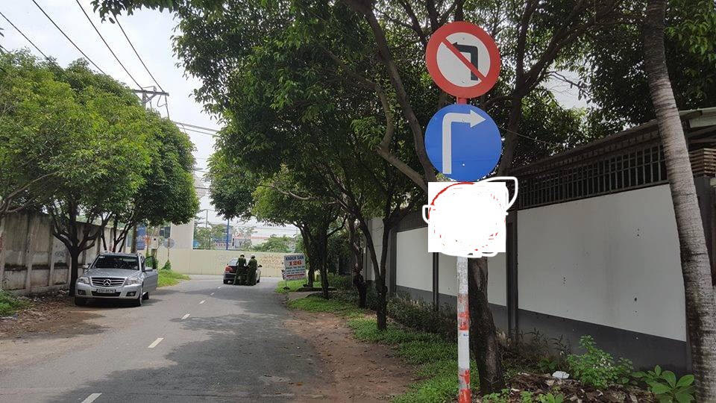
You can't turn left here. You have to turn right (because of the traffic system)

Slide 9
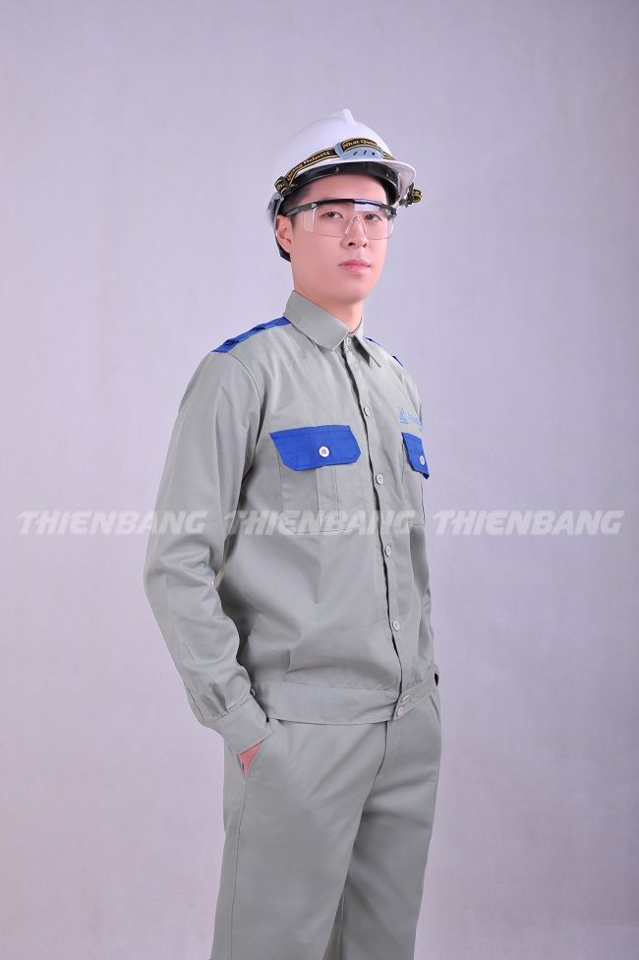
He has to wear a uniform at work
(because of the factory’s rule)

Slide 10
EXAMPLES :
1. You can't turn right here. You have to turn left (because of the traffic system)
2. Her office is far from her house, so she has to go to work by car.

Slide 11
“Have to” to express obligation or necessity
(+) S +
have to
/has to
+ V (bare infinitive)
don’t/doesn’t
(-) S+
+ have to
+ V (bare infinitive)
+ S +
have to
+ V (bare infinitive) ?
(?) Do/Does
Notice : don’t/doesn’t have to :
không phải, không cần thiết
must
not (mustn’t) :
không được (dùng để ngăn cấm )

Slide 13
Fill in the blank with “mustn’t” or “don’t/doesn’t have to”
1. I have already done the homework. You ____________ help me with it.
2. The sign says “No parking”. We __________ park here.
3. I'm not working tomorrow, so I _________ get up early
4. He ________________ tell her the news because she has just known it.
5. They promise they will be on time. They _______ be late.
6. The baby is sleeping. You _______make noise

Slide 14
Fill in the blank with “mustn’t” or “don’t/doesn’t have to”
1. I have already done the homework. You ____________ help me with it.
2. The sign says “No parking”. We __________ park here.
3. I'm not working tomorrow, so I _________ get up early
4. He ________________ tell her the news because she has just known it.
5. They promise they will be on time. They _______ be late.
6. The baby is sleeping. You _______ make noise
don’t have to
mustn’t
don’t have to
doesn’t have to
mustn’t
mustn’t

Slide 15
Complete the sentences with
the correct form of “have to”
1.My mother says that I _______ be home by 9 p.m
2.We ______ go now because our dad is waiting for us
3. She ______ wear that costume because it’s the family tradition.
4.In the past, men ________ wear Ao dai, but today they __________ wear it.
5. Before leaving the dinner table, ________ your son _________ask for permission?
6. We ___________ go to school today because it was raining heavily.

Slide 17
Complete the sentences with
the correct form of “have to”
1.My mother says that I _______ be home by 9 p.m sharp.
2.We ______ go now because our dad is waiting for us
3. She ________ wear that costume because it’s the family tradition.
4.In the past, men ________ wear Ao dai, but today they ______________ wear it.
5. Before leaving the dinner table, ________ your son _________ask for permission?
6. We __________________ go to school today because it was raining heavily.
have to
have to
has to
had to
don’t have to
Does
have to
didn’t have to

Slide 19
THANKS FOR
YOUR ATTENDING
AND
OBSERVING!

